Slide 1
Preliminary Research
Presenter Name

Slide 2
Introduction
Preliminary research should help the researcher to gain a better understanding of the problem and to narrow the problem down to a researchable topic for study. Preliminary research should help the researcher to find answers to questions such as: “What is the problem?”; “Why does the problem exist?”; “Is the problem important?”; and “What are the benefits of solving the problem?”

Slide 3
The way to get started is to quit talking and begin doing.
Walt Disney

Slide 4
Preliminary Research ?
Preliminary research should help the researcher to gain a better understanding of the problem and to narrow the problem down to a researchable topic for study.
Preliminary research should help the researcher to find answers to questions such as:
“What is the problem?”;
“Why does the problem exist?”;
“Is the problem important?”;
“What are the benefits of solving the problem?”
Classified under two headings:
1. Information on the organization and its environment – that is, the contextual factors.
2. Information on the topic of interest.

Slide 5
Example: Background information on the organization
Information gathered on relevant contextual factors will be useful in talking knowledgeably with managers and
other employees in the company and raising the appropriate issues related to the problem.
1. The origin and history of the company – when it came into being, business it is in, rate of growth,
ownership and control, and so on.
2. Size in terms of employees, assets, or both.
3. Charter – purpose and ideology.
4. Location – regional, national, or other.
5. Resources – human and others.
6. Interdependent relationships with other institutions and the external environment.
7. Financial position during the previous five to ten years, and relevant financial data.
8. Information on structural factors (eg, roles and positions in the organization and number of employees at each job level, communication channels, control systems, workflow systems).
9. Information on the management philosophy.

Slide 6
Types of Data
Primary Data
First-hand data gathered by the researcher himself
Data originated by a researcher for the specific purpose of addressing the research problem.
Included among primary sources are interviews, observations etc.
Example:
Questionnaire to collect data on students' satisfaction with online learning
Secondary Data
Data collected by someone else earlier.
Data that have been previously collected for some purpose Included among secondary data are reports available in the libraries/ internet, magazines, newspapers etc.
Example:
Data from Statistics Department website on GDP, inflation rate etc

Slide 7
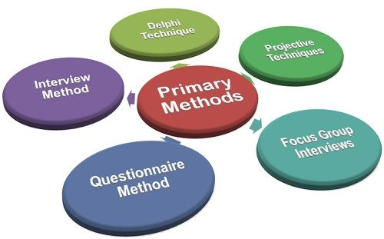
Primary Data Collection
Primary data – data you collect
Surveys
Focus groups
Personal interviews
Experiments
Observational study

Slide 8
Secondary data Collection
Data someone else has collected
Sources.
1. Internal company Records
2. Stock Exchange
3. Internal computer databases
4. Reports and publications of government
agencies
5. Other publications.
6. Computerized databases.
The data for the research work is collected
from source like EBSCO, PROQUEST, Emerald

Slide 9
A Classification of Published Secondary Sources
Published Secondary Data
General Business Sources
Government Sources
Guides
Directories
Indexes
Statistical
Data
Census Data
Other Government Publications

Slide 10
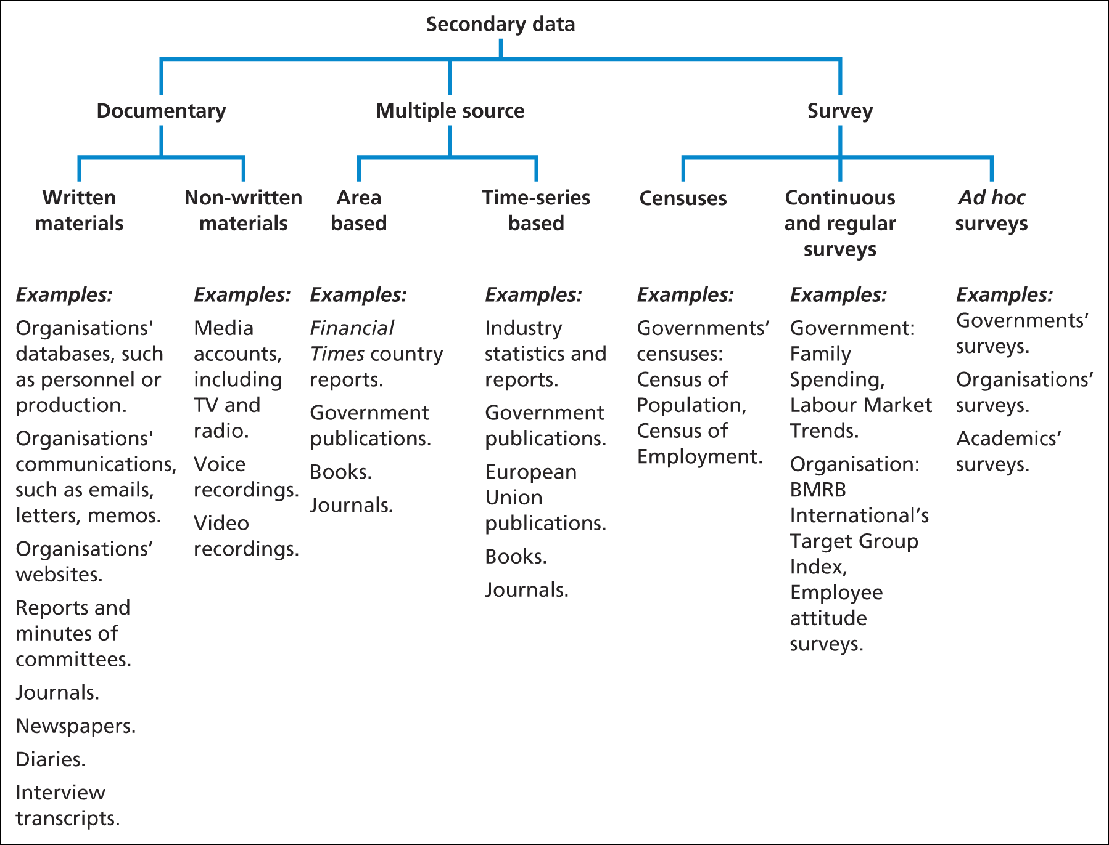
Using secondary data for research (2)
Figure 8.1 Types of secondary data
Source: Saunders

Slide 11
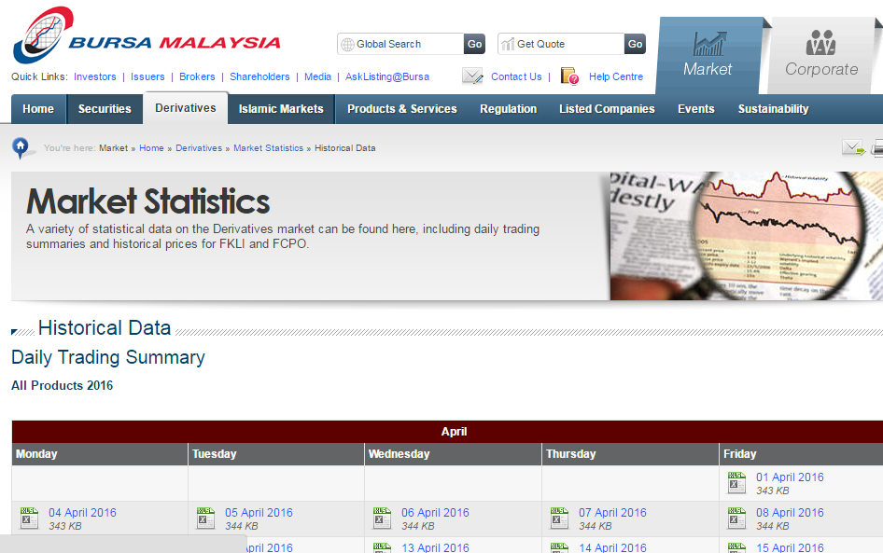
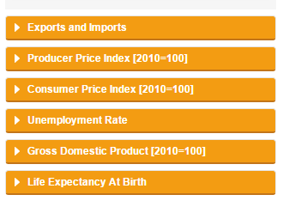
Secondary data Sources in Malaysia
https://www.statistics.gov.my/
Department of Statistics
Share prices

Slide 12
Example: Background information on the organization
CRITERIA FOR EVALUATING SECONDARY DATA
Timeliness of the data. When were the data collected? It is important that the data are up‐to‐date.
Check the dates on all of your secondary data to make sure that you have the newest information available.
Accuracy of the data. What was the purpose of (presenting) the data? Web pages are created with a specific purpose in mind. Commercial organizations oft en post information online that might favor them in some way or represent their own interests.
Who collected the data? How were the data collected?
What are the author ’ s credentials on this subject? Th e accuracy of data can be impacted by who collected it and how the data were collected.
Are the data consistent with data from other sources? If specific c information varies
from source to source, you need to find out which information is more accurate.
Relevance of the data. Not all of the secondary data you find will be relevant to your particular needs.
Data may be accurate and up‐to‐date but not applicable to your research objective(s) and research
questions.
Costs of the data. How much do the data cost? Do the benefits outweigh the costs? Are you better off
collecting other data? Are you better off using other (primary?) methods of data collection?

Slide 13
Sources of Data

Slide 14
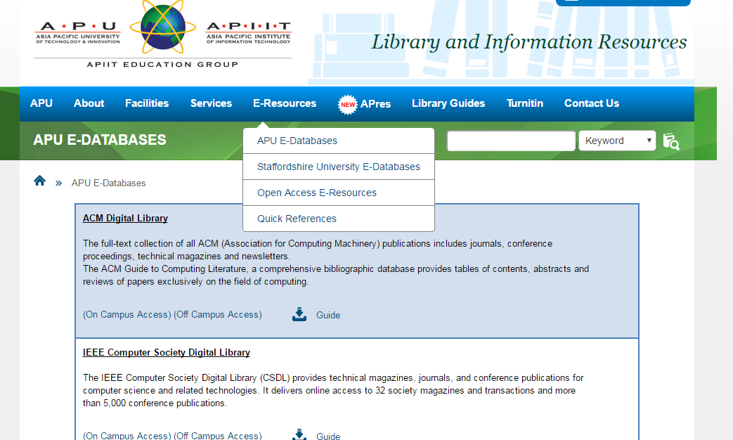
Search University Databases
Emerald, ProQuest, Science Direct, SpringerLink, eBrary

Slide 15
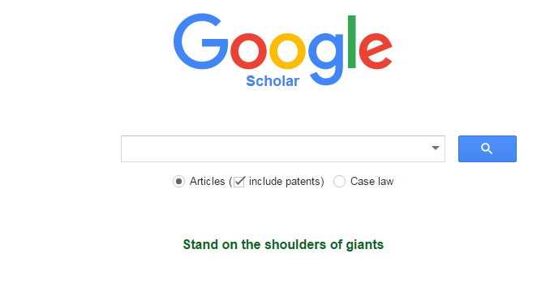
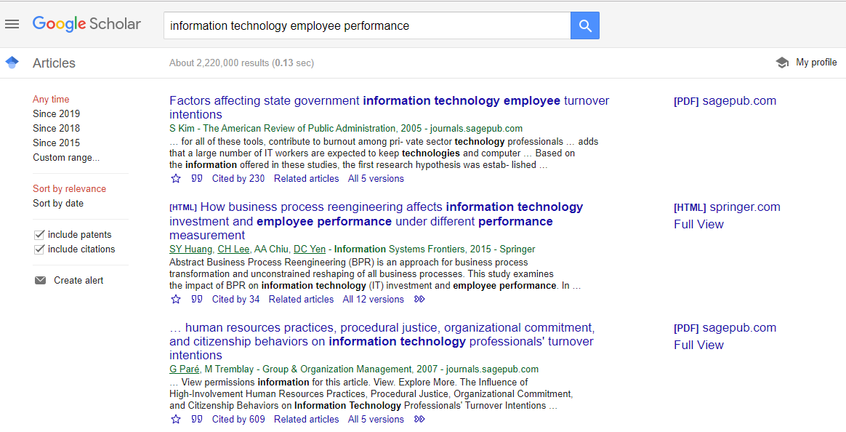

Slide 16
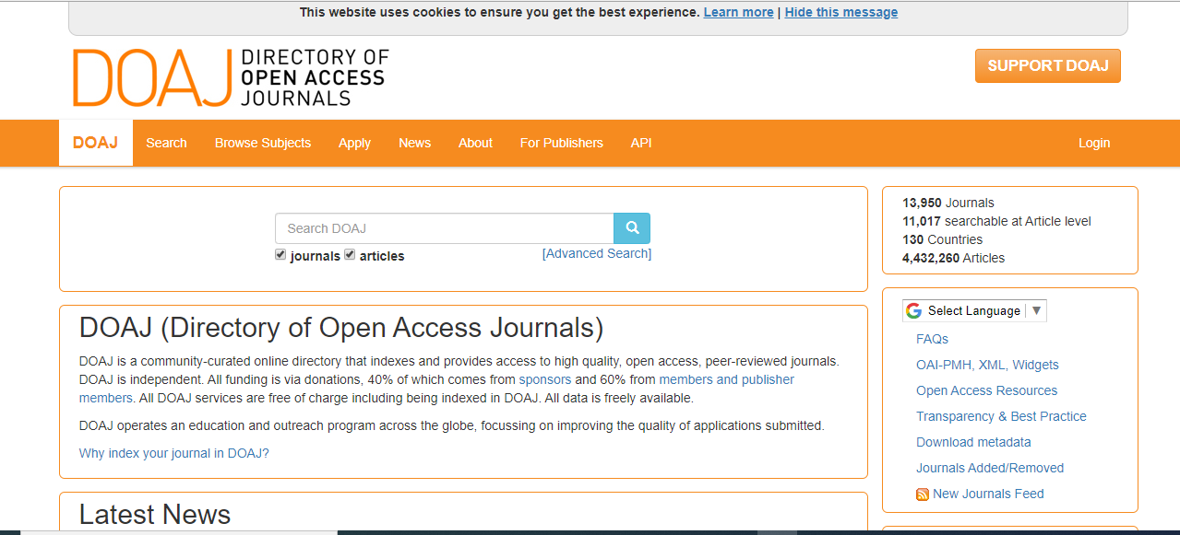

Slide 17
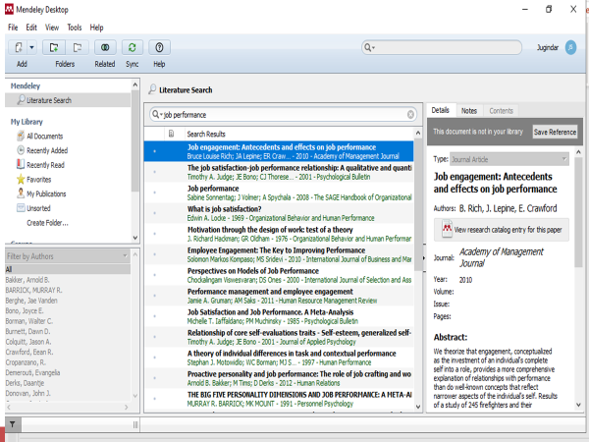

Slide 18
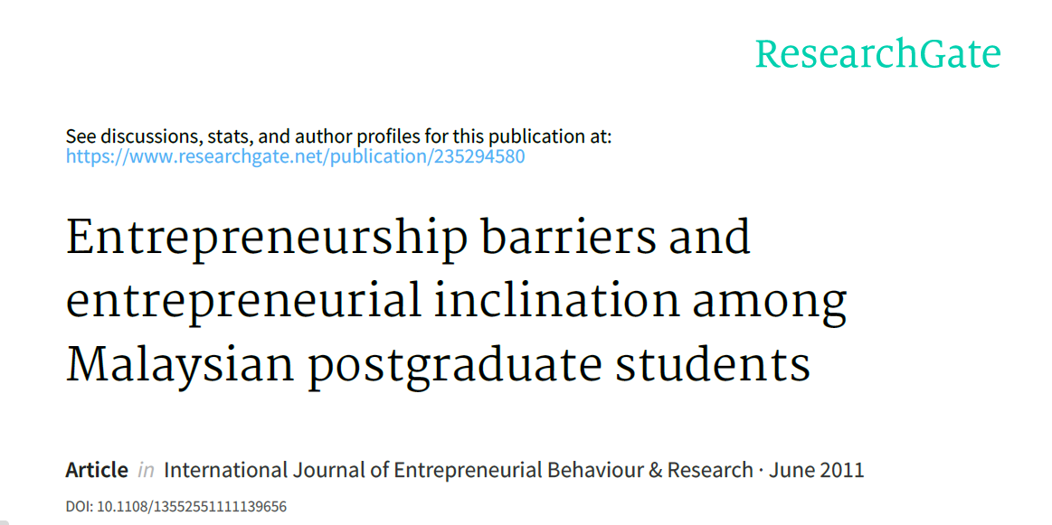
Research Gate

Slide 19
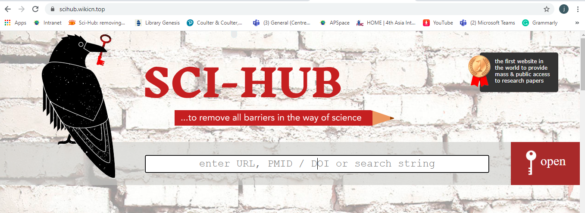

Slide 20
Find books

Slide 21
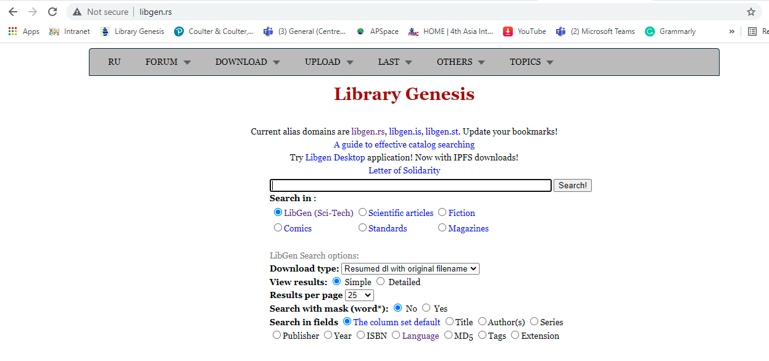
Find books

Slide 22
Summary
Preliminary research should help the researcher to gain a better understanding of the problem and to narrow the problem down to a researchable topic for study.

Slide 23
Thank You

