Slide 1
Qualitative method
Dr Jugindar Singh

Slide 2
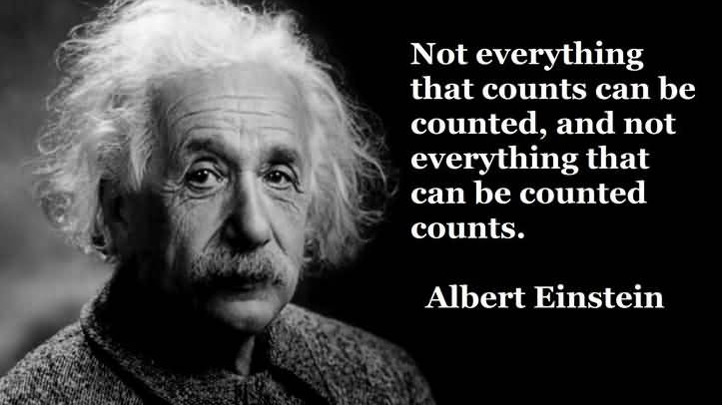
Qualitative Research

Slide 3
TABLE OF CONTENTS
TITLE PAGE
TABLE OF CONTENTS
LIST OF TABLES
LIST OF FIGURES
LIST OF ABBREVIATIONS
CHAPTER 1 INTRODUCTION
1.1 Background to the Study
1.2 Problem Statement
1.3 Purpose Statement
1.4 Research Questions
1.5 Significance of the Study
1.6 Scope of the Study
1.7 Limitations
1.8 Definitions of Terms
CHAPTER 2 REVIEW OF LITERATURE
Depends on Type of study
2.1
2.2
TABLE OF CONTENTS
CHAPTER 3 METHODOLOGY
3.1 Introduction/Research design
3.2 Research Philosophy
3.3 Research Approach
3.4 Research Strategy
3.5 Research Choices
3.6 Time Horizon
3.7 Data type (Primary or Secondary)
3.8 Instrumentation/ Questionnaire
3.9 Sampling technique and sample size
3.10 Data collection
3.11 Data processing
3.12 Data Analysis
3.13 Ethical Consideration
References
Appendices

Slide 4
Chapter 1: Introduction
CHAPTER 1 INTRODUCTION
1.1 Background to the Study
1.2 Problem Statement
1.3 Purpose statement
1.4 Research Questions
1.6 Significance of the Study
1.7 Scope of the Study
1.8 Limitations
1.9 Definitions of Key Terms
This chapter explains the background of the study, statement of the problem, purpose statement, research questions, significance of the study, scope of study, limitations of the study, and the definitions of key terms

Slide 5
1. Definition of Qualitative Research What is Qualitative Research

Slide 6
Definition of Qualitative : Creswell 2018
Qualitative research is an approach for exploring and understanding the meaning individuals or groups ascribe to a social or human problem.
The process of research involves:
Emerging questions and procedures,
Data typically collected in the participant’s setting
Data analysis inductively building from particulars to general themes, and the researcher making interpretations of the meaning of the data.
The final written report has a flexible structure.
Example: Explore the Lived experience of first-time mothers

Slide 7
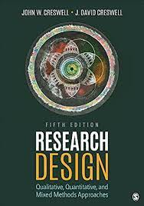
What is Qualitative Research
(adapted from Creswell 2002, p. 58)
Subjective
Qualitative research is an inquiry approach in which the inquirer:
Explores a central phenomenon (one key concept)
Asks participants broad, general questions
Collects detailed views of participants in the form of words or images
Analyses and codes the data for description and themes
Interprets the meaning of the Information drawing on personal reflections and past research
Writes a Final Report

Slide 8
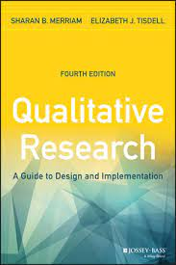
Definition Sharan B. Merriam, Elizabeth J. Tisdel
Qualitative research is based on the belief that knowledge is constructed by people in an ongoing fashion as they engage in and make meaning of an activity, experience, or phenomenon
Understanding how people interpret their experiences, how they construct their worlds, and what meaning they attribute to their experiences.
Example:
Rather than finding out how many retired folks take on part - time jobs after retirement, which could be done through a survey, we might be more interested in how people adjust to retirement, how they think about this phase of their lives, the process they engaged in when moving from full - time work to retirement, and so on
(

Slide 9
Qualitative Research Process
Written Record
(Thesis, book, report, article etc)
Data Analysis Approach
(Hermeneutics, semiotics, content analysis etc)
Data Collection Technique
(interviews, focus group, observation, documents etc)
Research Method
(action research, case study, ethnography, grounded theory etc)
Philosophical Assumptions
(positivist, interpretive, pragmatic)

Slide 10
What is the Difference between Qualitative and Quantitative

Slide 12
Qualitative vs Quantitative Research
 | Qualitative | Quantitative
Focus of Research | Understand and interpret | Describe, explain, and predict
Researcher Involvement | High | Limited, controlled to prevent bias
Research Purpose | In-depth understanding | Describe or predict, built and test theory
Sample Design | Non-probability, purposive | Probability
Sample Size | Small | Large
Data Type and Preparation | Verbal or pictorial description Reduced to verbal codes | Reduced to numerical codes for computerized analysis
Feedback Turnaround | Smaller sample sizes make data collection faster | Larger sample sizes lengthen data collection
Research Design | Longitudinal, Multi Method | Cross-sectional or longitudinal, Single method
Data Analysis | Non-quantitative; human Judgment mixed with fact Emphasis on themes | Computerized analysis Facts distinguished Emphasis on counts

Slide 13
Research Problem Purpose Statement Research Questions

Slide 14
Problem Identification Is a Research Problem? - Cresswell
A research problem is an educational issue or concern that an investigator presents and justifies in a research study.
Cresswell, 2002
The lived experience of parents with autistic children
A statement of the problem is an argument at the beginning of a research report that justifies why the research study was needed.
It is called the “statement of the problem” because the researcher identifies a problem and argues that a particular research study is needed to address this problem Clark & Cresswell (2015)
However, little research has explored parents’ experiences raising a child with autism using qualitative methods, and the meanings of the experiences
for parents are unknown
A Research problem is the issue, controversy, or concern that guides the need for a study
(Clark and Cresswell, 2015)

Slide 15
Deficiency Model - Cresswell
Flow of Ideas
Justification
for Research
Problem
Deficiencies in
the Evidence
Relating the
Discussion
to Audiences
Topic
Research
Problem
Subject
area
Concern or issue
A problem
Something that needs a solution
Evidence from the literature
Evidence from practical experience
In this body of evidence what is missing or what do we need to know more about?
How will addressing what we need to know
help researchers, educators, policy makers, and other individuals?
Qualitative Study
about Parents Raising
Children
with Autism
Raising a child with autism can be stressful for parents and parent stress can affect the well being of the whole family
(Citation)
Literature documents the sources of stress for parents raising a child with a disability and the effects of stress on families (citation)
However, little research has explored parents’ experiences raising
a child with autism using qualitative methods, and the
meanings of the experiences
for parents are unknown
By better understanding
parent experiences, those working with parents of children with disabilities could better develop effective interventions and support systems

Slide 16
Purpose Statement
The purpose statement is a statement that advances the overall direction for a study.
Typically identify the focus and intent for the study, and may mention the participants, setting, and the researcher’s framework.
Example: The purpose of this qualitative study is to explore the effect of Covid 19 on the business of tour operators in Seychelles.
Is the central controlling idea in a study
Is written in a sentence or several sentences
Sets the objectives, the intent, or the major idea of a proposal or a study
Use words such as purpose, intent, study aim, or objective to signal attention to this statement as the central controlling idea.

Slide 17
Purpose Statement
Here is a script for a good qualitative purpose statement:
“The purpose of this qualitative study (replace later with type of qualitative tradition) will be to ______(understand, describe, develop, discover) the ________(central focus) for _______(participants: person, process, groups) at ______________(site)."
Example:
Perception of Employers towards hiring of ex-offenders
Purpose Statement
The purpose of this qualitative study will be to understand the perception of employers towards hiring of ex-offenders in the education sector in Kuala Lumpur

Slide 18
Lived experiences of first-time mothers
The purpose (or study aim) of this phenomenology_____ (strategy of inquiry, such as ethnography, case study, or other type) study is (was? will be?) to explore____ (understand? explore? develop? generate? discover?) the lived experience of becoming first time mothers_____ (central phenomenon being studied) for mothers______ (the participants, such as the individual, groups, organization) at/in Kuala Lumpur_______ (research site).
Example
Another way of writing The phenomenological inquiry, as part of uncovering meaning, articulated “essences” of meaning in mothers’ lived experiences becoming first time mothers. Using the lens of the feminist perspective, the focus was on mothers’ memories and their “living through” experience. This perspective facilitated breaking through the silence surrounding mothers’ experiences; it assisted in articulating and amplifying mothers’ memories and their stories. Methods of inquiry included phenomenological reflection on data elicited by existential investigation of mothers’ experiences, and investigation of the phenomenon in the creative arts.

Slide 19
Research Questions
Research questions are statements used to narrow the purpose statement to specific questions that the researcher seeks to answer by conducting a study.

Slide 20
Research questions
These research questions assume two forms:
Central question
a broad question that asks for an exploration of the central phenomenon or concept in a study
Sub questions
Sub-divides central question into more specific topics questions
Limited number
Begin the research questions with the words what or how to convey an open and emerging design
Use Verbs like: To explore.. To Discover….
Do not use Verbs lime Relate, Influence, Impact, Cause, Effect (quantitative)

Slide 21
Scripts to help design qualitative central questions and sub-questions:
Central Question Script: (usually write only one)
“What does it mean to ______________ (central phenomenon)?”
“How would _________ (participants) describe __________ (central phenomenon)?“
Sub-Question Script:
“(What) ______________ (aspect) does ______ (participant) engage in as a _____________(central phenomenon)?”

Slide 22
Example
Research Topic
Exploring the Impact of Online Learning on the Psychological Wellbeing of University Students: A Qualitative Study
Purpose/Aim of Study (from the gaps in the literature):
The purpose of this qualitative study is to understand the major stressors associated with online learning that are experienced by students during the COVID-19 pandemic in Malaysia. In addition, this study will explore the effects of online learning on students’ mental health and wellbeing.
Research Questions
Research Question 1: What are students major stressors associated with the online learning during the COVID-19 pandemic? Stress Attributes
Research Question 2: How has the current situation affected the students’ mental health and wellbeing? Imp

Slide 23
Example
Research Topic
A case study on strategies to deal with the impacts of COVID-19 pandemic by SMEs in the food and beverage industry
Purpose/Aim of Study (from the gaps in the literature):
The purpose of this qualitative study is to explore the impact of the pandemic and strategies to deal with the impact by SMEs in Bangladesh
Research Questions
RQ1: What are the potential impacts of COVID-19 pandemic on the food and beverage industry during and after the pandemic?
RQ2: What are some potential strategies for dealing with the impacts of COVID-19 pandemic and for improving resilience in this sector?

Slide 24
Title: THE ROLE OF SELF-DIRECTED LEARNING IN OLDER ADULTS’ HEALTH CARE.
Example
Research Questions
1. What motivates older adults to take control of their learning regarding health care?
2. What health care behaviors are controlled by self-directed learners?
3. What contextual factors are controlled by self-directed learners?
4. What is the process of self-directed learning of one’s health care?
5. How does self-directed learning affect one’s health care?
Source: Valente (2005).
Example
Not more than 5 questions

Slide 25
Chapter 2 Literature Review
The main purpose of Chapter Two is to critically review the published work in the area of study which the student is undertaking. The learner will have to look at the concepts, theoretical development and empirical and non-empirical studies done to explain the phenomenon of interest. The result of the review would indicate the current state of knowledge in the area in terms of its breadth and depth of research, the strengths and weaknesses of previous research and the knowledge gap which needs further study.
Although books can be used as references, it is preferable that learners use as much of the references as possible from the journals which are well recognized and known in the area. The references used should be as current or most up-to-date as possible.
REVIEW OF LITERATURE
2.1 (Varies according to the research)
2.2
2.3

Slide 26
Qualitative Approach: What is Literature Review
What do we already know about the topic?
A literature review is an account of what has been published on a topic by accredited scholars and researchers.
What do you have to say critically about what is already known?
Has anyone else done anything similar or related to what you propose?
Why is your research worth doing, in the light of what has already been done?
To show how current findings fit into what is already known

Slide 27
Literature Review in a Qualitative Study
Documents the importance of the research problem at the beginning of the study
Does not foreshadow the research questions (which are broad in scope to encourage participants to provide their own views)
Is used to compare and contrast with other studies at the end of the study

Slide 28
What Literature Review must do?
A literature review must do these things:
Be organized around and related directly to the thesis or research question you are developing
Synthesize results into a summary of what is and is not known
Identify areas of controversy in the literature
Formulate questions that need further research

Slide 29
CHAPTER 3 METHODOLOGY
Detail the methodology to be used in the pursuit of the research.
The objective here is to convince the reader that your overall research design and methods of analysis will correctly address the problem and that the methods will provide the means to interpret the potential results effectively.
Your design and methods should be unmistakably tied to the specific aims of your study.
Consider research philosophy, research approach, research strategy, research choice, sampling method, data collection and data analysis. Keep in mind that a methodology is not just a list of tasks; it is an argument as to why these tasks add up to the best way to investigate the research problem.
3.1 Introduction/Research design
3.2 Research Philosophy
3.3 Research Approach
3.4 Research Strategy
3.5 Research Choices
3.6 Time Horizon
3.7 Data type (Primary or Secondary)
3.8 Instrumentation
3.9 Sampling technique and sample size
3.10 Data collection
3.11 Data processing
3.12 Data Analysis
3.13 Ethical Consideration
References
Appendices

Slide 30
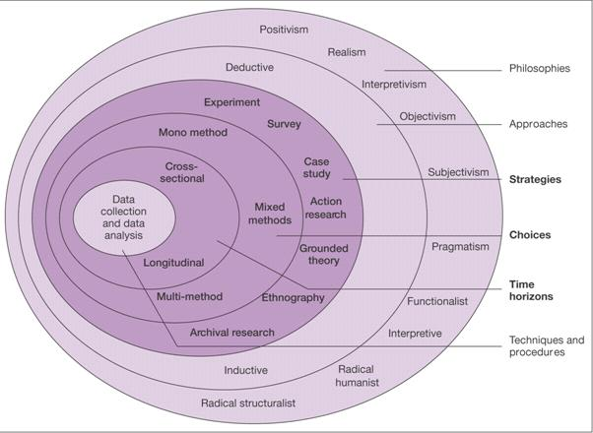
The Research Methodology – The Research Onion
1. Philosophy
2. Research Approach
3. Research Strategy
4. Methodological Choice
5. Time Horizon
6. Data Collection and Data
Analysis
Sampling
Data collection
Data analysis
Data validity and reliability
Positivism
Deductive
experiment
survey
Data Collection
Secondary data
Observation
Interviews
Questionnaires
Data Analysis
case
study
grounded
theory
phenomenology
action research
ethnography
Source: Saunders et al, 2012

Slide 31
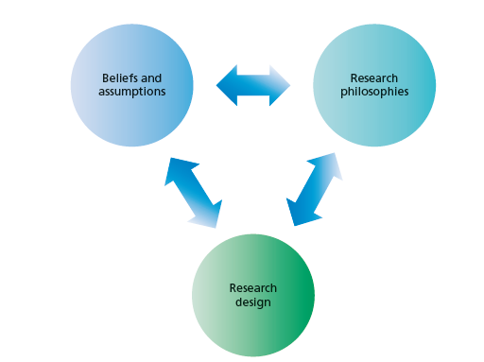
1. Research Philosophy
Research philosophy is an over-arching term relating to the development of knowledge and the nature of that knowledge’ Adapted from Saunders et al, (2016)
What you are doing when embarking on research – developing knowledge in a particular field
Philosophy you adopt contains important assumptions about the way in which you view the world.
Eg: Concerned with Feelings and attitudes OR Facts
Your particular view of the relationship between knowledge and the process by which it is developed. -Adapted from Saunders et al, (2016)
These include assumptions about human knowledge (epistemological assumptions), about the
realities you encounter in your research (ontological assumptions) and the extent and
ways your own values influence your research process (axiological assumptions).

Slide 32
Ontology: ways of constructing reality, “how things really are” and “how things really work”.. Denzin and Lincoln, (1998; 2010)
Ontology
Epistemology
Axiology
Research objects include organizations, management, individuals’ working lives and organizational events and artefacts.
One reality or More than one reality
Axiology: The role of values and ethics within the research process.
This incorporates questions about how we, as researchers, deal with both our own values and those of our research participants
Epistemology: different forms of knowledge of that reality.
Ways of knowing – that is, how do we know what we know? What constitutes acceptable knowledge,
Research Paradigm
Different types of knowledge numerical data to textual and visual data, from facts to interpretations, and including narratives, stories and even fictional accounts –
Eg: you value personal interaction
Methodology: What tools do we use to know that reality?

Slide 33
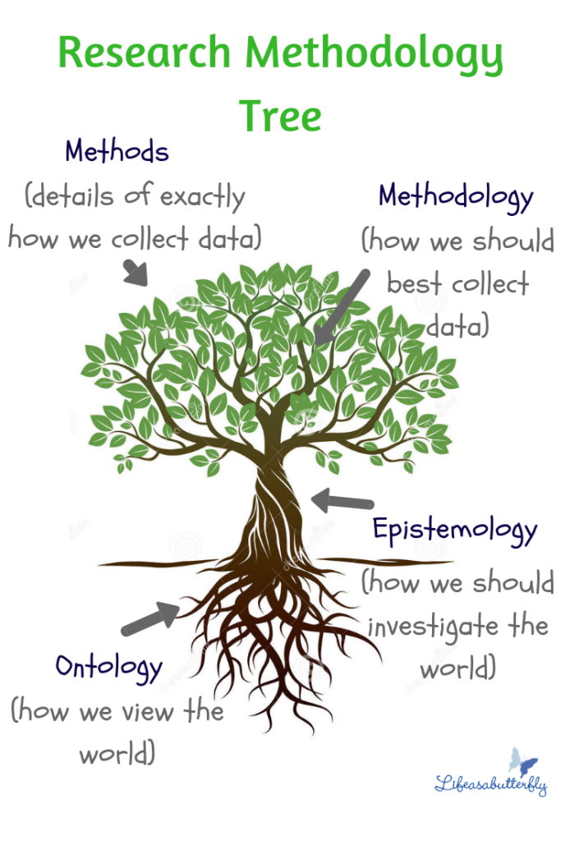
Main research philosophies
Positivism -
The stance of the natural scientist.
2. Realism
What the senses show us as reality is the truth;
Interpretivism
Researchers as ‘social actors’
Pragmatism
Pragmatism asserts that concepts are only relevant where they support action (Kelemen and Rumens 2008).

Slide 34
Ontology
Ontology
What is reality
What shapes reality What is happening
Eg: What is the problem/what are the solutions
Singularity
There is only one reality
Only one set of solution to the problem
2. More than one Reality Depends on how people perceive How people are shaping the reality
Research Philosophy
Epistemology
Epistomology
Knowledge of the reality
How do we collect knowledge
Epistomology
Knowledge can be measured
Knowledge can be interpreted

Slide 35
Ontology
Epistemology
Philosophy
Singularity
There is only one reality
Only one set of solution to the problem
Positivism
Epistemology
Knowledge can be measured
2. More than one Reality Depends on how people perceive How people are shaping the reality
Epistemology
Knowledge can be interpreted
Interpretivism
Assumes that reality is socially constructed, that is, there is no single, observable reality.
Rather, there are multiple realities, or interpretations, of a single event

Slide 36
Interpretivism/Constructivism Focus on meaning.
Interpreted by the individual according to his or her ideological positions
Reality is subjective and multiple
Seek to understand meaning as experienced by participants. Researcher as a social actor to appreciate differences between people
Meaning of events is mediated by interactions with others, and social and cultural context
Start with open-ended inquiry and result in hypothesis
Eg: Lived Experience of first-time mothers
Interpretivisim advocates it is necessary for the researcher to understand differences between humans in our role as social actors. Interpretive research is concerned with the meanings that people attach to norms, rules, and values that regulate their interactions

Slide 37
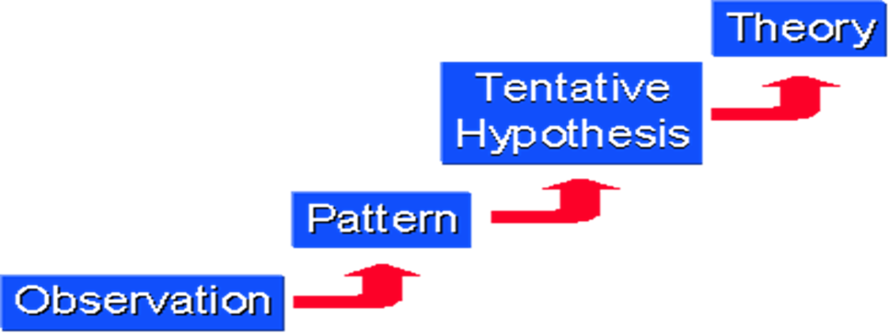
2. Research Approach
Starts with the observations and theories are proposed towards the end of the research process as a result of observations Goddard, W. & Melville, S. (2004)
It is a plan and procedure that consists of the steps of broad assumptions to detailed methods of data collection, analysis, and interpretation.
Inductive Approach
Inductive means that you are researching to create theory.
The process of going from observations to conclusions.
Induction: building theory

Slide 38
3 Research Strategies
A research strategy usually has
♦ A goal: something it can be used for
♦ A procedure: steps to follow to achieve results
♦ A set of techniques involved in the procedures
Basic qualitative research,
Phenomenology,
Grounded theory,
Ethnography,
Narrative analysis,
Qualitative case study

Slide 39
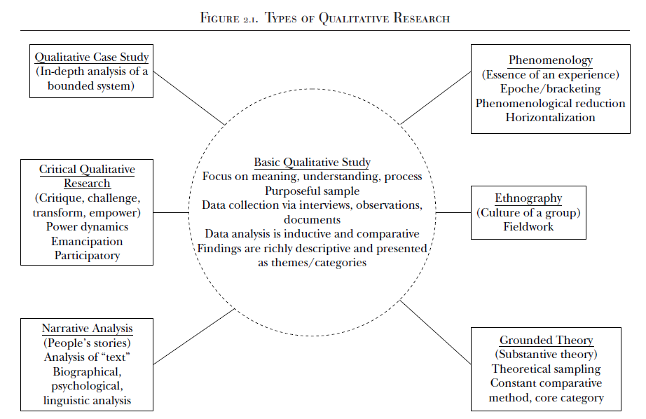

Slide 40
Research Strategy Examples
Basic Qualitative
Motivation of females to choose to work in gig economy in Malaysia
Phenomenology:
Lived experience of female students who have been physically assaulted by students
Qualitative Case study:
What strategies are being used by small businesses that have effective and viable workplace wellness programs?
Grounded Theory
Victimizing of School Bullying: a Grounded Theory

Slide 41
Basic Qualitative Research
A central characteristic of all qualitative research is that individuals construct reality in interaction with their social worlds. - Interpretivism
The researcher is interested in understanding the meaning a phenomenon has for those involved.
Meaning, however, “is not discovered but constructed.
(1) how people interpret their experiences,
(2) how they construct their worlds,
(3) what meaning they attribute to their experiences.
The overall purpose is to understand how people make sense of their lives and their experiences
Example: a qualitative study to uncover the process Malaysian retirees engaged in in transitioning into a postretirement second career

Slide 42
Narrative research
In narrative research, researchers describe the lives of individuals, collect and tell stories about people’s lives, and write narratives of individual experiences.
Focuses on studying a single person, gathering data through the collection of stories, reporting individual experiences, and discussing the meaning of those experiences for the individual. Creswell, 2008
Spoken or written text giving an account of an event/action or series of events/actions, chronologically connected (Czarniawska, 2004, p. 17)
Single individual
Interested in exploring the experiences of that individual
Examples of Narrative Research:
A study of the experiences of an autistic student who has moved from a self-contained program to an inclusion setting
A study of the experiences of a high school track star who has been moved on to a championship-winning university track team

Slide 43
Phenomenology:Phenomenologists are interested in our “lived experience” (Van Manen, 2014),
Describes the meaning of lived experiences for several individuals
Describes what the participants have in common as they experience a phenomenon
The purpose is to reduce the experiences of the participants with a phenomenon to a description of a universal essence
Phenomenological reduction is the process of continually returning to the essence of the experience to derive the inner structure or meaning in and of itself
Example:
The essence of being a mother for the first time
A Phenomenological Study of the Experiences of employees with Disabilities
A phenomenological study on drug usage by employees
Phenomenologists are interested in our “lived experience”(Van Manen, 2014),

Slide 44
Grounded Theory Glaser and Strauss (1967) developed a pioneering book that expounded in detail on their grounded theory procedures, The Discovery of Grounded Theory
Creswell (2009), “a qualitative strategy of inquiry in which the researcher derives a general, abstract theory of process, action, or interaction grounded in the views of participants in a study.” (p. 13 & 229)
This process involves using multiple stages of data collection and the refinement and interrelationships of categories of information (Charmaz, 2006; Strauss and Corbin, 1990, 1998).
A grounded theory design is a systematic, qualitative or quantitative procedure used to generate a theory that explains, at a broad conceptual level, a process of an action, or an interaction about a substantive topic (Glaser and Strauss, 1999).
Iteration and Constant Comparison
The purpose of grounded theory research in education and management is to develop new concepts and theories of education/management related phenomena, where these concepts and theories are firmly grounded in qualitative data

Slide 45
Grounded theory
Move beyond description and to generate or discover a theory. Strauss & Corbin 1998)
Intends to generate or discover a theory that relates to a particular situation.
If little is known about a topic, grounded theory is especially useful.
Because the theory emerges from the data, it is said to be grounded in the data.
Data collection and analysis occur simultaneously, until “saturation” is reached.
A specific methodology developed by Glaser and Strauss (1967) for the purpose of building theory from data. (Corbin & Strauss, 2008)
The overall object of this analysis is to identify patterns in the data.
These patterns are arranged in relationships to each other in the building of a grounded theory
Example: Toward a Theory of Culturally Relevant Pedagogy
Examined the pedagogical practices of eight elementary school teachers in a small town in North Carolina

Slide 46
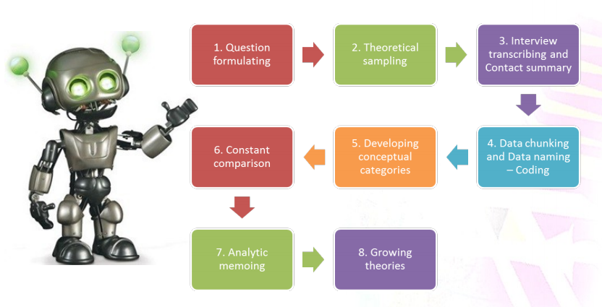
How to do a Grounded Theory
The data is collected mainly through 20- 30 interviews during
multiple visits to the field to saturate categories
(happenings, events, documents)
Focus research questions on understanding how individuals experience the process and identify the steps in the process
Interviews with 20-30 participants
Questions focus on the steps in the process
Additional questions focus on what was central to the process, the causes of the phenomenon, the strategies employed during the process, and the effects or consequences that occurred
Data collection occurs until there is saturation
Grounded theory is an inductive methodology.

Slide 47
Example of Grounded Theory
“Victimizing of School Bullying: a Grounded Theory” by Robert Thornberg, Karolina Halldin, Natalie Bolmsjö & Annelie Petersson
This study analyses the experiences and perceptions of victims of bullying in elementary schools in Sweden. The study’s initial goal was to “investigate how individuals, who had been victims of school bullying perceived their bullying experiences and how these had affected them, as well as to generate a grounded theory of being a victim of bullying at school” (Thornberg et al., 2011, p. 311).

Slide 48
Ethnography
A description and interpretation of a cultural or social group or system.
The researcher examines the group’s observable patterns of behavior, customs, and ways of life.
Involves prolonged observation of the group, typically through participant observation.
Focus: study human behaviour in the cultural context in which it is embedded
Example:
Study with the purpose of understanding a very isolated tribe in the Amazon basin

Slide 49
Case Study
A case study is an in-depth inquiry into a topic or phenomenon within its real-life setting (Yin 2014).
“A case study is an empirical study that investigates a contemporary phenomenon in depth and with its real-life context” (Yin, 2009, p18)
Patton (1990) suggests that case studies are valuable in creating deep understanding of particular people, problems or situations in comprehensive ways.
Once defined, case study research sets out to understand the dynamics of the topic being studied within its setting or context
Saunders 2016

Slide 50
Creswell (2002) "an in-depth exploration of a bounded system (e.g., an activity, event, process, or individuals) based on extensive data collection" (p. 485).
Creswell recommends case study as a methodology if the problem to be studied "relates to developing an in-depth understanding of a 'case' or bounded system" (p. 496) and if the purpose is to understand "an event, activity, process, or one or more individuals" (p. 496).
Cases are bounded by time and activity, and researchers collect detailed information using a variety of data collection procedures over a sustained period of time (Stake, 1995; Yin, 2009, 2012).
Case Studies
Bounded
system
"'Bounded' means that the case is separated out for research in terms of time, place, or some physical boundaries" (Cresswell p. 485).
In other words, it is possible to create limits around the object to be studied (Merriam, 1998)

Slide 51
CASE STUDIES - Cases are units of investigation
Cases can be
Person/persons
Group/groups
Organization/organizations
Institution/institutions
Event/events.
Employee/group employees
Student/group of students
The ‘case’ in case study research may refer to a person (e.g. a manager), a group (e.g. a work team), an organisation (e.g. a business), an association (e.g. a joint venture), a change process (e.g. restructuring a company), an event (e.g. an annual general meeting) as well as many other types of case subject
A case study is an in-depth description and analysis of a bounded system.
A single entity, a unit around which there are boundaries.
An in-depth analysis of a case, often a program, event, activity, process, or one or more individuals.

Slide 52
Case study Collection of data
Three main methods used: Survey, field study, historical info
Direct observations (e.g., human actions or a physical environment)
Interviews (e.g., open-ended conversations with key participants)
Archival records (e.g., student records)
Documents (e.g., newspaper articles, letters and e-mails, reports)
Participant-observation (e.g., being identified as a researcher but also filling a real-life role in the scene being studied)
Physical artifacts (e.g., computer downloads of employees’ work)

Slide 53
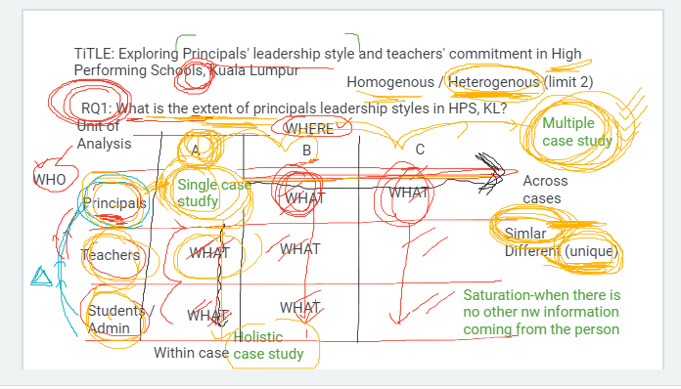
Title: Exploring Principals leadership style and teachers commitment in High Performing Schools in Kuala Lumpur
RQ1: What are the leadership styles in High performing schools?
WHO
Homogeneous or Heterogeneous
Units of Analysis | School A | School B | School C
Principals | What | What | What
Teachers | What | What | What
Students Admin | What | What
Data Triangulation
Holistic or Embedded (within the Case study)
Single Case Vs Multiple Case Study
(across cases)

Slide 54
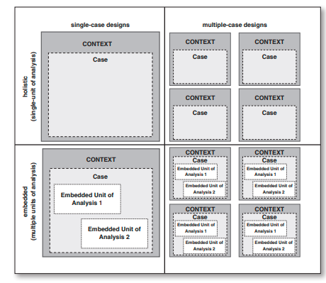
Types of Case Studies Designs
A single or multiple cases
Single case: allow for an in-depth understanding of the single phenomenon
Multiple: allows for a more in-depth understanding of the cases as a unit,
through comparison of similarities and differences
Holistic or embedded
Holistic case studies - where the case is studied as a whole,
Embedded case studies - where multiple units of analysis are studied within a case

Slide 55
Types of Case Studies
Intrinsic case study
Researcher wants to understand a particular case in-depth
Eg: A case of discipline in an institution
Instrumental case study –
Carried out to understand a theory or a theory related problem
Collect rich data related to a theory
Eg: Case study on implementation of transformational leadership style of a manager to increase performance
Collective or multiple instrumental case study
A combination of a number of instrumental case studies – in depth
Understand theory from a larger context
Eg: A collective case study to understand the reasons for the defeat of a political party. Research carried on a number of single cases (instrumental case studies)

Slide 56
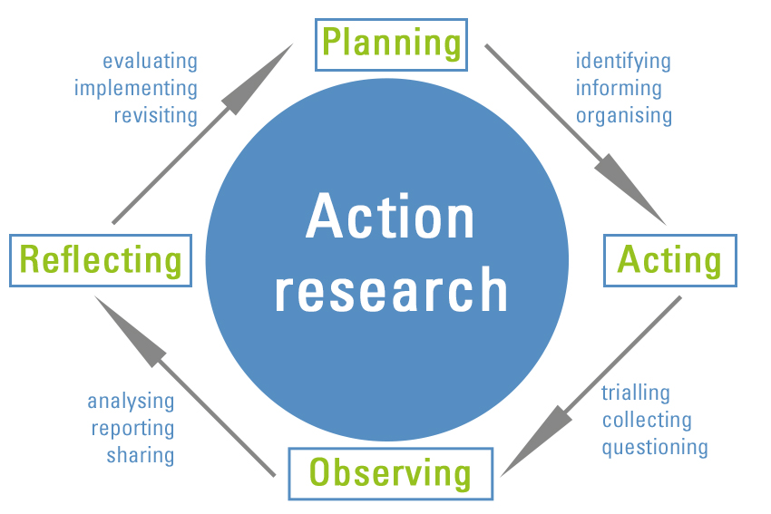
Action Research
Disciplined inquiry into practices undertaken by those involved in them
Done to inform and change the practice studied. To address problems
Often undertaken as a collaborative activity among colleagues
Often undertaken in situ
Could focus on a single issue in a classroom, a program, etc.
Denscombe (2010, p. 6) - An action research strategy's purpose is to solve a particular problem and to produce guidelines for best practice.

Slide 57
Qualitative research: Exploratory
Associated with an interpretive philosophy
Studies participants’ meanings and the relationships between them
Small samples of data
Data in words or voice
Data collection through interviews etc.
Eg: structured interviews
Example: Lived experience of first-time mothers
♦ quantitative approach: Interview first time
mothers
♦ qualitative approach: understand the experience – Interview (words, voice)
4. Methodological Choice
Qualitative
Allows researchers to have a deeper understanding of the research area by taking into account the perspective of the study population and the context in which they live (Hennink, Hutter & Bailey, 2011).

Slide 58
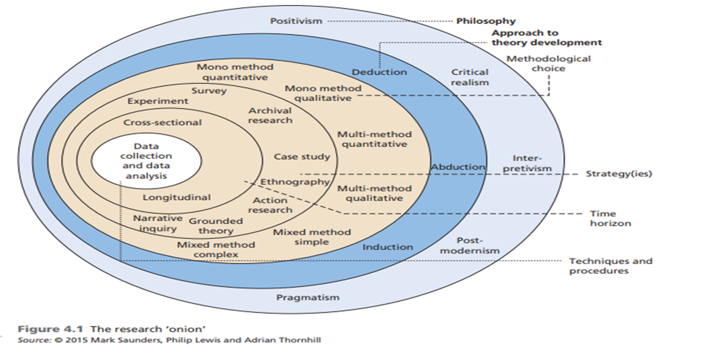
5. Time Horizon
Cross Sectional
A study can be done in which data are gathered just once, perhaps over a period of days or weeks or months, in order to answer a research question
Longitudinal
The researcher might want to study people or phenomena at more than one point in time in order to answer the research question.
Eg: To study employees‘ behavior before and after a change in the top management, so as to know what effects the change accomplished. Data are gathered at two different points in time

Slide 59
Time Horizon
Time of Data Collection
Study at One Point in Time
Study Over Time
Longitudinal
Cross-sectional
Trends in
the same
population
over time
Changes
in a
subpopulation
group identified
by a common
characteristic
over time
Changes
in the
same
people
over time
Attitudes
and
Practices
Customer
Satisfaction
Program
Evaluation
Panel
Group
Comparisons
National
Survey
Trend
Cohort

Slide 60
6. Data Collection and Data Analysis
Sampling – Sample Size
Data Collection Instrumentation
Data Processing
Data Analysis (Reliability and Validity)

Slide 61
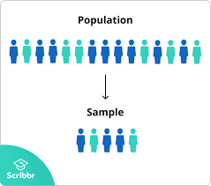
Populations and Samples
Sampling
Target
Population
Sample
Sample
Nonprobability sampling
Most common sampling methods are:
Purposive sampling/Judgement sampling
Select participants according to pre-selected criteria relevant to a particular research question.
Quota sampling
If the researcher needs a specific number of participants, quota sampling is better

Slide 62
Sampling: Sample size Based on the phenomena to be studied
There are no specific rules when determining an appropriate sample size in qualitative research. Qualitative sample size may best be determined by the time allotted, resources available, and study objectives (Patton, 1990).
Two general guidelines: the number of participants is sufficient when…
the extent to which the selected participants represent the range of potential participants in the setting
the point at which the data gathered begin to be redundant (data saturation)
Saturation
A situation in data analysis where participants’ descriptions become repetitive and confirm previously collected data
An indication that data analysis is complete
When data analysis is complete, data collection is terminated

Slide 63
Sampling: Sample size Saunders et al., 2012
For a general study, you should expect to undertake between 5 and 30 interviews (Creswell 2013).
Saturation
A situation in data analysis where participants’ descriptions become repetitive and confirm previously collected data
An indication that data analysis is complete
When data analysis is complete, data collection is terminated
Saturation occurs when adding more participants to the study does not result in additional perspectives or information. Glaser, B. & Strauss, A. (1967)

Slide 64
Sample Size – Rule of Thumb
Saturation Point
Urquhart (2013: p. 194) defines saturation as: ‘the point in coding when you find that no new codes occur in the data. There are mounting instances of the same codes, but no new ones’,
Given (2016: p. 135) considers saturation as the point at which ‘additional data do not lead to any new emergent themes’
Creswell (2013)
Recommends 20–30 informants for a grounded theory study, 4–5 cases per study for case study research and 2 or 3 for narrative research
Dukes (1984)
Recommends 3–10 participants in a phenomenological study
Kuzel (1999)
Recommends 5–8 participants in a homogeneous sample (or homogeneous subgroups within a sample) or 12–20 if looking for disconfirming evidence or to achieve maximum variation sampling
Lincoln and Guba (1985, p. 235)
Recommend between 12 and 20 participants in interview studies
Marshall, Cardon, Poddar, and Fontenot (2013)
Recommend 20–30 interviews for grounded theory studies and 15–30 for single-case studies
Morse (1994, 2000) Morse (1994)
Recommends at least 6 participants for phenomenological studies and approximately 35 for studies based in grounded theory, ethnography and ethnoscience. The number of interviews per informant is important, as well as the number of informants
Parse (1990)
Recommends 2–10 participants in order to achieve ‘redundancy or saturation’ (p. 10)
Ray (1994)
Suggests that phenomenological studies usually focus on a group of between 8 and 12 people, but may also focus on just a single person (p. 127)
Sandelowski, 1995 : Ten may be adequate for sampling among a homogenous population ().

Slide 65
Data Collection Methods
In-depth interviews
Narratives, detailed responses to probing questions
Direct observation
Field notes containing descriptions of activities, behaviors, actions, interactions, and processes
Document analysis
Written documents: records, memoranda, correspondence, reports, diaries
Focus Group
Interview format, but in a group setting
John Creswell (1998) notes there are four basic types of data that may be collected, depending on the methodology used:
Observations
Interviews
Documents
Audio-visual materials

Slide 66
Observation
Interview
Focus Group
Intensive, usually long term, examination of a social group, an organization, etc.
Researcher becomes a participant in the lives of group members
Observes their behavior and learns meaning systems (which are tied to language)
Most closely associated with Ethnography, as developed in Classical Anthropology
Now done in a variety of disciplines
Decide on the type of interview to use
Individual
Electronic Eg: Zoom
Telephone
Create an interview protocol
Ask open-ended questions (5-7)
allows the participant to create options for responding
participants can voice their experiences and perspectives
If possible, tape record and transcribe for analysis
1. Interview format, but in a group setting
6-12 participants with common experience
2. Transcript of discussion is the data
Focus groups: : 6-9 participants (Krueger, 2000); 6- 10 participants (Langford, Schoenfeld, & Izzo, 2002; Morgan, 1997); 6-12 participants (Johnson & Christensen, 2004); 6-12 participants (Bernard, 1995)
DATA COLLECTION METHODS

Slide 67
Structured
Semi structured
Unstructured
Questions are planned and created in advance.
All candidates are asked the same questions in the same order.
These interviews are guided by a predefined and very rigorous set of questions to which the interviewers must restrict themselves.
No room for improvisation! The aim here is to collect a maximum number of standardised answers.
A semi-structured interview is a type of interview in which the interviewer asks only a few predetermined questions
The interviewer can use cues or prompts
More structured than free interviews but more flexible than structured interviews.
Type of interview in which the interviewer asks questions which are not prepared in advance.
Characterized by the complete absence of an interview guide or structure of any kind. The aim here is to take a vast sweep of a given subject.
Instead, questions arise spontaneously in a free-flowing conversation, and different candidates are asked different questions
Types of Interviews

Slide 68
Data Processing
Transcribing your data

Slide 69
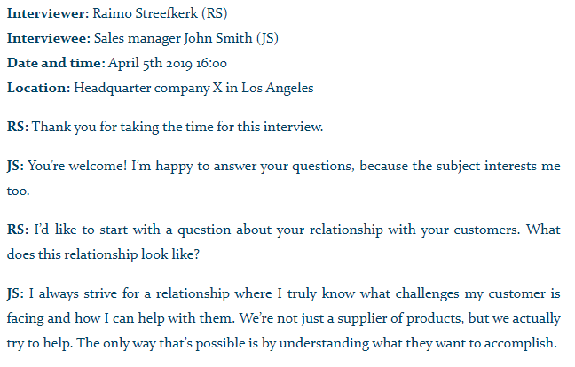
Transcribing your data Transcribing is converting speech to text word for word.
Transcription methods
1. Verbatim transcription
Write down every single word, including pauses, the expression of emotions such as laughter, stuttering, and hesitations such as “uh”.
2. Intelligent verbatim transcription (most common)
Write down every word, but without irrelevant fillers like “uhm”, “yeah”, “you know” etc. To improve readability, you can also fix grammar mistakes, broken sentences and long paragraphs
3. Edited transcription
A summarized and edited version of an intelligent verbatim transcript. In addition to omitting fillers like “you know”, irrelevant sentences can be omitted if it doesn’t change the meaning of the story.

Slide 70
Data Analysis
Data analysis is the process of making sense out of the data.
And making sense out of data involves:
consolidating,
reducing,
interpreting
what people have said and what the researcher has seen and read—it is the process of making meaning
Merriam and Tisdell

Slide 71
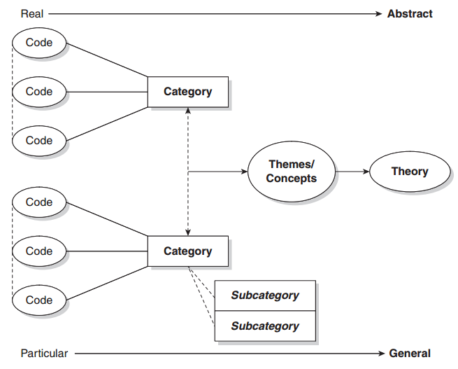
Data Analysis
Coding is the analytic process through which the qualitative data
that you have gathered are reduced

Slide 72
CODING
Coding is the process perusing data for categories and meanings (themes, ideas, etc.) and then systematically marking similar strings of text with a code label.
CODE
A code in qualitative inquiry is most often a word or short phrase that symbolically assigns a summative, salient, essence capturing, and/or evocative attribute for a portion of language-based or visual data’
(Saldaña, 2013)
CATEGORY
‘(Q)ualitative codes are essence-capturing and essential elements of the research story, that, when clustered together according to similarity and regularity (a pattern), they actively facilitate the development of categories and thus analysis of their connections.’
(Saldaña, 2013: 8)Ñ

Slide 73
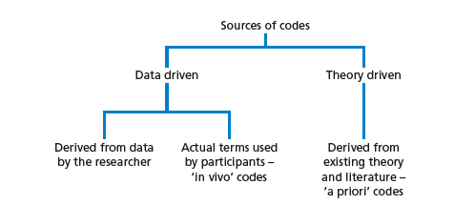
Steps in Coding
What is a code
Read through all transcripts
Start with one transcript
Identify text segments – ask “what is this person saying?”
Bracket text segment
Assign code word
Reduce redundancy
Collapse codes into themes
A code is a word, phrase, or sentence that represents aspect(s) of a data or captures the essence or feature(s) of a data

Slide 74
Thematic Analysis – Braun and Clarke
Six-step process:
Familiarization
Coding
Generating themes
Reviewing themes
Defining and naming themes
Writing up

Slide 75
Thematic Analysis – Braun and Clarke
Step 1: Familiarization
The first step is to get to know our data. It’s important to get a thorough overview of all the data we collected before we start analyzing individual items.
This might involve transcribing audio, reading through the text and taking initial notes, and generally looking through the data to get familiar with it.
Braun, V., & Clarke, V. (2006). Using thematic analysis in psychology. Qualitative Research in Psychology, 3, 77–101.

Slide 76
Thematic Analysis – Braun and Clarke
Step 2: Coding
Coding means highlighting sections of our text – usually phrases or sentences – and coming up with shorthand labels or “codes” to describe their content.
Let’s take a short example text. Say we’re researching perceptions of climate change among conservative voters aged 50 and up, and we have collected data through a series of interviews. An extract from one interview looks like this:
In this extract, we’ve highlighted various phrases in different colors corresponding to different codes. Each code describes the idea or feeling expressed in that part of the text.
At this stage, we want to be thorough: we go through the transcript of every interview and highlight everything that jumps out as relevant or potentially interesting. As well as highlighting all the phrases and sentences that match these codes, we can keep adding new codes as we go through the text.
After we’ve been through the text, we collate together all the data into groups identified by code. These codes allow us to gain a a condensed overview of the main points and common meanings that recur throughout the data.

Slide 77
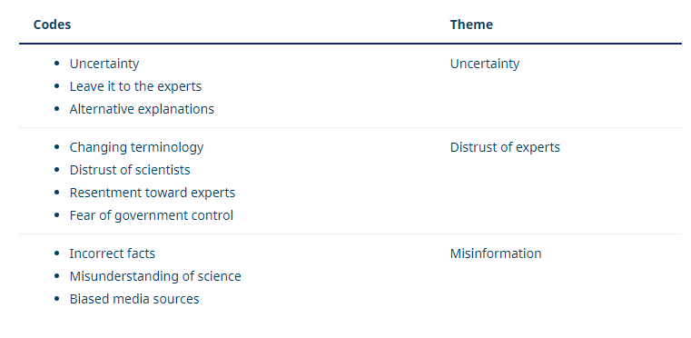
Thematic Analysis – Braun and Clarke
Step 3: Generating themes
Next, we look over the codes we’ve created, identify patterns among them, and start coming up with themes.
Themes are generally broader than codes. Most of the time, you’ll combine several codes into a single theme. In our example, we might start combining codes into themes like this:
At this stage, we might decide that some of our codes are too vague or not relevant enough (for example, because they don’t appear very often in the data), so they can be discarded.
Other codes might become themes in their own right. In our example, we decided that the code “uncertainty” made sense as a theme, with some other codes incorporated into it.
Again, what we decide will vary according to what we’re trying to find out. We want to create potential themes that tell us something helpful about the data for our purposes.

Slide 78
Thematic Analysis – Braun and Clarke
Step 4: Reviewing themes
Now we have to make sure that our themes are useful and accurate representations of the data. Here, we return to the data set and compare our themes against it. Are we missing anything? Are these themes really present in the data? What can we change to make our themes work better?
If we encounter problems with our themes, we might split them up, combine them, discard them or create new ones: whatever makes them more useful and accurate.
For example, we might decide upon looking through the data that “changing terminology” fits better under the “uncertainty” theme than under “distrust of experts,” since the data labelled with this code involves confusion, not necessarily distrust.

Slide 79
Thematic Analysis – Braun and Clarke
Step 5: Defining and naming themes
Now that you have a final list of themes, it’s time to name and define each of them.
Defining themes involves formulating exactly what we mean by each theme and figuring out how it helps us understand the data.
Naming themes involves coming up with a succinct and easily understandable name for each theme.
For example, we might look at “distrust of experts” and determine exactly who we mean by “experts” in this theme. We might decide that a better name for the theme is “distrust of authority” or “conspiracy thinking”.

Slide 80
Thematic Analysis – Braun and Clarke
Step 6: Writing up
Writing up a thematic analysis requires an introduction to establish our research question, aims and approach.
Include a methodology section, describing how we collected the data (e.g. through semi-structured interviews or open-ended survey questions) and explaining how we conducted the thematic analysis itself.
The results or findings section usually addresses each theme in turn. We describe how often the themes come up and what they mean, including examples from the data as evidence. Finally, our conclusion explains the main takeaways and shows how the analysis has answered our research question.
In our example, we might argue that conspiracy thinking about climate change is widespread among older conservative voters, point out the uncertainty with which many voters view the issue, and discuss the role of misinformation in respondents’ perceptions.

Slide 81
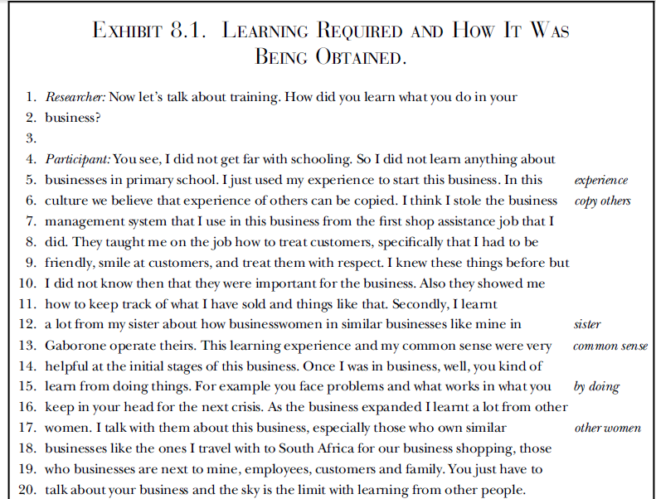
Sample
RQ1: How to learn what to do in business
Codes

Slide 82
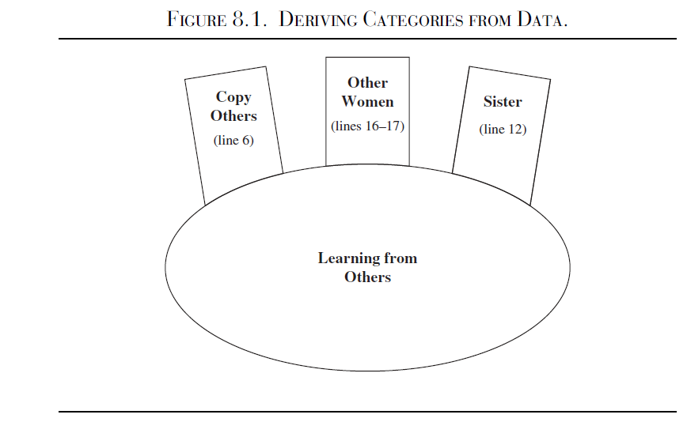

Slide 83
Trustworthiness
Trustworthiness is important to ensure the findings are worthy of attention (Lincoln & Guba, 1985).
Lincoln and Guba (1985) introduced the criteria of:
a) credibility (in preference to internal validity);
b) transferability (in preference to external validity/generalisability);
c) dependability (in preference to reliability);
d) conﬁrmability (in preference to objectivity).
The aim of trustworthiness in a qualitative inquiry is to support the argument that the inquiry’s findings are “worth paying attention to” (Lincoln & Guba, 1981, p.290).

Slide 84
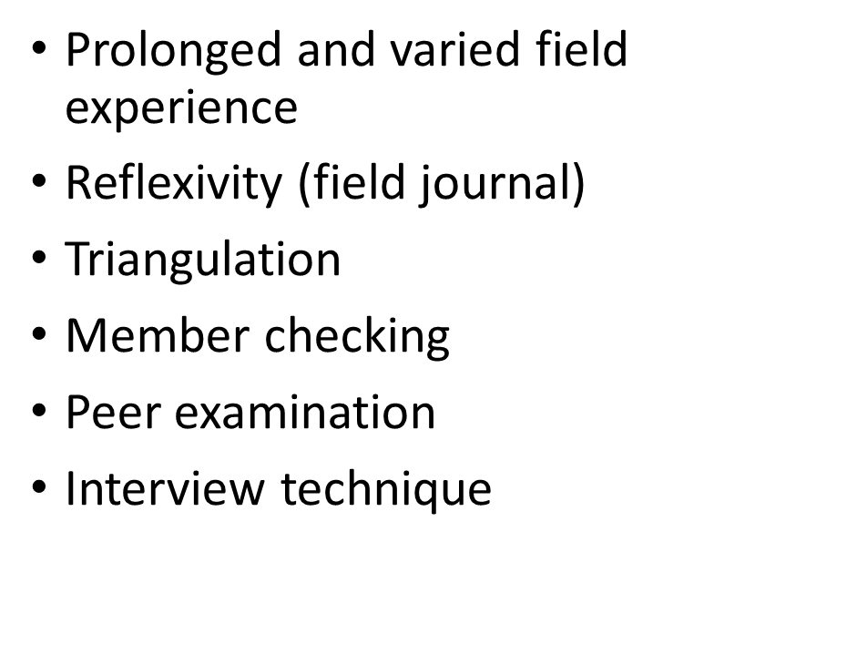
Credibility:
Guba and Lincoln (1989), the credibility of this research was addressed through prolonged engagement with the respondents.
Eg; Member checking to test the findings and interpretations with the participants (Lincoln and Guba, 1985).
The credibility criteria involves establishing that the results of qualitative research are credible or believable from the perspective of the participant in the research.
How confident the qualitative researcher is in the truth of the research study’s findings.
How do you know that your findings are true and accurate?
Use triangulation

Slide 85
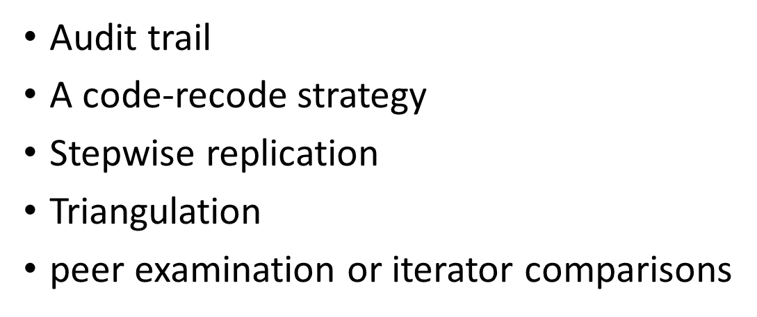
Dependability:
To demonstrate the dependability of this study, an audit trail was maintained (Koch, 1994).
To achieve dependability, the researcher kept records of the raw data, field notes, transcripts, and a reflexive journal.
These activities enabled the researcher with ease of reporting and the ability to systemize, relate, and cross reference data (Halpren, 1983).
Dependability is the extent that the study could be repeated by other researchers and that the findings would be consistent

Slide 86
Confirmability:
Concerned with establishing that the researcher’s interpretations and findings are clearly derived from the data (Guba and Lincoln, 1989). Throughout the study, the researcher included markers such as reasons analytical of methodological choices to ensure readers can understand why and how decisions were made (Koch, 1994).
Degree of neutrality in the research study’s findings.
The findings are based on participants’ responses and not any potential bias or personal motivations of the researcher

Slide 87
Transferability
How the qualitative researcher demonstrates that the research study’s findings are applicable to other contexts.
In this case, “other contexts” can mean similar situations, similar populations, and similar phenomena.
Qualitative researchers can use thick description to show that the research study’s findings can be applicable to other contexts, circumstances, and situations.
Purposive sampling
Provide thick description

Slide 88
Lincoln and Guba's Evaluative Criteria
Lincoln and Guba posit that trustworthiness of a research study is important to evaluating its worth. Trustworthiness involves establishing:
Credibility - confidence in the 'truth' of the findings
Transferability - showing that the findings have applicability in other contexts
Dependability - showing that the findings are consistent and could be repeated
Confirmability - a degree of neutrality or the extent to which the findings of a study are shaped by the respondents and not researcher bias, motivation, or interest.
Lincoln, YS. & Guba, EG. (1985). Naturalistic Inquiry. Newbury Park, CA: Sage Publications.

Slide 89
Thank You

