Slide 1
Digital Marketing Funnel
BM031-3-M BSSMMA and Version: VD2
Chapter 4

Slide 2
AIDA MODEL

Slide 3
AIDA
FOUR Key Stages in Advertising Process 1. Obtaining Attention of potential customer 2. Evoking Interest
3. Developing the desire
4. Inducing Action

Slide 4
ATTENTION
An advertisement must grab the attention of a potential customer.
Coca-Cola Zero original campaign consisted of posters on bus stations and billboards with no notion that it was an advertisement
The posters were black and had peculiar red questions written on them.
The campaign successfully attracted attention of massive amounts of people before they even knew what it was about.

Slide 5
Interest
It is essential to keep the potential customers interested in the advertisement.
The above stated campaign formed the questions always incorporating the symbol or the word ‘zero’.
When people started noticing that this was the only consistent thing (in addition to appearance) in the posters, they became interested to know what it represented.

Slide 6
DESIRE
Building up the desire to have or use a product/service in potential customers consist mostly of accumulation of positive arguments.
The Coca Cola Zero campaign introduced the beverage and focused on advertising the fact that although it does not contain sugars.
It tastes the same as the original beverage. This stimulated customers to give it a try!

Slide 7
ACTION
A percentage of customers has fallen off as each stage progressed.
• Who acquired a positive impression of the product/service which was advertised and the only thing which can now be done is offering them a sale.
• This is a stage where you win some and you lose some.
• However, if the work in the previous stages was done well, a solid ground is made for potential future transactions.

Slide 8
THE FUNNEL MODEL: CUSTOMER ACQUISITION, CONVERSION, AND RETENTION
Benchmarks effectiveness of one/more marketing strategies.
The wider is the base of the funnel, better is the strategy.

Slide 9
CUSTOMER LIFE CYCLE

Slide 10
CUSTOMER RELATIONSHIP MANAGEMENT
Goal is to create strong relationships with customers throughout its life-cycle.
Why important:
Good customer experiences builds loyalty and repeat business.
Opportunities for cross-selling or up-selling.
It costs much less to retain an existing customer than gain a new customer.
Customer acquisition costs:
Costs of attracting and converting a visitor into a paying customer (includes conversion costs).
Netflix: $37 per customer (2004).
E-Trade: $250 per customer (2001).

Slide 11
Evolution of consumer behavior
Paradigm 1 First Moment of Truth (2005) P&G | Paradigm 2 Zero Moment of Truth + Customer Decision Journey (2011) Google | Paradigm 3 The Accelerated Loyalty Journey (2015) McKinsey

Slide 12
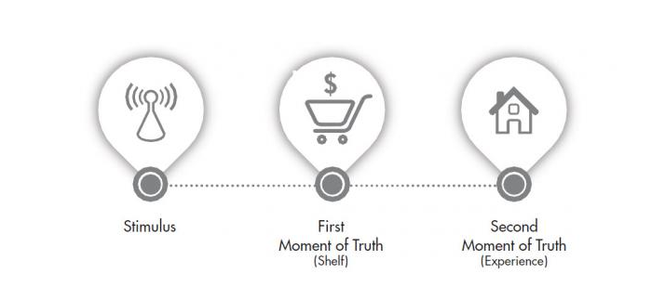
Paradigm 1 - “Moment of Truth” model

Slide 13
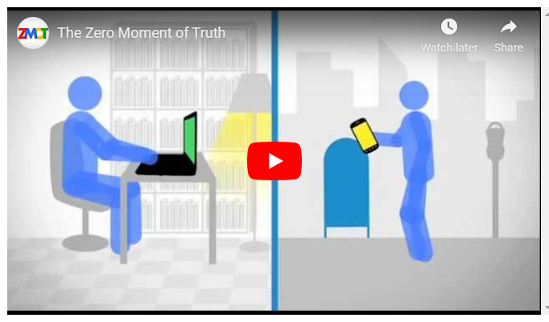
Paradigm 2: Zero Moment of Truth + Customer Decision Journey
describes how digital channels such as social media and search influence the customer decision journey.

Slide 14
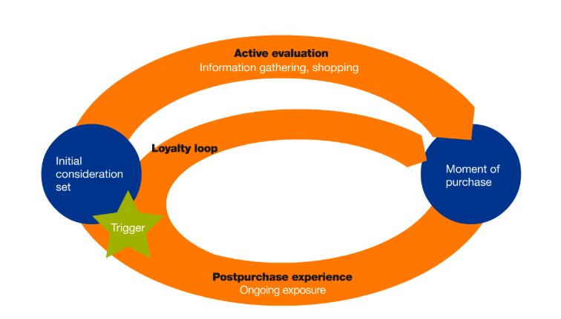
Paradigm 3: The Accelerated Loyalty Journey
From trigger, to initial consideration set, to active evaluation, to moment of purchase. Then we do it all again in the ongoing post purchase experience and loyalty loop (McKinsey, 2015)
Notes:
https://medium.com/analytics-for-humans/the-evolution-of-consumer-behavior-in-the-digital-age-917a93c15888
This “consideration set” model showed companies the importance of providing their customers with enough information for them to make the purchase decision
Is the most popular marketing framework of this decade. It has been evangelized by countless online courses, and used by businesses ranging from Fortune 500 companies to small ecommerce stores.

Slide 15
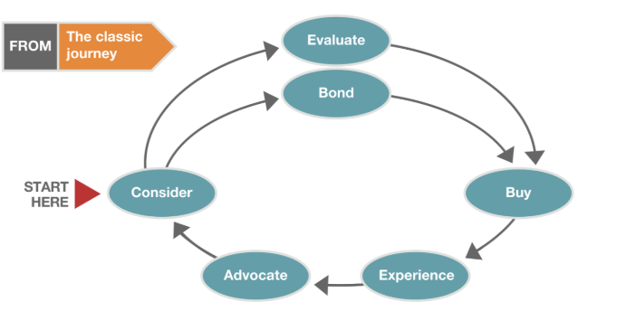
Customer Decision Journey
Classic Customer Decision Journey

Slide 16
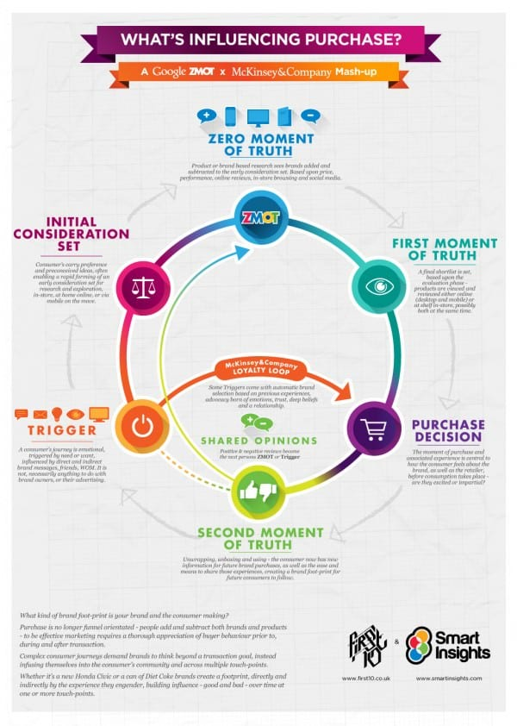

Slide 17
Advantages of Customer Decision Journey
Shoppers take advantage of technology to evaluate products and services more actively
Continuous feedback through continuous product and service evaluation
Creates pressure on the seller to maintain or improve product / brand performance
Ensure greater experience and deliver greater value

Slide 18
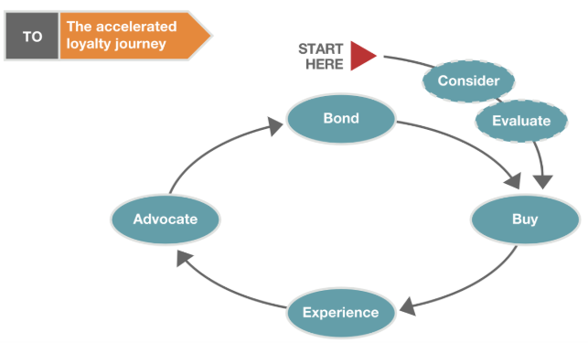
Accelerated Loyalty Journey
Accelerated loyalty journey

Slide 19
Advantages of Accelerated Loyalty Journey
delivering information in the shortest amount of time to the most targeted customer segments – allowing customers to take immediate action and convert.
Enabled by advanced technologies such as machine learning and artificial intelligence for “hyper-speed targeting” to their audience ~ new age of marketing automation and acceleration.

Slide 20
Optimize Customer decision journeys
Strategies
compress the consideration and evaluation phases
Eliminate Consideration and Evaluation phase during purchase process
Shift consumer right to the loyalty phase
Outcome
journey itself becoming the defining source of competitive advantage

Slide 21
Class Sharing
Research and provide any ONE example of a company practicing either the classic Customer Decision Journey or Accelerated Loyalty Journey

Slide 22
Thank you
Q and A

