Slide 1
Strategies in Emerging Markets
Marketing and Economic
Development

Slide 2
Learning Objectives
The political and economic changes affecting global marketing
The connection between the economic level of a country and the marketing task
Marketing’s contribution to the growth and development of a country’s economy
The growth of developing markets and their importance to regional trade
The political and economic factors that affect stability of regional market groups
The New Industrilized Country (NIC) growth factors and their role in economic development

Slide 3
Global Perspective Wal-Mart, Tide, and Three-Snake Wine
China and other emerging markets throughout the world will account for 75% of the world’s total growth in the next decade and beyond.
As countries prosper and their people are exposed to new ideas and behavior patterns via global communication networks, old stereotypes, traditions, and habits are cast aside or tempered, and new patterns of consumer behavior emerge.
A pattern of economic growth and global trade that will extend well into the 21st century appear to be emerging.
Three multinational market regions
Europe, Asia, and America

Slide 4
Marketing and Economic Development
Economic Development is generally understood to mean an increase in national production that results in an increase in the average per capita gross domestic product, (GNP).
The stage of economic growth within a country affects the attitudes toward foreign business activity, the demand for goods, the distribution systems found within a country, and the entire marketing process.
Static economy
Dynamic economy

Slide 5
Marketing and Economic Development
Introduction of Coca Cola Early Indicator

Slide 6
Stages of Economic Development
Stage 1: The traditional society
Stage 2: The preconditions for takeoff
Stage 3: The takeoff
Stage 4: The drive to maturity
Stage 5: The age of high mass consumption
The United Nations groups countries into three categories:
MDCs (more-developed countries)
LDCs (less-developed countries)
LLDCs (least-developed countries)
Newly Industrialized Countries (NICs) - Countries that are experiencing rapid economic expansion and industrialization and do not exactly fit as LDCs or MDCs

Slide 7
Economic and Social Data for Selected Countries
Exhibit 9.1

Slide 8
Impact of Emerging Economies on World Markets
Vietnamese Coffee Growers Impact World Market Price
Brazilian Coffee Growers Suffer the Consequences

Slide 9
Newly Industrialized Countries Growth Factors
The factors that existed to some extent during the economic growth of NICs were as follows:
Political stability in policies affecting their development
Economic and legal reforms
Entrepreneurship
Planning
Outward orientation
Factors of production
Industries targeted for growth
Incentives to force a high domestic rate of savings and to direct capital to update the infrastructure, transportation, housing, education, and training
Privatization of state-owned enterprises (SOEs) that placed a drain on national budgets

Slide 10
Newly Industrialized Countries Growth Factors
Indian Pharmaceutical Companies Hampered

Slide 11
Information Technology, the Internet, and Economic Development
New, innovative electronic technologies can be the key to a sustainable future for developed and developing nations alike.
The Internet accelerates the process of economic growth by speeding up the diffusion of new technologies to emerging economics.
Wireless technologies greatly reduce the need to lay down a costly telecom infrastructure to bring telephone service to areas not now served.
Substantial investments in the infrastructure to create easy access to the Internet and other aspects of IT are being made by governments and entrepreneurs.

Slide 12
Objectives of Developing Countries
Industrialization is the fundamental objective of most developing countries.
Most countries see in economic growth the achievement of social as well as economic goals.
Better education
Better and more effective government
Elimination of many social inequities
Improvements in moral and ethical responsibilities
The trend toward privatization is currently a major economic phenomenon in industrialized as well as in developing countries.

Slide 13
Infrastructure and Development
Infrastructure represents those types of capital goods that serve the activities of many industries.
The quality of an infrastructure directly affects a country’s economic growth potential and the ability of an enterprise to engage effectively in business.
The less developed a country is the less adequate the infrastructure is for conducting business.
Countries begin to lose economic development ground when their infrastructure cannot support an expanding population and economy.

Slide 14
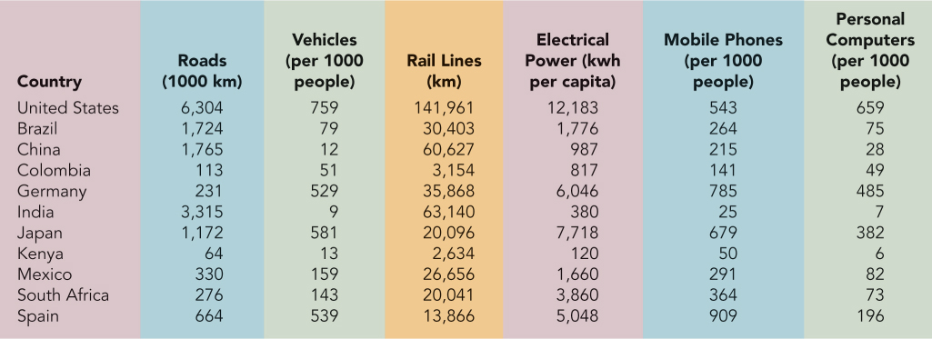
Infrastructure of Selected Countries
Insert Exhibit 9.2

Slide 15
Marketing’s Contributions
Marketing (or distribution) is not always considered meaningful to those responsible for planning.
Marketing is an economy’s arbitrator between productive capacity and consumer demand.
The marketing process is the critical element in effectively utilizing production resulting from economic growth.
Instrumental in laying the groundwork for effective distribution.

Slide 16
Marketing’s Contributions

Slide 17
Marketing in a Developing Country
Level of market development
The level of market development roughly parallels the stages of economic development.
The more developed an economy, the greater the variety of marketing functions demanded, and the more sophisticated and specialized the institutions become to perform marketing functions.
Demand in a developing country
Three distinct kinds of markets in each country
The traditional rural/agricultural sector
The modern urban/high-income sector
The often very large transitional sector usually represented by low-income urban slums

Slide 18
Marketing in a Developing Country (cont’d)
Demand in a developing country (continued)
Tomorrow’s markets will include expansion in industrialized countries and the development of the transitional and traditional sectors of less-developed nations
New markets also means that the marketer has to help educate the consumer.
The companies that will benefit are the ones that invest when it is difficult and initially unprofitable.
Bottom-of-the-pyramid markets
Bottom-of-the-pyramid markets (BOPMs) – consisting of the 4 billion people with incomes of less than $1,200 across the globe.
Most often concentrated in the LDCs and LLDCs.

Slide 19
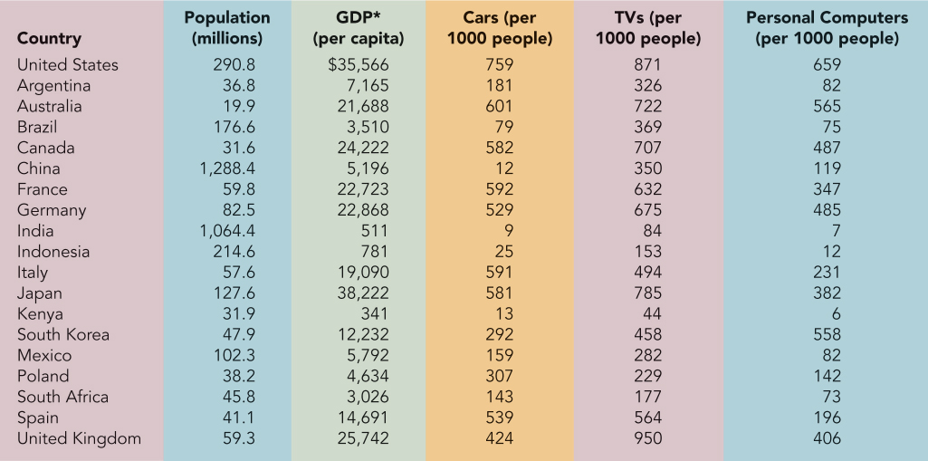
Market Indicators in Selected Countries
Insert Exhibit 9.4

Slide 20
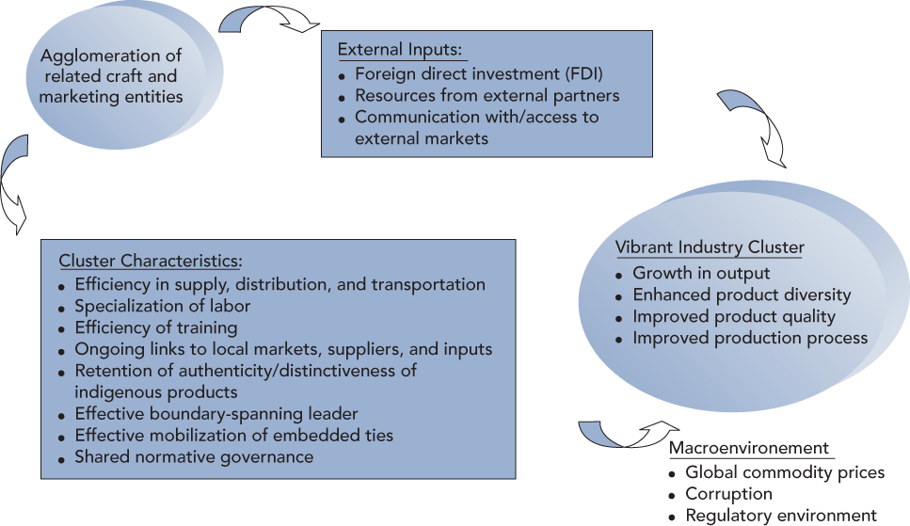
Dynamic Transformation of BOPM Clusters
Insert Exhibit 9.5
Eric Arnold & Jakki Mohr – July 2005

Slide 21
Developing Countries and Emerging Markets
The U.S. Department of Commerce estimates that over 75% of the expected growth in world trade over the next two decades will come from the more than 130 developing and newly industrialized countries.
Big emerging markets share a number of important traits
Are all physically large
Have a significant populations
Represent considerable markets for a wide range of products
Have strong rates of growth or the potential for significant growth
Are of major political importance within their regions
Are “regional economic drivers”
Will engender further expansions in neighboring markets as the grow
Because many of these countries lack modern infrastructure, much of the expected growth will be in industrial sectors.

Slide 22
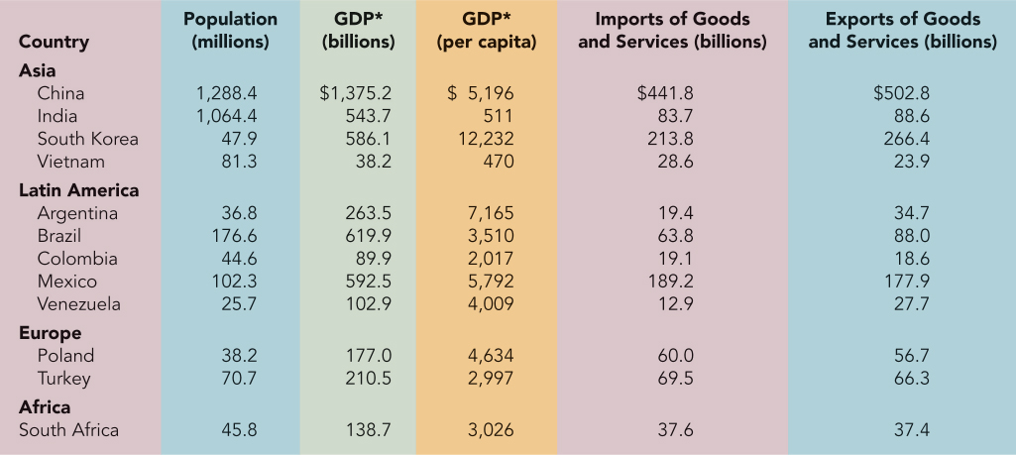
Big Emerging Markets
Exhibit 9.6

Slide 23
The Americas

Slide 24
The Americas
Most of the countries have moved from military dictatorships to democratically elected governments.
The trend toward privatizations of state-owned enterprises in the Americas followed a period in which governments dominated economic life for most of the 20th century.
Today many Latin American countries are at roughly the same stage of liberalization that launched the dynamic growth in Asia during the 1980s and 1990s.

Slide 25
Eastern Europe and the Baltic States
Those countries that rapidly instituted the broadest free market policies and implemented the most radical reforms have prospered most in the long run.
Eastern Europe
Most eastern European countries are privatizing state-owned enterprises, establishing free market pricing systems, relaxing import controls, and wrestling with inflation.
The Baltic States
Estonia, Latvia, and Lithuania
All three countries started off with roughly the same legacy of inefficient industry and Soviet-style command economics.
All three Baltic countries are WTO members and as of 2004 EU members.

Slide 26
Eastern European Markets

Slide 27
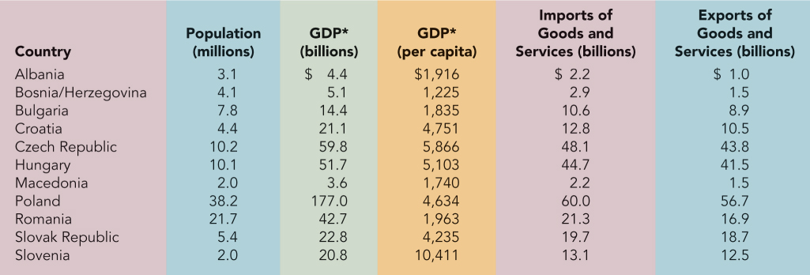
Eastern European Markets
Insert Exhibit 9.9

Slide 28
Asia
Asia has been the fastest-growing area in the world for the past three decades.
Asian-Pacific Rim
Four Tigers (Hong Kong, South Korea, Singapore, Taiwan)
First countries in Asia to move from a status of developing countries to newly industrialized countries.
China
Aside from the U.S., there is no more important single market than China.
Two major events that occurred in 2000 are having a profound effect on China’s economy
Admission to the WTO
U.S. granting China normal trade relations on a permanent basis.

Slide 29
Asian Markets

Slide 30
Asian Markets – Selected Countries
Exhibit 9.11

Slide 31
Asia (continued)
China (continued)
China has two important steps to take if the road to economic growth is to be smooth :
Improving human rights
Reforming the legal system
The American embassy in China has seen a big jump in complaints from disgruntled U.S. companies.
Two Chinas – one a maddening bureaucratic, bottomless money pit, the other an enormous emerging market.

Slide 32
China Evolves
Vendor delivers Christmas Tree in Beijing – Christians have grown from 2 million in 1977 to 50 million today

Slide 33
Asia (continued)
Hong Kong
Hong Kong reverted to China in 1997 when it became a special administrative region (SAR) of the People’s Republic of China.
The Hong Kong government negotiates bilateral agreements and makes major economic decisions on its own.
The keys to Hong Kong’s economic success:
Free market philosophy
Entrepreneurial drive
Absence of trade barriers
Well-established rule of law
Low and predictable taxes
Transparent regulations
Complete freedom of capital movement

Slide 34
Asia (continued)
Taiwan
Mainland-Taiwan economic ties are approaching a crossroads as both countries enter the World Trade Organization
“Three Direct Links”- The three-direct-links must be faced because each country has joined the WTO and the rules insist that members should communicate over trade disputes and other issues.
India
Five-Point Agenda
Improving the investment climate
Developing a comprehensive WTO strategy
Reforming agriculture, food processing and small scale industry
Eliminating red-tape
Instituting better corporate government

Slide 35
Newest Emerging Markets
The U.S. decision to lift the embargo against Vietnam.
If Vietnam follows the same pattern of development as other Southeast Asian countries, it could become another Asian Tiger.
The United Nations’ lifting of the embargo against South Africa.
South Africa has an industrial base that will help propel it into rapid economic growth.
The South African market also has a developed infrastructure.
Vietnam and South Africa future development will depend on government action and external investment by other governments and multinational firms.

Slide 36
Strategic Implications for Marketing
As a country develops:
Incomes change
Population concentrations shift
Expectations for a better life adjust to higher standards
New infrastructures evolve
Social capital investments made
When incomes rise, new demand is generated at all income levels for everything from soap to automobiles.
If a company fails to appreciate the strategic implications of the $10,000 Club, it will miss the opportunity to participate in the world’s fastest-growing global consumer segment.

Slide 37
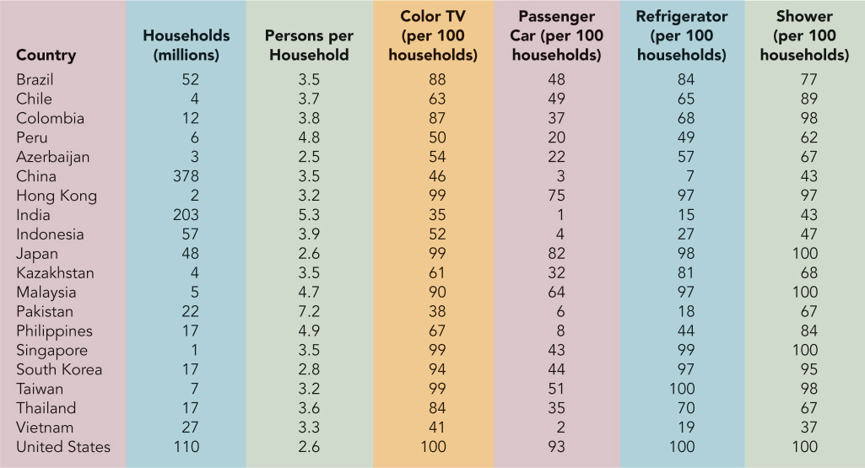
Living Standards in Selected Countries
Insert Exhibit 9.12

Slide 38
Consumption Patterns in Selected Countries
Insert Exhibit 9.13

Slide 39
Summary
The foreign marketer of today and tomorrow must be able to react to market changes rapidly and to anticipate new trends within constantly evolving market segments that may not have existed as recently as last year.
As nations develop their productive capacity, all segments of their economies will feel the pressure to improve.
Marketers must focus on devising marketing plans designed to respond fully to each level of economic development.
Though big emerging markets present special problems, they are promising markets for a broad range of products now and in the future.
Emerging markets create new marketing opportunities for MNCs as new market segments evolve.

