Slide 1
CT105-3-M Cloud Infrastructure and Services
Cloud Security – Concepts & Threats

Slide 2
Lesson: Cloud Security
This lesson covers the following topics:
Cloud security concepts
Key security threats in cloud
Notes:
This lesson focuses on the security function of the cloud computing reference model. It covers the importance of security and the security concepts. It also focuses on key security threats to a cloud infrastructure.

Slide 3
Why Security is Important?
To access the video, please click the below link
https://edutube.emc.com/Player.aspx?vno=sM5v7XOPfi9kTMmfHHwIgg==&autoplay=true&t=0h0m0s
Notes:
Information security is critical for most businesses and also for individual users. The information includes bank account details, payment information, thoughts and ideas, trade secrets, personal files and so on. All of this information can be hard to recover and potentially dangerous if it falls into the wrong hands. This video highlights the importance of securing the information by providing an example of Coca cola drink. It also covers the importance of achieving confidentiality, integrity, availability, and accountability for guaranteeing information security. To understand more about the security concept, look at the video.

Slide 4
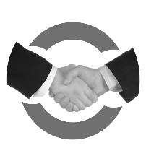
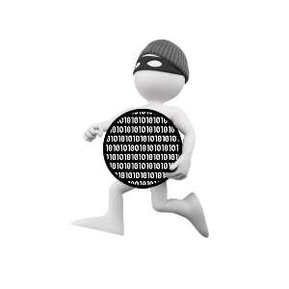
Impact of Security Breach
$3
$9
The global average cost of a data breach is $3.62 million.
Ponemon Institute 2017
$0
$3.62
Million
$12
Trust
Data loss creates negative impact on customer’s trust
Legal Action
When the sensitive data is used for criminal purposes
Revenue
Data unavailability causes loss of revenue
Reputation
Data unavailability causes loss of company‘s reputation
Theft
Theft of innovative ideas, intellectual property, and product designs
Notes:
WannaCry attack in May 2017, affected the countries all around the world by targeting the computers running Microsoft Windows operating system. It encrypted all the files in the system. And, it also demanded a ransom of approximately $300 to $600 to be paid in bitcoins within three days to decrypt the data.

Slide 5
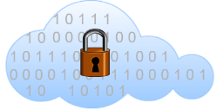
Cloud Security Overview
Threats cause
Information destruction.
Trust depends on degree of control and visibility.
Threats
Trust
Cloud
Security
Mechanism must
be deployed to protect the information.
Mechanism
Information
Organization's most valuable asset.
Data
GRC enhances the power
of cloud security.
GRC

Slide 6
How security requirements are different in cloud?
Network Security
Rapid Elasticity
Resource Pooling
Firewalls are not sufficient, and it requires extra mechanisms like VPNs, and IDPS.
Security tools must detect the newly provisioned resources and integrate with the existing resources.
Resource pooling requires extra mechanism like logical isolation of tenants, and strong access control to support multitenancy.
Security is a necessity whether it is data center environment or cloud environment.

Slide 7
Confidentiality, Integrity, Availability
C
Confidentiality
Ensures the secrecy of information
I
Integrity
Ensures no unauthorized changes to the information
A
Availability
Ensures that the resources are always available to authorized users
Note: Accountability refers to the process where, the users or the applications hold the responsibility
for the actions or events executed on the system.

Slide 8
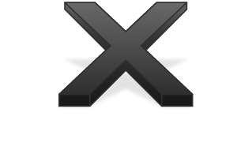
Authentication, Authorization, Auditing
Authentication
Cloud ‘users’ or ‘assets’ are who they claim to be
Single-factor authentication
Multifactor authentication
Authorization
Process to determine the privileges that a user has, example: read/write or read only
Performed only if authentication is successful
Auditing
Logging of all transactions to assess the effectiveness of the security controls
Helps to validate the behavior of infrastructure components
Useful for debugging and monitoring activities

Slide 9
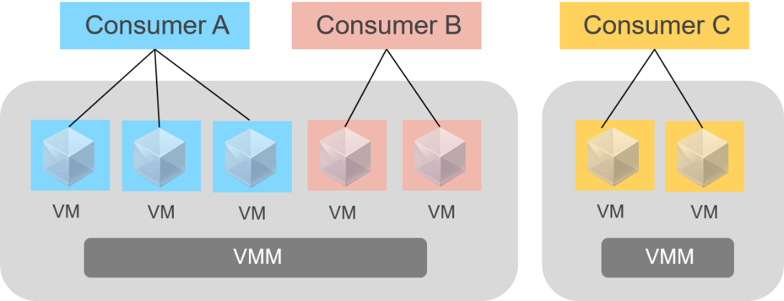
Secure Multitenancy
Multitenancy enables multiple consumers to share the resources
Multitenancy increases security risks to data confidentiality, integrity, and availability
Secure multitenancy must be deployed to mitigate the security concerns
Secure multitenancy requires mechanisms and rigid security policies
Secure multitenancy through isolation

Slide 10
Velocity of Attack
A situation where an existing security threat in a cloud may spread rapidly and have a large impact.
Factors amplifying velocity-of-attack
Attack surface
Involves various entry points that an attacker can use to launch attacks
Large number of cloud infrastructure components spanning geographic boundaries.
Attack vector
Step or a series of steps necessary to complete an attack
Homogeneity and standardization in cloud platforms and components.
Work factor
Amount of time and effort required to exploit an attack vector

Slide 11
Velocity of Attack: Public cloud vs Private Cloud
Criteria | Public cloud | Private cloud
Attack surface | Evident as the resources are accessed via Internet | In-evident as the resources are accessed via secure internal network
Impact of an error | Widespread impact because of great many tenants | Less impact because the tenants are internal employees of the organization
Visibility and control | Lack of visibility and control over the resources | Has visibility and control over the resources as the tenant is the CSP itself
Contracts and SLAs | Strict as it includes customers from industry sectors worldwide | Not strict as the customers are internal employees of the organization

Slide 12
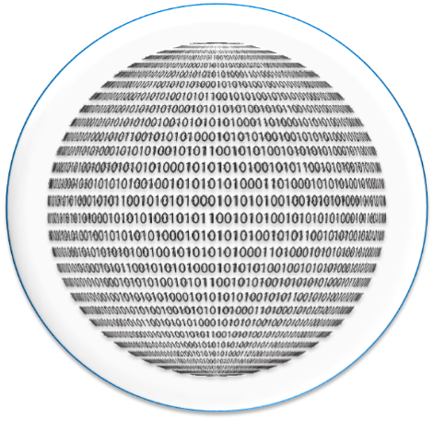
Information Assurance
Ensures confidentiality, integrity, and availability of consumer’s data in the cloud
Consumers need to access the data to which they have rights and only to the degree that policies and their roles permit
Information assurance is primarily a consumer’s concern
Cloud providers should deploy strong authentication and authorization mechanisms to protect the consumer’s data
100%
Information assurance

Slide 13
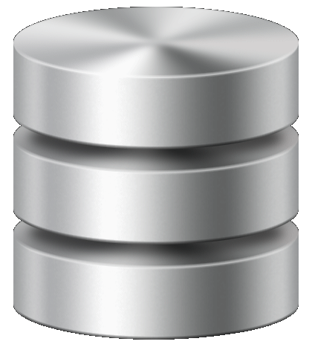
Data Privacy and Ownership
Data privacy
Data ownership
Providers must ensure that the sensitive data of their customers are legally protected from unauthorized disclosure
Factors such as copyright, contract, type of data, and the country in which it is created and stored influences the ownership of the data
Data
Two basic scenarios to determine the ownership of the data:
Scenario 1: The data is created on-premise and then stored in the cloud, data ownership clearly remains with the creator.
Scenario 2: The data is created in the cloud environment, the determination of who is responsible to protect the data primarily depends on terms of services

Slide 14
Defense-in-depth Strategy
A layered approach
Data
Application
Focuses on securing each layer of cloud environment
Host
Internal network
Increases barrier to exploitation
Perimeter
Physical security
Policies and procedures
An attacker must breach each layer of defense to be successful
Defense-in-depth strategy in a data center

Slide 15
Trusted Computing Base
TCB refers to the set of hardware and software components that are critical to the security of cloud environment.
TCB with Hosted Hypervisor in IaaS
TCB with Bare-metal Hypervisor in IaaS
Trusted Computing Base
Trusted Computing Base
Application
Virtual Machine
Application
Hosted Hypervisor
Virtual Machine
Operating System
Bare-metal Hypervisor
Hardware
Hardware
No direct interaction with the underlying resources
Requires an extra component i.e., operating system, through which all the requests pass through
This type expands the TCB, by adding one more critical component to protect
Can interact directly with the hardware resources
Does not require an extra operating system to communicate with the underlying resources
Reduces the number of critical components in the TCB and decreases the vulnerability

Slide 16
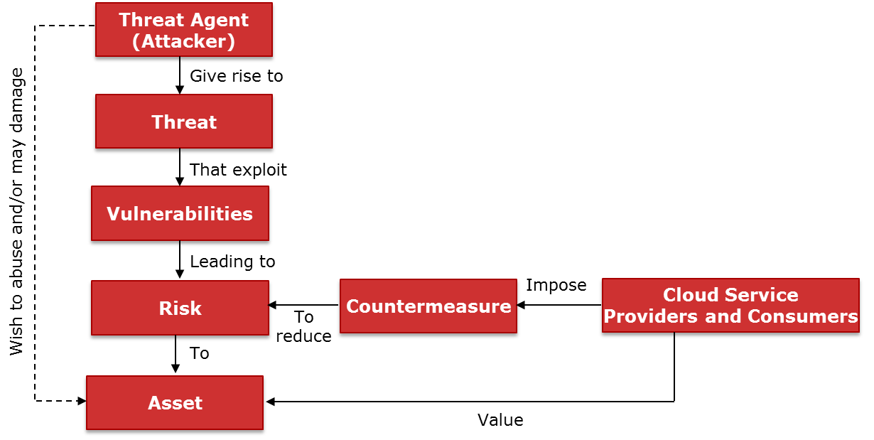
Relationship among Security Concepts

Slide 17
Security Concerns for Cloud Adoption
Cloud provider concerns
Cloud consumer concerns
Securing their physical infrastructure and facility
Risks and vulnerabilities of cloud
Cloud provider viability
Meeting SLAs
Disaster recovery and business continuity
Earning security certifications
Undergoing external audits
Legal and regulatory compliance

Slide 18
Cloud Security Threats
1
Data breaches
7
Advanced Persistent
Threats
Weak identity, credential and access management
Data loss
8
2
Insufficient due diligence
3
Insecure APIs
9
Exploitation of cloud services
System and application vulnerabilities
4
10
Account hijacking
Denial of service
5
11
Shared technology issues
Malicious insiders
6
12
Source: Cloud Security Alliance

Slide 19
Data Breaches
An attacker may gain unauthorized access to consumers’ confidential data in various ways.
An incident in which an unauthorized entity gaining access to a cloud consumer’s confidential data.
Confidential data may include health data, financial information, trade secrets, PII, and intellectual property.
Example
A leading financial organization had a data breach where the names, social security numbers, birth dates, and addresses of millions of customers was exposed. This attack was due to failure to do a timely patch update to fix a vulnerability in the dependent 3rd party software.
To mitigate the risk of data leakage, providers may deploy a multifactor authentication and encryption techniques.
Notes:
RSA
SHA-0,1, 256, 528 etc

Slide 20
Weak Identity, Credentials, and Access Management
Identity management
Establish the attributes of an individual, application, or device
Credential management
Track and update the credentials
Recommendation
Strong passwords, and multifactor authentication
Example
Access management
Control and manage access to the authorized users
A multinational e-commerce organization reported a cyberattack in which the hackers got into the company network using the credentials of few corporate employees.

Slide 21
Insecure Application Programming Interface (API)
APIs are used in cloud to perform various activities
Security of cloud services depends upon the security of APIs
The attacker may exploit the vulnerability in an API to carry out an attack
Mechanism to control insecure API threat:
Authentication and authorization, encryption, and avoiding buffer overflows
Security review of APIs
Restrict access to the API only to authorized users
Example
An online gifts vendor experienced a security breach due to an insecure API. The hackers exploited the vulnerability in the API using the company’s mobile application
Notes:
The hackers entered the static set of credentials and sequential customer IDs for the authentication process requested by the mobile application. This insecure API method, returned the last four digits of the credit card, it’s expiration date, owner’s name and other details to the attacker. Later the company stopped its mobile application to look into the issue and resolve it.

Slide 22
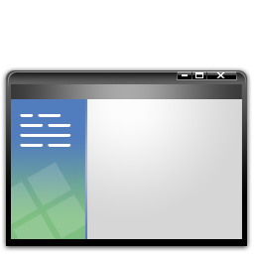
System and Application Vulnerabilities
System and application vulnerabilities are the exploitable bugs in programs
Multitenancy and resource pooling creates an attack surface for the hackers
Vulnerabilities could be because of program errors or intended features
Can be controlled by installing security patches, regular vulnerability scanning, preventing access to complete files
Example
A film entertainment company reported a cyber attack, in which the hackers exploited the bugs in the software program using “Zero-Day” vulnerability.
Notes:
A zero-day vulnerability is a software security flaw that is known to the software vendor but doesn’t have a patch in place to fix the flaw. It has the potential to be exploited by cybercriminals.

Slide 23
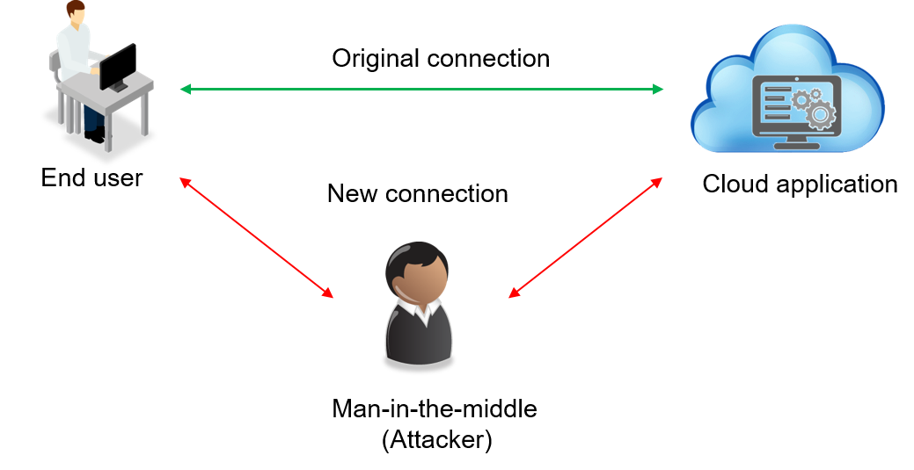
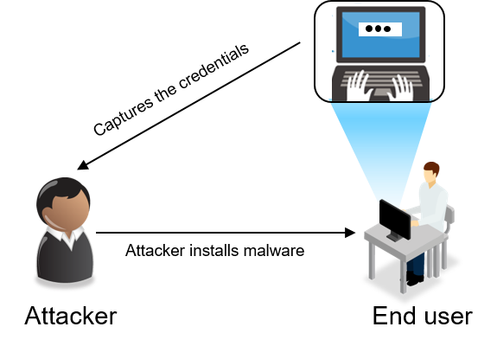
Account Hijacking
Two methods of account hijacking are:
Man-in-the-middle attack
Keystroke-logging malware attack
Example
Many social media accounts were hijacked, and hackers posted false messages.

Slide 24
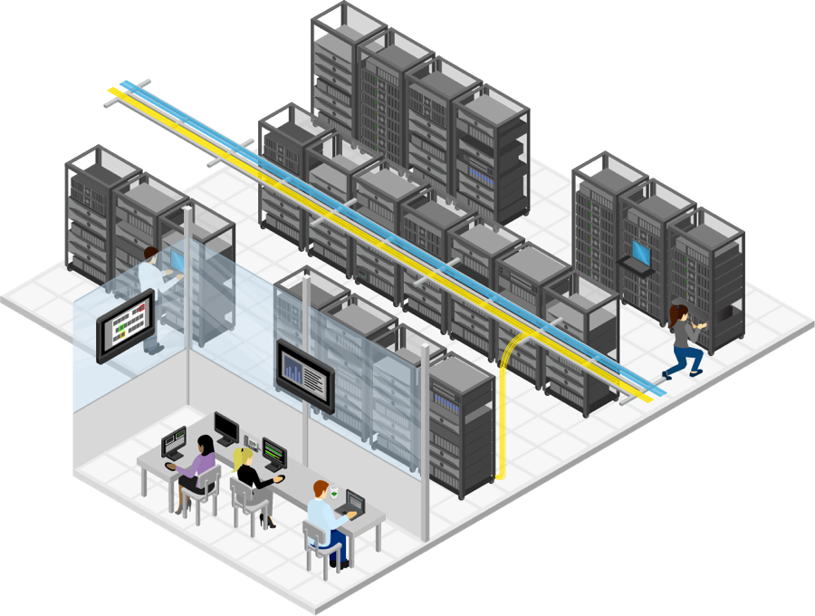
Malicious Insiders
100%
According to IBM report, in 2015, the insiders who had access to organization's systems carried out 60% of the attacks.
60%
A malicious insider could be an organization’s current or former employee, contractor, or other business partner
0%
Malicious insiders
Can be controlled by having a strict access control policies, disable employee accounts immediately after separation from the company, security audit, encryption, and segregation of duties policies
Example
A healthcare organization had a data breach where its own employees, medical professionals, inappropriately accessed and printed the patients’ information.

Slide 25
Advanced Persistent Threats (APT)
APT typically has below phases:
Phase 1
Phase 2
Phase 3
They adapt to the security measures which were intended to defend against them and harvest valuable information for a long period
They move laterally across the data center network and install malware to achieve their objectives
Gain access to the network through legitimate means
Example
An independent civil service agency working for a government discovered a data breach in which the PII including finger prints of millions of government employees was exposed due to an APT

Slide 26
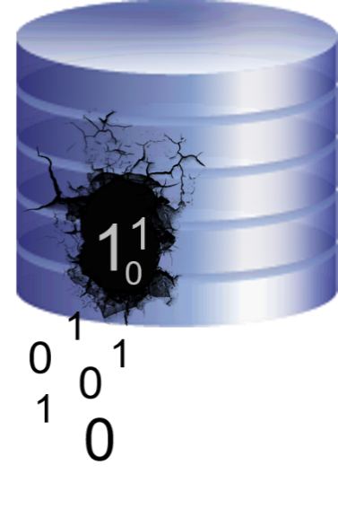
Data Loss
Causes
Malicious attacks
Accidental deletion
Natural disasters
Prevention
Example
Data backup
Data protection mechanisms
Service contract
A code hosting and code publishing company was forced to shut down their operations after an attacker deleted their customer data and backup.

Slide 27
Insufficient Due Diligence
Cloud provider
Cloud consumer
Should pay due diligence towards who is in charge of what areas, while offering the cloud services.
Customers must also have a complete understanding of cloud service provider’s environment
Example
A cloud service provider shuttered its operations and a mail was sent to its customers to move their data in less than two weeks to another service. Customer’s due diligence process should be more robust to understand who the provider is; are they funded and secure to sustain in the industry for a longer period, and their SLAs.
Example: A complete understanding of operational responsibilities is required in hybrid cloud.
Example: Customers must review the provider’s data access and retention policies to determine whether they are consistent with the customer organizations policies.

Slide 28
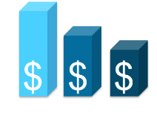
Exploitation of Cloud Services
Cloud computing services and the resources can be misused to perform unauthorized or malicious activities.
Misuse of cloud services
Low cost
Cloud computing services and the resources can be misused to perform unauthorized or malicious activities.
The cloud services are relatively cheaper, and also few cloud providers offer free trial period.
!
Example
Mechanism
Way of exploitation
The attackers misused the cloud storage service, to infect the computer systems with a malware using a massive spear phishing campaign.
Service provider should also establish incident response team to address the misuse of resources.
An attacker might use the cloud computing infrastructure to crack an encryption key.

Slide 29
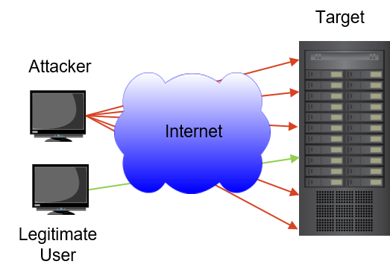
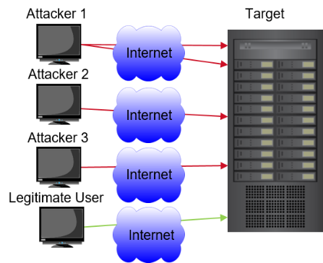
Denial and Distributed Denial of Service
Denial of Service
Distributed Denial of Service
Example
A single attacker carrying out an attack on the target system prevents the legitimate users from accessing the resources. This mechanism causes Denial of Service attack.
A Distributed DoS (DDoS) attack is a variant of the DoS attack in which several systems launch a coordinated, simultaneous DoS attack on their targets
A commercial news and information broadcast company suffered an outage on a New Year’s Eve, as a result of the DDoS attack. Their news website and other sites were down for more than three hours.

Slide 30
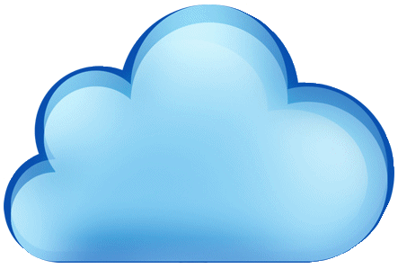
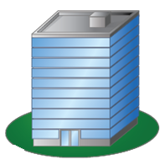
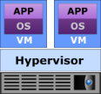
Shared Technology Issues
Causes for shared technology issues:
Enterprise P
Enterprise Q
Failure of multitenancy mechanisms
Cloud Provider’s Resources
Exposing one consumer’s data to other consumers
Compromising a hypervisor
Individual R
Applications
Applications
Applications
Multitenant environment
Example
VENOM is a security vulnerability affecting the virtualization platforms. This vulnerability allows an attacker to access the host system along with other VMs running on the system, by escaping a guest virtual machine to steal the sensitive data on VMs.
Notes:
VENOM (Virtualized Environment Neglected Operations Manipulation)

Slide 31
Division of Responsibility in Cloud Service Models
IaaS
PaaS
SaaS
Application
Application
Application
Cloud
Consumer
Cloud Consumer
Database
Database
Database
Programming framework
Programming framework
Programming framework
Cloud Provider
Operating system
Operating system
Cloud Provider
Operating system
Compute
Compute
Compute
Cloud Provider
Storage
Storage
Storage
Network
Network
Network

Slide 32
Activity: Identify the Threat
Identify the security threat in the below scenarios:
The attackers targeted an unrelated third-party athletic race site for credentials, where many number of race participants including bank employees had registered. The attackers after obtaining the credentials, exposed the names, email, postal addresses, and phone numbers of account holders.
A company experienced an outage due to accidental deletion of information that controls load balancing.
A former employee of a cloud service provider is aware of the security weaknesses in that cloud infrastructure. This former employee exploited the weakness and carried out an attack.

Slide 33
Lesson Summary
During this lesson, the following topics were covered:
Key security concepts like CIA, AAA, secure multitenancy, velocity of attack, information assurance, data privacy and ownership, and trusted computing base
Various cloud security threats and the shared responsibility between the provider and consumer

