Slide 1
CT105-3-M Cloud Infrastructure and Services
Cloud Deployment Models

Slide 2
Lesson: Cloud Deployment Models
This lesson covers the following topics:
Public cloud
Private cloud
Community cloud
Hybrid cloud
Notes:
This lesson covers the four primary cloud deployment models: public cloud, private cloud, community cloud, and hybrid cloud.

Slide 3
Introduction to Cloud Deployment Models
A cloud deployment model specifies how a cloud infrastructure is built, managed, and accessed
NIST specifies four primary cloud deployment models:
Public
Private
Community
Hybrid

Slide 4
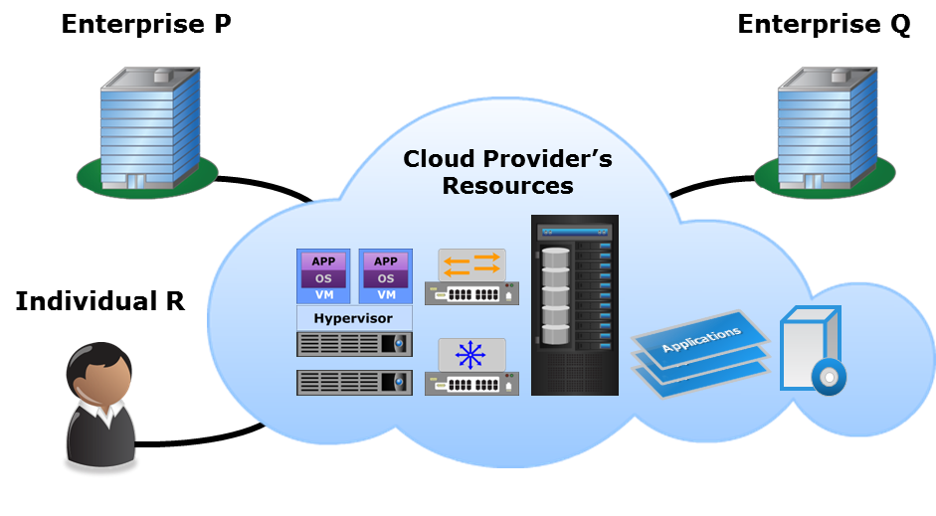
Public Cloud
Public Cloud
The cloud infrastructure is provisioned for open use by the general public. It may be owned, managed, and operated by a business, academic, or government organization, or some combination of them. It exists on the premises of the cloud provider.
– U.S. National Institute of Standards and Technology, Special Publication 800-145
Notes:
Cloud Foundry: Open Source PaaS

Slide 5
Private Cloud
Private Cloud
The cloud infrastructure is provisioned for exclusive use by a single organization comprising multiple consumers (for example, business units). It may be owned, managed, and operated by the organization, a third party, or some combination of them, and it may exist on or off premises.
– U.S. National Institute of Standards and Technology, Special Publication 800-145
There are two variants of private cloud:
On-premise
Externally-hosted
Notes:
Multi-tenancy

Slide 6
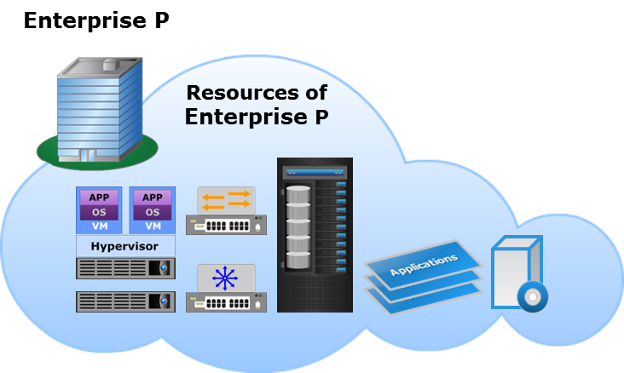
On-premise Private Cloud
Cloud infrastructure is deployed by an organization on its data centers within its premises
Provides complete control over the infrastructure and data
Enables standardization of IT resources, processes, and services

Slide 7
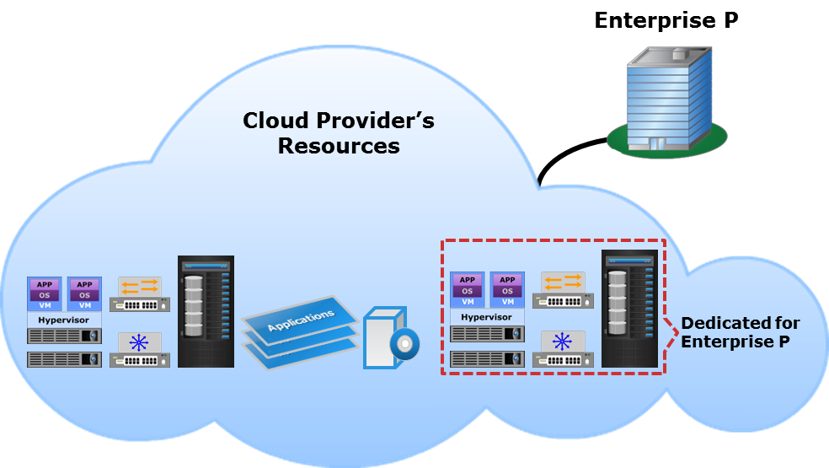
Externally-hosted Private Cloud
Cloud implementation is outsourced to an external provider
Cloud is hosted on the provider’s premises and the consumers connect to it over a secure network
Access policies isolate the cloud resources from other tenants

Slide 8
Community Cloud
Community Cloud
The cloud infrastructure is provisioned for exclusive use by a specific community of consumers from organizations that have shared concerns (e.g., mission, security requirements, policy, and compliance considerations). It may be owned, managed, and operated by one or more of the organizations in the community, a third party, or some combination of them, and it may exist on or off premises.
– U.S. National Institute of Standards and Technology, Special Publication 800-145
There are two variants of community cloud:
On-premise
Externally-hosted

Slide 9
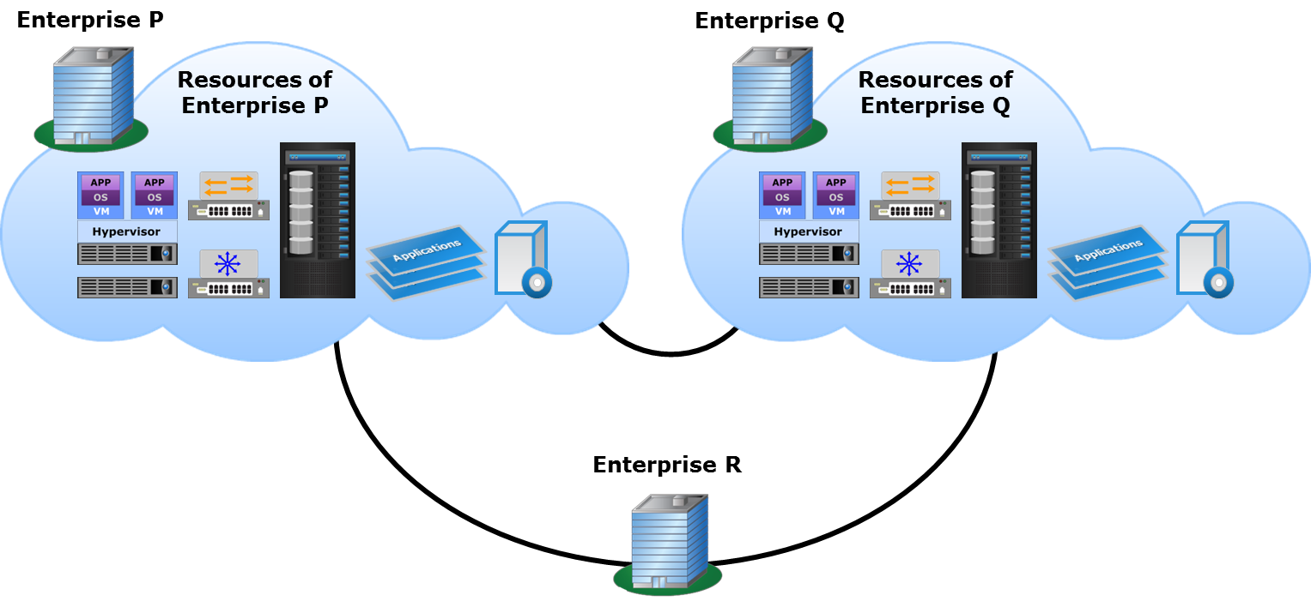
On-premise Community Cloud

Slide 10
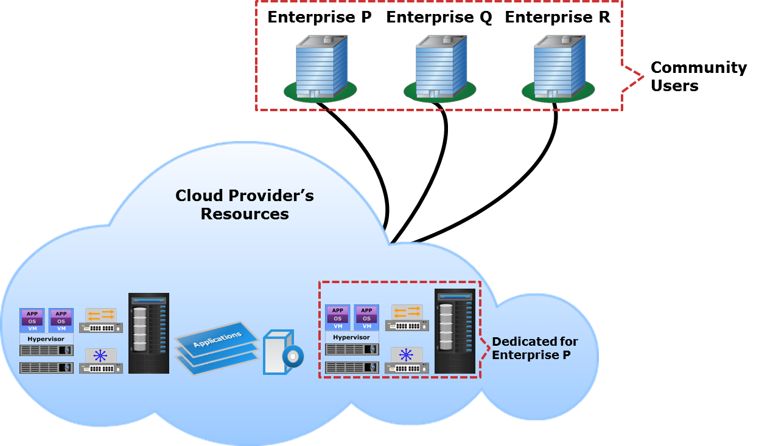
Externally-hosted Community Cloud

Slide 11
Hybrid Cloud
Hybrid Cloud
The cloud infrastructure is a composition of two or more distinct cloud infrastructures (private, community, or public) that remain unique entities, but are bound together by standardized or proprietary technology that enables data and application portability (e.g., cloud bursting for load balancing between clouds).
– U.S. National Institute of Standards and Technology, Special Publication 800-145
Notes:
Portability: Private Cloud → Public Cloud
Interoperability: private cloud <--> public cloud
Cloud Bursting
Vendor Lock-in → SLA

Slide 12
Hybrid Cloud Model Use Cases
Use case | Description
Cloud bursting | Provisioning resources for a limited time from a public cloud to handle peak workloads
Web application hosting | Hosting less critical applications such as e-commerce applications on the public cloud
Migrating packaged applications | Migrating standard packaged applications such as email to the public cloud
Application development and testing | Developing and testing applications in the public cloud before launching them
Notes:
Migration:
Legacy to Cloud
Cloud to Cloud

Slide 13
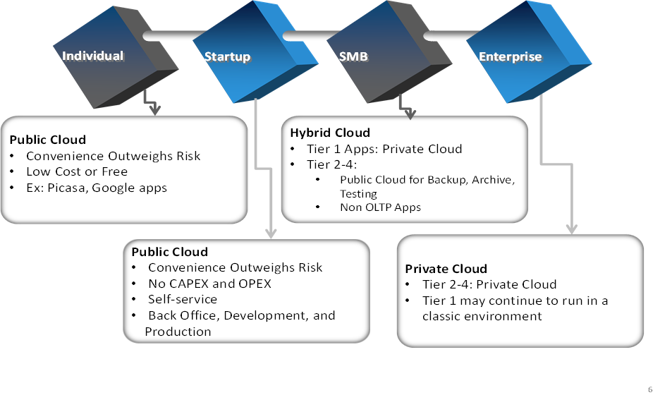
Suitability of a Cloud Service Model

Slide 14
Lesson Summary
During this lesson the following topics were covered:
Public cloud
Private cloud: on-premise and externally-hosted
Community cloud: on-premise and externally-hosted
Hybrid cloud and its use cases

