Slide 1
CT105-3-M Cloud Infrastructure and Services
Cloud Computing Overview

Slide 2
Lesson: Cloud Computing Overview
This lesson covers the following topics:
Definition of cloud computing
Essential characteristics of cloud computing
Key benefits of cloud computing
Notes:
This lesson covers the definition of cloud computing and describes the essential cloud characteristics. This lesson also describes the key benefits of cloud computing.

Slide 3
The Cloud Computing Phenomenon
Adoption of cloud computing is significantly rising in organizations
Cloud computing is seen as a leading “disruptive” technology in the coming decade
Cloud is driving optimization and innovation of business models in organizations
Trends like mobility, Big Data, and social media are also influencing cloud adoption

Slide 4
What is Cloud Computing?
Cloud Computing
A model for enabling ubiquitous, convenient, on-demand network access to a shared pool of configurable computing resources, (e.g., servers, storage, networks, applications, and services) that can be rapidly provisioned and released with minimal management effort or service provider interaction.
– U.S. National Institute of Standards and Technology, Special Publication 800-145
A cloud is a collection of network-accessible IT resources
Consists of shared pools of hardware and software resources deployed in data centers
Cloud model enables consumers to hire a provider’s IT resources as a service
Notes:
NIST: National Institute of Standards and Technology

Slide 5
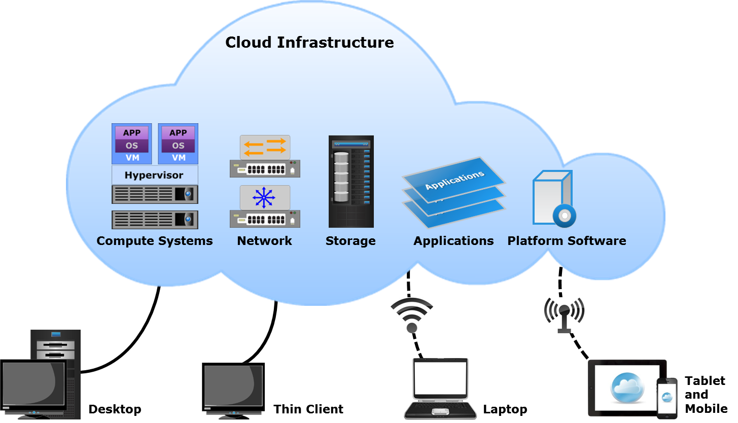
What is Cloud Computing? (Cont'd)

Slide 6
Essential Cloud Characteristics
On-demand self-service
Broad network access
Resource pooling
Rapid elasticity
Measured service

Slide 7
On-demand Self-service
On-demand Self-service
A consumer can unilaterally provision computing capabilities, such as server time and network storage, as needed automatically without requiring human interaction with each service provider.
– U.S. National Institute of Standards and Technology, Special Publication 800-145
Consumers use a web-based self-service portal to view a service catalog and request cloud services
Enables consumers to provision cloud services in a simple and flexible manner
Reduces the time needed to provision new or additional IT resources

Slide 8
Broad Network Access
Broad Network Access
Capabilities are available over the network and accessed through standard mechanisms that promote use by heterogeneous thin or thick client platforms, (e.g., mobile phones, tablets, laptops, and workstations).
– U.S. National Institute of Standards and Technology, Special Publication 800-145
Consumers access cloud services on any client/end-point device from anywhere over a network
Standard mechanisms support the use of heterogeneous client platforms
OSI and TCP/IP protocols
SOAP and REST web services

Slide 9
Resource Pooling
Resource Pooling
The provider’s computing resources are pooled to serve multiple consumers using a multi-tenant model, with different physical and virtual resources dynamically assigned and reassigned according to consumer demand. There is a sense of location independence in that the customer generally has no control or knowledge over the exact location of the provided resources but may be able to specify location at a higher level of abstraction (e.g., country, state, or datacenter). Examples of resources include storage, processing, memory, and network bandwidth.
– U.S. National Institute of Standards and Technology, Special Publication 800-145
Enables providers to improve resource utilization and to flexibly provision and reclaim resources

Slide 10
Rapid Elasticity
Rapid Elasticity
Capabilities can be elastically provisioned and released, in some cases automatically, to scale rapidly outward and inward commensurate with demand. To the consumer, the capabilities available for provisioning often appear to be unlimited and can be appropriated in any quantity at any time.
– U.S. National Institute of Standards and Technology, Special Publication 800-145
Consumers can adapt to variations in workloads and maintain required performance levels
Consumers may be able to avoid excessive costs from over-provisioning resources

Slide 11
Measured Service
Measured Service
Cloud systems automatically control and optimize resource use by leveraging a metering capability at some level of abstraction appropriate to the type of service (e.g., storage, processing, bandwidth, and active user accounts). Resource usage can be monitored, controlled, and reported, providing transparency for both the provider and consumer of the utilized service.
– U.S. National Institute of Standards and Technology, Special Publication 800-145
Enables billing of cloud services
Resource monitoring helps providers with capacity and service planning

Slide 12
Cloud Computing Benefits
Benefit | Description
Business agility | Enables quick resource provisioning Facilitates innovation Reduces time-to-market
Reduces IT costs | Reduces up-front capital expenditure (CAPEX) Improves resource utilization Reduces energy and space consumption
High availability | Ensures resource availability based on consumer’s requirements Enables fault tolerance
Notes:
ERP: Enterprise Resource Management
CRM: Customer Relationship Management
CAPEX: Capital Expenditure
OPEX: Operational Expenditure
Availability: 24 * 7 * 365
Fault tolerance: ability to operate in case of a failure

Slide 13
Cloud Computing Benefits (Cont'd)
Benefit | Description
Business continuity | Reduces impact of downtime Example: Cloud-based backup
Flexible scaling | Enables scaling of resources to meet demand Unilateral and automatic resource scaling
Flexibility of access | Enables access to services from anywhere Eliminates dependency on a specific end-point device
Notes:
autoscaling

Slide 14
Cloud Computing Benefits (Cont'd)
Benefit | Description
Application development and testing | Enables application development and testing at a greater scale Enables testing on multiple platforms
Simplified infrastructure management | Consumers manage only those resources that are required to access cloud services
Increased collaboration | Enables sharing and simultaneous access of resources and information
Masked complexity | Intricacies of IT operations are hidden from end users

Slide 15
Lesson Summary
During this lesson the following topics were covered:
Definition of cloud computing
Essential cloud characteristics
Cloud computing benefits

