Slide 1
Digital Marketing Processes
BM031-3-M-BSSMMA Version #2
Chapter 4

Slide 2
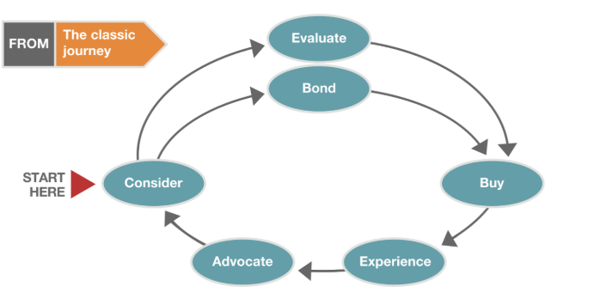
Customer Decision Journey
Classic Customer Decision Journey

Slide 3
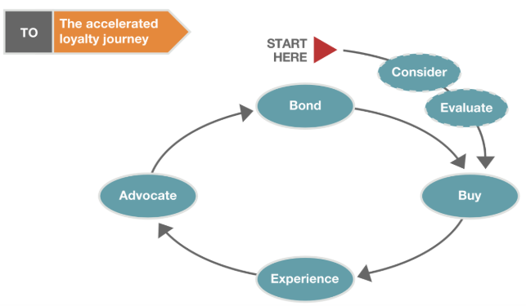
Accelerated Loyalty Journey
Accelerated loyalty journey

Slide 4
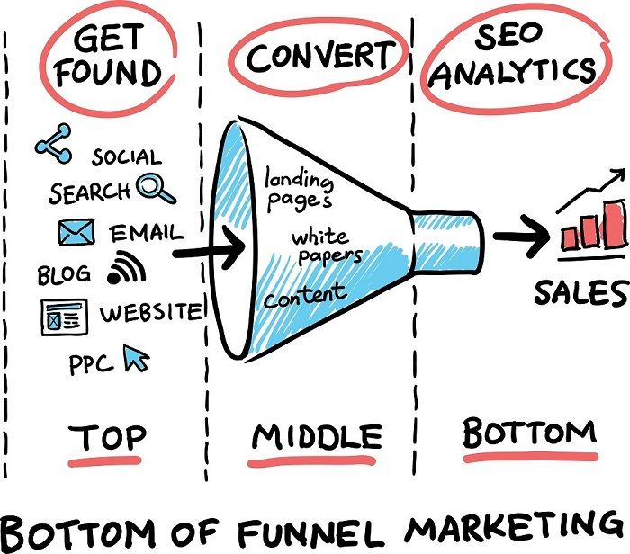
Conversion Funnel TOFU – MOFU - BOFU

Slide 5
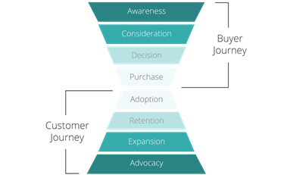
Customer Journey conventional funnel to hourglass

Slide 6
Stage | Behavior | Strategy | Actions
Awareness | Aware they are facing a challenge They need a solution not certain of their solution Looking for answers to connect | Attract large pool of users on your website by giving them the answers they need to solve their challenges Avoid introduction of our products or services Appear to help | Landing page Blog posts and articles Videos Infographics Social media posts Lead magnets (downloadable content)
Interest | customers have identified their problem actively searching for solutions to solve it reading a piece of helpful content | don’t push products forcefully at this stage. convert your potential customer into a lead. get their contact information get conversions on social media just by interacting with people who comment on your posts | Landing Page eBooks Checklists Templates Tip Sheets Free tools and resources

Slide 7
Stage | Behavior | Strategy | Actions
Consideration | considering their options longest stage of the buying cycle | try to learn more about these people so you can qualify them. Personalization emails with content tailored specifically for them to see if they maintain their interest. show your leads that you not only understand them also have what it takes to solve their problems and add value. | Webinars Podcasts Original research reports White papers
Intent | your leads are ready to hear about your company as well as your products and services | Give them sales-level content pricing information | Case studies Competitor research and analyses Sales presentations Customer testimonials Product or service deep dives

Slide 8
Stage | Behavior | Strategy | Actions
Evaluation | prospect is preparing to make a final decision comparing the information you’ve provided them with other offers |  | Email templates Sales scripts Slide decks and presentation materials Social media messages Product sheets
Purchase | guide them through the transaction process | right processes in place positive experience

Slide 9
Funnel Interpretation
Market | how many potential customers are there in the target audience?
Awareness | how much of that audience is aware of the brand?
Acquisition | how many of that audience clicked through to the site?
Interest | how many visitors became users (created an account / downloaded a content offer)?
Conversion | how many activated users become customers (paid/made you money)?
Retention | how many times do they pay you money over their lifetime?
Referral | how many of your visitors tell their friends about you?

Slide 10
Examples of Journey Tracking and Analytics

Slide 11
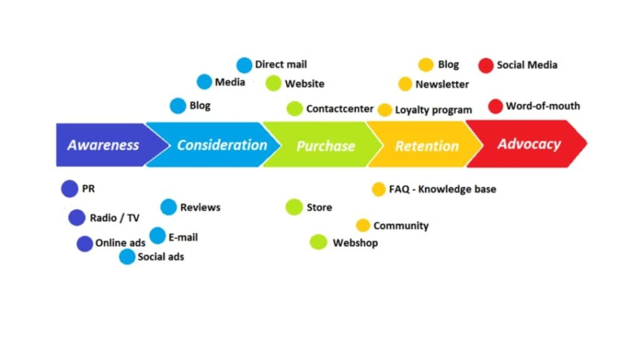
Customer Journey in Marketing Funnel

Slide 12
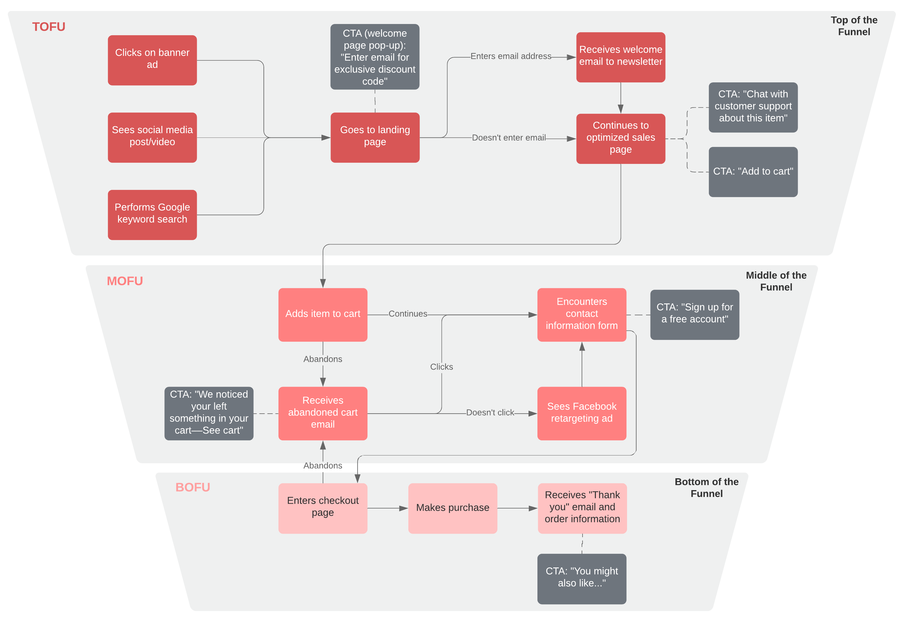

Slide 13
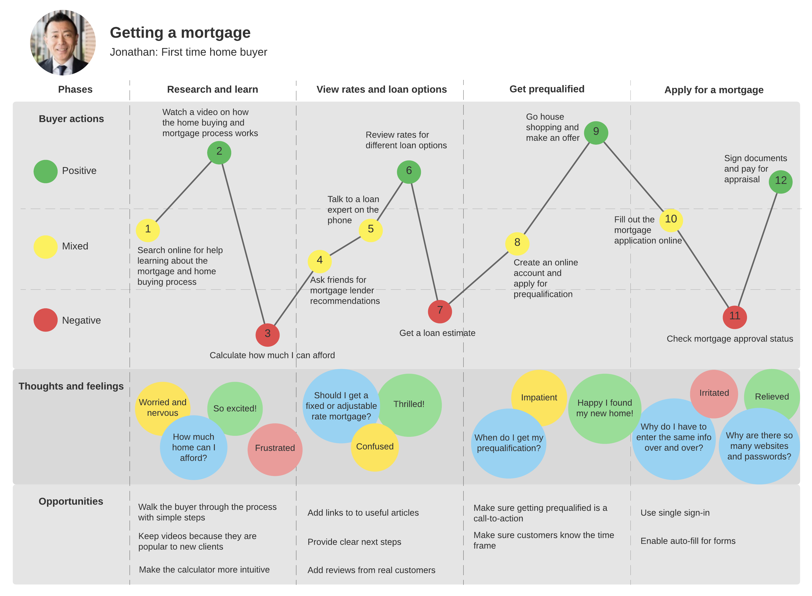

Slide 14
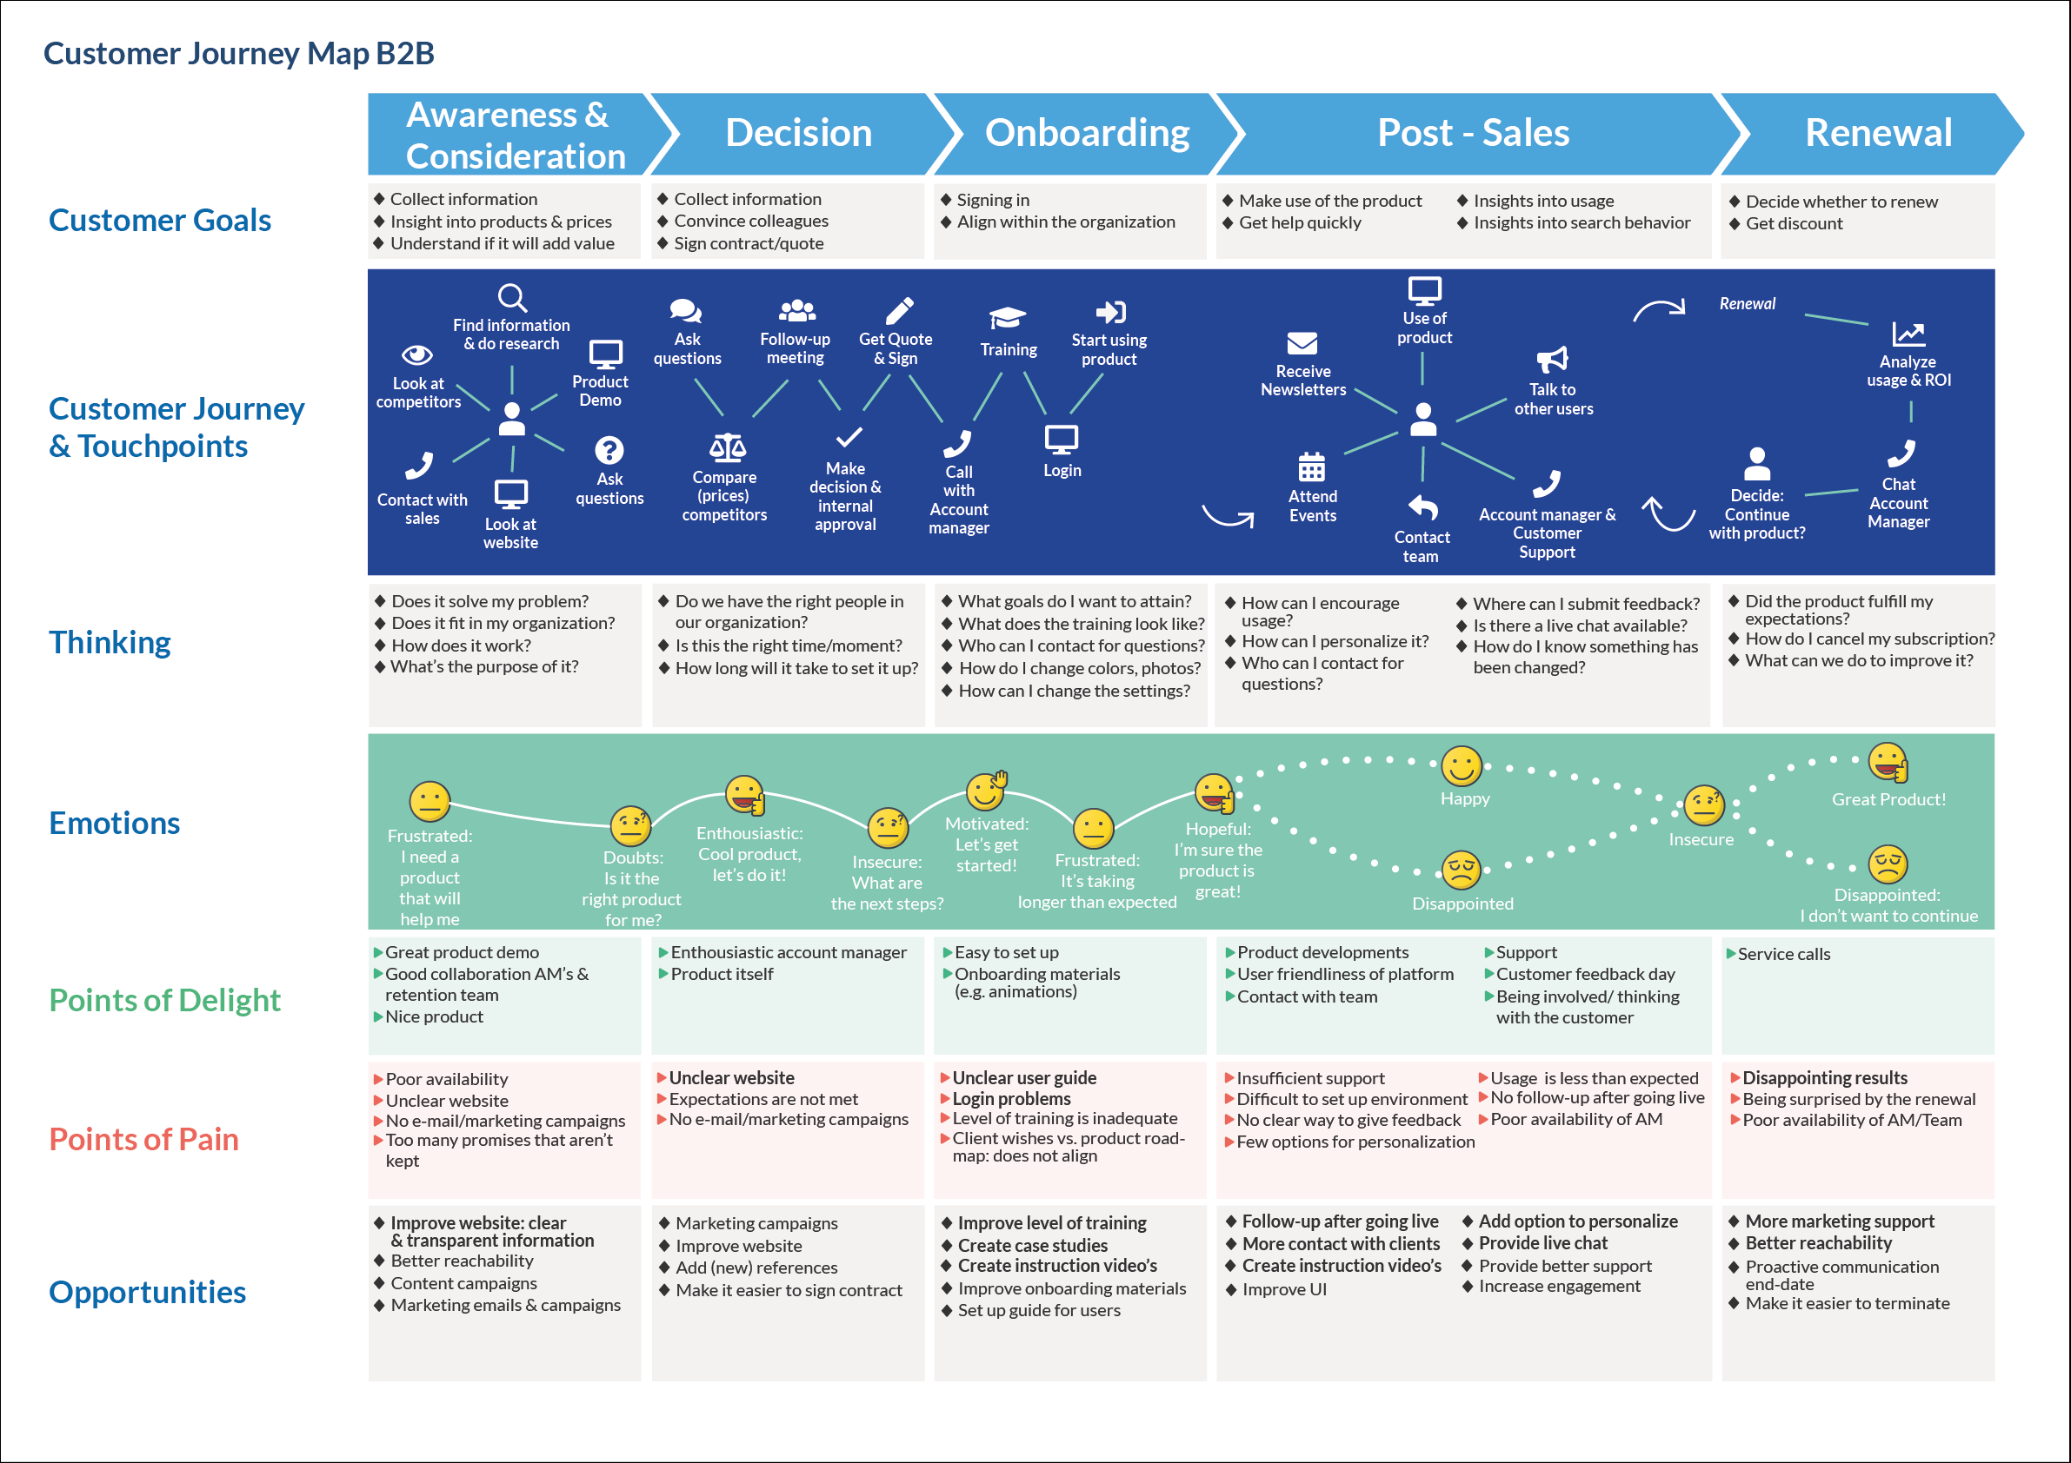

Slide 15
Class Discussion
Behavioral Analytics: A Data Driven Marketer’s Most Powerful Tool
https://www.cooladata.com/behavioral-analytics+
UX Mapping Methods Compared
(Empathy mapping / Customer journey mapping / Experience mapping )
https://www.nngroup.com/articles/ux-mapping-cheat-sheet/

Slide 16
Thank you
Q and A

