Slide 1
Your Research Title
Dr Jugindar Singh

Slide 2
Selecting a PhD topic
You like it- Interested
Appropriate - Area which is
not too mature.
Area which is not too
immature.
Capable
Pick an area which is trendy.
Too trendy/common: high competition
Not trendy: less impact and recognition.
Remember – Contribution of you study

Slide 3
Initial checklist
1. Why this Topic/study?
Do you have the knowledge/skills in chosen
Is the study doable within a certain time frame
Is data available for collection and analysis
Is there literature available.
Choosing the Topic:
Capable and Interested
Appropriateness Is worth doing
Novelty and Contribution
Relevance
Is this related to my study

Slide 4
Initial checklist
2. Contribution of study
Is this study worth doing
Is there a contribution from this study
What is the problem and why it should be studied.
What is the Contribution of your study?
Alignment and Coherence

Slide 5
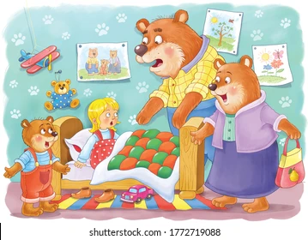
Initial checklist
3. What are the research questions and objectives?
Are the questions “just right”?
Can the hypothesis be tested?
Is the objective/questions clearly formulated
Alignment and Coherence
Writing Research Questions
Consistent with expected standards
Able to produce clear conclusions
At the right level (not too broad/difficult)
Not too descriptive
Use Goldilocks Test
Questions: Too Easy
Questions: Too Hard
Questions: Just Right

Slide 6
Initial checklist
Goldilocks Test – Too Easy 1. Have you read it a lot of time before? 2. Do you understand the story very well? 3. Do you know almost every word?
4. Can you read it smoothly?
5. Are you reading without think?
Goldilocks test
A test used to decide if research questions are
too big (demand too many sources),
too small (insufficient substance),
too hot (sensitivities aroused as a result of
doing the research),
Just right.
If all YES – Too Easy Don’t do it
Goldilocks Test – Just right 1. Is the Topic New
2. Do you understand most of the ideas? 3. Are there only a couple of words on each page you don’t understand – There is newness?
4. When you read – some easy and some hard?
5. Do you think your thought process is provoked when reading?
Goldilocks Test – Too Hard 1. Are there more than 5 words in a page you don’t understand?
2. Are you confused – What is happening when reading –Difficult?
3. When you read – sound difficult to understand
4. Are you finding that you are not enjoying?
If all YES – JUST RIGHT Do it
If all YES – Too Hard Don’t do it

Slide 7
Initial checklist
4. What is the study about?
Who are the target respondents/population
How will the respondents be recruited/reached?
What is are the inclusion and exclusion criteria?
UNITS OF ANALYSIS

Slide 8
Initial checklist
5. What is the design of the
study?
What is the proposed study design?
What is the Philosophy
What are the instruments & instrumentation?
Are measurements for constructs available?
Can the data be collected?
Is there a tool or process to analyze the data
Is there any bias

Slide 9
Recap Attributes of a good research Topic
Capability: is it feasible?
Are you fascinated by the topic? INTEREST
Do you have the necessary research skills? CAPABLE
Can you complete the project in the time available? DOABLE
Will you be able to collect or gain access to data?
Is there sufficient literature available?
You are interested There is Contribution
Relate to your field of study
The Research Questions are JUST RIGHT
Precision yet concise: Reader knows exactly what you are trying to achieve
Not Too Ambitious

Slide 10
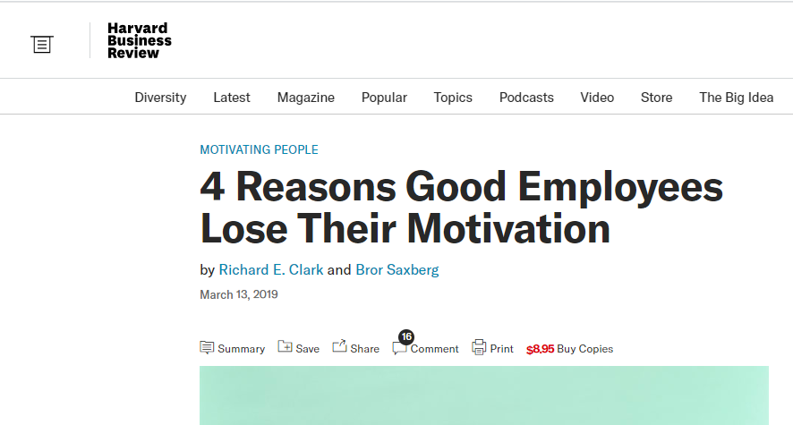
No to commonly used titles
Customer Satisfaction
Employee Motivation
Customer Purchasing Behavior
BUT
Something Recent or Innovative can be allowed
values mismatch,
lack of self-efficacy,
disruptive emotions,
attribution errors.
Each of these four traps has distinct causes and comes with specific strategies to release an employee from its clutches.
Don’t use old Titles -

Slide 11
Check You Research is not too broad
Research Questions too open
Too many research questions and/or hypotheses;
Too many concepts, theories, and/or variables;
The population you are interested in is too broad to target effectively;
There is no identifiable outcome to your dissertation.
Examples
The impact of oil price on the country GDP, inflation, stock market, CPI and employment
A study on the relationship between service quality, customer satisfaction and customer loyalty in China
Don’t be too narrow

Slide 12
Research Title
Descriptive and explanatory, not general
Helps the reader to understand the core focus of your dissertation.
Precise
Accurately’ reflect the scope and content of the study
Concise
Explain what the nature of your research is in fewest words
possible (15 words).
Example:
Barriers to Digital banking adoption: A qualitative study among corporate customers in Kuala Lumpur, Malaysia
Barriers [focus] to digital banking adoption [area of interest]: A qualitative study [qualitative research design] among corporate customers [population] in Malaysia [situated nature of the study]

Slide 13
Focus your Title
Examples:
No Focus
An examination of quality dimensions in service industry …
This title should be avoided because it is too broad, it has no specific focus, and it fails to catch the reader's attention.
Suggested wordings:
The influence of service quality dimensions on the behavioral intentions of the outgoing students in higher educational institutions in Malaysia
The relationship between service quality, customer satisfaction, and customer loyalty in the higher education industry in Malaysia

Slide 14
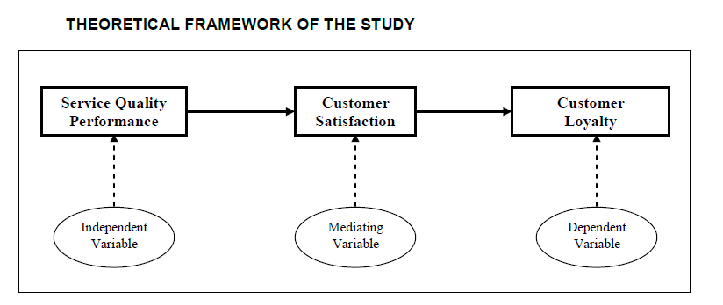
Phrasing the research title - Example
The relationship between service quality, customer satisfaction, and customer loyalty in the higher education industry in Malaysia.
Remember, the topic should highlight the importance of your research because it will bring a certain impression to your audience.

Slide 15
Sources of research topics
Personal interest (your favorite course, subject, topic)
Eg: Using Social Media in Marketing
2. Information/observation (any behavior that arouses your curiosity) Eg: Lack of women in leadership positions.
3. Practical problems (problems in your class, school, job) Eg: Diversity and Inclusion in
the workplace today
4. Pop ups -fleeting thoughts (falling apples)
5. Readings (books, magazines, web sites, Newspapers etc)
6. Theories (theories that predict a behavior- opposing theories for the same behavior) Eg: Motivation theory

Slide 16
BE PRECISE AND SPECIFIC Focus, Focus………
You need to understand completely that you are not writing a descriptive essay.
A research paper is an accurate and thorough work, which is based on facts details.
Your statement should be supported with examples or reference other profound research and academicals works.

Slide 17
BE INNOVATIVE - Recent
An innovative approach can give you the edge among other students.
A topic should address the matter from a different and surprising perspective.
With a deep investigation, you may even find the unknown until now facts that can blow your readers’ minds.
This approach will intrigue your readers and will make research paper stand out.

Slide 18
Argumentative research paper topics
Here, you must argue out your points – for and against. Moreover, you have to present facts to demonstrate a clear understanding of the topic. Your introduction and concluding paragraph must be equally strongly worded.
Examples:
The minimum wage rate in your country or state.
Incivility (Rudeness of bosses)?
Do we need shorter working weeks?
Mergers are much better compared to acquisitions?
Businesses need to invest more in digital marketing and social media campaigns to capture the right target audience
Is working long hours encouraged?

Slide 19
Controversial topics for research paper
There are people who like to court controversy whenever they say or do something, more so, in public. A good example here is an activist. Whether it is advocacy for gay rights or same-sex marriage, writing on issues like these can be painstakingly difficult. So, you must put your act together right from the beginning, and controversial topics for research paper like the following will most certainly get you moving in the right direction:
Employment of LBGT.
Employment of ex-Offenders
Violence in media content.
Whistleblowing should be encouraged
Corruption in the public sector
Romance in the workplace

Slide 20
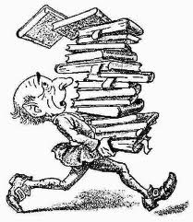
Some areas of research
Is college entrepreneurship education efficient for creating entrepreneurship intention?
Are the soft skills taught in Universities aligned to current industry needs
Is there a difference between a man and a woman’s EI?
Working mothers and intention to stay.
Ex-convicts and job searching. Is it difficult finding employment?
What should be the basis of workplace promotion: seniority, degree, or performance evaluation?
The significance of Search Engine Optimization to businesses today.
Leadership skills during a crisis

Slide 21
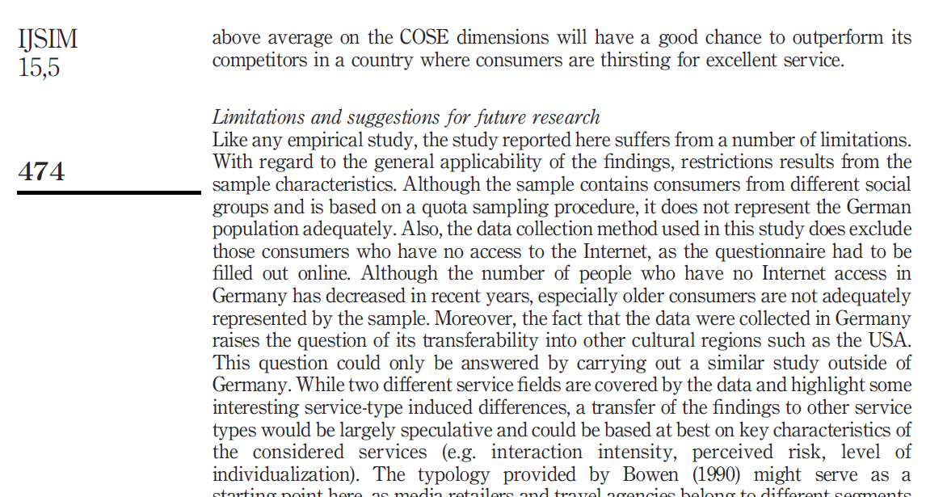
Dissertation topics
Finding a potential dissertation topic
1. Limitations and Future Research section of journal articles
Limitations and Future Research section - suggestion into a potential topic idea.
REASON #1: The suggestions made are generally considered reasonable
REASON #2: You can more easily identify why your research would be significant
REASON #3: The journal article provides a platform for your research plan
REASON #4: You can get an insight into the potential achievability of your topic
REASON #5: Your dissertation topic is more likely to be current and add to the literature
REASON #6: The logic of your dissertation topic choice is more difficult to criticise and your topic is more likely to be accepted

Slide 22
Ecologically Conscious Buying Behaviour of Organic Products: A Quantitative Study in Thimpu, Bhutan
Chimi Yangzom, Jugindar Singh Kartar Singh
Faculty of Business and Management, Asia Pacific University of Technology and Innovation, Malaysia
These limitations of this study provide directions for future research. For future studies, more in-depth research on factors that affect the intention to purchase organic food can be undertaken. Future research should incorporate factors like the promotion, knowledge and government regulation while studying consumer intention towards organic food products. This study was a cross-sectional study and for future research, a longitudinal study can be undertaken. Also, future research can include a larger sample size to get better results. It is also recommended that future research should include face to face interviews to obtain more in-depth and reliable results. Through qualitative research, more in-depth information can be obtained. Demographics such as age and income could be further investigated to test the differences towards purchase intention.

Slide 23
Can Research Titles be extended or Replicated The Research can be NEW or REPLICATED/Extended
Example: Can the following titles be extended or replicated
FACTORS AFFECTING INVESTORS’ INTENTION TO INVEST IN A PEER-TO-PEER LENDING PLATFORM IN MALAYSIA
An Evaluation of Factors Affecting Brand Awareness in the Context of Social Media in Malaysia
Defining and measuring service quality in a manufacturing company in Sweden

Slide 24
Replication-based dissertations
Duplication
Take a piece of published research and repeat it - in an identical way to see if the results that you obtain are the same as the original authors.
Eg: New data OR data analysis techniques and capabilities
It may have been 5 years, 10 years, or even longer since the study was published
2. Generalization
To determine whether the findings are generalizable within a different population or setting/context
Past study on undergraduate students at a single university in the UK. Further test whether generalizations could be made across populations such as postgraduate
3. Extending
Extending existing research to take into account new research designs, methods and measurement procedures, and data analysis techniques
Eg: Add, modify or omit certain constructs and/or variables from the original study.
Dissertation could either (a) incorporate elements of all three types or (b) simply follow one of these three routes.

Slide 25
The Research can be NEW or REPLICATED/Extended
Exploring the antecedents of effectiveness and efficiency. A quantitative study on the effect of entrepreneurial and financial orientations on performance in the service industry in Switzerland
Consider:
Cultural Orientation
Market Orientation

Slide 26
Thank You

