Slide 1
Introduction to Data Analytical Programming
Notes:
Welcome to BAS 250!

Slide 2
Data Analytical Programming
Mr. Dhason Padmakumar
Senior Lecturer and Project Manager (FYP, SoCT)

Slide 3
Lecturer Introduction
Name: Mr.Dhason Padmakumar
Email: dhason@apu.edu.my
Contact: 0122711802
Office: SoCT, Level 5
Consultation: By iConsult System, APSAPCE / Email

Slide 4
Module Learning Outcomes
At the end of this module, YOU should be able to:
CLO1: Assess various forms of data sets by reading, combining and categorizing using data analytical programming techniques. (C5, PLO2)
CLO2: Produce analytical data models by creating summary reports and enhanced listings. (C6, PLO7)
CLO3: Formulate visualization and discovery strategies using the datasets given. (A4, PLO5)

Slide 5
How you will be assessed
Incourse Assessment 100%

Slide 6
Learning Objectives
Explain Analytical Programming
Connect to SAS Studio
Create a Logical Data Flow

Slide 7
Part 1: Analytical Programming

Slide 8
What is Analytical Programming?
Programming (coding) to collect, explore and present large amounts of data to discover underlying patterns, trends and insights using statistical software.
Statistics are applied every day – in research, industry and government – to become more scientific about decisions that need to be made.
Data-driven decisions vs “Gut Driven” decisions

Slide 9
Analytical Programming (1 of 3)
This course introduces statistical software for analytics
Topics include utilization of analytical and statistical software packages for data management, data visualization, and exploratory data analysis.
Upon completion, students should be able to use statistical programming tools to conduct descriptive analytics.
Essential for making data-based decisions in EVERY field.

Slide 10
Analytical Programming (2 of 3)
The course has five distinct parts:
Getting started with analytical programming
Logic
Technology
Foundational programming skills
Nuts and bolts of programming
Fostering good programming habits
Getting external data sets into SAS
Constructing an analysis data set

Slide 11
Analytical Programming (3 of 3)
Reporting on your analysis
Producing customized tables
Generating more attractive output
Producing high-quality graphical displays.
Creating descriptive statistics and summaries
Advanced topics, tricks and tips

Slide 12
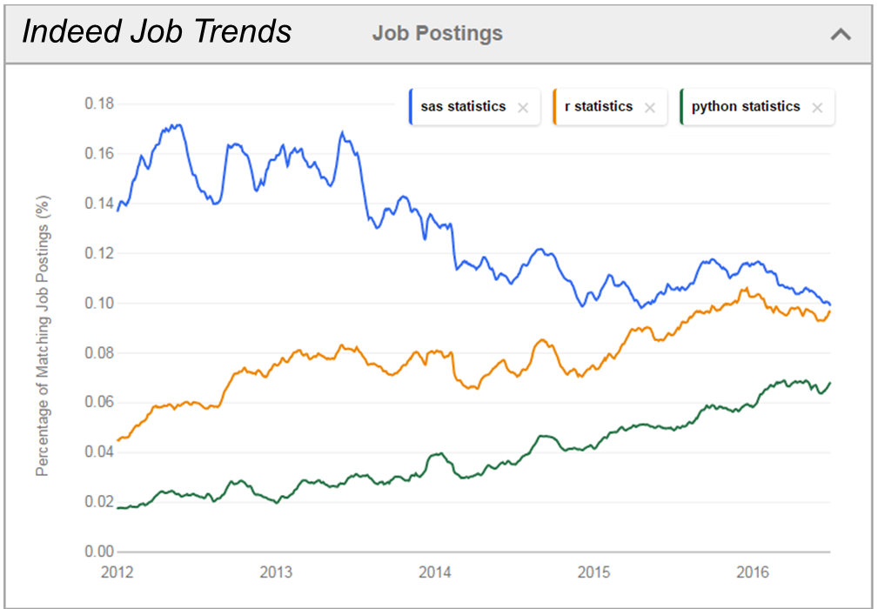
Software Review (1 of 4)

Slide 13
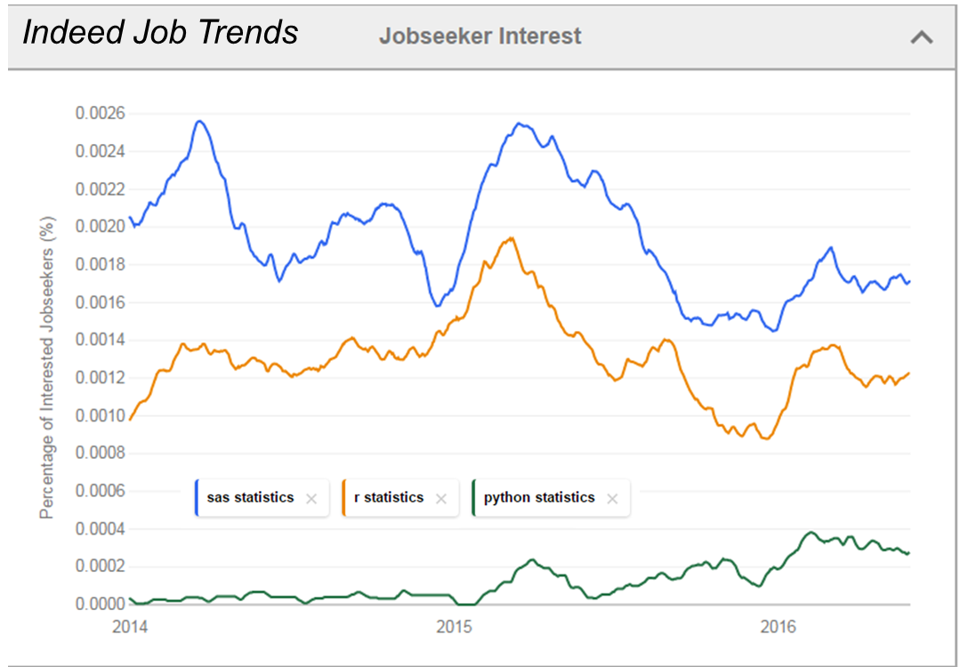
Software Review (2 of 4)

Slide 14
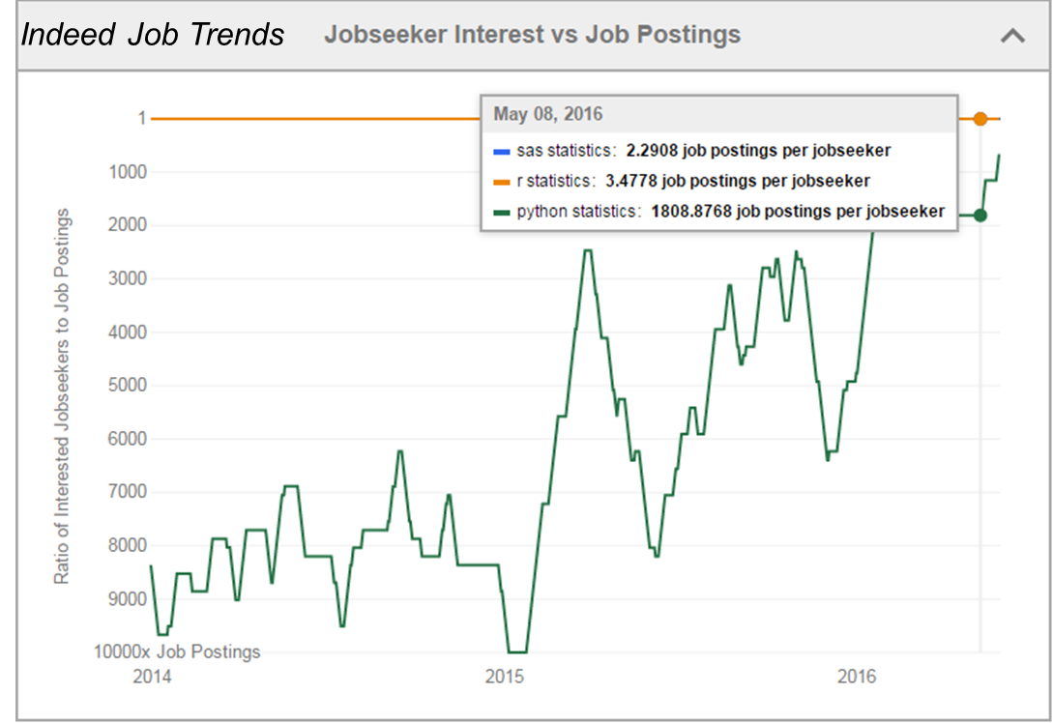
Software Review (3 of 4)

Slide 15
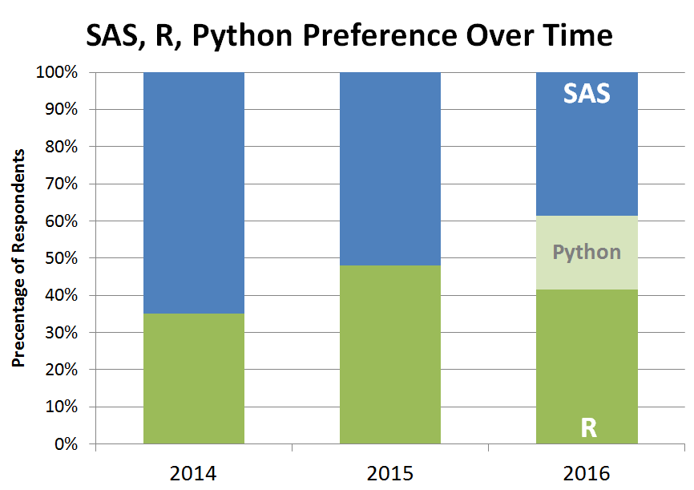
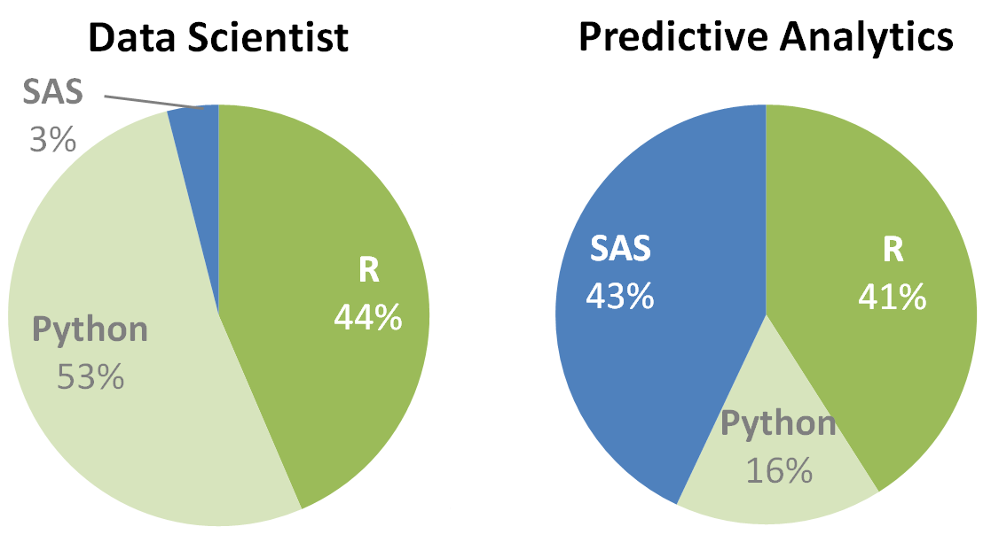
Software Review (4 of 4)

Slide 16
Why SAS?
Still the most frequently used business analytics tool today.
91 of the top 100 companies on the 2015 Fortune Global 500® are SAS customers.
SAS says that the #1 most valuable career skill is the understanding of their data analysis software. This skill commands the highest salary premium at SAS (+6.1%).
“Money and PayScale analyzed 54 million employee profiles across 350 industries, with 15,000 job titles—from entry-lefvel workers to top execs. The stuydy compared people with the same title, age, location and experience, isolating the specific skills (from a universe of about 2,300) correlated with higher pay, advancement, and career opportunity.” (Source)

Slide 17
What is SAS? (1 of 2)
Began as a statistical package
Also allows users to:
Store data
Manipulate data
Create reports
PDF
Excel
HTML
XML
RTF / Word
Etc. Etc. Etc.

Slide 18
What is SAS? (2 of 2)
Also allows users to:
Create graphs
Create maps
Send e-mails
Create web applications
Create iPhone Apps
Access R
Schedule regularly run reports

Slide 19
Software
SAS University Edition provides free access to SAS software quickly and easily for anyone to learn quantitative analysis. SAS University Edition makes writing and submitting code easy, with a powerful graphical interface to SAS advanced statistical analysis software.
In addition, free e-learning resources and online tutorials are available to help users get started or to get help with specific tasks in SAS.
SAS University Edition
http://www.sas.com/en_us/software/university-edition.html

Slide 20
Part 2: Coding Mindset

Slide 21
Coding Mindset (1 of 2)
What does it take to become a good SAS programmer?
Thinks logically
Organized
Attention to detail
Looks for ways to be more efficient
Can interpret and explain results clearly
Focused on results

Slide 22
Coding Mindset (2 of 2)
Critical tool in your analytical toolbox…
“Logical Data Flow Map”
The end-to-end flow of data
Raw data → Actionable insights
Begin with the end in mind?

Slide 23
Logical Data Flow Map Example
1
Data
2
Code
3
Show
Customer Purchases
Clean Normalize Subset Analyze
Actionable Insights
Cost of Products Sold
$$$
Inventory of Products

Slide 24
Logical Data Flow Map
1
Data
Begin with where the data can be found
Questions to ask…
“Where is the data stored?”
“What type of data is this?”
“What format is the data saved?”

Slide 25
Logical Data Flow Map Example: Sources of Data
1
Data
Customer Purchases - “Point of Sale data” – CSV file format
Cost of Products Sold – “Accounting department” – Excel file format
Inventory of Products - “ IT Data Warehouse” - XML file format

Slide 26
Logical Data Flow Map
2
Code
Data management & analysis
Questions to ask…
“Do I need to clean the data?”
“How do I merge the data?”
“What types of analytics do I need to uncover insights?”
“How do I subset the data to report the insights?”

Slide 27
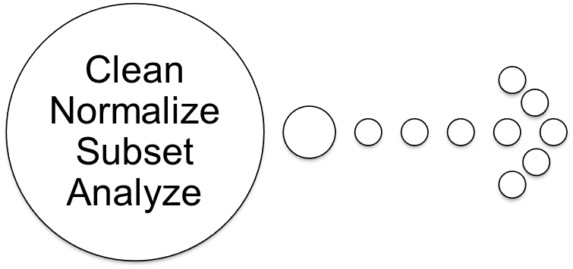
Logical Data Flow Map Example
2
Code

Slide 28
Logical Data Flow Map
3
Show
End with an actionable insight to share
Questions to ask…
“Who is my audience?”
“What type of reports do they want to see?”
“How do I format output to easily “see” the insights?”
“Is the insight actionable?”

Slide 29
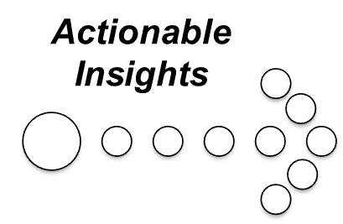
Logical Data Flow Map Example
3
Show
$$$

Slide 30
Logical Data Flow Map Example
1
Data
2
Code
3
Show
Customer Purchases
Clean Normalize Subset Analyze
Actionable Insights
Cost of Products Sold
$$$
Inventory of Products

Slide 31
Summary
Learning objectives…
“Explain Analytical Programming”
“Connect to SAS Studio”
“Create a Logical Data Flow Map”

Slide 32
Q & A

