Slide 1
Digital Marketing Analytic Metrics BM031-3-M BSSMMA VD2
Chapter 5

Slide 2
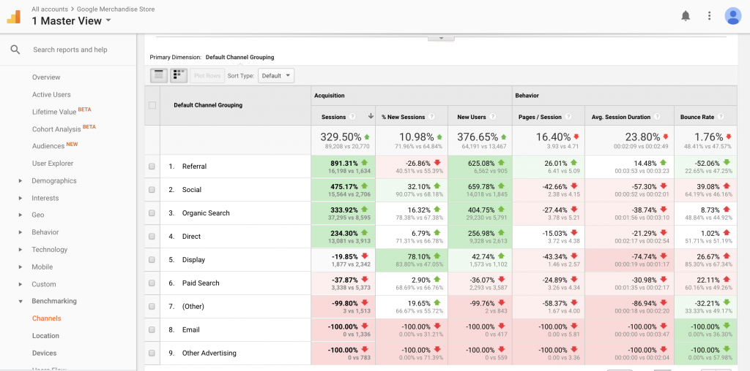
Key Metrics : Traffic Source
shows the exact source of the traffic on your website.
an easy way to know which channels are getting the most relevant traffic to your website.

Slide 3
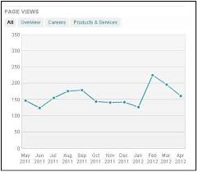
Key Metrics
Page Views
indicate how much overall web content is being consumed by site visitors.
Each user will typically generate at least one page view when they visit a website unless the page tagging is set up incorrectly or the user is interacting with non-page-based content (file downloads, videos).
Source from bruceclay.com

Slide 4
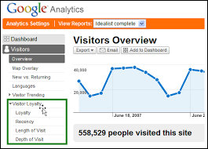
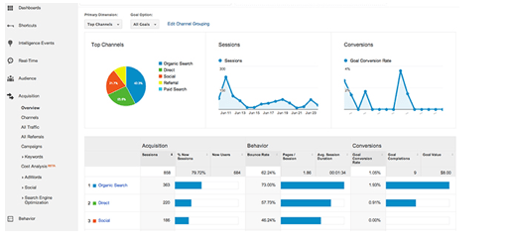
Key Metrics
Visits
visits reveal how popular your website is; the more visits
Source from kaushik.net

Slide 5
Key Metrics
Unique Visitors
When an individual visits a website more than once during a reporting period, it will be counted as one unique visitor. When a visitor first comes to a website, analytics tool uses a persistent cookie to assign her a unique ID that will identify her if she returns to the site.

Slide 6
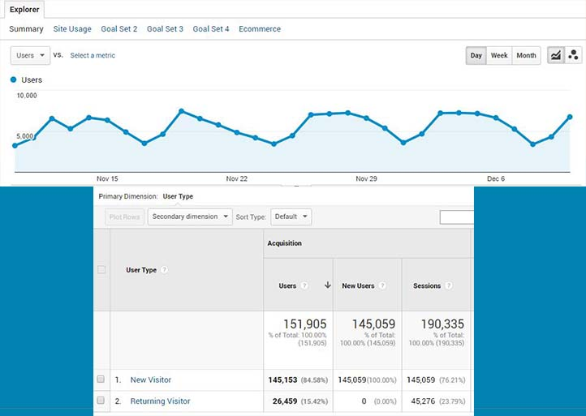
Realtime Analytics Google Merchandise Store

Slide 7
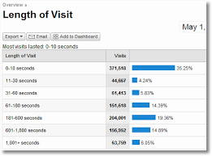
Key Metrics
Average Visit Duration
indicates how much time visitors are typically spending on your site (average time spent)

Slide 8
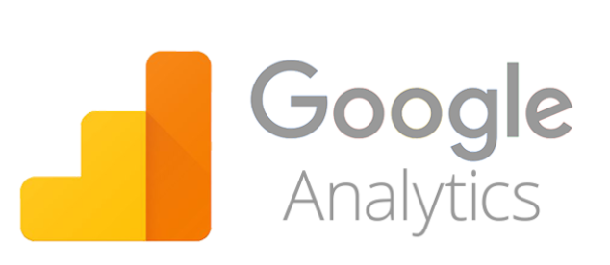
Key Metrics
Page Views per Visit
it can show how engaged visitors are with your site content or at least how much page content each visitor is consuming during a single visit.

Slide 9
Key Metrics
Bounce Rate
Bounce rate is the percentage of entering visits (entries or entrances) that are single-page visits or entering visits that leave (bounce from) the site after viewing only one page. High bounce rate means :
Messaging and content that doesn’t match visitors’ expectations
Poor page design or layout
Slow loading times

Slide 10
Key Metrics
Exit Rate
Exit rate is the percentage of visits that terminate or exit on a particular page.
(Every visit or session ends at some point )
Conversion Rate
Conversion rate is the percentage of visitors (or visit
Each organization’s online business goals will define what it wants visitors to do and what represents a conversion (a desired action, behavior, or outcome).
For retailers, a conversion is a purchase or order. For other companies, it could be an application submission, a subscription, a newsletter sign-up, a scheduled appointment, or an app download. s) that reached a particular outcome or performed a target action

Slide 11
Five Key Attributes of Effective Metrics
Simple
Avoid overly complex metrics that are hard to capture, understand, interpret, or act on.
2. Relevant
Don’t be distracted by interesting but irrelevant metrics. Your key metrics should be pertinent to your business goals and the current needs of your organization.
Timely
If metrics are unavailable or delayed when you need them to make timely business decisions, they are useless.

Slide 12
Five Key Attributes of Effective Metrics
Credible
Ensure your organization can trust the metrics. If the implementation or data collection approach is ever viewed as suspect, the metrics will either never be fully embraced or they will be abandoned. No metric will be 100% clean, but definitely avoid metrics that are inherently unreliable or problematic.
Actionable
If you don’t know how to react when a metric significantly increases or decreases, you’re probably looking at a vanity or nice-to-know metric. Actionable metrics are easier to interpret and convert into tactical responses because they directly relate to levers in your business that you control or influence.

Slide 13
Father Reading
https://www.youtube.com/user/googleanalytics
https://www.youtube.com/watch?v=e6ntvZDErQ4&ab_channel=Simplilearn
https://analytics.google.com/analytics/web/
Highly recommended course with google certificate:
https://analytics.google.com/analytics/academy/

Slide 14
THANK YOU :)

