Slide 1
Chapter 11: Creating Summary Reports
11.1 The FREQ Procedure
11.2 The MEANS and UNIVARIATE Procedures
11.3 Using the Output Delivery System

Slide 2
Chapter 11: Creating Summary Reports
11.1 The FREQ Procedure
11.2 The MEANS and UNIVARIATE Procedures
11.3 Using the Output Delivery System

Slide 3
Objectives
Produce one-way and two-way frequency tables with the FREQ procedure.
Enhance frequency tables with options.
Use PROC FREQ to validate data in a SAS data set.

Slide 4
Business Scenario
Orion Star management wants to know the number of male and female sales employees in Australia.

Slide 5
Considerations
Use the FREQ procedure to analyze the Gender variable in a subset of orion.sales.
The FREQ Procedure
Gender Frequency Percent ƒƒƒƒƒƒƒƒƒƒƒƒƒƒƒƒƒƒƒƒƒƒƒƒƒƒƒƒƒƒƒ
F XX XX.XX
M XX XX.XX

Slide 6
FREQ Procedure
The FREQ procedure produces a one-way frequency table for each variable named in the TABLES statement.
If the TABLES statement is omitted, a one-way frequency table is produced for every variable in the data set. This can produce voluminous output and is seldom desired.
proc freq data=orion.sales;
tables Gender;
where Country='AU';
run;
PROC FREQ DATA=SAS-data-set;
<TABLES variable(s) </ options>> ;
RUN;
p111d01
Notes:
Notes: PROC FREQ displays a report by default. The output can be saved in a SAS data set.
The procedure can optionally compute:
chi-square tests for one-way to n-way tables
tests and measures of agreement for contingency tables
tests and measures of association for contingency tables and more

Slide 7
Viewing the Output
A one-way frequency table was created for Gender. It lists the discrete values found in the data set and the number of observations in which the variable has that value.
The default output includes frequency and percentage values, including cumulative statistics.
The FREQ Procedure
Cumulative Cumulative
Gender Frequency Percent Frequency Percent
ƒƒƒƒƒƒƒƒƒƒƒƒƒƒƒƒƒƒƒƒƒƒƒƒƒƒƒƒƒƒƒƒƒƒƒƒƒƒƒƒƒƒƒƒƒƒƒƒƒƒƒƒƒƒƒƒƒƒƒ
F 27 42.86 27 42.86
M 36 57.14 63 100.00

Slide 8
Options to Suppress Statistics
Use options in the TABLES statement to suppress the display of selected default statistics.
TABLES variable(s) / options ;
Option | Description
NOCUM | Suppresses the cumulative statistics.
NOPERCENT | Suppresses the percentage display.
Notes:
In addition, there are options that can be placed on the TABLES statement …

Slide 9
Options to Suppress Statistics
NOCUM suppresses
The FREQ Procedure
Cumulative Cumulative
Gender Frequency Percent Frequency Percent
ƒƒƒƒƒƒƒƒƒƒƒƒƒƒƒƒƒƒƒƒƒƒƒƒƒƒƒƒƒƒƒƒƒƒƒƒƒƒƒƒƒƒƒƒƒƒƒƒƒƒƒƒƒƒƒƒƒƒƒ
F 27 42.86 27 42.86
M 36 57.14 63 100.00
NOPERCENT suppresses

Slide 10
11.01 Quiz
Open and submit p111a01. Review the log to determine the cause of the error. Correct the program and resubmit.
What change was needed?
proc freq data=orion.sales;
tables country nocum nopercent;
run;
Notes:
Type answer here

Slide 11
11.01 Quiz – Correct Answer
What change was needed? A slash is required before the options in the TABLES statement.
31 proc freq data=orion.sales;
32 tables country nocum nopercent;
ERROR: Variable NOCUM not found.
ERROR: Variable NOPERCENT not found.
33 run;
proc freq data=orion.sales;
tables country / nocum nopercent;
run;
The FREQ Procedure
Country Frequency
ƒƒƒƒƒƒƒƒƒƒƒƒƒƒƒƒƒƒƒƒ
AU 63
US 102
p111a01s
Notes:
Type answer here

Slide 12
Idea Exchange
This step creates a table for every variable in the data set:
Employee_ID
First_Name
Last_Name
Gender
Salary
Which variables are most appropriate for a frequency analysis? Why?
proc freq data=orion.sales;
run;
Job_Title
Country
Birth_Date
Hire_Date

Slide 14
Business Scenario
Orion Star management wants to know how many sales employees are in each country, as well as the count of males and females.

Slide 15
TABLES Statement
You can list multiple variables in a TABLES statement. A separate table is produced for each variable.
PROC FREQ Output
proc freq data=orion.sales;
tables Gender Country;
run;
The FREQ Procedure
Cumulative Cumulative
Gender Frequency Percent Frequency Percent
ƒƒƒƒƒƒƒƒƒƒƒƒƒƒƒƒƒƒƒƒƒƒƒƒƒƒƒƒƒƒƒƒƒƒƒƒƒƒƒƒƒƒƒƒƒƒƒƒƒƒƒƒƒƒƒƒƒƒƒ
F 68 41.21 68 41.21
M 97 58.79 165 100.00
Cumulative Cumulative
Country Frequency Percent Frequency Percent
ƒƒƒƒƒƒƒƒƒƒƒƒƒƒƒƒƒƒƒƒƒƒƒƒƒƒƒƒƒƒƒƒƒƒƒƒƒƒƒƒƒƒƒƒƒƒƒƒƒƒƒƒƒƒƒƒƒƒƒƒ
AU 63 38.18 63 38.18
US 102 61.82 165 100.00
p111d02

Slide 16
BY Statement
The BY statement is used to request separate analyses for each BY group.
The data set must be sorted or indexed by the variable (or variables) named in the BY statement.
proc sort data=orion.sales out=sorted;
by Country;
run;
proc freq data=sorted;
tables Gender;
by Country;
run;
p111d02

Slide 17
Viewing the Output
Each group displays on a separate page with a BY line.
------------------------- Country=AU --------------------------
The FREQ Procedure
Cumulative Cumulative
Gender Frequency Percent Frequency Percent
ƒƒƒƒƒƒƒƒƒƒƒƒƒƒƒƒƒƒƒƒƒƒƒƒƒƒƒƒƒƒƒƒƒƒƒƒƒƒƒƒƒƒƒƒƒƒƒƒƒƒƒƒƒƒƒƒƒƒ
F 27 42.86 27 42.86
M 36 57.14 63 100.00
-------------------------- Country=US ------------------------
The FREQ Procedure
Cumulative Cumulative
Gender Frequency Percent Frequency Percent
ƒƒƒƒƒƒƒƒƒƒƒƒƒƒƒƒƒƒƒƒƒƒƒƒƒƒƒƒƒƒƒƒƒƒƒƒƒƒƒƒƒƒƒƒƒƒƒƒƒƒƒƒƒƒƒƒƒƒƒ
F 41 40.20 41 40.20
M 61 59.80 102 100.00

Slide 18
Crosstabulation Table
An asterisk between two variables generates a two-way frequency table, or crosstabulation table.
A two-way frequency table generates a single table with statistics for each distinct combination of values of the selected variables.
proc freq data=orion.sales;
tables Gender*Country;
run;
rows
columns
p111d02

Slide 19
Viewing the Output
PROC FREQ Output
The FREQ Procedure
Table of Gender by Country
Gender Country
Frequency‚
Percent ‚
Row Pct ‚
Col Pct ‚AU ‚US ‚ Total
ƒƒƒƒƒƒƒƒƒˆƒƒƒƒƒƒƒƒˆƒƒƒƒƒƒƒƒˆ
F ‚ 27 ‚ 41 ‚ 68
‚ 16.36 ‚ 24.85 ‚ 41.21
‚ 39.71 ‚ 60.29 ‚
‚ 42.86 ‚ 40.20 ‚
ƒƒƒƒƒƒƒƒƒˆƒƒƒƒƒƒƒƒˆƒƒƒƒƒƒƒƒˆ
M ‚ 36 ‚ 61 ‚ 97
‚ 21.82 ‚ 36.97 ‚ 58.79
‚ 37.11 ‚ 62.89 ‚
‚ 57.14 ‚ 59.80 ‚
ƒƒƒƒƒƒƒƒƒˆƒƒƒƒƒƒƒƒˆƒƒƒƒƒƒƒƒˆ
Total 63 102 165
38.18 61.82 100.00

Slide 20
Options to Suppress Statistics
Use options in the TABLES statement to suppress the display of selected default statistics.
TABLES variable(s) / options ;
Option | Description
NOROW | Suppresses the display of the row percentage.
NOCOL | Suppresses the display of the column percentage.
NOPERCENT | Suppresses the percentage display.
NOFREQ | Suppresses the frequency display.
Notes:
In addition, there are options that can be placed on the TABLES statement …

Slide 21
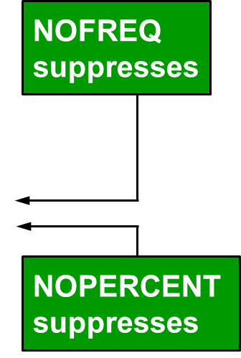
Options to Suppress Statistics
Table of Gender by Country
Gender Country
Frequency‚
Percent ‚
Row Pct ‚
Col Pct ‚AU ‚US ‚ Total
ƒƒƒƒƒƒƒƒƒˆƒƒƒƒƒƒƒƒˆƒƒƒƒƒƒƒƒˆ
F ‚ 27 ‚ 41 ‚ 68
‚ 16.36 ‚ 24.85 ‚ 41.21
‚ 39.71 ‚ 60.29 ‚
‚ 42.86 ‚ 40.20 ‚
ƒƒƒƒƒƒƒƒƒˆƒƒƒƒƒƒƒƒˆƒƒƒƒƒƒƒƒˆ
M ‚ 36 ‚ 61 ‚ 97
‚ 21.82 ‚ 36.97 ‚ 58.79
‚ 37.11 ‚ 62.89 ‚
‚ 57.14 ‚ 59.80 ‚
ƒƒƒƒƒƒƒƒƒˆƒƒƒƒƒƒƒƒˆƒƒƒƒƒƒƒƒˆ
Total 63 102 165
38.18 61.82 100.00

Slide 22
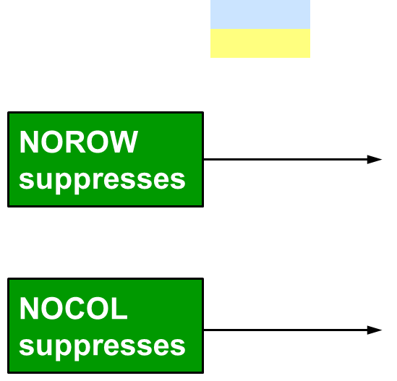
Options to Suppress Statistics
Table of Gender by Country
Gender Country
Frequency‚
Percent ‚
Row Pct ‚
Col Pct ‚AU ‚US ‚ Total
ƒƒƒƒƒƒƒƒƒˆƒƒƒƒƒƒƒƒˆƒƒƒƒƒƒƒƒˆ
F ‚ 27 ‚ 41 ‚ 68
‚ 16.36 ‚ 24.85 ‚ 41.21
‚ 39.71 ‚ 60.29 ‚
‚ 42.86 ‚ 40.20 ‚
ƒƒƒƒƒƒƒƒƒˆƒƒƒƒƒƒƒƒˆƒƒƒƒƒƒƒƒˆ
M ‚ 36 ‚ 61 ‚ 97
‚ 21.82 ‚ 36.97 ‚ 58.79
‚ 37.11 ‚ 62.89 ‚
‚ 57.14 ‚ 59.80 ‚
ƒƒƒƒƒƒƒƒƒˆƒƒƒƒƒƒƒƒˆƒƒƒƒƒƒƒƒˆ
Total 63 102 165
38.18 61.82 100.00

Slide 23
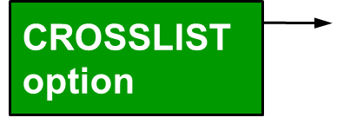
LIST and CROSSLIST Options
You can use the LIST and CROSSLIST options in the TABLES statement to “flatten” the output.
Cumulative Cumulative
Gender Country Frequency Percent Frequency Percent
ƒƒƒƒƒƒƒƒƒƒƒƒƒƒƒƒƒƒƒƒƒƒƒƒƒƒƒƒƒƒƒƒƒƒƒƒƒƒƒƒƒƒƒƒƒƒƒƒƒƒƒƒƒƒƒƒƒƒƒƒƒƒƒƒƒƒƒƒƒƒ
F AU 27 16.36 27 16.36
F US 41 24.85 68 41.21
M AU 36 21.82 104 63.03
M US 61 36.97 165 100.00
LIST option
Table of Gender by Country
Row Column
Gender Country Frequency Percent Percent Percent
ƒƒƒƒƒƒƒƒƒƒƒƒƒƒƒƒƒƒƒƒƒƒƒƒƒƒƒƒƒƒƒƒƒƒƒƒƒƒƒƒƒƒƒƒƒƒƒƒƒƒƒƒƒƒƒƒƒƒƒƒƒƒƒƒ
F AU 27 16.36 39.71 42.86
US 41 24.85 60.29 40.20
Total 68 41.21 100.00
----------------------------------------------------------------
M AU 36 21.82 37.11 57.14
US 61 36.97 62.89 59.80
Total 97 58.79 100.00
----------------------------------------------------------------
Total AU 63 38.18 100.00
US 102 61.82 100.00
Total 165 100.00
ƒƒƒƒƒƒƒƒƒƒƒƒƒƒƒƒƒƒƒƒƒƒƒƒƒƒƒƒƒƒƒƒƒƒƒƒƒƒƒƒƒƒƒƒƒƒƒƒƒƒƒƒƒƒƒƒƒƒƒƒƒƒƒƒ

Slide 25
Business Scenario
A new data set, orion.nonsales2, must be validated. It contains information on non-sales employees and might include invalid and missing values.
Partial orion.nonsales2
Employee_ID | First | Last | Gender | Salary | Job_Title | Country
120101 | Patrick | Lu | M | 163040 | Director | AU
120104 | Kareen | Billington | F | 46230 | Admin Mgr | au
120105 | Liz | Povey | F | 27110 | Secretary I | AU
120106 | John | Hornsey | M | . | Office Asst II | AU
120107 | Sherie | Sheedy | F | 30475 | Office Asst II | AU
120108 | Gladys | Gromek | F | 27660 | Warehouse Asst II | AU

Slide 26
Considerations
Use the FREQ procedure to screen for invalid, missing, and duplicate data values.
Requirements of non-sales employee data:
Employee_ID values must be unique and not missing.
Gender must be F or M.
Job_Title must not be missing.
Country must have a value of AU or US.
Salary values must be in the numeric range of 24000 to 500000.

Slide 27
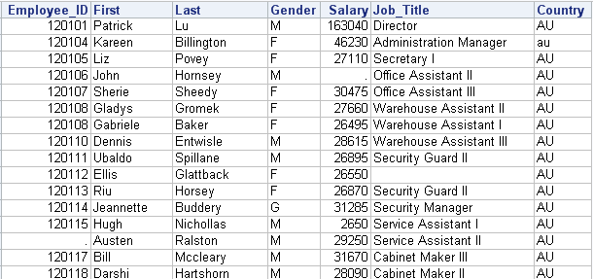
11.02 Quiz
What problems exist with the data in this partial data set?
Hint: There are seven data problems.
Notes:
Observation 2: Country = au
Observation 4: Salary is missing
Observation 5: Hire_Date < Birth_Date
Observation 6 & 7: Duplicate Employee_Ids
Observation 9: Hire_Date is missing
Observation 10: Job_Title is missing
Observation 12: Gender = G
Observation 13: Salary < 24000
Observation 14: Employee_ID is missing
Look at this small snippet of the NONSALES data set. Based on our requirements, do you see any problems with the data?
LW: If you see a problem, send it in as a text response. There are nine different problems. Instructors, as soon as one person identifies one of the problems come over the phone line with the issue. Continue until you have quite a few, you don’t have to wait until you have all nine.
IBT: You might ask for verbal responses. Anyone see a problem with Employee_ID? Yes, … What about Gender? … What about Salary? … Continue with all the appropriate columns.

Slide 28
11.02 Quiz – Correct Answer
What problems exist with the data in this partial data set?
Hint: There are seven data problems.
Notes:
Observation 2: Country = au
Observation 4: Salary is missing
Observation 5: Hire_Date < Birth_Date
Observation 6 & 7: Duplicate Employee_Ids
Observation 9: Hire_Date is missing
Observation 10: Job_Title is missing
Observation 12: Gender = G
Observation 13: Salary < 24000
Observation 14: Employee_ID is missing

Slide 29
FREQ Procedure for Data Validation
The FREQ procedure lists all discrete values for a variable and reports missing values.
proc freq data=orion.nonsales2;
tables Gender Country / nocum nopercent;
run;
p111d03

Slide 30
Viewing the Output
PROC FREQ Output
The FREQ Procedure
Gender Frequency
ƒƒƒƒƒƒƒƒƒƒƒƒƒƒƒƒƒƒƒ
F 110
G 1
M 123
Frequency Missing = 1
Country Frequency
ƒƒƒƒƒƒƒƒƒƒƒƒƒƒƒƒƒƒƒƒ
AU 33
US 196
au 3
us 3

Slide 31
NLEVELS Option
The NLEVELS option displays a table that provides the number of distinct values for each analysis variable.
proc freq data=orion.nonsales2 nlevels;
tables Gender Country / nocum nopercent;
run;
PROC FREQ DATA=SAS-data-set NLEVELS;
TABLES variable(s) ;
RUN;
p111d03
Notes:
Instead of going through each ID, you might consider using NLEVELS …

Slide 32
Viewing the Output
PROC FREQ Output
The FREQ Procedure
Number of Variable Levels
Missing Nonmissing
Variable Levels Levels Levels
ƒƒƒƒƒƒƒƒƒƒƒƒƒƒƒƒƒƒƒƒƒƒƒƒƒƒƒƒƒƒƒƒƒƒƒƒƒƒƒƒƒƒƒƒƒƒ
Gender 4 1 3
Country 4 0 4
Gender Frequency
ƒƒƒƒƒƒƒƒƒƒƒƒƒƒƒƒƒƒƒ
F 110
G 1
M 123
Frequency Missing = 1
Country Frequency
ƒƒƒƒƒƒƒƒƒƒƒƒƒƒƒƒƒƒƒƒ
AU 33
US 196
au 3
us 3

Slide 33
Check for Uniqueness
The values of Employee_ID must be unique and not missing. PROC FREQ can be used to check for duplicate or missing values.
The ORDER=FREQ option displays the results in descending frequency order.
proc freq data=orion.nonsales2 order=freq;
tables Employee_ID / nocum nopercent;
run;
p111d04

Slide 34
Viewing the Output
Partial PROC FREQ Output
The FREQ Procedure
Employee_ID Frequency
ƒƒƒƒƒƒƒƒƒƒƒƒƒƒƒƒƒƒƒƒƒƒƒƒ
120108 2
120101 1
120104 1
120105 1
120106 1
121134 1
121141 1
121142 1
121146 1
121147 1
121148 1
Frequency Missing = 1
p111d04

Slide 35
NLEVELS Option
NLEVELS can also be used to identify duplicates, when the number of distinct values is known.
This example uses the NOPRINT option to suppress the frequency table. Only the Number of Variable Levels table is displayed.
proc freq data=orion.nonsales2 nlevels;
tables Employee_ID / noprint;
run;
p111d04
Notes:
Instead of going through each ID, you might consider using NLEVELS …

Slide 36
Viewing the Output
Partial PROC FREQ Output
There are 235 employees, but there are only 234 distinct Employee_ID values. Therefore, there is one duplicate value and one missing value for Employee_ID.
The FREQ Procedure
Number of Variable Levels
Missing Nonmissing
Variable Levels Levels Levels
ƒƒƒƒƒƒƒƒƒƒƒƒƒƒƒƒƒƒƒƒƒƒƒƒƒƒƒƒƒƒƒƒƒƒƒƒƒƒƒƒƒƒƒƒƒƒƒƒƒ
Employee_ID 234 1 233
Notes:
If we know that we have 235 employees, this NLEVELS table shows that there are 233 distinct nonmissing values plus we have one type of missing value. That means we either have duplicate nonmissing values or duplicate missing values.

Slide 37
NLEVELS Option
The _ALL_ keyword with the NOPRINT option displays the number of levels for all variables without displaying frequency counts.
proc freq data=orion.nonsales2 nlevels;
tables _all_ / noprint;
run;
p111d04

Slide 38
Viewing the Output
PROC FREQ Output
No frequency tables were displayed.
The FREQ Procedure
Number of Variable Levels
Missing Nonmissing
Variable Levels Levels Levels
ƒƒƒƒƒƒƒƒƒƒƒƒƒƒƒƒƒƒƒƒƒƒƒƒƒƒƒƒƒƒƒƒƒƒƒƒƒƒƒƒƒƒƒƒƒƒƒƒƒ
Employee_ID 234 1 233
First 204 0 204
Last 228 0 228
Gender 4 1 3
Salary 230 1 229
Job_Title 125 1 124
Country 4 0 4

Slide 39
11.03 Quiz
Modify p111a02 to analyze Job_Title. Display the NLEVELS table listing the frequency counts in decreasing order.
How many unique, nonmissing job titles exist?
Which job title occurs most frequently?
What is the frequency of missing job titles?
Notes:
Type answer here

Slide 40
11.03 Quiz – Correct Answer
How many unique, nonmissing job titles exist? 124
Which job title occurs most frequently? Trainee
What is the frequency of missing job titles? 1
proc freq data=orion.nonsales2 nlevels
order=freq;
tables Job_Title /nocum nopercent;
run;
p111a02s
Notes:
Type answer here

Slide 41
Identifying Observations with Invalid Data
PROC FREQ has uncovered the existence of invalid data values for Gender, Country, and Employee_ID. Use PROC PRINT to display the observations with invalid values.
proc print data=orion.nonsales2;
where Gender not in ('F','M') or
Country not in ('AU','US') or
Job_Title is null or
Employee_ID is missing or
Employee_ID=120108;
run;

Slide 42
Viewing the Output
PROC PRINT Output
Obs Employee_ID First Last Gender Salary Job_Title Country
2 120104 Kareen Billington F 46230 Administration Manager au
6 120108 Gladys Gromek F 27660 Warehouse Assistant II AU
7 120108 Gabriele Baker F 26495 Warehouse Assistant I AU
10 120112 Ellis Glattback F 26550 AU
12 120114 Jeannette Buddery G 31285 Security Manager AU
14 . Austen Ralston M 29250 Service Assistant II AU
84 120695 Trent Moffat M 28180 Warehouse Assistant II au
87 120698 Geoff Kistanna M 26160 Warehouse Assistant I au
101 120723 Deanna Olsen 33950 Corp. Comm. Specialist II US
125 120747 Zashia Farthing F 43590 Financial Controller I us
197 120994 Danelle Sergeant F 31645 Office Administrator I us
200 120997 Mary Donathan F 27420 Shipping Administrator I us
original
observation
numbers

Slide 44
Business Scenario
The manager of Human Resources has requested a report showing the number and percent of sales employees hired each year.
%

Slide 45
Using Formats in PROC FREQ
A FORMAT statement can be used in PROC FREQ to format data values.
Partial PROC FREQ Output
proc freq data=orion.sales;
tables Hire_Date / nocum;
format Hire_Date date9.;
run;
The FREQ Procedure
Hire_Date Frequency Percent
ƒƒƒƒƒƒƒƒƒƒƒƒƒƒƒƒƒƒƒƒƒƒƒƒƒƒƒƒƒƒƒƒƒƒ
01JAN1978 17 10.30
01FEB1978 2 1.21
01APR1978 1 0.61
01JUL1978 1 0.61
01AUG1978 1 0.61
many discrete values, and not what the manager requested
p111d05

Slide 46
Using Formats in PROC FREQ
A FORMAT statement can also be used in PROC FREQ to group the data.
Partial PROC FREQ Output
proc freq data=orion.sales;
tables Hire_Date / nocum;
format Hire_Date year4.;
run;
The FREQ Procedure
Hire_Date Frequency Percent
ƒƒƒƒƒƒƒƒƒƒƒƒƒƒƒƒƒƒƒƒƒƒƒƒƒƒƒƒƒƒƒƒƒƒ
1978 23 13.94
1979 2 1.21
1980 4 2.42
1981 3 1.82
1982 7 4.24
fewer discrete values
p111d05

Slide 47
11.04 Quiz
Open and submit p111a03 and view the output. Add a statement to apply the TIERS format to Salary and resubmit.
Can user-defined formats be used to group data?
Notes:
Type answer here

Slide 48
11.04 Quiz – Correct Answer
Can user-defined formats be used to group data? yes
The FREQ Procedure
Cumulative Cumulative
Salary Frequency Percent Frequency Percent
ƒƒƒƒƒƒƒƒƒƒƒƒƒƒƒƒƒƒƒƒƒƒƒƒƒƒƒƒƒƒƒƒƒƒƒƒƒƒƒƒƒƒƒƒƒƒƒƒƒƒƒƒƒƒƒƒƒƒƒ
Tier1 1 0.61 1 0.61
Tier2 158 95.76 159 96.36
Tier3 4 2.42 163 98.79
Tier4 2 1.21 165 100.00
p111a03s
Notes:
Type answer here

Slide 49
FORMAT Statement
User-defined formats can also be used to display levels with alternate text in a frequency table.
proc freq data=orion.sales;
tables Gender*Country;
format Country $ctryfmt.
Gender $gender.;
run;
p111d06

Slide 50
Viewing the Output
Partial PROC FREQ Output
Table of Gender by Country
Gender Country
Frequency‚
Percent ‚
Row Pct ‚
Col Pct ‚Australi‚United S‚ Total
‚a ‚tates ‚
ƒƒƒƒƒƒƒƒƒˆƒƒƒƒƒƒƒƒˆƒƒƒƒƒƒƒƒˆ
Female ‚ 27 ‚ 41 ‚ 68
‚ 16.36 ‚ 24.85 ‚ 41.21
‚ 39.71 ‚ 60.29 ‚
‚ 42.86 ‚ 40.20 ‚
ƒƒƒƒƒƒƒƒƒˆƒƒƒƒƒƒƒƒˆƒƒƒƒƒƒƒƒˆ
Male ‚ 36 ‚ 61 ‚ 97
‚ 21.82 ‚ 36.97 ‚ 58.79
‚ 37.11 ‚ 62.89 ‚
‚ 57.14 ‚ 59.80 ‚
ƒƒƒƒƒƒƒƒƒˆƒƒƒƒƒƒƒƒˆƒƒƒƒƒƒƒƒˆ
Total 63 102 165
38.18 61.82 100.00
Labels are wrapped.

Slide 51
FORMAT= Option
Use the FORMAT= option in the TABLES statement to format the frequency value and to change the width of the column.
proc freq data=orion.sales;
tables Gender*Country / format=12.;
format Country $ctryfmt.
Gender $gender.;
run;
p111d06

Slide 52
Viewing the Output
PROC FREQ Output
The FREQ Procedure
Table of Gender by Country
Gender Country
Frequency‚
Percent ‚
Row Pct ‚
Col Pct ‚Australia ‚United States‚ Total
ƒƒƒƒƒƒƒƒƒˆƒƒƒƒƒƒƒƒƒƒƒƒƒˆƒƒƒƒƒƒƒƒƒƒƒƒƒˆ
Female ‚ 27 ‚ 41 ‚ 68
‚ 16.36 ‚ 24.85 ‚ 41.21
‚ 39.71 ‚ 60.29 ‚
‚ 42.86 ‚ 40.20 ‚
ƒƒƒƒƒƒƒƒƒˆƒƒƒƒƒƒƒƒƒƒƒƒƒˆƒƒƒƒƒƒƒƒƒƒƒƒƒˆ
Male ‚ 36 ‚ 61 ‚ 97
‚ 21.82 ‚ 36.97 ‚ 58.79
‚ 37.11 ‚ 62.89 ‚
‚ 57.14 ‚ 59.80 ‚
ƒƒƒƒƒƒƒƒƒˆƒƒƒƒƒƒƒƒƒƒƒƒƒˆƒƒƒƒƒƒƒƒƒƒƒƒƒˆ
Total 63 102 165
38.18 61.82 100.00
Columns are 12 characters wide.
Notes:
Notes: The FORMAT= option applies only to the frequency. Percentage values are always displayed with two decimal places.

Slide 54
Exercise
This exercise reinforces the concepts discussed previously.

Slide 55
Chapter 11: Creating Summary Reports
11.1 The FREQ Procedure
11.2 The MEANS and UNIVARIATE Procedures
11.3 Using the Output Delivery System

Slide 56
Objectives
Calculate summary statistics and multilevel summaries with the MEANS procedure.
Enhance summary tables with options.
Identify extreme and missing values with the UNIVARIATE procedure.

Slide 57
Business Scenario
The payroll manager would like to see the average salary for all employees.

Slide 58
MEANS Procedure
The MEANS procedure produces summary reports with descriptive statistics.
Analysis variables are the numeric variables for which statistics are to be computed.
Classification variables are variables whose values define subgroups for the analysis. They can be character or numeric.
proc means data=orion.sales;
run;
PROC MEANS DATA=input-data-set <options statistics>;
<VAR analysis-variable(s);>
<CLASS classification-variable(s);>
RUN;
p111d07

Slide 59
Viewing the Output
PROC MEANS Output
Default statistics are displayed for all numeric variables.
The MEANS Procedure
Variable N Mean Std Dev Minimum Maximum
ƒƒƒƒƒƒƒƒƒƒƒƒƒƒƒƒƒƒƒƒƒƒƒƒƒƒƒƒƒƒƒƒƒƒƒƒƒƒƒƒƒƒƒƒƒƒƒƒƒƒƒƒƒƒƒƒƒƒƒƒƒƒƒƒƒƒƒƒƒƒƒƒƒƒƒƒ
Employee_ID 165 120713.90 450.0866939 120102.00 121145.00
Salary 165 31160.12 20082.67 22710.00 243190.00
Birth_Date 165 3622.58 5456.29 -5842.00 10490.00
Hire_Date 165 12054.28 4619.94 5114.00 17167.00
ƒƒƒƒƒƒƒƒƒƒƒƒƒƒƒƒƒƒƒƒƒƒƒƒƒƒƒƒƒƒƒƒƒƒƒƒƒƒƒƒƒƒƒƒƒƒƒƒƒƒƒƒƒƒƒƒƒƒƒƒƒƒƒƒƒƒƒƒƒƒƒƒƒƒƒƒ

Slide 60
VAR Statement
The VAR statement identifies the analysis variable (or variables) and their order in the output.
proc means data=orion.sales;
var Salary;
run;
VAR variable(s);
The MEANS Procedure
Analysis Variable : Salary
N Mean Std Dev Minimum Maximum
ƒƒƒƒƒƒƒƒƒƒƒƒƒƒƒƒƒƒƒƒƒƒƒƒƒƒƒƒƒƒƒƒƒƒƒƒƒƒƒƒƒƒƒƒƒƒƒƒƒƒƒƒƒƒƒƒƒƒƒƒƒƒƒƒƒƒƒ
165 31160.12 20082.67 22710.00 243190.00
ƒƒƒƒƒƒƒƒƒƒƒƒƒƒƒƒƒƒƒƒƒƒƒƒƒƒƒƒƒƒƒƒƒƒƒƒƒƒƒƒƒƒƒƒƒƒƒƒƒƒƒƒƒƒƒƒƒƒƒƒƒƒƒƒƒƒƒ
p111d07

Slide 61
Business Scenario
Analyze Salary by Country within Gender.
female
male

Slide 62
CLASS Statement
The CLASS statement identifies variables whose values define subgroups for the analysis.
Classification variables are character or numeric.
They typically have few discrete values.
The data set does not need to be sorted or indexed by the classification variables.
proc means data=orion.sales;
var Salary;
class Gender Country;
run;
CLASS classification-variable(s);
p111d08

Slide 63
Viewing the Output
Statistics are produced for each combination of values of the classification variables.
N Obs – the number of observations with each unique combination of class variables
N – the number of observations with nonmissing values of the analysis variable (or variables)
The MEANS Procedure
Analysis Variable : Salary
N
Gender Country Obs N Mean Std Dev Minimum Maximum
ƒƒƒƒƒƒƒƒƒƒƒƒƒƒƒƒƒƒƒƒƒƒƒƒƒƒƒƒƒƒƒƒƒƒƒƒƒƒƒƒƒƒƒƒƒƒƒƒƒƒƒƒƒƒƒƒƒƒƒƒƒƒƒƒƒƒƒƒƒƒƒƒƒƒƒƒƒ
F AU 27 27 27702.41 1728.23 25185.00 30890.00
US 41 41 29460.98 8847.03 25390.00 83505.00
M AU 36 36 32001.39 16592.45 25745.00 108255.00
US 61 61 33336.15 29592.69 22710.00 243190.00

Slide 64
11.05 Quiz
For a given data set, there are 63 observations with a Country value of AU. Of those 63 observations, only 61 observations have a value for Salary.
Which output is correct?
a. b.
Analysis Variable : Salary
N
Country Obs N
ƒƒƒƒƒƒƒƒƒƒƒƒƒƒƒƒƒƒƒƒƒ
AU 63 61
ƒƒƒƒƒƒƒƒƒƒƒƒƒƒƒƒƒƒƒƒƒ
Analysis Variable : Salary
N
Country Obs N
ƒƒƒƒƒƒƒƒƒƒƒƒƒƒƒƒƒƒƒƒƒ
AU 61 63
ƒƒƒƒƒƒƒƒƒƒƒƒƒƒƒƒƒƒƒƒƒ
Notes:
a. NObs=63 N=61

Slide 65
11.05 Quiz – Correct Answer
For a given data set, there are 63 observations with a Country value of AU. Of those 63 observations, only 61 observations have a value for Salary.
Which output is correct?
a. b.
Analysis Variable : Salary
N
Country Obs N
ƒƒƒƒƒƒƒƒƒƒƒƒƒƒƒƒƒƒƒƒƒ
AU 63 61
ƒƒƒƒƒƒƒƒƒƒƒƒƒƒƒƒƒƒƒƒƒ
Analysis Variable : Salary
N
Country Obs N
ƒƒƒƒƒƒƒƒƒƒƒƒƒƒƒƒƒƒƒƒƒ
AU 61 63
ƒƒƒƒƒƒƒƒƒƒƒƒƒƒƒƒƒƒƒƒƒ
Notes:
a. NObs=63 N=61

Slide 66
Business Scenario
Analyze Salary by Country within Gender. Generate a report that includes the number of missing Salary values, as well as the minimum, maximum, and sum of salaries.
female
male

Slide 67
PROC MEANS Statistics
Use options in the PROC MEANS statement to request specific statistics.
The requested statistics override the default statistics.
proc means data=orion.sales nmiss min max sum;
var Salary;
class Gender Country;
run;
p111d09

Slide 68
PROC MEANS Statistics
The statistics are displayed in the order in which they are requested.
The MEANS Procedure
Analysis Variable : Salary
N N
Gender Country Obs Miss Minimum Maximum Sum
ƒƒƒƒƒƒƒƒƒƒƒƒƒƒƒƒƒƒƒƒƒƒƒƒƒƒƒƒƒƒƒƒƒƒƒƒƒƒƒƒƒƒƒƒƒƒƒƒƒƒƒƒƒƒƒƒƒƒƒƒƒƒƒƒƒƒƒƒƒƒƒƒƒƒƒƒƒƒƒƒ
F AU 27 0 25185.00 30890.00 747965.00
US 41 0 25390.00 83505.00 1207900.00
M AU 36 0 25745.00 108255.00 1152050.00
US 61 0 22710.00 243190.00 2033505.00
ƒƒƒƒƒƒƒƒƒƒƒƒƒƒƒƒƒƒƒƒƒƒƒƒƒƒƒƒƒƒƒƒƒƒƒƒƒƒƒƒƒƒƒƒƒƒƒƒƒƒƒƒƒƒƒƒƒƒƒƒƒƒƒƒƒƒƒƒƒƒƒƒƒƒƒƒƒƒƒƒ

Slide 69
PROC MEANS Statement Options
Options can also be placed in the PROC MEANS statement.
Option | Description
MAXDEC= | Specifies the number of decimal places to display.
NONOBS | Suppresses the N Obs column.

Slide 70
MAXDEC= Option
MAXDEC=0
The MEANS Procedure
Analysis Variable : Salary
N
Country Obs N Mean Std Dev Minimum Maximum
ƒƒƒƒƒƒƒƒƒƒƒƒƒƒƒƒƒƒƒƒƒƒƒƒƒƒƒƒƒƒƒƒƒƒƒƒƒƒƒƒƒƒƒƒƒƒƒƒƒƒƒƒƒƒƒƒƒƒƒƒƒƒƒƒƒƒƒƒƒƒƒƒƒƒƒƒƒƒƒ
AU 63 63 30159 12699 25185 108255
US 102 102 31778 23556 22710 243190
MAXDEC=1
The MEANS Procedure
Analysis Variable : Salary
N
Country Obs N Mean Std Dev Minimum Maximum
ƒƒƒƒƒƒƒƒƒƒƒƒƒƒƒƒƒƒƒƒƒƒƒƒƒƒƒƒƒƒƒƒƒƒƒƒƒƒƒƒƒƒƒƒƒƒƒƒƒƒƒƒƒƒƒƒƒƒƒƒƒƒƒƒƒƒƒƒƒƒƒƒƒƒƒƒƒƒƒ
AU 63 63 30159.0 12699.1 25185.0 108255.0
US 102 102 31778.5 23555.8 22710.0 243190.0
p111d10

Slide 71
NONOBS Option
N Obs included by default
The MEANS Procedure
Analysis Variable : Salary
N
Country Obs N Mean Std Dev Minimum Maximum
ƒƒƒƒƒƒƒƒƒƒƒƒƒƒƒƒƒƒƒƒƒƒƒƒƒƒƒƒƒƒƒƒƒƒƒƒƒƒƒƒƒƒƒƒƒƒƒƒƒƒƒƒƒƒƒƒƒƒƒƒƒƒƒƒƒƒƒƒƒƒƒƒƒƒƒƒƒƒƒ
AU 63 63 30158.97 12699.14 25185.00 108255.00
US 102 102 31778.48 23555.84 22710.00 243190.00
NONOBS option
The MEANS Procedure
Analysis Variable : Salary
Country N Mean Std Dev Minimum Maximum
ƒƒƒƒƒƒƒƒƒƒƒƒƒƒƒƒƒƒƒƒƒƒƒƒƒƒƒƒƒƒƒƒƒƒƒƒƒƒƒƒƒƒƒƒƒƒƒƒƒƒƒƒƒƒƒƒƒƒƒƒƒƒƒƒƒƒƒƒƒƒƒƒƒƒƒƒƒƒ
AU 63 30158.97 12699.14 25185.00 108255.00
US 102 31778.48 23555.84 22710.00 243190.00
p111d10

Slide 72
Other PROC MEANS Statistics
Descriptive Statistic Keywords
CLM | CSS | CV | LCLM | MAX
MEAN | MIN | MODE | N | NMISS
KURTOSIS | RANGE | SKEWNESS | STDDEV | STDERR
SUM | SUMWGT | UCLM | USS | VAR
Quantile Statistic Keywords
MEDIAN | P50 | P1 | P5 | P10 | Q1 | P25
Q3 | P75 | P90 | P95 | P99 | QRANGE
Hypothesis Testing Keywords
PROBT | T

Slide 73
Idea Exchange
Which PROC MEANS statistics would you request when validating numeric variables?
Notes:
Min, max, nmiss
But min and max only report the highest and lowest value, and there may be more than ne value outside of the valid range.
Use this as a lead-in to proc univariate.

Slide 75
Business Scenario
Validate salary data in orion.nonsales2. Salary must be in the numeric range of 24000 to 500000.
Partial orion.nonsales2
Employee_ID | First | Last | Gender | Salary | Job_Title | Country
120101 | Patrick | Lu | M | 163040 | Director | AU
120104 | Kareen | Billington | F | 46230 | Admin Mgr | au
120105 | Liz | Povey | F | 27110 | Secretary I | AU
120106 | John | Hornsey | M | . | Office Asst II | AU
120107 | Sherie | Sheedy | F | 30475 | Office Asst II | AU
120108 | Gladys | Gromek | F | 27660 | Warehouse Asst II | AU

Slide 76
UNIVARIATE Procedure
PROC UNIVARIATE displays extreme observations, missing values, and other statistics for the variables included in the VAR statement.
If the VAR statement is omitted, PROC UNIVARIATE analyzes all numeric variables in the data set.
proc univariate data=orion.nonsales2;
var Salary;
run;
PROC UNIVARIATE DATA=SAS-data-set;
<VAR variable(s);>
RUN;
p111d11

Slide 77
Viewing the Output: Extreme Observations
The Extreme Observations section includes the five lowest and five highest values for the analysis variable and the corresponding observation numbers.
Partial PROC UNIVARIATE Output
 Obs is the observation number, not the count of observations with that value.
Extreme Observations
-----Lowest---- -----Highest----
Value Obs Value Obs
2401 20 163040 1
2650 13 194885 231
24025 25 207885 28
24100 19 268455 29
24390 228 433800 27
Notes:
Include the note from the current course below the slide.

Slide 78
NEXTROBS= Option
The NEXTROBS= option specifies the number of extreme observations to display.
Partial PROC UNIVARIATE Output
proc univariate data=orion.nonsales2
nextrobs=3;
var Salary;
run;
The UNIVARIATE Procedure
Variable: Salary
Extreme Observations
-----Lowest---- -----Highest----
Value Obs Value Obs
2401 20 207885 28
2650 13 268455 29
24025 25 433800 27
p111d11

Slide 79
ID Statement
The ID statement displays the value of the identifying variable (or variables) in addition to the observation number.
proc univariate data=orion.nonsales2;
var Salary;
id Employee_ID;
run;
ID variable(s);
p111d11

Slide 80
Viewing the Output
Partial PROC UNIVARIATE Output
The UNIVARIATE Procedure
Variable: Salary
Extreme Observations
------------Lowest---------- ------------Highest----------
Value Employee_ID Obs Value Employee_ID Obs
2401 120191 20 163040 120101 1
2650 120115 13 194885 121141 231
24025 120196 25 207885 120260 28
24100 120190 19 268455 120262 29
24390 121132 228 433800 120259 27

Slide 81
Viewing the Output: Missing Values Section
The Missing Values section displays the number and percentage of observations with missing values of the analysis variable.
Partial PROC UNIVARIATE Output
Missing Values
-----Percent Of-----
Missing Missing
Value Count All Obs Obs
. 1 0.43 100.00
Notes:
Here, we are showing the last two sections …

Slide 82
11.06 Quiz
PROC UNIVARIATE identified two observations with Salary values less than 24,000.
What procedure can be used to display the observations containing the invalid values?
Notes:
Type answer here

Slide 83
11.06 Quiz – Correct Answer
PROC UNIVARIATE identified two observations with Salary values less than 24,000.
What procedure can be used to display the observations containing the invalid values? PROC PRINT
PROC PRINT Output
proc print data=orion.nonsales2;
where Salary<24000;
run;
Obs Employee_ID First Last Gender Salary Job_Title Country
4 120106 John Hornsey M . Office Assistant II AU
13 120115 Hugh Nichollas M 2650 Service Assistant I AU
20 120191 Jannene Graham-Rowe F 2401 Trainee AU
p111a04s
Notes:
Type answer here

Slide 85
Exercise
This exercise reinforces the concepts discussed previously.

Slide 86
Chapter 11: Creating Summary Reports
11.1 The FREQ Procedure
11.2 The MEANS and UNIVARIATE Procedures
11.3 Using the Output Delivery System

Slide 87
Objectives
Define the Output Delivery System and ODS destinations.
Create report output in PDF, RTF, and HTML format.
Specify a style definition using the STYLE= option.
Create report output that can be viewed in Microsoft Excel.

Slide 88
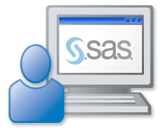
Business Scenario
Generate reports in various formats for distribution within Orion Star.

Slide 89
SAS Procedure Output
Historically, SAS procedures generate plain text output using monospace fonts.
Obs First_Name Last_Name Job_Title Salary
1 Satyakam Denny Sales Rep. II 26780
2 Monica Kletschkus Sales Rep. IV 30890
3 Kevin Lyon Sales Rep. I 26955
4 Petrea Soltau Sales Rep. II 27440
5 Marina Iyengar Sales Rep. III 29715
6 Shani Duckett Sales Rep. I 25795
7 Fang Wilson Sales Rep. II 26810
8 Michael Minas Sales Rep. I 26970
9 Amanda Liebman Sales Rep. II 27465
10 Vincent Eastley Sales Rep. III 29695

Slide 90
Output in SAS Enterprise Guide
SAS Enterprise Guide produces SAS Report output by default.
The output from each program is written to a specially formatted file.
You can request the following output styles by selecting Tools ⇨ Options ⇨ Results General:
PDF
RTF
HTML
LISTING (plain text)
The PDF, RTF, and HTML files can be saved and opened outside of Enterprise Guide.

Slide 91
Output in the SAS Windowing Environment
SAS 9.3 produces HTML output by default.
All procedure output accumulates in a single file.
LISTING output can be requested by selecting Tools ⇨ Options ⇨ Preferences ⇨ Results.
LISTING output is the default for prior releases and for SAS 9.3 in batch mode.

Slide 92
Output Delivery System (ODS)
Use the Output Delivery System to create different output formats by directing output to various ODS destinations.
ODS statements and destinations can be used regardless of the mode, operating environment, or platform.
LISTING
Procedure Output
HTML
RTF
PDF
Notes:
So far, our reports have been going to the Output window. However, we can add some ODS statements to send our reports to other locations. You can send your reports to destinations such as HTML, RTF, and PDF.

Slide 93
ODS Statements
Open an ODS destination, submit one or more procedures that generate output, and then close the destination.
ods html file="&path\myreport.html";
proc freq data=orion.sales;
tables Country;
run;
ods html close;
ODS destination FILE="filename" <options>;
<SAS code to generate the report>
ODS destination CLOSE;
p111d12
Notes:
Here’s an example of sending to HTML and how the results will look in Internet Explorer.

Slide 94
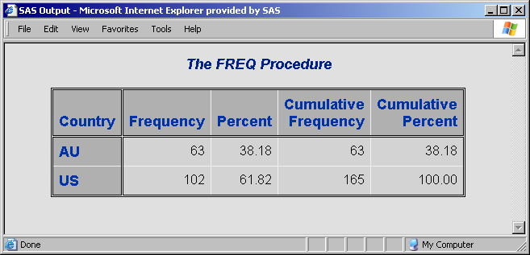
Viewing the Output
HTML output can be viewed in the interactive environment or using a browser.
Notes:
Here’s an example of sending to HTML and how the results will look in Internet Explorer.

Slide 95
ODS Destinations
ODS creates various types of output based on the specified destinations and file types.
Destination | Type of File | Extension | Viewed In
LISTING | Plain text |  | SAS Output window
HTML | Hypertext Markup Language | html | Web Browsers such as Internet Explorer
PDF | Portable Document Format | pdf | Adobe products such as Acrobat Reader
RTF | Rich Text Format | rtf | Word processors such as Microsoft Word

Slide 96
Multiple Destinations and Procedures
Output from multiple procedures can be sent to multiple ODS destinations.
ods pdf file="&path\example.pdf";
ods rtf file="&path\example.rtf";
proc freq data=orion.sales;
tables Country;
run;
proc means data=orion.sales;
var Salary;
run;
ods pdf close;
ods rtf close;
p111d14

Slide 97
Closing All Destinations
Use _ALL_ in the ODS CLOSE statement to close all open destinations. This includes the LISTING destination.
ods pdf file="&path\example.pdf";
ods rtf file="&path\example.rtf";
proc freq data=orion.sales;
tables Country;
run;
ods _all_ close;
p111d15

Slide 98
No Open Destinations
Be sure to have at least one destination open.
ods _all_ close;
2724 proc freq data=orion.sales;
2725 tables Country;
2726 run;
WARNING: No output destinations active.
NOTE: There were 165 observations read from the data set ORION.SALES.
2727
2728 ods listing;
2729
2730 proc freq data=orion.sales;
2731 tables Country;
2732 run;
NOTE: There were 165 observations read from the data set ORION.SALES.
Output is generated but not displayed.
Output is displayed.
p111d15

Slide 99
11.07 Quiz
What is the problem with this program?
ods html file="&path\myreport.html";
proc print data=orion.sales;
run;
ods close;
p111a05
Notes:
Missing pdf in ods close;.
LW: Send in a text response.
IBT: Take answers verbally.

Slide 100
11.07 Quiz – Correct Answer
What is the problem with this program?
ods html file="&path\myreport.html";
proc print data=orion.sales;
run;
ods html close;
p111a01s
Notes:
Missing html in ods close;.

Slide 101
STYLE= Option
Use a STYLE= option in the ODS statement to specify a style definition.
A style definition sets presentation aspects including colors and fonts.
 STYLE= has no effect in the LISTING destination.
ODS destination FILE="filename"
STYLE=style-definition;
Notes:
Each destination has a particular look to it. For example, the HTML file used the colors of grays, blues, and black. You can change the visual look by using the STYLE= …

Slide 102
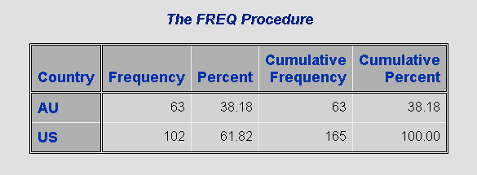
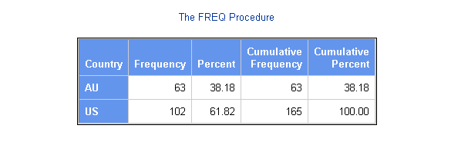
HTML Examples
STYLE=DEFAULT
STYLE=SASWEB
p111d12

Slide 103
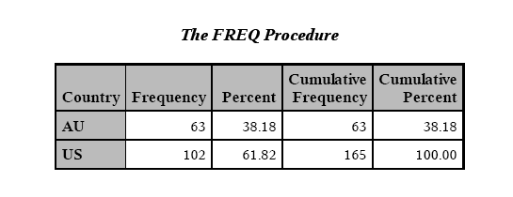
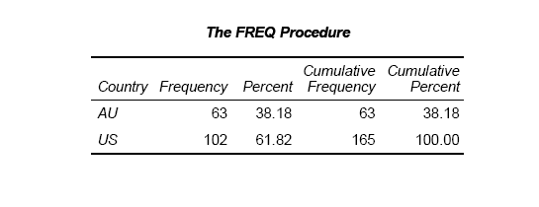
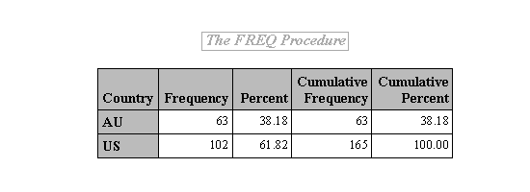
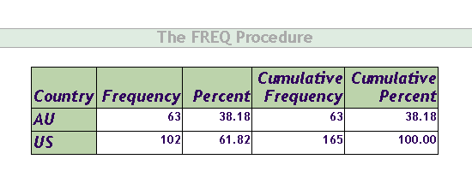
PDF and RTF Examples
STYLE=PRINTER
STYLE=JOURNAL
STYLE=RTF
STYLE=OCEAN
p111d17

Slide 104
Available Styles
Use the TEMPLATE procedure to see the available styles.
Partial Output
proc template;
list styles;
run;
Listing of: SASHELP.TMPLMST
Path Filter is: Styles
Sort by: PATH/ASCENDING
Obs Path Type
ƒƒƒƒƒƒƒƒƒƒƒƒƒƒƒƒƒƒƒƒƒƒƒƒƒƒƒƒƒƒƒƒ
1 Styles Dir
2 Styles.Analysis Style
3 Styles.Astronomy Style
4 Styles.Banker Style
5 Styles.BarrettsBlue Style
6 Styles.Curve Style
7 Styles.Default Style
8 Styles.Dtree Style
9 Styles.EGDefault Style
10 Styles.Education Style
p111d13

Slide 106
Business Scenario
Create SAS reports that can be opened in Microsoft Excel using the CSVALL, MSOFFICE2K, and EXCELXP destinations.
csvall
msoffice2k
excelxp
Notes:
There are several destinations that create files that can be opened in Excel …
EXCELXP is the most powerful but you do have to have Excel 2002 or greater.
All three of these destinations are part of ODS MARKUP.

Slide 107
Destinations Used with Excel
Destination | Type of File | Extension | Viewed In
CSVALL | Comma-Separated Value | csv | Editor or Microsoft Excel
MSOFFICE2K | Hypertext Markup Language | html | Web browser or Microsoft Word or Microsoft Excel
TAGSETS. EXCELXP | Extensible Markup Language | xml | Microsoft Excel

Slide 108
11.08 Quiz
Complete the ODS statements below to send the output to a CSVALL destination.
ods file="&path\myexcel. ";
proc freq data=orion.sales;
tables Country;
run;
proc means data=orion.sales;
var Salary;
run;
ods close;
Notes:
Correct Answers:
ods csvall "&path\myexcel.csv"; <procedures> ods csvall close;

Slide 109
11.08 Quiz – Correct Answer
Complete the ODS statements below to send the output to a CSVALL destination.
ods csvall file="&path\myexcel.csv";
proc freq data=orion.sales;
tables Country;
run;
proc means data=orion.sales;
var Salary;
run;
ods csvall close;
p111a06s
Notes:
Correct Answer:

Slide 110
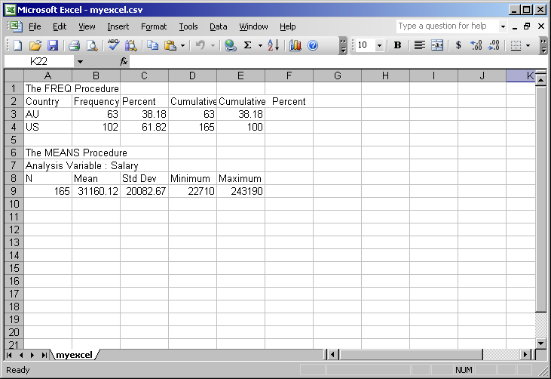
CSVALL Destination
CSVALL does not include any style information.

Slide 111
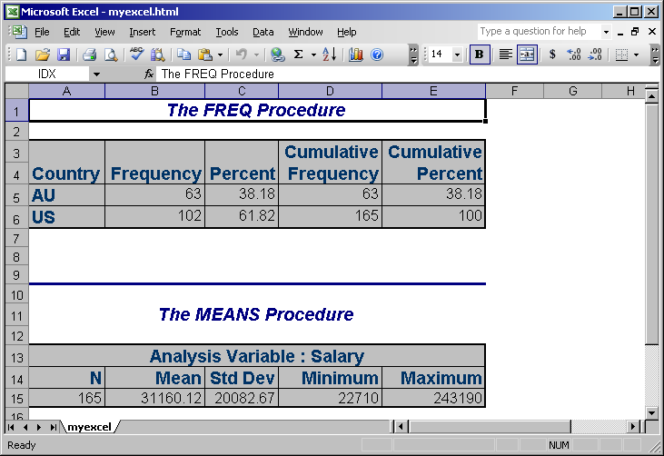
MSOFFICE2K Destination
MSOFFICE2K keeps the style information, including spanning headers.

Slide 112
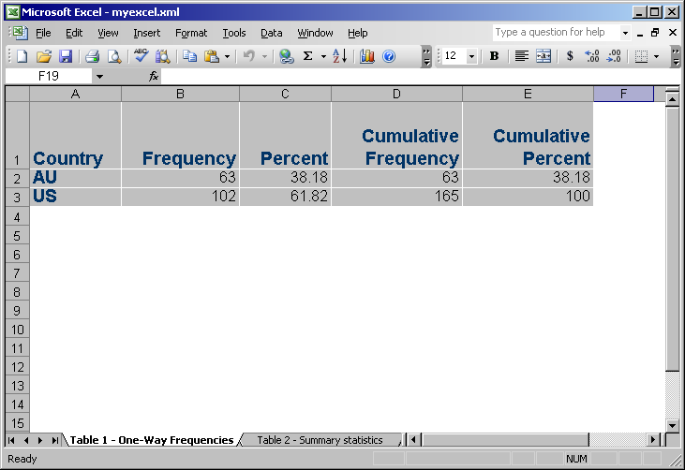
EXCELXP Destination
EXCELXP keeps the style information. Output from each procedure is on a separate sheet.

Slide 113
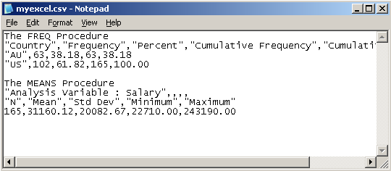
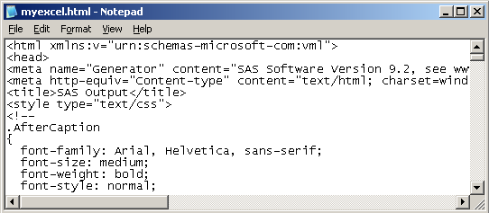
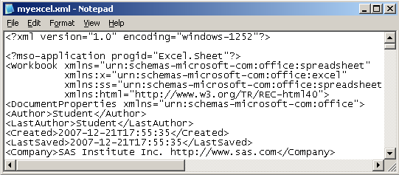
Keep in Mind
The file you are creating is not an Excel file.
CSVALL
MSOFFICE2K
EXCELXP

Slide 114
Using the Output Delivery System
This demonstration illustrates using ODS statements to direct output to various destinations.
p111d18
p111d19
Notes:
After you run the code, expand the tree structure of the Results window. From there you can click on each icon. The CSV file automatically opens in Excel but the other two will not automatically open in Excel. You can view those files outside of SAS. OR go back to the program and change the HTML and XML extensions to XLS. This will allow you to click on the icon and have it open in Excel. If you get a lot of questions on Excel, you might demo the self-study program about the options in EXCELXP on page 11-80.

Slide 116
Exercise
This exercise reinforces the concepts discussed previously.

Slide 117
Notes:
Would like a review of the exercises?
Please answer with your Yes or No seat indicator.

Slide 118
1. Which of these procedures produces output that is most useful for detecting duplicate values?
PROC PRINT
PROC FREQ
PROC MEANS
PROC UNIVARIATE
Notes:
Correct answer: b
PROC MEANS and PROC UNIVARIATE analyze numeric variables. PROC PRINT is more useful for producing a report of invalid values, with a WHERE statement to specify conditions. PROC FREQ identifies duplicate values by default in the Frequency column of the report.

Slide 119
1. Which of these procedures produces output that is most useful for detecting duplicate values?
PROC PRINT
PROC FREQ
PROC MEANS
PROC UNIVARIATE
Notes:
Correct answer: b
PROC MEANS and PROC UNIVARIATE analyze numeric variables. PROC PRINT is more useful for producing a report of invalid values, with a WHERE statement to specify conditions. PROC FREQ identifies duplicate values by default in the Frequency column of the report.

Slide 120
2. Which of these programs is most useful for determining the exact observation that contains a numeric variable with an extreme value?
a. proc print data=sales.totals; var ProdNum Sales Region; run;
b. proc freq data=sales.totals;
tables ProdNum Sales Region;
run;
c. proc univariate data=sales.totals;
run;
Notes:
Correct answer: c
Only PROC UNIVARIATE provides observation numbers for data outliers.

Slide 121
2. Which of these programs is most useful for determining the exact observation that contains a numeric variable with an extreme value?
a. proc print data=sales.totals; var ProdNum Sales Region; run;
b. proc freq data=sales.totals;
tables ProdNum Sales Region;
run;
c. proc univariate data=sales.totals;
run;
Notes:
Correct answer: c
Only PROC UNIVARIATE provides observation numbers for data outliers.

Slide 122
3. A PROC FREQ analysis identified invalid and missing values in a data set. Which of these procedures will display the observations that contain invalid or missing values?
PROC PRINT
PROC FREQ
PROC MEANS
PROC UNIVARIATE
Notes:
Correct answer: a
PROC PRINT is the only one of these procedures that displays the observations themselves. The other three procedures produce summary reports that display descriptive statistics.

Slide 123
3. A PROC FREQ analysis identified invalid and missing values in a data set. Which of these procedures will display the observations that contain invalid or missing values?
PROC PRINT
PROC FREQ
PROC MEANS
PROC UNIVARIATE
Notes:
Correct answer: a
PROC PRINT is the only one of these procedures that displays the observations themselves. The other three procedures produce summary reports that display descriptive statistics.

Slide 124
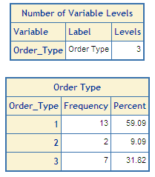
4. Which PROC FREQ step creates the output shown here?
a. proc freq data=orion.qtr1_2007; tables Order_Type; run;
b. proc freq data=orion.qtr1_2007 nlevels; tables Order_Type / nocum; run;
c. proc freq data=orion.qtr1_2007 nlevels; tables Order_Type / noprint; run;
d. proc freq data=otion.qtr1_2007 nlevels; tables Order_Type nocum; run;
Notes:
Correct answer: b
To display a table showing the levels of all variables, you specify the NLEVELS option in the PROC FREQ statement. To suppress the cumulative frequency and cumulative percent that appear in a one-way frequency table by default, you specify the NOCUM option in the TABLES statement. You must use a slash before any options in a TABLES statement.

Slide 125
4. Which PROC FREQ step creates the output shown here?
a. proc freq data=orion.qtr1_2007; tables Order_Type; run;
b. proc freq data=orion.qtr1_2007 nlevels; tables Order_Type / nocum; run;
c. proc freq data=orion.qtr1_2007 nlevels; tables Order_Type / noprint; run;
d. proc freq data=otion.qtr1_2007 nlevels; tables Order_Type nocum; run;
Notes:
Correct answer: b
To display a table showing the levels of all variables, you specify the NLEVELS option in the PROC FREQ statement. To suppress the cumulative frequency and cumulative percent that appear in a one-way frequency table by default, you specify the NOCUM option in the TABLES statement. You must use a slash before any options in a TABLES statement.

Slide 126
5. This PROC MEANS step creates all of the statistics listed below.
minimum and maximum
the total number of observations that PROC MEANS processes for each subgroup (N Obs)
mean and standard deviation
the number of nonmissing values (N)
 True
 False
proc means data=orion.sales;
run;
Notes:
Correct Answer: False
By default, a PROC MEANS step that has no CLASS statement produces all of these statistics except for N Obs.

Slide 127
5. This PROC MEANS step creates all of the statistics listed below.
minimum and maximum
the total number of observations that PROC MEANS processes for each subgroup (N Obs)
mean and standard deviation
the number of nonmissing values (N)
 True
 False
proc means data=orion.sales;
run;
Notes:
Correct Answer: False
By default, a PROC MEANS step that has no CLASS statement produces all of these statistics except for N Obs.

Slide 128
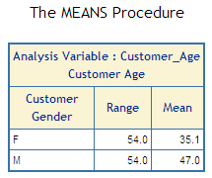
6. What must be added to the PROC MEANS statement to produce this output?
nonobs
range mean
range mean nonobs bestw.
range mean nonobs maxdec=1
proc means data=orion.customer_dim
_______________________;
var Customer_Age;
class Customer_Gender;
where Customer_Country ne 'US';
run;
Notes:
Correct answer: d
This output does not display the default statistics, so you need to specify the statistics keywords RANGE and MEAN. To suppress the N Obs column that the CLASS statement creates, you must include the NONOBS option. Specifying MAXDEC=1 ensures that statistics are displayed with one decimal place.

Slide 129
6. What must be added to the PROC MEANS statement to produce this output?
nonobs
range mean
range mean nonobs bestw.
range mean nonobs maxdec=1
proc means data=orion.customer_dim
_______________________;
var Customer_Age;
class Customer_Gender;
where Customer_Country ne 'US';
run;
Notes:
Correct answer: d
This output does not display the default statistics, so you need to specify the statistics keywords RANGE and MEAN. To suppress the N Obs column that the CLASS statement creates, you must include the NONOBS option. Specifying MAXDEC=1 ensures that statistics are displayed with one decimal place.

Slide 130
7. Which option lets you specify the number of extreme observations displayed by PROC UNIVARIATE?
NEXTROBS=
NLEVELS
NOPRINT
_ALL_
Notes:
Correct Answer: a
In PROC UNIVARIATE, you use the NEXTROBS= option to specify the number of extreme observations.
In PROC FREQ, you can use the NLEVELS option to display a table with the number of distinct variable values. You use the NOPRINT option in the TABLES statement to suppress individual frequency tables. To display only the number of levels for all variables, you can use _ALL_, along with the NOPRINT option in the TABLES statement.

Slide 131
7. Which option lets you specify the number of extreme observations displayed by PROC UNIVARIATE?
NEXTROBS=
NLEVELS
NOPRINT
_ALL_
Notes:
Correct Answer: a
In PROC UNIVARIATE, you use the NEXTROBS= option to specify the number of extreme observations.
In PROC FREQ, you can use the NLEVELS option to display a table with the number of distinct variable values. You use the NOPRINT option in the TABLES statement to suppress individual frequency tables. To display only the number of levels for all variables, you can use _ALL_, along with the NOPRINT option in the TABLES statement.

Slide 132
8. Which destination creates a file that keeps the style information and opens in multiple worksheets in an Excel workbook?
CSVALL
EXCELXP
MSOFFICE2K
none of the above
Notes:
Correct answer: b
CSVALL does not include any style information.
MSOFFICE2K keeps the style information, including spanning headers.
EXCELXP keeps the style information, and each procedure is a separate sheet.

Slide 133
8. Which destination creates a file that keeps the style information and opens in multiple worksheets in an Excel workbook?
CSVALL
EXCELXP
MSOFFICE2K
none of the above
Notes:
Correct answer: b
CSVALL does not include any style information.
MSOFFICE2K keeps the style information, including spanning headers.
EXCELXP keeps the style information, and each procedure is a separate sheet.

Slide 134
9. Which statement about style definitions is true?
The STYLE= option affects the display in all destinations.
You can use the STYLE= option in an ODS statement or in a PROC statement.
A style definition specifies colors, fonts, and a file format for an external file.
If you do not specify a style definition, SAS uses a default style definition that varies by the destination.
Notes:
Correct Answer: D
SAS uses a default style definition that varies by the destination. By placing the STYLE= option in the ODS statement, you can specify a style for many, but not all, destinations. A style definition specifies how output is presented but does not specify a file format.

Slide 135
9. Which statement about style definitions is true?
The STYLE= option affects the display in all destinations.
You can use the STYLE= option in an ODS statement or in a PROC statement.
A style definition specifies colors, fonts, and a file format for an external file.
If you do not specify a style definition, SAS uses a default style definition that varies by the destination.
Notes:
Correct Answer: D
SAS uses a default style definition that varies by the destination. By placing the STYLE= option in the ODS statement, you can specify a style for many, but not all, destinations. A style definition specifies how output is presented but does not specify a file format.

Slide 136
10. Suppose you submit the program shown below. What happens if you then submit a PROC PRINT step?
The PROC PRINT output is displayed in the default window.
The PROC PRINT output is not displayed and a warning is written to the log indicating that there are no active destinations.
The PROC PRINT output is appended to the PROC FREQ output in the file ctry.csv.
ods _all_ close;
ods csvall file='c:\ctry.csv';
proc freq data=orion.sales;
tables Country;
run;
ods csvall close;
Notes:
Correct answer: b
To start, the program closes all destinations and opens only the CSVALL destination. At the end, the program closes the CSVALL destination. There is now no open destination to send the output to. SAS issues a warning in the log but does not display output for the PROC PRINT step.

Slide 137
10. Suppose you submit the program shown below. What happens if you then submit a PROC PRINT step?
The PROC PRINT output is displayed in the default window.
The PROC PRINT output is not displayed and a warning is written to the log indicating that there are no active destinations.
The PROC PRINT output is appended to the PROC FREQ output in the file ctry.csv.
ods _all_ close;
ods csvall file='c:\ctry.csv';
proc freq data=orion.sales;
tables Country;
run;
ods csvall close;
Notes:
Correct answer: b
To start, the program closes all destinations and opens only the CSVALL destination. At the end, the program closes the CSVALL destination. There is now no open destination to send the output to. SAS issues a warning in the log but does not display output for the PROC PRINT step.

