Slide 1
Quantitative research Design
Dr Jugindar Singh

Slide 2
CHAPTER 3 METHODOLOGY
Detail the methodology to be used in the pursuit of the research.
The objective here is to convince the reader that your overall research design and methods of analysis will correctly address the problem and that the methods will provide the means to interpret the potential results effectively.
Your design and methods should be unmistakably tied to the specific aims of your study.
Consider research philosophy, research approach, research strategy, research choice, sampling method, data collection and data analysis. Keep in mind that a methodology is not just a list of tasks; it is an argument as to why these tasks add up to the best way to investigate the research problem.
3.1 Introduction/Research design
3.2 Research Philosophy
3.3 Research Approach
3.4 Research Strategy
3.5 Research Choices
3.6 Time Horizon
3.7 Data type (Primary or Secondary)
3.8 Instrumentation/ Questionnaire
3.9 Sampling technique and sample size
3.10 Data collection
3.11 Data processing
3.12 Data Analysis
3.13 Ethical Consideration
References
Appendices

Slide 3
Quantitative Research Design
Quantitative methods emphasize objective measurements and the statistical, mathematical, or numerical analysis of data collected through polls, questionnaires, and surveys, or by manipulating pre-existing statistical data using computational techniques.
Quantitative research focuses on gathering numerical data and generalizing it across groups of people or to explain a particular phenomenon.
Babbie, Earl R. The Practice of Social Research. 12th ed. Belmont, CA: Wadsworth Cengage, 2010; Muijs, Daniel. Doing Quantitative Research in Education with SPSS. 2nd edition. London: SAGE Publications, 2010.

Slide 4
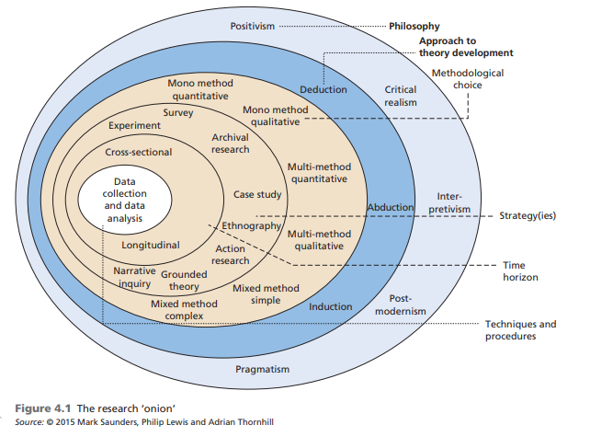
Research Design Saunders et al, (2009)
Figure 5.1 The research ‘onion’
The research ‘onion’

Slide 5
1. Research Philosophy

Slide 6
1. Research Philosophy?
Research philosophy deals with the source, nature and development of knowledge - Bajpai, N. (2011) “Business Research Methods” Pearson Education India
In simple terms, a research philosophy is belief about the ways in which data about a phenomenon should be:
collected
analyzed
used
Research Philosophy

Slide 7
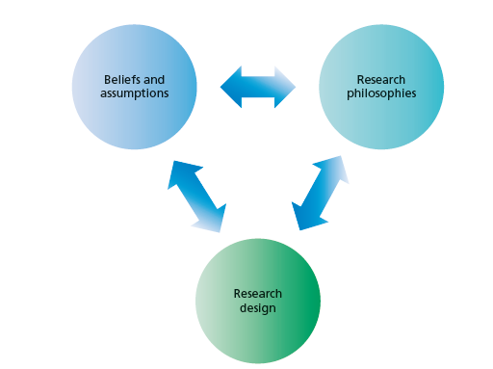
Philosophy:
‘Research philosophy is an over-arching term relating to the development of knowledge and the nature of that knowledge’
What you are doing when embarking on research –
developing knowledge in a particular field
Philosophy you adopt contains important assumptions about the way in which you view the world.
Eg: Concerned with Feelings and attitudes OR Facts
Your particular view of the relationship between knowledge and the process by which it is developed.
-Adapted from Saunders et al, (2016)
These include assumptions about human knowledge (epistemological assumptions), about the
realities you encounter in your research (ontological assumptions) and the extent and
ways your own values influence your research process (axiological assumptions).

Slide 8
Ontology, Epistemology and Axiology (Patton, 2002)
Ontology:
The nature of social reality – that is, what do we believe about the nature of reality?
Ontology relates to whether we believe there is one verifiable reality or whether there exist multiple, socially constructed realities - (Patton, 2002)
Epistemology
Ways of knowing – that is, how do we know what we know?),
Epistemology inquires into the nature of knowledge and truth. It asks the questions:
What are the sources of knowledge? Eg: Smoking is bad for health
How reliable are these sources?
What can one know?
How does one know if something is true?
Axiology
Ethics and value systems – that is, what do we believe is true?

Slide 9
Ontology: ways of constructing reality, “how things really are” and “how things really work”.. Denzin and Lincoln, (1998; 2010)
Ontology
Epistemology
Axiology
Research objects include organisations, management, individuals’ working lives and organisational events and artefacts.
Axiology: The role of values and ethics within the research process.
This incorporates questions about how we, as researchers, deal with both our own values and those of our research participants
Epistemology: different forms of knowledge of that reality, what nature of relationship exists between the inquirer and the inquired? How do we know?
Research Paradigm
Different types of knowledge numerical data to textual and visual data, from facts to interpretations, and including narratives, stories and even fictional accounts –
Eg: you value personal interaction
Methodology: What tools do we use to know that reality?

Slide 10
Ontology The nature of social reality – that is, what do we believe about the nature of reality?
Concerned with nature of reality.
Ontology is a system of belief that reflects an interpretation by an individual about what constitutes a fact - whether social entities should be perceived as objective or subjective..
Ontology relates to whether we believe there is one verifiable reality or whether there exist multiple, socially constructed realities - (Patton, 2002)
Two aspects
Objectivism
The first aspect of ontology we discuss is objectivism. This portrays the position that social entities exist in reality external to social actors concerned with their existence.
Subjectivism
The second aspect, subjectivism holds that social phenomena are created from the perceptions and consequent actions of those social actors concerned with their existence

Slide 11
Epistemology: Ways of knowing – that is, how do we know what we know? What constitutes acceptable knowledge,
It concerns what constitutes acceptable knowledge in a field of study.Closely coupled with ontology and its consideration of what constitutes reality,
Epistemology considers views about the most appropriate ways of enquiring into the nature of the world (Easterby-Smith, Thorpe and Jackson, 2008)
‘What is knowledge and what are the sources and limits of knowledge’ (Eriksson and Kovalainen, 2008).
Questions of epistemology begin to consider the research method,
Epistemology inquires into the nature of knowledge and truth. It asks the questions:
What are the sources of knowledge? Eg: Smoking is bad for health
How reliable are these sources?
What can one know?
How does one know if something is true?

Slide 12
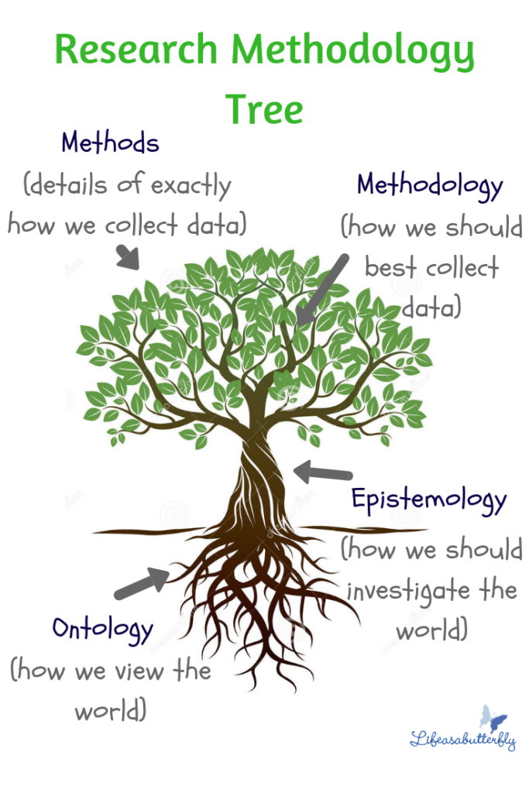
Main research philosophies
Positivism -
The stance of the natural scientist.
2. Realism
What the senses show us as reality is the truth;
Interpretivism
Researchers as ‘social actors’
Pragmatism
Pragmatism asserts that concepts are only relevant where they support action (Kelemen and Rumens 2008).

Slide 13
Ontology
Ontology
What is reality
What shapes reality What is happening
Eg: What is the problem/what are the solutions
Singularity
There is only one reality
Only one set of solution to the problem
2. More than one Reality Depends on how people perceive How people are shaping the reality
Research Philosophy
Epistemology
Epistomology
Knowledge of the reality
How do we collect knowledge
Epistomology
Knowledge can be measured
Knowledge can be interpreted

Slide 14
Ontology
Epistemology
Philosophy
Singularity
There is only one reality
Only one set of solution to the problem
Positivism
Epistemology
Knowledge can be measured
2. More than one Reality Depends on how people perceive How people are shaping the reality
Epistemology
Knowledge can be interpreted
Interpretivism

Slide 15
Positivism Believes in the possibility to observe and describe reality from an objective viewpoint
The stance of the natural scientist.
Adheres to the view that only “factual” knowledge gained through observation (the senses), including measurement, is trustworthy.
Cause and effect/Scientific method
Experimentation and measurement can reveal objective reality
Strive for objectivity
Start with hypothesis and test
Eg: Relationship bet. student’s financial position and academic performance
Positivism - research approaches that employ empirical methods, make extensive use of quantitative analysis, or develop logical calculi

Slide 16
Positivism

Slide 17
The Positivistic approach
Define your research topic
Literature review
Define your research question(s)
i.e. hypothesis
Deductive
Design data collection
Pilot study
Positivists believe that the best way to investigate the world is through objective methods, such as observations.
Objective Facts
Design data analysis
Collect data
Analyse data
Interpret results
Quantitative
Report your findings
Adapted from Maylor and Blackmon (2005)

Slide 18
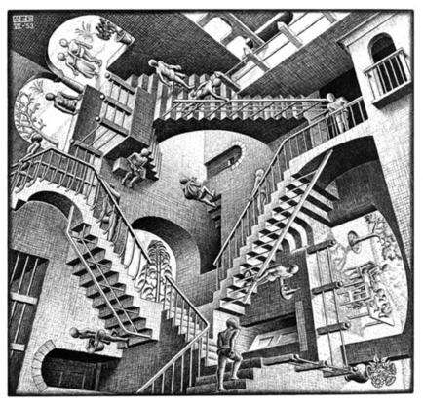
2. Interpretivism/Constructivism Focus on meaning.
Interpreted by the individual according to his or her ideological positions
Reality is subjective and multiple
Seek to understand meaning as experienced by participants. Researcher as a social actor to appreciate differences between people
Meaning of events is mediated by interactions with others, and social and cultural context
Start with open-ended inquiry and result in hypothesis
Eg: A study of challenges faced by disabled employees
Interpretivisim advocates it is necessary for the researcher to understand differences between humans in our role as social actors. Interpretive research is concerned with the meanings that people attach to norms, rules, and values that regulate their interactions

Slide 19
Interpretivism Phenomenological approach
Define your research topic
Literature review
Define your research question(s)
Inductive
Design data collection
Collect data
Analyse data
Literature review
Interpretivism believe that reality does not exist by itself. Instead, it is constructed and given meaning by people. Their focus is therefore on feelings, beliefs and thoughts, and how people communicate these.. Subjective .. Feelings and attitudes
Interpret data
Research question answered?
Report your findings
Qualitative
Adapted from Maylor and Blackmon (2005)

Slide 20
Interpretivism

Slide 21
3. Pragmatism
Derived from the Greek word “pragma,” which means action, and which is the central concept of pragmatism (Pansiri 2005).
Pragmatism asserts that concepts are only relevant where they support action (Kelemen and Rumens 2008).

Slide 22
Pragmatism
Derived from the Greek word “pragma,” which means action, and which is the central concept of pragmatism (Pansiri 2005).
Pragmatism asserts that concepts are only relevant where they support action (Kelemen and Rumens 2008).
Pragmatists are more interested in practical outcomes than abstract distinctions
Pragmatist ontology, epistemology and axiology are focused on improving practice.
Strives to reconcile both objectivism and subjectivism, facts and values, accurate and rigorous knowledge and different contextualised experiences
Pragmatists adopt a wide range of research strategies, the choice of which is driven by the specific nature of their research problems.
Pragmatist’s view that it is perfectly possible to work with different types of knowledge and methods

Slide 23
Pragmatism

Slide 24
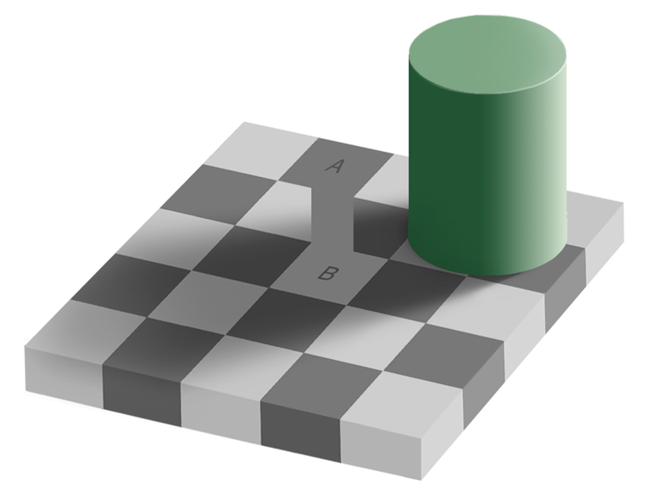
Realism
What the senses show us as reality is the truth;
Relies on the idea of independence of reality from the human mind.
Direct realism - “what you see is what you get. Portrays the world through personal human senses. Saunders, M., Lewis, P. & Thornhill, A. (2012)
Critical Realism: Recognize that our senses and other factors may get in the way between us as
researchers and researched reality. We experience the sensations and images of the real world – can be deceptive and do not portray the real world. Novikov, A.M. &Novikov, D.A. (2013)
Direct realists would state that squares A and B have different colors, because this is what they see.
Critical realists may notice that squares A and B are actually the same colour.

Slide 25
2. Research Approach

Slide 26
Approach

Slide 27
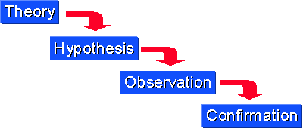
Research Approach Deductive Reasoning
A deductive approach is concerned with “developing a hypothesis based on existing theory, and then designing a research strategy to test the hypothesis Wilson, J. (2010)
Starts with a general rule (a theory) which we know to be true.
Then, from that rule, we make a true conclusion about something specific.
The process of reasoning from known facts to conclusions.
Begins with theory and hypotheses,

Slide 28
Deduction
Characteristics of Deduction
Explaining causal relationships between variables
Establishing controls for testing hypotheses
Independence of the researcher
Concepts operationalised for quantitative measurement
Generalisation
5 sequential stages of testing theory
Deducing a hypothesis
Expressing the hypothesis operationally
Testing the operational hypothesis
Examining the specific outcome of the enquiry
Modifying the theory (if necessary)
Adapted from Robson (2002)

Slide 29
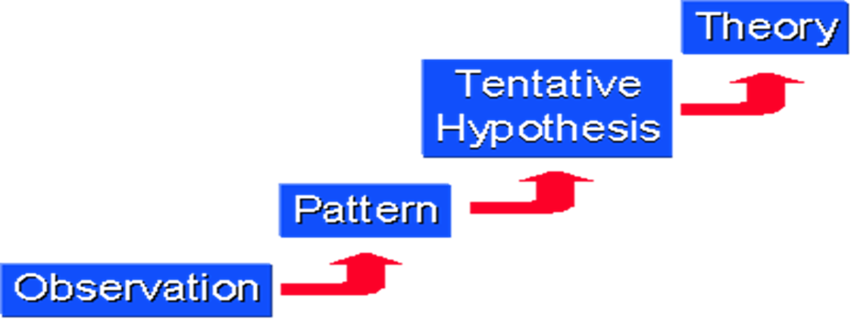
Inductive Approach
Starts with the observations and theories are proposed towards the end of the research process as a result of observations Goddard, W. & Melville, S. (2004)
Inductive means that you are researching to create theory.
The process of going from observations to conclusions.
The process moves in the opposite direction to the deductive approach taking its focus from the working title of the researcher not the existing theory
Induction: building theory

Slide 30
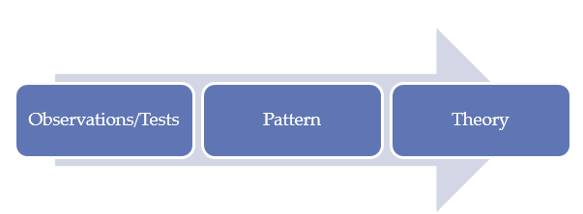
Induction
Building theory by –
Understanding the way human build their world
Permitting alternative explanations of what’s going on
Being concerned with the context of events
Using more qualitative data
Using a variety of data collection methods

Slide 31
Abduction
Instead of moving from theory to data (as in deduction) or data to theory (as in induction), an abductive approach moves back and forth, in effect combining deduction and induction (Suddaby 2006).
Data are used to explore a phenomenon, identify themes and explain patterns, to generate a new or modify an existing theory which is subsequently tested, often through additional data collection.
Deduction and induction complement abduction
Example: Research on the reasons for high employee absenteeism in a retail store would mean obtaining data that were sufficiently detailed and rich to allow us to explore the phenomenon and identify and explain themes and patterns regarding employee absenteeism. We would then try to integrate these explanations in an overall conceptual framework, thereby building up a theory of employee absenteeism in a retail store. This we would test using evidence provided by existing data and new data and revise as necessary

Slide 32
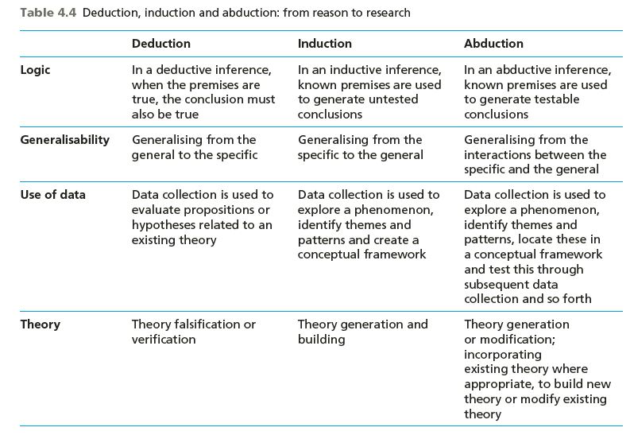

Slide 33
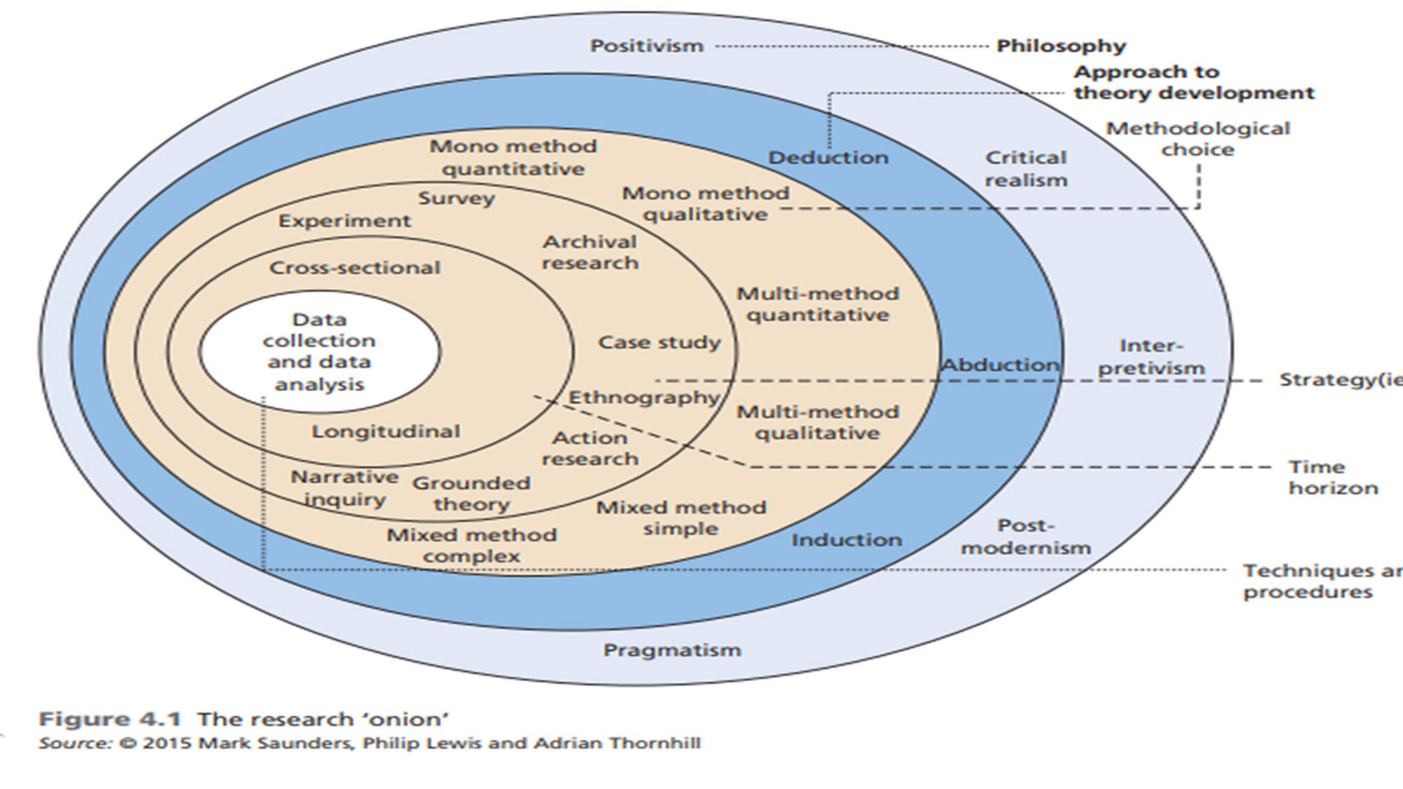
Methodological Choice Quantitative Qualitative

Slide 34
Methodological Choice

Slide 35
Methodological Choice
Mixed Method
Quantitative
Qualitative
Modelling
Empirical
Experimental
Qualitative
Case Study
Phenomenology
Grounded Theory
Basic Qualitative Ethnography

Slide 36
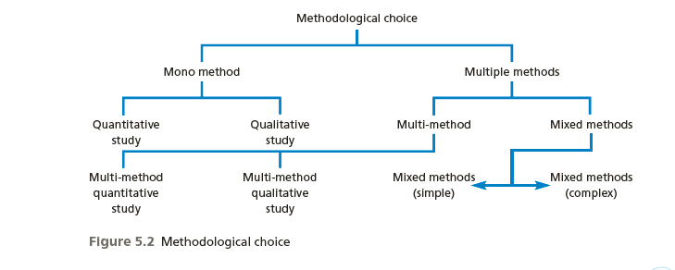
Methodological choices
Quantitative
Qualitative
Mixed Method
Figure 5.4 Research choices
Saunders et al, (2009)

Slide 37
Quantitative research: Predictive
Focuses on verifying hypotheses using typically large amounts of data.
Numerical data
Quantitative research is generally associated with positivism
Usually associated with a deductive approach, where the focus
Large sample
Data collected through Questionnaire
Is on using data to test theory
Example: Investigate employees' absenteeism
♦ quantitative approach: collect ratings, verify user responses (numerical)
♦ qualitative approach: understand why employees absent (words, voice)
Qualitative vs. Quantitative Analysis

Slide 38
Qualitative research: Exploratory
Associated with an interpretive philosophy
Studies participants’ meanings and the relationships between them
Small samples of data
Data in words or voice
Data collection through interviews etc
Eg: structured interviews
Example: investigate employees' absenteeism
♦ quantitative approach: collect ratings, verify user responses (numerical)
♦ qualitative approach: understand why employees absent – Interview (words, voice)
Qualitative vs. Quantitative Analysis

Slide 39
Quantitative and qualitative data analysis
Quantitative analysis
Use statistical analysis,
For description
For comparing groups
For relating variables
Qualitative analysis
Use text and images,
For coding
For theme development
For relating themes
Notes:
Quantitative analysis
Numeric data
Descriptive trend analysis
Hypothesis testing, effect size, interval estimates
Qualitative analysis:
Text/image data
Coding
Themes
Description
Interrelated themes to build a picture of the phenomenon.

Slide 40
Mixed Method
Mixed methods research aims to answer research questions that cannot be answered by “qualitative” or “quantitative” approaches alone.
Mixed methods research focuses on collecting, analyzing, and mixing both quantitative and qualitative data in a single study or series of studies.
A mixed methods approach is increasingly advocated within business research. The attractiveness of this approach is that it allows researchers to combine inductive and deductive thinking, to use more than one research method to address the research problem, and to solve this problem using different types of data.
Mixed methods research is both a method and methodology for conducting research that involves collecting, analyzing, and integrating quantitative and qualitative research in a single study or a longitudinal program of inquiry.
The purpose of this form of research is that both qualitative and quantitative research, in combination, provide a better understanding of a research problem or issue than either research approach alone.

Slide 41
Mixed Method combine two types of data?
Qualitative
Text Data
This is a sample of a text file of words that might be collected on interview transcripts, observation fieldnotes, or optically-scanned documents.
Quantitative Numeric Data
2 3 4 2 5 2 3 1 1 2 3 4 2 3 3 2 1 1 1 5 3 4 1 2 3 1 4 4 5 5 4 1 2 1 4 3 3 5 1 4 2 3 1 5 5 2 2 1 5 3 5 1 3 1 5 3 2 2 5 1 3 2 4 4 3 1 2 4 2 2 4 1 5 5 4 2 1 5
Collects both quantitative and qualitative data
“Mixes” them
“Mixes” them at the same time (concurrently) or one after the other (sequentially)
Emphasizes both equally or unequally

Slide 42
Parsimonious designs (Creswell & Plano Clark, 2007)
Concurrent Mixed Methods Designs
Triangulation Design
QUAN Data & Results
QUAL Data & Results
Interpretation
Embedded Design
QUAN Pre-test Data & Results
Intervention
QUAN Post-test Data & Results
Interpretation
qual Process

Slide 43
Sequential designs
Explanatory Design
QUAN Data & Results
qual Data & Results
Interpretation
Following up
Exploratory Design
QUAL Data & Results
quan Data & Results
Interpretation
Building to
Sequential Embedded Design
QUAN Intervention
Trial
Before-intervention qual
After-intervention qual
Interpretation

Slide 44
Research Strategy

Slide 45
Research Strategies
A research strategy usually has
♦ A goal: something it can be used for
♦ A procedure: steps to follow to achieve results
♦ A set of techniques involved in the procedures
Experiment Action research
Grounded theory Survey
Ethnography Case study
Phenomenology
Archival research
A research strategy will help you to meet your research objective(s) and to answer the research questions of your study.
The choice for a particular research strategy will depend on the research objective(s) and (the type of) research questions of your study, but also on your viewpoint on what makes good research and on practical aspects such as access to data sources and time constraints.

Slide 46
Research Strategies - Survey A Survey collects information
A survey is a system for collecting information from or about people to describe, compare, or explain their knowledge, attitudes, and behavior (Fink, 2003).
A survey strategy is often associated with a quantitative method using a questionnaire
Collecting large amounts of data from a Sample to address the who, what, where, when and how of any given topic or issue
Example: Surveys of consumer decision making, customer satisfaction, job satisfaction, the use of health services, management information systems,

Slide 47
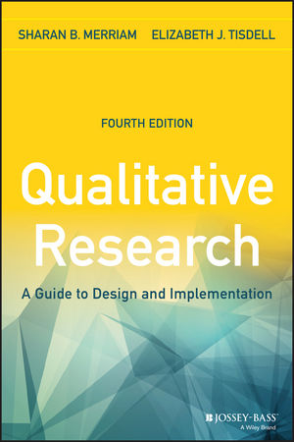
Research Strategies Qualitative
A research strategy usually has
♦ A goal: something it can be used for
♦ A procedure: steps to follow to achieve results
♦ A set of techniques involved in the procedures
Basic qualitative research,
Phenomenology,
Grounded theory,
Ethnography,
Narrative analysis,
Qualitative case study

Slide 48
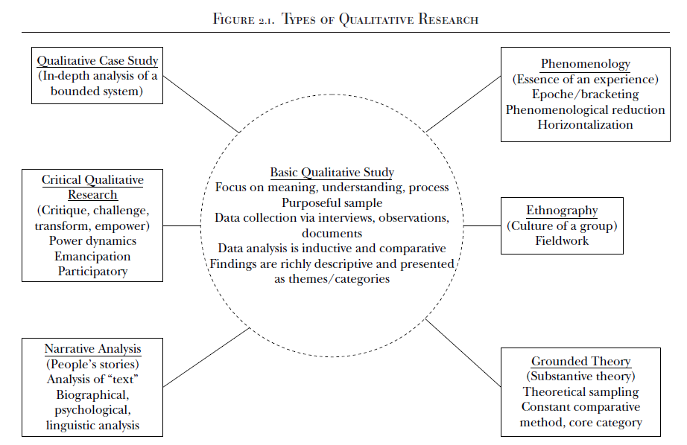

Slide 49
Research Strategy Examples
Basic Qualitative
Motivation of females to choose to work in gig economy in Malaysia
Phenomenology:
Lived experience of female students who have been physically assaulted by students
Qualitative Case study:
What strategies are being used by small businesses that have effective and viable workplace wellness programs?
Grounded Theory
Victimizing of School Bullying: a Grounded Theory

Slide 50
Basic Qualitative Research
A central characteristic of all qualitative research is that individuals construct reality in interaction with their social worlds. - Interpretivism
The researcher is interested in understanding the meaning a phenomenon has for those involved.
Meaning, however, “is not discovered but constructed.
(1) how people interpret their experiences,
(2) how they construct their worlds,
(3) what meaning they attribute to their experiences.
The overall purpose is to understand how people make sense of their lives and their experiences
Example: a qualitative study to uncover the process Malaysian retirees engaged in in transitioning into a postretirement second career

Slide 51
Narrative research
In narrative research, researchers describe the lives of individuals, collect and tell stories about people’s lives, and write narratives of individual experiences.
Focuses on studying a single person, gathering data through the collection of stories, reporting individual experiences, and discussing the meaning of those experiences for the individual. Creswell, 2008
Spoken or written text giving an account of an event/action or series of events/actions, chronologically connected (Czarniawska, 2004, p. 17)
Single individual
Interested in exploring the experiences of that individual
Examples of Narrative Research:
A study of the experiences of an autistic student who has moved from a self-contained program to an inclusion setting
A study of the experiences of a high school track star who has been moved on to a championship-winning university track team

Slide 52
Phenomenology:Phenomenologists are interested in our “lived experience” (Van Manen, 2014),
Describes the meaning of lived experiences for several individuals
Describes what the participants have in common as they experience a phenomenon
The purpose is to reduce the experiences of the participants with a phenomenon to a description of a universal essence
Phenomenological reduction is the process of continually returning to the essence of the experience to derive the inner structure or meaning in and of itself
Example:
The essence of being a mother for the first time
A Phenomenological Study of the Experiences of employees with Disabilities
A phenomenological study on drug usage by employees
Phenomenologists are interested in our “lived experience”(Van Manen, 2014),

Slide 53
Grounded Theory Glaser and Strauss (1967) developed a pioneering book that expounded in detail on their grounded theory procedures, The Discovery of Grounded Theory
Creswell (2009), “a qualitative strategy of inquiry in which the researcher derives a general, abstract theory of process, action, or interaction grounded in the views of participants in a study.” (p. 13 & 229)
This process involves using multiple stages of data collection and the refinement and interrelationships of categories of information (Charmaz, 2006; Strauss and Corbin, 1990, 1998).
A grounded theory design is a systematic, qualitative or quantitative procedure used to generate a theory that explains, at a broad conceptual level, a process of an action, or an interaction about a substantive topic (Glaser and Strauss, 1999).
Iteration and Constant Comparison
The purpose of grounded theory research in education and management is to develop new concepts and theories of education/management related phenomena, where these concepts and theories are firmly grounded in qualitative data

Slide 54
Ethnography
A description and interpretation of a cultural or social group or system.
The researcher examines the group’s observable patterns of behavior, customs, and ways of life.
Involves prolonged observation of the group, typically through participant observation.
Focus: study human behaviour in the cultural context in which it is embedded
Example:
Study with the purpose of understanding a very isolated tribe in the Amazon basin

Slide 55
Case Study
A case study is an in-depth inquiry into a topic or phenomenon within its real-life setting (Yin 2014).
“A case study is an empirical study that investigates a contemporary phenomenon in depth and with its real-life context” (Yin, 2009, p18)
Patton (1990) suggests that case studies are valuable in creating deep understanding of particular people, problems or situations in comprehensive ways.
Once defined, case study research sets out to understand the dynamics of the topic being studied within its setting or context
Saunders 2016

Slide 56
Creswell (2002) "an in-depth exploration of a bounded system (e.g., an activity, event, process, or individuals) based on extensive data collection" (p. 485).
Creswell recommends case study as a methodology if the problem to be studied "relates to developing an in-depth understanding of a 'case' or bounded system" (p. 496) and if the purpose is to understand "an event, activity, process, or one or more individuals" (p. 496).
Cases are bounded by time and activity, and researchers collect detailed information using a variety of data collection procedures over a sustained period of time (Stake, 1995; Yin, 2009, 2012).
Case Studies
Bounded
system
"'Bounded' means that the case is separated out for research in terms of time, place, or some physical boundaries" (Cresswell p. 485).
In other words, it is possible to create limits around the object to be studied (Merriam, 1998)

Slide 57
CASE STUDIES - Cases are units of investigation
Cases can be
Person/persons
Group/groups
Organization/organizations
Institution/institutions
Event/events.
Employee/group employees
Student/group of students
The ‘case’ in case study research may refer to a person (e.g. a manager), a group (e.g. a work team), an organisation (e.g. a business), an association (e.g. a joint venture), a change process (e.g. restructuring a company), an event (e.g. an annual general meeting) as well as many other types of case subject
A case study is an in-depth description and analysis of a bounded system.
A single entity, a unit around which there are boundaries.
An in-depth analysis of a case, often a program, event, activity, process, or one or more individuals.

Slide 58
Case study Collection of data
Three main methods used: Survey, field study, historical info
Direct observations (e.g., human actions or a physical environment)
Interviews (e.g., open-ended conversations with key participants)
Archival records (e.g., student records)
Documents (e.g., newspaper articles, letters and e-mails, reports)
Participant-observation (e.g., being identified as a researcher but also filling a real-life role in the scene being studied)
Physical artifacts (e.g., computer downloads of employees’ work)

Slide 59
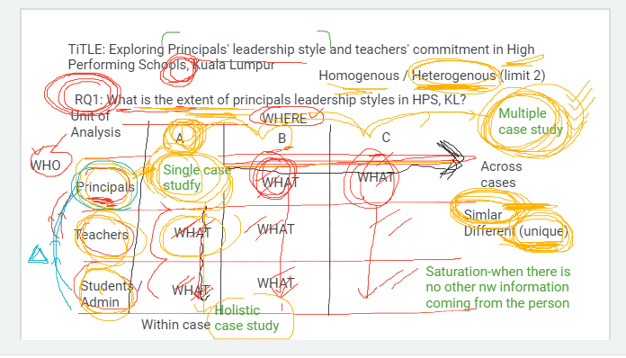
Title: Exploring Principals leadership style and teachers commitment in High Performing Schools in Kuala Lumpur
RQ1: What are the leadership styles in High performing schools?
WHO
Homogeneous or Heterogeneous
Units of Analysis | School A | School B | School C
Principals | What | What | What
Teachers | What | What | What
Students Admin | What | What
Data Triangulation
Holistic or Embedded (within the Case study)
Single Case Vs Multiple Case Study
(across cases)

Slide 60
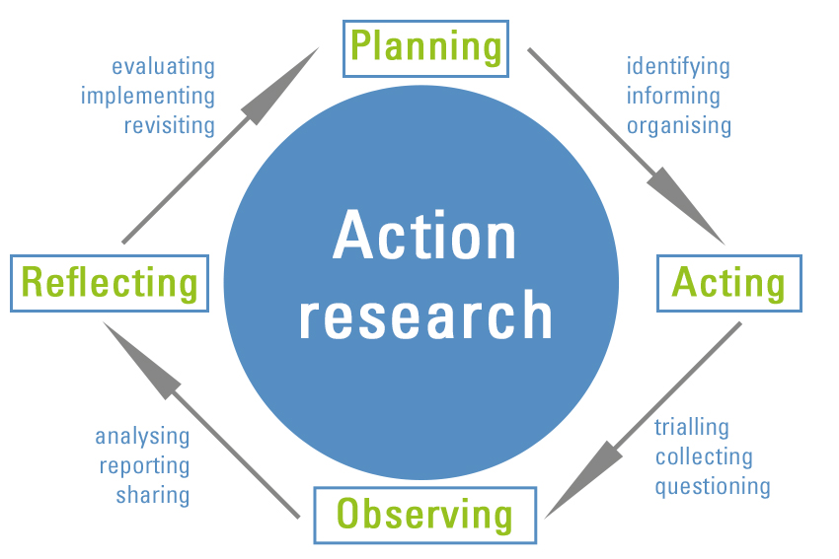
Action Research
Disciplined inquiry into practices undertaken by those involved in them
Done to inform and change the practice studied. To address problems
Often undertaken as a collaborative activity among colleagues
Often undertaken in situ
Could focus on a single issue in a classroom, a program, etc.
Denscombe (2010, p. 6) - An action research strategy's purpose is to solve a particular problem and to produce guidelines for best practice.

Slide 61
Research Strategies: Experiment
The purpose of an experiment is to study the probability of a change in an independent variable causing a change in another, dependent variable.
Eg: Customer services training (IV) of IT telephone support staff will not lead to a significant improvement in users’ satisfaction (DV) feedback
To do experiment, 2 groups
Given Training
(Experimental Group)
Customer Satisfaction
Not Given Training
(Control Group)

Slide 62
5. Time Horizon Longitudinal Cross Sectional

Slide 63
Time Horizon

Slide 64
5. Time Horizon
Cross Sectional
A study can be done in which data are gathered just once, perhaps over a period of days or weeks or months, in order to answer a research question
Longitudinal
The researcher might want to study people or phenomena at more than one point in time in order to answer the research question.
Eg: To study employees‘ behavior before and after a change in the top management, so as to know what effects the change accomplished. Data are gathered at two different points in time

Slide 65
Time Horizon
Time of Data Collection
Study at One Point in Time
Study Over Time
Longitudinal
Cross-sectional
Trends in
the same
population
over time
Changes
in a
subpopulation
group identified
by a common
characteristic
over time
Changes
in the
same
people
over time
Attitudes
and
Practices
Customer
Satisfaction
Program
Evaluation
Panel
Group
Comparisons
National
Survey
Trend
Cohort

Slide 66
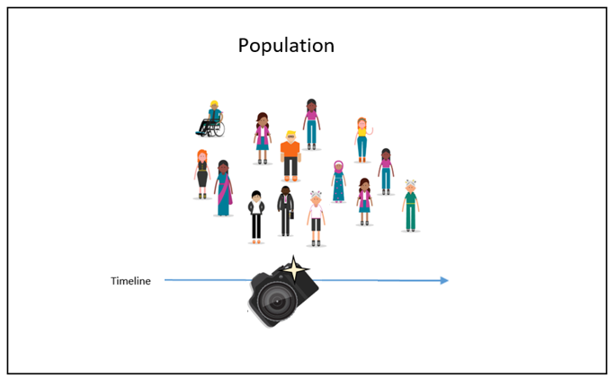
TIME HORIZON: CROSS-SECTIONAL
A study can be done in which data are gathered just once, perhaps over a period of days or weeks or months, in order to answer a research question.
Example: Data were collected from customers just once to study their satisfaction level.

Slide 67
LONGITUDINAL STUDIES
The researcher might want to study people or phenomena at more than one point in time in order to answer the research question.
Eg: To study employees‘ behavior before and after a change in the top management, so as to know what effects the change accomplished. Data are gathered at two different points in time.
PANEL STUDIES
Panel studies describe information about the same cases at two or more points in time. (referred to as waves)
Respondents interviewed at wave one of a survey are interviewed again at wave two,.
Eg: Effects of smoking at two points in time
TREND STUDIES
Trend studies use cross-sections at two or more points in time to examine change over time. The Virginia Slims Opinion Poll asked various questions about women at six points in time. Example Opinion pools study over three years
Cohort surveys
Respondents are followed from an identical point in their life onwards, often from birth. These surveys prove very useful to study child development over time, change in marital circumstances or health for instance among people belonging to the same
generation.

Slide 68
6. Data Collection and Analysis

Slide 69
6. Data Collection and Data Analysis
Sampling – Sample Size
Data Collection Instrumentation
Data Processing
Data Analysis (Reliability and Validity)

Slide 70
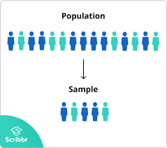
Populations and Samples
Sampling
Target
Population
Sample
Sample
Nonprobability sampling
Most common sampling methods are:
Purposive sampling/Judgement sampling
Select participants according to pre-selected criteria relevant to a particular research question.
Quota sampling
If the researcher needs a specific number of participants, quota sampling is better

Slide 71
Sampling Quantitative
1- Defining the population: Who is qualified to provide data
Sampling begin with precisely defining the target population.
Ensure the qualification criteria is right
2- Determining the sample frame: A listing of the target population
The sampling frame is a representation of all the elements in the population from whish the
sample is drawn.
3- Determining the sampling design: ( Two types )
Probability sampling, the elements in the population have some known probability of being
selected as sample subject.
Nonprobability sampling, the elements do not have a known chance of being selected as
sample subject.
4- Sample size – How many respondents
Sample size to represent the population

Slide 72
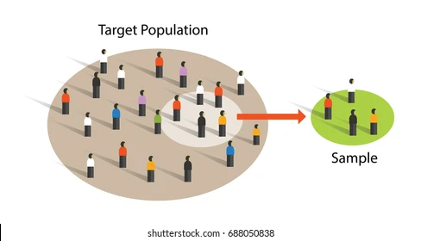
Types of Quantitative Sampling
Quantitative Sampling Strategies
Probability Sampling
Nonprobability Sampling
Simple Systematic Stratified Multistage Cluster
Random Sampling Sampling Sampling Sampling
Sampling
Convenience Snowball Quota Purposive

Slide 73
Data Collection

Slide 74
Collecting both quantitative and qualitative data
Quantitative data
Instruments Eg Questionnaire
Checklists
Records
Qualitative data
Interviews
Observations
Documents
Audio-visual materials
Notes:
Quantitative data
Close-ended scales
Attitudinal/behavioral scales
Behavioral checklists
Census, attendance records
Qualitative data
Open-ended responses
Semi-structured interviews
Semi-structured observations
Records/documents
Videotapes
Images such as pictures or drawings

Slide 75
Steps in Designing an Instrument
Eg: Questionnaire
Interview
Focus Group
Instrumentation
Types of Questions
Personal
Attitudinal
Behavioral
Sensitive
Closed-ended
Open-ended
Write different types of questions
Use strategies to construct good questions
Perform a pilot test of the questions
Questions:
Adopted
Adapted
Developed

Slide 76
Instrumentation/ Questionnaire
Questionnaires are a popular means of collecting data.
Describe the questionnaire used in the study
Is it original? If any items are taken from existing questionnaire,
identify the sources (adopted/adapted)
The structure and the question categories (demographic/rating questions)
Describe the scaling methods used and state the reasons for choosing them
Issues on validity and reliability
Was Pilot test done to check the clarity and appropriateness of the survey questionnaire
(Attach a sample of the questionnaire)
Remember: Questions are ADOPTED or ADAPTED

Slide 77
Data Collection Based on Who Completes or Records the Data
Who completes or records the data?
Participant
Researcher
Mailed
Questionnaire
Electronic
Questionnaire
One on one
One
To a
Group
Over
Telephone
Individual
Interview
Focus Group
Interview
Telephone
Interview

Slide 78
Describe how the questionnaire will be administered and discuss problems encountered
• Internet- or intranet-mediated,
• postal,
• delivery and collection,
• telephone
• interview
State the steps in data collection ie:
• What method was used
Sample Size
• How many questionnaires/respondents
• How was the response rate and follow up
If pilot testing was done, state the reliability and validity testing results and what amendments done to
Data collection

Slide 79
Data Processing Data Analysis

Slide 80
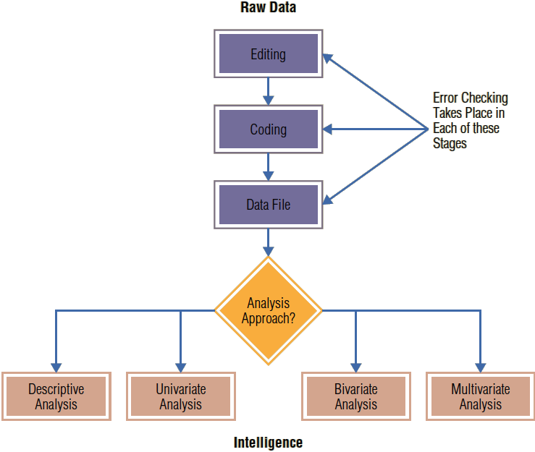
Data Processing and data Analysis

Slide 81
Getting Data Ready for Analysis
After data are obtained through questionnaires, they need to be coded, keyed in, and edited.
That is, a categorization scheme has to be set up before the data can be typed in.
Then, outliers, inconsistencies, and blank responses, if any, have to be handled in some way.

Slide 82
Editing, coding and tabulation
Editing Data
The process of checking and adjusting responses in the completed questionnaires for omissions, legibility, and consistency
Data editing deals with detecting and correcting illogical, inconsistent, or illegal data and omissions. Eg: Missing data, Outliers
CODING
The process of identifying and classifying each answer with a numerical score or other character symbol. Usually, a number to each response
If male=1 and if female=2
TABULATION
Tabulation is the process of summarizing raw data and displaying the same in compact form (i.e., in the form of statistical table) for further analysis
Data Transformation
Data transformation, a variation of data coding, is the process of changing the original numerical representation of a quantitative value to another value
Data transformation is also necessary when several questions have been used to measure a single concept. Scores on the original questions have to be combined into a single score

Slide 83
Quantitative and qualitative data analysis
Quantitative analysis
Use statistical analysis,
For description
For comparing groups
For relating variables
Qualitative analysis
Use text and images,
For coding
For theme development
For relating themes
Notes:
Quantitative analysis
Numeric data
Descriptive trend analysis
Hypothesis testing, effect size, interval estimates
Qualitative analysis:
Text/image data
Coding
Themes
Description
Interrelated themes to build a picture of the phenomenon.

Slide 84
Data Analysis
In data analysis we have three objectives:
getting a feel for the data,
testing the goodness of data, and
testing the hypotheses developed for the research.

Slide 85
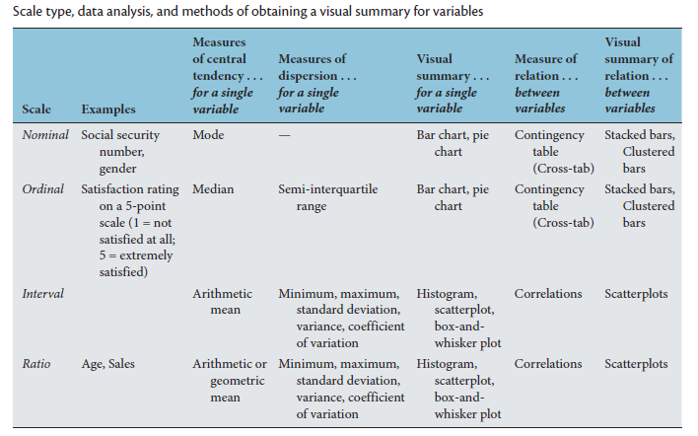
Data Analysis – Getting a Feel of Data
We can acquire a feel for the data by obtaining a visual summary or by checking the central tendency and the dispersion of a variable.
We can also get to know our data by examining the relation between two variables
The mode, median, or mean, and the semi-interquartile range, standard deviation, or variance

Slide 86
The Goodness of Data
Reliability
The reliability of a measure is established by
testing for both consistency and stability.
Consistency indicates how well the items measuring a concept hang together as a set.
Cronbach’s alpha is a reliability coefficient that indicates how well the items in a set are positively correlated to one another.
The closer Cronbach’s alpha is to 1, the higher the internal consistency reliability.
Validity
Validity is defined as the extent to which a concept is accurately measured in a quantitative study
Content validity - looks at whether the instrument adequately covers all the content that it should with respect to the variable
Face validity - experts are asked their opinion about whether an instrument measures the concept intended.
Construct validity- refers to whether you can draw inferences about test scores related to the concept being studied. Eg: if a person has a high score on a survey that measures anxiety, does this person truly have a high degree of anxiety?
Criterion validity. A criterion is any other instrument that measures the same variable. Correlations can be conducted to determine the extent to which the different instruments measure the same variable. Includes Convergent validity and Divergent validity

Slide 87
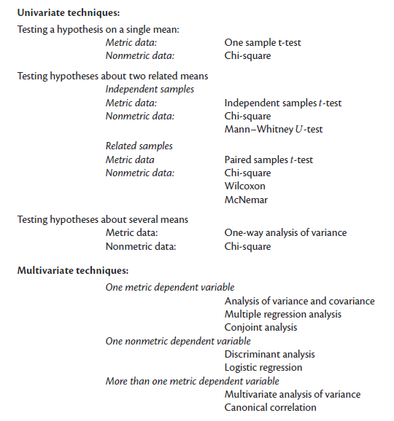
Hypothesis Testing
The choice of the appropriate statistical technique
largely depends on the number of (independent and dependent) variables you are examining and the scale of measurement (metric or nonmetric) of your variable(s).
Univariate statistical techniques are used when you want to examine two‐variable relationships. For instance, if you want to examine the effect of gender on the number of candy bars that students eat per week, univariate statistics are appropriate.
Multivariate Statistical Techniques - you are interested in the relationships between many variables,
The appropriate univariate or multivariate test largely depends on the measurement scale you have used,

Slide 88
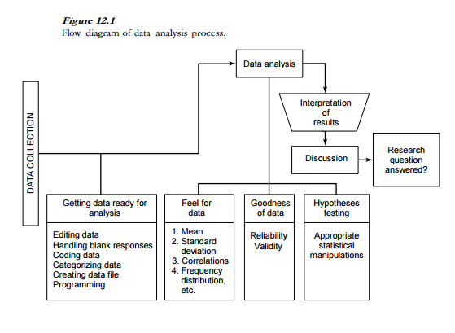
Data Analysis – Uma Sekaran

Slide 89
Ethics

Slide 90
Ethical Considerations
Ethics are the norms or standards for conduct that distinguish between right and wrong.
They help to determine the difference between acceptable and unacceptable behaviors.

Slide 91
Rights & Obligations of Subject
The researcher
Ethical conduct
Obligation to reduce bias
Do not misrepresent data
Privacy
Commitment to research
No Plagiarism
No Falsification
No Manipulation
Right to informed consent
Obligation to be truthful
Right to privacy
Right to confidentiality
Right to no harm
Right to be informed – No deception

Slide 92
Thank You

