Slide 1
Qualitative method
Dr Jugindar Singh

Slide 2
Definition of Qualitative : Creswell 2018
Qualitative research is an approach for exploring and understanding the meaning individuals or groups ascribe to a social or human problem.
The process of research involves:
Emerging questions and procedures,
Data typically collected in the participant’s setting
Data analysis inductively building from particulars to general themes, and the researcher making interpretations of the meaning of the data.
The final written report has a flexible structure.
Example: Explore the Lived experience of first-time mothers

Slide 3
What is Qualitative Research
(adapted from Creswell 2002, p. 58)
Subjective
Qualitative research is an inquiry approach in which the inquirer:
Explores a central phenomenon (one key concept)
Asks participants broad, general questions
Collects detailed views of participants in the form of words or images
Analyses and codes the data for description and themes
Interprets the meaning of the Information drawing on personal reflections and past research
Writes a Final Report

Slide 4
Data Processing
Transcribing your data

Slide 5
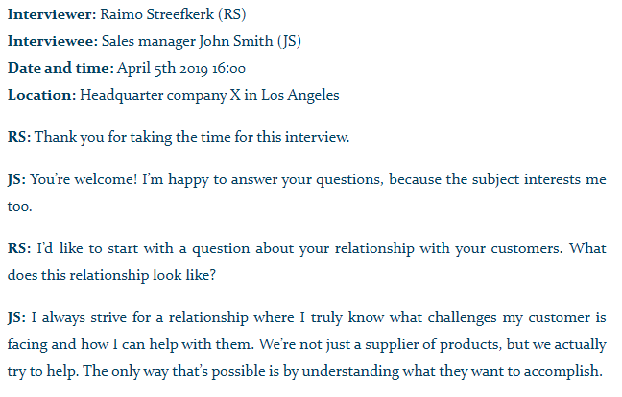
Transcribing your data Transcribing is converting speech to text word for word.
Transcription methods
1. Verbatim transcription
Write down every single word, including pauses, the expression of emotions such as laughter, stuttering, and hesitations such as “uh”.
2. Intelligent verbatim transcription (most common)
Write down every word, but without irrelevant fillers like “uhm”, “yeah”, “you know” etc. To improve readability, you can also fix grammar mistakes, broken sentences and long paragraphs
3. Edited transcription
A summarized and edited version of an intelligent verbatim transcript. In addition to omitting fillers like “you know”, irrelevant sentences can be omitted if it doesn’t change the meaning of the story.

Slide 6
Data Analysis
Data analysis is the process of making sense out of the data.
And making sense out of data involves:
consolidating,
reducing,
interpreting
what people have said and what the researcher has seen and read—it is the process of making meaning
Merriam and Tisdell

Slide 7
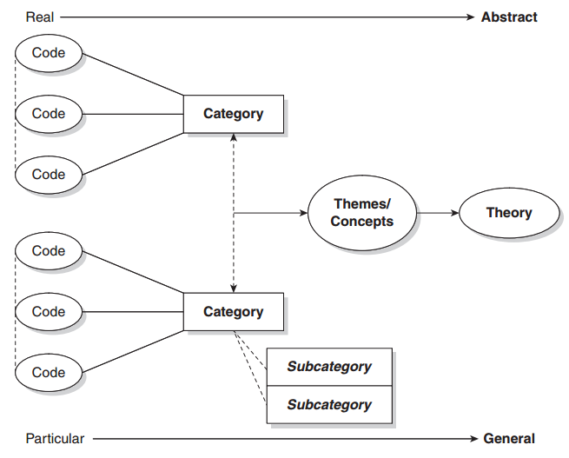
Data Analysis
Coding is the analytic process through which the qualitative data
that you have gathered are reduced

Slide 8
CODING
Coding is the process perusing data for categories and meanings (themes, ideas, etc.) and then systematically marking similar strings of text with a code label.
CODE
A code in qualitative inquiry is most often a word or short phrase that symbolically assigns a summative, salient, essence capturing, and/or evocative attribute for a portion of language-based or visual data’
(Saldaña, 2013)
CATEGORY
‘(Q)ualitative codes are essence-capturing and essential elements of the research story, that, when clustered together according to similarity and regularity (a pattern), they actively facilitate the development of categories and thus analysis of their connections.’
(Saldaña, 2013: 8)Ñ

Slide 9
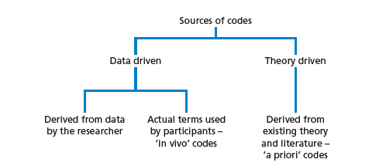
Steps in Coding
What is a code
Read through all transcripts
Start with one transcript
Identify text segments – ask “what is this person saying?”
Bracket text segment
Assign code word
Reduce redundancy
Collapse codes into themes
A code is a word, phrase, or sentence that represents aspect(s) of a data or captures the essence or feature(s) of a data

Slide 10
Data Analysis: how will we analyze it? The overall process
Codes the Text for
Description to be Used
in the Research Report
Codes the Text for
Themes to be Used
in the Research Report
The Researcher Codes the Data (i.e., locates text
segments and assigns a code to label them)
Interactive
Simultaneous
The Researcher Reads Through Data
( i.e., obtains general sense of material)
The Researcher Prepares Data for analysis
( e.g., transcribes fieldnotes)
The Researcher Collects Data (i.e., a text file, such as
fieldnotes, transcriptions, optically scanned material)

Slide 11
A Visual Model of the Coding Process in Qualitative Research
Divide text
into segments
of information
Label
segments of
information
with codes
Reduce
Overlap and
redundancy
of codes
Collapse
codes into
themes
Initially read
through data
Many
Pages
of Text
Many
Segments
of Text
Codes
reduced
to 20
30-40
codes
Reduce Codes to
5-7 Themes

Slide 12
Thematic Analysis – Braun and Clarke
Six-step process:
Familiarization
Coding
Generating themes
Reviewing themes
Defining and naming themes
Writing up

Slide 13
Thematic Analysis – Braun and Clarke
Step 1: Familiarization
The first step is to get to know our data. It’s important to get a thorough overview of all the data we collected before we start analyzing individual items.
This might involve transcribing audio, reading through the text and taking initial notes, and generally looking through the data to get familiar with it.
Braun, V., & Clarke, V. (2006). Using thematic analysis in psychology. Qualitative Research in Psychology, 3, 77–101.

Slide 14
Thematic Analysis – Braun and Clarke
Step 2: Coding
Coding means highlighting sections of our text – usually phrases or sentences – and coming up with shorthand labels or “codes” to describe their content.
Let’s take a short example text. Say we’re researching perceptions of climate change among conservative voters aged 50 and up, and we have collected data through a series of interviews. An extract from one interview looks like this:
In this extract, we’ve highlighted various phrases in different colors corresponding to different codes. Each code describes the idea or feeling expressed in that part of the text.
At this stage, we want to be thorough: we go through the transcript of every interview and highlight everything that jumps out as relevant or potentially interesting. As well as highlighting all the phrases and sentences that match these codes, we can keep adding new codes as we go through the text.
After we’ve been through the text, we collate together all the data into groups identified by code. These codes allow us to gain a a condensed overview of the main points and common meanings that recur throughout the data.

Slide 15
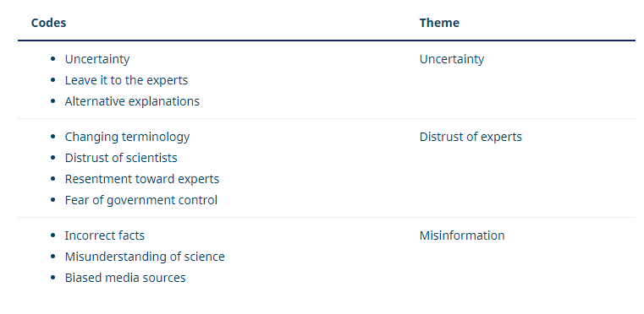
Thematic Analysis – Braun and Clarke
Step 3: Generating themes
Next, we look over the codes we’ve created, identify patterns among them, and start coming up with themes.
Themes are generally broader than codes. Most of the time, you’ll combine several codes into a single theme. In our example, we might start combining codes into themes like this:
At this stage, we might decide that some of our codes are too vague or not relevant enough (for example, because they don’t appear very often in the data), so they can be discarded.
Other codes might become themes in their own right. In our example, we decided that the code “uncertainty” made sense as a theme, with some other codes incorporated into it.
Again, what we decide will vary according to what we’re trying to find out. We want to create potential themes that tell us something helpful about the data for our purposes.

Slide 16
Thematic Analysis – Braun and Clarke
Step 4: Reviewing themes
Now we have to make sure that our themes are useful and accurate representations of the data. Here, we return to the data set and compare our themes against it. Are we missing anything? Are these themes really present in the data? What can we change to make our themes work better?
If we encounter problems with our themes, we might split them up, combine them, discard them or create new ones: whatever makes them more useful and accurate.
For example, we might decide upon looking through the data that “changing terminology” fits better under the “uncertainty” theme than under “distrust of experts,” since the data labelled with this code involves confusion, not necessarily distrust.

Slide 17
Thematic Analysis – Braun and Clarke
Step 5: Defining and naming themes
Now that you have a final list of themes, it’s time to name and define each of them.
Defining themes involves formulating exactly what we mean by each theme and figuring out how it helps us understand the data.
Naming themes involves coming up with a succinct and easily understandable name for each theme.
For example, we might look at “distrust of experts” and determine exactly who we mean by “experts” in this theme. We might decide that a better name for the theme is “distrust of authority” or “conspiracy thinking”.

Slide 18
Thematic Analysis – Braun and Clarke
Step 6: Writing up
Writing up a thematic analysis requires an introduction to establish our research question, aims and approach.
Include a methodology section, describing how we collected the data (e.g. through semi-structured interviews or open-ended survey questions) and explaining how we conducted the thematic analysis itself.
The results or findings section usually addresses each theme in turn. We describe how often the themes come up and what they mean, including examples from the data as evidence. Finally, our conclusion explains the main takeaways and shows how the analysis has answered our research question.
In our example, we might argue that conspiracy thinking about climate change is widespread among older conservative voters, point out the uncertainty with which many voters view the issue, and discuss the role of misinformation in respondents’ perceptions.

Slide 19
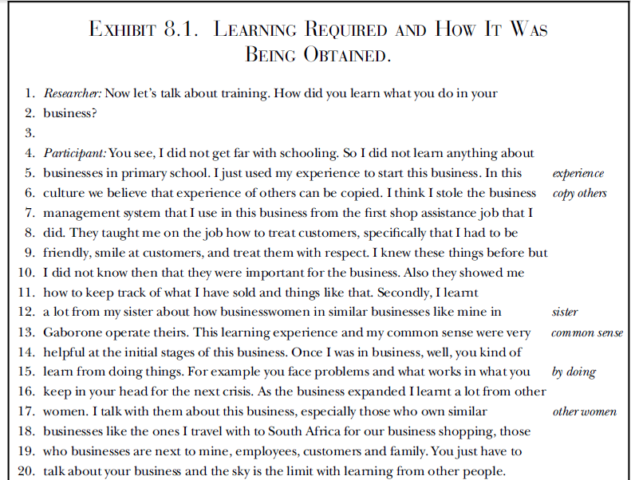
Sample
RQ1: How to learn what to do in business
Codes

Slide 20
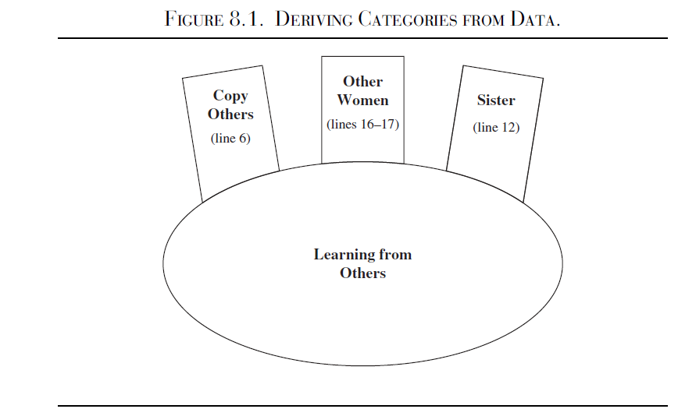

Slide 21
Trustworthiness
Trustworthiness is important to ensure the findings are worthy of attention (Lincoln & Guba, 1985).
Lincoln and Guba (1985) introduced the criteria of:
a) credibility (in preference to internal validity);
b) transferability (in preference to external validity/generalisability);
c) dependability (in preference to reliability);
d) conﬁrmability (in preference to objectivity).
The aim of trustworthiness in a qualitative inquiry is to support the argument that the inquiry’s findings are “worth paying attention to” (Lincoln & Guba, 1981, p.290).

Slide 22
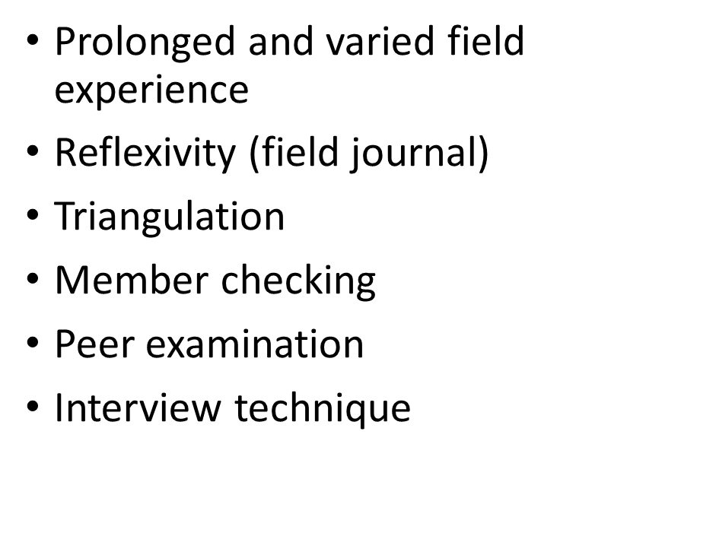
Credibility:
Guba and Lincoln (1989), the credibility of this research was addressed through prolonged engagement with the respondents.
Eg; Member checking to test the findings and interpretations with the participants (Lincoln and Guba, 1985).
The credibility criteria involves establishing that the results of qualitative research are credible or believable from the perspective of the participant in the research.
How confident the qualitative researcher is in the truth of the research study’s findings.
How do you know that your findings are true and accurate?
Use triangulation

Slide 23
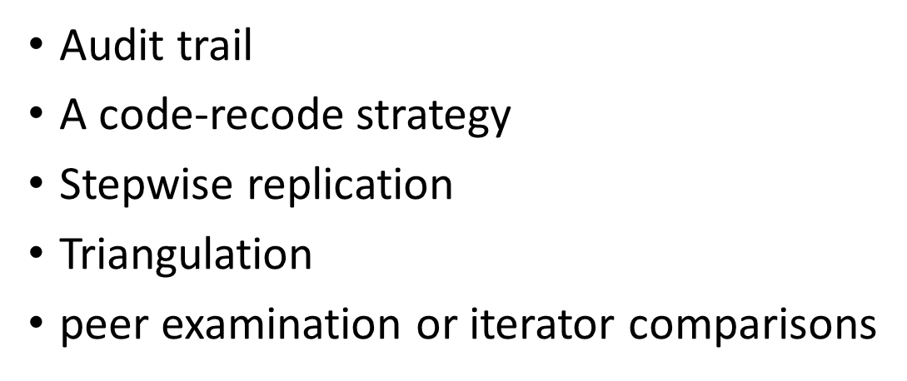
Dependability:
To demonstrate the dependability of this study, an audit trail was maintained (Koch, 1994).
To achieve dependability, the researcher kept records of the raw data, field notes, transcripts, and a reflexive journal.
These activities enabled the researcher with ease of reporting and the ability to systemize, relate, and cross reference data (Halpren, 1983).
Dependability is the extent that the study could be repeated by other researchers and that the findings would be consistent

Slide 24
Confirmability:
Concerned with establishing that the researcher’s interpretations and findings are clearly derived from the data (Guba and Lincoln, 1989). Throughout the study, the researcher included markers such as reasons analytical of methodological choices to ensure readers can understand why and how decisions were made (Koch, 1994).
Degree of neutrality in the research study’s findings.
The findings are based on participants’ responses and not any potential bias or personal motivations of the researcher

Slide 25
Transferability
How the qualitative researcher demonstrates that the research study’s findings are applicable to other contexts.
In this case, “other contexts” can mean similar situations, similar populations, and similar phenomena.
Qualitative researchers can use thick description to show that the research study’s findings can be applicable to other contexts, circumstances, and situations.
Purposive sampling
Provide thick description

Slide 26
Lincoln and Guba's Evaluative Criteria
Lincoln and Guba posit that trustworthiness of a research study is important to evaluating its worth. Trustworthiness involves establishing:
Credibility - confidence in the 'truth' of the findings
Transferability - showing that the findings have applicability in other contexts
Dependability - showing that the findings are consistent and could be repeated
Confirmability - a degree of neutrality or the extent to which the findings of a study are shaped by the respondents and not researcher bias, motivation, or interest.
Lincoln, YS. & Guba, EG. (1985). Naturalistic Inquiry. Newbury Park, CA: Sage Publications.

Slide 27
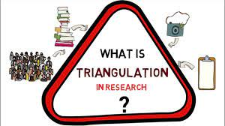
Triangulation
What is Triangulation?

Slide 28
Triangulation
Triangulation has been viewed as a qualitative research strategy to test validity through the convergence of information from different sources
O’Donoghue and Punch (2003)
Triangulation is a “method of cross-checking data from multiple sources to search for regularities in the research data
Patton (1999)
Triangulation refers to the use of multiple methods or data sources in qualitative research to develop a comprehensive understanding of phenomena.

Slide 29
Types of triangulation
Denzin (1978) and Patton (1999) identified four types of triangulation:
Method triangulation,
Investigator triangulation,
Theory triangulation,
data source triangulation
Data source triangulation
Methods triangulation
Researcher triangulation
Theory triangulation

Slide 30
Data Source Triangulation
Data source triangulation involves the collection of data from different types of people, including individuals, groups, families, and communities, to gain multiple perspectives and validation of data (Patton, 1999)

Slide 31
Data Triangulation
1) Data Triangulation (different sources of information)
Time – e.g., longitudinal
Space – more than 1 site
Person – more than 1 person
Eg: In-depth interviews could be conducted with 2 groups to gain insight into their perspectives on the research phenomena outcomes
Data triangulation involves the use of different sources of data/information.
A key strategy is to categorize each group or type of stakeholder for the program that you are evaluating.
To be certain to include a comparable number of people from each stakeholder group in the evaluation study.
Example
Suppose you are evaluating an afterschool program that you are overseeing. You would first identify the stakeholder groups such as youth in the program, their parents, schoolteachers, and school administrators
You decide to conduct in-depth interviews to gain insight on what the stakeholders perceive as outcomes of the program.
You would then interview representatives of each stakeholder group. You would triangulate by looking for outcomes that are agreed upon by all stakeholder groups.
The weight of evidence suggests that if every stakeholder, who is looking at the issue from different points of view, sees an outcome then it is more than likely to be a true outcome

Slide 32
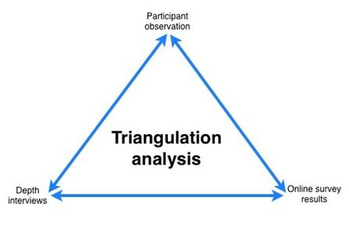
Method Triangulation
Method triangulation involves the use of multiple methods of data collection about the same phenomenon (Polit & Beck, 2012).
This type of triangulation, frequently used in qualitative studies, may include interviews, observation, and field notes.

Slide 33
Method Triangulation
2) Method Triangulation (multiple qualitative and/or quantitative methods)
Design – e.g. Mixed method
Data collection – More than 1 collection method
Eg:
Results from surveys, focus groups, and interviews could be compared to see if similar results are being found
Methodological triangulation involves the use of multiple qualitative and/or quantitative methods to study the program.
If the conclusions from each of the methods are the same, then validity is established.
For example,
Suppose you are conducting a case study of one of your Welfare-to-Work participants to document changes in her life as a result of participating in your program over a one- year period.
You would not just use one method, but you would use interviewing, observation, document analysis, or any other feasible method to assess the changes.
You could also survey the participant, her family members and case workers (quantitative method).
If the findings from all of the methods draw the same or similar conclusions, then validity in the finding has been established.

Slide 34
Investigator Triangulation
Investigator triangulation involves the participation of two or more researchers in the same study to provide multiple observations and conclusions.
This type of triangulation can bring both confirmation of findings and different perspectives, adding breadth to the phenomenon of interest (Denzin, 1978)

Slide 35
3) Investigator Triangulation (several different investigators )
Multiple investigators to explain
Eg:
Two investigators observing employees
The findings from each evaluator would then be compared to develop a broader and deeper understanding of how the different investigators view the issue
Investigator triangulation involves using several different investigators/evaluators in an evaluation project.
Typically, this would manifest as an evaluation team that consists of your colleagues
within your program area/field of study.
In order to triangulate, each different evaluator would study the program using the same qualitative method (interview, observation, case study, or focus groups).
The findings from each evaluator would be compared. If the findings from the different
evaluators arrive at the same conclusion, then validity has been established.
If the conclusions differ substantially, then further study is warranted to uncover the "true" and "certain" finding.
For example,
Suppose you are conducting pre/post observations of youth in the 4-H public speaking program to assess changes in nonverbal communication and public speaking skills.
In order to triangulate, you would line up different colleagues in your disciple/field to serve as evaluators.
Each person would have the same observation check sheet for pre- and post-observations.
In the final analysis, validity would be established for those same practice changes and skills that were identified by each different observer (per child).

Slide 36
Theory Triangulation
Theory triangulation uses different theories to analyze and interpret data.
With this type of triangulation, different theories or hypotheses can assist the researcher in supporting or refuting findings.

Slide 37
4) Theory Triangulation - More than 1 theory
Theory triangulation involves the use of multiple professional perspectives to interpret a single set of data/information.
Unlike investigator triangulation, this method typically entails using professionals outside of your field of study.
One popular approach is to bring together people from different disciplines, however, individuals within disciplines are used if they are in different status positions.
In theory it is believed that individuals from different disciplines or positions bring different perspectives.
Therefore, if each evaluator from the different disciplines interprets the information in the same way (draws the same conclusions), then validity is established.
For example,
Suppose you are interviewing participants from your nutrition program to learn what diet or healthy lifestyle practice changes they attribute to participating in your program.
To triangulate the information, you could then share the transcripts with colleagues in different disciplines (i.e. nutrition, nursing, pharmacy, public health education, etc.) to see what their findings and conclusions are.
You would compare those and again, as with others methods of triangulation, you would look for congruence to establish validation in your findings.

Slide 38
Environment Triangulation
This type of triangulation involves the use of different locations, settings and other key factors related to the environment in which the study took place, such as time of the day, day of the week or season of the year

Slide 39
5. Environmental Triangulation - The use of different locations, settings, and other key factors related to the environment in which the study took place, such as the time, day, or season
This type of triangulation involves the use of different locations, settings and other key factors related to the environment in which the study took place, such as time of the day, day of the week or season of the year.
The key is identifying which environmental factor, if any, may influence the information you received during the study.
The environmental factor is changed to see if the findings are the same. If the findings remain the same under varying environmental conditions, then validity has been established.
For example,
Suppose you want to evaluate the effectiveness of your money management program.
You want to determine if your program helps participants develop budgets to minimize spending and increase savings. If you evaluate during the holiday season, you may get different results because spending is greatly increased during that time of year.
In order to triangulate, you would need to evaluate the budgeting, spending and saving habits of your participants throughout the year in order to gather true and certain information on their behavior changes.

Slide 40
Triangulation - Example
THE EFFECTS OF CORPORAL PUNISHMENT ON DISCIPLINE AMONG STUDENTS
Collect data from multiple sources
Collect data in multiple ways from subjects
Collect different kinds of data in multiple ways from multiple subjects
For example:
May interview teachers, principals & parents
May interview & observe students
May review student records, interview teachers, observe students

Slide 41
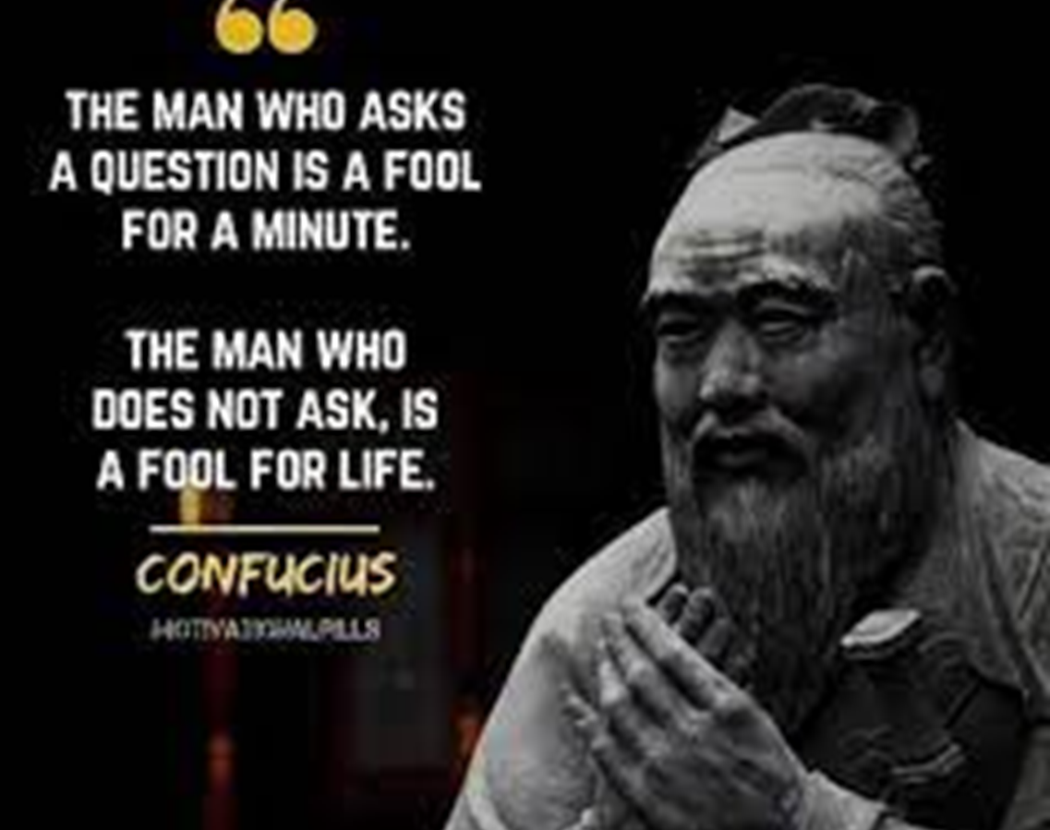
Questions

