Slide 1
CT105-3-M Cloud Infrastructure and Services
Cloud Security – Control Mechanisms

Slide 2
Lesson: Cloud Security
This lesson covers the following topics:
Classification of information security controls
Administrative, physical and technical security mechanism
Governance, risk management, and compliance
Key activities for audits
Notes:
This lesson covers security controls deployed in the cloud environment and various security mechanisms to fight against the threats. It also covers the areas of cloud governance, key steps of risk management, compliance that control IT operations, and key auditing activities in cloud.

Slide 3
Security mechanisms
Information security controls
Preventive control
Detective control
Corrective control
The goal is to avoid a vulnerability being exploited in the cloud environment.
The goal is to detect an attack that has occurred in the cloud environment.
The goal is to reduce the after-effects of an attack by restoring the system to its expected state.
Deterrent control
They are used when the preventive controls are failed.
They are used during or after an attack has been detected.
Aim is to reduce the likelihood of a vulnerability being exploited in a cloud environment by warning the attackers.
Example: Physical security for the data center, firewall, hardening, and authentication mechanism
Example: Audit trails and logs
Example: Data restore from backup

Slide 4
Security mechanisms classification: Administrative security
Security mechanisms can be broadly classified into three types
1. Administrative security
Includes security and personnel policies or standard procedures
Includes regulatory compliance, policies, and procedures, contracts and SLAs, background verification of the employees, and trainings
2. Physical security
3. Technical security

Slide 5
Security mechanisms classification: Physical security
Security mechanisms can be broadly classified into three types
1. Administrative security
24/7/365 onsite security
Biometric or security badge-based authentication
2. Physical security
Video surveillance cameras to monitor the activity
Redundant utilities for HVAC systems
Sensors and alarms to detect unusual activities and fire
3. Technical security
Use metal detection to screen the visitors

Slide 6
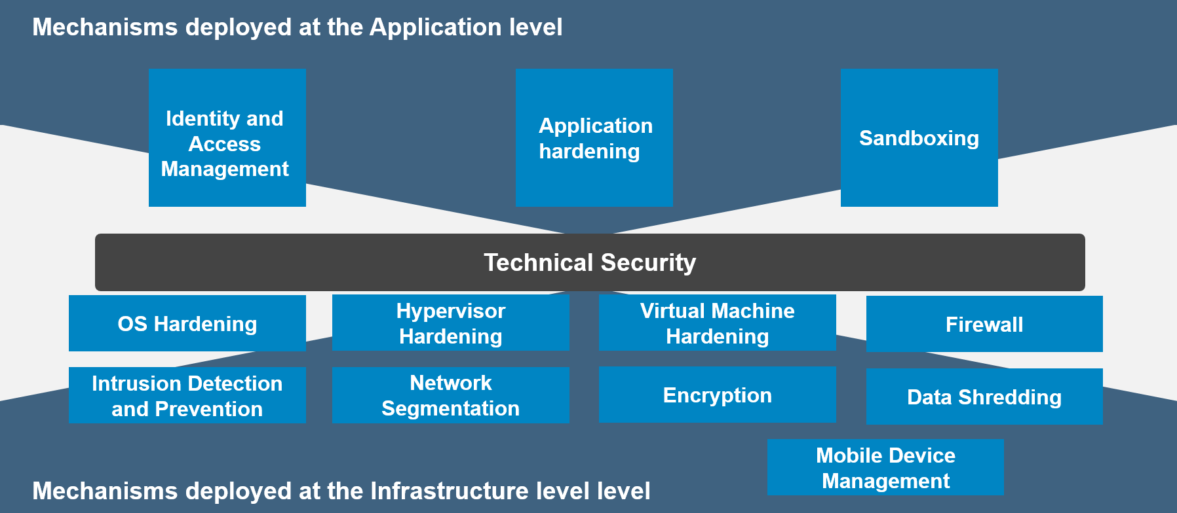
Security mechanisms classification- Technical security
Security mechanisms can be broadly classified into three types
1. Administrative security
2. Physical security
3. Technical security

Slide 7
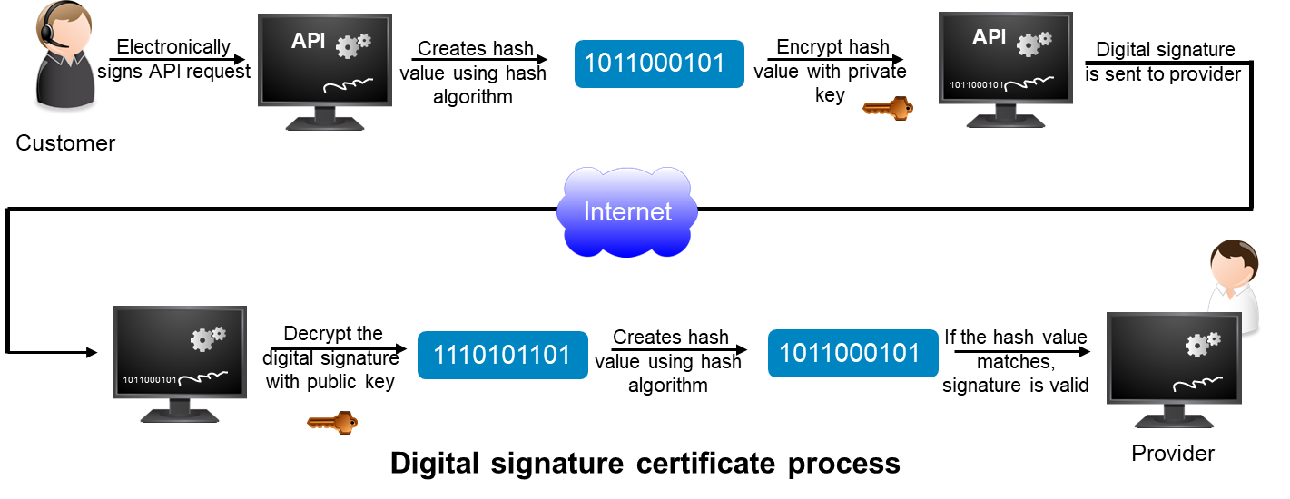
Identity and access management
Notes:
SHA 256

Slide 8
Identity and access management(Cont’d.)
Username
Abc@123
Password
Token
513862
Successfully
Authenticated
Role-based access control
Login
A secure method of restricting access to the user based on their respective roles.
Multifactor authentication
App 1
Provides a greater degree of control over cloud resources.
Username
Public cloud
Abc@123
Password
Login
Customer/User
App 2
Single Sign-on
Private cloud

Slide 9
Application hardening
Application hardening checklist
Identify security policies and procedures
Consider transmission of credentials over the network
Implement ACI
Secure third party applications and tools
Install current application updates or patches
Application hardening
Notes:
Client → Interface HotelBooking
Construction logic: which class/method will be called based on client’s request
Client → Interface HotelBooking → ConstructionLogic
Construction logic: which class/method will be called based on client’s request

Slide 10
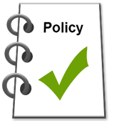
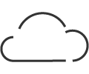
Sandboxing
Sandboxing mechanism provides the isolation capability by packaging the application and data with the infrastructure that it runs on along with the security policies.
To test and verify the untrusted applications
To analyze the threats in the environment
To create a uniform environment

Slide 11
Operating system hardening
Operating system hardening includes:
Deletion of unused files and programs
Installation of current OS updates—patches
Configuration of the components following the hardening checklist
Operating system hardening
Performing vulnerability scanning and penetration testing

Slide 12
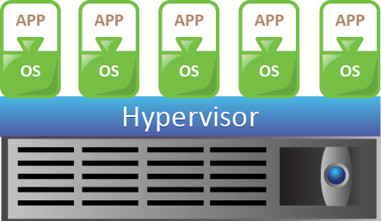
Hypervisor hardening
Hypervisor hardening includes:
Separation of management network from the VM network
Installation of security critical hypervisor updates
Accessing the management server be restricted to authorized administrators
Given least privileges to service accounts
Hypervisor hardening
Disabling the services which are not used in everyday operations.

Slide 13
Virtual machine hardening
Virtual machine hardening includes:
Change the default configuration of the VM
VM1
VM2
VM3
VM4
VM5
Disconnection of the virtual components that are not required
Ensuring that the security mechanisms are enabled, and are up-to-date
Isolation of the VM network using VLANs
Virtual machine hardening
Creation of the virtual machine from the VM template

Slide 14
Firewall
Traditional firewall
Cloud-based firewall
Monitors the network traffic
Implemented at network level
Implemented at host level
Filters the traffic based on the defined set of security rules
Protects cloud infrastructure
Protects consumers infrastructure
Establishes a barrier between the internal network and Internet
Offered in IaaS and PaaS
Offered in FWaaS, SaaS, and SECaaS

Slide 15
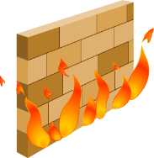
Firewall use case: Demilitarized zones
Secures all the internal resources while still allowing Internet-based access only to the selected resources.
VMs that need the Internet access to use the public cloud are placed between two sets of firewalls.
Exposed compute systems or VMs may or may not be allowed to communicate with internal resources.
VM1
VM2
VM3
VM4
VM5
Public cloud
Internet
Intranet
Private cloud
Demilitarized zone
Demilitarized zone in a hybrid cloud scenario

Slide 16
Intrusion detection and prevention systems
Intrusion detection system (IDS)
Intrusion prevention system (IPS)
A security tool, that detects the events that can cause exploitation of vulnerabilities in the cloud provider’s network or server
A security tool that prevents the events after they have been detected by the IDS
Intrusion detection classification
Signature-based
Anomaly-based
Laser-based
Compares the signature against observed events by relying on a database that contains known attack patterns, or signature.
Compares the observed events with the normal activities to identify the abnormal patterns.
Uses laser light source that produces narrow and invisible light beam to guard the physical premises.

Slide 17
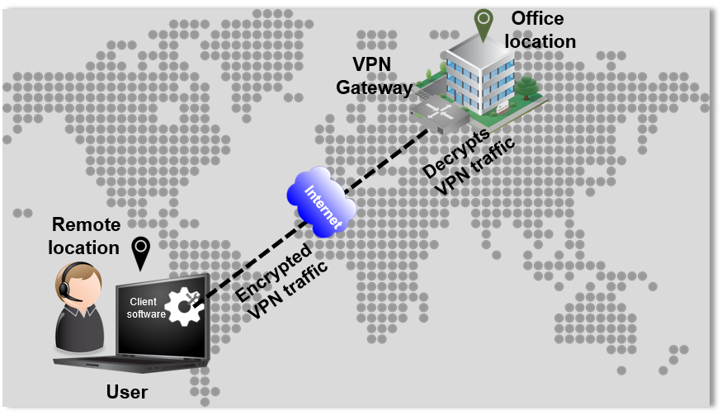
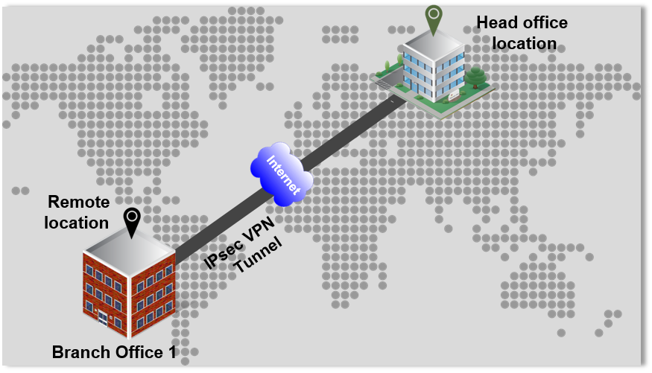
Network segmentation
Remote-site VPN
Site-to-site VPN
A remote customer initiates a remote VPN connection request using a VPN client software installed on their system.
IPsec protocol creates an encrypted tunnel from provider’s site to the customer’s site.

Slide 18
Network segmentation(Cont’d.)
Network virtualization implementation methods
Virtual Local Area Network (VLAN)
Virtual Storage Area Network (VSAN)
Virtual network created on a physical LAN
Virtual network created on a physical SAN
Divide a large LAN into smaller virtual LANs or combine separate LANs into one or more virtual LANs
Builds larger consolidated fabrics and still maintain the required security and isolation between them.

Slide 19
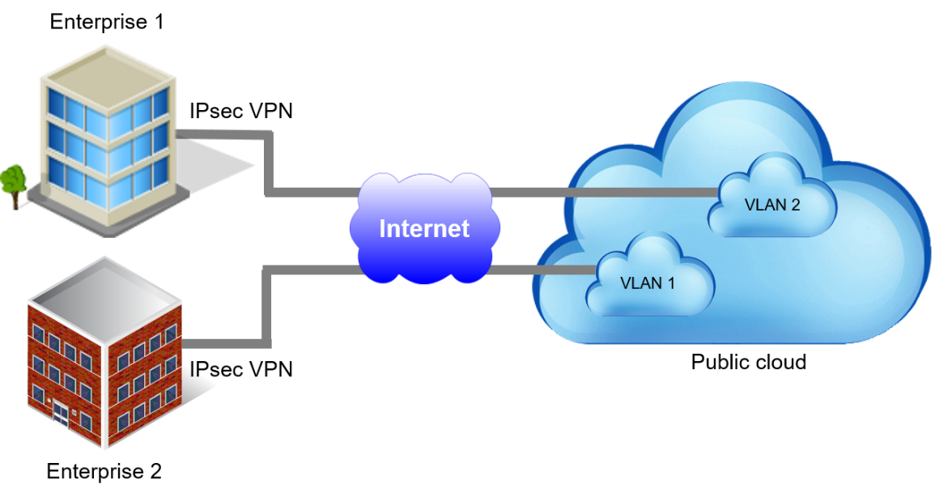
VLAN extension in hybrid cloud
Hybrid cloud use case:
Workload migration
Web application hosting
Application development and testing
Disaster recovery
Same IP address, subnet mask, and default gateway, as the once used in their own private data centers.
VLAN extension from enterprise data center to public cloud

Slide 20
Encryption
Data encryption is a cryptographic technique in which data is encoded and made unreadable to eavesdroppers.
Secure Socket Layer (SSL)
Data in-flight encryption
A standard security technology that uses data in-flight encryption to establish a secure connection between a provider’s web server and customer’s browser through Internet.
Process of encrypting the data that is being transferred over a network.
Performed at network level
Data at-rest encryption
Process of encrypting the data that is stored on a storage device.
Performed at storage level

Slide 21
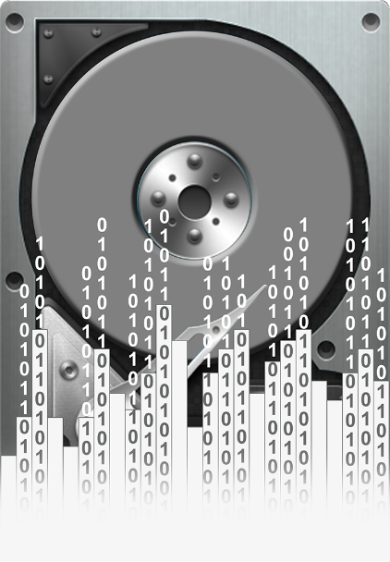
Data shredding
Data deleted by the customer or a process leaves traces on the system
Deletes data or residual representations of data
An attacker may perform unauthorized recovery of consumers’ data
Providers may create multiple copies of consumers data at multiple locations
Data shredding mechanism should be deployed at all location where the data is stored
Data shredding

Slide 22
Mobile device management
Challenges
Secure
Solution
BYOD policy at workplaces has created considerations for security and data privacy
MDM is a security solution to monitor, manage, and secure the employees mobile devices that are being used in the workplace.
Mobile devices may have varied mobile service providers and varied operating systems
Manage
Monitor
Mobile device management

Slide 23
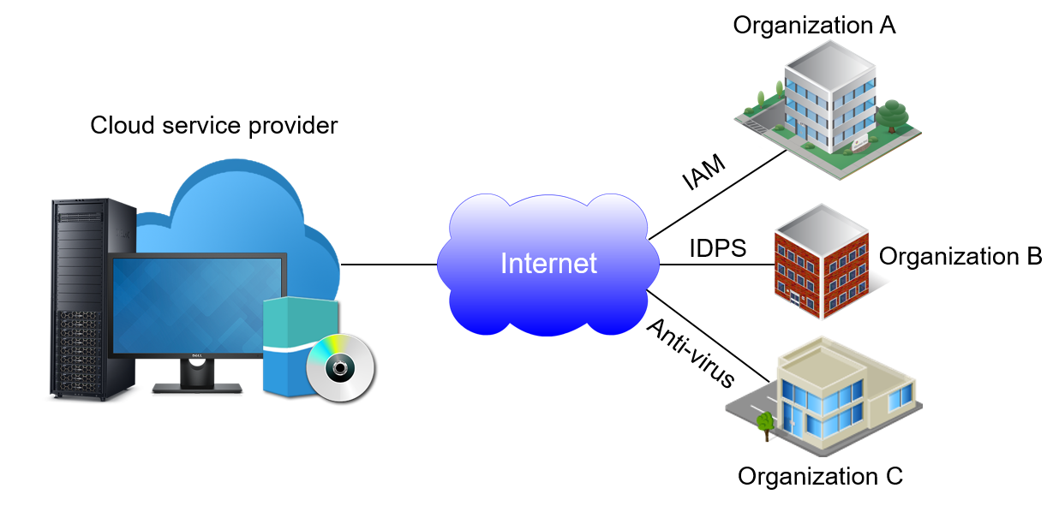
Security-as-a-Service
Gartner estimates that the cloud-based security services market reaches close to $9 billion by 2020
Cloud service provider delivers various security mechanisms through cloud - SECaaS

Slide 24
Governance, risk, and compliance
GRC is a term encompassing processes that help an organization to ensure that their acts are ethically correct and in accordance with their risk appetite.
Governance
Risk management
Compliance
!
Compliance
Assures that the policies are being enforced
Authority for making policies
Restricting access to certain users

Slide 25
Governance
Governance policies and procedures determine:
The security mechanisms of the provider
Redundancy and failover procedure
Location of provider’s data center and the data retention policies
Accountability and notifying the customers if there is a data breach
Governance
Financial stability of the provider

Slide 26
Risk management
Points to the various sources of threats that cause risk.
Determines the extent of potential threat and the risks associated with cloud resources.
1
2
Risk identification
Risk assessment
4
3
Monitoring
Risk mitigation
Involves continuous observation of existing risks and security mechanisms to ensure their proper control
Involves planning and deploying various security mechanisms
Risks management steps
Note: Cloud insurance is a new risk management approach which provides a financial compensation or data backup facility to the customers on behalf of the providers.

Slide 27
Compliance
Compliance checklist includes:
Ensure adherence to the security demands that are expressed in contracts
Review the security and privacy controls that are in place
Compliance
Ensure adherence to the industry regulations related to the flow of data out of an organization

Slide 28
Compliance standards: Examples
Health Insurance Portability and Accountability Act
Payment Card Industry Data Security Standards
U.S. law that regulates an individual’s healthcare information
An information security standard for the organizations that handle credit card data
Privacy rule: requires that data is kept encrypted when in transit and at rest
This standard was introduced to reduce the credit card fraud
Security rule: requires that stringent controls are in place for access to data
The validation of compliance is provided by Self-Assessment Questionnaire (SAQ)

Slide 29
Cloud security standards: Examples
Cloud Control Matrix of Cloud Service Alliance
European Network and Information Security Agency
Provides detailed understanding of security concepts and principles
Provides standards related to network and information security issues
Provides organizations with the detail related to information security, personalized to the cloud industry
Contributes to the development of a culture of network and information security
Provides standardized security and operational risk management measures

Slide 30
Audits
Audits function:
Determines the validity and reliability about the enforcement of control
Assess the cloud provider’s control mechanisms and their ability to provide the logs
100%
In security audit, cloud auditor makes an independent assessment of security controls
Audits
In a privacy audit, the cloud auditor assesses the processes and mechanisms

Slide 31
Lesson Summary
During this lesson, the following topics were covered:
Various technical security mechanism to address the threats
Governance, risk, compliance, and auditing to boost the cloud security
Notes:
This module covered the security measures that the cloud provider, and consumer should take to address the threats. Security mechanism was classified into physical, administrative and technical. More focus was given on technical mechanism. It also covered how governance, risk management, compliance, and audit activities are important to strengthen the security in cloud computing.

