Slide 1
CT105-3-M Cloud Infrastructure and Services
Cloud Service Models and Cloud Services Brokerage

Slide 2
Lesson: Cloud Service Models and Cloud Services Brokerage
This lesson covers the following topics:
Infrastructure as a Service
Platform as a Service
Software as a Service
Cloud services brokerage
Notes:
This lesson covers the three primary cloud service models: Infrastructure as a Service, Platform as a Service, and Software as a Service. This lesson also covers cloud services brokerage.

Slide 3
Introduction to Cloud Service Models
A cloud service model specifies the services and the capabilities provided to consumers
NIST specifies three primary cloud service models:
Infrastructure as a Service (IaaS)
Platform as a Service (PaaS)
Software as a Service (SaaS)

Slide 4
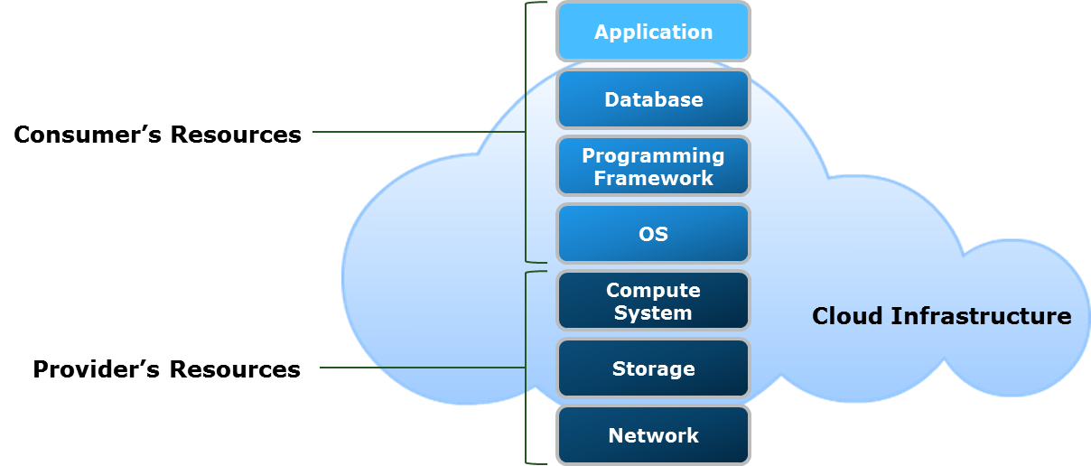
Infrastructure as a Service
Infrastructure as a Service
The capability provided to the consumer is to provision processing, storage, networks, and other fundamental computing resources where the consumer is able to deploy and run arbitrary software, which can include operating systems and applications. The consumer does not manage or control the underlying cloud infrastructure but has control over operating systems, storage, and deployed applications; and possibly limited control of select networking components , (e.g., host firewalls).
– U.S. National Institute of Standards and Technology, Special Publication 800-145

Slide 5
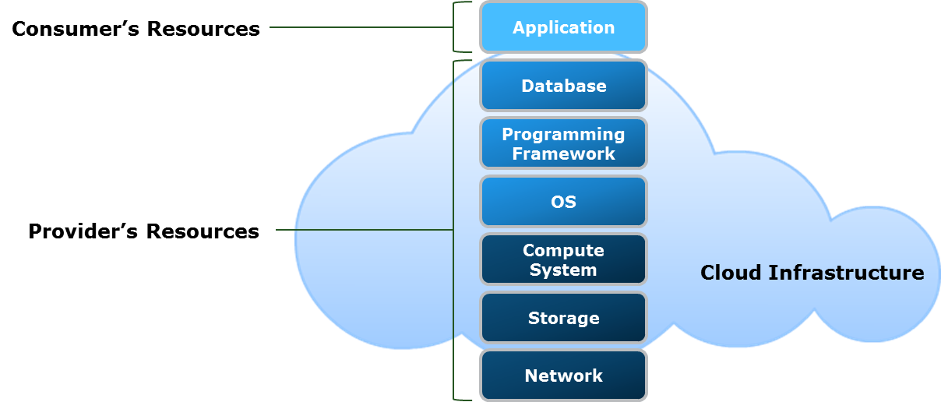
Platform as a Service
Platform as a Service
The capability provided to the consumer is to deploy onto the cloud infrastructure consumer-created or acquired applications created using programming languages, libraries, services, and tools supported by the provider. The consumer does not manage or control the underlying cloud infrastructure including network, servers, operating systems, or storage, but has control over the deployed applications and possibly configuration settings for the application-hosting environment.
– U.S. National Institute of Standards and Technology, Special Publication 800-145
Notes:
WISA - Microsoft
LAMP – Open Source

Slide 6
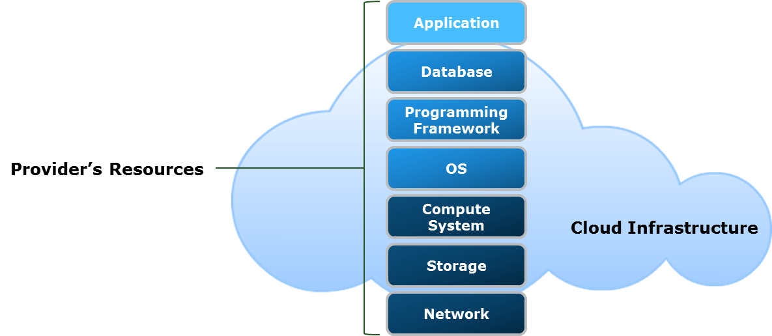
Software as a Service
Software as a Service
The capability provided to the consumer is to use the provider’s applications running on a cloud infrastructure. The applications are accessible from various client devices through either a thin client interface, such as a web browser, (e.g., web-based email, or a program interface. The consumer does not manage or control the underlying cloud infrastructure including network, servers, operating systems, storage, or even individual application capabilities, with the possible exception of limited user-specific application configuration settings.
– U.S. National Institute of Standards and Technology, Special Publication 800-145

Slide 7
Cloud Services Brokerage (CSB)
Cloud Services Brokerage
Cloud services brokerage (CSB) is an IT role and business model in which a company or other entity adds value to one or more (public or private) cloud services on behalf of one or more consumers of that service.
– Gartner IT Glossary
CSB is provided by a cloud broker
An entity that acts as an intermediary between cloud consumers and providers
Cloud broker manages the use, performance ,and delivery of cloud services

Slide 8
Categories of Cloud Services Brokerage
Service intermediation
The broker enhances and adds value to a given service
Service aggregation
The broker combines and integrates multiple services into one or more new services
Service arbitrage
Similar to service aggregation except that the services being aggregated may vary

Slide 9
Lesson Summary
During this lesson, the following topics were covered:
Infrastructure as a Service (IaaS)
Platform as a Service (PaaS)
Software as a Service (SaaS)
Cloud services brokerage (CSB)

