Slide 1
CT105-3-M Cloud Infrastructure and Services
Cloud Orchestration

Slide 2
Lesson: Cloud Orchestration
This lesson covers the following topics:
Orchestration Software or Orchestrator
System Integration using Orchestration software
Application Programming Interface (API)
Workflow Modeling
Orchestration use cases
Notes:
This lesson covers orchestration software, system integration using orchestrator software, application programming interface(API), and workflow modeling with use cases of orchestration.

Slide 3
Introduction to Service Orchestration
Service Orchestration
Automated arrangement, coordination, and management of various system or component functions in a cloud infrastructure to provide and manage cloud services.
Benefits:
Saves service provisioning time
Eliminates possibility of manual errors
Reduces operating expenses
Simplifies cloud infrastructure management

Slide 4
Why Service Orchestration?
Business across the world are adopting the cloud orchestration to speed up their infrastructure deployment and provisioning
30%
Already implemented cloud orchestration
51%
Planning to use it within next 12 months
Cloud orchestration market is expected to reach
14$
Billion dollars in 2021
Sources:
https://www.intel.com/content/dam/.../us/.../cloud-orchestration-for-business-agility.pdf
https://www.marketsandmarkets.com/Market-Reports/cloud-orchestration-market-121240924.html

Slide 5
Orchestrator
Enables automated arrangement, coordination, and management of various system or component functions in a cloud infrastructure to provide and manage cloud services.
Programmatically integrates and sequences various system functions into automated workflow
Provides a library of predefined workflows and an interface to create user-defined workflows
Example
A deployment of an application in the cloud environment might include automated provisioning and configuration of the multiple servers, storage, databases, and networking
Connection of multiple system or component functions into a workflow to provide and manage services
Orchestrator enables defining workflows to logically integrate system functions

Slide 6
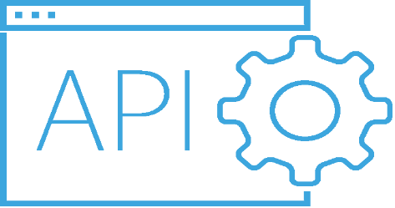
Application Programming Interface(API)
A Source-code-based specification intended to be used by software components as an interface to communicate with each other.
Example: Credit Card Transaction
Orchestrator uses the API send the request to an approval system that validates the service request to start execution of component function.

Slide 7
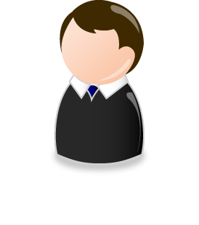
Workflow Modeling
Orchestrators commonly provide interfaces to model workflows
Common elements in workflows are: Start, Action, Manual interaction, Condition, Waiting time, Waiting event, Child workflow, End.
Waiting Event
Action
Action
Action
End
Action
Action
Condition
Start
Action
Manual Interaction
Action
Waiting Time
Child Workflow
Action
End
Notes:
Orchestrators commonly provide interfaces to model workflows similar to a flow diagram. A workflow includes multiple related API functions and logical connections between them. Common elements in a workflow are as follows:
Start: It is the starting point of a workflow. A workflow can have only one start element.
Action: It is an activity that is executed by calling an API function. It takes one or more input parameters and returns a value. Multiple activities can be executed in sequence or simultaneously.
Manual interaction: It prompts a user for input. An architect can set a timeout period within which a user can answer.
Condition: It consists of conditional branches. It takes one or more input parameters and returns either true or false. It allows a workflow to branch into different directions, depending on the input parameters.
Waiting time: Wait for a given time period or until a certain date/time has passed at which a workflow resumes running.
Waiting event: Wait for a specific event to resume workflow running.
Child workflow: A workflow can be hierarchical and can contain a child workflow.
End: The end point of a workflow.
Note: The icons used to represent workflow elements are for illustration purpose only. Vendors of orchestration software provide their own set of icons.

Slide 8
Orchestration Use Case: Provisioning Virtual Machine
Resource available in pool?
Update cloud portal
(Wait for order approval)
Provision more resources to resource pool
Start
No
Yes
Resource available in
pool?
No
Update cloud portal
(Order failed)
Update cloud portal (order in progress)
Yes
Create VM
Generate bill for new service
Update cloud portal
(Service ready)
Stop
Install guest OS
Update CMS
Stop
Connect VM to VLAN
Assign IP address to VM

Slide 9
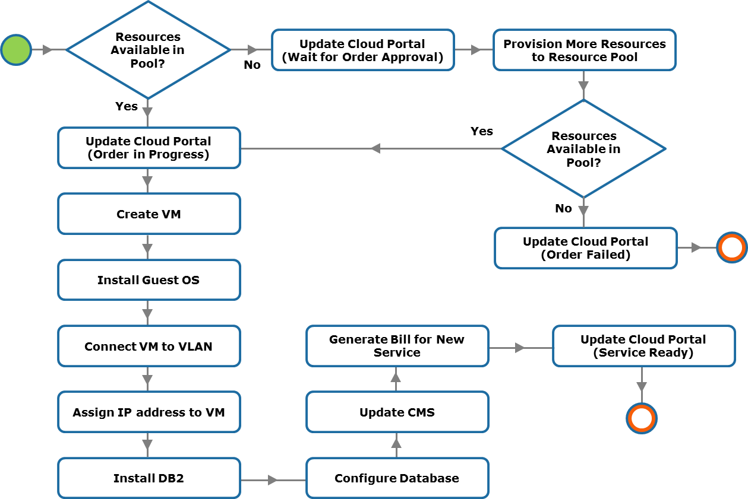
Orchestration Use Case: Provisioning DB2 Database

Slide 10
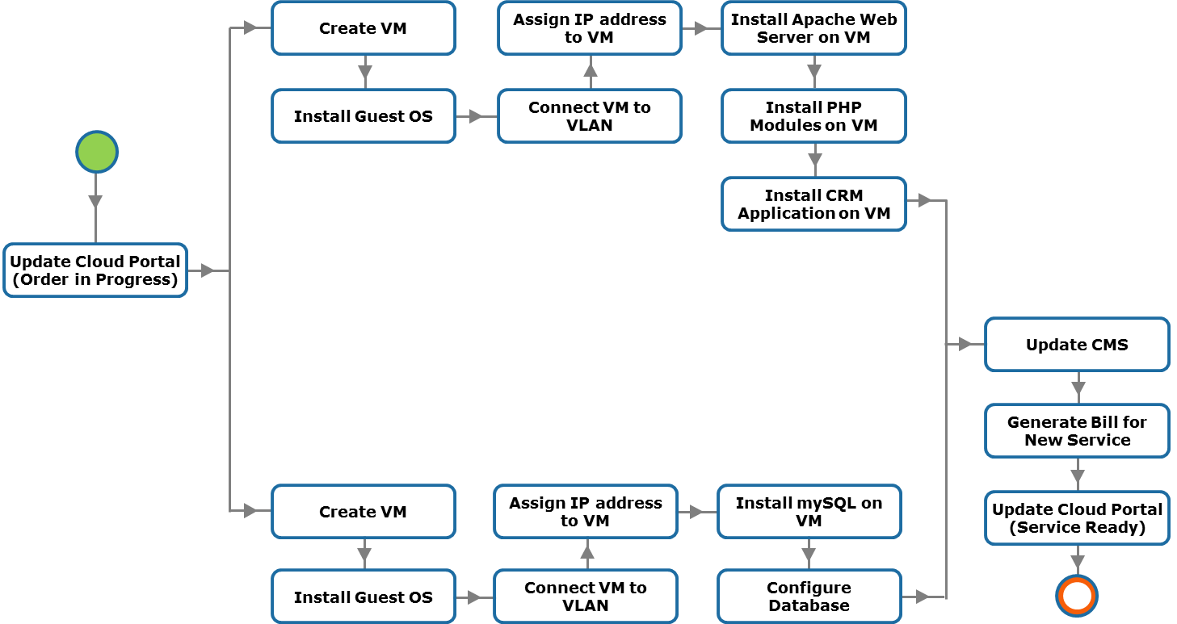
Orchestration Use Case: Provisioning CRM Application

Slide 11
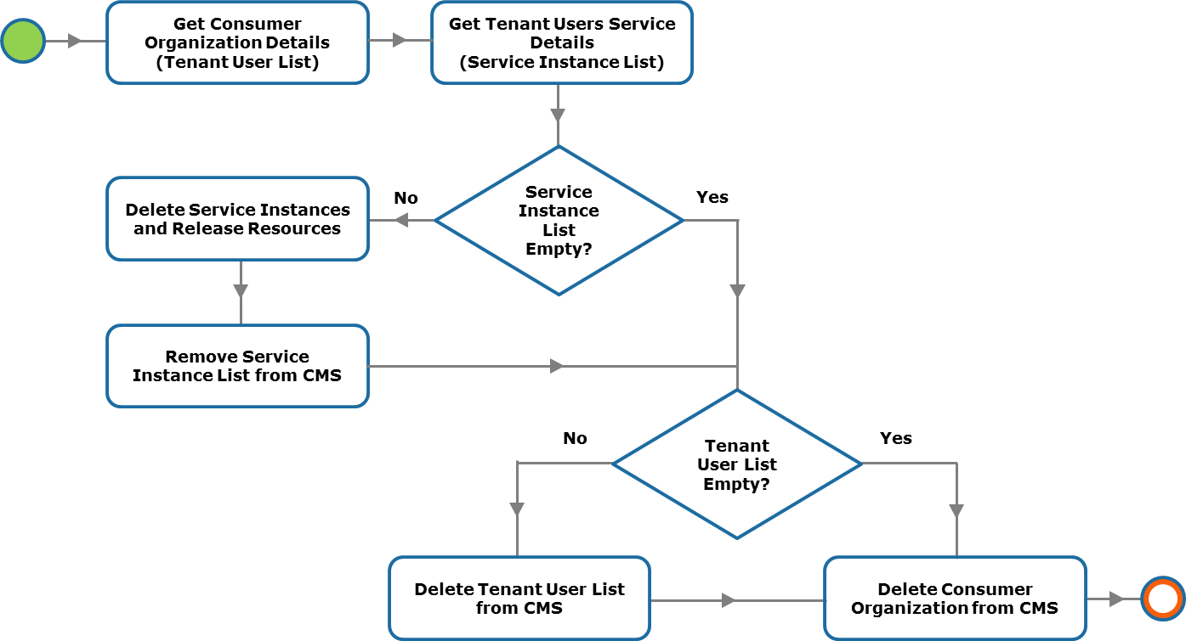
Orchestration Use Case: Removing Tenant

Slide 12
Concepts in Practice

Slide 13
Customer Success Story: VMware vRealize Automation
To access the video, please click the below link
https://edutube.emc.com/Player.aspx?vno=eXEQEaymLQ/auOdudSlNSQ==&autoplay=true&t=0h0m0s

Slide 14
Lesson Summary
During this lesson the following topics were covered:
Orchestration Software or Orchestrator
System Integration using Orchestration software
Application Programming Interface (API)
Workflow Modeling
Orchestration use cases

