Slide 1
CT105-3-M Cloud Infrastructure and Services
Options and Considerations for Building a Cloud Infrastructure

Slide 2
Lesson: Options and Considerations for Building a Cloud Infrastructure
This lesson covers the following topics:
Greenfield and brownfield deployment options
Technology solutions for building a cloud infrastructure
Factors to consider while building a cloud infrastructure
Notes:
This lesson covers the greenfield and the brownfield deployment options, the technology solutions and the various factors that should be considered while building a cloud infrastructure.

Slide 3
Deployment Options
Greenfield Deployment Option
It is typically used when an infrastructure does not exist
and an organization has to build the cloud infrastructure
starting from the physical layer.
Brownfield Deployment Option
It is used when some of the infrastructure entities exist,
which can be transformed to cloud infrastructure by
deploying the remaining entities required for the cloud
infrastructure.

Slide 4
Solutions for Building Cloud Infrastructure
Two solutions for building cloud infrastructure:
Integrating best-of-breed cloud infrastructure components
Cloud-ready converged infrastructure

Slide 5
Solutions for Building Cloud Infrastructure
Integrating Best-of-breed Cloud Infrastructure Components
Built by integrating multi-vendor infrastructure components
Enables repurposing the existing infrastructure components
Requires spending a significant amount of IT staff time on:
Evaluating individual and disparate hardware components
Installing and integrating infrastructure components
Testing hardware, middleware, and software
Checking compatibility of all the components
Enables organizations to choose and switch vendors easily
Notes:
ARM
INTEL
DELL EMC

Slide 6
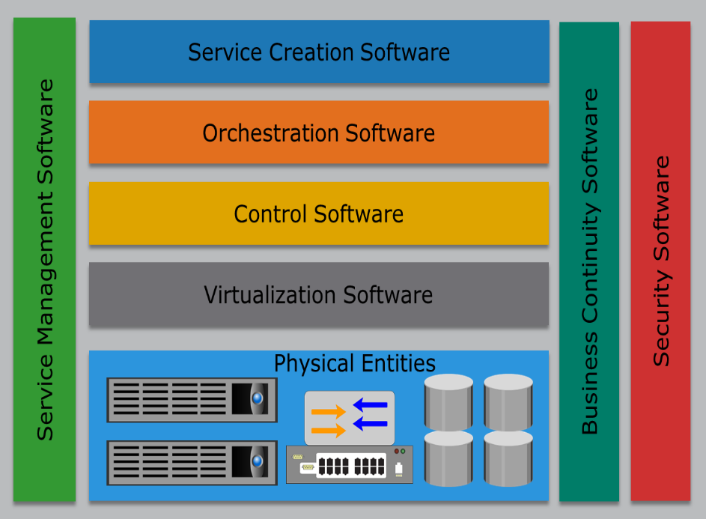
Solutions for Building Cloud Infrastructure
Cloud-ready Converged Infrastructure
This solution combines compute, storage, network, virtualization, and management components into a single package.
This package is a self-contained unit that can be utilized to deploy cloud services, or can be aggregated with additional packages to support the demand for more capacity and performance.
The package is pre-configured, reducing the time to deploy cloud services.
A potential area of concern is the lack of flexibility to use infrastructure components from different vendors.

Slide 7
Factors to Consider while Building a Cloud Infrastructure
Governance
Organization
Finance
Tools
Service-level agreement and service contract (SLAs)
Avoiding vendor lock-in
Software licensing concerns
Service model considerations
Migration
Testing

Slide 8
Governance
Governance
Governance is the active distribution of decision-making rights and accountability among different stakeholders in an organization. It also describes the rules and procedures for making and monitoring those decisions to determine and achieve the desired behaviors and results.
IT governance enables the service provider to:
Ensure IT resources are implemented and used according to policies and procedures
Ensure the resources are properly controlled and maintained
Ensure the resources are providing value to the organization
Instituting IT governance involves establishing a review board

Slide 9
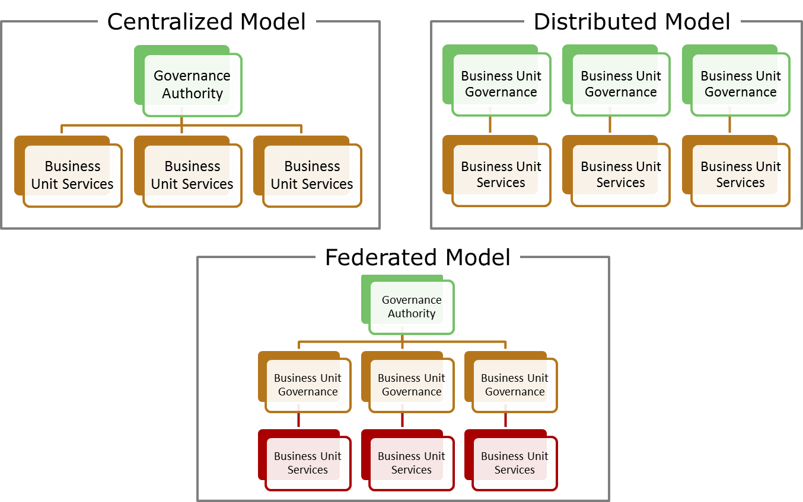
Governance Models

Slide 10
Organization
New Roles in Cloud
Service Manager
Account Manager
Cloud Architect
Service Operations Manager
Key interface between clients and IT staff
Understands consumers’ needs and industry trends
Ensures IT delivers cost-competitive services
Manages consumers’ expectations of product offerings
Supports service managers in service planning, development, and deployment
Creates detailed designs for the cloud infrastructure
Streamlines service delivery and execution
Coordinates with architecture team to define technology roadmaps and ensure SLOs are met
Notes:
SDLC: Software Development Life Cycle
SLC: Service Life Cycle

Slide 11
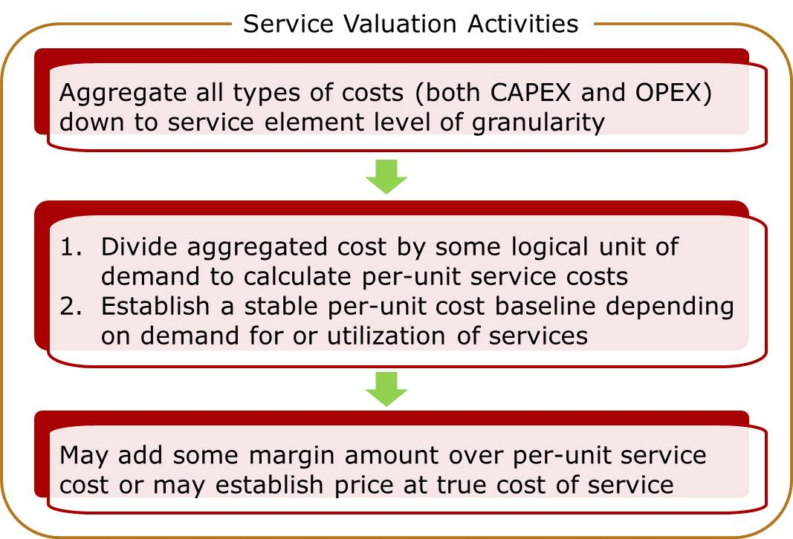
Finance
Service Valuation
Determines the price (or chargeback) that a service consumer is expected to pay to meet the provider’s business goal
Recovery of cost
Profit
ROI goal
Reinvestment goal

Slide 12
Finance
Chargeback Models
Define how consumers need to pay for the consumed services
Model | Description
Pay-as-you-go | Metering and pricing is based on consumption of resources Consumers do not pay for unused resources
Subscription by time | Cost of providing a service for a subscription period is divided among a predefined number of consumers
Subscription by peak usage | Consumers are billed according to their peak usage of IT resources for a subscription period
Fixed cost or pre-pay | Consumers commit needed resources upfront for committed period Consumers pay fixed charge periodically through a billing cycle regardless of the utilization of resources
User-based | Billing is based on the number of users logged in

Slide 13
Tools
Tools play an important role in building a cloud infrastructure:
Virtualization and orchestration software
Security and business continuity software
Self-service portal software
Other tools that should be considered specially when deploying hybrid cloud, community cloud, or brokerage service:
Cloud integration tools
Application Programing Interface (API)
Specialized connection
Transformation and business logic programs

Slide 14
Service-level Agreement and Legal Contract
Service-level Agreement
A contract negotiated between a provider and a consumer that specifies various parameters and metrics such as cost, service availability, maintenance schedules, performance levels, service desk response time, and consumer’s and provider’s responsibilities.
Key points that must be included in a legal contract are:
Business level policies such as data privacy, data ownership, security, and jurisdiction
Availability and performance metrics
DR plan, exit plan, and penalties for not meeting SLA
How unexpected incidents and prolonged service outage will be handled

Slide 15
Avoid Vendor Lock-in
Vendor Lock-in
A situation where a consumer is unable to move readily from the current provider to another.
Causes for vendor lock-in includes:
High migration cost
Application requires significant re-engineering for migration
Lack of open standards
Restrictions or burdensome penalties imposed by the current provider
Vendor lock-in can be prevented by:
Using open standard tools, APIs, and file formats
Including appropriate exit clause in the agreement

Slide 16
Software Licensing Concerns
Typically, relevant to IaaS and PaaS models
Consumers can use their existing license if it is cloud enabled
If consumer’s existing license is not cloud enabled then:
Paying additional fees may get their license cloud enabled
May use software provided by the service provider
Providers must work to understand the software license rights and its usage:
Prevents any non-compliance and violation of license agreements

Slide 17
Considerations for SaaS
Software as a Service:
Ensures the software offered are thoroughly tested
Ensures the new features and functionalities are developed to the software to meet consumer’s needs
Ensures applications are scalable and can handle increasingly larger consumer workloads
Ensures the applications are resilient and can withstand failures such as
Underlying component failure
Dependent service failure
Ensures the consumers are provided a secure environment

Slide 18
Considerations for PaaS and IaaS
Platform as a Service:
Provides application development platform to the consumers
Supports large variety of OS, application development tools, and deployment tools
Ensures the consumers are provided a secure environment
Provides the consumer the required computing resources to operate the application
Infrastructure as a Service:
Provides the consumer the required infrastructure resources to deploy their OS, application, and data
Ensures that the consumers are provided a secure environment

Slide 19
Migration
Consumer may plan to migrate application or only data
Two application migration strategies are:
For migrating data to cloud:
Consider copying data to cloud using replication technology
Consider factors such as network bandwidth, data security and integrity, and jurisdiction
Migration Strategy | Description
Forklift | Entire application is migrated at once instead of in parts Good for tightly coupled or self contained applications
Hybrid migration strategy | Applications and its components are moved in parts Lower-risk approach to migrate applications to the cloud Good for application that have loosely coupled components

Slide 20
Testing
DEFINE
Define roles and responsibilities of personnel involved in testing
IDENTIFY
Identify tools to perform test management and automation
DESIGN
Design tests for data migration to cloud
Design test cases to perform various testing modes
Stress, performance, functional, interoperability, and compatibility
TEST
Test cloud capabilities committed by provider such as
Fault tolerance, disaster recovery, and security controls

Slide 21
Lesson Summary
During this lesson the following topics were covered:
Greenfield and brownfield deployment options
Best-of-breed cloud infrastructure components
Cloud-ready converged infrastructure
Considerations for Building a Cloud Infrastructure
Governance and organization considerations
Finance and tools considerations
SLAs and vendor lock-in considerations
Software and licensing considerations
Considerations for service models
Migration and testing considerations

