Slide 1
Chapter 1: Introduction
1.1 Overview of SAS Foundation
1.2 Course Logistics
1.3 Course Data Files
Notes:
We’ll begin the course with an overview of Foundation SAS and then discuss course logistics and the course data.

Slide 2
Chapter 1: Introduction
1.1 Overview of SAS Foundation
1.2 Course Logistics
1.3 Course Data Files
Notes:
Lets start by looking at SAS Foundation.

Slide 3
Objectives
Characterize SAS software.
Describe the functionality of Base SAS and SAS Foundation tools.
Notes:
TAG_AltText:

Slide 4
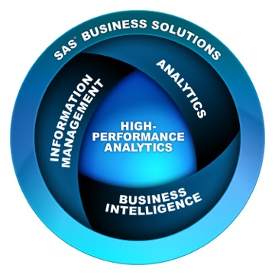
What Is SAS?
SAS is a suite of business solutions and technologies to help organizations solve business problems.
Notes:
TAG_AltText: Graphic describing major solution and technology categories, which are SAS Business Solutions, Analytics, Information Management, Business Intelligence, and High-Performance Analytics

Slide 5
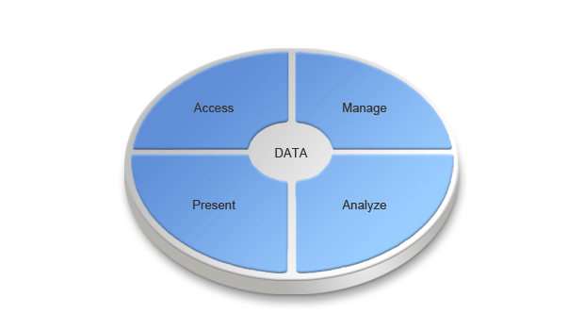
What Can You Do with SAS?
SAS software enables you to do the following:
access data across multiple sources
manage data
perform sophisticated analyses
deliver information across your organization
Notes:
The functionality of SAS is built around the four data-driven tasks common to virtually any application: data access, data management, data analysis, and data presentation.

Slide 6
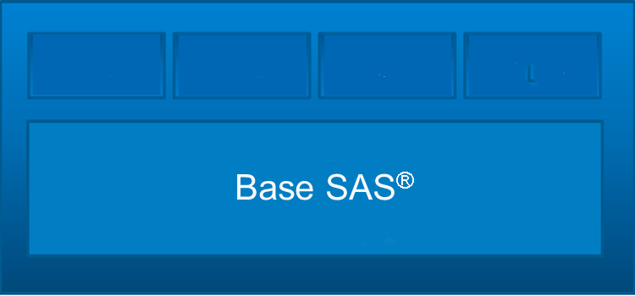
What Is Base SAS?
Base SAS is the centerpiece of all SAS software.
Base SAS is a product within the SAS Foundation set of products that provides
a highly flexible, highly extensible fourth-generation programming language
a rich library of encapsulated programming procedures
a graphic user interface for administering SAS tasks.
Flexible
Extensible
Integrated
Powerful
Notes:
TAG_AltText: “ “

Slide 7
About This Class
This class focuses on writing SAS programs to do the following:
access data in various forms
create SAS data sets
use prewritten procedures to analyze data and write basic reports
combine data sets
generate detail and summary reports in various formats, including HTML, RTF, PDF
Notes:
TAG_AltText: “ “
TAG_Instructor: So, that’s a very high level view of SAS software and the part that we will be learning in this class. More specifically, we will access different types of data files that are external to SAS, such as Excel workbooks and Oracle tables. We’ll turn that data into a form that SAS likes to process – a SAS data set. We will manipulate and analyze that data, generate reports, and more…

Slide 8
1.01 Multiple Choice Poll
Have you worked with Base SAS?
yes, just maintaining programs
yes, writing some programs
no, not at all
Notes:
Type answer here

Slide 10
Chapter 1: Introduction
1.1 Overview of SAS Foundation
1.2 Course Logistics
1.3 Course Data Files
Notes:
TAG_Instructor: That’s enough overview for now. Let’s take a quick look at some course logistics.

Slide 11
Objectives
Describe the data used in the course.
Designate the editors and processing mode available for workshops.
Specify the naming convention used for course files.
Define the three levels of exercises.
Navigate the Help facility.
Notes:
TAG_AltText:

Slide 12
Orion Star Sports & Outdoors
This course focuses on a fictitious global sports and outdoors retailer that has traditional stores, an online store, and a catalog business.
Notes:
TAG_AltText: “ “

Slide 13
Orion Star Data
Large amounts of data are stored in transactional systems in various formats.
1,000 employees
90,000 customers
150,000
orders
64 suppliers
Notes:
TAG_AltText: Graphics describing that there is data for one thousand employees, one hundred and fifty thousand orders, ninety thousand customers, and sixty-four suppliers

Slide 14
Orion Star Business Scenarios
In this course, you write SAS programs that access Orion Star data and create reports using an editor.
data newemp;
set orion.emp;
where Salary le 100000;
run;
proc means data=newemp;
class Job_Title;
var Salary;
run;
SAS Enterprise Guide Program Editor
SAS Windowing Environment Editor
Notes:
TAG_AltText: Graphic showing that the two types of editors that can be used in class are the SAS Enterprise Guide Program Editor and the SAS windowing environment editor.
You will be writing program during class using an editor. You will have your choice of two different editors to use: the SAS Enterprise Guide Program Editor and the SAS windowing environment editor. Which editor you use is up to you. If you are unsure of which you will use when you go home, then you can try both in class. In fact, I encourage you to try both during workshops.

Slide 15
What Is SAS Enterprise Guide?
SAS Enterprise Guide is a powerful Windows client application that provides a GUI for transparently accessing the power of SAS.
It provides the following:
a point-and-click interface with menus and wizards that enable the user to define tasks
SAS code generation and execution based on user selections
a full programming interface that can be used to write, edit, and submit SAS code
 This class uses the programming interface.

Slide 16
What Is the SAS Windowing Environment?
The SAS windowing environment consists of a series of windows that you can use to edit and submit programs, and view the results.
The SAS windowing environment editor contains the following windows:
the Enhanced Editor and Program Editor windows for preparing and submitting a program
the Log window for viewing notes, warning messages, and error messages
the Output window, which contains the output generated by most SAS procedures
Notes:
SAS Windowing Environment is on interactive mode.

Slide 17
1.02 Multiple Choice Poll
Which editor will you use outside of this class to write SAS programs?
SAS Enterprise Guide Program Editor
the Program Editor in the SAS windowing environment
a different editor
I do not know.
Notes:
Type answer here

Slide 18
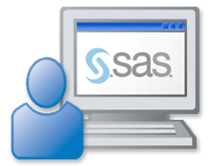
Running SAS Programs
In this course, you invoke SAS in interactive mode (SAS Enterprise Guide or windowing environment) to process programs.
Notes:
TAG_AltText: “ “
There are several different ways that you can invoke SAS. In this course, we will be using interactive mode. Depending on which you chose, that can be SAS Enterprise Guide or the windowing environment.

Slide 19
Running SAS Programs
There are other modes for processing SAS programs.
Batch Mode for z/OS (OS/390) | Noninteractive Mode
Use any editor to create a file with SAS statements plus job control statements (JCL), and then submit the file to the operating system. Example file: //jobname JOB … // EXEC SAS //SYSIN DD * proc freq data=x.pay; tables ID; run; | Use any editor to create a file with SAS statements, and then issue the SAS command referencing the file. Directory-based example: z/OS (OS/390) example:
SAS filename
SAS INPUT(filename)
Notes:
TAG_AltText: The directory-based SAS command is the keyword SAS followed by a filename. The z/OS (OS/390) SAS command is the keywords SAS INPUT followed by a filename in parenthesis.

Slide 20
1.03 Multiple Choice Poll
How will you invoke SAS outside of this class?
interactive mode using SAS Enterprise Guide
interactive mode using the windowing environment
batch mode
noninteractive mode
I do not know.
Notes:
Type answer here

Slide 21
Program Naming Conventions
In this course, you retrieve and save SAS programs using the structure below.
p104d01x
❶ course ID
❷ chapter #
❸ type a=activity d=demo e=exercise s=solution
❹ item #
❺ placeholder
Programming 1, Chapter 4, Demo 1
Notes:
TAG_AltText: “ “
In this course, we will be using numerous SAS programs. The programs that we use will follow a convention. All the programs start with P1, which stands for Programming 1, and then the next two numbers will correspond to the chapter. At that point, you will see a letter, such as D for demo or E for exercise. Next will be a sequential number taking up two places. There will be a few programs that will also then be followed by a letter such as A or B. Looking at the example on this slide, p104d01 stands for the first demo in Chapter 4. If you see an A in the place of the D, that is an activity, which is a quick task that you will need to perform in a SAS session. It is a mini-exercise. If you see an S, that is a solution. Many of your exercises will consist of a starter program. These starter programs will use the letter E, like p104e01.

Slide 22
Filename and Library Name References
In this course, macro variable references are used to give a more flexible approach for locating files.
Examples:
%let path=s:\workshop;
filename sales "&path\sales.dat";
infile "&path\payroll.dat";
Notes:
TAG_AltText:
Example one shows two statements:
%let location=s:\workshop;
libname orion "&location";
Example two shows one statement:
filename "&location\salesdata.dat";
Example three shows one statement:
infile "&location\payroll.csv";

Slide 23
Three Levels of Exercises
The course is designed to have you complete only one
set of exercises. Select the level most appropriate for
your skill set.
Level 1 | Provides step-by-step instructions.
Level 2 | Provides less information and guidance.
Challenge | Provides minimal information and guidance. You might need to use the Help facility.
Notes:
TAG_AltText:
Throughout the course, you will be doing exercises. When we break for exercises, you will have a choice of exercises to try. The exercises are broken into two levels: levels 1 and 2. In some places, we might have also included a challenge exercise that you will probably not have time to complete during the workshop time allotted. However, you can try these on a break or outside of class. These challenge exercises often involve the use of the Help facility.
In general, the recommendation is to do the level 1 exercise and, if there is time, work on level 2 exercises. We will plan to allow enough time for everyone to complete one exercise out of the three levels.
LW: When class is over, you will be able to work on any of the exercises because you have downloaded the data to your PC at C:\SAS_EDUCATION\LWPRG1.
IBT: At the end of class, we will provide you with an access code for the course data so you will be able to work on any of the exercises on your own.
I mentioned that the challenge exercises often involve the use of the Help facility. So, let’s talk about that facility next.

Slide 24
Getting Help
In class, you can get product help in several ways, depending on the editor being used.
Getting Started tutorials
Help facilities included in the software
web-based help, if web access is available
Notes:
TAG_AltText: “ “

Slide 25
Investigating the Help Facility
The demonstration illustrates how to access and explore the Help facility in Enterprise Guide and in the windowing environment.
Notes:
TAG_AltText:” “

Slide 26
Setup for the Poll
Start an Enterprise Guide or SAS session.
Open the Help facility.
Notes:
TAG_AltText:
LW: At this point, I would like everyone to go into their Enterprise Guide or SAS session on the virtual lab and make sure that you can access the Help facility by using the pull-down menu or selecting the button. (This is the students’ first time getting into the virtual lab, so supply information on how to access their SAS session and give plenty of time.) When you access the Help facility in the virtual lab, I want you to head back into Connect and change your status to the checkmark. When everyone has changed their status to the checkmark, load the poll pod with the question on slide xx. (This is the students’ first time seeing the poll pod, so explain how the polls work and how they will make their selection.)
IBT: For an activity, you could have the students check out the documentation from the Web site by going to www.sas.com, selecting Support & Training ⇨ Documentation ⇨ Find Documentation for Specific Product.

Slide 27
1.04 Multiple Choice Poll
Were you able to open the Help facility in your session?
I opened Help in Enterprise Guide.
I opened Help in SAS.
I was not able to open Help.
Notes:
Type answer here

Slide 28
Extending Your Learning
After class, you will have access to an extended learning page that was created for this course. The page includes
course data and program files
a PDF file of the course notes
other course-specific resources.
 This page might also be available during class.
Notes:
TAG_AltText: “ “
These pages were built for to extend the customers’ classroom learning experience. Extended learning pages are available for one year following activation, at no charge. For a public class, access codes can be distributed during class. This would be a great time to actually distribute them. If at an onsite, you might not be able to give access during class, but they will be able to access at home, if not at work, after class. ELP access codes will be sent to customers in their “Thank you” letters after class.
Extended learning page materials include
<your course list here>
Possible list of what is included.
course data and program files
course notes
publications and videos relevant to the topics covered in this course.
self-study materials
frequently asked questions
case studies
code examples
links to company-wide resources

Slide 30
Chapter 1: Introduction
1.1 Overview of SAS Foundation
1.2 Course Logistics
1.3 Course Data Files
Notes:
TAG_Instructor: Next we’ll discuss the course data files

Slide 31
Objectives
Execute a SAS program to create the course data files.
Execute a SAS program to define the data location.
Notes:
TAG_Instructor: We need to create the files before we can run any demo or exercise programs.

Slide 32
Business Scenario
Identify a location for the course data files and execute programs to create the files and define the location.
Data
location?
cre8data.sas
libname.sas
Notes:
TAG_Instructor: You need to identify a location to store your data files and then execute two programs.
Cre8data.sas will create the data files in the location you specify, and
libname.sas sets up the course environment based on this data location.

Slide 33
Creating Course Data Files
This demonstration illustrates how to create the course data files and define the data location.
Notes:
TAG_Instructor: Demo this process in Enterprise Guide and in SAS windowing environment. Do not try to explain the program or the environment. Just show how to open the programs, run them, and verify that they executed successfully.

Slide 34
Exercise
This exercise reinforces the concepts discussed previously.
Notes:
TAG_Instructor: Now it’s your turn. You must run the two programs in your session. You can run them in the SAS windowing environment or SAS Enterprise Guide. There is no need to submit them in both environments.

