Slide 1
CT105-3-M Cloud Infrastructure and Services
Virtualization

Slide 2
Lesson: Virtual Layer Overview
Upon completion of this lesson, you should be able to:
Describe the virtual layer and virtualization software
Describe resource pool
Describe virtual resources
Notes:
This lesson focuses on the entities of the virtual layer of the cloud computing reference model. It focuses on virtualization software, resource pool, and virtual resources.

Slide 3
Introduction to Virtualization
Virtualization
Refers to the logical abstraction of physical resources, such as compute, network, and storage that enables a single hardware resource to support multiple concurrent instances of systems or multiple hardware resources to support single instance of system.
Enables a resource to appear larger or smaller than it actually is
Enables a multitenant environment improving utilization of physical resources

Slide 4
Benefits of Virtualization
Optimizes utilization of IT resources
Reduces cost and management complexity
Reduces deployment time
Increases flexibility

Slide 5
Virtual Layer Overview
Virtualized compute, network, and storage forms the virtual layer
Enables fulfilling two characteristics of cloud infrastructure
Resource pooling
Rapid elasticity
Specifies the entities operating at this layer
Virtualization software
Resource pools
Virtual resources

Slide 6
Virtualization Process and Operations
Step 1: Deploy virtualization software on:
Compute systems
Network devices
Storage devices
Step 2: Create resource pools:
Processing power and memory
Network bandwidth
Storage
Step 3: Create virtual resources:
Virtual machines
Virtual networks
LUNs
Virtual resources are packaged and offered as services

Slide 7
Compute Virtualization Software
Hypervisor
Hypervisor
Software that is installed on a compute system and enables multiple OSs to run concurrently on a physical compute system.
Hypervisor kernel
Provides functionality similar to an OS kernel
Designed to run multiple VMs concurrently
Virtual machine manager (VMM)
Abstracts hardware
Each VM is assigned a VMM
Each VMM gets a share of physical resources
VMM
VMM
Hypervisor Kernel

Slide 8
Compute Virtualization Software (Cont'd)
Types of Hypervisor
Bare-metal Hypervisor
It is an operating system
Installed on a bare-metal hardware
Requires certified hardware
Suitable for enterprise data centers and cloud infrastructure
Hosted Hypervisor
Installed as an application on an OS
Relies on OS, running on physical machine for device support
Suitable for development, testing, and training purposes
Notes:
Type 1: Bare-metal Hypervisor
Type 2: Hosted Hypervisor

Slide 9
Network Virtualization Software
Abstracts physical network resources to create virtual resources:
Virtual LAN/virtual SAN
Virtual Switch
Network virtualization software can be:
Built into the operating environment of a network device
Installed on an independent compute system
Fundamental component for deploying software defined network
Hypervisor’s capability

Slide 10
Storage Virtualization Software
Abstracts physical storage resources to create virtual resources:
Virtual volumes
Virtual disk files
Virtual arrays
Storage virtualization software can be:
Built into the operating environment of a storage device
Installed on an independent compute system
Fundamental component for deploying software defined storage
Hypervisor’s capability
Notes:
File Based Storage: Hierarchical storage – traditional method
Block Based Storage: store data in blocks
Object Based Storage: store data in the form of objects

Slide 11
Resource Pool
Resource Pool
A logical abstraction of the aggregated computing resources, such as processing power, memory capacity, storage, and network bandwidth that are managed collectively.
Cloud services obtain computing resources from resource pools
Resources are dynamically allocated as per consumer demand
Resource pools are sized according to service requirements
Resources for Aggregation
Service A
Consumer A
Resource Allocation
Consumer B
Resource Pool
Service B
Cloud Infrastructure

Slide 12
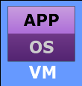
Example: Pooling Processing Power and Memory Capacity
Assigned to
Consumer A
Resource Allocation
Processing power = 1500 MHz
Memory Capacity = 2 GB
Compute System 1
Processing Power = 4000 MHz
Memory Capacity = 6 GB
Resource Allocation
Processing power = 1500 MHz
Memory Capacity = 2 GB
Service A
Service B
Compute System 2
Processing Power = 4000 MHz
Memory Capacity = 6 GB
Resource Allocation
Processing power = 1500 MHz
Memory Capacity = 2 GB
Resource Allocation
Processing power = 1500 MHz
Memory Capacity = 2 GB
Compute System 3
Processing Power = 4000 MHz
Memory Capacity = 6 GB
Resource Allocation
Processing power = 1500 MHz
Memory Capacity = 2 GB
Processor Pool: Processing Power = 12000 MHz
Memory Pool: Memory Capacity = 18 GB
Assigned to
Consumer B

Slide 13
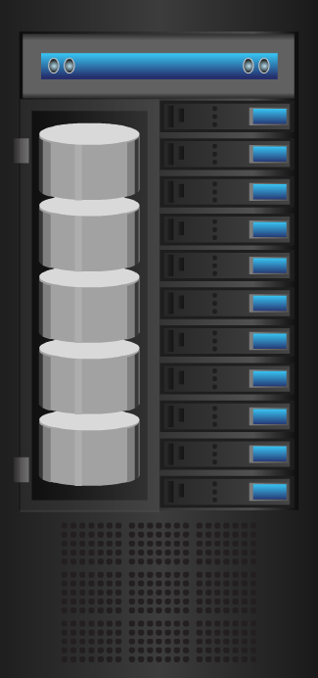
Example: Pooling Storage in a Block-based Storage System
Block-based Storage System
Service A
Resource Allocation
Assigned to
Consumer A
Drive 1
Storage Space =
1000 GB
Logical Unit
Storage Space = 200 GB
Service B
Drive 2
Storage Space =
1000 GB
Resource Allocation
Assigned to
Consumer B
Logical Unit
Storage Space = 400 GB
Drive 3
Storage Space = 1000 GB
Service C
Resource Allocation
Assigned to
Consumer C
Drive 4
Storage Space =
1000 GB
Logical Unit
Storage Space = 800 GB
Storage Pool: Storage Space = 4000 GB

Slide 14
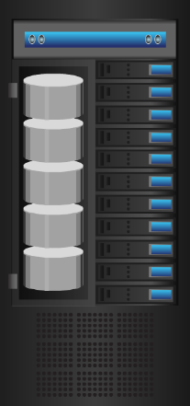
Example: Pooling Storage Across Block-based Storage Systems
Assigned to
Consumer A
Assigned to
Consumer B
Assigned to
Consumer C
Service A
Service B
Service C
Logical Unit
Logical Unit
Logical Unit
Block-based
Storage System
Block-based
Storage System
Block-based
Storage System
Block-based
Storage System
Storage
Pool
Storage
Pool
Higher-level Storage Pool

Slide 15
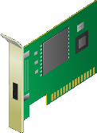
Example: Pooling Network Bandwidth of NICs
Service A
Service B
Assigned to
Consumer A
Assigned to
Consumer B
Resource Allocation
Bandwidth = 600 Mbps
Bandwidth = 300 Mbps
Compute System
NIC 1
Bandwidth =
1000 Mbps
NIC 2
Bandwidth =
1000 Mbps
NIC 3
Bandwidth =
1000 Mbps
Network Bandwidth Pool: Bandwidth = 3000 Mbps

Slide 16
Identity Pool
Specifies a range of network identifiers (IDs) such as virtual network IDs and MAC addresses
IDs are allocated from the identity pools to the elements of cloud services
An identity pool may map to a particular service or to a group of services
Service A
ID Allocation
Assigned to
Consumer A
ID Range: 1 to 10
Identity Pool A
Service B
ID Range: 11 to 100
ID Allocation
Assigned to
Consumer B
Identity Pool B

Slide 17
Virtual Resources
Virtual machine (VM) and VM hardware
VM files and file system to manage VM files
VM console
VM template
Virtual appliance
VM network and its components
Logical Unit Number

Slide 18
Virtual Machine (VM)
Virtual Machine
A logical compute system that, like a physical compute system, runs an OS and applications.
Created by a hypervisor installed on a physical compute system
Comprises virtual hardware, such as virtual processor, memory, storage, and network resources
Appears as a physical compute system to the guest OS
Hypervisor maps the virtual hardware to the physical hardware
Provider provisions VMs to consumers for deploying applications
VMs on the same compute system or cluster run in isolation

Slide 19
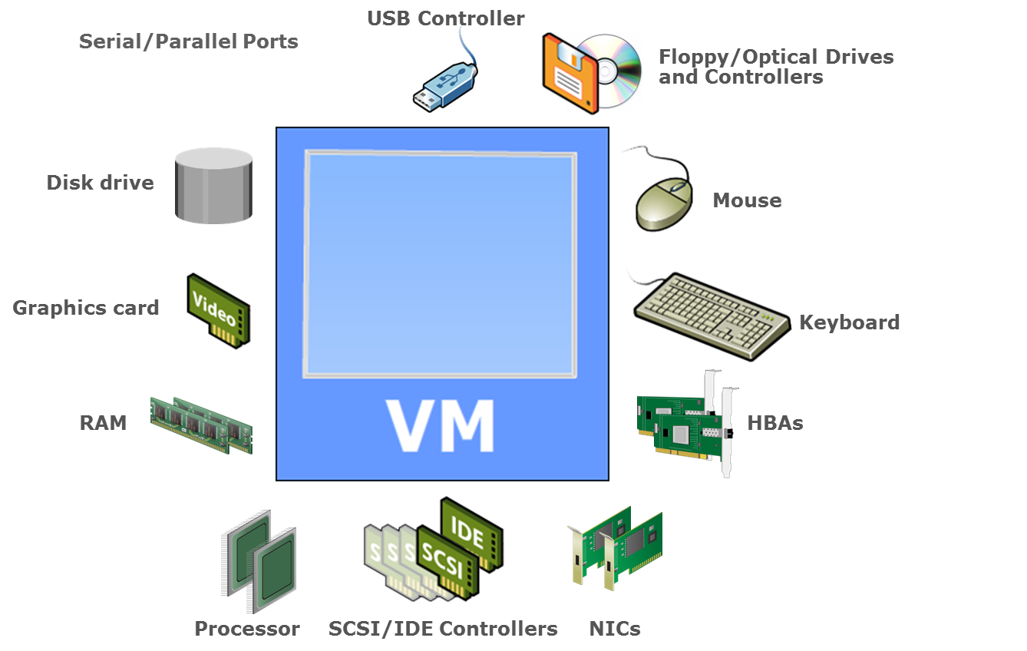
VM Hardware
Notes:
HBA stands for Host Bus Adapter and is used to connect to block level storage such as Fibre Channel, SATA or SCSI.
NIC stands for Network Interface Adapter and is used to connect ethernet storage to a switch or server.

Slide 20
VM Files
From a hypervisor’s perspective, a VM is a discrete set of files such as:
Configuration file
Stores information, such as VM name, BIOS information, guest OS type, memory size
Virtual disk file
Stores the contents of the VM's disk drive
Memory state file
Stores the memory contents of a VM in a suspended state
Snapshot file
Log file
Stores the VM settings and virtual disk of a VM
Keeps a log of the VM’s activity and is used in troubleshooting
Notes:
Suspend-to-RAM (STR) occurs when a system enters a low-power state. Information on system configuration, open applications, and active files is stored in main memory (RAM), while most of the system's other components are turned off.
When you take a snapshot, you capture the state of the virtual machine settings and the virtual disk

Slide 21
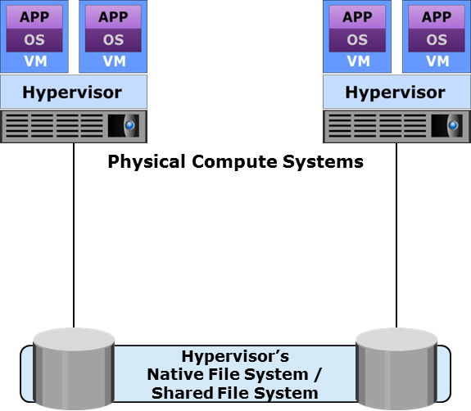
File System to Manage VM Files
Hypervisor’s native file system
Clustered file system deployed on local or external storage
Enables multiple hypervisors to perform concurrent reads and writes
Enables high availability to protect against hypervisor or compute system failure
Shared file system
Enables storing VM files on remote file servers or NAS devices
Hypervisors have built-in NFS or CIFS clients
Notes:
NAS: Network-attached storage
One of the most common reasons for getting a NAS drive is to be able to stream movies, TV shows, music, and photos around the house, to multiple machines and displays, without having to keep one computer running all the time to serve up the content to other devices.

Slide 22
VM Console
VM console is an interface to view and manage the VMs on a compute system or a cluster
VM console may be:
Installed locally on a compute system
Web-based
Accessed over a remote desktop connection
Used to perform activities such as:
Installing a guest OS and accessing VM BIOS
Powering a VM on or off
Configuring virtual hardware and troubleshooting

Slide 23
VM Template
VM Template
A master copy of a VM with standardized virtual hardware and software configuration that is used to create new VMs
Created in two ways:
Converting a VM into a template
Cloning a VM to a template
Steps involved in updating a VM template are:
Convert the template into VM
Install new software or OS/software patches
Convert the VM back to a template

Slide 24
Virtual Appliance
Virtual Appliance
Preconfigured virtual machine(s) preinstalled with a guest OS and an application dedicated to a specific function.
Used for functions, such as providing SaaS, routing packets, or deploying a firewall
Simplifies the delivery and operation of an application
Simplifies installation and eliminates configuration issues
The application is protected from issues in other virtual appliances
Typically created using Open Virtualization Format (OVF)

Slide 25
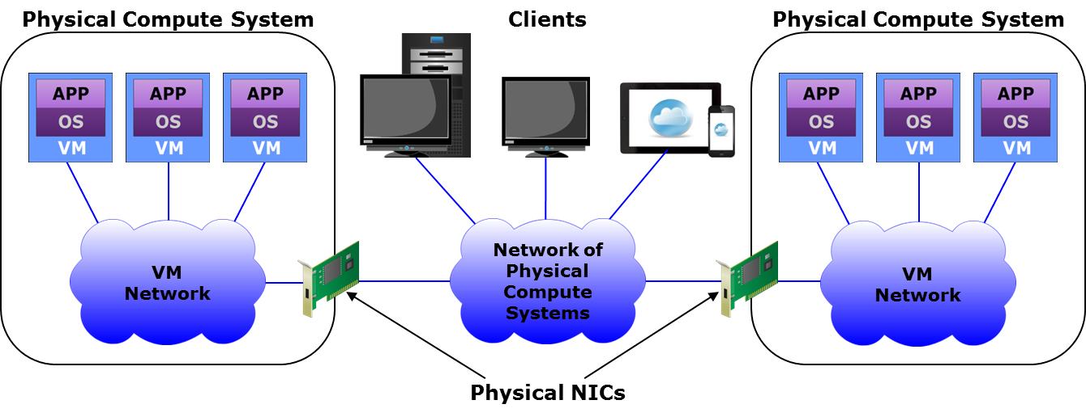
VM Network
VM Network
A logical network that provides Ethernet connectivity and enables communication between VMs within a compute system.

Slide 26
VM Network Components
Component | Description
Virtual switch | A logical OSI Layer 2 Ethernet switch created in a compute system Connects VMs locally and also directs VM traffic to a physical network Forwards frames to a virtual switch port based on destination address A distributed virtual switch can function across multiple physical compute systems
Virtual NIC | Connects a VM to a virtual switch and functions like a physical NIC Has unique MAC and IP addresses Forwards the VM’s network I/O in the form of Ethernet frames to the virtual switch
Uplink NIC | A physical NIC connected to the uplink port of a virtual switch Functions as an ISL between virtual and physical Ethernet switches Not addressable from the network
Notes:
ISL: Inter switch Link

Slide 27
Logical Unit Number
Logical Unit Number
Abstracts the identity and internal functions of storage system(s) and appear as physical storage to the compute system.
Mapping of virtual to physical storage is performed by the virtualization layer.
Provider provisions Logical Unit Number to consumers for storing data
Its storage capacity can be dynamically expanded or reduced
Logical Unit Number can be created from
RAID set (traditional approach)
Storage pool

Slide 28
Lesson Summary
During this lesson the following topics were covered:
Virtual layer
Virtualization software
Resource pool
Virtual resources

