Slide 1
Strategies in Emerging Markets
Emerging economies

Slide 2
Emerging Economies
Objectives
Introduction
Triad firms and emerging economy firms: why the mutual interest?
An overview of emerging economies, by region
Shifting patterns of comparative and competitive advantage
Market access to the triad

Slide 3
Objectives
Examine the relative attractions, opportunities and threats in the triad regions and emerging economies for firms looking to internationalize.
Explain how many emerging economies are becoming more integrated into the global economy, in terms of trade, FDI and other forms of interaction and interdependence.
Understand the nature of the new multinationals from emerging economies, as collaborators and competitors.
Examine the implications of changes in emerging economies for MNE managers in terms of new strategies and organization structures.

Slide 4
Introduction
Emerging market countries are:
Growing in importance for international managers for both market-seeking investments and resource-seeking investment.
Strongly government-controlled, in that government agencies play a central role in negotiating with foreign investors and deciding the local rules of the game.
Less predictable and riskier than triad markets, which investors often underestimate in their pursuit of the high level of rewards on offer.
The source of new competitors, as local firms move up the value-chain, becoming more sophisticated and more international.

Slide 5
Types of international
expansion
There are two types of international expansion that are important in relation to non-triad firms:
internationalization from the triad into non-triad regions;
the internationalization of newer MNEs from outside the triad who are looking to access larger economies.

Slide 6
Triad firms and emerging economy firms: why the mutual interest?

Slide 7
Triad firms and emerging economy
firms: why the mutual interest?
For triad-based MNEs:
Triad economies are growing slowly relative to emerging markets both large, like India, China and Brazil and small, like Poland or Malaysia
Triad regions also tend to be more expensive, in terms of labour costs, infrastructure, land, materials and supporting industries, relative to non-triad regions.
As a result, there are strong incentives for triad-based firms to:
sell products, services, and other outputs into these growing, non-triad markets;
to source inputs, from cheap labour or manufactured components to services, from such places.

Slide 8
Triad firms and emerging economy
firms: why the mutual interest? (Continued)
For non-triad-based MNEs:
Large, mature markets like the US, the EU and Japan offer opportunities to sell their products.
Many firms also look to these countries to fill gaps in their assets, resources and capabilities, from technological know-how or specialist components, to brands.

Slide 9
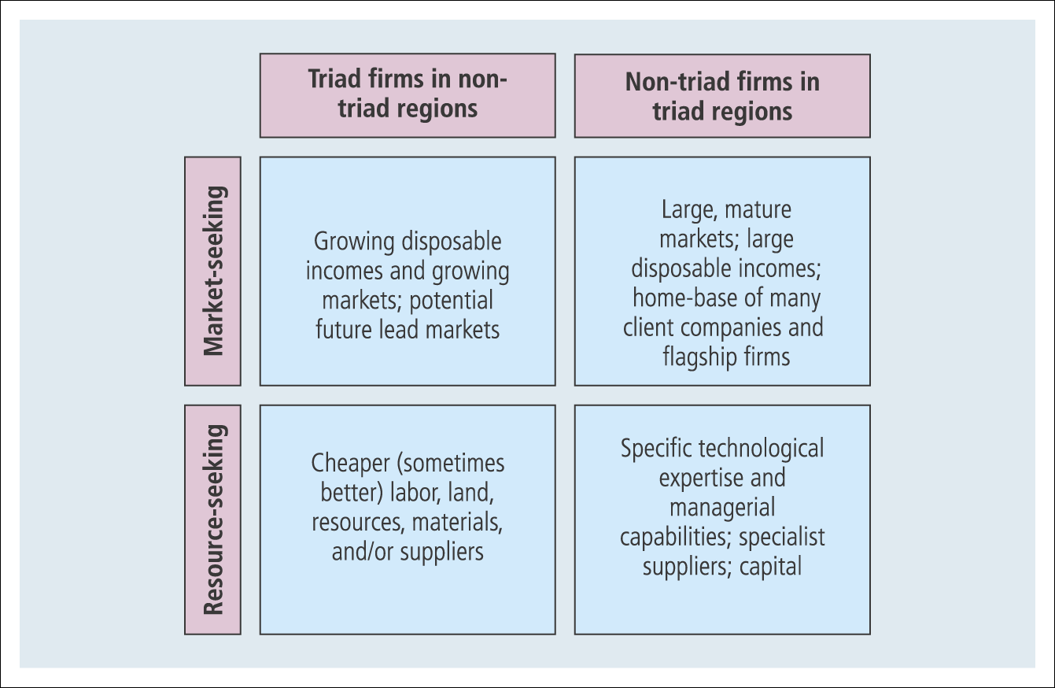
Figure 19.1 What is the attraction for triad and non-triad firms investing in each other’s home regions?

Slide 10
An overview of emerging economies, by region

Slide 11
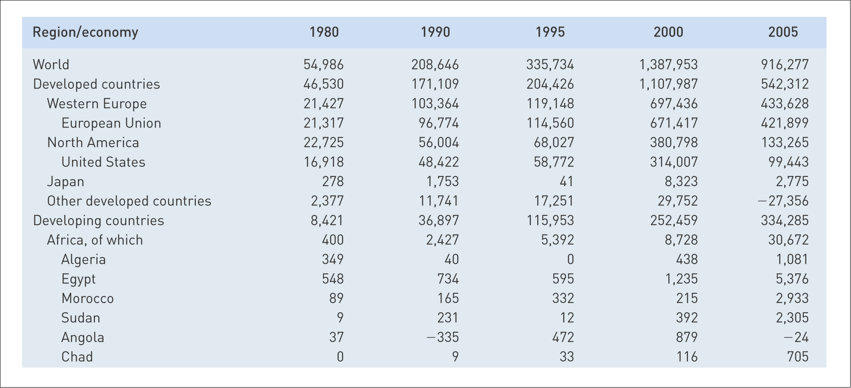
Table 19.1 FDI inflows, by host region and economy, 1980–2005 (millions of dollars)

Slide 12
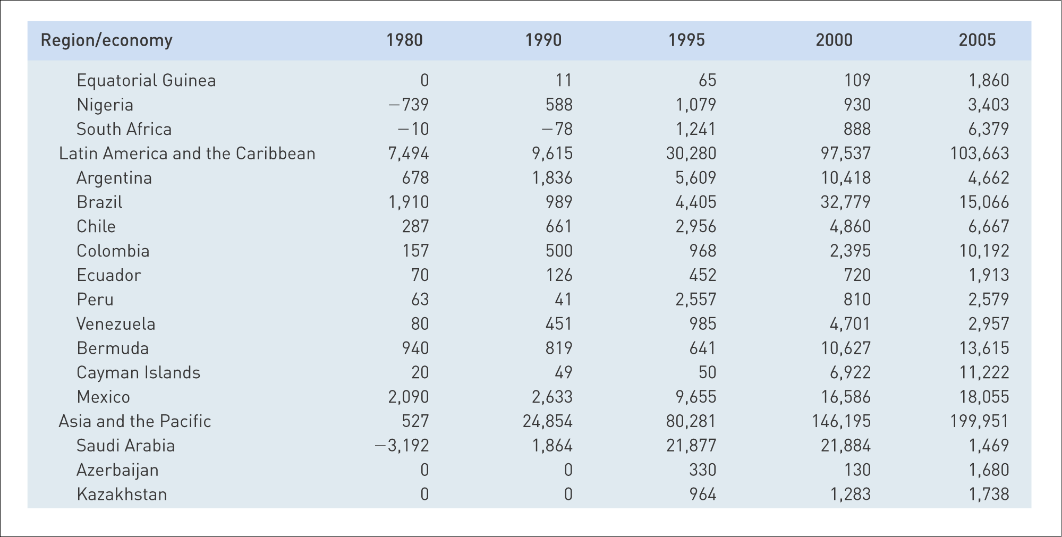
Table 19.1 FDI inflows, by host region and economy, 1980–2005 (millions of dollars) (Continued)

Slide 13
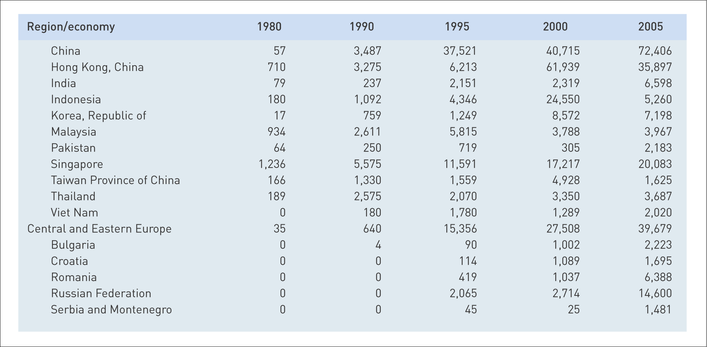
Table 19.1 FDI inflows, by host region and economy, 1980–2005 (millions of dollars) (Continued)

Slide 14
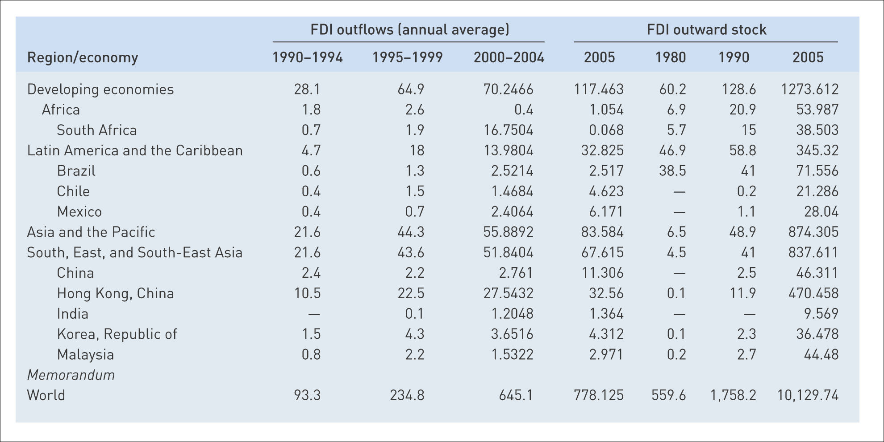
Table 19.2 FDI from developing countries, 1980–2005 (billions of dollars)
Source: UNCTAD, World Investment Report, 2004 (Geneva: UNCTAD, 2006), at www.unctad.org

Slide 15
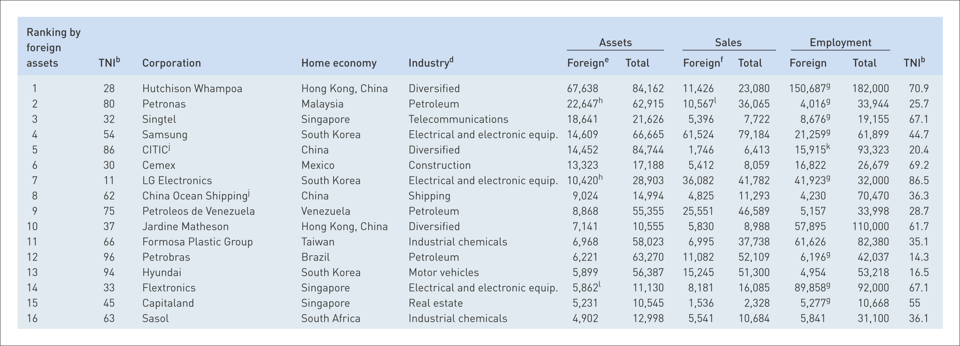
Table 19.3 The top 50 non-financial TNCs from developing economies ranked by foreign assets, 2005ª (millions of dollars, number of employees)
Source: United Nations, World Investment Report, 2006 © United Nations 2001, 2006, 2007 www.unctad.org/wit

Slide 16
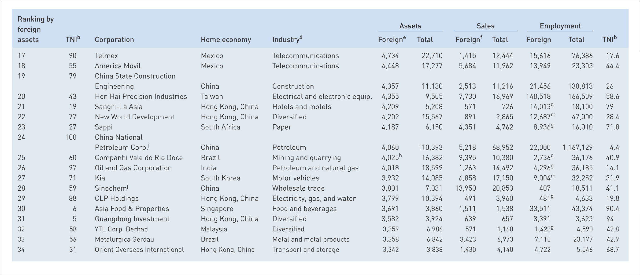
Table 19.3 The top 50 non-financial TNCs from developing economies ranked by foreign assets, 2005ª (millions of dollars, number of employees) (Continued)
Source: United Nations, World Investment Report, 2006 © United Nations 2001, 2006, 2007 www.unctad.org/wit

Slide 17
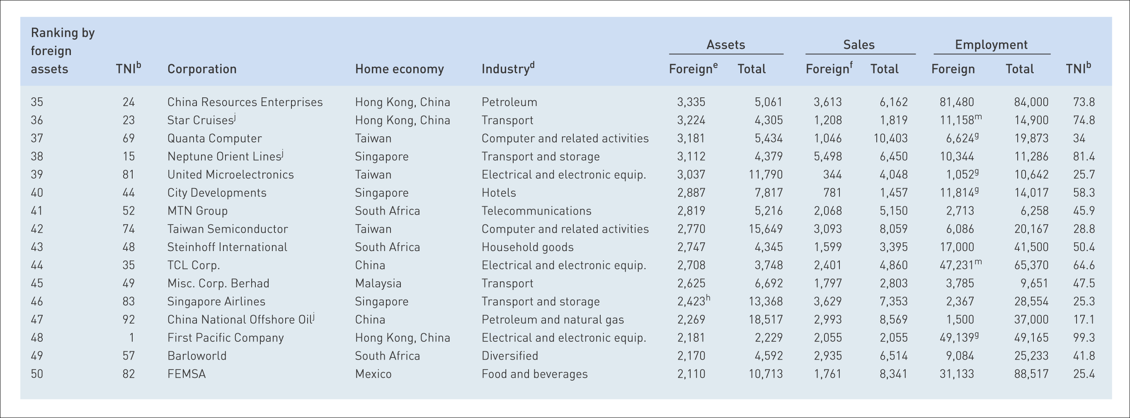
Table 19.3 The top 50 non-financial TNCs from developing economies ranked by foreign assets, 2005ª (millions of dollars, number of employees) (Continued)
Note:
ª All data are based on the annual reports of TNCs (MNEs) unless otherwise stated.
^{b} TNI, or “Transnationality Index,” is calculated as the average of the following three ratios: foreign assets to total sales, foreign sales to total sales, and foreign employment to total employment.
^{d} Industry classifications for companies follows the US Standard Industrial classification as used by the US Securities and Exchange Commission (SEC).
^{e} In a number of cases, companies reported only partial foreign sales. In a number of cases companies reported sales only by destination.
^{f} Foreign sales are based on the origin of the sales. In a number of cases companies reported sales only by destination.
^{g} Foreign employment data are calculated by applying the share of foreign employment in total employment of the previous year to total employment of 2006.
^{h} Foreign assets data are calculated by applying the share of foreign assets in total assets of the previous year to total assets of 2006.
^{i} Foreign sales data are calculated by applying the share of foreign sales in total assets of the previous year to total sales of 2006.
^{j} Data were obtained from the company in response to an UNCTAD survey.
^{l} Data for foreign activities are outside Asia.
^{m} Foreign employment data are calculated by applying the average of the share of foreign employment in total employment of all companies in the same industry (omitting the extremes) to total Employment
Source: United Nations, World Investment Report, 2006 © United Nations 2001, 2006, 2007 www.unctad.org/wit

Slide 18
Asia-Pacific and the Middle East
Receive 22% of global FDI flows, the most of any non-triad region.
90% of FDI is concentrated in only 10 countries.
China, Hong Kong (China) & Singapore receive the most FDI.
The oil rich countries of the Middle East also experience FDI, but this is almost exclusively related to their oil industries.
Many of the countries in the region continue to liberalize their economies and privatize state-owned assets.

Slide 19
Asia-Pacific and the Middle
East (Continued)
There are two clear trends that indicate the dynamism of the Asia region.
The growth on intra-regional investment, particularly driven by the regional giants India and China joining countries like Malaysia, South Korea, Taiwan and Singapore as active investors.
FDI in services is growing rapidly and now represents over 50% of FDI stock in the Asia region.

Slide 20
MNEs from Asia Pacific
36 out of the 50 largest non-financial MNEs from developing countries listed by UNCTAD (UN Corporate On Trade & Development) are from the Asia-Pacific region.
The largest number from any country comes from Hong Kong (China), for example, Hutchison Whampoa (Hong Kong)
Others from the region include Singtel (Singapore); Petronas (Malaysia); Samsung Electronics (South Korea); etc.

Slide 21
Central and Eastern Europe
Despite years of political and economic change, including liberalization, the Central and Eastern European region still attracts a relatively small percentage of global FDI inflows (just over 4%).
Poland, the Czech Republic and Hungary receive larger shares of FDI than other countries in the region but have experienced declines in recent years, as has the Russian Federation.
These, plus 5 other CEE countries (Estonia, Latvia, Lithuania, Slovenia and Slovakia) joined the EU in May 2004 and all saw FDI inflows shrink recently, but prospects look better from now on.

Slide 22
MNEs from Central and Eastern Europe
The largest MNEs in the CEE region are Russian, many of them based on the country’s abundant natural-resources, such as Gazprom, Rosneft and LuKoil.

Slide 23
Latin America and the Caribbean
11% of global FDI went to the Latin America region in 2006.
The three largest economies of Argentina, Brazil and Mexico had a difficult decade in terms of economic growth and recession, which stymied FDI inflows.
A spate of privatizations during the late 1990s boosted inward FDI for these and other regional economies and as this process came to an end, so did the FDI inflows.
Brazil and Mexico still received the highest amounts of FDI and, as we would expect, one-third of all FDI into the region came from the USA.
Many Latin American countries now face increased competition for US manufacturing investment from China and the Asian region.

Slide 24
MNEs from Latin America
8 of the 50 largest non-financial MNEs from developing countries listed by UNCTAD are from the Latin American region.
Half of them are based in Mexico.
Many of the largest are natural resources based.
These include the largest of all, Cemex (Mexico), Petrobras (Brazil), Companhia Vale do Rio Doce (Brazil), Metalurgica Gerdau (Brazil) and Perez Companc (Argentina).

Slide 25
Africa
Less than 4% of total global FDI goes to Africa.
Resource-rich economies (oil, diamonds, gold and platinum)
Home to most of the world’s least-developed countries (LDCs).
Africa has always recorded low levels of inward FDI because of its relative lack of political instability, weak infrastructure, poor labour skills and macro-economic fragility.

Slide 26
MNEs from Africa
Only 5 of the 50 largest non-financial MNEs from developing countries listed by UNCTAD are from Africa and they are all South-African.
Sappi, Sasol, MTN Group and Barloworld are major players in their respective sectors throughout the region.

Slide 27
Shifting patterns of comparative and competitive advantage

Slide 28
Shifting patterns of comparative and competitive advantage
FDI into non-triad regions:
Tends to be concentrated in a few countries within each region.
Still tends to be related to primary resources.
There is a growing volume of manufacturing and service-related FDI.
this is particularly true for a group of emerging markets or “newly-industrializing countries” (NICs), which have broken the cycle of underdevelopment to achieve economic growth and wealth-creation, partly through increased integration with other parts of the global economy.

Slide 29
Shifting patterns of comparative and competitive advantage (Continued)
Traditional trade theories can help explain current patterns of growth in emerging markets.
The theory of absolute advantage suggests that each nation should specialize in producing goods it has a natural or acquired advantage in producing.
The theory of comparative advantage holds that a relative advantage is all that is necessary for net gains from trade.
The factor endowments theory allows us to look at the relative availability of different factors of production (land, labour and capital) and therefore their relative price in each country.

Slide 30
The Flying Geese model
Asian economies are following similar development paths, but are at different stages along this path, following the lead “goose” Japan.
Over time each country, or group, will gain and then subsequently loose specific comparative advantage in a particular industry.

Slide 31
The Flying Geese model
(Continued)
In each country the transition is marked by a shift of employment from one sector to another, within the broader move from agriculture to manufacturing and then to services.
Overall, rising skills and improved technological capabilities, increased capital investment and wage inflation (as predicted by the HOS model) drive and are driven by, the change process.

Slide 32
The Flying Geese model
(Continued)
The timescale over which individual countries develop the economic conditions, resources and capabilities to specialize in a particular industry sector appears to be shortening.
Comparative advantage between nations is also therefore shifting faster than in the past.
Time it took to evolve into leading firms in their industries:
Toyota and Sony (Japan): 30–35 years;
Samsung (South Korea) and Acer (Taiwan): 20–25 years;
WIPRO, Infosys and TCS (India):15–20 years.

Slide 33
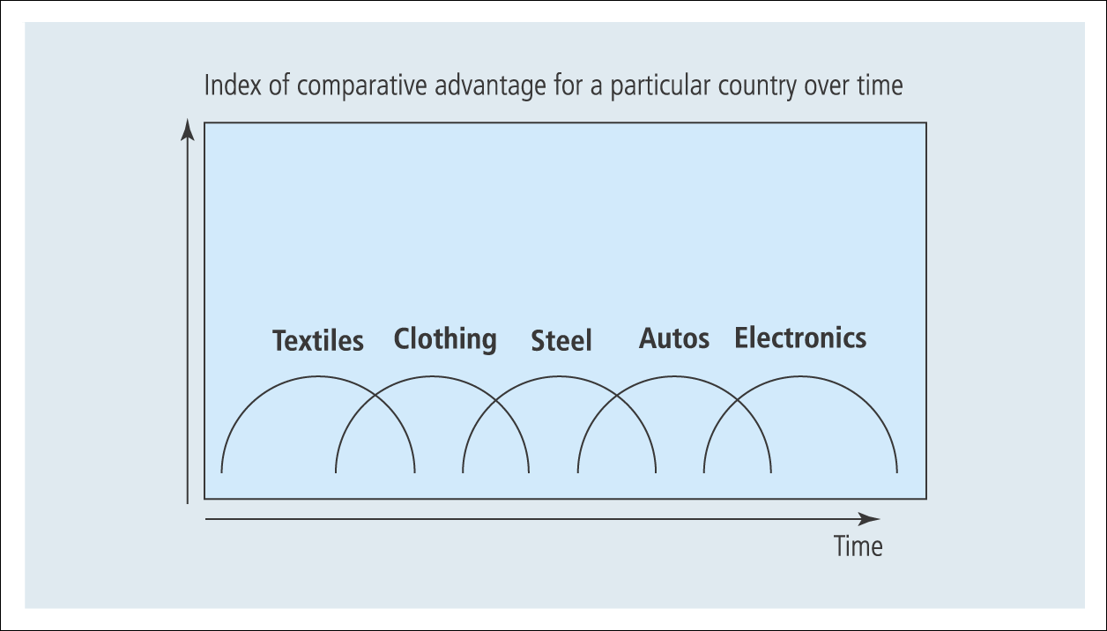
Figure 19.2 “Flying Geese” model: changing national-level specialization

Slide 34
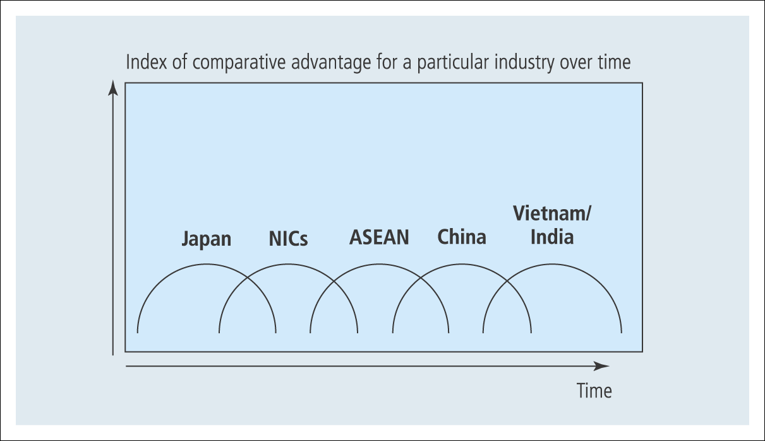
Figure 19.3 “Flying Geese” model: the shifting location of industrial production

Slide 35
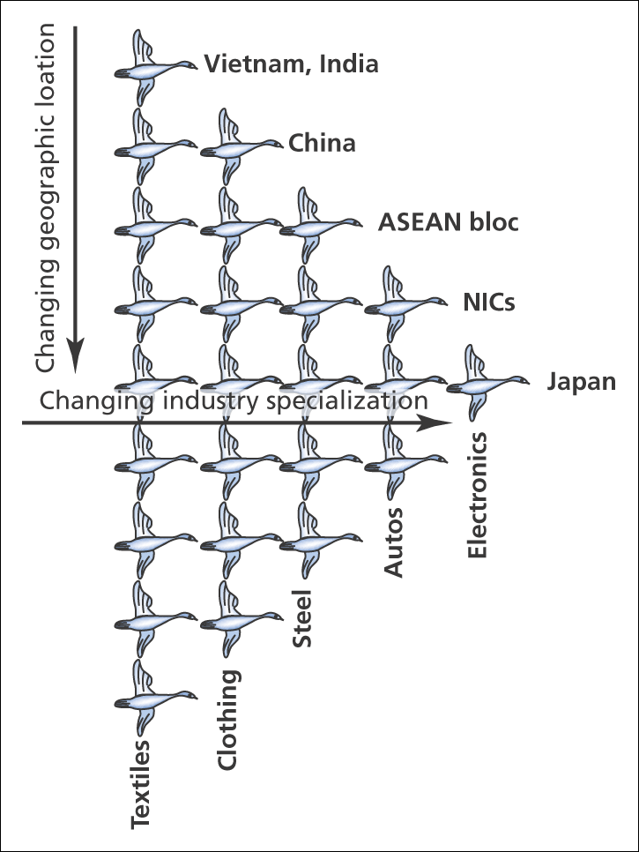
Figure 19.4 “Flying Geese” pattern of shifting comparative advantage

Slide 36
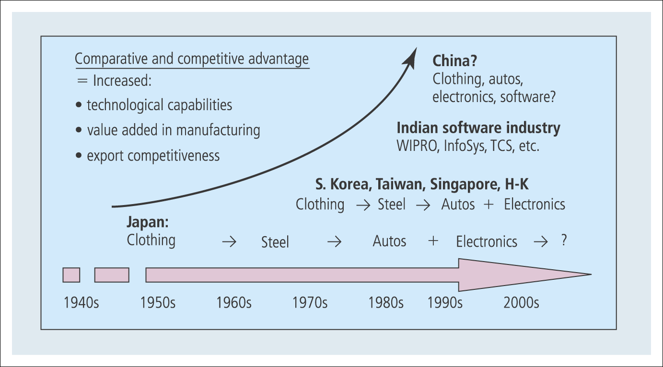
Figure 19.5 Accelerated structural transformation (are the geese flying faster?)

Slide 37
Criticism of Flying Geese model
Many studies note that the sequential transfer of industrial specialization does not follow the same pattern in each country, or that it tends to be more of a parallel process whereby emerging economies seem to develop capabilities and grow exports across several industries at the same time.
The example of the Indian IT and services industry also demonstrates that leapfrogging is possible. Here a less developed country (LDC) has evolved competitive advantages in an advanced service sector without going through the stages depicted by the model.
However, some insights can be gained into the processes affecting the changing global locations of different industries and business activities and into the changing relatively competitive advantage between countries.

Slide 38
Emerging economies as sources of innovation
Traditional theories about the MNE tended to view the Triad a source of innovation and non-triad regions as recipients.
The development of ‘‘national innovation systems’’ have made some emerging economies attractive to R&D FDI from MNEs.
This influx of high-technology investment further adds to the importance of emerging economies as sources of, rather than passive recipients of, innovation.

Slide 39
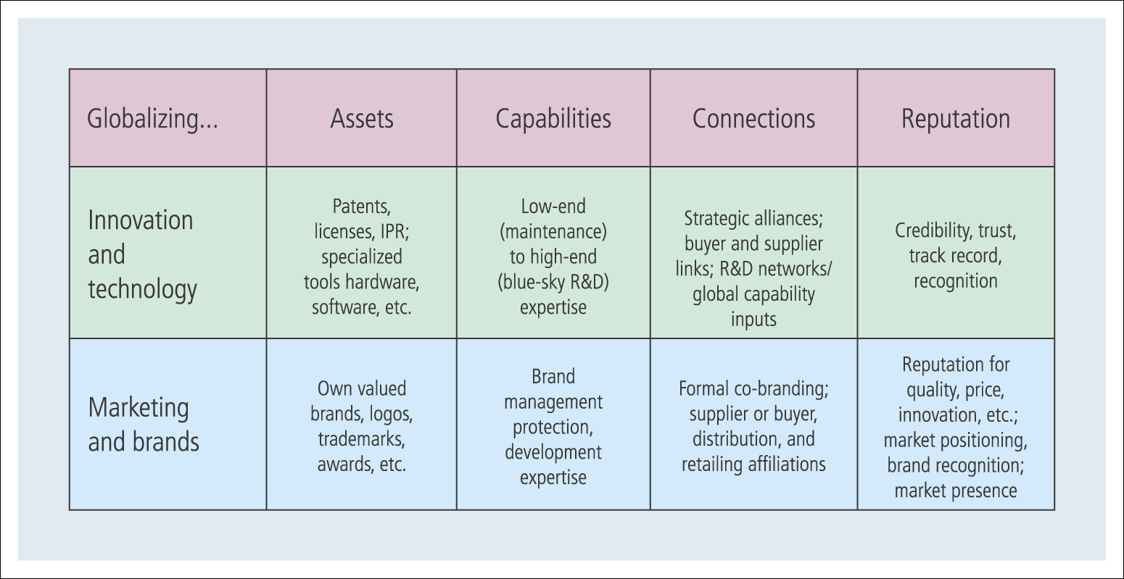
Figure 19.6 Firm-specific advantages (FSAs) for the new multinationals

Slide 40
Market access to the triad

Slide 41
Market access to the triad
Non-triad nations need both trade and investment with triad nations and also access to the markets of at least one of the triad regions.
Access can be subject to complex arrangements with varying degrees of economic trade liberalization and protectionism that are inherent in the institutional and political structures of these regions.

Slide 42
Market access to the triad
(Continued)
The focus of business strategy for non-triad nation firms should be to secure inward triad investment and market access for exports to a triad bloc.
Direct business contact of a double diamond type.
Formal linkages arranged by the governments.
“Clusters” of nations are making such arrangements with triad blocs. Some smaller, non-triad nations may attempt to open the doors to two triad markets.
For example, both South Korea and Taiwan have equal trade and investment with the US and Japan. Firms from these countries need two double diamonds.

