Slide 1
CT105-3-M Cloud Infrastructure and Services
Cloud Services

Slide 2
Lesson: Cloud Services
This lesson covers the following topics:
Cloud services and its functions
Service catalog and its elements
Service ordering
Cloud interfaces
Cloud portal
Cloud service lifecycle
Service automation
Notes:
This lesson covers the overview of the cloud services and its functions. It focuses on service catalog and its elements. The lesson also focuses on how to request or order a service. Finally, the lesson describes the cloud interfaces, cloud portal and walk through the cloud service lifecycle.

Slide 3
Introduction video: Transforming IT into cloud service provider
To access the video, please click the below link
https://edutube.emc.com/Player.aspx?vno=x2vado2wR+qK3TlKOOtFQg==&autoplay=true&t=0h0m0s
Notes:
The video on the slide talks about how IT department in the organizations provide a self-service portal to add and provision the virtual. Today, if IT wants to become a cloud service provider, IT must not only embrace the public cloud, IT needs to provide broader range of cloud services.

Slide 4
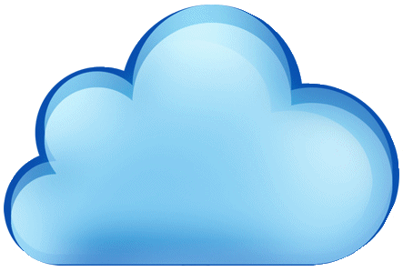
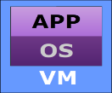
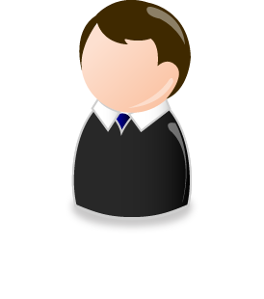
Cloud service - Introduction
Cloud services are pack of IT resources made available to the cloud consumer by the cloud service provider.
Example:
In IaaS, a service provider supplies the virtual servers, Virtual LAN, and storage for deploying test environment
VLAN 10
Application Server
VLAN 30
Test Servers
VLAN 20
IT Resource Package
Database server
Logical Unit No (LUN)
Example of Cloud Service
User Request Services

Slide 5
Cloud service - Introduction (Cont’d)
Cloud computing deployment should begin with service definition
Steps targeted to achieve business outcomes
Complex Situationally dependent
Coordination- Oriented
Cross-Silo
Business Services Automation
Identify IT services that you offer or procure
Document the internal processes
Map the workloads to the associated cloud services
Business Value
IT Service Automation
Cloud Computing Services
IT Task Automation
Provisioning
Patch
Configuration Access
Compliance
and Audit
……..
Functionality Specific
Simple: Fixed Sequence
Technically Focused
Source: Gartner - Aug 2017

Slide 6
Key Functions of Cloud Service Component
Enables defining services in a service catalog
ensure that the consumers are able to view the available services, service level options, and service cost.
Enable on-demand self-service provisioning of services
such as required resources, needed configurations, and location of data.
Presents cloud interfaces to consume services
consumers perform computing activities, such as executing a transaction and administer their use of rented service instances such as modifying, scaling, stopping, or restarting a service instance.
Cloud Services

Slide 7
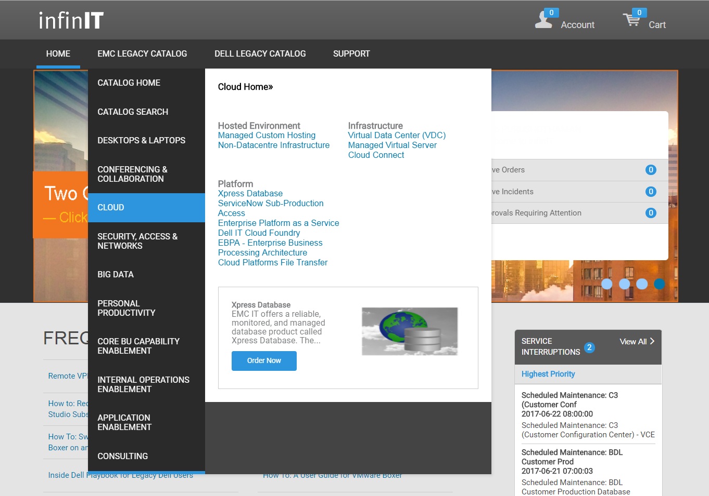
Service catalog
Menu of services that lists services, attributes of services, service level commitments, terms and conditions for service provisioning, and prices of services.
Service providers define services in a catalog
For example:
VM, and Storage
Example: DELL EMC Cloud Service Catalog

Slide 8
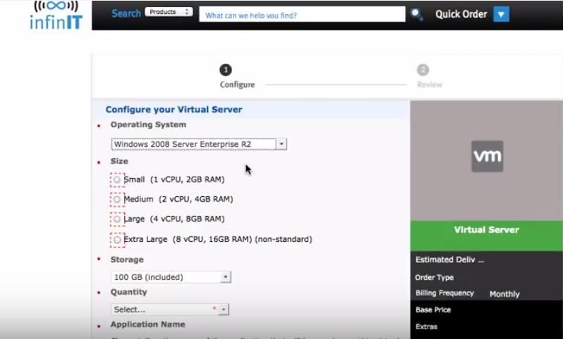
Service ordering
Choose a Service from a Service Catalog
Select suitable attributes of the service
Agree to Contract Terms and Submit the Form
Example : Web Form for Ordering VM

Slide 9
Service catalog - demo video
To access the video, please click the below link
https://edutube.emc.com/Player.aspx?vno=huo+MObUdvYllp5jPJLWsQ==&autoplay=true&t=0h0m0s
Notes:
The video talks about service catalog infinIT - the one destination for everything you need from the Dell EMC IT portal. This IT portal gives the online shopping experience to the customers with the choices you need transparent pricing and service levels. The portal allows the customers to browse, search, and learn about IT services.

Slide 10
Cloud service interfaces
Enable computing activities and administration of rented service instance
Types of cloud Interface
Management
Functional
Cloud services are accessed using web services which are primarily based on:
REST
SOAP
 | IaaS Functions | PaaS Functions | SaaS Functions
 | Start, stop, and configure VMs Add storage volumes of specific size | Add, configure, and delete database Modify infrastructure resources that are available to applications and database | Add new users Change user roles and permissions
 | Specifics of hardware, such as processors, memory, network adapters, and storage volumes | Integrated development environment (IDE) that consists of programming interface, libraries, and tools Development environment offering software development kit (SDK) | Graphical user interface (GUI) of a business application
Management
Functional

Slide 11
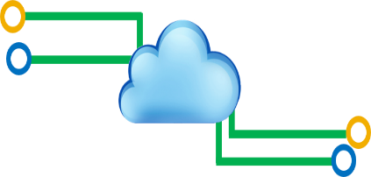
Cloud portal
A web portal that presents service catalog and cloud interfaces, enabling consumers to order and manage cloud services
Cloud Portal
Created using Portal software
Cloud portal has two key functions
Common elements of the Cloud portal
Hosted on one or more portal servers
Enable providers to design and publish cloud portals
User may use URL of cloud to log on
Service catalog
Management Interface
Link to functional interface
Presentation
Interaction with orchestration layer

Slide 12
Cloud service lifecycle
Assessing Service
Requirements
Defining Service
Template
Discovering Service
Assets
Deprovisioning
Service Instance
Developing Service
Enablement Roadmap
Creating Orchestration
Workflow
Managing Service
Operations
Activities
Establishing Billing
Policy
Defining Service
Offering
Creating Service
Contract
Time
Service Planning
Service Creation
Service Operation
Service Termination

Slide 13
Phase 1: Service planning
It Involves making business case decisions for cloud service offering portfolio
Activities
Assessing Service Requirement
Consider both business requirements and IT capability as inputs
Include both current and future needs
Service Planning
Developing Service Enablement Roadmap
Guides the strategic direction to fulfill service requirement
Follows five steps service framework – Understand, Plan, Build, Enable, and optimize
Establishing Billing Policy
Generating bills from the cloud resource usage data
In private cloud, chargeback and show back are commonly used
Factors for billing policy
Providers business goal
Service-specific pricing strategy

Slide 14
Phase 2: Service creation
Creating Orchestration Template
It involves defining services in the service catalog and creating workflows for the service orchestration
Defining Service Template
Common activities during service creation:
Creating workflow Template
Resources are allocated, configured, and integrated as per service template to create an instance of a service
Provides standard to create predictable service instances
Defined in service catalog
Workflow for service orchestration are created based on service template specification
Workflows enable automated allocation, configuration, and integration of resources

Slide 15
Phase 2: Service creation (Cont’d)
Defining Service Offering
Creating Service Contract
Creating workflow Template
An entry in the service catalog that describes a service template combined with constraints, policies, rules, price, and SLA
SLA – A contract between the cloud service provider and the cloud consumer that defines the service levels
Agreement between the service provider and consumer
Service contract describes terms and conditions for using a service
Must be established with the provider while ordering a service

Slide 16
Service offering: Examples
Policy
Service Offering
Service Template Specifics
Security | Security Patching Occurs Without Prior Notification
Price
Service Template Specifics
Constraints
Policies
Rules
Price
SLA
Processor | 4 CPUs: 1.5 GHz per CPU
Memory | 8 GB
Storage | 100 GB
OS | Windows
Backup | Every 24 Hours
Service Charge | From $302
Service Access | Engineering Unit
Data Restore | Only BU Manager can Initiate Data Restore Request
Storage Limit | Storage per VM can be Incremented up to 500 GB
Subscription Period | 1 Month
Provision Time | 8 minutes
Billing | Billed for Whole Month—No Partial Month Billing
Licensing | Company is Responsible for OS License
Service Catalog
Constraints
Rules
SLA
Notes:
The slide shows an example of the IaaS offering that combines service template specifics, constraints, policies, rules, price, and SLA. This service offering includes compute and storage components and a data backup service. It is defined in the service catalog.

Slide 17
Phase 3: Service operation
Activities
It involves ongoing management operations to maintain cloud infrastructure and deployed services
Managing Service Operations
Discovering Service Assets
Activities
Common activities during service operation:
Managing service operations
Managing service operations
Developing service enablement roadmap
Developing service enablement roadmap
Developing service enablement roadmap
Developing service enablement roadmap
Developing service enablement roadmap
Developing service enablement roadmap
Developing service enablement roadmap
Developing service enablement roadmap
Developing service enablement roadmap
Developing service enablement roadmap
Developing service enablement roadmap
Developing service enablement roadmap
Involves service-related operations across cloud infrastructure
Ensures and restores service levels while continuously optimizing management operations
Key management operations are monitoring and reporting, provisioning, and troubleshooting
Automating service operations as much as possible is a key goal
Involve service-related operations across cloud infrastructure
Ensure and restore service levels while continuously optimizing management operations
Key management operations include:
Monitoring and reporting
Provisioning
Troubleshooting
Involve service-related operations across cloud infrastructure
Ensure and restore service levels while continuously optimizing management operations
Key management operations include:
Monitoring and reporting
Provisioning
Troubleshooting
Discovery provides visibility into each service asset
Discovery enables monitoring cloud infrastructure resources centrally
Discovery is performed using specialized tool
Discovery tool commonly interacts with service assets through APIs

Slide 18
Phase 4: Service termination
Service Provider
Consumer
Service termination deals with the end of the relationship between the cloud service provider and cloud service consumer.
Managing service operations
Developing service enablement roadmap
Developing service enablement roadmap
Service providers no longer offer a service
Common reasons to terminate:
Business circumstances
Disaster at premise
Violation of contract or SLA
Resource upgradation - Hardware or software
Terminated easily and quickly through the cloud portal
Common reasons for terminate
Business circumstances
Service requirements are temporary
Performance not acceptable to the customer

Slide 19
Service Automation: Demo
To access the video, please click the below link
https://edutube.emc.com/Player.aspx?vno=Y0XURCZdEEM+GiEknKHq/g==&autoplay=true&t=0h0m0s

Slide 20
Challenges of traditional service management
Challenges
Does not offer necessary services in required time frame
Asset specific management
Complex for large and multivendor environment
Management processes are implemented separately from service design
Capex is high for resource management
May not support service-oriented infrastructure

Slide 21
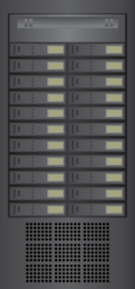
What is Service Automation?
Automated Operations Management
Service request
Automation
Orchestrated Service Delivery
Self-Service Portal
Service Catalog
Request for provisioning
User request services
Infrastructure

Slide 22
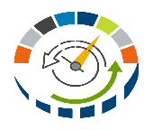
Automation of Operations Management
Key automated operations management processes are:
Monitoring
Availability Management
Configuration Management
Incident Management
.
.
.
.
.
Change Management
Problem Management
?
Current State
Future State
Performance Management
Security Management

Slide 23
Orchestration of Service Delivery
User
User request
Services available
Self-Service portal
Service creation request
Provisioned services
Orchestrator and Automation Software
Provisioning request
Provisioned resources
IT Infrastructure
Example:
Automating the password request

Slide 24
Service Automation: Key Benefits
!
Reduced Service Provisioning Time
Eliminate Manual Errors
Benefits
Simplified Infrastructure
Management
Reduced Operating Expenses

Slide 25
Lesson Summary
During this lesson the following topics were covered:
Cloud services and its functions
Cloud services catalog and portal
Cloud interfaces
Cloud service lifecycle
Service automation

