Slide 1
Entry Strategies: Emerging Market Economies

Slide 2
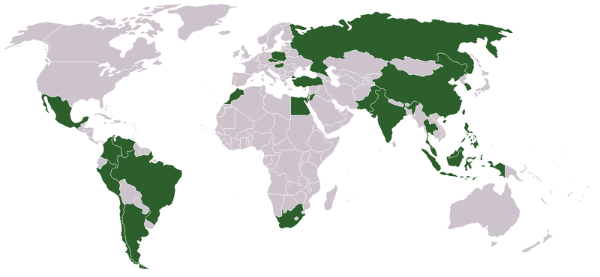
Emerging Markets

Slide 3
The 86% Markets
The developed world - GNP of over $10K per capita- constitutes only 14% of the world’s population
86% of the world – the emerging markets - has a GNP of less than $10K per capita
It is this 86% that represents the future of global commerce

Slide 4
Challenges in the 86% Markets
Markets, culture and environments are demanding
Extremely fragmented markets
Youthful and growing populations
Limited income and space
Underdeveloped infrastructure
Weak supply and distribution channels
Rapidly changing markets
Can these Challenges
be converted into Opportunities?

Slide 5
The 86% Opportunities
Demanding markets, culture and environments
“Don’t build a car when you need a bullock cart”
Rapidly changing markets
Develop with the market
Youthful and growing populations
Think Young
Limited income and space
Grow big by thinking small
Weak supply and distribution channels
Take the market to the people
Underdeveloped infrastructure
‘Bring your own infrastructure/ Look for the Leapfrog’

Slide 6
Challenge : Demanding markets, culture and environments
Opportunity :
Don’t Build A Car When You Need A Bullock Cart

Slide 7
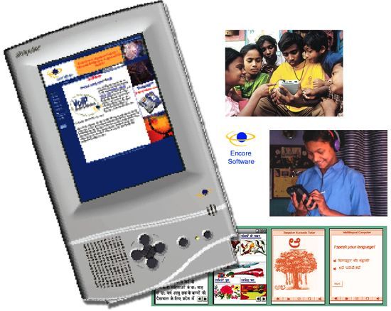
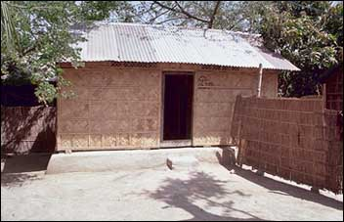
Don’t Build A Car When You Need A Bullock Cart
Less is more
Product formulation and design must reflect the environment
Poor infrastructure - strip things down to basics
People don’t need advanced functions – they need to get work done . Eg: Simputer -India
Low price doesn’t mean low quality
Emerging market customers expect the most from their meager resources. Eg: Grameen Bank housing -Bangladesh

Slide 8
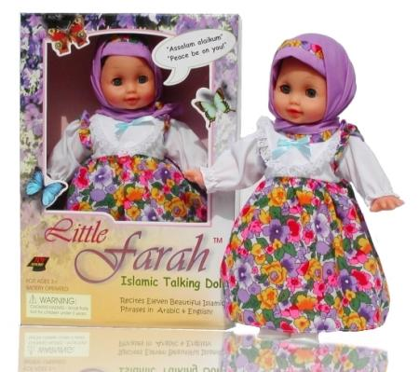
Don’t Build A Car When You Need A Bullock Cart (cont.)
Look at the deeper meaning of products
Products may have deeper meanings than their intended use
Address deeper elements of culture and religion
Eg: talking Farah dolls - Middle East
No customer culture
Lack an understanding of consumerism
Need to be educated about how to be customers
Eg: Spice Jet

Slide 9
Challenge: Rapidly changing markets
Opportunity:
Connect Brands to the market

Slide 10
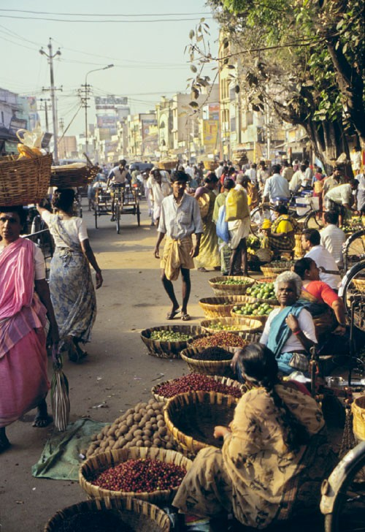
Connect Brands to the Market
There is no such thing as an ‘Indian’ or ‘Chinese’ market
Every national market is made up of several highly unique and fragmented markets
Local brands thrive
Localize the brand
Tailor brand to individual markets
Use the national/regional language
Eg: MTV Asia

Slide 11
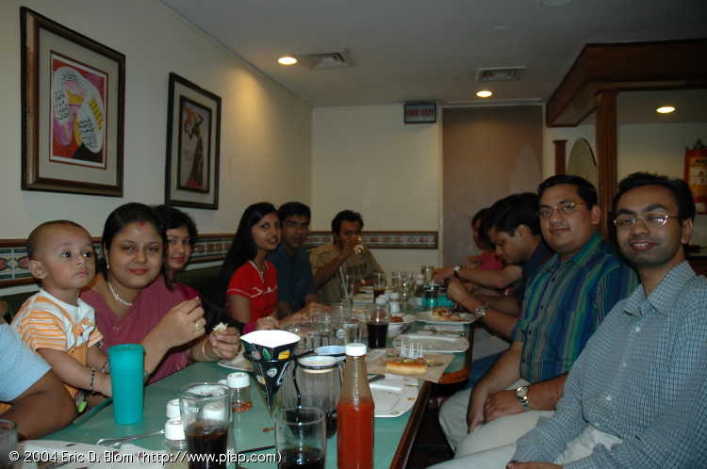
Connect Brands to the Market (cont.)
Use local brands to establish market presence
Use the existing goodwill
Find brands that reflect the spirit of the company
Grow local brands when possible
Acquiring local brands may be expensive
Create brands to counter well established local brands in their own market. Eg: Coca Cola’s Tian Yu Di
Brands mean something different in emerging markets
Global brands may benefit because of their foreignness. Eg: Pizza Hut
Or they may lose in areas where they are not recognized

Slide 12
Challenges: Youthful and Growing Populations
Opportunities:
Think Young

Slide 13
Think Young
Young countries
Young adults make up nearly half the population in several of these countries
High birth rates
Create loyal customers when they’re young
Make your product ‘cool’
Huge market for entertainment, apparel, computers, fashion and other such youthful products and services
Young celebrity endorsements. Eg: Fastrack watches –MTV India VJs

Slide 14
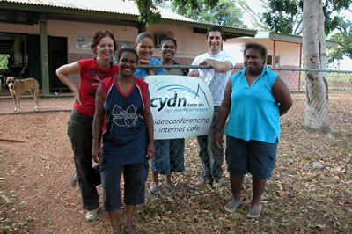
Think Young (cont.)
Multiple channels of communication to reach the young
Eg: Community Internet for youth in the Dominican Republic
‘Dual passports’
Although plugged into global culture, youth are deeply rooted in their own culture and tradition
Individualism ranks higher than communities
Global theme, local feel

Slide 15
Challenges: Limited Income and Space
Opportunity:
Grow Big by Thinking Small

Slide 16
Grow Big By Thinking Small
Reducing pack size to reach a larger audience
Smaller packages for price, not convenience
Installment plans for products that are expensive or out of reach to most
Eg: The Maruti Suzuki car for at a down payment of Rs.2000($45) and 0% interest

Slide 17
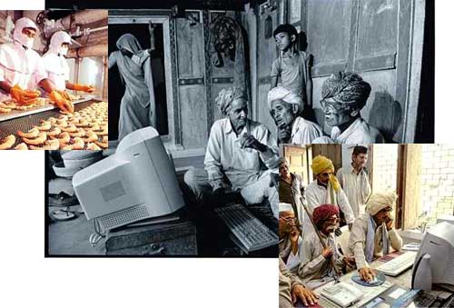
Grow Big By Thinking Small (cont.)
Small packs with several variants popular
Allow customers to get a wide choice of products for their scarce resources
Pool demand
What one customer may not be able to afford, several customers together can
Eg: E-Choupal

Slide 18
Challenge: Underdeveloped infrastructure
Opportunity:
Working with Technology

Slide 19
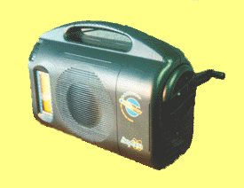
Working with Technology
Create markets in the gaps
Find ways to fill gaps in infrastructure
Eg: Aquaguard in India, Sulabh International
Create work around solutions
Work within limitations of climate, infrastructure and resources
Eg: Crank powered radio in Africa
Build infrastructure to support the business or use existing infrastructure creatively

Slide 20
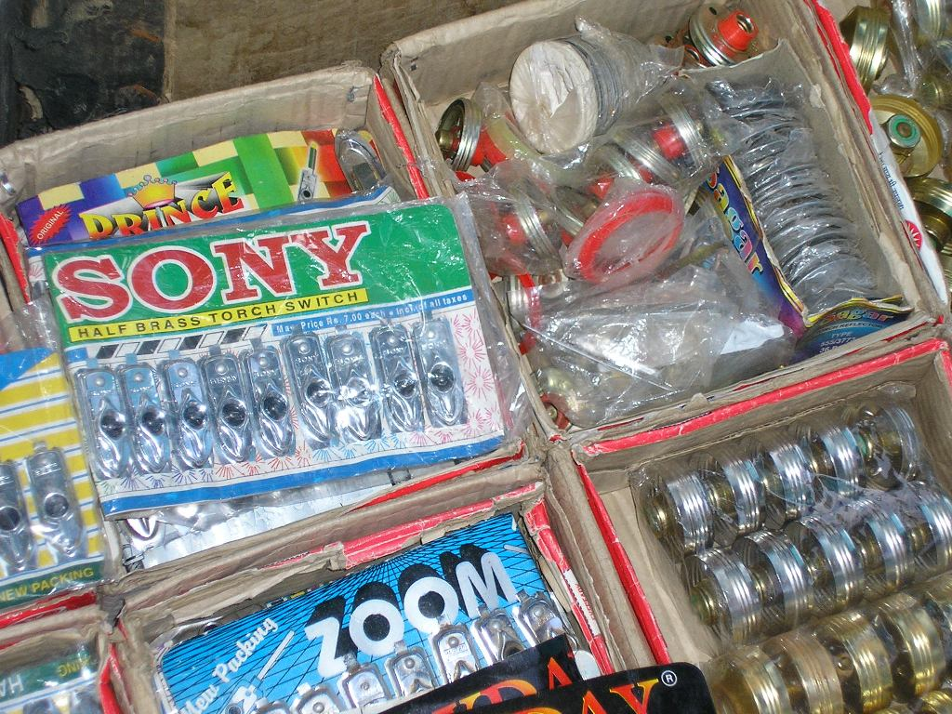
Working with Technology (cont.)
Recognize unseen rivals
Thriving business in counterfeits
Build barriers, such as quality guarantees to keep them out
Modify and Apply existing technologies in new ways
Eg: CNG Autos in Delhi or ‘fuel flex’ cabs in Mexico
Digitize and MPower
Digital media more accessible
Cheaper to run. Eg: telemedicine

Slide 21
Challenge: Weak Supply and Distribution Channels
Opportunity:
Take the Market to the People

Slide 22
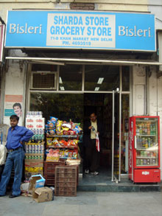
Take the Market to the People:
Position for the smallest shop owner
The organized retail sector in emerging markets is often only 2-8% of total
Small stores number in the millions and have greater reach
Eg: the kirana stores of India
Build strong supply and distribution channels
Distribution systems are only just being developed
Look for local or entrepreneurial networks that help understand and connect to local markets

Slide 23
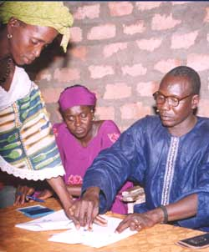
Take the Market to the People (cont.)
Take the bank out of the branch
Finance and credit options scarce, but very important in emerging markets
Banks need to reach the smallest customer to tap ‘Fortune at the Bottom of the Pyramid’
Eg: Micro Credit in Africa

Slide 24
Challenge: Rapidly Changing Markets
Opportunity:
Develop with the Market

Slide 25
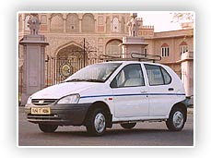
Develop With the Market:
Work with Government, NGOs and other players
Use their understanding of the local culture and needs
Look for patterns of change
Emerging markets often follow the growth patterns of other developed markets
Exporting a success from one market to another.
Eg: Indica

Slide 26
In Conclusion
"The transformation is just beginning.
There will be hiccups along the way
The only certainty is, the 86 percent markets are here to stay.
Even though they won't become developed tomorrow, they are the future.
And the companies that can develop the right solutions to meet their needs will find a rich source of growth."

