Slide 1
Questionnaire Design

Slide 2
What is a Questionnaire
Questionnaire as a general term to include all methods of data collection in which each person is asked to respond to the same set of questions in a predetermined order (De Vaus 2014).
A questionnaire is a preformulated written set of questions to which respondents record their answers, usually within rather closely defined alternatives (Sekaran and Bougie, 2016)

Slide 3
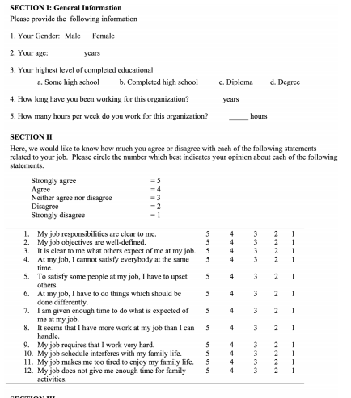
Objective of Questionnaire
A questionnaire should meet the objectives of the study
Complete and accurate information
Easy for the respondents to respond
Makes the interview concise and to the point
The ideal question accomplishes three goals:
◦ It measures the underlying concept
it is intended to tap
◦ It doesn’t measure other concepts
◦ It means the same thing to all
respondents

Slide 4
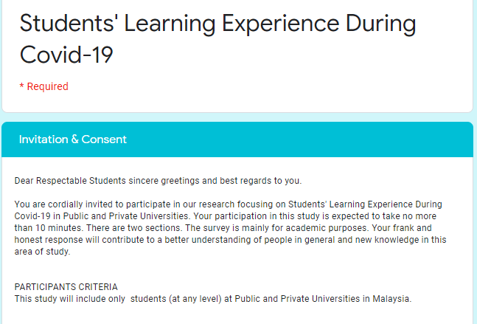
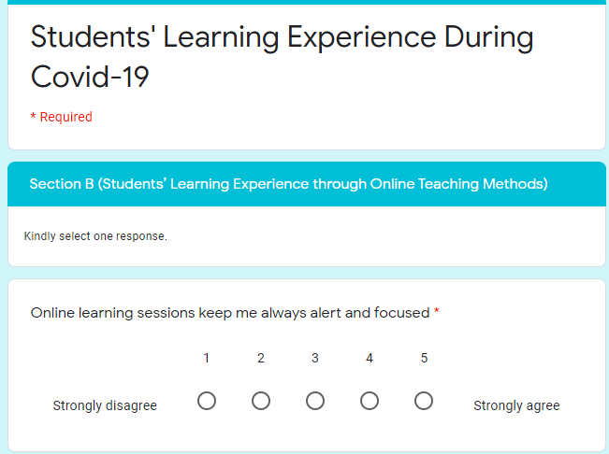
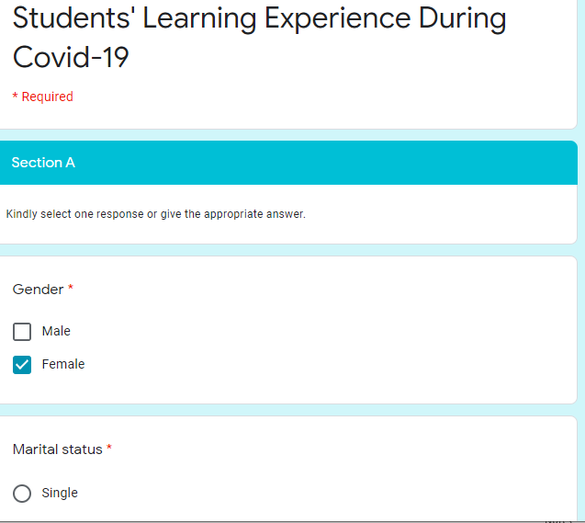
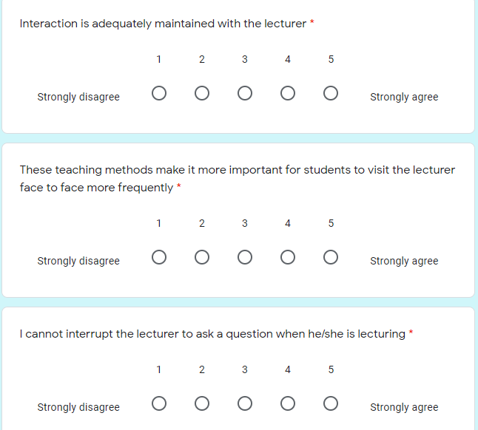
Google Form

Slide 5
The Types and Choice of Questionnaire

Slide 6
Types of Questionnaires
Personally administered questionnaires
When the survey is confined to a local area - collect data by personally administer questionnaires
Can establish rapport and motivate
respondent.
Doubts can be clarified.
Less expensive when administered to groups of respondents.
Almost 100% response rate Anonymity of respondent is high.
Mail questionnaires
A mail questionnaire is a self‐administered (paper and pencil) questionnaire that is sent to respondents via the mail.
Anonymity is high.
Wide geographic regions can be reached.
Respondent can take more time to respond at convenience.
Response rate is low – 30%
Electronic Questionnaires
Email the invitations
to complete a survey, post a link on a website or personal blog, or use social networks. Google Form
Easy to administer.
Can reach globally.
Very inexpensive.
Fast delivery.
Respondents can answer at their
convenience 6. Low response rate

Slide 7
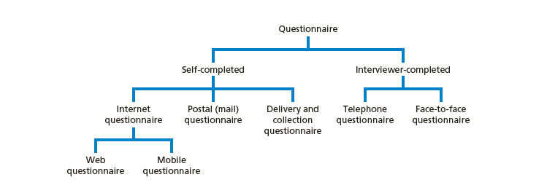
Types of questionnaire
The design of a questionnaire differs according to how it is delivered, returned or collected and the amount of contact with the respondents
Self-completed questionnaires
Usually completed by the respondents and are often referred to as surveys – Internet, direct delivery
Interviewer-completed questionnaires
Are recorded by the interviewer on the basis of
each respondent’s answers.
Include face to face and telephone/Skype interviews
Structured Interviews
Source; Saunders et al., 2016
Questionnaire format depends on strategy for data collection
Notes:
The way questionnaires are used can be broadly divided into two groups;
Self-completed questionnaires; where respondents provide their answers themselves without any other input, and
Interviewer-lead; where the questions are read out to the respondent by the interviewer and their responses are noted.
Self-completed questionnaires commonly include paper-based postal surveys and those delivered electronically such as internet surveys or other electronic device such as kiosks or hand-held computers.
Interviewer lead questionnaires commonly includes face-to-face approaches or questionnaires conducted over the telephone.
Additional info:
There are pros and cons to using each method
According to the HTA review, no one mode of administration consistently outperforms all others.

Slide 8
Choice of Questionnaire
Characteristics of the respondents
Eg: Students/professionals/Internet savvy
Importance of reaching a particular person
Eg: Higher with e-mail OR Telephone Interview
3. Sample size and response rate
Eg: large and dispersed – use internet
Response rate low, 30–50% within organisations, or 10% or lower
Types of question
Eg: Closed question or Open questions
Number of questions
Eg: Equivalent of 6–8 A4 pages – use self administered
Longer questionnaires are best presented face-to-face

Slide 9
Criteria for Choosing a Good Instrument
Have authors developed the instrument recently?
Is the instrument widely cited by other authors?
Are reviews available for the instrument?
Does the procedure for recording data fit the research questions/hypotheses in your study?
Does the instrument contain accepted scales of measurement?
Is there information about the reliability and validity of scores from past uses of the instrument?

Slide 10
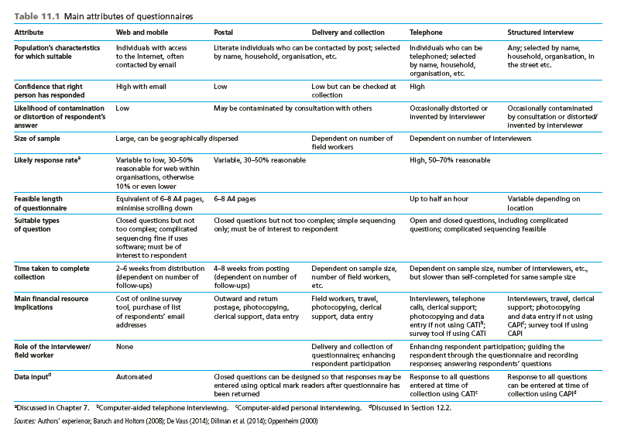
Source: Saunders et al, 2016)

Slide 11
Deciding on the data to be collected

Slide 12
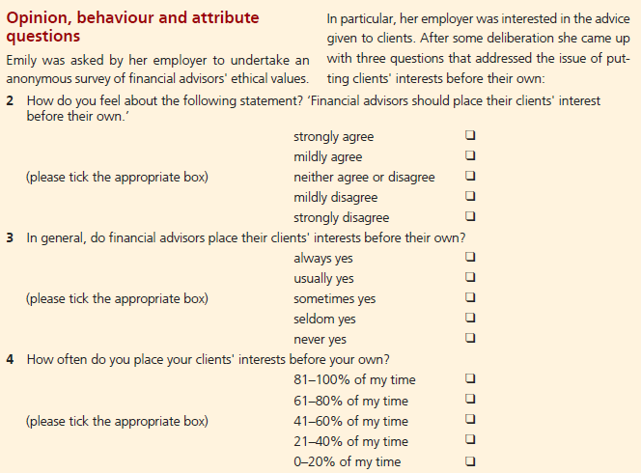
Types of data Variables: Dillman 2009
Factual and demographic (variables contain data that are readily available to the respondent – Eg Age)
Attitudes and Opinion variables (how respondents feel about something or what they think or believe is true or false);
Behavioral and Events variables (what people did in the past, do now or will do in future)

Slide 13
Types of data Variables
Explanatory Research
All the variables are included
Be clear about which relationships you think are likely to exist between variables:
• a dependent variable that changes in response to changes in other
variables;
• an independent variable that causes changes in a dependent variable;
a mediating variable that transmits the effect of an independent variable to a dependent variable;
• a moderating variable that affects the relationship between an
independent variable and a dependent variable

Slide 14
Guidelines for questionnaire design

Slide 15
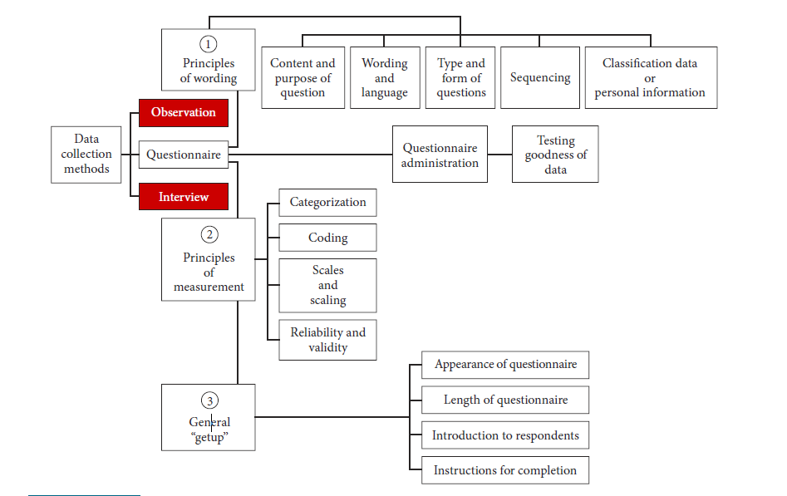
GUIDELINES FOR QUESTIONNAIRE DESIGN
Sound questionnaire design principles should focus on three areas

Slide 16
Principles of wording
1
1. Content of the questions.
Eg: Subjective feelings such as satisfaction or objective facts such as age
2. Wording and Language
How questions are worded and the level of sophistication of the language used
The language of the questionnaire should approximate the level of understanding of the respondents
3. Types and form of questions
Whether the question is open‐ended or closed
4. Sequencing: The sequencing of the questions.
Questions of a general nature to those that are more specific, and from questions that are relatively easy to answer to those that are progressively more difficult
5. Classification or personal information
Elicit such information as age, educational level, marital status, and income

Slide 17
1. Content and purpose of the question Subjective feelings such as satisfaction or objective facts such as age
The nature of the variable tapped – subjective feelings or objective facts – will determine what kinds of questions are asked.
If the variables tapped are of a subjective nature (e.g., satisfaction), where respondents’ beliefs, perceptions, and attitudes are to be measured, the questions should tap the dimensions and elements of the concept.
Where objective variables, such as age and educational levels of respondents, are tapped, a single direct question – preferably one that has an ordinal scaled set of categories – is appropriate.
Thus, the purpose of each question should be carefully considered so that the variables are adequately measured and yet no superfluous questions are asked.

Slide 18
2. Wording and Language Subjective feelings such as satisfaction or objective facts such as age
The language of the questionnaire should approximate the level of understanding of the respondents.
The choice of words will depend on their educational level, the usage of terms and idioms in the culture, and the frames of reference of the respondents.
Eg: even when English is the spoken language in two cultures, certain words may be alien to one culture.
Thus, it is essential to word the questions in a way that can be understood by the respondent.
If some questions are either not understood or are interpreted differently, the researcher will obtain the wrong answers to the questions,
Hence, the questions asked, the language used, and the wording should be appropriate to tap respondents’ attitudes, perceptions, and feelings.

Slide 19
“Do’s” of Questionnaire Wording
The question should be focused on a single issue or topic.
Eg:“What type of hotel do you stay in on a trip?” Pleasure or business trip? En route or final destination?
2. The question should be brief.
3. The question should be
grammatically simple, if possible.
4. The question should be crystal clear.
Target the vocabulary and grammar to the population be surveyed
Make sure it is absolutely clear what you are asking and how you want it answered.

Slide 20
Avoid
Avoid unnecessary abbreviations or jargons
Avoid ambiguity, confusion, and vagueness.
Avoid emotional language/loaded
Avoid prestige bias/socially desirable questions
Watch for prestige markers that cue the respondent to give the "right" answer.
Avoid leading questions
Avoid double barreled questions

Slide 21
3. Types of questions – Open and Closed questions
Closed
Ask the respondents to make choices among a set of alternatives given by the researcher
Closed’ items limit the responses that a participant can provide.
Eg: the Likert (i.e. 1-5) scale, ‘agree/disagree’ items, or items which give the respondent a selection of statements which best reflects their view,
Open-ended
Allow respondents to answer them in any
way they choose.Allow your participants to express and elaborate on their perceptions and attitudes regarding the topic you want to evaluate.
Example
What is your perception towards e-learning?
How has the course helped to prepare you for your future?
Notes:
The way questionnaires are used can be broadly divided into two groups;
Self-completed questionnaires; where respondents provide their answers themselves without any other input, and
Interviewer-lead; where the questions are read out to the respondent by the interviewer and their responses are noted.
Self-completed questionnaires commonly include paper-based postal surveys and those delivered electronically such as internet surveys or other electronic device such as kiosks or hand-held computers.
Interviewer lead questionnaires commonly includes face-to-face approaches or questionnaires conducted over the telephone.
Additional info:
There are pros and cons to using each method
According to the HTA review, no one mode of administration consistently outperforms all others.

Slide 22
Types of questions – Positively and Negatively worded
Positively and negatively worded questions
It is advisable to include some negatively worded questions as well, so the tendency in respondents to mechanically circle the points toward one end of the scale is minimized.
Example:
Questions” on a five‐point scale, with 1 being “very low” and 5 being “very high” on the scale.
Q1: I feel I have been able to accomplish a number of different things in my job,
Q2: I do not feel I am very effective in my job.
A good questionnaire should therefore include both positively and negatively worded questions.
Notes:
The way questionnaires are used can be broadly divided into two groups;
Self-completed questionnaires; where respondents provide their answers themselves without any other input, and
Interviewer-lead; where the questions are read out to the respondent by the interviewer and their responses are noted.
Self-completed questionnaires commonly include paper-based postal surveys and those delivered electronically such as internet surveys or other electronic device such as kiosks or hand-held computers.
Interviewer lead questionnaires commonly includes face-to-face approaches or questionnaires conducted over the telephone.
Additional info:
There are pros and cons to using each method
According to the HTA review, no one mode of administration consistently outperforms all others.

Slide 23
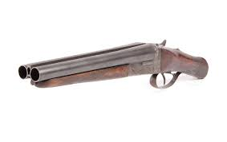
Leading, Loaded and Double Barelled
Leading question.
The question should not “lead” the respondent to a particular answer.
Eg:“Don’t you see any problem with using credit cards for online purchases?”
2. Loaded Questions
The question should not have “loaded” wording or phrasing. - emotionally charged
Eg: To what extent do you think management is likely to be vindictive if the union decides to go on strike?”
The words “strike” and “vindictive” are emotionally charged
Double Barreled Questions
Eg: “Do you think there is a good market for the product
and that it will sell well?”

Slide 24
Ambiguous and Social Desirability
Ambiguous questions
The respondent may not be sure what exactly they mean.
Eg: “To what extent would you say you are happy?”
Respondents might find it difficult to decide whether the question refers to their state of feelings in the workplace, or at home, or in general.
Social desirability
Questions should not be worded such that they elicit socially desirable responses.
Eg: “Do you think that older people should be laid off?”

Slide 25
4. Sequencing
Order bias
Bias caused by the influence of earlier questions in a questionnaire or by an answer’s position in a set of answers.
Funnel technique
Asking general questions before specific questions in order to obtain unbiased responses.
Filter question
A question that screens out respondents who are not qualified to answer a second question.
Pivot question
A filter question used to determine which version of a second question will be
The respondent is led from questions of a general nature to those that are more specific, and from questions that are relatively easy to answer to those that are progressively more difficult

Slide 26
5. Classification of Personal Information
Elicit such information as age, educational level, marital status, and income.
Unless absolutely necessary, it is best not to ask for the name
of the respondent.
In surveys, it is advisable to gather certain demographic data such as age, sex, educational level, job level, department, and number of years in the organization,
Such data help to describe the sample characteristics in the report written after data
analysis.

Slide 27
Therefore, Questions should be:
Relevant - pertain to the research problem
Accurate - accurately depict the attitudes, behaviors, etc. intended to investigate
Respondents can understand and interpret the question correctly
Focused on a single problem or issue
Researchable using primary and/or secondary sources
Feasible to answer within the timeframe and practical constraints
Specific enough to answer thoroughly
Respondents will give the information

Slide 28
General appearance or “getup” of the questionnaire

Slide 29
Outline what you want to cover
Consider the following categories
Attitudes: feelings and opinions
Behaviors: what they actually do
Demographics: who they are
Demographics
Need to know how opinions and behaviors vary across different categories of people
Such things as
Age, income, education
Put at end of instrument
Easy to answer

Slide 30
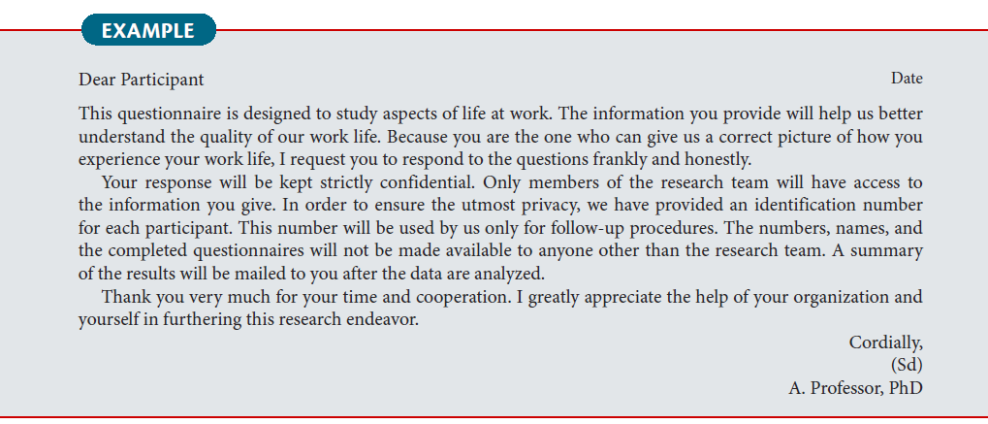
A good introduction ad Instructions
Beginning of each section, should include clear instructions
Disclose needed information for respondents to decide whether to complete the survey
Tell whether
Anonymous: no names or IDs
Confidential: names or IDs, not attached responses
4. Short and Precise
At the start of your questionnaire, you need to explain clearly and concisely why you want the respondent to complete the survey (Dillman et al., 2014). Achieve as high response rate

Slide 31
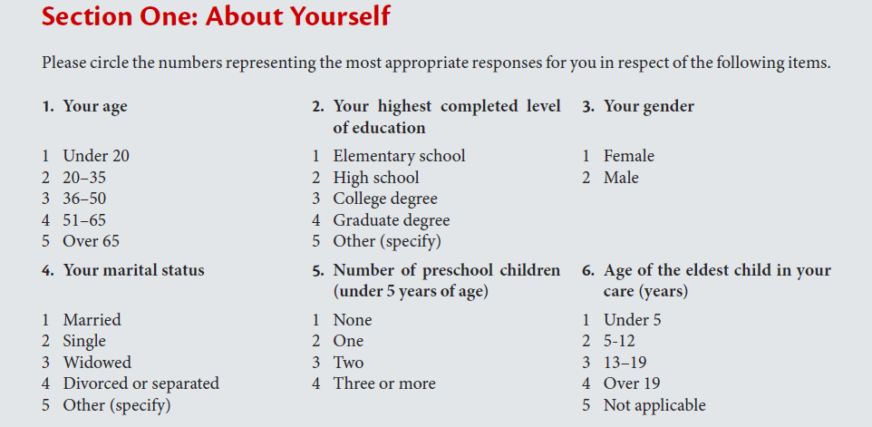
Organizing questions, giving instructions and guidance, and good alignment
Organizing the questions logically and neatly in appropriate sections and providing instructions on how to complete the items in each section will help the respondents to answer them without difficulty

Slide 32
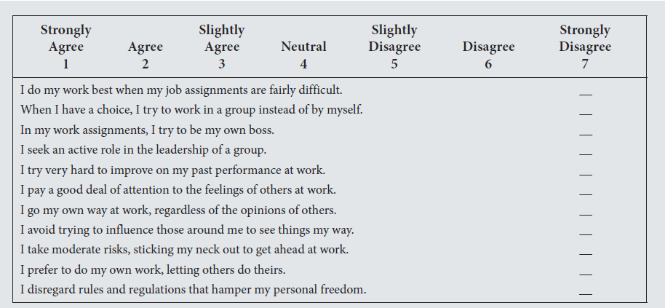
Organizing questions, giving instructions and guidance, and good alignment

Slide 33
Organizing questions, giving instructions and guidance, and good alignment

Slide 34
Where do questions come from?

Slide 35
Can you develop your own Questions in a Quantitative study?

Slide 36
Where the questions come from

Slide 37
Designing individual questions
The design of each question should be determined by the data you
need to collect
When designing individual questions researchers do one of three
things (Bourque and Clark 1994):
Adopt questions used in other questionnaires;
Adapt questions used in other questionnaires;
Develop their own questions.
Adopting or adapting questions allow reliability to be assessed.
Adopting and Adapting
It is also more efficient than developing your own questions
Beware-There are a vast number of poor questions in circulation
Check whether they are under copyright. You need to obtain the
author’s permission
If adapted check validity

Slide 38
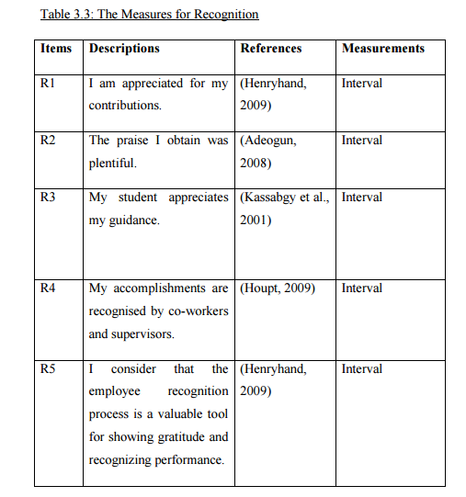
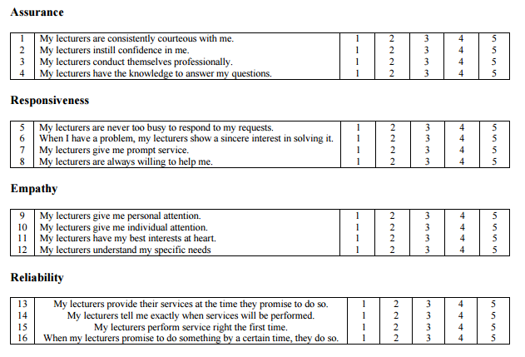
Adopt, Adapt Questions
Adopting:
The instrument is adopted from past research
The reliability and validity have been conducted on that instrument
Adapting
Adapted by rephrasing the questions
Researcher adds items, removes items, and/or changes the content of each item
Adopted: SERQUAL MODEL

Slide 39
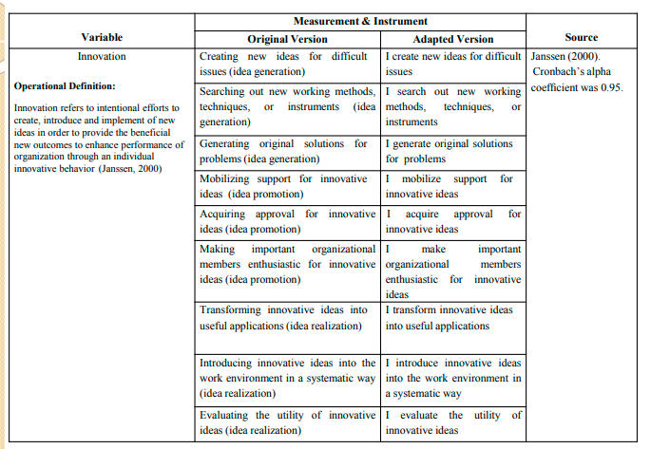
Adapting Questions

Slide 40
Adapting Questionnaire
Adapting an instrument requires more substantial changes than adopting an instrument.
Follow the general design of another instrument but adds items, removes items, and/or substantially changes the content of each item.
Adapting an instrument is similar to developing a new instrument
Include what changes were made to the instrument and why.
Example: a sample description of an instrument that was adapted in Korb (2009).
This study adapted the Factors Influencing Teaching Choice (FIT-Choice) scale. This instrument was developed by Watt and Richardson (2007). Validity evidence was provided by factor analysis and the longitudinal relationship of the factors influencing teaching to subsequent engagement in the teaching profession. The purpose of the FIT-Choice is to determine the factors that preservice teachers identify as being most influential in their choice of the teaching profession. The FIT-Choice scale was only slightly modified to fit the Nigerian context. All factors were identical to the original FIT-Choice instrument except for two. Watt and Richardson identified a job transferability factor that included items such as "Teaching will be a useful job for me to have when traveling." This factor was judged as not applicable to Nigerian pre-service teachers. Additionally, an exploitation factor was added to the instrument to represent choosing teaching as a lazy, easy career with items such as "Teaching will allow me to work other jobs," "Teaching will allow me to collect a salary by doing little work," and "When teaching, I can use the students for gaining money."

Slide 41
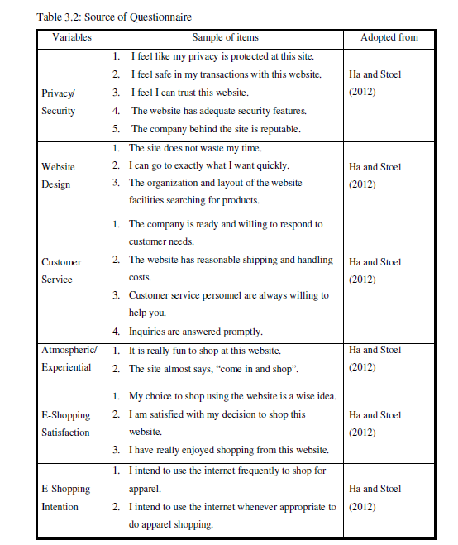
Adapted
Questionnaire
FACTORS AFFECTING ONLINE SHOPPING OF PURCHASING APPARELS AMONG YOUNG ADULTS IN KL

Slide 42
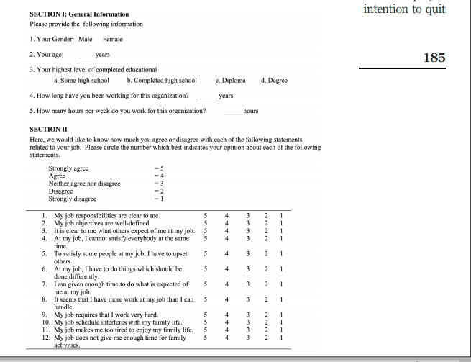
1. Emerald Questions
Measures
A questionnaire adapted from the comprehensive workplace scale developed by Tate et al. (1997) for their tri-nation study was used in this study (see the Appendix). Tate and colleagues reported adequate internal reliability for each factor of the scale (a ¼ 0:61 to 0.91). The factors assessed were stressors, job stress, job satisfaction, commitment to the organization, locus of control, self-esteem, support offered by supervisors and intention to quit. Each of the factors is explained below

Slide 43
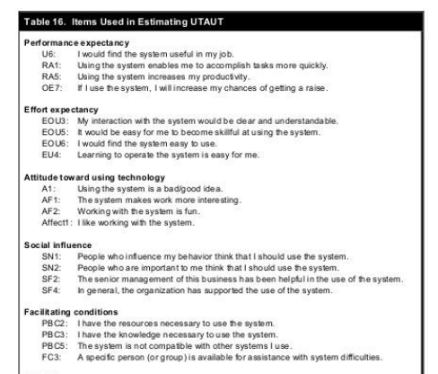
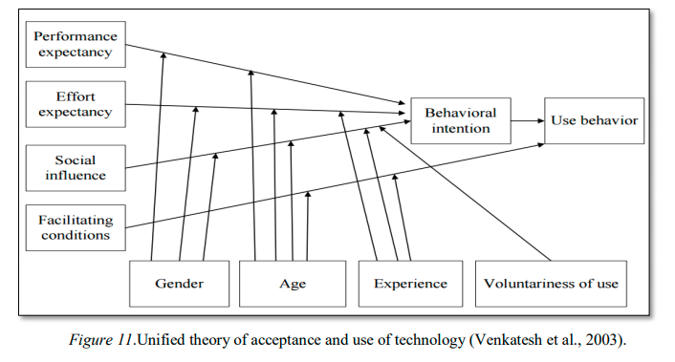
UTAUT Theory Questionnaire

Slide 44
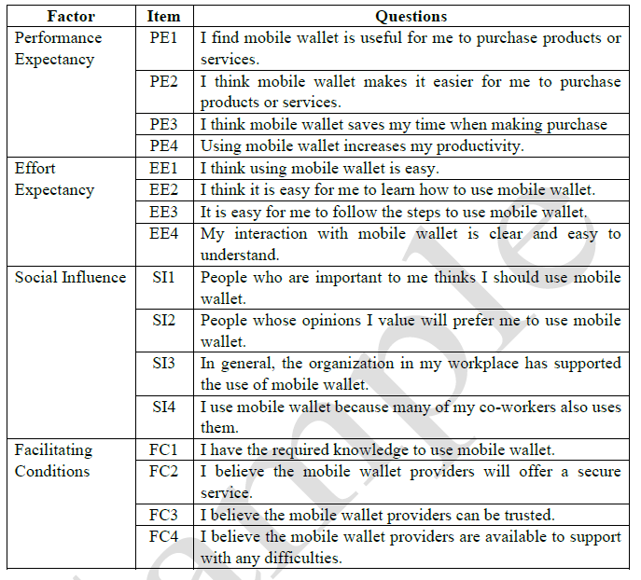
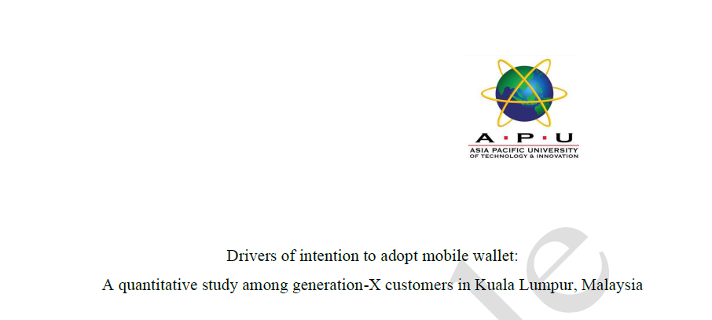
Adapted Questions
This research also used items adapted from Venkatesh et al. (2003), Lin, Lin and Ding (2020), Megadewandanu et al. (2016) and Trivedi (2016) to develop the questionnaires

Slide 45
You need to Write:
Performance Expectancy
The questions on Performance Expectancy (PE) were adapted from a study by Venkatesh et al. (2003). Previous testing of PE “has produced a Cronbach’s alpha for reliability of between 0.89 and 0.98” (Venkatesh & Davis, 2000, p. 203). Macharia (2011) also reported factor loadings for validity above 0.72. Legris et al.’s (2003) reported “acceptable level of internal consistency greater or equal to 0.83” (p. 99).
Effort Expectancy
The questions on Effort Expectancy (EE) were adapted from a study by Venkatesh et al. (2003). Previous testing of EE has produced a “Cronbach’s alpha for reliability of above 0.79” (Davis, 1989; Venkatesh & Davis, 2000;Venkatesh, Morris, & Ackerman, 2001) and factor loadings for validity above 0.59 (Davis, 1989). Studies emphasizing cultural contexts including Alghatani et al.’s (2007) and Banyopadhyay and Fraccastor’s (2007) studies reported factor loadings of 0.84, 0.82, 0.83 and 0.85 and 0.91, 0.87, 0.92 and 0.86, respectively.
Source of Questions
Previous Testing
Past Reliability and Validity
Scales used

Slide 46
You need to Write:
Social Influence
Social Influence (SI) is the basis to which individuals decide to use technology if they believe that the people who are important to them are already using it or will support their use of this technology (Ghandalari, 2012). The questions were adapted from a study by Venkatesh et al. (2003). Macharia (2011) indicated that, previous testing of SI as produced a Cronbach’s alpha for reliability of above 0.80 and factor loadings for validity above 0.55. More recent studies emphasizing cultural contexts including Al-Gahtani et al.’s (2007) and Bandyopadhyay and Fraccastoro’s (2007) studies produced factor loadings of 0.94, 0.95, 0.92 and 0.91 and 0.97, 0.95, 0.92 and 0.90 for each
of the items, respectively.
Facilitating Conditions
Facilitating Conditions (FC) is the basis to which individuals decide to use technology if they believe that “technical and organization infrastructures” are available for them (Ghandalari, 2012, p. 803). The questions were adapted from a study by Venkatesh et al. (2003). Venkatesh et al. (2003) found that facilitating conditions had no effect on BI but was a positive predictor of technology use. Cronbach’s alpha for reliability of facilitating conditions in Melocchi’s (2014) study generated a reliability of above 0.84 while Cronbach’s alpha for reliability of facilitating conditions in
McComb’s (2011) study generated a reliability of 0.77.

Slide 47
Adopting Questions
Adopt questions used in other questionnaires; Verbatim
In the description, include
Who developed the instrument
Who validated the instrument
Other studies that have used the instrument
Example:
Positive and negative affect were assessed using the Positive and Negative Affect Scale (PANAS; Watson, Clark, & Tellegren, 1988)...Watson and colleagues report reliability coefficient alphas as .89 for positive and .85 for negative affect. Validity evidence for the instrument as a measure of state affect was found by correlating the instrument with situations that should influence positive and negative affect. Positive affect has been found to be related to social activity and negative affect has been found to be related to fluctuations in stress (Watson et al., 1988). The PANAS has been used to assess affect in other studies with SDT (e.g., Elliot and Sheldon, 1999; Sheldon & Kasser, 2001; Sheldon, Ryan, Deci, & Kasser, 2004).

Slide 48
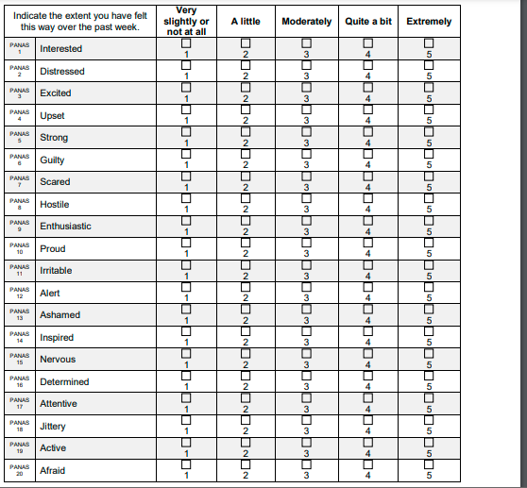
The Positive and Negative Affect Schedule (PANAS) (Watson, Clark, & Tellegen, 1988)
3. WATSON PANAS
One of the most widely used scales to measure mood or emotion.
This brief scale is comprised of 20 items, with 10 items measuring positive affect (e.g., excited, inspired) and 10 items measuring negative affect (e.g., upset, afraid).
Each item is rated on a five-point Likert Scale, ranging from 1 = Very Slightly or Not at all to 5 = Extremely,
Measure the extent to which the affect has been experienced in a specified time frame.
Measure affect in various contexts such as at the present moment, the past day, week, or year, or in general (on average).

Slide 49
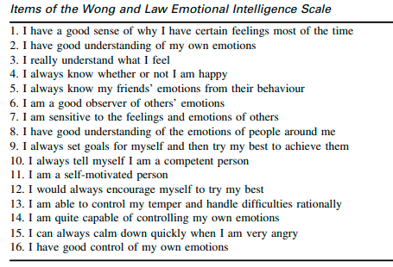
Emotional Intelligence Questions - Adopted
4. Wong and Law EI Questions
Wong and Law Emotional Intelligence Scale
Wong, C.-S., & Law, K. S. (2002). Wong and Law Emotional Intelligence Scale (WLEIS) [Database record]. APA PsycTests.
https://doi.org/10.1037/t07398-000

Slide 50
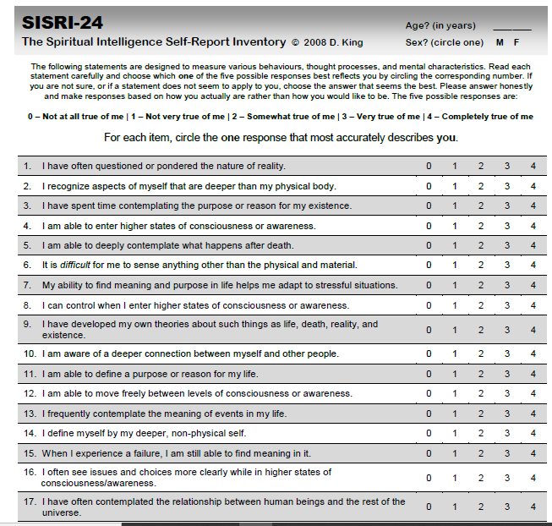
Spiritual Intelligence Questions - Adopted
5. SI Questionnaire
King, D.B. (2008). Rethinking claims of spiritual intelligence: A definition, model, & measure. Unpublished master's thesis. Ontario, Canada: Trent University, Peterborough.

Slide 51
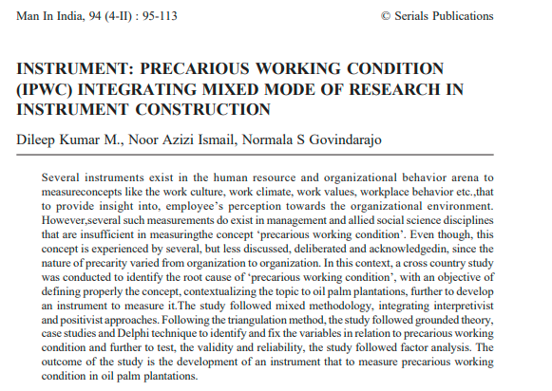
Developing own Questionnaire
6. Precarious working Questionnaire

Slide 52
Process for Developing your own questions

Slide 56
Translating questions

Slide 57
Translation of Questionnaire

Slide 59
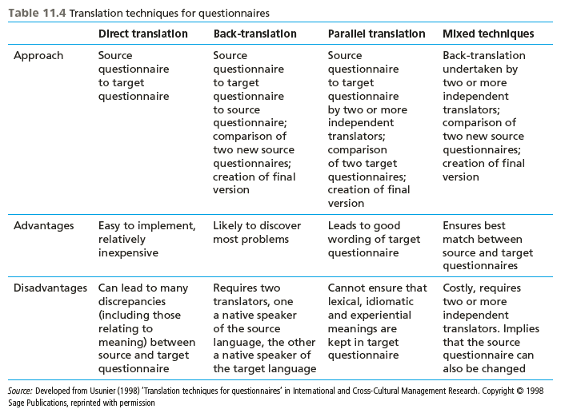

Slide 60
The way to get started is to quit talking and begin doing.
Walt Disney

Slide 61
Summary
A questionnaire should meet the objectives of the study
Complete and accurate information
Easy for the respondents to respond
Makes the interview concise and to the point

Slide 62
Thank You
Presenter name: Dr Jugindar Singh
Email address: jugindar.singh@apu.edu.my

