Slide 1
CT105-3-M Cloud Infrastructure and Services
Driving Digital Transformation through Cloud

Slide 2
Lesson: Driving Digital Transformation through Cloud
This lesson covers the following topics:
Describe digital transformation
Explain various businesses and IT challenges
Explain digital and IT transformation for cloud adoption
Describe IT transformation key focus areas
Notes:
This lesson focuses on digital disruption, and how it affects every industry. It also focuses on various business and IT challenges. Further the lesson focuses on how digital and IT transformation drives cloud adoption, and also covers IT transformation key focus areas.

Slide 3
Digital transformation
To access the video, please click the below link
https://edutube.emc.com/Player.aspx?vno=FQv/TyYWr2dHnYsFJOz8fA==&autoplay=true&t=0h0m0s
Notes:
Many organizations undertaken the digitization that started in the late 20th century, and accelerating in the 21st century, and spurs the digital transformation. Mandatorily organizations have to transform digitally at a faster pace to satisfy the modern customer’s expectations which is the result of a confluence of technologies. Let us see a video to get an overview of digital transformation.

Slide 4
Digital disruption
By 2018, digitally enabled competitors disrupt 33% of market leaders. - IDC
45% believe that there is a possibility their business becomes obsolete within the next 3–5 years. - Findings from Dell’s Research
78% see digital start-ups as a threat to their business, now or in the future. - Dell
50% of the G2000 by 2020 see that most of their business depends on digitally enhanced products, services, and experiences. - IDC
Digital is the main reason just over half of the companies on the Fortune 500 have disappeared since the year 2000. - Pierre Nanterme, CEO of Accenture

Slide 5
What is digital transformation?
Digital Transformation puts technology at the heart of an organization’s products, services and operations – to help accelerate the business and competitively differentiate itself – in order to improve the experience for its customers.
Customers
Are going digital
Competitors
Are going digital
Things
Are going digital

Slide 6
Influence of digital transformation
Uber
Facebook
Alibaba
Airbnb
Founded: 2009
Founded: 2004
Founded: 1999
Founded: 2008
No vehicles
No content
No inventory
No real estate

Slide 7
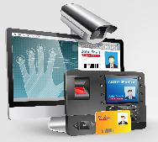
Digital business attributes
Software Driven
With future estimates spot new opportunities
Demonstrate transparency and trust
Deliver personal experiences
Operate in real time
Innovate in an agile way

Slide 8
Digital transformation index
DIGITAL LAGGARDS
DIGITAL FOLLOWERS
DIGITAL EVALUATORS
DIGITAL ADOPTERS
DIGITAL LEADERS
15%
14%
5%
32%
34%
LOW
HIGH
Sources: DELL Technologies Sponsors—www.delltechnologies.com/en-us/perspectives/digital-transformation-index.htm

Slide 9
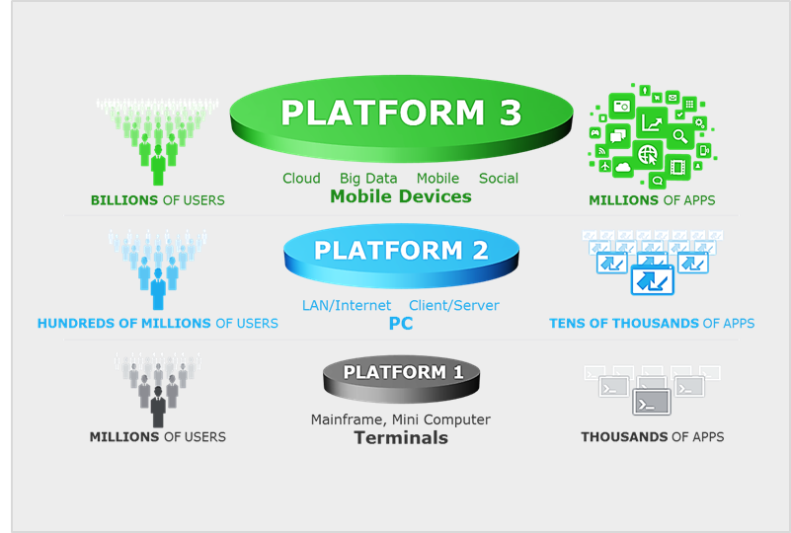
Business challenges in digital world
Shrinking Market Opportunities
Implication of the third Platform and IoT
Rising Competition
Accurate prediction and planning for future business
Time-to-market

Slide 10
Implication of the third Platform and IoT

Slide 11
Challenges of IT to meet business demand
Data growth
Poor scalability, performance, and security
Aging technology, facilities, and the outdated policies
Shadow IT
Technologies fail to support customer growth
Financial
Pressure

Slide 12
Digital business drives IT transformation
Key attributes for IT to transform:
Should become a strategic business partner
Should be service-centric organization
Should change the focus to manage the supply and demand of services
Should build products and services that support business objectives
Should cultivate line of business relationship

Slide 13
Digital and IT transformation drives cloud adoption
Cloud provides business agility
Ensures quick time-to-market and improved competitive advantage
Cloud also provides
Reduction of IT infrastructure investment
Improved resource utilization
Reduction of IT management complexity and cost
IBM
Microsoft
Java
Oracle
Cloud

Slide 14
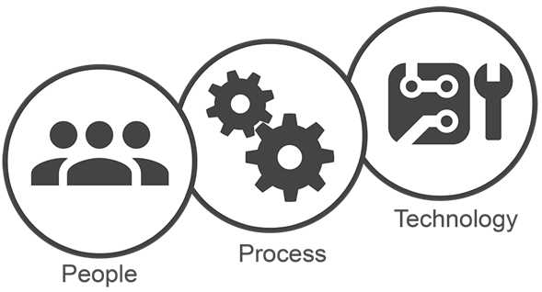
IT transformation key focus areas
Modern IT infrastructure (Flash, Scale-out, Software-defined, Cloud-enabled)
Orchestration
Service catalog and self-service portal
Automation and self-service
Charge-back models
Devops
New Roles
Shift in IT Skills

Slide 15
Digital transformation – customer success story
To access the video, please click the below link
https://edutube.emc.com/Player.aspx?vno=qnk2kiGxZhyS+/ZTgJxY4A==&autoplay=true&t=0h0m0s
Notes:
Now let us see a video of digital transformation - customer success story. The video tells the success story of Callaway, a golf company, how the company has benefitted with digital transformation. See the video for details.

Slide 16
Lesson Summary
During this lesson, the following topics were covered:
Digital disruption
Business and IT challenges
Digital and IT transformation drives cloud adoption
IT transformation key focus areas
Notes:
Digital disruption is happening all around us. Now, is the time the organization must decide to become one of the organizations that utilizes digital transformation to disrupt the market. The common business challenges across the world are shrinking market opportunities, rising competition, implication of third platform technologies and IoT. And, other challenges, time-to-market, and accurate prediction and planning for future business.
Some of the IT department challenges in supporting business challenges; aging facilities, outdated policies, shadow IT. And the existing IT equipment is unable to support the scalability, security, and performance requirements of third platform applications. Also, technologies are not able to meet potential growth of customers, the infrastructure are siloed.
To survive in the business, the organization has to transform and adopts cloud computing to support the digital and IT transformation.
IT transformation does not come from technology alone. It requires a transformation of IT operations, which is all about transforming the people and processes that deliver value to the business.

