Slide 1
Online Customer Behavior
BSSMMA BM031-3-M and Version: VD2
Chapter 2

Slide 2
Ask yourself….
Customers don’t read pages… they scan pages
Omit needless words
Happy Talk MUST Die.. “Welcome to…..”
Instructions must die… “Please select from the followings…”
If you want a great site … you got to TEST it!!!
Notes:
Presented by Paul Randall (B2B
www.evosite.co.uk
@paulrandall

Slide 3
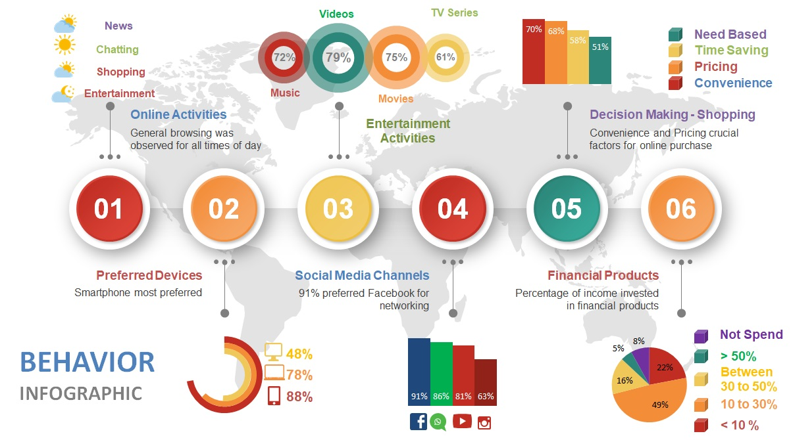
Brazil, Germany, India, Indonesia, Mexico, Nigeria, Russia, Saudi Arabia, South Africa, and the UAE
Market Research in the Mobile World(MRMW, 2019)

Slide 4
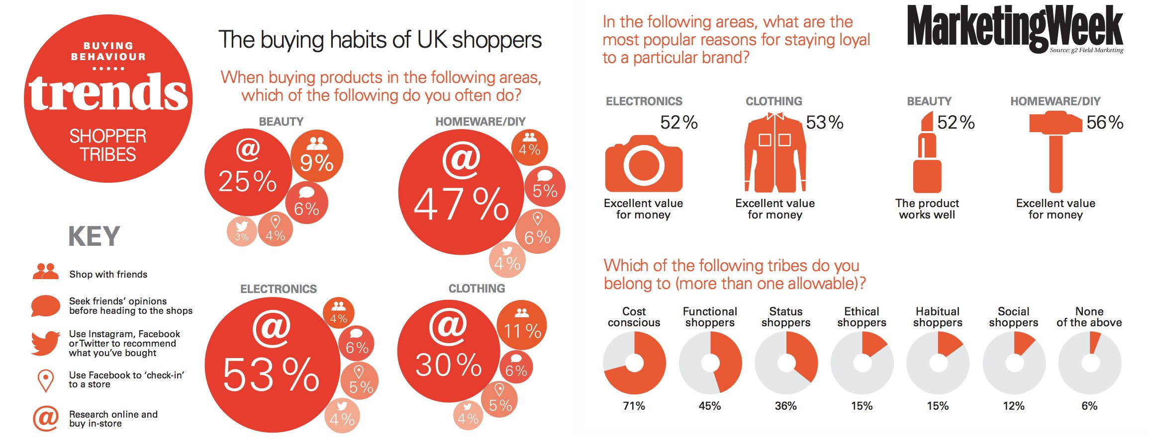

Slide 6
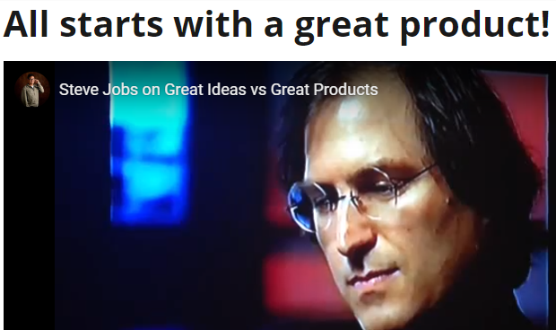
Understanding Digital Customers
Behavioral traits of digital consumers:
Digital-savvy consumers are well informed
They want relevant and quick information
They share a lot
https://youtu.be/1KTLv7wmpLE

Slide 7
Concept of Digital Consumer
digital consumer encompasses of both passive (visiting websites) and active (commenting, blogging) e-behaviour.
demanding, conscious, and active
manifesting and fulfilling their needs with products (goods and services) bought on-line

Slide 8
Concept of Digital Consumer (cont’d)
using free services, exchange personal details, taking advantage of digital content (audio/video streaming, games) or who just searches for information
taking advantage of the content published on-line, aware of themselves and of their needs, and keen on simplifying the decisions they need to make

Slide 9
Types of Digital Consumers
Basic Digital Consumers
Retail Scouts
Brand Scouts
Digitally Driven Segment
Calculated Shoppers
Eternal Shoppers

Slide 10
Types of Digital Consumers
first and largest group of digital shoppers
search brand and retail sites and are comfortable with purchasing online
not focused on mobile or social steps in the steps to purchase
quick in their path to purchase and make quick decisions and purchases, they have a lower step count (Around 3) in their path
most receptive to digital coupons

Slide 11
Types of Digital Consumers
prefer brand sites - brand loyal
make quick decisions on purchases
rely on paid searches to help guide them in their path to purchase
prefer features and perks – Free Shipping
highly mobile and highly social on their path to purchase
receptive to advertising
value level of convenience
Predicted to be largest segment of digital purchasers

Slide 12
Types of Digital Consumers
can make up to 14 steps in their path to purchase
don’t make quick decisions and they are in no rush to make a purchase - makes careful decision
look at all offers so they can receive the best price
Might window shop before purchasing online
extremely responsive to adds that offer a discount or percent off.

Slide 13
Types of Digital Consumers
has the longest path to purchase
They want the answers to, “Should I buy?”, “What do I buy?” and “What brand do I buy?”–all at the same time.
no urgency to make a purchase

Slide 14
Summary of Digital Consumers

Slide 15
Impact of Digital Consumers Perspective of Business and Science
participate in co-creation of their favorite brands and products, customizing them to their needs and preferences ..engagement
customers want their voice to be heard… get into interaction …valued

Slide 16
Technological Impact on Digital Consumer Behaviour
Internet access and speed
greater opportunities (developing countries)
risk: cybercrime or personal data theft.
Mobile technology development –
Smart capabilities that influence user’s life: city guide, shopping, payment, parking, cloud resources, e-communities, etc….

Slide 17
Technological Impact on Digital Consumer Behaviour (cont’d)
‘On-demand’ media
movie, entertainment, rental services
Wearable technologies
bracelets, glasses and other wearable technologies that track information ranging from a user’s health to their current location to social media updates (Euromonitor,2015).

Slide 18
Reflect How Apple Uses Customer Behavior for Marketing
Reflection Time!!!
Go to MS Teams

Slide 19
Reflect How Apple Uses Customer Behavior for Marketing
How Apple acquire customer’s behavior?
Discuss the decision taken by Apple upon acquiring customer behavior details
How Apple uses Customer behavior details to improve Customer Experience
Provide your reflection on Apple’s strategy to establish its brand in the mind of a Consumer.

Slide 20
Thank you
Q and A

