Slide 1
CT105-3-M Cloud Infrastructure and Services
Cloud Computing Reference Model

Slide 2
Lesson: Cloud Computing Reference Model
This lesson covers the following topics:
Layers of cloud computing reference model
Entities and functions of each layer
Cross-layer functions of cloud computing reference model
Notes:
This lesson covers the cloud computing reference model. It covers the entities and functions of the five layers of the model. It also covers the three cross-layer functions of the cloud computing reference model.

Slide 3
What is a Reference Model?
Reference Model
A reference model is an abstract framework for understanding significant relationships among the entities of some environment, and for the development of consistent standards or specifications supporting that environment. It is based on a small number of unifying concepts and may be used as a basis for education and explaining standards. It is not directly tied to any standards, technologies, or other concrete implementation details, but it does seek to provide a common semantics that can be used unambiguously across and between different implementations.
- Organization for the Advancement of Structured Information Standard (OASIS)
Facilitates efficient communication of system details between stakeholders
Provides a point of reference for system designers to extract system specifications
Notes:
CSP
Consumer
Broker

Slide 4
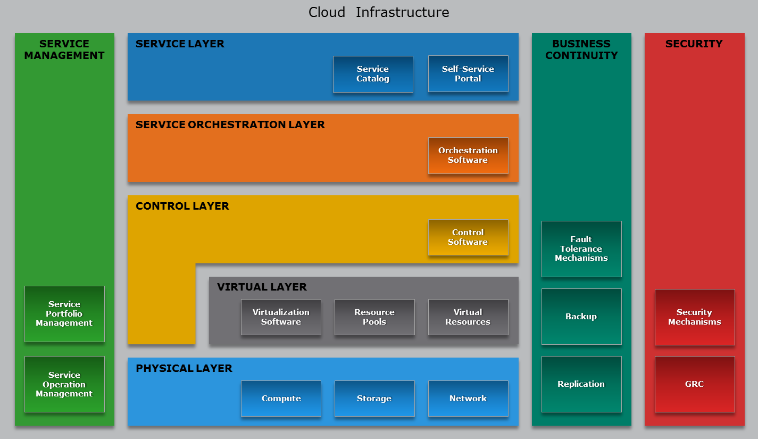
Cloud Computing Reference Model

Slide 5
Cloud Computing Layer
Physical Layer
Foundation layer of the cloud infrastructure
Specifies entities that operate at this layer:
Compute systems, network devices, and storage devices
Operating environment, protocol, tools, and processes
Functions of physical layer:
Executes requests generated by virtualization and control layer

Slide 6
Cloud Computing Layer
Virtual Layer
Deployed on the physical layer
Specifies entities that operate at this layer:
Virtualization software
Resource pools
Virtual resources
Functions of virtual layer:
Abstracts physical resources and makes them appear as virtual resources
Enables multitenant environment, thereby improving utilization
Executes the requests generated by control layer

Slide 7
Cloud Computing Layer
Control Layer
Deployed either on virtual layer or on physical layer
Specifies entities that operate at this layer – control software
Functions of control layer:
Enables resource configuration and resource pool configuration
Enables resource provisioning
Executes requests generated by service layer
Exposes resources to and supports the service layer
Collaborates with the virtualization software and enables
Resource pooling and creating virtual resources
Dynamic allocation of resources
Optimizing utilization of resources

Slide 8
Cloud Computing Layer
Service Orchestration Layer
Specifies the entities that operate at this layer:
Orchestration software
Functions of orchestration layer:
Provides workflows for executing automated tasks
Interacts with various entities to invoke provisioning tasks

Slide 9
Cloud Computing Layer
Service Layer
Consumers interact and consume cloud resources via this layer
Specifies the entities that operate at this layer:
Service catalog
Self-service portal
Functions of service layer:
Stores information about cloud services in service catalog and presents them to the consumers
Enables consumers to access and manage cloud services via a self-service portal

Slide 10
Cross-layer Function
Business Continuity
Specifies adoption of measures to mitigate the impact of downtime:
Enables ensuring the availability of services in line with SLA
Supports all the layers to provide uninterrupted services
Measures | Description
Proactive | Business impact analysis Risk assessment Technology solutions deployment (backup and replication)
Reactive | Disaster recovery Disaster restart
Notes:
SLA: Service Level Agreement

Slide 11
Cross-layer Function
Security
Specifies the adoption of:
Administrative mechanisms
Security and personnel policies
Standard procedures to direct safe execution of operations
Technical mechanisms
Firewall
Intrusion detection and prevention systems
Antivirus
Deploys security mechanisms to meet GRC requirements
Supports all the layers to provide secure services

Slide 12
Cross-layer Function
Service Management
Specifies adoption of activities related to:
Activities | Description
Service portfolio management | Defines service roadmap, service features, and service levels Establishes budgeting and pricing Deals with consumers in supporting activities Performs market research Collects information about competitors
Service operation management | Enables infrastructure configuration and resource provisioning Enables problem resolution Enables capacity and availability management Enables compliance conformance Enables monitoring cloud services and their constituent elements

Slide 13
Cloud Reference Architecture
APPLICATIONS
Traditional Applications
Modern Applications
Cloud Extensibility
Public
Cloud
Cloud Infrastructure
SERVICE MANAGEMENT
SERVICES
SECURITY
BUSINESS CONTINUITY
Self-Service Portal
Service Catalog
ORCHESTRATION
Orchestration software
SOFTWARE-DEFINED INFRASTRUCTURE
Portfolio Management
Software-Defined Compute
Software-Defined Storage
Software-Defined Network
Security Threats and Mechanisms
Fault Tolerance Mechanisms
VIRTUAL INFRASTRUCTURE
GRC
Virtual Compute
Virtual Storage
Virtual Network
Backup
Operation Management
PHYSICAL INFRASTRUCTURE—BEST OF BREED / CONVERGED
Replication
Compute
Storage
Network

Slide 14
Discussion topic
What is the difference between a traditional data center, and an on-premise private cloud?

Slide 15
Lesson Summary
During this lesson the following topics were covered:
Cloud computing reference model
Entities and functions of the five layers
Activities of the three cross-layer functions

