Slide 1
Attract Website Visitors BM031-3-M-BSSMMA Version #2
Lecture 8

Slide 2
Is Your Website Performing?
Attract website visitors
(Blog, SEO, Social Media, other forms email marketing, affiliate marketing, Ads, etc)
Convert visitors to leads
(Landing Pages)
Produce Measurable ROI (Leads, Sales)

Slide 3
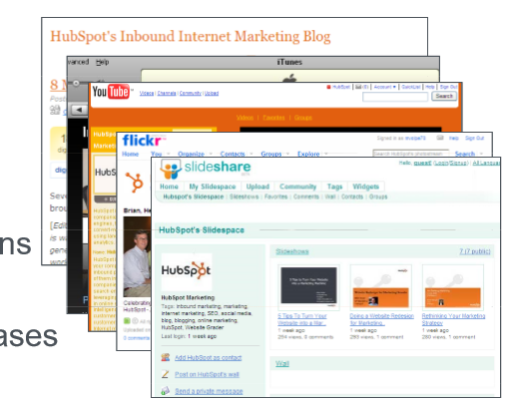
What to Publish?
Attract website visitors
Blogs
Podcast
Videos
Photos
Presentations
eBooks
News Releases

Slide 4
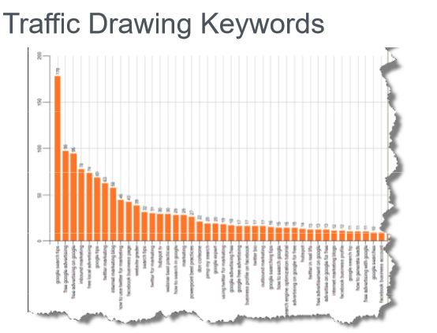
Blog Metrics :Traffic Drawing Keyword
Attract website visitors
Leading Marketing Metrics firm McKinsey recently revealed two astonishing truths in Forbes:
The total amount of available data increases 40% each year.
Companies which use blogging metrics and analytics are, on average, 5-6% more profitable than their competitors

Slide 5
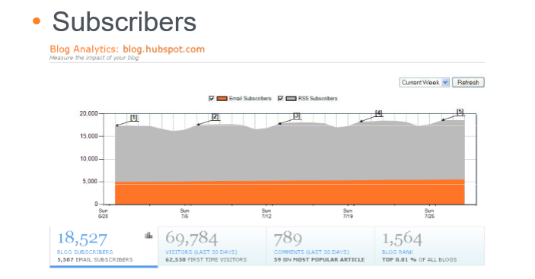
Blog Metrics: Subscribers
Attract website visitors
Blog subscribers on its own tells you only how many people were interested in the subject matter of your blog at a given moment in time.

Slide 6
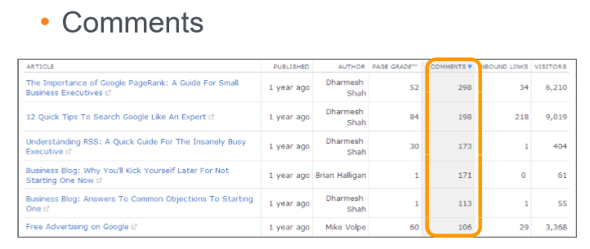
Blog Metrics : Comments
Attract website visitors
Get a better idea of the type of content your readers like

Slide 7
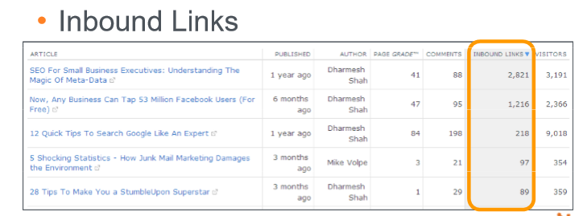
Blog Metrics : Inbound Links
Attract website visitors
Inbound link is a link coming from another site to your own website.
They can drive traffic to your website – gain benefit from that referral traffic.
They can help you rank higher in search. Backlinks tell search engines that your website is an authority on a certain subject -- so the more backlinks you have from high quality, high authority sites, the better your website will rank in search engine results pages (SERPs).

Slide 8
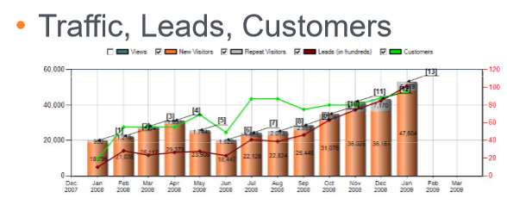
Blog Metrics : Traffic, Leads, Customers
Attract website visitors

Slide 9
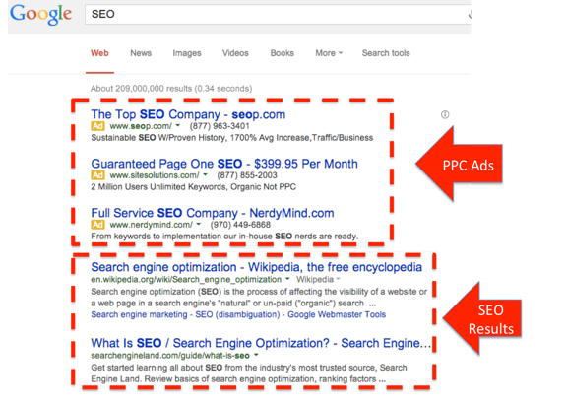
SEO Metrics : Organic VS Pay Per Click
Attract website visitors

Slide 10
SEO Metrics : Organic VS Pay Per Click
Attract website visitors
PPC or Pay Per Click is– you pay every time someone clicks your link.
provides a great place to test the effectiveness of different titles, descriptions
set up several variations and know which ones are getting the most visitors to your site.
We can use this information to drive the organic meta tags on your site – the title and descriptions that most search engines will use when your site comes up in the search results
Organic SEO can be achieved by:
Optimizing the Web page with relevant content
Spreading links pointing to the content
Incorporating metatags and other types of tag attributes
Benefits of organic SEO:
Generates more clicks as the organically optimized sites offer relevant content related to the keywords searched
Due to the content relevancy, the search engine results will last longer.
Builds greater trust among the users
Very cost-effective when compared to paid listings

Slide 11
SEO Metrics :On-Page VS Off-Page
On-page SEO is the act of optimizing different parts of your web site that affect your search engine rankings. It's stuff that you have control over and can change on your own website.
Factors - Title Tags, Headings (H1), URL structure, Alt text for images, Page content, Links
Off-page SEO focuses on increasing the authority of your domain through the act of getting links from other websites. E.g: Wikipedia ranks for pretty much everything under the sun.
http://www.digitalthirdcoast.net/blog/on-page-off-page-seo-difference

Slide 12
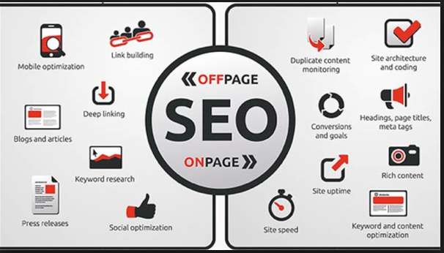
SEO Metrics :On-Page VS Off-Page
Attract website visitors
https://www.quora.com/What-are-the-most-effective-off-site-SEO-strategies

Slide 13
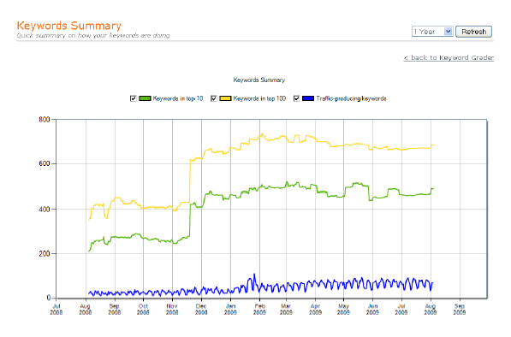
SEO Metrics : Keywords in Google
Attract website visitors
It is also called Metatag
Words or phrases describing your product or service that you choose to help determine when and where your ad can appear. The keywords you choose are used to show your ads to people. Keywords are also used to match your ad to sites in the Google Network that are related to your keywords and ads.

Slide 14
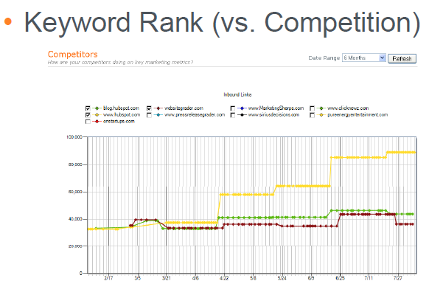
SEO Metrics : Keywords Rank
Attract website visitors
Google keyword ranking is the position that your website is listed in Google when a user searches that phrase or keyword. A ranking of 1 means that you are at the top. If you are number 11, that means that you are on page 2 of Google as most search results have 10 listings per page.

Slide 15
SEO Metrics : Others
Attract website visitors
Inbound Links
Traffic, Leads, Customers from SEO

Slide 16
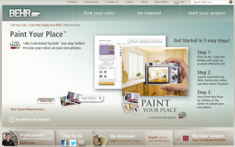
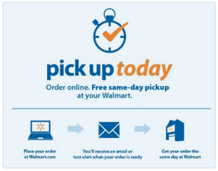
Instant Gratification
The Power of Now:
Get It Now
See It Now

Slide 17
Instant Gratification
Help Me Now
By 2020, 45% of consumers say they will switch brands if a company doesn’t actively anticipate their needs.
According to a Proctor & Gamble survey, moms get an average of just 26 minutes per day to themselves. The more time you save them when they have an issue or need something, the more loyal they will be to your brand.

Slide 18
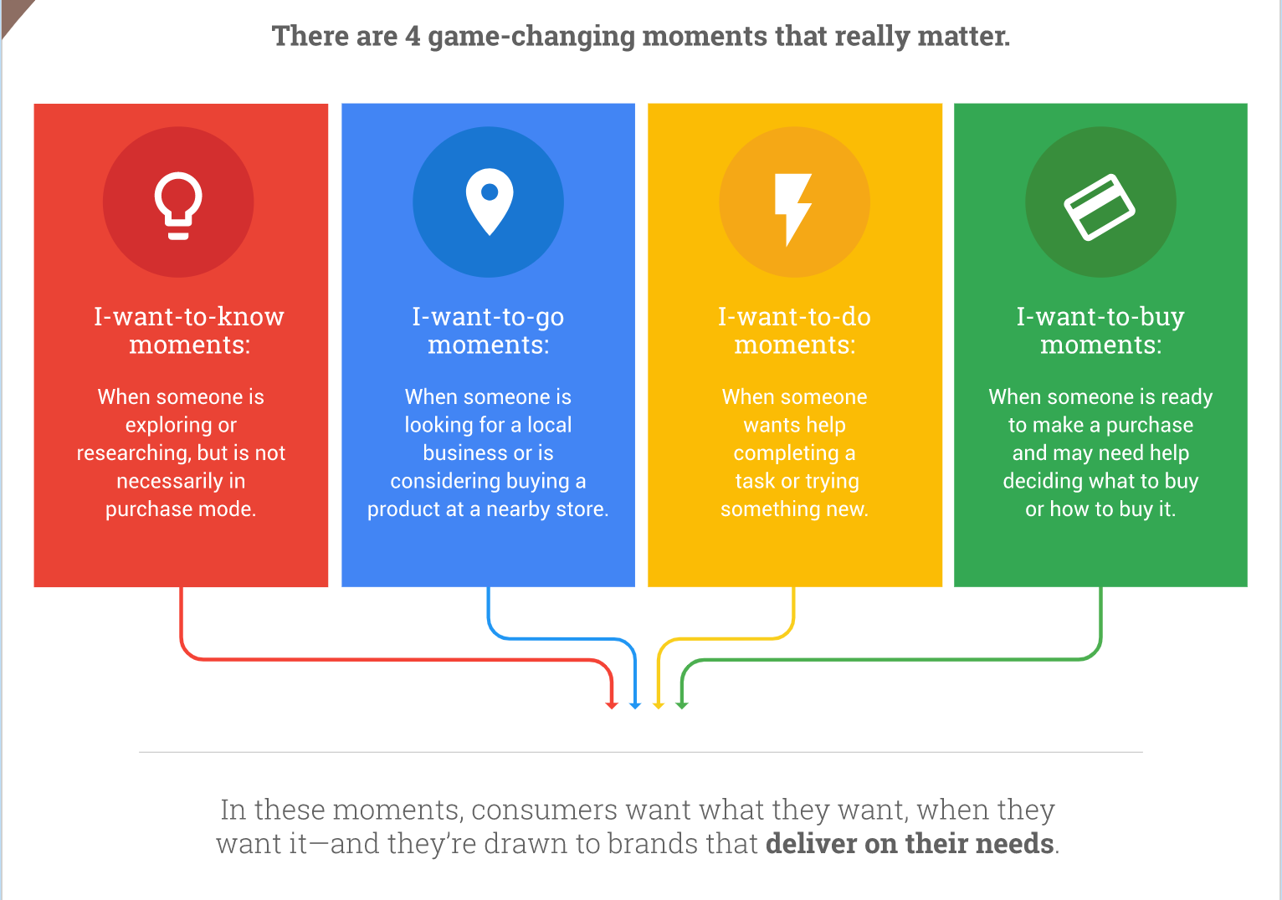
Understanding Micro-Moments
Notes:
https://learn.g2.com/micro-moments

Slide 19
Understanding Micro-Moments GOOGLE
Search Behavior (2015 – 2017)
https://www.thinkwithgoogle.com/consumer-insights/near-me-searches/

Slide 20
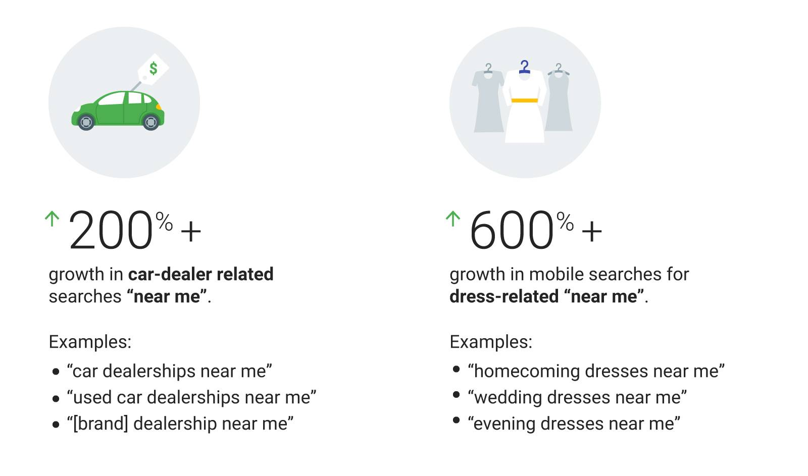
Understanding Micro-Moments GOOGLE
Search Behavior (2015 – 2017)

Slide 21
Google Search Trend (recent years)
150%+ growth - searches for “___ near me now” (for example, “food near me now,” “gas station near me now,” and “delivery near me open now”).²
900%+ growth - searches for “___ near me today/tonight” (for example, “open houses near me today,” “cheap hotels near me tonight,” and “movies playing near me today”).³
200%+ growth - searches for “Open” + “now” + “near me” (for example, “restaurants near me open now,” “stores open near me right now,” and “pharmacy near me open now”).⁴

Slide 22
Micro Moment Strategies
Investigate Data-driven tour of micro moments in the online travel industry :
Booking.com Expedia and TripAdvisor
https://www.innovationtactics.com/micro-moments-and-the-customer-journey/
https://medium.com/startup-grind/the-foolproof-guide-to-guaranteed-success-in-micro-moment-marketing-ae6b78cfec59

Slide 23
Predict Customer Journey
Predict
Strategize
Build Solution
Lock Customer
Predict consumer intent | Strategize the action plan | Build an engine that predicts what people need throughout the journey | Lock customers as advocates
Assistive experience for their customers and new opportunities for their business.
Notes:
https://www.thinkwithgoogle.com/marketing-resources/experience-design/consumer-intent/

Slide 24
Assistive experience strategy through behavior prediction
Optimize media toward business outcomes
Leaning into customer lifetime value (CLV)
Applying automation and machine learning to make the engine run
Note: The lifetime value of a customer, or customer lifetime value (CLV), represents the total amount of money a customer is expected to spend in your business, or on your products, during their lifetime.

Slide 25
Optimize media toward business outcomes
Identifying and focusing on business outcomes that put results over media metrics.
strategic metrics, like gross revenue, market share, or CLV, to measure the effectiveness of their campaigns.
 | Previous strategy - measured last-click, same-device conversions. Now HomeAway is optimizing its media to drive profit and using data-driven attribution to help marketing teams understand the intent, interactions, and signals that are driving long-term growth.

Slide 26
Lean into customer lifetime value
CLV measures the value a person brings to a business across all of their interactions over time — not just a single transaction.
With CLV, marketers can attract more of the customers they care about, stoke ongoing engagement, and ultimately, increase retention.
recognizing that its loyal Perks members are 66% more valuable than other customers. Aligning this insight with media optimization, Papyrus increased profits by 10X in just three months.

Slide 27
Marketing Automation
effective way for marketers to predict consumer intent
machines can now see, identify, and build those patterns - automation and machine learning technologies to drive marketing activities.
Shifting to data-driven attribution and automated bidding was instrumental to its success.
Results - grow gross bookings in 2017 by 46% year over year and revenue by 115% year over year.

Slide 28
Predict intent drives growth
ability to understand consumers and tap into real intent is a game-changer for marketers.
start building the engine to deliver what you care about: predicting intent to drive outcomes that grow your business.

Slide 29
Tutorial
Watch 3 Videos on
Search Intent
Marketing automation
AI for Marketing & Growth
Machine Learning in Marketing Automation
Present how customer information can be valuable in predicting their intent to speed their buying decisions (15 marks)

Slide 30
Benefits of Social Media Metrics
Understand how large your social media audience is,
How fast it’s growing,
How much traffic social media drives,
How many leads or customers you are generating from that traffic

Slide 31
Metric 1 :Social Audience Growth & Reach
Definition
The total number of people engaging with your brand in social media channels, such as Facebook “Likes,” Twitter followers, LinkedIn Group members, blog subscribers, YouTube channel subscribers, etc.
How to Use
The more people who are connected with your brand via social media channels, the more reach you have for your content.
Measure your social audience growth over time
Purpose
to attract that audience to take other actions, such as sharing your content, visiting your website, signing up for your email newsletter, or completing lead generation forms.

Slide 32
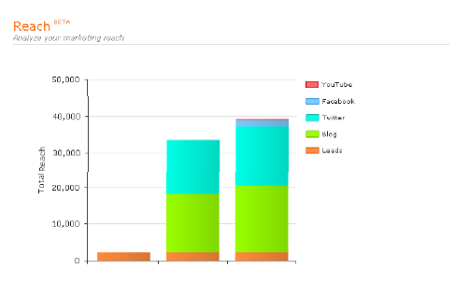
Social Media Metric: Reach
Attract website visitors

Slide 33
Metric 2: Social Media Engagement
The number of interactions generated in social media channels, as measured by metrics such as…
Facebook “Likes” (AKA fans)
Retweets and @replies on Twitter
Blog comments
Facebook Page comments
YouTube video views, YouTube channel subscribers, etc.
Shared links on social bookmarking sites such as Digg and StumbleUpon
Content downloads

Slide 34
Social Media Engagement
How to Use
Social media should be interactive . So monitoring your social media engagement tells you whether the content is actually interesting and relevant enough to engage your audience in that dialogue.
If you notice that your Facebook posts or blog articles aren’t generating many comments or other interactions, then perhaps you’re not covering the topics that really matter to your target audience. On the other hand, if you notice that certain types of tweets or Facebook posts tend to generate more retweets or Likes, you can get a good sense of what kind of content engages your audience.

Slide 35
Metrics 3: Visibility & Brand Perception
Definition
All the mentions of your brand in social media channels along with qualitative analysis of whether those mentions are positive, negative, or neutral
How to Use
Listen to your customers, know who’s talking about your brand,
spot opportunities to engage prospects and customers in conversation, share relevant content, or handle customer service issues.
Monitor the volume of brand mentions after launching a marketing campaign. Are people talking about it or sharing links you provided? Also measure your share of voice, or how much your brand is mentioned vs. your competitors.

Slide 36
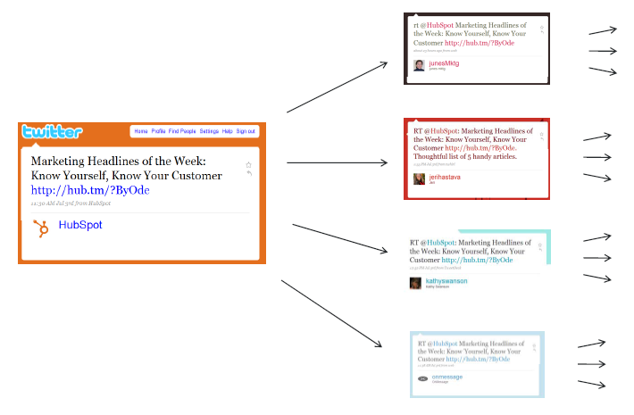
Good Content Spread
Attract website visitors

Slide 37
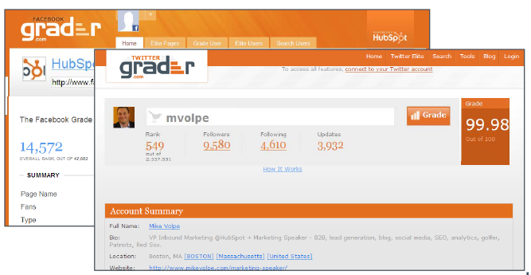
Social Media Metric: Influence
Attract website visitors

Slide 38
Metric 4: Traffic from Social Media
Definition
The percentage of unique visitors to your website that comes from social media channels.
How to Use
Monitor traffic from social media sources rising over time, especially as your social media reach grows. After all, a major goal of social media outreach is to attract visitors to your website where they can convert into leads or customers.
If your traffic from social media isn’t growing, examine your social media strategy. Do your tweets or Facebook posts include relevant links back to your website, where readers can get more information on a particular topic or take advantage of a special offer on a landing page?

Slide 39
Metric 5: Conversion Rate from Social Media
Definition
The percentage of visitors from social media that convert into leads or customers.
How to Use
This metric is critical for measuring the value of your social media reach. Comparing the percentage of leads or customers you generate through social media vs. other channels will help you determine the ROI of your social media outreach.

Slide 40
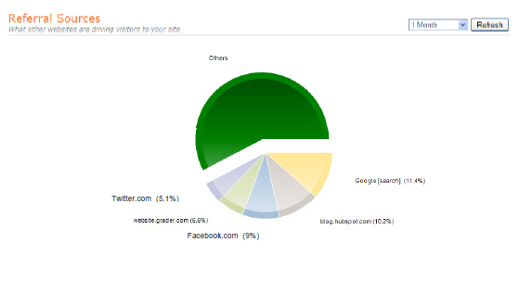
Social Media Metric: Referrals from Social Media
Attract website visitors

Slide 41
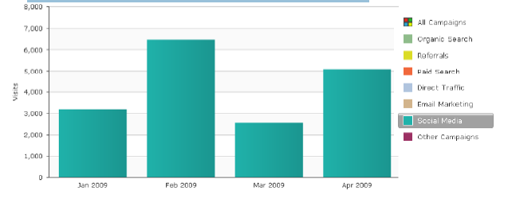
Social Media Metric: Traffic, Leads, Customers
Attract website visitors

Slide 42
Q and A

