Slide 1
Scales Rating and Ranking Scales

Slide 2
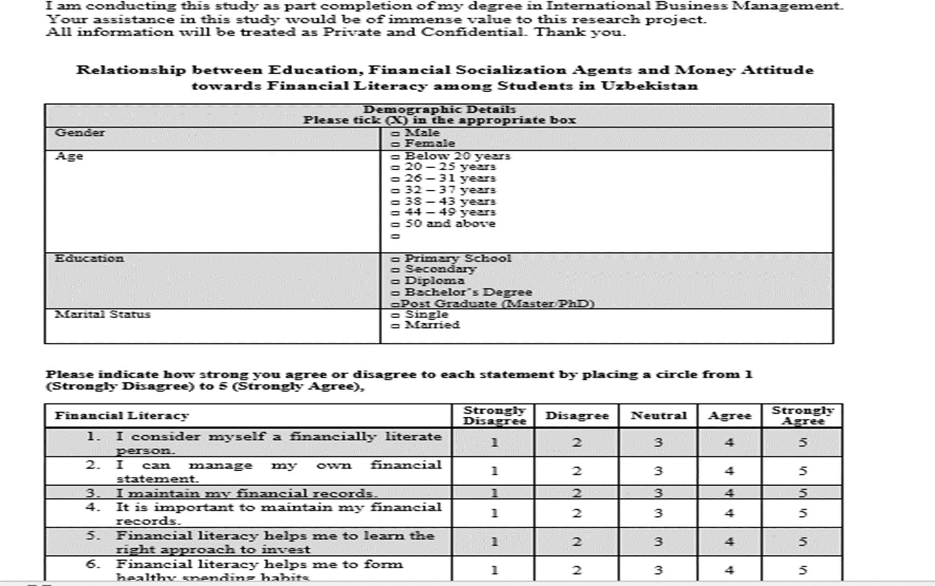
Scales
Sample Questionnaire

Slide 3
What are the different types of Measurement Scales

Slide 4
Scales: The Hierarchy of Levels
Ratio
Continuum of Values
Absolute zero
Interval
Equal intervals
Distance is meaningful
Ordinal
Preserves order
Attributes can be ordered
Nominal
Uniquely classifies
Attributes are only named; weakest

Slide 5
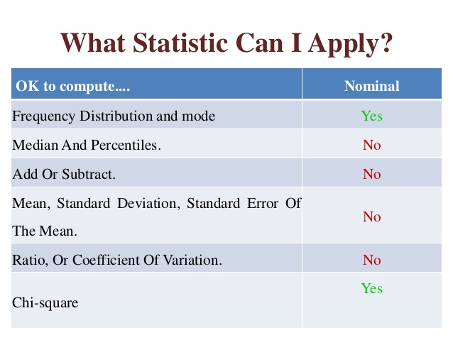
Nominal Scale
Consists of categorizing items into groups
It is used to indicate categories
Numbers are only used as labels
It has no numerical significance
It does not represent any order or distance.
Example of nominal scale:
Gender | Code
Male | 1
Female | 2
A nominal scale assigns a value to an object for identification or classification purposes only –
Zikmund

Slide 6
Ordinal Scale
Ordinal scale: rank-orders categories in some meaningful way.
What is the highest level of education you have completed?
O Less than High School
O High School/GED Equivalent
O College Degree
O Masters Degree
O Doctoral Degree
Even though differences in the ranking of objects/persons are clearly known, we do not know their magnitude.
Ordinal scales allow things to be arranged in order based on how much of some concept they possess.
Zikmund

Slide 7
Interval Scale
To measure the distance between any two points on the scale. Numerical distances between intervals
Has measurements where the difference between values is meaningful
The differences between points on the scale are measurable and exactly equal.
EG: The difference between a 110 degrees F and 100 degrees F is the same difference as between 70 degrees F and 80 degrees F.
Examples
Temperature, in degrees Fahrenheit
IQ test (intelligence scale).
Voltage e.g. 110 and 120 volts (AC); 220 and 240 volts (AC) and etc.
Scales that have both nominal and ordinal properties, but that also capture information about differences in quantities of a concept from one observation to the next. No true zero Zikmund

Slide 8
Interval scale

Slide 9
Ratio Scale
Represent absolute quantities
Has an absolute (in contrast to an arbitrary) zero point, which is a meaningful measurement point.
Eg: Sales volume, income in dollars,
length, area or volume, height, weight
Test scores
Income
Height
Weight
Ratio scales represent the highest form of measurement in that they have all the properties of interval scales with the additional attribute of representing absolute quantities. Zikmund

Slide 10
Exercise: What are the scales of measurement for these variables?
Variable | Scale
Program of study
Speed (km/hr)
Motivation scores
Income categories
Number of WhatsApp received
Marital status
Quality of work life scores
Gender
Perception scores
Membership status

Slide 11
Exercise: What are the scales of measurement for these variables?
Variable | Scale
Program of study | Nominal
Speed (km/hr) | Ratio
Motivation scores | Interval
Income categories | Ordinal
Number of WhatsApp received | Ratio
Marital status | Nominal
Quality of work life scores | Interval
Gender | Nominal
Perception scores | Interval
Membership status | Nominal

Slide 12
Recap: Scales
Scale | Description | Example
Nominal | The values “name” the attribute uniquely. The value does not imply any ordering of the cases | Gender 1 = Male 2 = Female
Ordinal | When attributes can be rank-ordered… Arranged from lowest to highest | Education Level 1= Diploma 2= Degree 3=Masters 4=Phd
Interval | An interval scale measures quantitative differences, not just relative The distance between attributes does have meaning. Arbitrary zero (eg Zero degree F has value) | Temperature (in Fahrenheit), the distance from 30-40 is same as distance from 70-80 Time
Ratio | Continuum of values Aa non-arbitrary zero point True zero (eg Zero income) | Size, weight, Height, Age Income

Slide 13
Rating and Ranking Scales

Slide 14
Rating and Ranking Scales
Categories of scales: (not to be confused with the four different types of scales)
1. The Rating Scales
2. The Ranking Scales
Rating scales
Have several response categories and are used to elicit responses with regard to the object, event, or person studied.
Ranking scales,
Make comparisons between or among objects, events, or persons and elicit the preferred choices and ranking among them

Slide 15
Types of Data Measures
An instrument is a tool for measuring, observing, or documenting quantitative data.
Types of instruments
Performance measures (e.g., test performance)
Attitudinal measures (measures feelings toward educational topics)
Behavioral measures (observations of behavior)
Factual measures (documents, records)

Slide 16
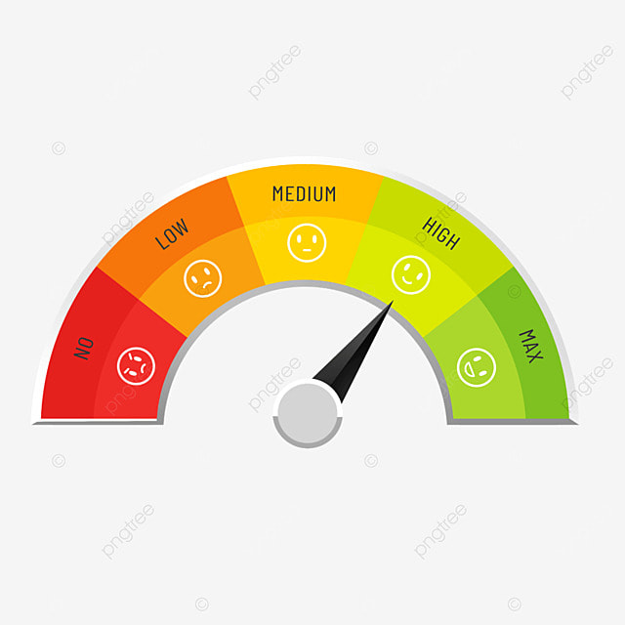
Rating Scales
Dichotomous scale
Category scale
Semantic differential scale
Numerical scale
Itemized rating scale
Likert scale
7.Fixed or constant sum rating scale
8. Stapel scale
9. Graphic rating scale
10 Consensus scale

Slide 17
Dichotomous Scale
Is used to elicit a Yes or No answer.
(Note that a nominal scale is used to elicit the response)
Example
Do you own a car? Yes No

Slide 18
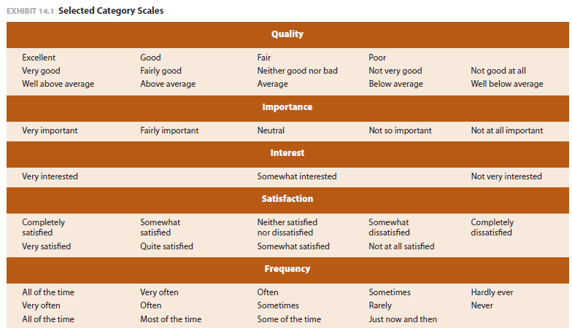
Category scale
A rating scale that consists of several response categories, often providing respondents with alternatives to indicate positions on a continuum.

Slide 19
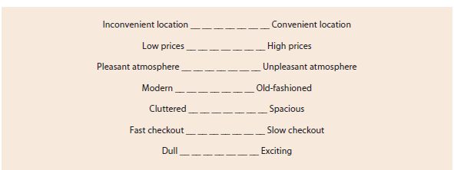
Semantic Differential Scale
Several bipolar attributes are identified at the extremes of the scale, and respondents are asked to indicate their attitudes, on what may be called a semantic space, toward a particular individual, object, or event on each of the attributes.
The bipolar adjectives used might employ such terms as Good–Bad; Strong–Weak; Hot–Cold.
The semantic differential scale is used to assess respondents’ attitudes toward a particular brand, advertisement, object, or individual.
Good – Bad
Strong – Weak
Hot – Cold
Example:
Going to the library is ……...
Bad for me. 1___2___3___4___5 Good for me.

Slide 20
Numerical Scale
Is similar to the semantic differential scale, with the difference that numbers on a 5- points or 7-points scale are provided
How pleased are you with your new lecturer?
Extremely Displeased 1 2 3 4 5 6 7 Extremely Pleased
1. I always pay attention in class
I disagree completely 1 2 3 4 5 I agree completely
2. I always complete my assignments and submit before the deadline
I disagree completely 1 2 3 4 5 I agree completely
3. For the efforts I put into my studies, I expect good grades
I disagree completely 1 2 3 4 5 I agree completely

Slide 21
Itemized Rating Scale
A 5-point or 7-point scale is provided for each item and the respondent states the appropriate number on the side of each item. This uses an Interval Scale.
Example 1
Respond to each item using the scale below, and indicate your response number on the line by each item.
1 2 3 4 5
Very unlikely neither likely very likely
Unlikely unlikely nor
likely
--------------------------------------------------------------------------------
I will be changing my job in the near future. 1 2 3 4
Example 2
Circle the number that is closest to how you feel for the item below:
Not at all Somewhat Moderately Very much
interested interested interested interested
1 2 3 4
--------------------------------------------------------------------------------
How would you rate your interest 1 2 3 4
In changing current organizational Policies?

Slide 22
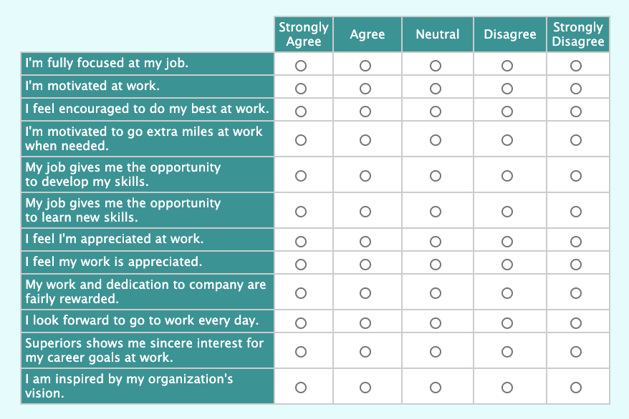
The Likert Scale
Extremely popular means for measuring attitudes.
Respondents indicate their own attitudes by checking how strongly they agree/disagree with statements.
Response alternatives:
“strongly agree”,
“agree”,
“Neutral”,
“disagree”,
“strongly disagree”.
Use either a 5- or 7-point scale

Slide 23
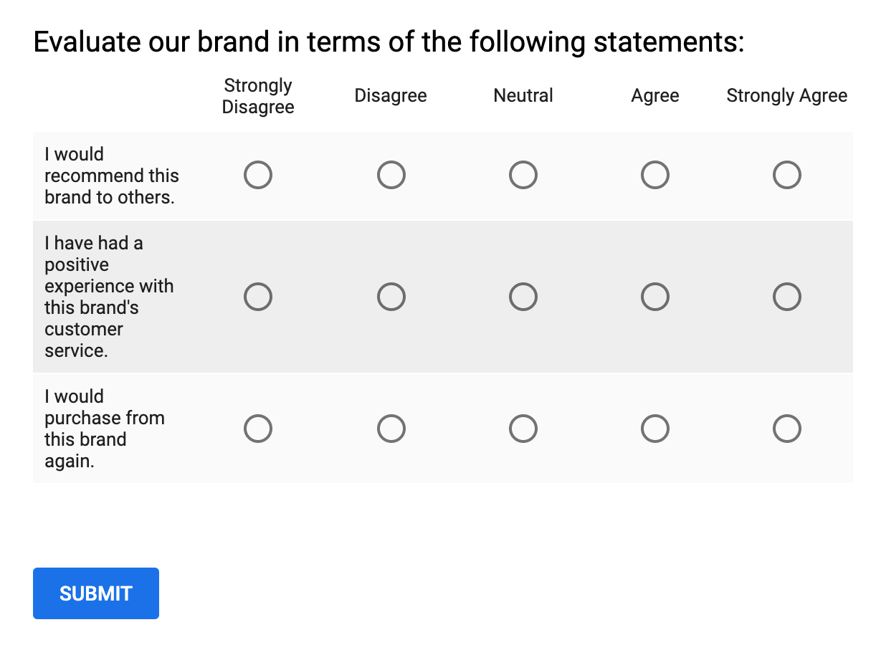
Likert Scale
This is a scale and the differences in responses between any two points on the scale remain the same.
For example, the researcher might ask the respondent to:
I am satisfied with the brand of my smartphone?
strongly disagree;
disagree;
neither agree nor disagree;
agree;
strongly agree with the statement, “
Google Form

Slide 24
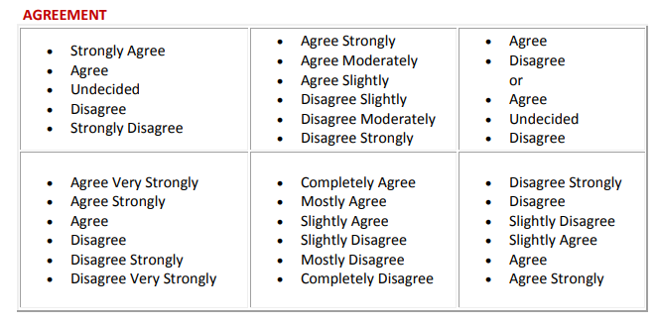
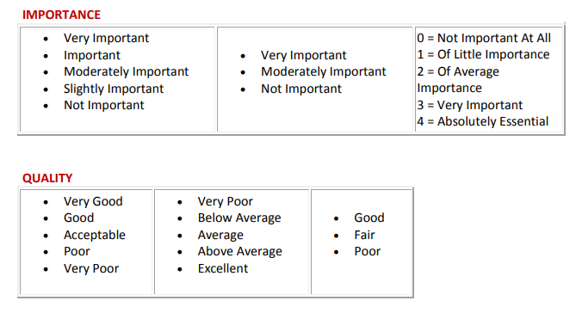
5 Point scales - Anchors

Slide 25
Likert Rating scales
Likert scale – designed to examine how strongly subjects agree or disagree with statement on a five-point scale with the following anchors:

Slide 26
Likert Scale Examples
Agreement Questions
This is the most common type of Likert scale question as survey creators can list a series of statements about a topic and gauge how much participants agree to them.
2. Frequency Questions
Frequency questions are great for companies who want to judge how often consumers use their products. It can also reveal insights into the everyday routines of each participant.

Slide 27
Likert Scale Examples
3. Importance Questions
Importance questions reveal some of the values and beliefs of your customers. They share how important certain aspects of your brand, services, and products are and what areas need to be improved.
s
4. Likelihood Questions
Likelihood questions determine how true a statement is for a participant. This can also be used to judge the values and beliefs of your audience.
5. Quality Questions
Quality questions test how your products, services, and brand are perceived by customers. This is a good question to use to judge consumer perception after releasing a new product.

Slide 28
Likert Rating scales
Likert scale – designed to examine how strongly subjects agree or disagree with statement on a five-point scale with the following anchors:

Slide 29
Fixed or constant sum rating scale
The respondents are here asked to distribute a given number of points across various items as per the example below.
This is more in the nature of an ordinal scale.

Slide 30
Stapel Scales
This scale simultaneously measures both the direction and intensity of the attitude toward the items under study.
The characteristic of interest to the study is placed at the center with a numerical scale ranging, say, from +3 to −3, on either side of the item.
This gives an idea of how close or distant the individual response to the stimulus is. Since this does not have an absolute zero point, this is an interval scale.

Slide 31
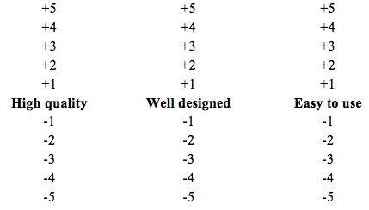
A Stapel Scale for Measuring iPhone Image
Select the appropriate plus number for the phrase that best represents attributes of the iPhone 6. If the phrase does not represent the iPhone 6, select the appropriate negative number that reflects your attitude.

Slide 32
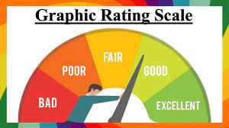
Graphic Rating Scales
Graphic Rating Scales: Graphic ratings scales include a graphic continuum anchored between two extremes. When used for online surveys, graphic rating scales may have a "slider," which respondents can move up or down the scale. Sliders allow respondents to make finely tuned responses using a continuous scale.
A graphic rating scale presents respondents with a graphic continuum.

Slide 33
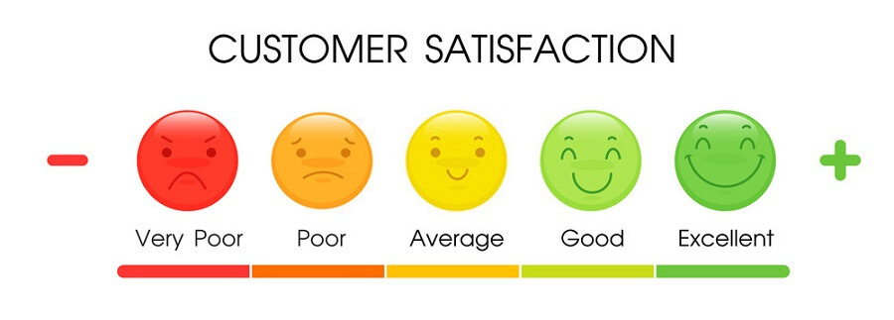
Graphic Rating Scale How you rate your friend?

Slide 34
Consensus scale
Scales can also be developed by consensus, where a panel of judges selects certain items, which in its view measure the relevant concept. The items are chosen particularly based on their pertinence or relevance to the concept.
Such a consensus scale is developed after the selected items have been examined and tested for their validity and reliability.
Example of consensus scale: Thurstone Equal Appearing Interval Scale
A concept is measured by a complex process followed by a panel of judges.
Using a pile of cards containing several descriptions of the concept, a panel of judges offers inputs to indicate how close or not the statements are to the concept under study.
The scale is then developed based on the consensus reached. However, this scale is rarely used for measuring organizational concepts because of the time necessary to develop it.

Slide 35
Ranking Scales
As already mentioned, ranking scales are used to tap preferences between two or among more objects or items (ordinal in nature).

Slide 36
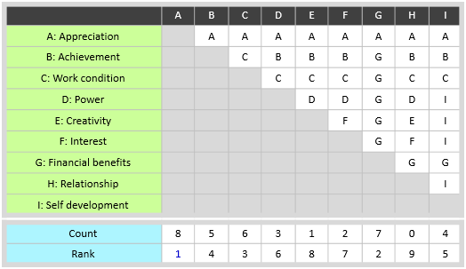
Paired comparison
The paired comparison scale is used when, among a small number of objects, respondents are asked to choose between two objects at a time. This helps to assess preferences.
Example:
During the paired comparisons, respondents consistently show a preference for product one over products two, three, and four, the manager can reliably understand which product line demands his utmost attention.
However, as the number of objects to be compared increases, so does the number of paired comparisons. The number of paired choices for n objects will be (n)(n − 1)/2.

Slide 37
Rank Order Scaling
Forced choice
The forced choice enables respondents to rank objects relative to one another, among the alternatives provided.
This is easier for the respondents, particularly if the number of choices to be ranked is limited in number.
Please rank the lecturers listed below in order of preference. For the lecturer you prefer the most, assign a “1”, assign a “2” to the lecturer you prefer the 2nd most, assign a “3” to the lecturer that you prefer 3rd most, and assign a “4” to the lecturer that you prefer the least.
Lecturer | Ranking
Cunningham | 1
Day | 3
Parker | 2
Thomas | 4

Slide 38
Comparative scale
The comparative scale provides a benchmark or a point of reference to assess attitudes toward the current object, event, or situation under study.
Example

Slide 39
Continuous Scales
Categorical Scales

Slide 40
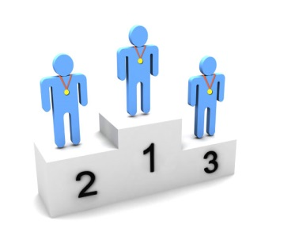
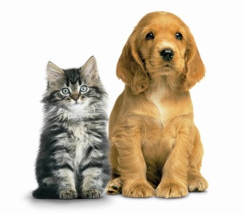
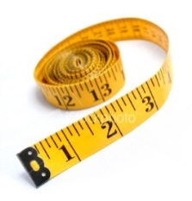
Data Variables
Variables
Scale
Categorical
Continuous
Measurements
takes any value
Discrete:
Counts/ integers
Ordinal:
obvious order
Nominal:
no meaningful order
Continuous variables can take any value within a range and are the most common, e.g. body weight, height, income, etc.
Discrete variables can only take whole numbers, such as number of students in class, number of new patients
Notes:
Categorical variables can be divided into two: ordinal and nominal. If the categories are meaningfully ordered, the variable is ordinal; if it doesn’t matter in which way the categories are ordered, then the variable is nominal. For example, satisfaction levels (dissatisfied, satisfied and highly satisfied) and education level (secondary, sixth form, undergraduate and postgraduate) are ordinal variables; Student’s religion (Christian, Muslim, Hindu, etc) and favourite animal are nominal variables.
Scale variables appear as meaningful comparable numbers, such as blood pressure, height, weight, income, age, and probability of illness etc. Numerical variables can be further divided into two subtypes: continuous and discrete. The continuous variables can take any value within a range and are the most common, e.g. body weight, height, income, etc. Discrete variables can only take whole numbers, such as number of students in class, number of new patients every day, etc but are treated as continuous for statistical analysis if there are a large range of numbers.
One point to make is that if ordinal data is scored as ranks such as 1, 2, 3 etc., and then this data is analysed as scale data, then a rather strong assumption is being made that the distances between the value of any pair of neighbouring ranks (e.g. 1 and 2 or 2 and 3 etc.) is the same, which is unlikely in practice to be true. Students often find the difference between ordinal and discrete difficult especially when ordinal is categorised as numbers
The point is that whilst this might not be the most interesting place to start – students need to be aware of the data they have since this affects what analyses are/not suitable.

Slide 41
Categorical, Discrete and Continuous variables
A discrete variable is a variable whose value is obtained by counting.
Examples: number of students present
number of red marbles in a jar
number of heads when flipping three coins
students’ grade level
A continuous variable is a variable whose value is obtained by measuring.
Examples: height of students in class
weight of students in class
time it takes to get to school
distance traveled between classes
Categorical variables contain a finite number of categories or distinct groups. Categorical data might not have a logical order.
For example: predictors include gender, material type, and payment method.

Slide 42
Thank You

