Slide 1


Topic 4 Sample Size Calculation
Dr Jugindar Singh

Slide 2

Sample Size

Slide 3
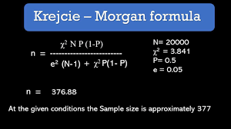
Krejcie and Morgan (1970)
The Krejcie and Morgan table (KMT, Krejcie & Morgan, 1970) is well known for sample size
determination among behavioral and social science researchers.
The KMT suggests that a sample of 384 is sufficient for a population of 1,000,000 or more.
A sample must be representative of the particular population under study when using the KMT.
The KMT should be used to determine sample size when probability sampling (e.g. simple random, systematic, stratified) is the appropriate choice.
Krejcie, R.V., & Morgan, D.W., (1970). Determining Sample Size for Research Activities. Educational and Psychological Measurement.

Slide 4
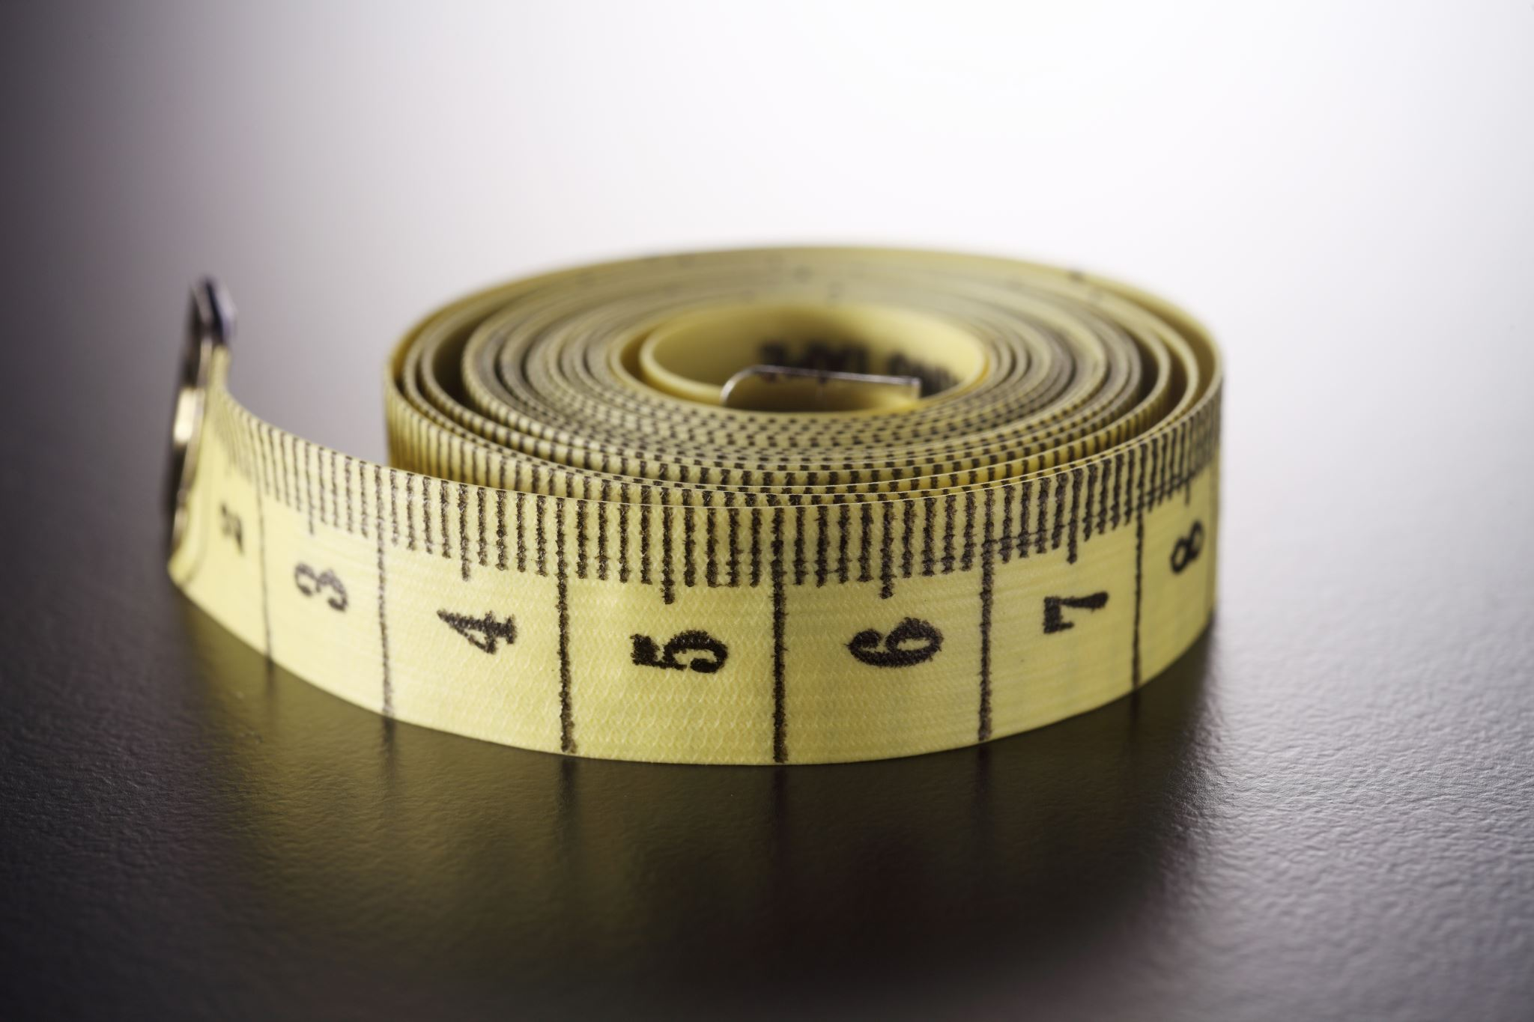
Sample Size
Sample size is governed by:
• The confidence level you need to have in your data – that is, the level of certainty that the characteristics of the data collected will represent the characteristics of the target population;
95% - at least 95 of these samples would be certain to represent
the characteristics of the target population
• The margin of error that you can tolerate – that is, the accuracy you require for any estimates made from your sample;
• The types of analyses you are going to undertake – in particular, the number of categories into which you wish to subdivide your data, as many statistical techniques have a minimum threshold of data cases for each cell (e.g. chi square)

Slide 5
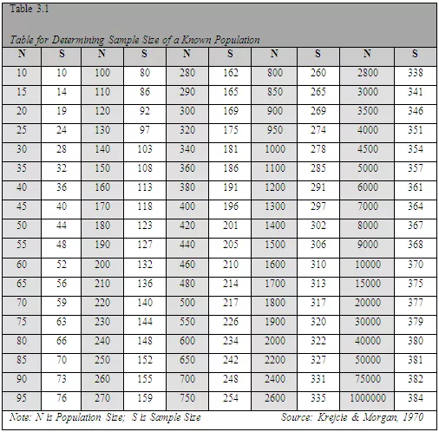
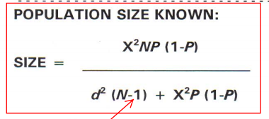
Sample Size: Krejcie & Morgan (1970)
This is the sub-population to be studied in order to make an inference to a reference population
(A broader population to which the findings from a study are to be generalized)
Formula (Krejcie & Morgan, 1970) may be used to determine the sample size.
Where:
S = Required Sample size
X = Z value (e.g. 1.96 for 95% confidence level)
N = Population Size
P = Population proportion (expressed as
decimal) (assumed to be 0.5 (50%)
d = Degree of accuracy (5%), expressed as a
proportion (.05); It is margin of error

Slide 6
Sample Size: Krejcie & Morgan (1970)
S = X² NP (1-P) ÷ d² (N-1) + X² P (1-P)
S = the required sample size.
X *2 = the table value of chi-square for 1 degree of freedom at the desired confidence level (3.841).
N = the population size.
P = the population proportion (assumed to be 0.50 as this would provide the maximum sample size).
d = the degree of accuracy expressed as a proportion (0.05).
Calculate sample size of population is 10,000

Slide 7
What governs the sample size
Sample size governed by:
• The confidence Level –the level of certainty that the characteristics of the data will represent the characteristics of the total population (normally 95%)
• The margin of error that you can tolerate - the accuracy you require for any estimates made from your sample 5%)
• The types of analyses to undertake
Eg: you wish to subdivide your data, as many statistical techniques have a minimum threshold of data cases for each cell
• The size of the total population
from which your sample is being drawn.
95 per cent level of certainty means that if your sample was selected 100 times, at least 95 of these samples would be certain to rep. the characteristics of the population
Where the population in the category is less than 30, collect data from all cases in that category.

Slide 8
Multivariate Statistics
Sample
Size
Green (1991)
Green, S.B. (1991). How many subjects does it take to do a regression analysis? Multivariate Behavioral Research, 1991, 26, 499-510
Green (1991) - Some simple rules of thumb are:
N = 50 + 8m (where m is the number of IVs) for testing the multiple correlation
N = 104 + m for testing individual predictors.
Example:
If you plan six predictors, you need:
50 + (8)(6) = 98 cases to test regression
104 + 6 = 110 cases for testing individual predictors.
If you are interested in both the overall correlation and the individual IVs, calculate N both ways and choose the larger number of cases
If either standard multiple or hierarchical regression is used, one would like to have
20 times more cases than IVs.
That is, if you plan to include 5 IVs, it would be lovely to measure 100 cases.

Slide 9
Response rate
Response rates of approximately 50 % (individuals) per cent and 35 to 40 % (organization members) are reasonable (Baruch and Holtom 2008).
Neuman (2014) suggests response rates of between 10 and 50 per cent for postal questionnaire surveys and up to 90 per cent for face-to-face interviews.
Sample size you require can be calculated using the following formula:
Na = n × 100/re%
where n a is the actual sample size required,
n is the minimum (or adjusted minimum) sample size
re % is the estimated response rate expressed as a percentage.
Example: return Rate 30%
Sample size is 439
na = 439 × 100/30 = 1463

Slide 10
Sample-to-item ratio
The sample-to-item ratio is used to decide sample size based on the number of items in a study.
The ratio should not be less than 5-to-1 (Gorsuch, 1983; Hatcher, 1994; Suhr, 2006).
Example
A study with 30 items (questions) would require 150 respondents.
A 20-to-1 ratio has also been suggested (Costello & Osborne, 2005). In this case, the same 30-item study would need 600 respondents.
Studies that followed this rule include Brown and Greene (2006), Liao, So, and Lam (2015), Yeoh, Ibrahim, Oxley, Hamid, and Rashid (2016), and Forsberg and Rantala (2020), among others
Memon, M. A., Ting, H., Cheah, J. H., Thurasamy, R., Chuah, F., & Cham, T. H. (2020). Journal of Applied Structural Equation Modeling.

Slide 11
Sample to Variable Ratio
The sample-to-variable ratio suggests a minimum observation-to-variable ratio of 5:1, but ratios of 15:1 or 20:1 are preferred (Hair et al., 2018).
This means that though a minimum of five respondents must be considered for each independent variable in the model, 15 to 20 observations per independent variable are strongly recommended.
This is in line with Tabachnick and Fidell (1989), who proposed five subjects for each independent variable as a “bare minimum requirement” for hierarchical or multiple regression analysis.
Although the 5:1 ratio appears easy to follow, students should consider higher ratios (e.g. 15:1, 20:1) when determining sample size for their research works
Memon, M. A., Ting, H., Cheah, J. H., Thurasamy, R., Chuah, F., & Cham, T. H. (2020). Journal of Applied Structural Equation Modeling.

Slide 12
Roscoe’s (1975) guidelines
Roscoe’s (1975) set of guidelines for determining sample size has been a common choice in the last several decades.
Roscoe suggested that a sample size greater than 30 and less than 500 is suitable for most behavioral studies
A sample size larger than 500 may lead to a Type II error (Sekaran & Bougie, 2016).
Roscoe also posited that for comparative analysis, if the data set needs to be broken into several subgroups (e.g. male/female, rural/urban, local/international, etc.), 30 respondents should be considered the minimum for each group.
Memon, M. A., Ting, H., Cheah, J. H., Thurasamy, R., Chuah, F., & Cham, T. H. (2020). Journal of Applied Structural Equation Modeling.

Slide 13
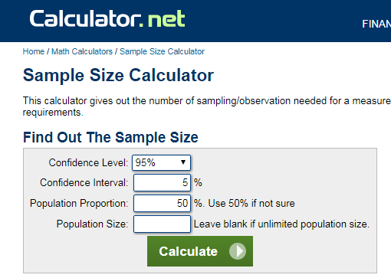
FORMULAE FOR SAMPLE SIZE CALCULATION
There are many formulae for calculating sample size
Determined largely by 3 factors
Population size: The total number of people who qualify for the study
The desired level of confidence.
Usually 95%≡1.96 in business
research
3. The acceptable margin of error.
Desired in the study. ~1%-5%
or 0.01 and 0.05

Slide 14
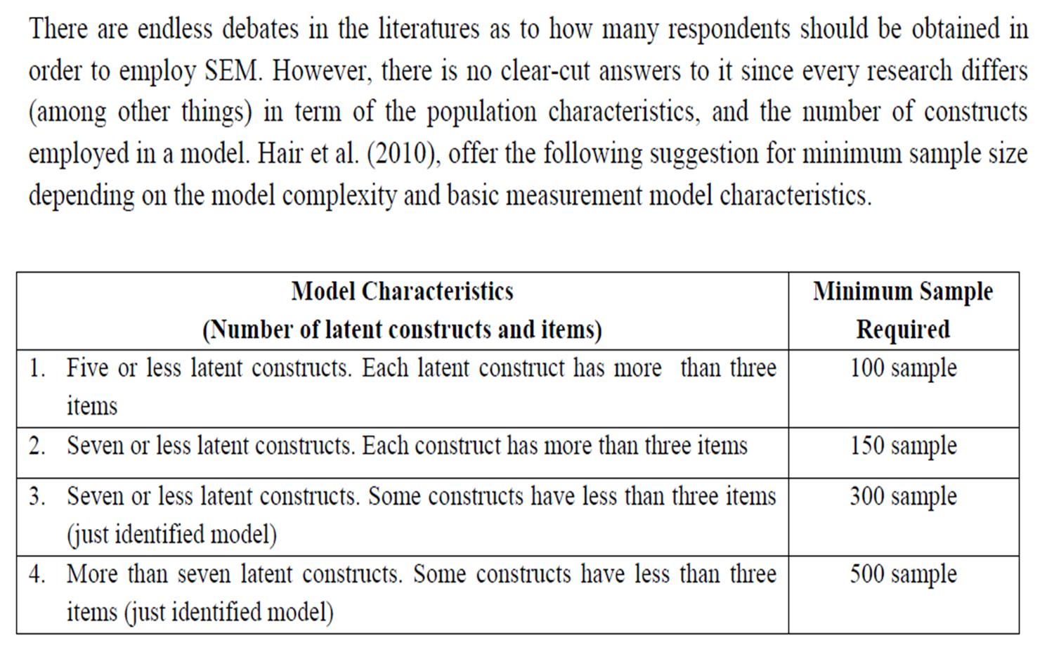
Sample Size for Regression Analysis and SEM (Hair et al. 2010)
Multiple Regression Sample Size
SEM Sample Size
For multiple regression analyses the desired level is between 15 to 20 observations for each predictor variable
For example, the predictor variables are 5, require a sample size of 100
Hair, J.F., W.C. Black, B.J. Babin, R.E. Anderson and R.L. Tatham, 2010. Multivariate Data Analysis, Prentice Hall, New Jersey

Slide 15
Sample size for SEM
The is no one size that fits
There are several widely adopted rules of thumb to calculate sample size, researchers remain unclear about which one to consider when determining sample size in their respective studies

Slide 16
“10-Times Rule”
Hair Jr et al. (2013),
In PLS SEM, the sample size is determined by the often-cited 10 times rule which indicates that the sample size should be equal to the larger of:
1. 10 times the largest number of formative indicators used to measure a single construct,
or
2. 10 times the largest number of structural paths directed at a particular construct in the structural model.
The “10-times rule” method has been a favorite (Hair et al., 2011) due to its simplicity of application – it builds on the rule that the sample size should be greater than 10 times the maximum number of inner or outer model links pointing at any latent variable in the model.
In spite of the 10-times rule method’s simplicity of application, it has been shown in the past to lead to inaccurate estimates (Goodhue et al., 2012).

Slide 17
Sample size for SEM – Rules of Thumb
Kline (2011) - a typical sample size in studies where SEM is used is about 200 cases. However, a sample size of 200 cases may be too small when analyzing a complex model.
Minimum sample sizes in absolute Ns were the first rules of thumb, suggesting that any N > 200 offers adequate statistical power for data analysis (Hoe, 2008;Singh et al., 2016).
A sample of 300 cases has also been suggested (Tabachnick & Fidell, 2013). Comrey and Lee (1992);
Comrey et al., 1973) graded a factor analysis sample of 50 as very poor, 100 as poor, 200 as fair, 300 as good, 500 as very good, and 1000 as excellent (quoted also by Costello & Osborne, 2005;DeVellis, 2017;Williams et al., 2010and others)
Memon, M. A., Ting, H., Cheah, J. H., Thurasamy, R., Chuah, F., & Cham, T. H. (2020). Journal of Applied Structural Equation Modeling.

Slide 18
Other rules of thumb
Aside from the rules of thumb discussed above, there are several other guidelines for determining sample size.
Harris (1975) recommended a minimum sample size of N ≥ 50+m
(where m is the number of predictors).
Cochran (1977) suggested that when determining sample size, researchers should identify the margin of error for the items considered most important in the survey and estimate sample size separately for each of these important items. As a result, researchers would get a range of sample sizes, i.e. small sample sizes for scaled/continuous variables and larger sample sizes for categorical/dichotomous variables. Interested researchers can refer to Bartlett et al. (2001) and Cochran (1977) to learn more about Cochran's sample size
estimation.
Memon, M. A., Ting, H., Cheah, J. H., Thurasamy, R., Chuah, F., & Cham, T. H. (2020). Journal of Applied Structural Equation Modeling.

Slide 19
Qualitative Research - Sample size
Usually smaller than quantitative study.
Two general guidelines: the number of participants is sufficient when…
  the extent to which the selected participants represent the range of potential participants in the setting
  the point at which the data gathered begin to be redundant (data saturation)

Slide 20
Sampling methods
Non probability sampling
Three of the most common sampling methods are:
  Purposive sampling
  Quota sampling
  Snowball sampling

Slide 21
Purposive sampling
Purposive sampling groups participants according to pre-selected criteria relevant to a particular research question.
  Example:
  Owners of SMEs in the Malaysia
  Blockchain experts
Sample sizes depend on:
  Resources and time available
  The study’s objectives
If the researcher needs a specific number of participants, quota sampling is better.

Slide 22
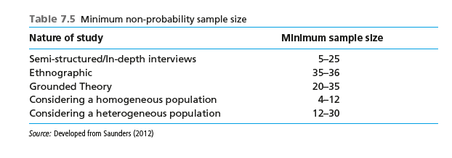
Sample Size: Qualitative
Conducting additional interviews, until data saturation is reached
Homogenous group, 12 in-depth interviews should suffice (Guest et al. 2006).

Slide 23
Sample Size: Cohen Statistical Power Analysis (1998)
Five Factors considered
1. Significance level or criterion
2. effect size
3. desired power
4. estimated variance
5. sample size
Correlational study
To find out the degree of the relationship between a DV and 10 IVs
With a predetermined effect size
of r = .30 (medium), a significant alpha = .05 and a statistical power of .80
Desired sample size to test these relationships is 85 (Cohen, 1992). This means that 85 respondents are sufficient to perform this statistical analysis.
The values of significance level, effect size, power and estimated variance have to be pre-determined.
Significance for most studies : = .05.
Effect sizes to test the significance of product moment correlation coefficient, r, are, .10, .30, and .50, for small, medium and large
Effect size index, f2 for small, medium and large effect sizes are f2 = .02, .15, and .35 respectively
Statistical Power: Cohen (1992) suggested fixing the power at .80 (β = .20),
Regression Analysis
Calculation can performed on the maximum of 10 independent variables (u = 10).
With the specified power of .80, a medium effect size of f2 = .15, a significant alpha of .05
Sample size is 116

Slide 24
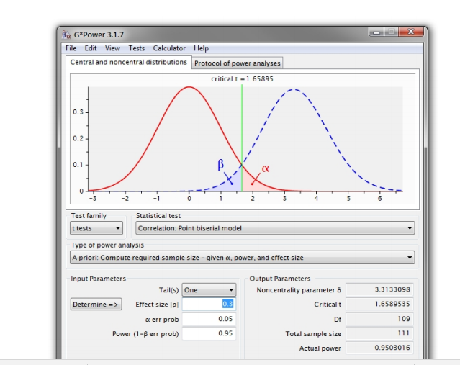
Cohen: GPower
Power: 95%
Alpha at: 0.05
Medium effect of 0.15
Number of Predictors: 2

Slide 25
G-Power Example
The priori power analysis assumed a medium effect size of .15 (f2 = .15) and a = .05 to achieve a power of .80 and .95

Slide 26

Thank You
Questions

