Slide 1
Personal Development and Study Methods BM006-3-0 PDSM
Learning Methods

Slide 2
Introduction
Definition of learning and method
Learning Approaches
Types of learning approaches
Studying at University
Types of learning situations
Learning Styles
VAK (Visual-Auditory-Kinesthetic)

Slide 3
Learning Outcomes
At the end of this lesson, you should be able to:
Outline the different types of learning approaches
Outline the different types of learning situations
Identify preferred learning styles for effective learning

Slide 4
Definitions
What is learning?
the acquisition of knowledge or skills through study, experience, or being taught
(Oxford Online Dictionary)
What is a method?
a particular procedure for accomplishing or approaching something, especially a systematic or established one
(Oxford Online Dictionary)

Slide 5
Learning approaches
Types of learning approaches

Slide 6
Learning Approaches
What is a learning approach?
There are 2 components in a student’s approach to learning:
Strategy
How the student approaches the task
Motive
Why the student wants to approach it
Notes:
Source: http://web.cortland.edu/andersmd/learning/Biggs.htm
http://www2.warwick.ac.uk/services/ldc/development/pga/introtandl/resources/2a_deep_surfacestrategic_approaches_to_learning.pdf

Slide 7
Types of Learning Approaches
There are 3 common approaches to learning:
Learning Approaches
Surface Approach
Deep Approach
Achieving Approach
(Biggs, 1987)
Notes:
Sources:
http://web.cortland.edu/andersmd/learning/Biggs.htm
http://www.uts.edu.au/research-and-teaching/teaching-and-learning/learning-and-teaching/students-approaches-learning

Slide 8
Surface Approach
Motivated by external positive or negative consequence
If he does well, he will win the instructor’s favor
Motivated by fear of failure
Memorizes information for assessments
E.g. rote-learning
Have a narrow view and concentrate on detail
Do not see interconnections between the meanings and implications of what is learned
Tend to stick closely to the course requirements

Slide 9
Deep Approach
Students have the intention to understand the subject
Motivated by interest
Actively seek to understand the subject
Make use of evidence, inquiry and evaluation
Relate new ideas to previous knowledge
Relate concepts to everyday experience
Have a broad view and able to relate ideas
Tend to study beyond the course requirements

Slide 10
Achieving Approach
Also known as strategic approach
Uses appropriate learning strategies to achieve positive outcomes
Intend to obtain high grades
Organize time and distribute effort efficiently
Ensure studying conditions and materials are suitable
Use previous exam papers to predict questions
Alert to cues about marking schemes, exam tips, etc.

Slide 11
Studying at university
Types of learning situations

Slide 12
How to Study at University?
Lecture
Tutorial
Seminar
Independent Learning (Self-study)
Notes:
Adapted from: http://www.ed.ac.uk/literatures-languages-cultures/new-undergrads/how-to-study

Slide 13
Lecture
A talk given to a large group – usually in a lecture theatre
Delivered as presentations
Take note during a lecture
Do further reading and research about the topic before and after the lecture

Slide 14
Tutorial
Intensive tuition provided to students
Materials introduced in lectures are often discussed further in tutorials
Smaller group
Involves discussions
You will be expected to contribute and participate with advance preparation

Slide 15
Seminar
A meeting at scheduled intervals, usually weekly
Stand-alone classes – not linked to a lecture
Similar to tutorial – involves discussion
discuss concepts and theories
students give presentations
debate information researched since the previous meeting

Slide 16
Independent Learning
You will have limited contact hours per week
Around 15 to 18 hours for all modules
Only a small fraction of your learning will be done in formal classroom settings; the rest will be spent on independent learning
Take charge of your own learning
Self-study (e.g. going to the library, lab)
Group discussions
Preparing for assignments
Reading and researching on related topics

Slide 17
LEARNING STYLES
What is your learning style?

Slide 18
Definitions
“Learning styles are the composite of characteristic cognitive, affective, and physiological factors that serve as relatively stable indicators of how a learner perceives, interacts with, and responds to the learning environment.”
Keefe (1979)
“Learning styles are the educational conditions under which a student is most likely to learn.”
Stewart and Felicetti (1992)

Slide 19
Learning Styles
A learning style is a way of learning
Your preferred learning style is the way which you learn best
Each individual has preferences for how they perceive and organize
Understanding your learning styles will enable you to enhance your learning potential
Some people, have a different combination of these styles
Notes:
Source: https://www.dlsweb.rmit.edu.au/lsu/content/1_StudySkills/study_tuts/learning%20styles/vak.html

Slide 20
Let’s find out your style!
If you come across the word ‘pie’, you will…

Slide 21
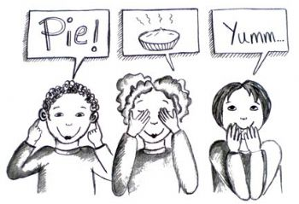
Notes:
Image source: http://photos-ak.sparkpeople.com/nw/3/5/l355370110.jpg

Slide 22
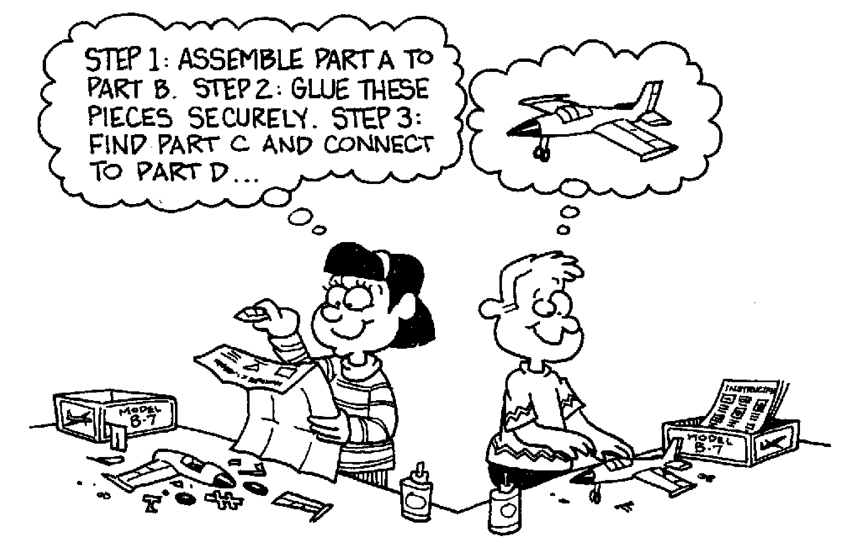
Will you…?
Notes:
Image source: https://witherseducation.files.wordpress.com/2013/09/models.gif

Slide 23
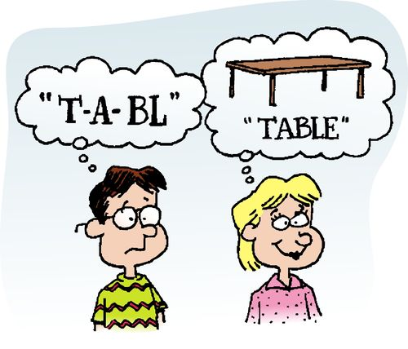
Will you…?
Notes:
Image source: https://etutorhome.files.wordpress.com/2013/10/online-tuition2.jpg

Slide 24
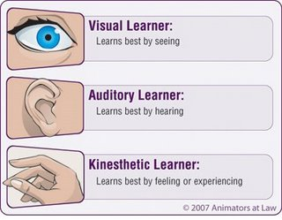
VAK Learning Styles
VAK learning styles is a model created by Barbe et al. (1979)

Slide 25
What is your learning style?
Do you remember faces rather than names?
Can you focus if a speaker is talking but not using any visuals?
Do you find you need to take notes or do something with your hands when you concentrate?
Notes:
Source: https://www.dlsweb.rmit.edu.au/lsu/content/1_StudySkills/study_tuts/learning%20styles/vak.html

Slide 26
What is your learning style?
Visual | Auditory | Kinesthetic
Slides | Discussions | Note-taking
Posters | Study groups | Games
Note-taking | Recite information | Trips and visits
Videos | Reading aloud | Doodling
Color-coding | Repeating instructions | Role-play
Tables/ Charts | Listening to music | Trace words with finger
Highlighting text | Podcasts | Construct flashcards
Notes:
Adapted from: http://www.southwesterncc.edu/sites/default/files/VAK_Learning_Styles.pdf

Slide 27
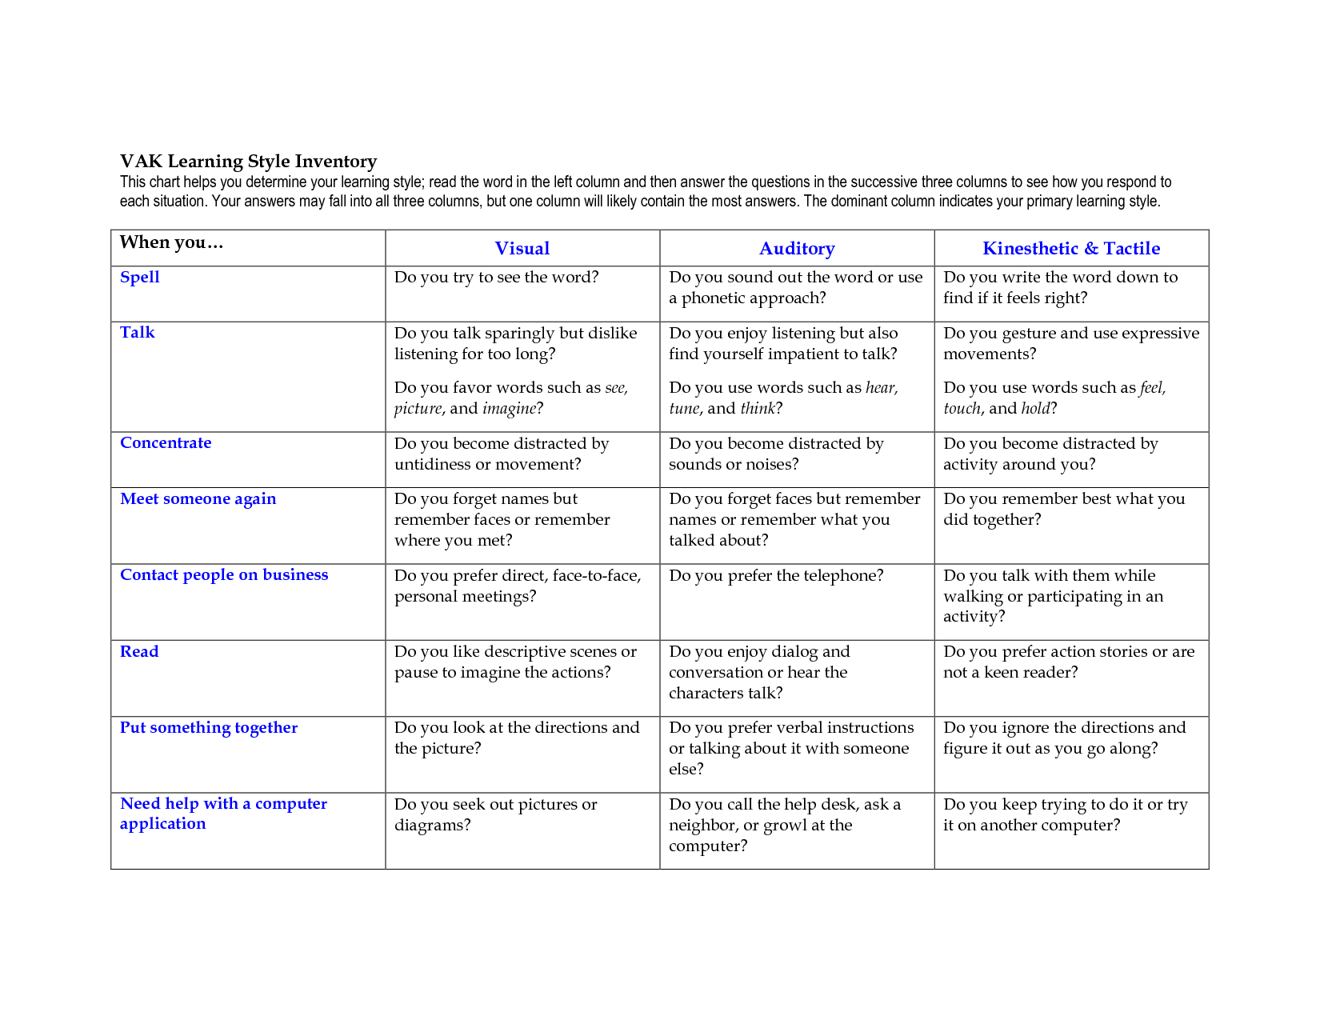

Slide 28
Notes:
Image source: http://1.bp.blogspot.com/-b13P0aQLOZQ/T57uMecoD6I/AAAAAAAAABA/dZK_zKKTyXU/s1600/visualThink.jpeg

Slide 29
Visual
Someone with a Visual learning style has a preference for seen or observed things
pictures, diagrams, demonstrations, displays, handouts, films, flip-chart, etc.
These people will use phrases such as ‘show me’, ‘let’s have a look at that’ and will be best able to perform a new task after reading the instructions or watching someone else do it first.
These are the people who will work from lists and written directions and instructions.

Slide 30
Notes:
Image source: http://blog.helphub.com/wp-content/uploads/2015/03/dollarphotoclub_77421432-1050x701.jpg

Slide 31
Auditory
Someone with an Auditory learning style has a preference for the transfer of information through listening to:
the spoken word, of self or others, of sounds and noises.
Use phrases such as ‘tell me’, ‘let’s talk it over’ and will be best able to perform a new task after listening to instructions from an expert.
These are the people who are happy being given spoken instructions over the telephone, and can remember all the words to songs that they hear!

Slide 32
Notes:
Image source: https://www.dlsweb.rmit.edu.au/lsu/content/1_StudySkills/study_tuts/learning%20styles/graphics/kinesthetic.gif

Slide 33
Kinesthetic
Someone with a Kinesthetic learning style has a preference for physical experience:
touching, feeling, holding, doing, practical hands-on experiences.
These people will use phrases such as ‘let me try’, ‘how do you feel?’ and will be best able to perform a new task by going ahead and trying it out, learning as they go.
These are the people who like to experiment, hands-on, and never look at the instructions first!

Slide 34
Review
What is the focus of the different learning approaches?
List the learning situations at university.
What kind of activities are carried out during the learning situations above?
How do you learn from these activities?
Briefly explain the different learning styles based on the VAK model.

Slide 35
Next Lecture…
Motivation and Self Discovery

