Slide 1
INTRODUCTION
TO
COMMUNICATION
BM002-4-0 – COMMUNICATION SKILLS

Slide 2

Learning Outcomes
At the end of this chapter, you should:
Describe the fundamentals of communication
Identify components of Shannon weaver communication model
Define interpersonal communication and intrapersonal communication
Differentiate between forma and informal communication
Differentiate between verbal and nonverbal communication
Describe Dr. Albert Mehrabian’s Theory of Feeling

Slide 3
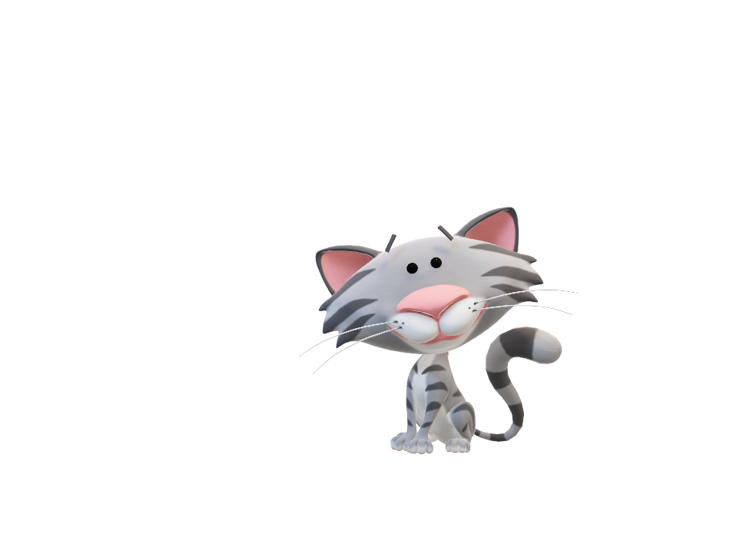
What is Communication To You?
Let’s brainstorm!
Throw your ideas!

Slide 4
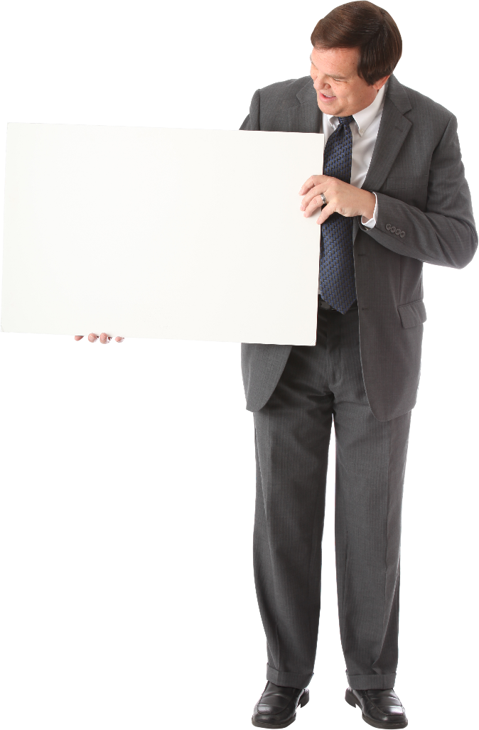

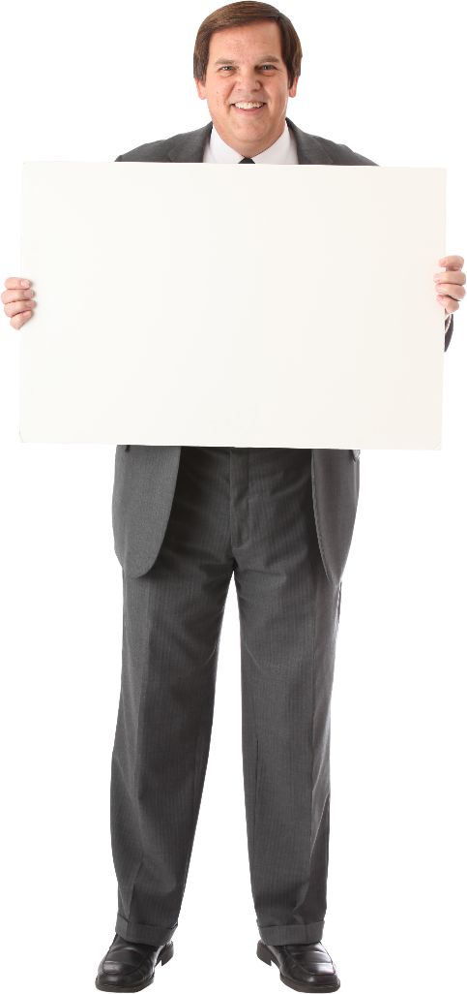
We Communicate to…
INFLUENCE
INFORM
INSTRUCT

Slide 5
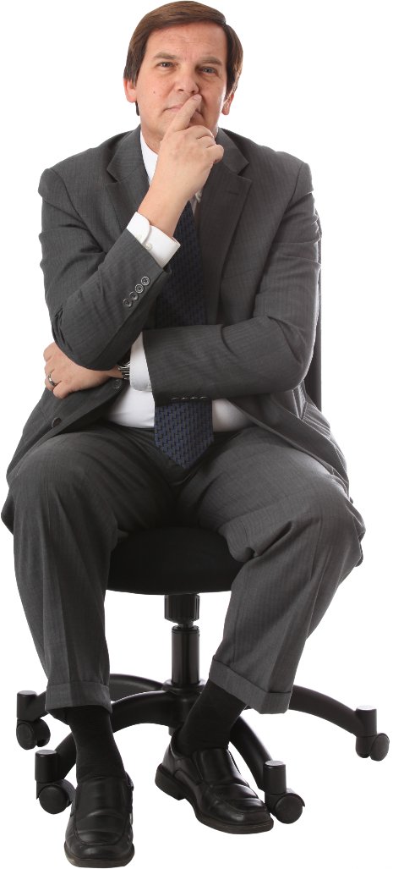
Intrapersonal Communication
Communication process within an individual.
Examples:
Self talk to motivate oneself
Think before answering a question
Deciding on what to eat

Slide 6
Interpersonal Communication
Communication process with other individual.
Examples:
Asking question to the class lecturer during lesson
Conversing with friends over coffee

Slide 7


Slide 8






TWO Basic Forms Of Communication:
VERBAL COMMUNICATION
Uses language (word + grammar) to communicate.
Message is sent through oral or written communication.
ORAL: WRITTEN:

Slide 9

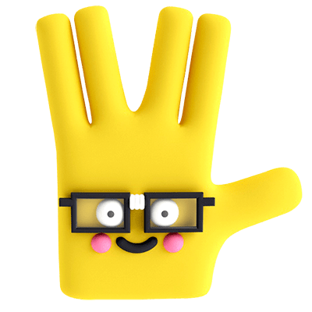

TWO Basic Forms Of Communication:
NON-VERBAL COMMUNICATION
Uses NO language to communicate
Message is sent through body language , paraverbal or pictorials.
WHAT YOU DON’T SAY CAN BE MORE IMPORTANT!
LET’S DISCUSS

Slide 10










Continuation:
Non-verbal Communication is Combination of:
Body language
Pictorials
Paraverbal
Hand gestures
Eye contact
Body movement
Facial expression
I didn’t say you are smart!

Slide 11
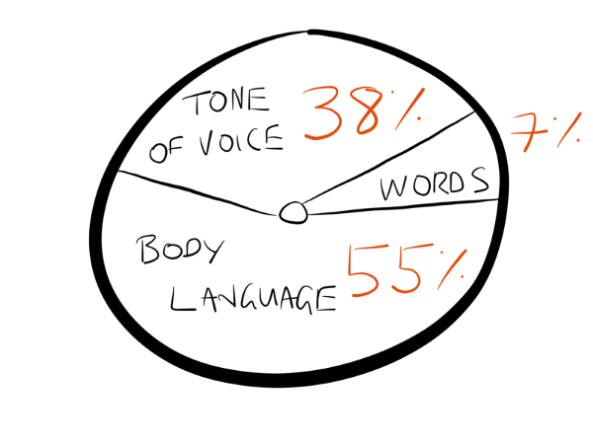
7 38 55 rule of Communication By Dr. Albert Mehrabian

Slide 12
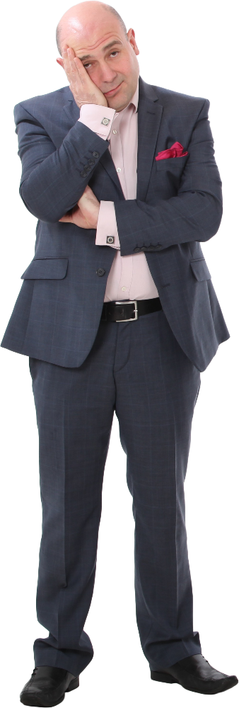
Does that mean the content has NO value?! Or the messages are not important?!

Slide 13
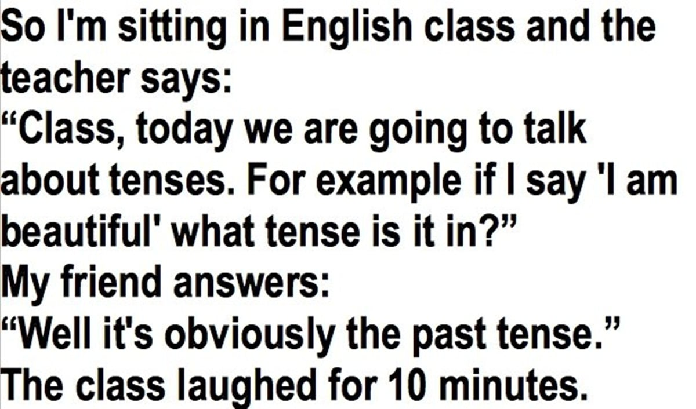

Let’s try this!

Slide 14


Continues…

Slide 15
Formal & Informal Communication:
Formal Communication
Informal Communication
Formal Format
Official
Precise
Unrestrained Communication
No Rigid Rules
No Boundaries of time/venue

Slide 16
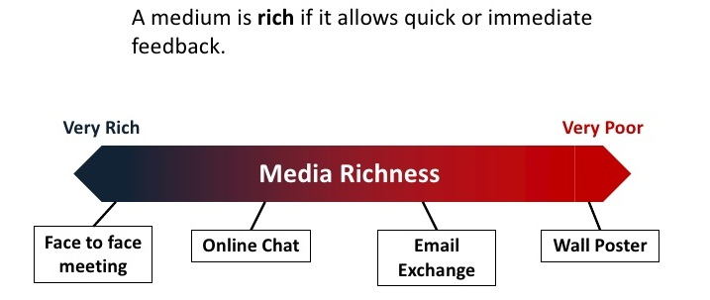
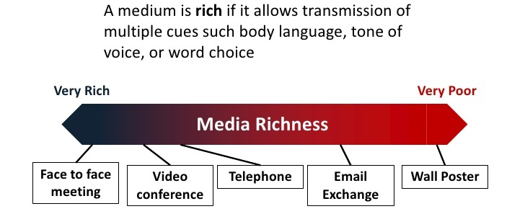
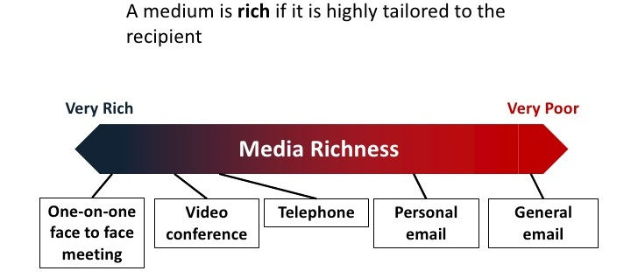
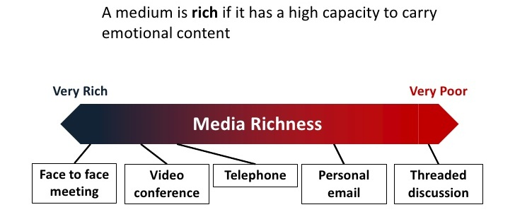
Factors that Need to be Considered When Choosing Your Communication Channel:
Feedback Speed
Cues
Personable
Emotional Content

Slide 17
