Slide 1
Personal Development and Study Methods BM006-3-0 PDSM
MOTIVATION AND SELF DISCOVERY

Slide 2
Introduction
Motivation
Intrinsic/ Internal Motivation
Extrinsic/ External Motivation
Maslow’s Hierarchy of Needs
The importance of motivation
Self Discovery

Slide 3
Learning Outcome
At the end of this lesson, you should be able to:-
Apply and understand the theories on motivation and its importance in personal development
Identify the needs in life to promote personal growth and achieve self-actualization
Identify personal strengths and weaknesses

Slide 4
DISCUSSION
What is your reason for pursuing your study?

Slide 5
What is Motivation?
Factors that activate, direct, and sustain goal-directed behavior
Motives are the "whys" of behavior - the needs or wants that drive behavior and explain what we do
We don't actually observe a motive but we infer based on the behavior we observe
(Nevid, 2013)

Slide 6
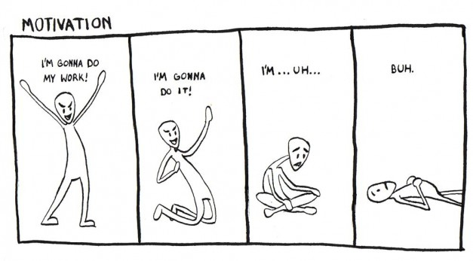
Notes:
Image source: http://host2.studlife.com/files/2013/12/Naomi-Giddings-627x347.jpg

Slide 7
Types of Motivation
Intrinsic and Extrinsic

Slide 8
Types of Motivation
External / Extrinsic
Internal / Intrinsic

Slide 9
Intrinsic Motivation
Internal desires to perform a particular task
The inner drive to achieve success and satisfaction in completing a task
Self-determination to achieve personal goals
Notes:
Source: http://www2.fiu.edu/~cryan/motivation/intrinsic.htm

Slide 10
Intrinsically-motivated Learners
According to Ryan and Deci (2000), learners who are intrinsically motivated, therefore being interested leaners:
are more content in their learning processes
acquire knowledge in a more differentiated and more coherent form
show a long-term retention of what was learned
apply their knowledge more often than others
show higher academic achievement
perceive themselves as more competent
Notes:
Source: http://userpages.umbc.edu/~koconne1/605TheAdultLearner/ivse.htm

Slide 11
Extrinsic Motivation
Motivated by external factors
Completes tasks with external incentives and reinforcements such as:
Good grades
Money
Fear
Recognition/ praise
Notes:
Source: http://www2.fiu.edu/~cryan/motivation/intrinsic.htm

Slide 12
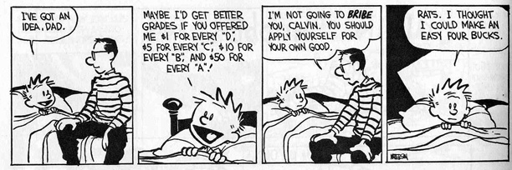
Notes:
Image source: https://instrinsicandextrinsicmotivation.files.wordpress.com/2014/11/calvin_pay4grade_extrinsic.jpg

Slide 13
Extrinsically-motivated Learners
Simons (2004) lists the following characteristics of extrinsically-motivated learners:
are more ego-oriented
study less regularly
show less excitement
persist less
use more surface level strategies
have lower exam results
are less interested in the course
Notes:
Source: http://userpages.umbc.edu/~koconne1/605TheAdultLearner/ivse.htm

Slide 14
Notes:
Image source: https://myeltchannel.files.wordpress.com/2015/07/intrinsic-motivation-2.jpg

Slide 15
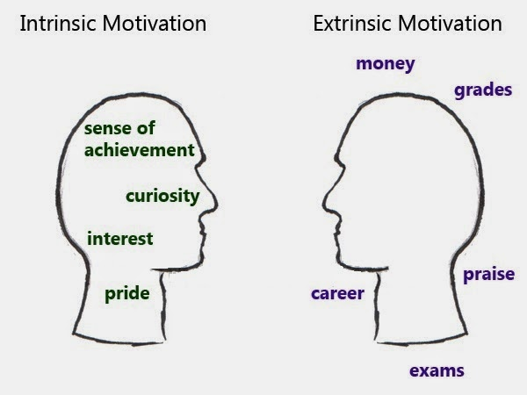
Intrinsic vs. Extrinsic
Notes:
Source: https://smartprimaryed.files.wordpress.com/2015/06/140120-the-right-motivation.jpg?w=300&h=225

Slide 16
Importance of Motivation for Students
Provide direction towards particular goal
Increased energy and overall effort
Increased initiative and drive
Enhanced cognitive processing abilities
Highlight reinforcing consequences
Overall improved performance
(Ormrod, 2003)
Notes:
Source: http://tccl.rit.albany.edu/knilt/index.php/Unit_Two:_Why_is_Motivation_Important_in_the_classroom%3F

Slide 17
Maslow’s hierarchy of needs
A Theory of Human Motivation

Slide 18
Human Needs
Other than food, water, and oxygen, what is ONE thing you cannot live without?

Slide 19
Maslow’s Hierarchy of Needs
Maslow (1943) stated that people are motivated to achieve certain needs
When one need is fulfilled a person seeks to fulfill the next one, and so on
One must satisfy lower level basic needs before progressing on to meet higher level growth needs
Developed by Abraham Maslow (1943, 1954)
Notes:
Source: http://www.simplypsychology.org/maslow.html

Slide 20
The Hierarchy of Needs
Physiological needs - air, food, drink, shelter, warmth, sleep, etc.
Safety and security needs - protection from elements, security, order, law, limits, stability, etc.
Love and belongingness - work group, family, affection, relationships, etc.
Self-esteem needs - self-esteem, achievement, mastery, independence, status, dominance, prestige, managerial responsibility, etc.
Self-Actualization needs - realising personal potential, self-fulfillment, seeking personal growth and peak experiences.
Notes:
Source: http://www.simplypsychology.org/maslow.html

Slide 21
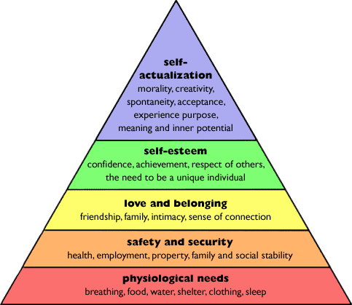
Maslow’s Hierarchy of Needs
Notes:
Source: http://www.researchhistory.org/2012/06/16/maslows-hierarchy-of-needs/

Slide 22
Traits of a Self-actualized Person
They embrace the unknown and the ambiguous
Not threatened nor afraid of new challenges
They accept themselves, together with all their flaws
They resist enculturation
they make their own decisions, selecting what they see as good, and rejecting what they see as bad
They are motivated by growth, not by the satisfaction of needs
They are grateful and do not take things for granted

Slide 23
Videos
Discuss Maslow’s motivational theory based on the videos
https://www.youtube.com/watch?v=dmtmxYbDhKA
https://www.youtube.com/watch?v=tzQ9vrvTAtk
https://www.youtube.com/watch?v=Iucf76E-R2s

Slide 24
Review
What is motivation?
What are the two types of motivation?
What are the five levels of Human Needs?

Slide 25
SWOT ANALYSIS
Discovering Self-Concept for Life Long Benefits

Slide 26
Self-concept
Self-concept is the act of respecting yourself
You must be aware of both your strengths and your weaknesses
You must believe in yourself and accept yourself
As your self-concept increases, there will be less and less that you have to prove to yourself
A person with a positive self-concept is pleasant, secure, and content

Slide 27
SWOT Analysis
SWOT
Strength
Weakness
Opportunity
External elements in the environment that could help
Threat
Characteristics that give an advantage over others
External elements in the environment that could cause trouble
Things you are good at
Characteristics that give a disadvantage over others
Things you need to improve in

Slide 28
What is SWOT Analysis?
A technique credited to Albert Humphrey
A strategic planning tool to understand and analyze:
Internal
Strengths
Weaknesses
External
Opportunities
Threats

Slide 29
Example of SWOT Analysis
Notes:
Image source: http://d3fhkv6xpescls.cloudfront.net/blog/wp-content/uploads/2013/10/Personal-SWOT-questions.png

Slide 30
Benefits of SWOT Analysis
Help develop competitive skills needed in job market and everyday life
Take advantage of strengths to promote self-confidence
Identify opportunities and grasp them when arise
Eliminate or minimize weaknesses for self-improvement
Be alert and develop survival skills towards uncontrollable threats

Slide 31
Next Lecture
Time Management for Personal Development and Goal-Setting

