Slide 1
Personal Development and Study Methods BM006-3-0 PDSM
LEADERSHIP AND TEAMWORK SKILLS

Slide 2
Introduction
Leadership and Collaborative Skills
Attribute of a leader
Collaborative leadership
Principles of effective collaboration
The Five Dysfunctions of a Team

Slide 3
Learning Outcomes
At the end of this chapter, you should be able to:
Identify the characteristics of a leader
Identify functional and dysfunctional teams
Apply effective collaboration in a team

Slide 4
What is Leadership?
Leadership can be defined as the capacity to influence people, by means of personal attributes and/or behaviours, to achieve a common goal
(Chartered Institute of Personnel and Development)

Slide 5
Leadership is a function of knowing yourself, having a vision that is well communicated, building trust among colleagues, and taking effective action to realize your own leadership potential.
Prof. Warren Bennis

Slide 6
Attributes of a Leader
Guiding vision
Passion
Integrity
Honesty
Trust
Curiosity
Risk
Dedication
Notes:
Source: http://sites.ieee.org/sem/files/2012/09/Leadership-Presentation.ppt
Notes:
Guiding vision: Effective leaders know what they want to do, and have the strength of character to pursue their objectives in the face of opposition and in spite of failures. The effective leader establishes achievable goals.
Passion: Effective leaders believe passionately in their goals. They have a positive outlook on who they are, and they love what they do. Their passion for life is a guiding star for others to follow, because they radiate promise!
Integrity: Because they know who they are, effective leaders are also aware of their weaknesses. They only make promises they can follow through on.
Honesty: Leaders convey an aura of honesty in both their professional and their personal lives.
Trust: Effective leaders earn the trust of their followers and act on behalf of their followers.
Curiosity: Leaders are learners. They wonder about every aspect of their charge. They find out what they need to know in order to pursue their goals.
Risk: Effective leaders take calculated risks when necessary to achieve their objectives. If a mistake is made, the effective leader will learn from the mistake and use it as an opportunity to explore other avenues.
Dedication: The effective leader is dedicated to his or her charge, and will work assiduously on behalf of those following. The leader gives himself or herself entirely to the task when it is necessary.

Slide 7
What is Collaboration?
Coercion:
No choice, no voice, no commitment
Cooperation:
I’ll work on your goal
Collaboration:
We’re committed to our goal
Participation:
I’m along for the ride
Notes:
Source: http://www.uwec.edu/ES/programs/upload/Preparing_Collaborative_Leaders_for_EAA_ECA.pptx

Slide 8
Participation VS Collaboration
Participation and Collaboration are both the action of taking part in something.
The key difference here is that ‘something’.
In participation, ‘something’ has already been created by a person (or persons)
In collaboration, ‘something’ is created by two or more people working together and therefore combining their knowledge to produce something
Notes:
Source: http://www.uwec.edu/ES/programs/upload/Preparing_Collaborative_Leaders_for_EAA_ECA.pptx

Slide 9
What is Collaborative Leadership?
Intentional and skillful management of relationships
Enables others to succeed individually while accomplishing a collective outcome
Collaboration is NOT the outcome or goal
It is a process; when successful, align people’s actions to accomplish a goal

Slide 10
5 Principles of Effective Collaboration
All team members work together towards a common goal
All participants are valued
Embraces the unique perspectives of all team members
Is based on a strong sense of purpose
Requires trust and a sense of shared responsibility

Slide 11
Collaborative Leaders
Facilitate the involvement of two or more people in a group working toward a shared outcome
Possess knowledge, skills, and characteristics that enable them to carry out “leaderful” actions:
Seeking new solutions
Sustaining focus
Promoting trust
Setting and monitoring goals and progress

Slide 12
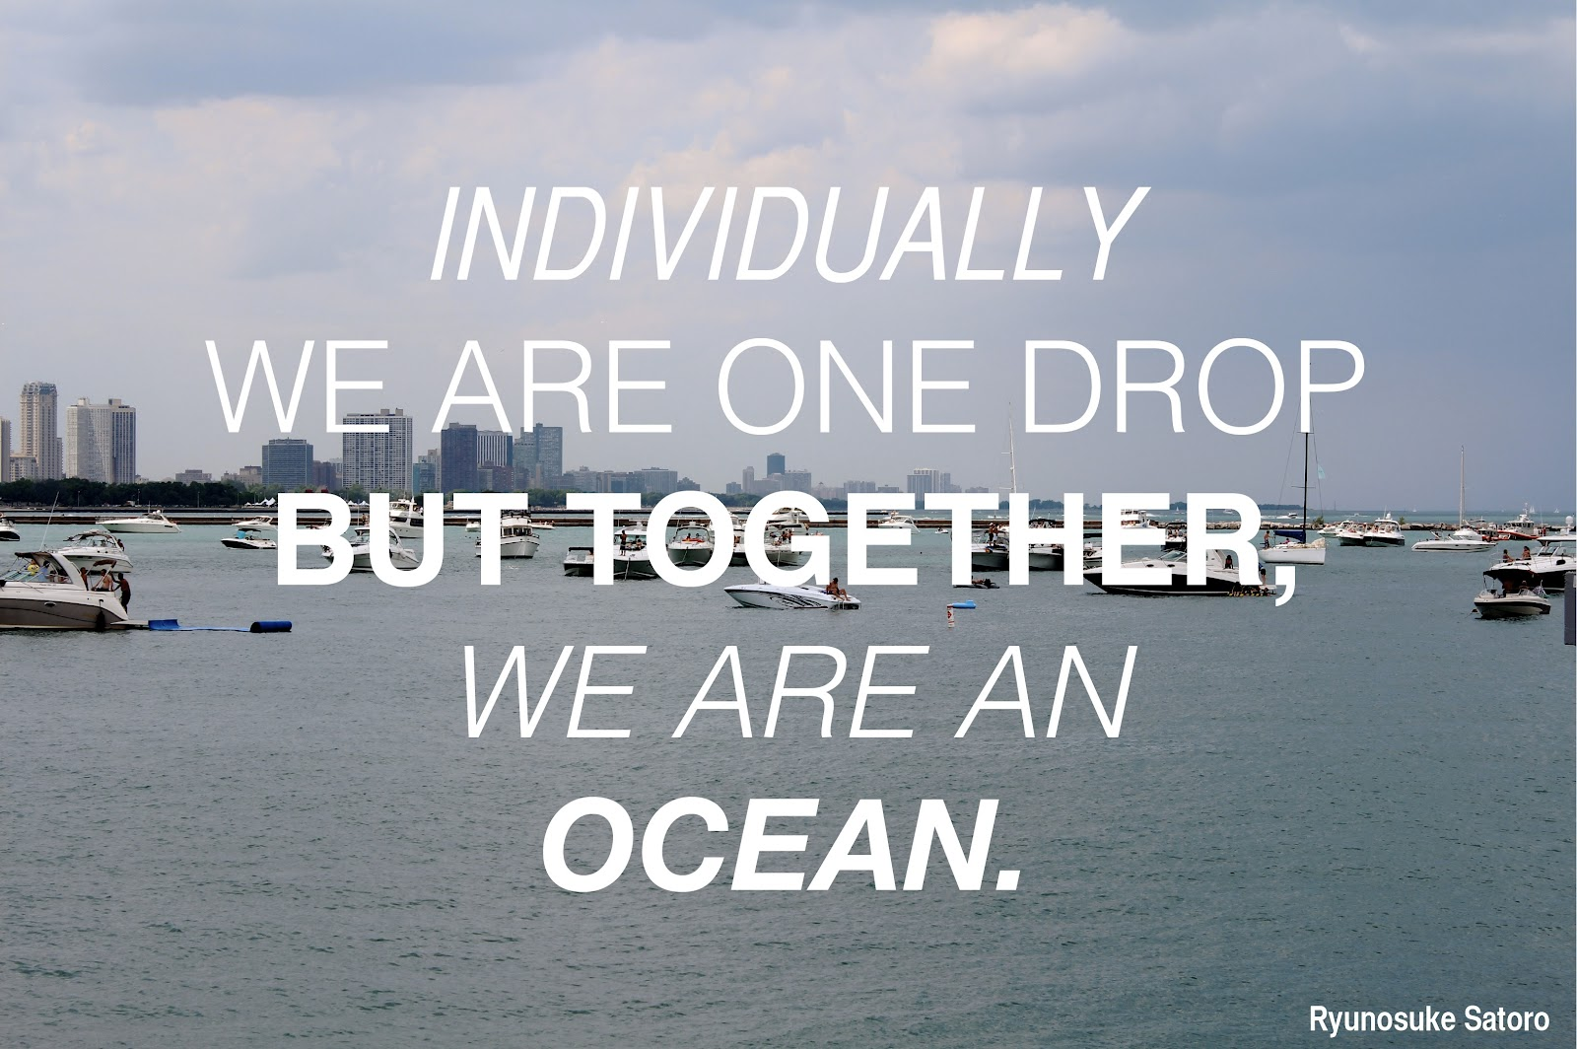
Notes:
Image source: http://refe99.com/wp-content/uploads/2014/08/teamwork-quotes.jpg

Slide 13
What is a Team?
A group may consist of two or more people who interact and communicate with one another
Interact and influence each other
Are mutually accountable for achieving common objectives
Perceive themselves as a social entity

Slide 14
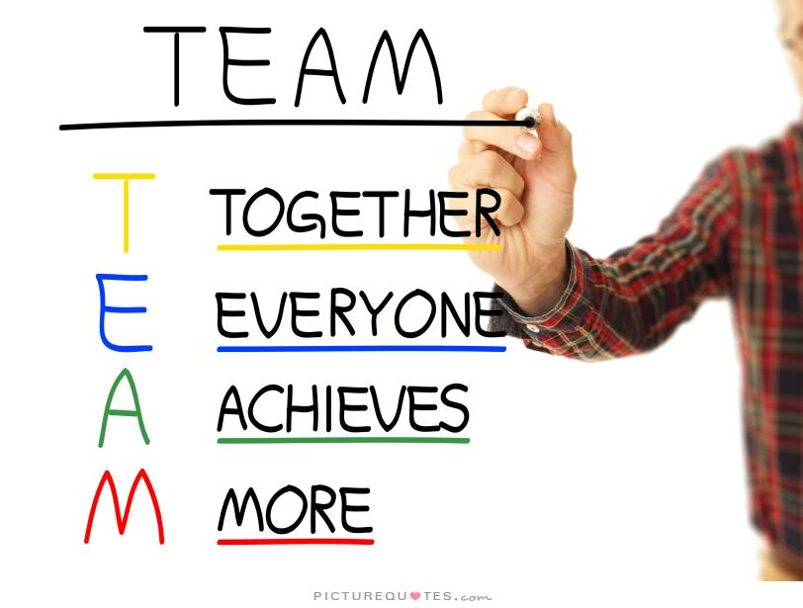
Notes:
Image source: http://img.picturequotes.com/2/25/24045/together-everyone-achieves-more-quote-1.jpg

Slide 15
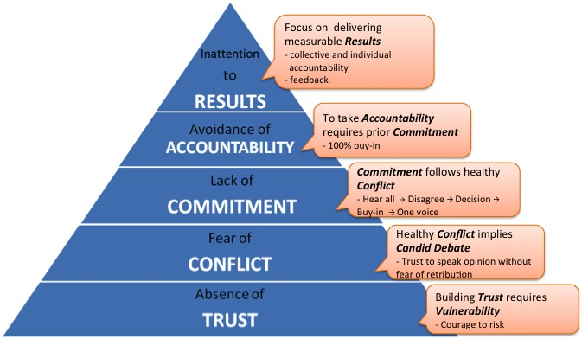
The 5 Dysfunctions of a Team
Lencioni (2002)
Notes:
Image source: http://www.healthyplan.ca/wp-content/uploads/2015/02/5-Dysfunctions-of-Team3.jpg

Slide 16
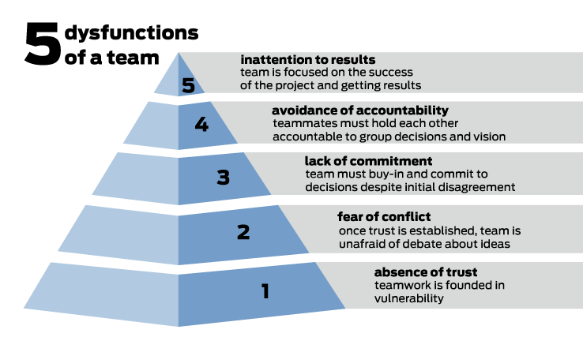
Notes:
Image source: http://reesenewslab.org/files/2013/11/pyramid.png

Slide 17
Notes:
Image source: http://image.slidesharecdn.com/agiletrickybits-131005101219-phpapp01/95/agile-at-enterprise-scale-the-tricky-bits-28-638.jpg?cb=1413208096

Slide 18
Trust
Functional Team
Dysfunctional Team
Teams that Engage in Conflict
Admit weaknesses and errors and ask for help
Apologies are O.K.
Accept questions about tasks
Grant the benefit of the doubt
Take risks in interactions
Express appreciation for others’ talents and skills
Focus on issues, not politics
Look forward to meetings
Teams that Avoid Conflict
Conceal weaknesses and errors, rarely ask for help
Don’t extend offers of help
Jump to conclusions before clarifying
Fail to recognize others’ talents
Waste time and energy on politics
Hold grudges
Avoid meetings or group work

Slide 19
Notes:
Image source: http://cdn.quotesgram.com/small/61/39/419239764-119070-Positive_quotesif_you_only_wal.jpg

Slide 20
Conflict
Functional Team
Dysfunctional Team
Teams that Engage in Conflict
Meetings are lively
Make use of everyone’s ideas
Solve real problems – quickly
Minimize politics
Voice critical issues
Teams that Avoid Conflict
Boring meetings
Behind-the-back politics are the norm
Ignore the real barriers to success
Miss many good ideas from members
Waste time and energy on posturing

Slide 21
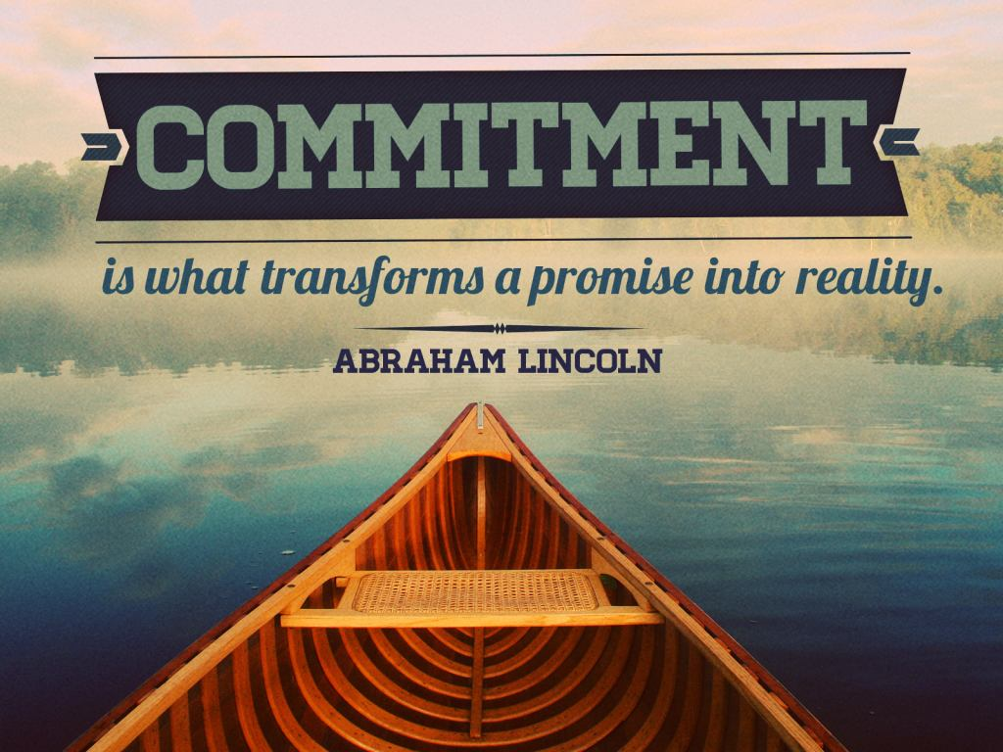
Notes:
Image source:http://thewowstyle.com/wp-content/uploads/2015/03/commitment-quotes-hd-wallpaper-3.jpg

Slide 22
Commitment
Functional Teams
Dysfunctional Teams
A committed team…
Creates and enjoys clarity
Aligns efforts
Learns from errors
Is flexible and nimble
Makes progress
Changes without guilt
A team that fails to commit…
Creates ambiguity about purpose and priorities
Fails to make timely progress
Breeds lack of confidence
Revisits decisions over and over
Encourages second-guessing

Slide 23
Notes:
Image source: http://jasonyesser.com/wp-content/uploads/2015/10/Bob-Proctor-Quotes-About-Accountability-1024x512.png

Slide 24
Accountability
Functional Teams
Dysfunctional Teams
Teams that hold each other accountable
Improve the performance of members
Identifies problems quickly
Establishes shared respect and expectations
Avoids excessive bureaucracy
Teams that avoid accountability
Foster resentment when standards differ
Encourage or accept mediocrity
Miss deadlines and opportunities
Overtaxes leaders as sole source of authority

Slide 25
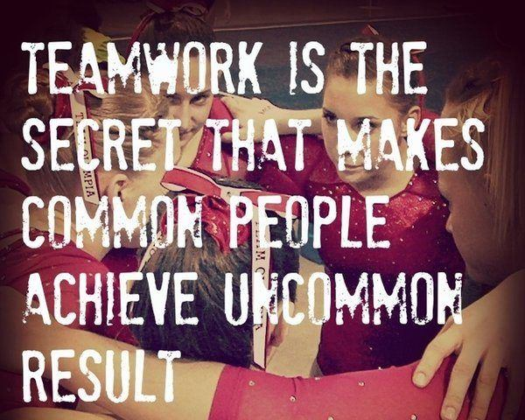
Notes:
Image source: http://www.goodmorningquote.com/wp-content/uploads/2015/08/teamwork-quotes-sayings.jpg

Slide 26
Result
Functional Teams
Dysfunctional Teams
A team that focuses…
Maintains success orientation
Minimizes individualistic behaviors
Celebrates successes and suffers failures acutely
Benefits from members who put the big goal first
Stays focused
A team that doesn’t focus…
Stagnates, waffles, fails to achieve goals
Loses focus and respect
Loses good people
Encourages self-serving attitudes and behaviors

Slide 27
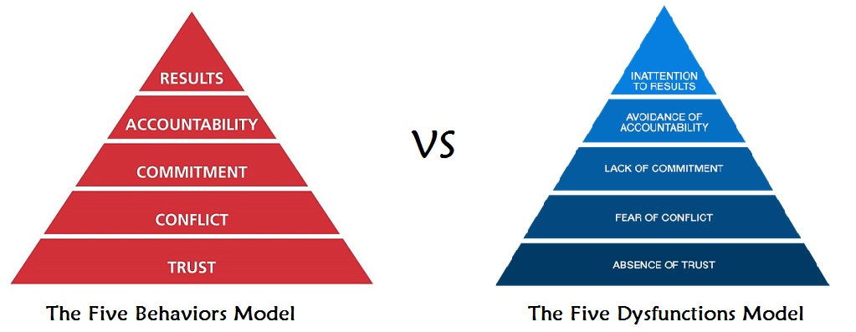
Functional vs. Dysfunctional Teams
Based on Lencioni’s The Five Dysfunctions of a Team (2002)
Notes:
Image source: https://encrypted-tbn0.gstatic.com/images?q=tbn:ANd9GcTmK6UbTa1RWrV9OrVkxV3Wvi-zbHRnmRBN4oqTIC1PpINZtu7v

Slide 28
Quick Review Questions
List the attributes of a leader.
Explain the 5 functions of a team and their importance
What are the benefits of working in a team?

Slide 29
Next Lecture
CONFLICT RESOLUTIONS AND PROBLEM-SOLVING SKILLS

