Slide 1
Business Intelligence System
CT048-3-M
Q and A
Delivery
Introduction
Week 1 – Module Introduction
Module Lecturer:
Dr. M. Selvakumar Samuel
selvakumar@staffemail.apu.edu.my

Slide 2
Data Science and BDA
Science
Data Science
Q and A
Delivery
Engineering
Introduction
Data Engineering
Technology
Big Data Analytics

Slide 3
A brief history of BI
In 1865, Richard Millar Devens presented the phrase “Business Intelligence” (BI) in the Cyclopædia of Commercial and Business Anecdotes.
He was using it to describe how Sir Henry Furnese, a banker, profited from information by gathering and acting on it before his competition.
More recently, in 1958, an article was written by an IBM computer scientist named Hans Peter Luhn, describing the potential of gathering Business Intelligence (BI) through the use of technology.
BIS Introduction
Q and A
Delivery

Slide 4
A brief history of BI
In 1968, only individuals with extremely specialized skills could translate data into usable information.
Many historians suggest the modern version of Business Intelligence evolved from the Decision Support System database.
The number of BI vendors grew in the 1980s, as business people discovered the value of Business Intelligence.
An assortment of tools were developed during this time, with the goal of accessing and organizing data in simpler ways.
BIS Introduction
Q and A
Delivery

Slide 5
A brief history of BI
Business Intelligence, as a technological concept, began shortly after the 1988 international conference, The Multiway Data Analysis Consortium, held in Rome.
A large number of BI businesses started up in response to the conference’s conclusions, with each new business offering new BI tools
During this period, there were two basic functions of BI: producing data and reports, and organizing and visualizing it in a presentable way.
BIS Introduction
Q and A
Delivery

Slide 6
A brief history of BI
In the late 1990s and early 2000s, BI services began providing simplified tools, allowing decision makers to become more self-sufficient.
The tools were easier to use, provided the functionality needed, and were very efficient.
Business people could now gather data and gain insights by working directly with the data.
Source: https://www.dataversity.net/brief-history-business-intelligence/#
BIS Introduction
Q and A
Delivery

Slide 7
Business Intelligence System
BIS is an umbrella term that combines people, processes, architectures, tools, databases, analytical tools, applications, and methodologies
BIS is a content-free expression, so it means different things to different people
BIS Introduction
Q and A
Delivery

Slide 8
Business Intelligence System…
Business Intelligence (BI) is providing decision makers with valuable information and knowledge by leveraging a variety of sources of data as well as structured and unstructured information. (Sabherwal 2007, 2008)
BIS helps transform data, to information (and knowledge), to decisions, and finally to action.
BIS Introduction
Q and A
Delivery

Slide 9
BIS Introduction
Q and A
Delivery

Slide 10
Business Intelligence System
Organizational Memory
Business Intelligence
Q and A
Delivery
Data Integration
Introduction
Presentation
Insights Creation
BIS Architecture

Slide 11
Generation 1
Data Sources
Integration
DBMS
RDBMS
Report Generator
Generating Report
Presentation
Interpretation
Decision Making
BI & DW Introduction
Q and A
Delivery
DBMS
ERP System

Slide 12
Generation 2
Data Sources
Integration [1]
Org. Memory
(OLTP) [2]
Data Warehouse
(OLAP)
Data Mining [3]
Presentation [4]
Interpretation
Decision Makings
BI & DW Introduction
Q and A
Delivery
ELT / ETL
BIS
ERP System

Slide 13
Generation 3
Data Sources
Integration
BIG DATA
DATA
WAREHOUSE
Data Analysis
Presentation
Evaluation
Deployment
BI & DW Introduction
Q and A
Delivery
ELT / ETL
BDA
ERP System

Slide 14
BIS
I
CAPABILITIES
I
INFRASTRUCTURE
BI & DW Introduction
Q and A
Delivery

Slide 15
FOUR CAPABILITIES OF BIS
1. Data Integration:
Data integration is the process of combining data from different sources into a single, unified view.
Organizational Memory (OLTP):
Organizational memory is the accumulated body of data, information, and knowledge created in the course of an individual organization's existence.
Data Mining:
A collection of tools for manipulating, mining, and analyzing the data in the data warehouse.
Presentation:
The act or process of interpreting in visual terms or of putting into visible form
BIS Introduction
Q and A
Delivery

Slide 16
Module Introduction
Q and A
Delivery
Module Information

Slide 17
COURSE LEARNING OUTCOMES (CLO’S)
CLO1:Criticise literatures to identify business problems and its solutions.
CLO2: Propose solutions of BI technologies to a given business scenario -
CLO3: Prepare a report on the implication of business intelligence activities to a given business scenario
CLO’S Introduction
Q and A
Delivery
Module Descriptor

Slide 18
Continuous Assessment |  | Percentage (%) | Due
1 | Knowledge & Information Analysis (CLO 1) | 30 | Ist Day
2 | Insight Creation (CLO 2) | 50 | Of the
3 | BI Report & Presentation (CLO 3) | 20 | Week 8
Assements Introduction
Q and A
Delivery

Slide 19
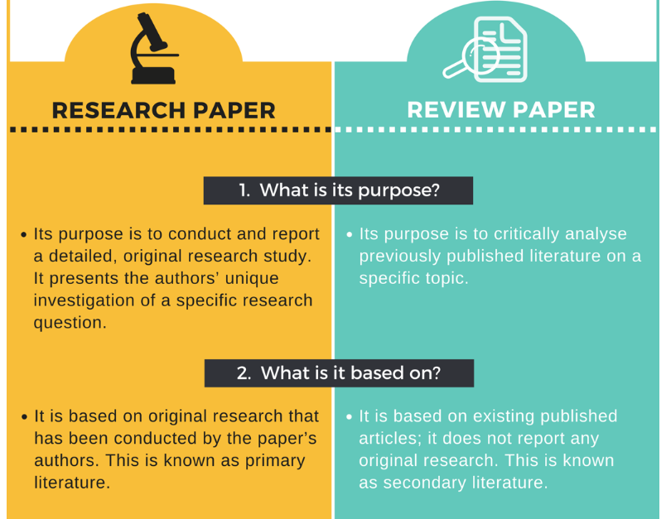
Assements Introduction
Q and A
Delivery

Slide 20
Week 2
Topic: BIS Tools and Technologies
Q and A
Delivery
Introduction

Slide 21
Week 3
Lecture: Org. Memory and Integration
Q and A
Delivery
Introduction

Slide 22
Week 4
Topic: Insight Creation and Data Mining processes
Q and A
Delivery
Introduction

Slide 23
Week 5
Topic: Insight Creation with Structure Data
Q and A
Delivery
Introduction

Slide 24
Week 6
Lecture: Insight Creation with Unstructured Data
Q and A
Delivery
Introduction

Slide 25
Week 7
Topic: Insight Creation through Information and Knowledge Analysis
Q and A
Delivery
Introduction

Slide 26
Week 8
Lecture: Presentation Capability
Q and A
Delivery
Introduction

Slide 27
Next Class?
Topic: BI Tools and Technologies
Q and A
Delivery
Introduction

Slide 28
Q and A
BI Vs DA
Delivery

Slide 29
Q and A
Please Ask Any Questions Related To Today’s Discussion
Q and A
Delivery
THANK YOU
Introduction

