Slide 1
Problem Statement, Purpose statement and Research Questions for Qualitative

Slide 2
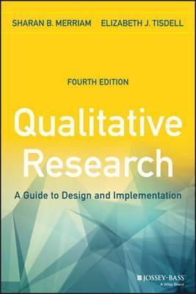
Merriam and Tisdell (2015)
A problem in the conventional sense is a matter involving doubt, uncertainty, or difficulty.
A person with a problem usually seeks a solution, some clarification, or a decision.
The structure of a problem statement, which essentially lays out the logic of the study, can be compared to a funnel shape—broad
at the top and narrow at the bottom.

Slide 3
Problem Identification
A research problem is a definite or clear expression [statement] about
an area of concern,
a condition to be improved upon,
a difficulty to be eliminated,
or a troubling question that exists in scholarly literature, in theory, or within existing practice
that points to a need for meaningful understanding and deliberate investigation (Bryman, 2007)
A problem area is an area of interest to the researcher where some aspect(s) is (are) still to be studied to find a complete or even a partial solution to an existing or an anticipated unanswered question.
Purpose Statement
Objective
Research Questions
Bryman, Alan. “The Research Question in Social Research: What is its Role?” International Journal of Social Research Methodology 10 (2007): 5-20; Guba, Egon G., and Yvonna S. Lincoln. “Competing Paradigms in Qualitative Research.” In Handbook of Qualitative Research. Norman K. Denzin and Yvonna S. Lincoln, editors. (Thousand Oaks, CA: Sage, 1994), pp. 105-117.

Slide 4
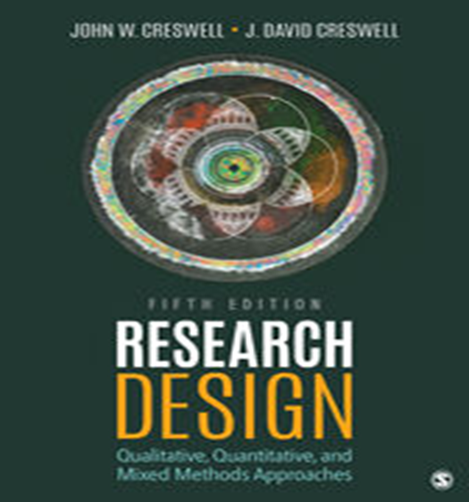
Problem Identification? - Creswell
Example: Exploratory study on Escalating violence in schools
Start by posing several questions and then writing down short answers to them.
◆ “What is the specific controversy or issue that I need to address?” Escalating violence in the schools
◆ “Why is this problem important?” Schools need to reduce the violence; students will learn better if violence is less a part of their lives, etc.
◆ “How will my study add to what we already know about this problem?” We really don’t have many school plans for addressing this escalating violence
◆ “Who will benefit from what I learn about this problem?” Schools, anybody interested in learning how schools can respond to escalating violence (the body of literature, administrators, teachers, etc.)

Slide 5
Five Elements of a “Problem Statement”
FLOW OF IDEAS
What
Remedying
the Deficiencies
will do for
Select
Audiences
Educational
Issue
Evidence for
the Issue
Deficiencies
in the
Evidence
Topic
Subject
Area Describe a goal or desired state of a given situation, phenomenon
A Concern/Problem
Something that needs a Solution
An issue, concern, or controversy related to the topic that needs a solution
A condition that prevents the goal, state, or value from being achieved or realized at the present time
Evidence from
the literature
Evidence from
Practical Experiences
Supporting evidence about the problem importance from the
literature and/or professional and personal experience
Justification based on what researchers have found
In this body of
evidence, what is
missing?
What do we need to know
more about?
Inconsistencies
Something that is not known about the problem
Use a connecting term - "however, "unfortunately,” or “in spite of.”
How will addressing
what we need to
know help:
researchers
educators
policy makers
individuals like
those in the study
Cresswell

Slide 6
Deficiency Model - Cresswell
Flow of Ideas
Justification
for Research
Problem
Deficiencies in
the Evidence
Relating the
Discussion
to Audiences
Topic
Research
Problem
Subject
area
Concern or issue
A problem
Something that needs a solution
Evidence from the literature
Evidence from practical experience
In this body of evidence what is missing or what do we need to know more about?
How will addressing what we need to know
help researchers, educators, policy makers, and other individuals?
Qualitative Study
about Parents Raising
Children
with Disabilities
Raising a child with a disability can be stressful for parents and parent stress can affect the well being of the whole family
(Citation)
Literature documents the sources of stress for parents raising a child with a disability and the effects of stress on families
However, little research has explored parents’ experiences raising
a child with a disability using qualitative methods, and the
meanings of the experiences
for parents are unknown
By better understanding
parent experiences, those working with parents of children with disabilities could better develop effective interventions and support systems
Title: A Phenomenological study about Parents Raising Children with Disabilities

Slide 7
PROBLEM STATEMENT: ENGAGING MOMENTS: ADULT EDUCATORS READING AND RESPONDING TO EMOTION IN THE CLASSROOM. An explratory study.
Context
Research in neuroscience indicates that emotional states are the starting point for all learning (Damasio, 1994a,1999, 2003; LeDoux, 1996, 1999, 2002). There are thousands of states, each containing a unique mix of potential behaviors, feelings, and 16 emotions that can either enhance or impede learning.
Significance
The literature in the fields of adult education and learning readily acknowledges that emotions influence the learning process (Argyris, Putnam, & Smith, 1985; Dirkx, 2001; Heron, 1999; Lovell, 1980; MacKeracher, 2004; Merriam et al., 2007; More, 1974).
Gap
However, there is surprisingly little research and/or literature on how this process plays out in the adult
classroom. This study sought to have in-depth understanding and thick description of the nature of the experiences of a group of adult educators and how they go about reading and responding to learners’ emotional states in practice.
Purpose Statement and Research Questions
The purpose of this study was to better understand the practices of adult educators in reading and responding to emotional states exhibited by learners. The study was guided by the following questions:
1. What indicators do adult educators use to read and determine emotional states?
2. What actions do adult educators take in response to learners’ emotional states?
3. What is the reasoning behind the actions taken?

Slide 8
Purpose Statement
The purpose statement is a statement that advances the overall direction for a study.
Typically identify the focus and intent for the study, and may mention the participants, setting, and the researcher’s framework.
Example: The purpose of this qualitative study is to explore the effect of Covid 19 on the business of tour operators in Seychelles.
Is the central controlling idea in a study
Is written in a sentence or several sentences
Sets the objectives, the intent, or the major idea of a proposal or a study
Use words such as purpose, intent, study aim, or objective to signal attention to this statement as the central controlling idea.

Slide 9
Purpose Statement
Here is a script for a good qualitative purpose statement:
“The purpose of this qualitative study (replace later with type of qualitative tradition) will be to ______(understand, describe, develop, discover) the ________(central focus) for _______(participants: person, process, groups) at ______________(site)."
Example:
Perception of Employers towards hiring of ex-offenders
Purpose Statement
The purpose of this qualitative study will be to understand the perception of employers towards hiring of ex-offenders in the education sector in Kuala Lumpur

Slide 10
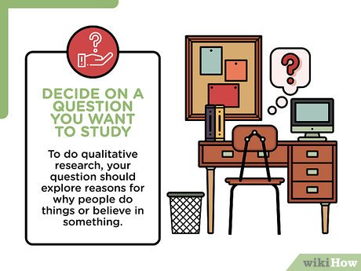
Research questions
These research questions assume two forms:
Central question
a broad question that asks for an exploration of the central phenomenon or concept in a study
Sub questions
Sub-divides central question into more specific topics questions
Limited number
Begin the research questions with the words what or how to convey an open and emerging design
Use Verbs like: To explore.. To Discover….
Do not use Verbs lime Relate, Influence, Impact, Cause, Effect (quantitative)

Slide 11
Title: THE ROLE OF SELF-DIRECTED LEARNING IN OLDER ADULTS’ HEALTH CARE.
Example
Research Questions
1. What motivates older adults to take control of their learning regarding health care?
2. What health care behaviors are controlled by self-directed learners?
3. What contextual factors are controlled by self-directed learners?
4. What is the process of self-directed learning of one’s health care?
5. How does self-directed learning affect one’s health care?
Source: Valente (2005).
Example
Not more than 5 questions

Slide 12
Example
Research Topic
Exploring the Impact of Online Learning on the Psychological Wellbeing of University Students: A Qualitative Study
Purpose/Aim of Study (from the gaps in the literature):
The purpose of this qualitative study is to understand the major stressors associated with online learning that are experienced by students during the COVID-19 pandemic in Malaysia. In addition, this study will explore the effects of online learning on students’ mental health and wellbeing.
Research Questions
Research Question 1: What are students major stressors associated with the online learning during the COVID-19 pandemic? Stress Attributes
Research Question 2: How has the current situation affected the students’ mental health and wellbeing? Imp

Slide 13
Thank You

