Slide 1
Quantitative and Qualitative
Dr Jugindar Singh

Slide 2
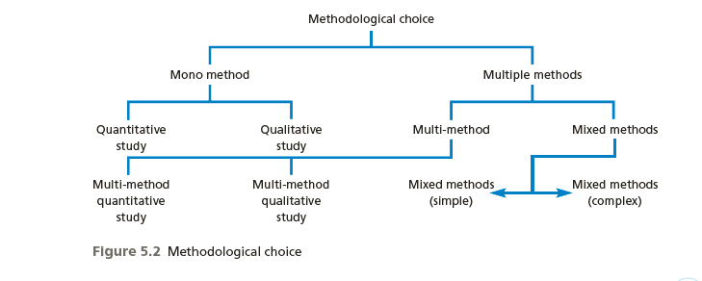
Methodological choices
Quantitative
Qualitative
Mixed Method
Figure 5.4 Research choices
Saunders et al, (2009)

Slide 3
Quantitative research: Predictive
Focuses on verifying hypotheses using typically large amounts of data.
Numerical data
Quantitative research is generally associated with positivism
Usually associated with a deductive approach, where the focus
Large sample
Data collected through Questionnaire
Is on using data to test theory
Example: Investigate employees' absenteeism
♦ quantitative approach: collect ratings, verify user responses (numerical)
♦ qualitative approach: understand why employees absent (words, voice)
Qualitative vs. Quantitative Analysis

Slide 4
Qualitative research: Exploratory
Associated with an interpretive philosophy
Studies participants’ meanings and the relationships between them
Small samples of data
Data in words or voice
Data collection through interviews etc
Eg: structured interviews
Example: investigate employees' absenteeism
♦ quantitative approach: collect ratings, verify user responses (numerical)
♦ qualitative approach: understand why employees absent – Interview (words, voice)
Qualitative vs. Quantitative Analysis

Slide 5
Difference between Qualitative and Quantitative

Slide 6
Qualitative vs Quantitative Research
 | Qualitative | Quantitative
Focus of Research | Understand and interpret | Describe, explain, and predict
Researcher Involvement | High | Limited, controlled to prevent bias
Research Purpose | In-depth understanding | Describe or predict, built and test theory
Sample Design | Non-probability, purposive | Probability
Sample Size | Small | Large
Data Type and Preparation | Verbal or pictorial description Reduced to verbal codes | Verbal descriptions Reduced to numerical codes for computerized analysis
Feedback Turnaround | Smaller sample sizes make data collection faster Insights are developed as the research progresses, shortening data analysis | Larger sample sizes lengthen data collection
Research Design | Longitudinal, Multi Method | Cross-sectional or longitudinal, Single method
Data Analysis | Non-quantitative; human Judgment mixed with fact Emphasis on themes | Computerized analysis Facts distinguished Emphasis on counts

Slide 7
Thank You

