Slide 1
Problem Statement, Objectives and Questions,
Dr Jugindar Singh

Slide 2
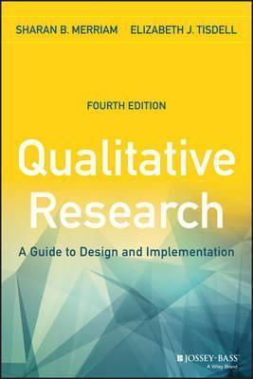
Merriam and Tisdell (2015)
A problem in the conventional sense is a matter involving doubt, uncertainty, or difficulty.
A person with a problem usually seeks a solution, some clarification, or a decision.
The structure of a problem statement, which essentially lays out the logic of the study, can be compared to a funnel shape—broad
at the top and narrow at the bottom.

Slide 3
1.2 Problem Identification
A research problem is a definite or clear expression [statement] about
an area of concern,
a condition to be improved upon,
a difficulty to be eliminated,
or a troubling question that exists in scholarly literature, in theory, or within existing practice
that points to a need for meaningful understanding and deliberate investigation (Bryman, 2007)
A problem area is an area of interest to the researcher where some aspect(s) is (are) still to be studied to find a complete or even a partial solution to an existing or an anticipated unanswered question.
Purpose Statement
Objective
Research Questions
Bryman, Alan. “The Research Question in Social Research: What is its Role?” International Journal of Social Research Methodology 10 (2007): 5-20; Guba, Egon G., and Yvonna S. Lincoln. “Competing Paradigms in Qualitative Research.” In Handbook of Qualitative Research. Norman K. Denzin and Yvonna S. Lincoln, editors. (Thousand Oaks, CA: Sage, 1994), pp. 105-117.

Slide 4
Research Problem
A research problem is an issue that attracts attention of OR motivates a researcher to conduct a study on it
(Source: Piaw, C.Y. 2016)
Eg: To study the cause of escalating violence in schools
The barriers towards leadership role of Women: A Qualitative study in Brunei
Exposing the Gap
Your current study must clearly explain what other studies have not examined
Explain the importance of a study or to justify it.

Slide 5
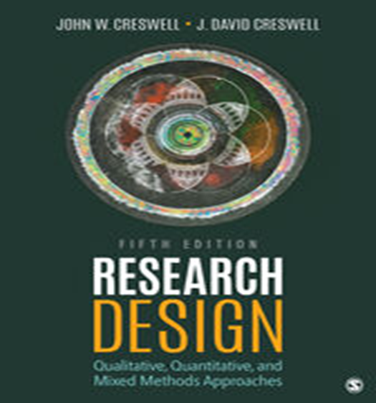
Problem Identification Is a Research Problem? - Creswell
A research problem is an educational issue or concern that an investigator presents and justifies in a research study Cresswell, 2002
To locate the research problem in a study, ask yourself:
◆ What was the issue, problem, or controversy that
the researcher wanted to address?
◆ What controversy leads to a need for this study?
◆ What was the concern being addressed “behind”
this study?
◆ Is there a sentence like “The problem addressed in this study is..?

Slide 6
Problem Identification? - Creswell
Example: Escalating violence in schools
Start by posing several questions and then writing down short answers to them.
◆ “What is the specific controversy or issue that I need to address?” Escalating violence in the schools
◆ “Why is this problem important?” Schools need to reduce the violence; students will learn better if violence is less a part of their lives, etc.
◆ “How will my study add to what we already know about this problem?” We really don’t have many school plans for addressing this escalating violence
◆ “Who will benefit from what I learn about this problem?” Schools, anybody interested in learning how schools can respond to escalating violence (the body of literature, administrators, teachers, etc.)

Slide 7
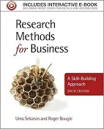
Problem Identification Sekaran & Bougie (2016)
A problem as any situation where a gap exists between an actual and a desired ideal state - Sekaran & Bougie (2016)
A “problem” does not necessarily mean that something is seriously wrong with a current situation that needs to be rectified immediately. A problem could also indicate an interest in an issue where finding the right answers might help to improve an existing situation

Slide 8
More Examples
Staff turnover is higher than anticipated.
Long and frequent delays lead to much frustration among airline passengers. These feelings may eventually lead to switching behavior, negative word‐of‐mouth communication, and customer complaints
The current instrument for the assessment of potential employees for management positions is imperfect.
Minority group members in organizations are not advancing in their careers.
The newly installed information system is not being used by the managers for whom it was primarily designed.
The introduction of flexible work hours has created more problems than it has solved.
Young workers in the organization show low levels of commitment to the organization.
Sekaran and Bougie
These problems also have in common is that they still have to be transformed into a researchable topic for investigation.
Once we have identified the management problem, it needs to be narrowed down to a researchable topic for study

Slide 9
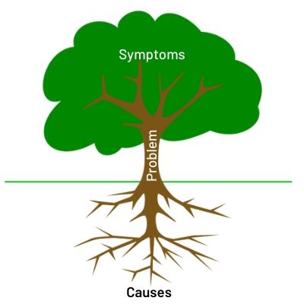
Problem vs Symptom

Slide 10
Problems versus symptoms of problems. Address the true cause – Not the symptom
It is very important that symptoms of problems are not defined as the real problem.
Example: a manager might have tried to decrease employee turnover by increasing wages, but with little success.
Here the real problem may be something else such as the low motivation of employees who feel they do not have enough control over their work.
The high turnover rate may merely be a symptom of the deep‐rooted motivational problem.
The 5 Whys Technique
My best employees are leaving the organization.
Why? Because they not satisfied with their jobs.
Why? Because they do not find a challenge in their jobs.
Why? Because they do not have control over their work.
Why? Because they do not have a lot of influence over planning, executing, and evaluating the work they do.
Why? Because we have been reluctant to delegate.

Slide 11
Practical Research Problems
An undesirable situation in a real world:
Issues with performance or efficiency in an organization
Processes that could be improved in an institution
Areas of concern among practitioners in a field
Difficulties faced by specific groups of people in society
A problem that currently exists in an organizational setting
An area that a manager believes needs to be improved in the organization.
Example:
Department A of Company B has a high staff turnover rate, affecting productivity and team cohesion.

Slide 12
Theoretical Research Problem
Theoretical research focuses on expanding knowledge and understanding. You can identify a research problem by reading recent research, theory and debates on your topic to find a gap in what is currently known about it.
A phenomenon or context that has not been closely studied
A contradiction between two or more perspectives
A situation or relationship that is not well understood
A troubling question that has yet to be resolved
Nothing is known about a topic (gap)
Much research on the topic is available, but the results are (partly) contradictory
Established relationships do not hold in certain situations
Example:
The relationship between gender, race and income inequality has yet to be closely studied in the context of the millennial gig economy.

Slide 13
What are the Components of a Problem Statement

Slide 14
Deficiency model
Creswell and Creswell, 2017

Slide 15
Deficiency Model - Creswell
What is a research Problem:
A research problem is an educational issue or concern that an investigator presents and justifies in a research study.
Locating the Research problem
What is the issue or problem?
What controversy leads to the need for a study?
What concern is being addressed behind the study?
Is there a sentence such as, “The problem being addressed in this study is…”?
Five parts:
The research problem;
Studies that have addressed the problem - Evidence
Deficiencies in the studies;
The importance of the study for an audience;
The purpose statement.

Slide 16
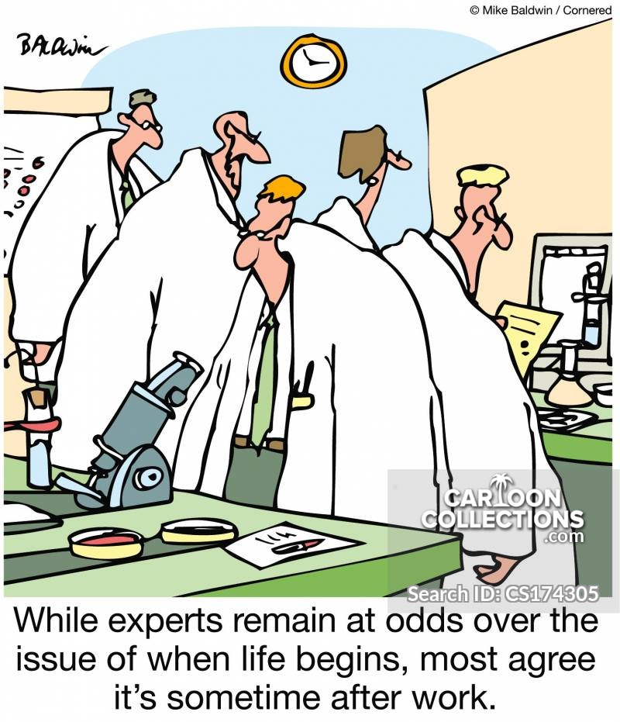
Determining Whether a Problem Should Be Researched
You should research a problem if the study of it potentially contributes to
educational knowledge or adds to the effectiveness of practice.
Can You Gain Access to People and Sites? - Data
Can You Find Time, Locate Resources, and Use Your Skills?
Should the Problem Be Researched? - whether your study will contribute
to knowledge and practice.
Investigating the problem has theoretical or practical significance.

Slide 17
Research Problem – ways to assess whether you should research a problem:
Fill a gap
Concept or new idea Hasn’t been studied
A research study is needed to fill a gap in the existing literature about the research problem.
Eg: Exploratory study on bullying by teachers ..
Past research has examined the bullying by students, but not teachers
Replicate past results about the research
A research study is needed to replicate past results about the research problem by examining different participants and different research sites.
Eg Research on Private sector replicated in a Public Sector
Extend past results
Examine the research problem more thoroughly
A research study is needed to extend past results or examine the research problem more thoroughly Eg: additional factors

Slide 18
Research Problem – ways to assess whether you should research a problem:
Learn from people affected by the problem
A research study is needed to learn from people affected by the problem whose voices have not been heard, who have been silenced, or who have been rejected in society Eg: Homeless, ex-Offenders etc
Improve current practices Study the problem if your study informs practice.
A research study is needed to improve current practices related to the research problem.
Eg: identification of new techniques or technologies
Conflicting
Results
Outdated Research
A research study is needed due to contradictory results from past studies. Eg: Motivation of Executives in MNCs - Contradictory results
There is conflicting research on how to support dissertation students
in an online environment.
Plano & Cresswell

Slide 19
Example of the Flow of Ideas in the Problem Statement
Flow of Ideas
Justification
for Research
Problem
Relating the
Discussion
to Audiences
Topic
Research
Problem
Deficiencies in
the Evidence
Subject
area
Concern or issue
A problem
Something that needs a solution
Evidence from the literature
Evidence from practical experience
In this body of evidence what is missing or what do we need to know more about?
How will addressing what we need to know Help researchers, educators, policy makers, and other individuals?

Slide 20
Five Elements of a “Problem Statement”
FLOW OF IDEAS
What
Remedying
the Deficiencies
will do for
Select
Audiences
Educational
Issue
Evidence for
the Issue
Deficiencies
in the
Evidence
Topic
Subject
Area Describe a goal or desired state of a given situation, phenomenon
A Concern/Problem
Something that needs a Solution
An issue, concern, or controversy related to the topic that needs a solution
A condition that prevents the goal, state, or value from being achieved or realized at the present time
Evidence from
the literature
Evidence from
Practical Experiences
Supporting evidence about the problem importance from the
literature and/or professional and personal experience
Justification based on what researchers have found
In this body of
evidence, what is
missing?
What do we need to know
more about?
Inconsistencies
Something that is not known about the problem
Use a connecting term - "however, "unfortunately,” or “in spite of.”
How will addressing
what we need to
know help:
researchers
educators
policy makers
individuals like
those in the study
Cresswell

Slide 21
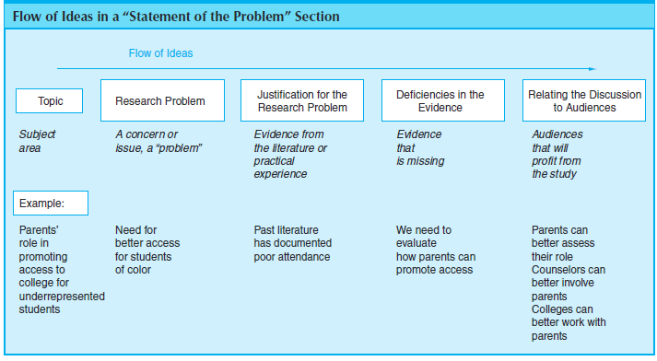

Slide 22
Five Elements of a “Problem Statement”
FLOW OF IDEAS
What
Remedying
the Deficiencies
will do for
Select Audiences
Educational
Issue
Evidence for
the Issue
Deficiencies
in the
Evidence
Topic
Subject
Area
Motivation of students
Only 59% of students on full-time four-year college courses graduate within six years (citation)
A Concern/Problem
Something that needs a Solution
There is a strong decline in motivation as students move from elementary to high school (Martin, 2009)
Students who are not motivated to study are at a much higher risk of not completing college (Bean, 2005)
Evidence from
the literature
Evidence from
Practical Experiences
Several factors identified by researchers.
Liu & Hou (2017) - intrinsic motivation
promotes academic performance.
Zusho et al., (2003)
found that self-efficacy and task value, which were two motivational components
In this body of evidence, what is missing?
What do we need to know more about? However, inconsistencies observed in past research.
Past research reveal inconsistent findings.
In addition, there is a dearth of research relating to the motivation of student in Private universities in Malaysia
How will addressing
what we need to know help others
The purpose of this study is to to provide the educator with suggestions that can be used to motivate his or her students
Gap
What is Missing

Slide 23
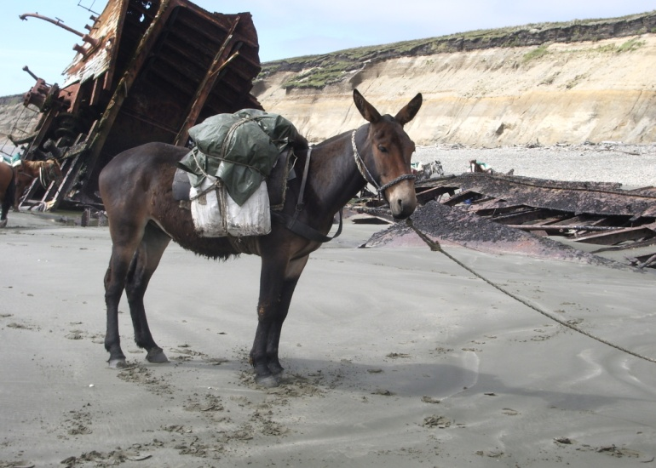
What Language Is Written on This Stone Found by Archaeologists?

Slide 24
Deficiency Model - Cresswell
Flow of Ideas
Justification
for Research
Problem
Deficiencies in
the Evidence
Relating the
Discussion
to Audiences
Topic
Research
Problem
Subject
area
Concern or issue
A problem
Something that needs a solution
Evidence from the literature
Evidence from practical experience
In this body of evidence what is missing or what do we need to know more about?
How will addressing what we need to know
help researchers, educators, policy makers, and other individuals?
Qualitative Study
about Parents Raising
Children
with Disabilities
Raising a child with a disability can be stressful for parents and parent stress can affect the well being of the whole family
(Citation)
Literature documents the sources of stress for parents raising a child with a disability and the effects of stress on families
However, little research has explored parents’ experiences raising
a child with a disability using qualitative methods, and the
meanings of the experiences
for parents are unknown
By better understanding
parent experiences, those working with parents of children with disabilities could better develop effective interventions and support systems

Slide 25
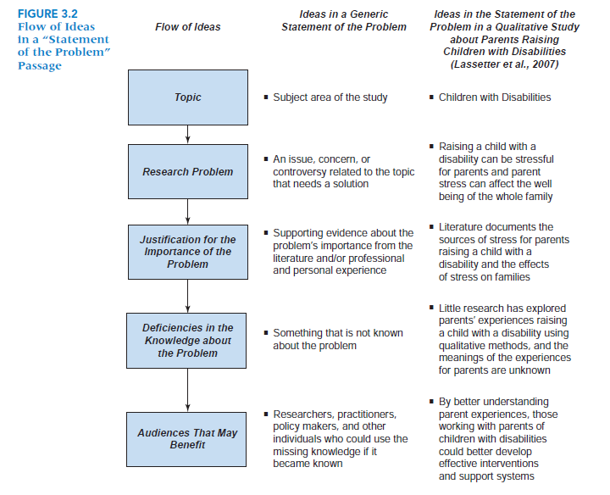
Plano @ Cresswell

Slide 26
KEYWORDS THAT SIGNIFY ‘GAP’
HOWEVER, THERE IS A PAUCITY OF RESEARCH…….
HOWEVER, THE RELATIONSHIPS ARE STILL UNCLEAR……
HOWEVER, THERE STILL EXISTS SOME AMBIGUITY……
HOWEVER, THE EFFECTS HAVE NOT BEEN EMPIRICALLY TESTED…….
HOWEVER, PAST RESEARCH HAS IGNORED……..
HOWEVER INCONSISTENCIES IN THE FINDINGS………
Authors should start by discussing the current situation and then state what they would like to achieve, change, or study.
Using words such as “but”, “however”, or “unfortunately” can help emphasize the contrast between the current and desired situations.
Start the sentence with the word “However”
Eg: However, there is a paucity of research……..

Slide 27
Problem Statement
Model by Merriam, S. and Tisdell (2015)
1. Context
What is the area or topic you are interested in and about which you have a particular question?
2. Significance
The literature in the field speaks to the significance of this study—that is, knowing more
3. Gap
The identification of the gap in the knowledge base—what we don’t know that your research will address.
4. Purpose
The purpose statement is followed by three research questions.

Slide 28
PROBLEM STATEMENT: ENGAGING MOMENTS: ADULT EDUCATORS READING AND RESPONDING TO EMOTION IN THE CLASSROOM. An explratory study.
Context
Research in neuroscience indicates that emotional states are the starting point for all learning (Damasio, 1994a,1999, 2003; LeDoux, 1996, 1999, 2002). There are thousands of states, each containing a unique mix of potential behaviors, feelings, and 16 emotions that can either enhance or impede learning.
Significance
The literature in the fields of adult education and learning readily acknowledges that emotions influence the learning process (Argyris, Putnam, & Smith, 1985; Dirkx, 2001; Heron, 1999; Lovell, 1980; MacKeracher, 2004; Merriam et al., 2007; More, 1974).
Gap
However there is surprisingly little research and/or literature on how this process plays out in the adult
classroom. This study sought to have in-depth understanding and thick description of the nature of the experiences of a group of adult educators and how they go about reading and responding to learners’ emotional states in practice.
Purpose Statement and Research Questions
The purpose of this study was to better understand the practices of adult educators in reading and responding to emotional states exhibited by learners. The study was guided by the following questions:
1. What indicators do adult educators use to read and determine emotional states?
2. What actions do adult educators take in response to learners’ emotional states?
3. What is the reasoning behind the actions taken?

Slide 29
PROBLEM STATEMENT: THE ROLE OF SELF-DIRECTED LEARNING IN OLDER ADULTS’ HEALTH CARE.
Context
Growing numbers of older adults are placing increasing demands on medical services systems and, subsequently,
will affect the future direction of health care policy. In response to the increasing numbers, costs, and health care
needs of older adults, the medical establishment has changed patient-care policies. For example, managed care
provider reimbursement policies have created incentives to move patients quickly through the health care system
and have pressured physicians to limit office visit time for dialogue and health education.
Significance
In response to these changes, health educators have been promoting an active role for patients in their own health care (Berman & Iris, 1998; Keller & Fleury, 2000; National Centers for Chronic Disease Prevention & Health Promotion, 2002). The importance of understanding factors contributing to health maintenance is especially relevant for older adults, as it is this segment of the population who are most at risk. Those older adults who have taken control of their health care are self-directing their own learning.
Gap
However, little is known about how older adults are using self-directed learning to gain access to health information and how this information is affecting their health care.
Purpose of the Study
The purpose of this study was to understand the role of self-directed learning in older adults’ health care.
The research questions that guide this study are as follows:
1. What motivates older adults to take control of their learning regarding health care?
2. What health care behaviors are controlled by self-directed learners?
3. What contextual factors are controlled by self-directed learners?
4. What is the process of self-directed learning of one’s health care?
5. How does self-directed learning affect one’s health care?

Slide 30
Purpose Statement and Objective
Purpose Statement - Quantitative
The purpose of this study is to determine if different types of teacher feedback affect a
fifth-grade student’s motivation and achievement.
Variables: The independent variables will be different types of feedback (i.e., graphical and traditional report cards); the dependent variables will be student motivation
and achievement as measured using numeric scales.
Participants: Teachers and fifth-grade students.
Unit of analysis: Students.
Location: An elementary school in Dade County, Florida.
Purpose Statement - Qualitative
The purpose of this study is to understand the life experiences of female math majors in
an effort to understand why they chose to major in math.
Central phenomenon: Reasons females choose to major in math.
Participants: Female math majors.
Unit of analysis: Individual female math majors.
Location: Pleasantville University.
Purpose statement tells the reader the overarching focus or goal of your study and should be included in both quantitative and qualitative research studies

Slide 31
Research Purpose/Objective
A specific result that a person or system aims to achieve within a time frame and with available resources. Ask yourself what you hope to uncover through your research, and then say it in a way that the reader will understand.
Quantitative - Objective
To examine the relationship between customer satisfaction and customer loyalty
Qualitative: Purpose Statement
The purpose of this qualitative case study is to understand the practices of adult educators in reading and responding to emotional states exhibited by learners in Kuala Lumpur.
For quantitative study, use the words:
To examine
To evaluate
To determine
To assess
For qualitative study, use the words:
To explore
To understand

Slide 32
The determinants of consumers intention to adopt e-Wallet. A quantitative study among Gen Z in Jakarta
GENERAL OBJECTIVE
THE OBJECTIVE OF THIS STUDY IS TO EXAMINE THE FACTORS THAT INFLUENCE THE ADOPTION OF e-WALLET BY GEN Z IN JAKARTA
SPECIFIC OBJECTIVES
To examine whether there a relationship between Trust and intention to adopt of e-wallet among Gen Z in Jakarta.
To examine whether there a relationship between Perceived Ease of Use and intention to adopt of e-wallet among Gen Z in Jakarta
To examine whether there a relationship between Perceived Security and intention to adopt of e-wallet among Gen Z in Jakarta
Objective of the study is what you intend to accomplish when you design your study.

Slide 33
The Relationship between Service Quality and Customer Satisfaction
GENERAL OBJECTIVE
GENERALLY, THE OBJECTIVE OF THIS STUDY IS TO EXAMINE THE RELATIONSHIPS BETWEEN Service Quality and Customer Satisfaction
SPECIFIC OBJECTIVES
TO DETERMINE whether there is a RELATIONSHIP BETWEEN Responsiveness and Customer Satisfaction
TO examine whether there is a SIGNIFICANT RELATIONSHIP BETWEEN Assurance and Customer Satisfaction
is a clear and concise statement of the purpose and aim of the study which essentially summarizes what needs to be achieved by the study

Slide 34
Examples of research objectives Source Awang Z. 2012
Example 1:
1. The objective of this study is to identify the factors that contribute to the declining demand for Proton among the Malaysian customers.
2. The objective of this study is to generate the items that constitute service quality in higher education from the students’ perspective.
3. The objective of this study is to measure the strength of association between socio-economic status of customers and their perception of quality concerning the service provided by higher educational institutions in the country.
4. The objective of this study is to assess the influence of service quality provided by the university and the corporate image of a university on students’ loyalty towards their university in doing postgraduate study.

Slide 35
Examples of research objectives Source Awang Z. 2012
Example 2:
The objective of the study Specifically the study is designed to achieve the following objectives: 1. To assess the effects of certain demographic variables on service quality, corporate image, and students’ satisfaction.
To determine the influence of service quality provided at the university on students’ satisfaction with their learning experience
To determine the influence of corporate image of the university on students’ satisfaction with their learning experience
To determine the influence of service quality provided at the university on students’ loyalty towards their university

Slide 36
Examples of research objectives Source: Sekaran and Bougie
To find out what motivates consumers to buy a product online.
To study the effect of leadership style on employees ’ job satisfaction.
To investigate the relationship between capital structure and profitability of the firm.
To establish success factors regarding the adoption and use of information systems.
To determine the optimal price for a product.
To investigate the influence of the in‐store shopping environment on impulse buying.
To establish the determinants of employee involvement.
To examine the causes of employee absence.

Slide 37
Research Questions
Research questions (RQs) are refined statements of the specific components of the problem.
The research questions must be in line with the objectives and should indicate the variables under investigation.
They should be clearly and unambiguously framed as they will influence research methodology and the type of data analysis to be conducted.
Quantitative Research Questions
1.Is there a relationship between Trust and intention to adopt of e-wallet among Gen Z?
2. Is there a relationship between Perceived Ease of Use and intention to adopt of e-wallet among Gen Z?
3. Is there a relationship between Perceived Security and intention to adopt of e-wallet among Gen Z?
Qualitative Research Questions
RQ1: What are the major stressors associated with the online learning by students? Stress Attributes
RQ2: How has the current situation affected the students’ mental health? (
Questions start with “What” or ‘How’
A good research question is essential to guide your research paper, project or thesis. It pinpoints exactly what you want to find out and gives your work a clear focus and purpose

Slide 38
Research Questions: focusing on exactly what we are trying to understand
The research question is derived from the purpose statement.
The research question is clear and focused.
The research question adheres to the same criteria as that of the problem statement:
a. Scope is manageable – not too broad
b. You have time, knowledge, and
resources
d. Data can be collected and analyzed.
e. Has theoretical or practical significance.
Quantitative Example
Is a student’s motivation level significantly affected by the use
of graphical feedback to report the students’ grades?
Qualitative Example What is the perception of students towards online learning

Slide 39
Types of Questions
Research question type | Formulation
Descriptive research | What are the characteristics of X?
Comparative research | What are the differences and similarities between X and Y?
Correlational research | What is the Correlation between variable X and variable Y?
Exploratory research | What are the main factors in X? What is the role of Y in Z?
Explanatory research | Does X influence Y? What is the impact of Y on Z? What are the causes of X

Slide 40
Examples of Research Questions: Source – Awang, Z. 2012
This study attempts to address the following research questions:
1. How significant is the effect of respondent’s socio-economic status on service quality, corporate image, and students’ satisfaction?
2. How significant is the effect service quality provided by the university in influencing students’ satisfaction with the university?
3. How significant is the effect of corporate image of the university in influencing students’ satisfaction towards the university?
4. How significant is the effect of service quality at the university in influencing students’ loyalty towards that university in the future?
5. How significant is the effect of corporate image of the university in influencing students’ loyalty towards that university in the future?
6. How significant is the students’ satisfactions with the university manage to influence their loyalty towards that particular university? Or in other words, the study is interested to answer questions like “Is there a significant relationship exists between students’ satisfaction and their loyalty?”

Slide 41
Research Questions Examples
1. Is there a relationship between Responsiveness and customer satisfaction?
2. Is there a correlation between Assurance and customer satisfaction?
3. Is there a difference based on gender towards customer satisfaction?
4. Will Women have higher customer satisfaction than their male counterparts?
Quantitative: Use Verbs like: Relate, Influence, Cause, effect
Qualitative: Use verbs like: Explore, Discover, Describe

Slide 42
Thank You

