Slide 1
types of Research,
Dr Jugindar Singh

Slide 2
What are the different types of Research?

Slide 3
Types of Research Basic and Applied Research
Basic Research
To expand the body of knowledge in the particular area
This type of research is not for solving the problem at hand
Eg: To investigate effect of the level of service quality provided by the hospital contributes to patient satisfaction (done by academician)
Applied Research
Carried out for the purpose of solving an existing problem.
Eg: The demand for PROTON is decreasing. The management is trying to identify the factors that contribute to the decreasing demand in order to take an appropriate step before
the problem gets worse.

Slide 4
Basic Research OR Pure Research
Attempts to expand the limits of knowledge.
Not directly involved in the solution to a pragmatic problem.
Eg: Factors impacting online purchasing behavior dietary
supplements by women in KL
To investigate effect of the level of service quality provided by the hospital contributes to patient satisfaction (done by academician)
Purely theoretical with the intent of increasing our understanding of certain phenomena or behavior but does not seek to solve or treat these problems

Slide 5
Examples
The role of service quality in improving satisfaction and loyalty of students
2. A study assessing whether men or women are more likely to have lower
EI
3. Impact of Distributive Justice and Procedural Justice on job satisfaction of
employees in Kuala Lumpur
4. Exploratory study on the Impact FinTech is having on the Financial
Services Industry in Malaysia
5. The effect of leadership style on job satisfaction.
6. The relationship between capital structure and profitability of the firm.
Purely Theoretical

Slide 6
Applied Research
Conducted when a decision must be made about a specific real-life problem
To address a specific problem for a specific organization
Example
Factors that contribute to the decreasing demand for PROTON cars
Study the cause of drop in students
enrolment in a University
Solve a current problem faced by the organization in the work setting

Slide 7
Examples
How to improve cyber-security in a particular organization
How can bullying by teachers be prevented in specific a school? An exploratory study
A study on the influence of Big Data on performance of an Organization
To study the low performance of students in…….
A study into the ways of improving the sales of Proton cars in Malaysia

Slide 8
Types of Research
Exploratory
Descriptive
Explanatory
To discover the insights and new ideas about the problem at hand.
Eg: Exploratory study on Why the sales of PROTON cars is falling
To describe the problem at hand and relate to the characteristics of the population under study
Eg: A Descriptive Study of the Effectiveness of Internet Advertising on Consumer Buying Behavior
To determine the cause and effect relationship between variables - the independent and dependent variables
Eg: To examine the effect of service quality on customer satisfaction

Slide 9
Exploratory Research
Example
An exploratory study on challenges faced by working mothers in the private education industry, KL
1.3 Purpose Statement
The purpose of this study is to explore the challenges faced by working mothers in the education industry of Malaysia and to determine perceived strategies to combat the issues.
1.4 Research Questions
What are the challenges faced by working mothers in the private education sector?
What are the perceived strategies organizations can adopt to help and retain working mothers?
Discover ideas/insights
Takes place where there is little knowledge of a phenomenon.
Conducted about a research problem when there are few earlier studies to refer – gaining insights or familiarity – looks for ideas or patterns
Include interviews, case study - qualitative
Eg: Exploratory study of soft skills employers seek in
graduates today
Exploratory research on adoption of artificial
intelligence in customer support
Exploratory research “tends to tackle new problems on which little or no previous research has been done” (Brown, 2006)

Slide 10
Descriptive Research
“Descriptive research may be characterized as simply the attempt to determine, describe or identify what is, while analytical research attempts to establish why it is that way or how it came to be. Ethridge, D.E. (2004)
Descriptive studies are used to describe various aspects of the phenomenon.
Used to describe characteristics and/or behavior of sample population
Eg: Descriptive study of plantation workers in Borneo
Descriptive Study of the Effectiveness of Internet
Advertising on Consumer Buying Behavior
Online purchasing of dietary supplements by Millennials.
A descriptive study in Kuala Lumpur
Research Questions
What is the frequency that millennials purchase dietary supplements online
What are the dietary products purchased online by millennials
Describes characteristics of existing phenomena
It is very useful when conducting research whose aim is to identify characteristics, frequencies, trends, and categories.

Slide 11
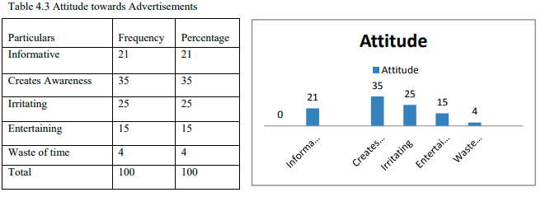
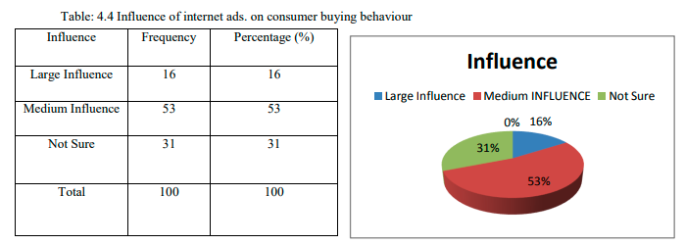
A Descriptive Study of the Effectiveness of Internet Advertising on Consumer Buying Behavior

Slide 12
Explanatory/Causal
Conducted in order to identify the extent and nature of cause-and-effect relationships.
The basis of the term “relationship” goes into two distinctions, the “cause and effect relationship”
and “associational relationship” between variables.
Cause and effect relationship provides better understanding regarding the relationship between variables.
If the study wants to determine the cause of one or more variables, it is called a causal study.
If the study is wants to determine the important variable associated with the problem - correlational study.
For example,
Does smoking cause cancer? - refers to the question for
causal study.
Are smoking and cancer related? - refers to the correlational
Examples:
1. To assess the impacts of foreign direct investment on the levels of economic growth in Malaysia
2. To examine the effect of service quality on customer loyalty among undergraduates in Private Universities in KL
3. To identify the perceive impact of leadership style on employee motivation among nurses in K. Lumpur

Slide 13
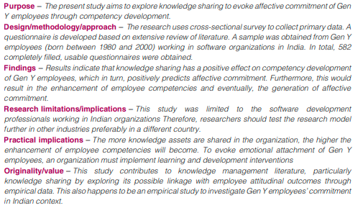
Effect of Knowledge sharing, competency development on affective commitment: evidence from Indian Gen Y employees Mohammad Faraz Naim and Usha Lenka
Knowledge sharing
Affective commitment
Competency development
Cause
Effect

Slide 14
Exploratory, Descriptive and Causal Research
Causal/Explanatory research
This type of research is involved in explaining why something happens and assessing causal relationships between variables.
Eg: The relationship bet. Motivation and Performance
Causal research, also known as explanatory research is conducted in order to identify the extent and nature of cause-and-effect relationships.
Exploratory
New/Explore
Descriptive
Description
Explanatory
Relationship

Slide 15
Thank You

