Slide 1
Topic 4 probability and non-probability sampling techniques
Dr Jugindar Singh

Slide 2
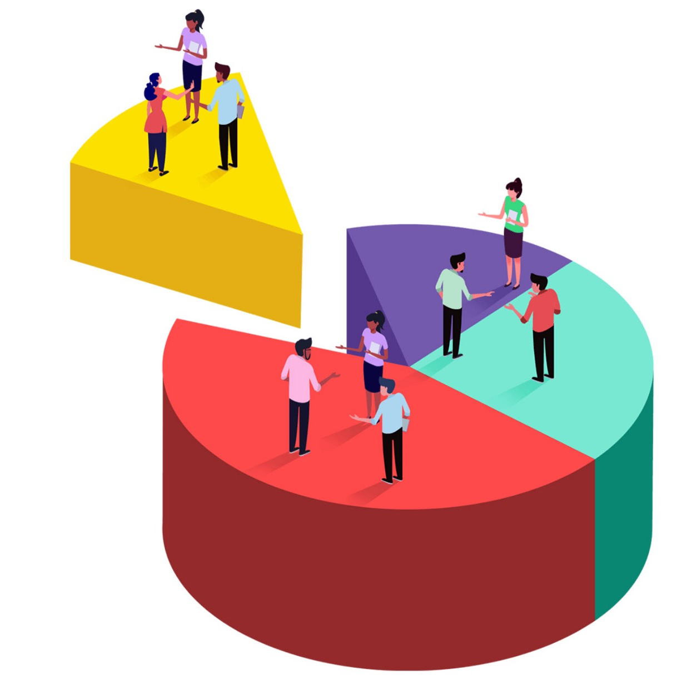
Types of Sampling methods

Slide 3
Types of sampling in quantitative researches
Probability samples
Non-probability samples
Non-probability sampling techniques
The probability of each case being selected from the target population is not known. Samples are selected based on the subjective judgment of the researcher, rather than random selection
Probability sampling techniques
The chance, or probability, of each case being selected from the target population is known and is usually equal for all cases.
Units are selected from the population at random using probabilistic methods.

Slide 4
Types of Sampling Methods
Sampling Strategies
Probability Sampling
Nonprobability Sampling
Simple Systematic Stratified Multistage Cluster
Random Sampling Sampling Sampling Sampling
Sampling
Convenience Snowball Quota Purposive

Slide 5
Probability Sampling Methods
The chance, or probability, of each case being selected from the target population is known and is usually equal for all cases
No biasness
Best method to achieve a representative sample
Random
Stratified random
Cluster
Systematic
Multistage
Simple Random Sampling
Systematic Sampling
Stratified Sampling
Cluster Sampling
Multistage area sampling

Slide 6
Probability Sampling
Population
(delinquents)
N
☹
😐
☺
☹
☺
😐
😐
😐
😐
😐
☹
☺
☺
😐
☺
😐
☺
☹
☹
☹
☹
☹
☺
😐
😐
☹
😐
😐
😐
😐
😐
☹
☹
☹
☺
☹
😐
😐
😐
☺
😐
☹
😐
☹
☹
😐
☹
😐
☺
☺
😐
Target population
(thieves)
☹
☹
😐
☹
☹
☺
☹
😐
😐
😐
☹
☺
☺
😐
😐
😐
☹
😐
😐
😐
☹
😐
☺
😐
☹
😐
☹
☺
☹
☹
😐
☹
😐
😐
😐
😐
😐
☹
☹
☹
☹
😐
☺
😐
☺
☺
😐
😐
😐
😐
😐
☹
😐
😐
😐
😐
☹
☹
☹
😐
😐
😐
😐
😐
😐
☹
😐
☹
☺
☹
☹
☹
☺
Sampling frame
(known as “thieves” by police)
😐
😐
😐
☹
😐
☹
😐
😐
😐
😐
😐
😐
☹
😐
😐
☹
😐
😐
😐
😐
☹
😐
😐
😐
☹
😐
😐
☹
😐
☹
☹
☺
😐
😐
☺
😐
😐
☹
☺
😐
😐
☹
😐
😐
😐
😐
☹
😐
☹
☹
😐
☺
☹
☺
☹
😐
😐
😐
😐
☹
😐
😐
☹
☹
😐
😐
😐
😐
😐
😐
☹
😐
😐
☺
☹
☹
😐
☹
☹
☹
😐
😐
😐
😐
😐
😐
😐
😐
☹
😐
😐
😐
😐
😐
😐
😐
😐
😐
😐
☹
😐
☺
😐
😐
😐
😐
😐
☹
Sample
n
😐
😐
😐
😐
😐
😐
😐
😐
😐
😐
😐
😐
😐
☹
😐
😐
😐
☺
😐
☹
😐
☹
☹
😐
😐
😐
😐
😐
☹
😐
😐
😐
😐
😐
😐
😐
😐
😐
😐
😐
☹
😐
😐
😐
😐
☺
☹
☹
😐
😐
☺
😐
😐
Sampling ratio
😐
😐
☹
😐
😐
😐
😐
😐
😐
😐
😐
😐
😐
😐
😐
☹
😐
☹
😐
😐
😐
😐
😐
😐
😐
😐

Slide 7
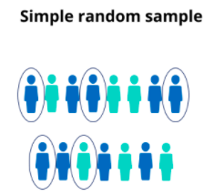
Simple Random Sampling
Selecting a sample from the population so all in the population have an equal chance of being selected
Each individual subject (human or otherwise) has an equal chance of being selected
Example
You want to select a simple random sample of 100 employees of Company X. You assign a number to every employee in the company database from 1 to 1000 and use a random number generator to select 100 numbers.
Define the population
List all members of population
Assign numbers to each member of population
Use criterion to select sample
Each member of the population has an equal and independent chance of being chosen
Advantages: The sample should represent the target population . Eliminate sampling bias

Slide 8
Simple random sample
1 | 2 | 3 | 4 | 5 | 6 | 7 | 8 | 9 | 10
11 | 12 | 13 | 14 | 15 | 16 | 17 | 18 | 19 | 20
21 | 22 | 23 | 24 | 25 | 26 | 27 | 28 | 29 | 30
31 | 32 | 33 | 34 | 35 | 36 | 37 | 38 | 39 | 40
41 | 42 | 43 | 44 | 45 | 46 | 47 | 48 | 49 | 50
51 | 52 | 53 | 54 | 55 | 56 | 57 | 58 | 59 | 60
61 | 62 | 63 | 64 | 65 | 66 | 67 | 68 | 69 | 70
71 | 72 | 73 | 74 | 75 | 76 | 77 | 78 | 79 | 80
81 | 82 | 83 | 84 | 85 | 86 | 87 | 88 | 89 | 90
91 | 92 | 93 | 94 | 95 | 96 | 97 | 98 | 99 | 100
101 | 102 | 103 | 104 | 105 | 106 | 107 | 108 | 109 | 110
111 | 112 | 113 | 114 | 115 | 116 | 117 | 118 | 119 | 120
121 | 122 | 123 | 124 | 125 | 126 | 127 | 128 | 129 | 130
131 | 132 | 133 | 134 | 135 | 136 | 137 | 138 | 139 | 140
141 | 142 | 143 | 144 | 145 | 146 | 147 | 148 | 149 | 150
151 | 152 | 153 | 154 | 155 | 156 | 157 | 158 | 159 | 160
161 | 162 | 163 | 164 | 165 | 166 | 167 | 168 | 169 | 170
171 | 172 | 173 | 174 | 175 | 176 | 177 | 178 | 179 | 180
181 | 182 | 183 | 184 | 185 | 186 | 187 | 188 | 189 | 190
191 | 192 | 193 | 194 | 195 | 196 | 197 | 198 | 199 | 200

Slide 9
STRATIFIED RANDOM SAMPLING
Stratifying the population on a characteristic (e.g., gender) then sampling from each stratum
Population is divided into two or more groups called strata Eg: Age, Gender,
Subsamples are randomly selected from each strata
The proportional representation of each class is determined (e.g., 40% females & 60% males)
Advantage: The sample should be highly representative of the target population and therefore we can generalize from the results obtained. Each subgroup within the population receives proper representation.

Slide 10
CLUSTER SAMPLING
The process of randomly selecting intact groups, not individuals, within the defined population sharing similar characteristics
The population is divided into subgroups (clusters) like families.
A simple random sample is taken from each cluster
Examples
Neighborhoods
School districts
Schools
Classrooms
Example
The company has offices in 10 cities across the country (all with roughly the same number of employees in similar roles). You don’t have the capacity to travel to every office to collect your data, so you use random sampling to select 3 offices – these are your clusters.

Slide 11
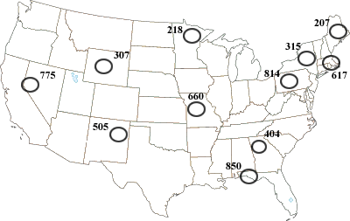
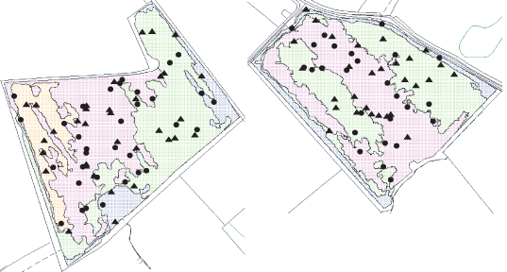
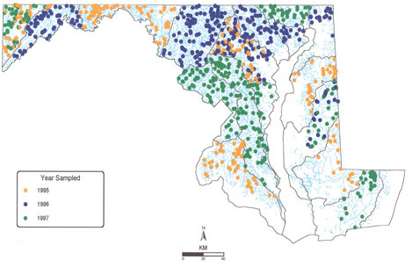
Cluster sampling

Slide 12
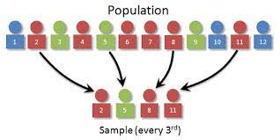
SYSTEMATIC RANDOM SAMPLING
Systematic: Choosing every “nth” individual or site in the population until the desired sample size is achieved
A sampling procedure in which a starting point is selected by a random process and then every nth number on the list is selected.
Order all units in the sampling frame
Set the starting point
Then every nth number on the list is selected
N= Sampling Interval
Example
All employees of the company are listed in alphabetical order. You randomly select a starting point: number 2. From number 2 onwards, every 3rd person on the list is selected (2,5,8,11 and so on), and you end up with a sample of 100 people.
Advantage: This method is that is should provide a representative sample. Eliminate biasness

Slide 13
Systematic sample
1 | 2 | 3 | 4 | 5 | 6 | 7 | 8 | 9 | 10
11 | 12 | 13 | 14 | 15 | 16 | 17 | 18 | 19 | 20
21 | 22 | 23 | 24 | 25 | 26 | 27 | 28 | 29 | 30
31 | 32 | 33 | 34 | 35 | 36 | 37 | 38 | 39 | 40
41 | 42 | 43 | 44 | 45 | 46 | 47 | 48 | 49 | 50
51 | 52 | 53 | 54 | 55 | 56 | 57 | 58 | 59 | 60
61 | 62 | 63 | 64 | 65 | 66 | 67 | 68 | 69 | 70
71 | 72 | 73 | 74 | 75 | 76 | 77 | 78 | 79 | 80
81 | 82 | 83 | 84 | 85 | 86 | 87 | 88 | 89 | 90
91 | 92 | 93 | 94 | 95 | 96 | 97 | 98 | 99 | 100
101 | 102 | 103 | 104 | 105 | 106 | 107 | 108 | 109 | 110
111 | 112 | 113 | 114 | 115 | 116 | 117 | 118 | 119 | 120
121 | 122 | 123 | 124 | 125 | 126 | 127 | 128 | 129 | 130
131 | 132 | 133 | 134 | 135 | 136 | 137 | 138 | 139 | 140
141 | 142 | 143 | 144 | 145 | 146 | 147 | 148 | 149 | 150
151 | 152 | 153 | 154 | 155 | 156 | 157 | 158 | 159 | 160
161 | 162 | 163 | 164 | 165 | 166 | 167 | 168 | 169 | 170
171 | 172 | 173 | 174 | 175 | 176 | 177 | 178 | 179 | 180
181 | 182 | 183 | 184 | 185 | 186 | 187 | 188 | 189 | 190
191 | 192 | 193 | 194 | 195 | 196 | 197 | 198 | 199 | 200

Slide 14
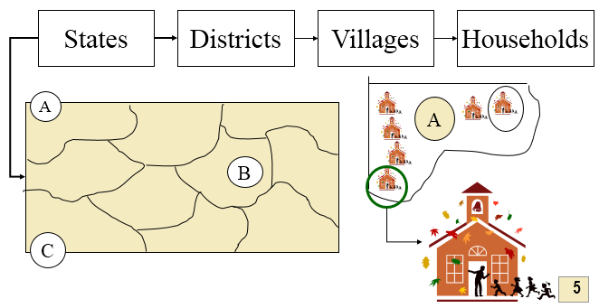
Multistage Sampling
Multistage sampling divides large populations into stages to make the sampling process more practical.
Large clusters of population are divided into smaller clusters in several stages in order to make primary data collection more manageable
Your research objective is to evaluate online spending patterns of households in the US through online questionnaires. You can form your sample group comprising 120 households:
Choose 6 states in the USA using simple random sampling (or any other probability sampling).
Choose 4 districts within each state using systematic sampling method (or any other probability sampling).
Choose 5 households from each district using simple random or systematic sampling methods. This will result in 120 households to be included in your sample group.

Slide 15
Non-Probability sampling methods...
1. Convenience sampling
2. Purposive sampling/Judgmental Sampling
3. Quota sampling
3. Snowball sampling

Slide 16
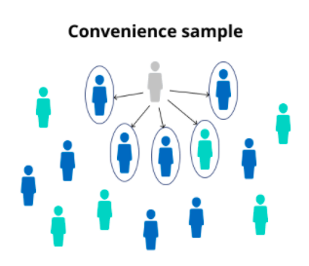
CONVENIENCE SAMPLING
A convenience sample simply includes the individuals who happen to be most accessible to the researcher.
Convenience sampling involves choosing respondents at the convenience of the researcher.
called “accidental” or “haphazard” sampling
Advantages
Very low cost
Extensively used/understood
Disadvantages
Variability and bias cannot be measured or controlled
Projecting data beyond sample not justified
Example
You are researching opinions about student support services in your university, so after each of your classes, you ask your fellow students to complete a survey on the topic.
Participants are selected because they are willing and available to be studied.
The sampling procedure of obtaining those people or units that are most conveniently available.

Slide 17
Haphazard / Accidental / Convenience sample
😐
☹
☺
😐
☺
😐
😐
☹
☹
☺
😐
😐
☹
😐
😐
😐
😐
😐
☹
☹
☺
☹
☺
☺
☺
☹
☹
☹
☺
☹
☹
😐
😐
☹
😐
😐
😐
😐
😐
☹
☹
😐
☹
☹
😐
😐
😐
😐
☺
😐
☹
😐
😐
😐
☹
☹
😐
😐
😐
☹
😐
☺
☺
😐
😐
😐
☹
☹
😐
😐
☹
☹
☺
☹
😐
😐
😐
😐
☹
☹
☺
☺
😐
😐
😐
😐
😐
☹
😐
😐
😐
☹
😐
☺
☹
😐
☹
☹
😐
😐
☹
☺
☹
☹
😐
☹
😐
😐
😐
😐
😐
😐
😐
☹
😐
☹
☹
☹
☹
😐
☺
😐
😐
☹
☺
☺
😐
😐
😐
😐
😐
☹
😐
😐
😐
😐
☹
☹
☹
😐
😐
😐
😐
😐
😐
😐
😐
😐
☹
☹
😐
☹
☹
☺
😐
😐
😐
😐
😐
☹
😐
😐
☹
😐
☺
😐
😐
☹
😐
😐
😐
😐
😐
😐
😐
😐
☹
😐
😐
😐
☹
☺
☹
😐
😐
☹
😐
😐
☹
☹
😐
☹
😐
😐
😐
😐
😐
☹
😐
☹
☺
😐
☹
☺
😐
😐
😐
😐
☹
😐
☹
😐
😐
☺
☹
☹
☹
☹
😐
😐
☹
😐
☹
😐
☹
☺
☹
😐
😐
😐
😐
😐
😐
😐
😐
😐
☹
☹
☹
😐
😐
☺
😐
😐
😐
😐
😐
😐
😐
😐
☹
😐
😐
☺
😐
😐
☹
☹
☹
😐
😐
😐
😐
😐
😐
☹
☹
😐
😐
😐
😐
😐
😐
😐
😐
😐
☹
😐
😐
☹
☺
😐
😐
😐
☹
😐
😐
😐
😐
😐
😐
😐
😐
😐
☹
😐
😐
😐
😐
☹
😐
😐
☺
😐
☹
😐
☹
☹
☹
😐
😐
😐
😐
😐
😐
😐
☺
☹
😐
😐
😐
😐
😐
😐
😐
😐
😐
☹
☹
☹
😐
☹
😐
😐
😐
😐
☺
☹
😐
😐
😐
😐
☺
😐
😐
😐
😐
😐
😐
😐
😐
😐
😐
😐
😐
😐
☹
😐
😐
😐
😐
😐
😐
😐
😐
😐
😐
☹
😐
☹
😐
😐
😐
😐
😐
☺

Slide 18
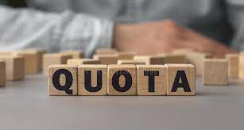
QUOTA SAMPLING
Sampling procedure that ensures that various subgroups of a population will be represented on pertinent characteristics to the exact extent that the investigator desires.
Example: age, gender and socioeconomic status or social class
To select a quota sample you:
1 Divide the population into specific groups. Eg: male and Female
2 Calculate a quota for each group based on relevant/available data.
3 Give each interviewer an ‘assignment’, which states the number of cases in each quota from which they must collect data.
4 Combine the data collected by interviewers to provide the full sample.

Slide 19
Quota sample (Eg: Age groups)
😐
☹
☺
😐
☺
☺
☺
☺
☺
😐
☹
☹
☺
😐
😐
😐
😐
😐
☹
😐
😐
😐
😐
😐
☹
☹
☺
☹
☺
☺
☺
☹
☹
☹
☺
☹
☹
☹
☹
☹
😐
😐
☹
😐
😐
😐
😐
😐
☹
☹
😐
☹
☹
😐
😐
😐
😐
☺
😐
☹
😐
☺
☺
☺
☺
😐
☹
☹
😐
😐
😐
☹
😐
☺
☺
😐
😐
☹
☹
😐
😐
☹
☹
☺
☹
😐
😐
😐
😐
😐
😐
😐
😐
☹
☹
☺
☺
😐
😐
😐
😐
☹
😐
😐
😐
☹
😐
☺
☹
☹
☹
☹
☹
😐
☹
☹
😐
😐
☹
☺
☹
☹
😐
☹
😐
😐
😐
😐
😐
😐
☹
😐
☹
☹
☹
☹
😐
☺
☺
☺
☺
☺
😐
😐
☹
☺
☺
😐
😐
😐
😐
☹
😐
😐
😐
😐
☹
☹
☹
😐
😐
😐
😐
😐
😐
😐
😐
😐
😐
😐
😐
😐
☹
☹
😐
☹
☹
☺
😐
😐
😐
😐
☹
😐
😐
☹
😐
☺
😐
😐
☹
😐
☹
☹
☹
☹
😐
😐
😐
😐
😐
😐
😐
☹
😐
😐
☹
☺
☹
😐
😐
☹
😐
😐
☹
☹
☺
☺
☺
☺
☹
😐
😐
😐
😐
😐
☹
😐
☹
☺
😐
☹
☺
😐
😐
😐
😐
☹
😐
☹
😐
😐
☺
☹
☹
😐
😐
😐
😐
☹
😐
😐
☹
😐
☹
😐
☹
☺
☹
😐
😐
😐
😐
😐
😐
😐
😐
😐
☹
☹
☹
😐
☹
☹
☹
☹
☺
😐
😐
😐
😐
😐
😐
😐
😐
☹
😐
😐
☺
😐
😐
☹
☹
☹
😐
😐
😐
😐
😐
😐
☹
😐
😐
😐
😐
😐
😐
😐
😐
😐
☹
😐
☹
☺
😐
😐
😐
☹
😐
😐
😐
😐
😐
😐
😐
😐
😐
😐
😐
😐
😐
☹
😐
😐
☺
😐
☹
😐
☹
☹
☹
😐
😐
😐
😐
😐
😐
😐
☹
😐
😐
😐
😐
😐
😐
😐
😐
😐
☹
☹
😐
☹
😐
😐
😐
😐
☺
☹
😐
😐
😐
😐
☺
😐
😐
😐
😐
😐
😐
😐
😐
😐
😐
😐
😐
☹
😐
😐
😐
😐
😐
😐
😐
😐
😐
☹
😐
☹
😐
😐
😐
😐

Slide 20
Purposive/ JUDGEMENTAL SAMPLING
Sampling technique in which an experienced individual selects the sample based on personal judgment about some appropriate characteristics of the sample member
Researcher selects participants from their sampling frame because they have characteristics that the researcher desires. Example: Research on working mothers – Only working mothers selected
The process whereby the researcher selects a sample
based on experience or knowledge of the group to be sampled
Advantages
There is a assurance of Quality response
Meet the specific objective.
Disadvantages
Bias selection of sample may occur
Time consuming process.
Purposive sampling is often used when working
with very small samples such as in case study
research and when you wish to select cases that are
particularly informative (Neuman 2005).

Slide 21
Purposive sample
😐
☹
☺
😐
☺
😐
☹
☹
☺
😐
☹
😐
😐
😐
😐
😐
☹
☹
☺
☹
☺
☺
☺
☹
☹
☹
☺
☹
😐
😐
☹
😐
😐
😐
😐
😐
☹
☹
😐
☹
☹
😐
😐
😐
😐
☺
😐
☹
😐
😐
☹
☹
😐
😐
😐
☹
😐
☺
☺
😐
😐
☹
☹
😐
😐
☹
☹
☺
☹
😐
😐
😐
😐
☹
☹
☺
☺
☺
☺
😐
😐
😐
😐
☹
😐
😐
😐
☹
😐
☺
☹
😐
☹
☹
😐
😐
☹
☺
☹
☹
😐
☹
☺
☺
😐
😐
😐
😐
😐
😐
☹
😐
☹
☹
☹
☹
😐
☺
😐
😐
☹
☺
☺
😐
😐
😐
😐
☹
😐
😐
😐
😐
☹
☹
☹
😐
☺
☺
😐
😐
😐
😐
😐
😐
😐
😐
☹
☹
😐
☹
☹
☺
☺
☺
😐
😐
😐
😐
☹
😐
😐
☹
😐
☺
😐
😐
☹
😐
😐
😐
😐
😐
😐
😐
😐
☹
😐
😐
☹
☺
☹
😐
😐
☹
😐
😐
☹
☹
☹
😐
😐
😐
😐
😐
☹
😐
☹
☺
😐
☹
☺
😐
😐
😐
😐
☹
😐
☹
😐
😐
☺
☹
☹
☹
😐
😐
☹
😐
☹
😐
☹
☺
☹
😐
😐
😐
😐
😐
😐
😐
😐
😐
☹
☹
☹
😐
☺
😐
😐
😐
😐
😐
😐
😐
😐
☹
😐
😐
☺
😐
😐
☹
☹
☹
😐
😐
😐
😐
😐
😐
☹
😐
😐
😐
😐
😐
😐
😐
😐
😐
☹
😐
☹
☺
😐
😐
😐
☹
😐
😐
😐
😐
😐
😐
😐
😐
😐
😐
😐
😐
😐
☹
😐
😐
☺
😐
☹
😐
☹
☹
☹
😐
😐
😐
😐
😐
😐
😐
☹
😐
😐
😐
😐
😐
😐
😐
😐
😐
☹
☹
😐
☹
😐
😐
😐
😐
☺
☹
😐
😐
😐
😐
☺
😐
😐
😐
😐
😐
😐
😐
😐
😐
😐
😐
😐
☹
😐
😐
😐
😐
😐
😐
😐
😐
😐
☹
😐
☹
😐
😐
😐
😐

Slide 22
SNOWBALL SAMPLING
The researcher asks participants to identify other participants to become members of the sample.
The research starts with a key person and introduce the next one to become a chain
Make contact with one or two cases in the population.
Ask these cases to identify further cases.
Ask these new cases to identify further new cases (and so on).
Stop when either no new cases are given, or the sample is as large as is manageable.
Advantages
Low cost
Useful in specific circumstances & for locating rare populations
Disadvantages
Not independent
Projecting data beyond sample not justified
Example
You are researching experiences of homelessness in your city. Since there is no list of all homeless people in the city, probability sampling isn’t possible. You meet one person who agrees to participate in the research, and she puts you in contact with other homeless people that she knows in the area.

Slide 23
Snowball sample
😐
☹
☺
😐
☺
😐
☹
☹
☺
☹
😐
😐
😐
😐
😐
☹
☹
☺
😐
☹
☺
☺
☺
☹
☹
☹
☺
☹
😐
😐
☹
😐
😐
😐
😐
😐
☹
☹
😐
☹
☹
😐
😐
😐
😐
☺
😐
☹
😐
😐
☹
☹
😐
😐
😐
☹
😐
☺
☺
😐
😐
☹
☹
😐
😐
☹
☹
☺
☹
😐
😐
😐
😐
☹
☹
☺
☺
😐
😐
😐
😐
☹
😐
😐
😐
☹
😐
☺
☹
😐
☹
☹
😐
😐
☹
☺
☹
☹
😐
☹
😐
😐
😐
😐
😐
😐
☹
😐
☹
☹
☹
☹
😐
☺
😐
😐
☹
☺
☺
😐
😐
😐
😐
☹
😐
😐
😐
😐
☹
☹
☹
😐
😐
😐
😐
😐
😐
😐
😐
😐
☹
☹
😐
☹
☹
☺
😐
😐
😐
😐
☹
😐
😐
☹
😐
☺
😐
😐
☹
😐
😐
😐
😐
😐
😐
😐
😐
☹
😐
😐
☹
☺
☹
😐
😐
☹
😐
😐
☹
☹
☹
😐
😐
😐
😐
😐
☹
😐
☹
☺
😐
☹
☺
😐
😐
😐
😐
☹
😐
☹
😐
😐
☺
☹
☹
☹
😐
😐
☹
😐
☹
😐
☹
☺
☹
😐
😐
😐
😐
😐
😐
😐
😐
😐
☹
☹
☹
😐
☺
😐
😐
😐
😐
😐
😐
😐
😐
☹
😐
😐
☺
😐
😐
☹
☹
☹
😐
😐
😐
😐
😐
😐
☹
😐
😐
😐
😐
😐
😐
😐
😐
😐
☹
😐
☹
☺
😐
😐
😐
☹
😐
😐
😐
😐
😐
😐
😐
😐
😐
😐
😐
😐
☹
😐
😐
☺
😐
😐
☹
😐
☹
☹
☹
😐
😐
😐
😐
😐
😐
😐
☹
😐
😐
😐
😐
😐
😐
😐
😐
😐
☹
☹
😐
☹
😐
😐
😐
😐
☺
☹
😐
😐
😐
😐
☺
😐
😐
😐
😐
😐
😐
😐
😐
😐
😐
😐
😐
☹
😐
😐
😐
😐
😐
😐
😐
😐
😐
☹
😐
☹
😐
😐
😐
😐

Slide 24
Summary – Non-Probability sampling
Convenience sample
researcher gathers data from whatever cases happen to be convenient
Purposive sample
when a researcher seeks out participants with specific characteristics
Quota sample
When a researcher selects cases from within several different subgroups
Snowball sample
when a researcher relies on participant referrals to recruit new participants

Slide 25
Thank You

