Slide 1

Data Collection

Slide 2
Steps in the Process of Quantitative Data Collection
Determining participants to study
1
Obtaining permissions needed
2
Considering what types of information to collect
3
Locating and selecting instruments
4
Administering the data collection
5

Slide 3
Five Steps in the Process of Qualitative Data Collection
Identify participants and sites
Gain access to individuals and sites
Identify what types of information will answer your research questions
Design protocols or instruments for collecting and recording information
Administer the data collection

Slide 4
Differences Between Qualitative and Quantitative Data Collection
Qualitative researchers identify participants and sites through purposeful sampling.
Qualitative studies are usually conducted at the research site.
Qualitative studies rely on general interviews or observations not others’ instruments.
Qualitative researchers record information through self-designed protocols.
Qualitative studies require sensitivity to challenges and ethical issues from gathering face-to-face information, often in homes and workplaces.

Slide 5
What type of Data? – Primary and Secondary
PRIMARY DATA:
Data originated by a researcher for the specific purpose of addressing the research problem.
Included among primary sources are survey, interviews
SECONDARY DATA:
Data collected from a source that has already been published in any form
Included among secondary data are reports available in the libraries/ internet, magazines, newspapers etc.
TYPES
PRIMARY
DATA
SECONDARY
DATA

Slide 6

Primary Data
Primary data source is the source that presents first-hand information.
Primary sources are the original data collected by the researcher himself for his study.
Primary data sources can come from direct outcomes of an event the actual experience that is recorded by the person involved.
  Survey
  Interview
  Observation
  Experiment

Slide 7
Primary Research Methods & Techniques
Primary Research
Quantitative Data
Qualitative Data
Surveys
Mail
Distribute and collect
Telephone, fax, e-mail,
Web, Google Form
Experiments
Focus groups
Observation
Interviews
Observation
Simulation
Case studies

Slide 8

Data Collection: Qualitative vs Quantitative Approaches
Qualitative
  Focus Group
  Interview
  Case Study
  Participant observation
  Secondary data analysis
Quantitative
  Surveys
  Experiments
  Structured observation
  Secondary data analysis

Slide 9

Secondary Data
Refers to information that has been already gathered by someone (individual or agencies) and readily available to the researcher.
Secondary data should possess the following characteristics:
Reliability of data
Suitability of data
Adequacy of data

Slide 10
Secondary Data Collection
Data obtained from historical information such as company's annual report, financial statement, Central Bank Report, newspaper, Statistics Dept etc.
It is a second-hand data or at least once removed from the original event.
The most important consideration when using secondary data is how much you can trust the original source of the data.
Some resources for secondary research information include:
1. Libraries and other public information centres.
2. Books, business publications.
3. Magazines and daily newspaper.
4. Trade associations - most associations have reports on the industries they serve
5. Local agencies such as district office, post-office, land-office, etc.
6. Consumer association, non-governmental organizations, etc.
7. Banks, real estate agencies, insurance companies.
8. Wholesalers and manufacturers.
9. Federal government resources – statistics dept.
10. Regional planning organizations, local governments

Slide 11
Secondary data
Data someone else has collected
Sources.
1. Internal company Records
2. Company reports
3. Internal computer databases
4. Reports and publications of government agencies
5. Other publications.
6. Computerized databases.
EBSCO, PROQUEST, Emerald
The research method consists of how the researcher:
collects,
analyzes,
interprets the data (Creswell, 2009).
Secondary data can be both quantitative and qualitative in form.

Slide 12
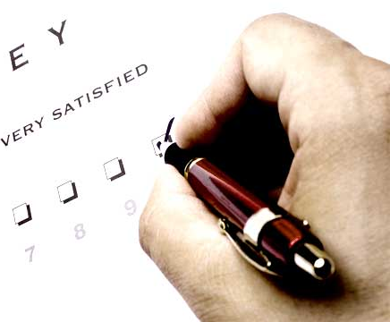
Primary Data collection
Describe how data was collected or how questionnaire was administered
  • Internet- or intranet-mediated,
  • postal,
  • delivery and collection,
  • telephone
  • interview
State the steps in data collection ie:
  • What method was used
  • How many questionnaires/respondents
  • How was the response rate
  How did you follow up
If pilot testing was done, state the reliability and validity testing results and what amendments done to questionnaire

Slide 13
Primary Data collection
Self-Administered Questionnaire
Advantages
Lower budget required since the questionnaire is self explained and can be distributed to many respondents at the same time.
Busy respondents can complete the questionnaire at their convenient time and the researcher can collect later.
Response rate is high since the researcher manages to talk and convince and follow up
Mailed Questionnaire
Advantages
Can cover wider geographical area.
Lower budget required compared to personal and telephone interview.
No response bias from interviewer.
Anonymity of respondents assured.
Respondent completes questionnaire at their own convenient time.

Slide 14
Primary Data collection
Personal Interviews
Conducted on a one-to-one basis
Uses an unstructured or semi structured questionnaires
Uses open-ended questions
Extensive probing questions
Usually recorded on audio visual tape
Interview typically lasts one hour
Usually no more than 50 persons are interviewed
Focus Groups Discussion
Conducted in a group of 8-12 people in a session
Led by a moderator who follows the pre-designed script
The sessions are audio or video recorded
The whole session normally lasts between 1 to 2 hours
Discussion is lively and proactive. Generates required information.

Slide 15

Observation
An observation is the process of gathering first-hand information by observing people and places at a research site.
Observational roles
  Participant observer: An observational role adopted by researchers when they take part in activities in the setting, they observe
  Nonparticipant observer: An observer who visits a site and records notes without becoming involved in the activities of the participants
Intensive, usually long term, examination of a social group, an organization, etc.
Researcher becomes a participant in the lives of group members
Observes their behavior and learns meaning systems (which are tied to language)
Most closely associated with Ethnography, as developed in Classical Anthropology

Slide 16

Interviews
Unstructured – e.g., ethnographic interviewing – researcher allows interview to proceed at respondent’s pace and subjects to vary by interviewee (to an extent)
Semi-structured – Asks same general set of questions (predominantly open-ended). Further probing
Structured – Precisely worded questions.
Everyone asked exactly the same questions in exactly
the same way, given exactly the same choices
Type of interview to use
  Face to face - individual
  Focus group
  Telephone

Slide 17
Interview Procedures
Identify
Identify the interviewees
Determine
Determine the type of interview you will use (e.g., focus group, one-on-one)
Record
Record the audio of the conversation.
Take Notes
Take brief notes during the interview
Locate Place
Locate a quiet, suitable place
Obtain Cosent
Obtain consent from the interviewee to participate in the study/Record
Have a Plan
During the interview, have an interview plan using your interview protocol, but be flexible
Use Probing
Use probes to elicit more information: Include possible probes in your interview protocol
Use probes to elaborate and clarify
Be Courteous
Be courteous and professional when the interview is over

Slide 18
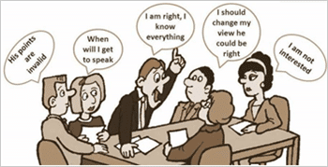
Focus group
A type of group interview.
Focuses on group interaction on a topic selected by the researcher.
Ideally 4- 12 participants.
The interaction is directed by a moderator who asks questions and keeps the discussion on the topic.
A small group of people are brought together to discuss specific topics of interest to the researcher.
The group process tends to elicit more information than individual interviews because there is cross-conversation and discussion.
  Different views can be explored.

Slide 19
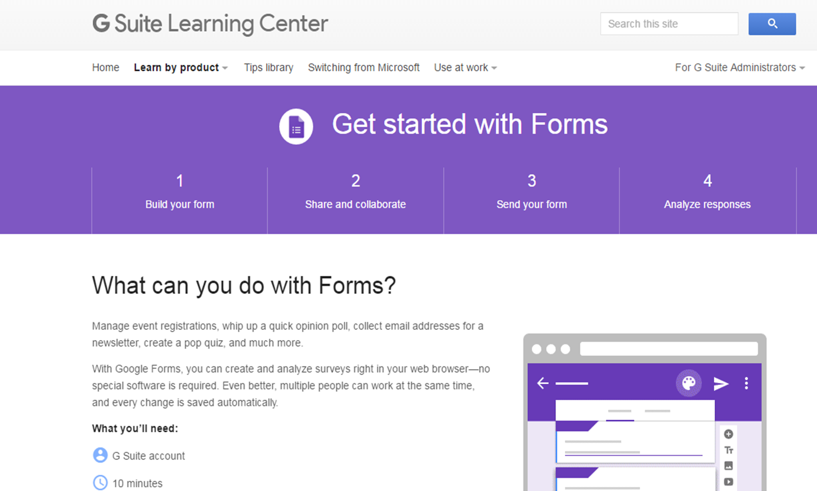
Surveys
A survey involves data collection from a large number of respondents using a predesigned questionnaire.
Four basic survey methods:
  Telephone survey
  Self Administered – mail/e-mail
  Person-administered surveys
  (distribute and collect)
  Website eg: Google Form

Slide 20
Thank You

