Slide 1
Topic 6 Reliability
Dr Jugindar Singh

Slide 2
The Goodness of Data
Reliability
The reliability of a measure is established by
testing for both consistency and stability.
Consistency indicates how well the items measuring a concept hang together as a set.
Cronbach’s alpha is a reliability coefficient that indicates how well the items in a set are positively correlated to one another.
The closer Cronbach’s alpha is to 1, the higher the internal consistency reliability.
Validity
Validity is defined as the extent to which a concept is accurately measured in a quantitative study
Content validity - looks at whether the instrument adequately covers all the content that it should with respect to the variable
Face validity - experts are asked their opinion about whether an instrument measures the concept intended.
Construct validity- refers to whether you can draw inferences about test scores related to the concept being studied. Eg: if a person has a high score on a survey that measures anxiety, does this person truly have a high degree of anxiety?
Criterion validity. A criterion is any other instrument that measures the same variable. Correlations can be conducted to determine the extent to which the different instruments measure the same variable. Includes Convergent validity and Divergent validity

Slide 3
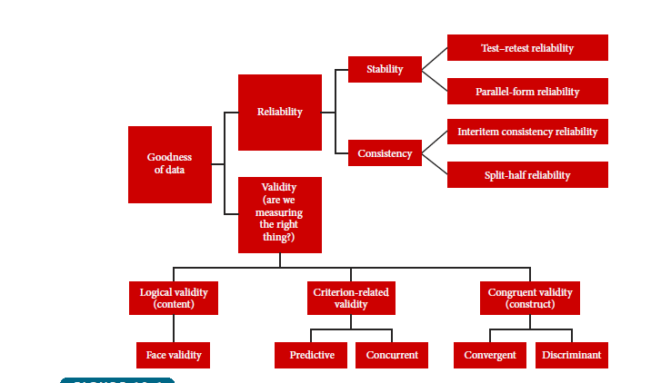
Testing Goodness of data Validity & Reliability
Reliability : the consistency of your measurement instrument
“…the degree to which a test or measure produces the same scores when applied in the same circumstances…” (Nelson 1997)
Validity : if an instrument measures what it is supposed to measure
“Degree to which a test or instrument measures what it purports to measure”
(Thomas & Nelson 1996)

Slide 4
Reliability Analysis
“…the degree to which a test or measure produces the same scores when applied in the same circumstances…”
(Nelson 1997)
Reliability Indicators
Pretest
Repeat question(s)
Test/retest
Split half and Parallel
1. Scale internal consistency- degree to which the items that make up the scale “hang together”. 2. The ability of the instrument to measure consistently the phenomenon it is designed to assess
Cronbach Alpha

Slide 5
Reliability→ 3 types
Interrater Reliability: when using behavior ratings, 2 raters, blind to each other
Not just when rating humans…nonhuman animals too!
Ex: children/introversion
Notes:
Data & Measurement

Slide 6
Reliability→ 3 types
2. Test-Retest Reliability: 1 rater but rate
at multiple time
Ex: Time #1, Time #2, Time #3 → I.Q
Day 1 Day 2 Day 3
Notes:
Data & Measurement

Slide 7
Reliability→ 3 types
3. Internal Consistency Reliability:
Index of how homogeneous (similar) individual items of a measure are or individual observations of a behavior are
Ex: Test → 3 question vs 25?? & hitting a baseball
Anxiety Scale
1. 7. .13
2. 8. .14
3. 9. .15
4. 10. .16
5. 11. .17
6. 12. .18
Anxiety Scale
1.
2.
3.
Notes:
Data & Measurement

Slide 8
How to Test Reliability
The Reliability of data is tested by Cronbach Alpha which should show a reliability score of more than 70% (> 0.7)
Reliability analysis is to test whether a group of items (i.e. items measuring a construct generated from factor analysis) consistently reflected the construct it is measuring (Field, 2005).
The most common measure of reliability is internal consistency of the scale (Hair et al., 2006).
Cronbach’s alpha was calculated in order to examine the internal consistency of the scales used in this study.
Cronbach’s alpha coefficient can range from 0.0 to 1.0.
A Cronbach’s alpha close to 1.0 indicates that the item is considered to have a high internal consistency reliability, above 0.8 is considered good, 0.7 is considered acceptable and less than 0.6 is considered to be poor (Sekaran, 2003).

Slide 9
Cronbach Alpha: Internal consistency
The key is "internal”: The response patterns of all items should be similar (consistent).
Cronbach Alpha can be used for both binary (1 or 0) and widely-spread (e.g. 1- 10) data.
Efficient: It takes one test only while test-retest requires two or more and alternate form needs two or more versions.

Slide 10
What is Cronbach Coefficient Alpha?
The theory behind it is that the observed score is equal to the true score plus the measurement error (Y = T + E).
For example, I know 80% of the materials but my score is 85% because of lucky guessing. In this case, my observed score is 85 while my true score is 80. The additional five points are due to the measurement error.

Slide 11
What is Cronbach Coefficient Alpha?
A reliable test should minimize the measurement error so that the error is not highly correlated with the true score.
On the other hand, the relationship between true score and observed score should be strong. Cronbach Alpha examines this relationship.

Slide 12
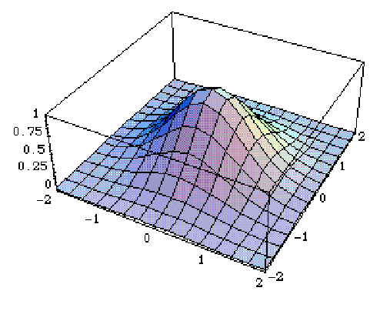
What is Cronbach Coefficient Alpha?
Two types of Cronbach Alpha:
Standardized: based on item correlation
Raw: based on item covariance matrix
What is covariance?
One variable: one distribution, one variance
Two variables: co-variance (Mexican hat)

Slide 13
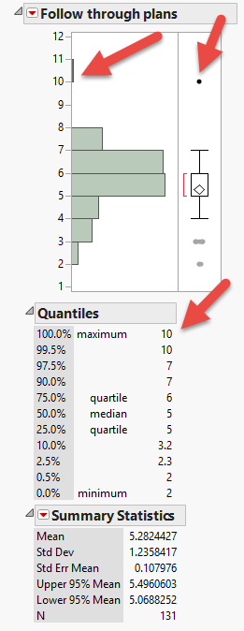
Always check the data accuracy!
Before doing any computation, we should always check the accuracy of the data.
The easiest way is to look at the distributions.
The scale is from 1 to 7. “10” must be a typo!

Slide 14
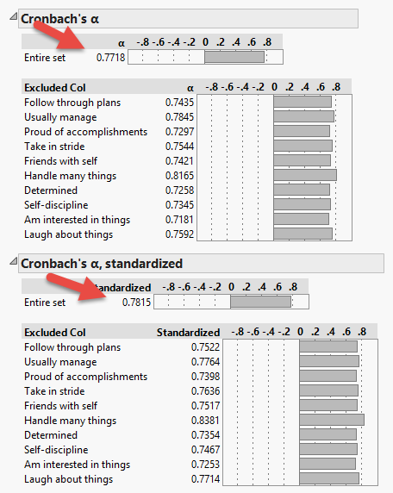
Entire set
Cronbach Alpha is about the entire scale.
There is NO alpha for a single item.
The number next to each item tells you: if this column is excluded (excluded Col), how would the alpha be changed?
This scale is OK, but not great (Cronbach alpha = .7726; .7821)

Slide 15
Remove the bad apple (item)!

Slide 16
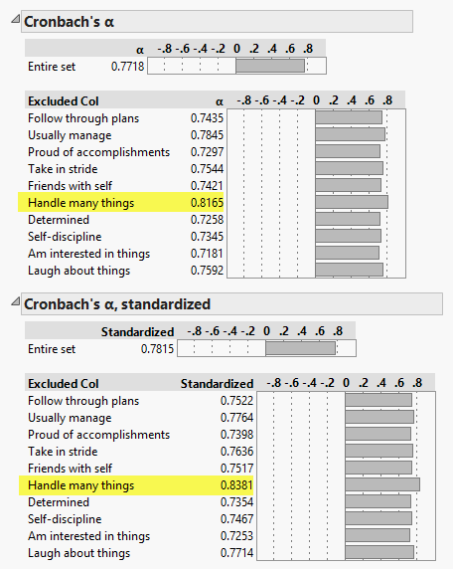
Remedies
You need to remove the item “Handle many things” to make the alpha better.
Reporting standardized alpha (based on covariance) makes it a bit better.

Slide 17
Thank You

