Slide 1
Topic 6 Validity
Dr Jugindar Singh

Slide 2
Validity
Are we testing what we think we’re testing?
A term to describe a measure that accurately reflects the concept it is intended to measure.
“The soundness or appropriateness of a test or instrument in measuring what it is designed to measure”
(Vincent 1999)

Slide 3
Types of Experimental Validity
Internal
Is the experimenter measuring the effect of the independent variable on the dependent variable?
External
Can the results be generalised to the wider population?

Slide 4
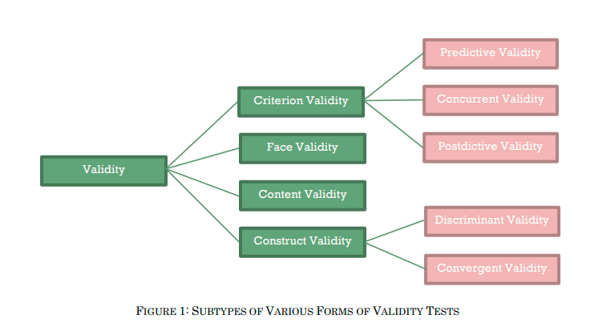
Validity Types
Content validity
Does the measure adequately measure the concept?
Face validity
Do “experts” validate that the instrument measures
what its name suggests it measures?
Criterion-related validity
Does the measure differentiate in a manner that helps
to predict a criterion variable?
Concurrent validity
Does the measure differentiate in a manner that helps to predict a criterion variable currently?
Predictive validity Does the measure differentiate individuals in a manner that helps predict a future criterion?
Construct validity
Does the instrument tap the concept as theorized?
Convergent validity Do two instruments measuring the concept correlate highly?
Discriminant validity Does the measure have a low correlation with a variable that is supposed to be unrelated to this variable?

Slide 5
Face Validity
Does the content of the test appear to be suitable to its aims?
How suitable the content of a test seems to be on the surface
Similar to content validity, but face validity is a more informal and subjective assessment.
Example
You create a survey to measure the regularity of people’s dietary habits. You review the survey items, which ask questions about every meal of the day and snacks eaten in between for every day of the week. On its surface, the survey seems like a good representation of what you want to test, so you consider it to have high face validity.
As face validity is a subjective measure, it’s often considered the weakest form of validity. However, it can be useful in the initial stages of developing a method.

Slide 6
Face Validity
Extent to which the measurement method appears “on its face” to measure the construct of interest
Called surface validity or appearance validity since it is merely a subjective, superficial assessment of whether the measurement procedure you use in a study appears to be a valid measure of a given variable or construct (e.g.,speed, EQ
EG: Variable (or construct) to be measured: Emotional intelligence
Face valid measures
I am good at judging others
I am in control of my emotions

Slide 7
Content Validity
Is the test fully representative of what it aims to measure?
Assesses whether a test is representative of all aspects of the construct.
To produce valid results, the content of a test, survey or measurement method must cover all relevant parts of the subject it aims to measure.
If some aspects are missing from the measurement (or if irrelevant aspects are included), the validity is threatened.
Example
A mathematics teacher develops an end-of-semester algebra test for her class. The test should cover every form of algebra that was taught in the class. If some types of algebra are left out, then the results may not be an accurate indication of students’ understanding of the subject. Similarly, if she includes questions that are not related to algebra, the results are no longer a valid measure of algebra knowledge.

Slide 8
Content Validity
Content validity refers to the extent to which an instrument covers the meanings included in the concept (Babbie, 1992).
Researchers, rather than by statistical testing, subjectively judge content validity (Chow and Lui, 2001). The content validity of the proposed instrument is at least sufficient because the instrument is carefully refined from a proven instrument with an exhaustive literature review process (Chow and Lui, 2001).
This can also be tested during the pre-test by using subjects who are qualified (academicians and practitioners) to rate whether the content of each factor was well represented by the measurement items (Saraph et al., 1989)
Content validity is the extent to which the elements within a measurement procedure are relevant and representative of the construct that they will be used to measure (Haynes et al., 1995).

Slide 9
Construct Validity
Does the test measure the concept that it’s intended to measure?
Evaluates whether a measurement tool really represents the thing we are interested in measuring. It’s central to establishing the overall validity of a method.
Example: Measure Depression
Can be measured based on a collection of indicators, such as low self-confidence and low energy levels.
If you develop a questionnaire to diagnose depression, you need to know: does the questionnaire really measure the construct of depression? Or is it actually measuring the respondent’s mood, self-esteem, or some other construct?
The questionnaire must include only relevant questions that measure known indicators of depression.
Convergent Validity
Discriminant Validity

Slide 10
Discriminant Validity
It is the extent to which people’s scores are not correlated with other variables that reflect distinct constructs.
Discriminant validity refers to the extent to which measures of 2 different
constructs are relatively distinctive, that their correlation values were
neither an absolute value of 0 nor 1 (Campbell and Fiske, 1959).
A more stringent rule was proposed by Smith et al. (1996) which was that the average variance extracted (AVE) of a factor is greater than the squared correlation between that and every other factor, the factor exhibit discriminant validity because the average amount of variance extracted by each factor is greater than the associated squared correlations. (Chow and Lui, 2001)
Example: Imagine, that a researcher with a new measure of self-esteem claims that self-esteem is independent of mood; a person with high self-esteem can be in either a good mood or a bad mood (and a person with low self-esteem can too).
Then this researcher should be able to show that his self-esteem measure is not correlated (or only weakly correlated) with a valid measure of mood.

Slide 11
Convergent Validity
Further to the construct validity test using the factor analysis (between scales) another factor analysis but this time using the within scale utilized to test the convergent validity.
According to Campbell and Fiske (1959) convergent validity refers to all items measuring a construct actually loading on a single construct.
Convergent validity is established when items all fall into 1 factor as theorized.

Slide 12
Criterion validity: Do the results correspond to a different test of the same thing?
Criterion validity evaluates how closely the results of your test correspond to the results of a different test.
The criterion is an external measurement of the same thing. It is usually an established or widely-used test that is already considered valid.
What is criterion validity?
To evaluate criterion validity, you calculate the correlation between the results of your measurement and the results of the criterion measurement. If there is a high correlation, this gives a good indication that your test is measuring what it intends to measure.
Example
A university professor creates a new test to measure applicants’ English writing ability. To assess how well the test really does measure students’ writing ability, she finds an existing test that is considered a valid measurement of English writing ability, and compares the results when the same group of students take both tests. If the outcomes are very similar, the new test has a high criterion validity.

Slide 13
CRITERION VALIDITY
The extent to which a measuring instrument accurately predicts behaviour or ability in a given area.
The measuring instrument is called ‘criteria’
It is of two types:
◉ Predictive validity
◉ Concurrent validity
Predictive Validity
Concurrent Validity

Slide 14
Concurrent Validity
Infers that the test produces similar results to a previously validated test
If you create some type of test, you want to make sure it’s valid: that it measures what it is supposed to measure. Concurrent validity measures how well a new test compares to a well-established test. It can also refer to the practice of concurrently testing two groups at the same time or asking two different groups of people to take the same test.
Example:
If you create a new test for depression levels, you can compare its performance to previous depression tests that have high validity. Concurrent means “as the same time”, so you would perform both tests at about the same interval: you could test depression level on one day with your test, and on the next day with the established test. A statistically significant result would mean that you have achieved concurrent validity.

Slide 15
Predictive Validity
If the test is used to predict future performance
Example: Entrance exam . . . .
Performance of these tests correlates with later performance in professional college

Slide 16
Thank You

