Slide 1
Topic 11 Practice data analysis using the preferred tool

Slide 2
Aims and Objectives
By the end of this session you should:
Have an understanding of the nature of qualitative data
Be aware of the features of qualitative analysis
Be aware of the challenges of analysing qualitative data
Be able to import and code documents using NVivo
Be able to produce queries and reports in NVivo
Source: https://www.academia.edu/23077439/Qualitative_Data_Analysis_Using_NVivo

Slide 3
What is Qualitative Data?
Non-numerical – converse of quantitative data
Typically word based – but may include imagery, video, etc.
Can record attitudes, behaviours, experiences, motivations, etc.
Descriptive – describing events/opinions etc.
Explanatory – explaining events/opinions etc.

Slide 4
Use Qualitative Data to Answer What/How/Why Questions
What?
What are the barriers to using social media as a research tool?
How?
How are researchers using social media to gather data?
Why?
Why are some people reluctant to take part in social media research?

Slide 5
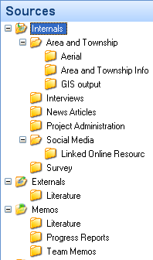
Examples of Qualitative Data Sources
Interviews
Focus groups
Speeches
Questionnaires
Journals/diaries
Documents
Observation
Audio/visual materials
Websites
Social media

Slide 6
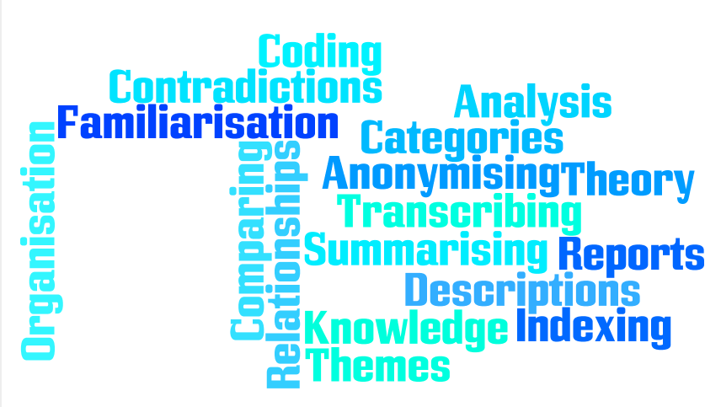
Analysing Qualitative Data
Identify similarities
Extract themes
Identify relationships
Highlight differences
Create generalisations
Notes:
Sort through data to identify similar phrases
Extract themes based on phrases
Identify relationships between themes
Highlight differences between subgroups
Identify patterns and processes
Build on consistencies to create generalisations
Iterative process – need to review initial findings to inform further analysis

Slide 7
Objectives of Qualitative Analysis
To draw conclusions
To develop theories
To test hypotheses

Slide 8
Coding Data
Divide data into meaningful units
Use words/phrases e.g. ‘physical environment’, ‘interpersonal relationships’
Codes can be ‘data-driven’ or ‘theory-driven’
Deductive coding codes are developed before examining the data
Inductive coding codes are derived from the data
In NVivo, codes are stored within Nodes
Keep a master list of codes used

Slide 9
Types of Code
Descriptive
What are the attributes of the source?
Thematic
What are the topics being discussed?
Analytic
How can this be interpreted?
What is going on?

Slide 10
Types of Code
This took place at Head Office
This is about discrimination against women
This is a reflection on misogyny in the workplace
Analytic
Descriptive
Thematic

Slide 11
Tree (Hierarchical) Coding
Interpersonal relationships
Family
Parent-child
Sibling
Non-family
Friends
Work colleagues
Spouse/ partner
Notes:
Usually need to explain how coding was carried out and present a table of codes for thesis or journal articles

Slide 12
Challenges
Large amount of data
Subjective nature of data
Validity of data
Use triangulation to increase reliability
No standard processes for coding or extracting themes
Time constraints

Slide 13
How can NVivo Help?
Manage data
Manage ideas
Query data
Model & report
Create database for storing different sources (text, audio, video, web resources, etc.)
Attach memos to files
Identify commonly occurring words
Illustrate relationships using models
Annotate data
Collate data relating to a theme or concept
Report knowledge developed from data

Slide 14
Qualitative Analysis Using NVivo
Import
Code
Query & Visualise
Summarise
Annotate

Slide 15
Limitations
Complex package that can take time to learn
Can distance researcher from their data
Researcher can get caught in ‘coding trap’
Can identify references to phrases but cannot discern different contexts
Will not compensate for poor data or weak interpretive skills!
Notes:
Does not prescribe a method but rather supports a range of methodological approaches
Emphasis on storage and retrieval rather than analysis
Automated or keyword searches are no substitute for interpretive coding

Slide 16
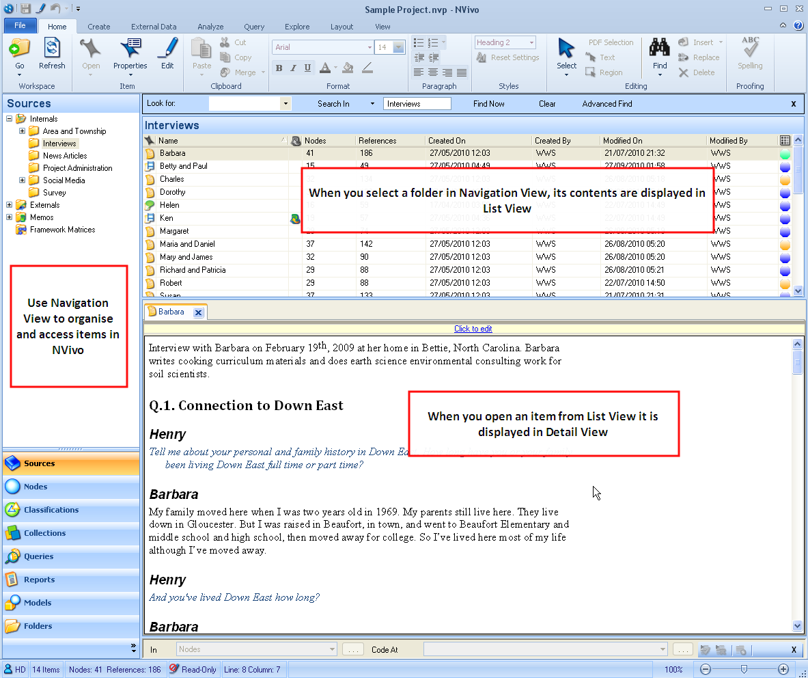

Slide 17
Terminology
Source – your data
Documents, audio, video, images, etc.
Memo – item in a project linked to a document or node
Node – a code or concept (theme node) or a component of your project e.g. participant or location (case node)
Can be free or tree
Classification – applied to a case or participant e.g. person, organisation, etc.
Attributes – data (demographics) known about a case (participant) recorded separately from the case

Slide 18
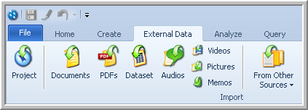
Importing Sources
Name documents appropriately before importing
Text-based data can be imported in .doc(x), .rtf, .txt or text-based .pdf format
For Microsoft Word documents, apply consistent heading styles to use autocoding
Multimedia files can be imported in a variety of formats including: .mp3/4, .wav, .jp(e)g
Edit videos before importing
Notes:
Make sure you use Heading Styles in Word to create headings – just making the text bold or larger won’t work! Check them in Outline View.
Heading 1 for topics and Heading 2 for speakers
Text that includes embedded objects cannot be imported.
Create hyperlinks after importing a document.
Autocoding cannot be applied to a table.

Slide 19
Other Datasets
Can connect to SurveyMonkey to import survey results
Import datasets such as Excel spreadsheets or Access database tables
Cannot edit datasets after importing – format and structure datasets before importing
Use NCapture to import social media data such as Facebook, Twitter or LinkedIn feeds

Slide 20
Coding in NVivo
Why is this interesting?
Thematic code
Why is this relevant to my research question?
Analytic code
Memo
Annotation/memo
What is this?
Descriptive code
Classification/attribute

Slide 21
Approaches to coding
Auto-coding based on structure or patterns
Manual coding in a source
Coding based on queries
Coding entire sources to a node

Slide 22
Creating Nodes
Use a separate node for each element
Who, what, how, when
Each node should encompass one concept only
Data can be coded at multiple nodes
Move free nodes into trees where appropriate
Organise trees based on conceptual relationships
Not observed or theoretical associations
E.g. events, strategies, attitudes, beliefs, characteristics
Each concept should appear in only one tree

Slide 23
Coding Sources
RENEWABLE ENERGY
Image
Video
Dataset
Interview
Website
Create nodes to link different sources related to a specific topic or theme

Slide 24
Case Nodes
HELEN
Interview
Video
Blog article
Photo
You can classify HELEN node as a PERSON with attributes such as: GENDER, AGE, OCCUPATION, LOCATION, etc.
You can create nodes for other ‘cases’ such as companies, locations, etc.

Slide 25
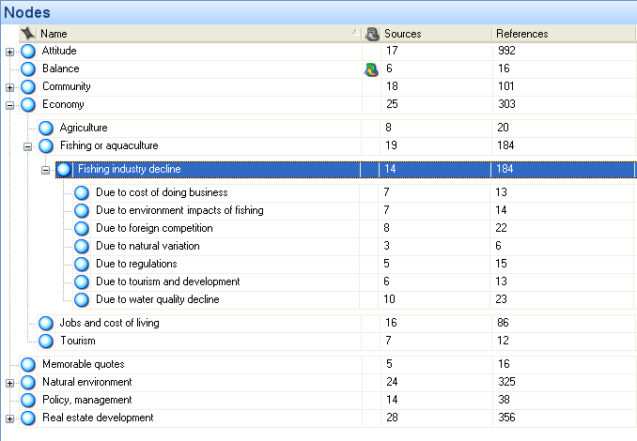
Tree Structures in NVivo

Slide 26
Using Memos
Use memos to tell the story of your research
Can help you make sense of your data
Research memo – goals, assumptions, journal
Source memo – key points of interview/document, description information, initial perceptions
Node memo – why theme is important, links to literature
Query memo – what results tell you, further queries

Slide 27
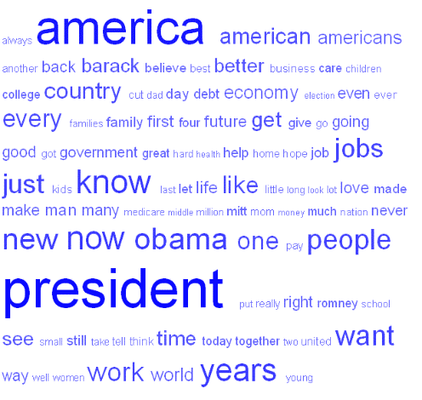
Queries
Find and analyse words or phrases
Text Search Query – search for a word/phrase
Create a word tree
Word Frequency Query – most frequently occuring words
Create a tag cloud
Use memos to record what you learn

Slide 28
Developing an NVivo Project
Descriptive coding
Thematic coding
Analytic coding
Research design, project outline
Folders, templates, case nodes
Finding obvious themes, autocoding
In Vivo coding
Creating node hierarchies
Using queries, matrices
Structuring phase
Optional analytic iterations
Creative/analytic phase
Source: Edhlund, B & Mcdougall, A (2013), NVivo 10 Essentials, p. 14

Slide 29
Literature Reviews in NVivo
Create a source folder called ‘Literature’
Code articles by themes
Create nodes for statistics, quotes, definitions, etc.
Annotate content you want to follow-up
Use memos to add descriptions or critiques
Use source classifications for date, author, etc.
Use queries to find common themes or gaps
YouTube Video

Slide 30
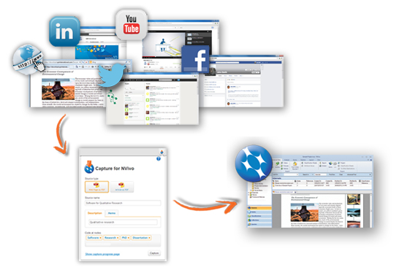
Web Pages and Social Media Data
Install NCapture for Internet Explorer/Chrome
Capture content from:
Web pages
Online PDFs
Facebook
Twitter
LinkedIn
YouTube

Slide 31
Tips
Code data at multiple nodes
Use descriptive, thematic and analytic codes
Keep a record of your codes and the themes that evolve
Use a Word Frequency query to help you identify key phrases
Use Text Search queries to help you explore themes
Take time to reflect on what you have found and record ideas using memos
Absence can be important! Ask why sources are NOT coded at a node
Keep a journal of your analysis process
Notes:
Place an underscore at the beginning of a document name e.g. _Journal so that it will appear at the top of any alphabetical list

Slide 32
Things to consider early!
Create your project journal
Use a model to visualise your preliminary ideas
Create case nodes for the people, organisations, places etc. in your project
Identify possible nodes based on your literature review
Prepare your sources for importing – format documents, clean datasets, edit video/audio

Slide 33
Practical Exercises
Import documents into NVivo
Create nodes and code data
Create memos and annotate data
Add classifications to a project
Define attributes for classifications
Produce reports
Create Text Search and Word Frequency queries

Slide 34
Online Resources
NVivo Toolkit: http://explore.qsrinternational.com/nvivo-toolkit
Getting Started Guide: http://download.qsrinternational.com/Document/NVivo10/NVivo10-Getting-Started-Guide.pdf
QSR website: http://www.qsrinternational.com/support.aspx
QSR Support - @QSRSup - on Twitter: https://twitter.com/QSRSup
QSR on Facebook: http://www.facebook.com/qsrinternational
QSR on YouTube: https://www.youtube.com/user/QSRInternational

Slide 35
Literature
Qualitative Data Analysis with Nvivo
Bazeley, P & Jackson, K (2013)
NVivo 10 Essentials
Edhlund, B & Mcdougall, A (2013)
Using QSR‐NVivo to facilitate the development of a grounded theory project: an account of a worked example
Andrew John Hutchison, Lynne Halley Johnston, Jeff David Breckon
International Journal of Social Research Methodology
Vol. 13, Iss. 4, 2010
Using NVivo to Answer the Challenges of Qualitative Research in Professional Communication: Benefits and Best Practices Tutorial
Hoover, R.S.; Koerber, A.L.,
Professional Communication, IEEE Transactions on
Vol.54, no.1, pp.68,82, March 2011 doi: 10.1109/TPC.2009.2036896 URL: http://ieeexplore.ieee.org/stamp/stamp.jsp?tp=&arnumber=5337919&isnumber=5718246

