Slide 1
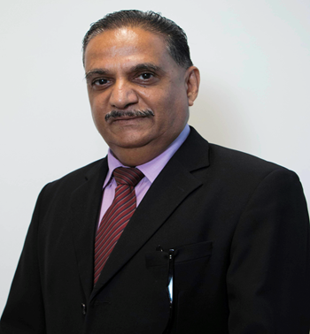
Topic 7 Ethics
Dr Jugindar Singh

Slide 2
What are ethics
Moral principles that govern a person’s behavior or the conducting of an activity: Oxford dictionary
Example:
Truthfulness
Integrity
Not cheating
No manipulation

Slide 3
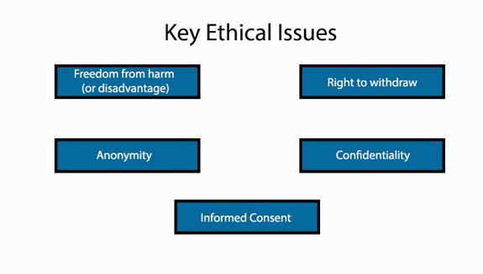
Ethical Consideration in Research
The goal of ethics in research is to ensure that no one is harmed or suffers adverse consequences while following any stage of research.

Slide 4
“Ethics refers to the appropriateness of your behaviour in relation to the rights of those who become the subject of your work or who are affected by it”
Saunders et al (2009, pg. 183 ‐184)

Slide 5
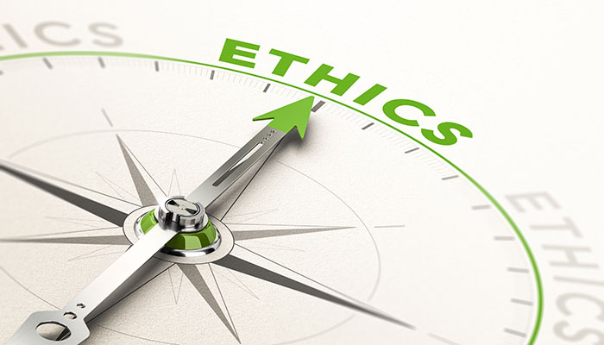
Ethics and Target Respondents
Information collected should not be misused for any other purpose
Participation is voluntary
Confidentiality of the replies
Not to embarrass respondents/informants

Slide 6
Ethical research?
Based on Diener and Chandall (1978) we can say that behaving ethically means:
No harm should come to research participants (No harm)
They should agree to participate and know what the research is about (Consent)
Their privacy should not be invaded (Privacy)
They should not be lied to or cheated (No Deception).

Slide 7
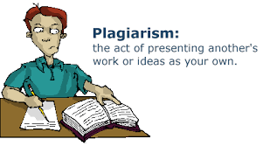
Academic Fraud
Fabrication
- the actual making up of research data and (the intent of) publishing them
Falsification
manipulation of research data
omitting critical data or results
Plagiarism
- the act of taking credit (or attempting
to take credit) for the work of another

Slide 8
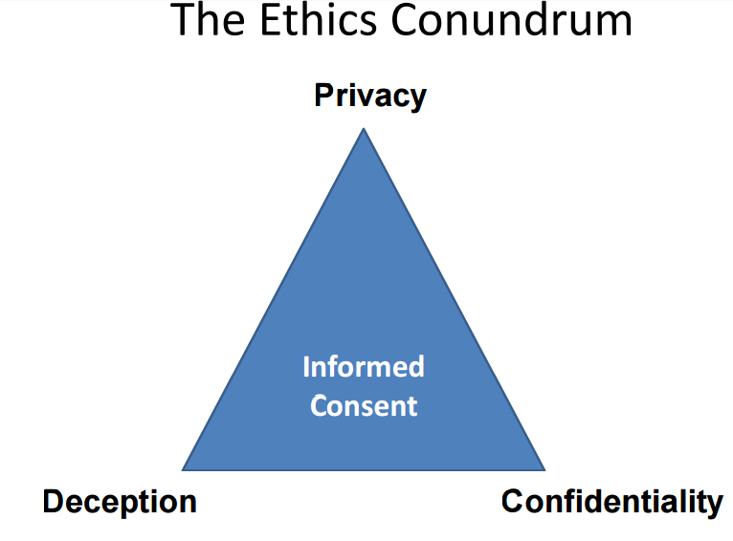

Slide 9
ESOMAR International Code on Market, Opinion and Social Research and Data Analytics
A comprehensive framework for self-regulation for those engaged in market, opinion and social research and data analytics.
Sets essential standards of ethical and professional conduct designed to maintain public confidence in research,
It ensures that researchers and analysts working with both traditional and new sources of data continue to meet their ethical,
professional and legal responsibilities to the
individuals whose data they use in research and
to the clients and organisations they serve.
Intended to safeguard the right of researchers to seek, receive and impart information

Slide 10
ESOMAR International Code on Market, Opinion and Social Research and Data Analytics
Fundamental principles
Three fundamental principles
1. When collecting personal data from data subjects for the purpose of
research, researchers must be transparent about
the information they plan to collect,
the purpose for which it will be collected,
with whom it might be shared and in what form.
2. Researchers must ensure that personal data used in research is thoroughly
protected from unauthorized access and not disclosed without the consent of
the data subject.
3. Researchers must always behave ethically and not do anything that might
harm a data subject or damage the reputation of market, opinion and social
research.

Slide 11
Responsibilities to data subjects
Duty of care
Ensure that data subjects are not harmed as a direct result of their personal data being used for research.
Exercise special care when the nature of the research is sensitive
Remain mindful that research relies on public confidence in the
integrity of research and the confidential treatment of the
information provided for its success.
4. If researchers engage in non-research activities, for example
promotional or commercial activities directed at individual data
subjects, they must clearly distinguish and separate those
activities from research.

Slide 12
Responsibilities to data subjects
Primary data collection: Researchers must :
Identify themselves promptly
State the general purpose of the research
Ensure that participation is voluntary
Inform data subjects if there is any activity that will involve re-contact and data subjects must agree to be re-contacted.
Respect the right of data subjects to refuse requests to participate in research
Allow data subjects to withdraw from the research at any time
Passive data collection should be based on the consent of the data subject .

Slide 13
Thank You

