Slide 1


Topic 7 Inferential Statistics
Dr Jugindar Singh

Slide 2

^{Inferential Statistics:} ^{Examining} ^{Relationships}
Popular inferential statistics examining relationships between variables include:
Correlations (Pearson, Spearman, etc)
Chi-square test
Simple linear regression and Multiple Regression

Slide 3
How to do a Correlation Test?
Describe the strength and direction of the linear relationship between 2 continuous variables.
Example: The correlation between examination scores and number of hours
Interested in two things:
magnitude of the relationship,
the direction of the relationship

Slide 4
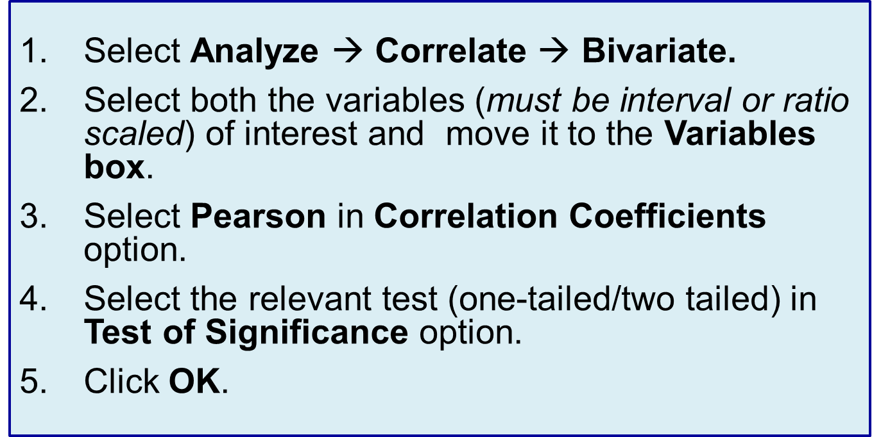
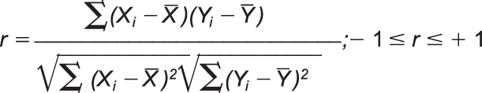
Pearson Correlation Coefficient (cont.)
The Pearson’s correlation coefficient (r) can be calculated using the formula given below:
Where,
X sample mean of X, and
Y sample mean of Y.

Slide 5
Pearson Correlation Coefficient (cont.)
H0: There is no correlation between hours spent on self-study and marks
H1: There is positive correlation between hours spent on self-study and marks
Example:
Recall our example of scores obtained by the students in the BRM course. Suppose through the survey, we also obtained the data from these 10 students on total hours per week they spent on self study for the course. A Professor believes that there is a positive relationship between the total hours spent per week on self-study and the marks obtained. The data is presented in the table.
Student | Score | Score
1 | 65 | 12
2 | 75 | 18
3 | 84 | 15
4 | 62 | 15
5 | 53 | 12
6 | 74 | 13
7 | 48 | 10
8 | 94 | 25
9 | 59 | 15
10 | 66 | 17

Slide 6
CORRELATION ANALYSIS
Pearson correlation is used to examine the strength and the direction of the relationship between all the constructs in the study.
The Pearson correlation coefficient values can vary from -1.00 to +1.00.
A correlation value of +1.00 indicates a perfect positive correlation, while a value of -1.00 represents a perfect negative correlation, and a value of 0.00 indicates no linear relationship between the X and Y variables or between two variables (Tabachnick & Fidell, 2007; Pallant, 2007).
Cohen (1988) interprets the correlation values as:
Small when the correlation value is r = .10 to .29 or r = -.10 to -.29,
Medium/moderate when the value is r = .30 to .49 or r = -.30 to -.49
Large/strong when the value is r = .50 to 1.0 or r = -.50 to -1.0 large.

Slide 7

Pearson Correlation
Used to examine relationships between two or more quantitative/numerical variables.
If they are related, we want to know how much. Is there a strong relationship between two variables or is it a weak
relationship? What is the direction of the
relationship?
The Pearson correlation tells you the strength and direction of a relationship between two quantitative/numerical variables. It ranges from negative (-1) to positive (+1) coefficient values.
Look at r value

Slide 8
Correlation

Slide 9
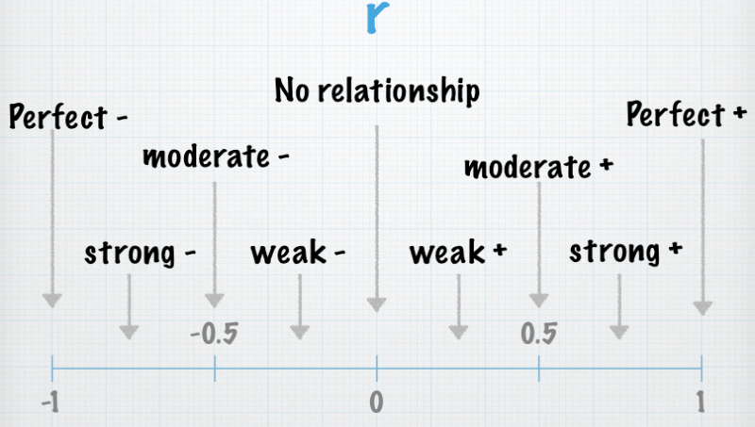
Interpret r value
Cohen (1988, pp. 79–81) suggests the following guidelines:
small r=.10 to .29
medium r=.30 to .49
large r=.50 to 1.0

Slide 10
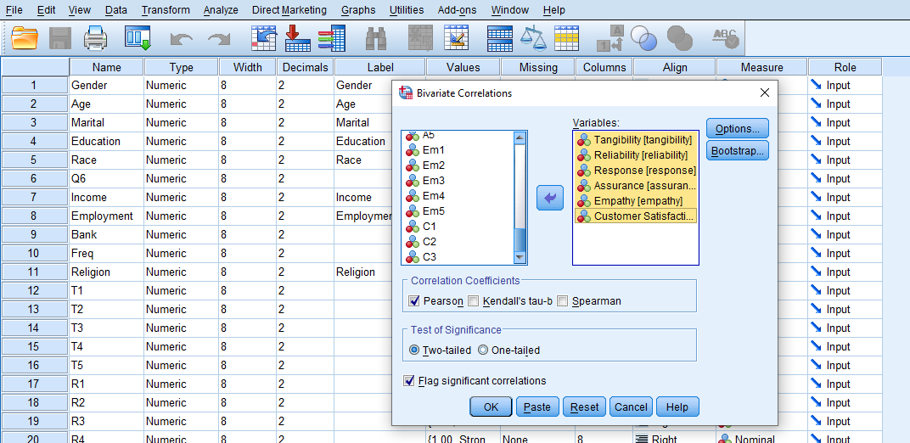
Bivariate correlation
Analyze⇒
Correlate⇒
Bivariate
Move the Variables in the ‘Variables’ box
Click OK

Slide 11
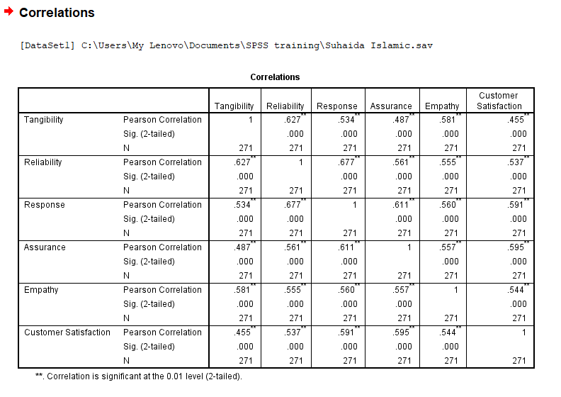
Result
R Value
Significance
Therefore Tangibles is significantly corelated with Customer Satisfaction

Slide 12
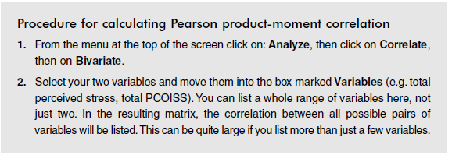
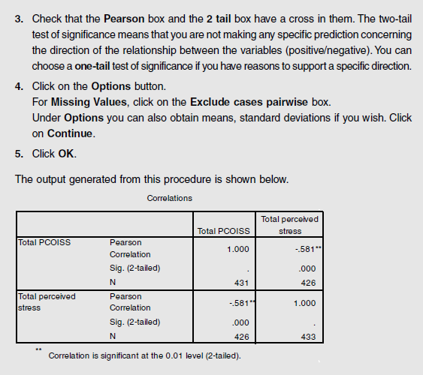
SPSS Exercise

Slide 13

MULTIPLE REGRESSION ANALYSIS
Multiple regression is a statistical technique that permits the researcher to examine the relationship between a single dependent variable and several independent variables (Tabachnick & Fidell, 2007; Hair et al., 2006).
Before conducting the multiple regression analysis, several main assumptions were considered and examined in order to ensure that the multiple regression analysis was appropriate (Hair et al., 2006).
The assumptions to be examined are as follow:
  (1) outliers,
  (2) normality, linearity and homoscedascitity,
  (3) muliticollinearity

Slide 14
Multiple Regression
It is used when we want to predict the value of a variable based on the value of two or more other variables.
The variables we are using to predict the value of the dependent variable are called the independent variables (or sometimes, the predictor variables).
Example
You could use multiple regression to understand whether exam performance can be predicted based on revision time, test anxiety and lecture attendance
Revision Time
Test Anxiety
Exam Performance
Lecture Attendance

Slide 15
What Is Linear Regression?
Linear: Straight line.
Regression: Finds the model that minimizes the total variation in the data (i.e., the best fit).
Linear Regression: Can be divided into two categories:
  Simple regression
  Multiple regression

Slide 16
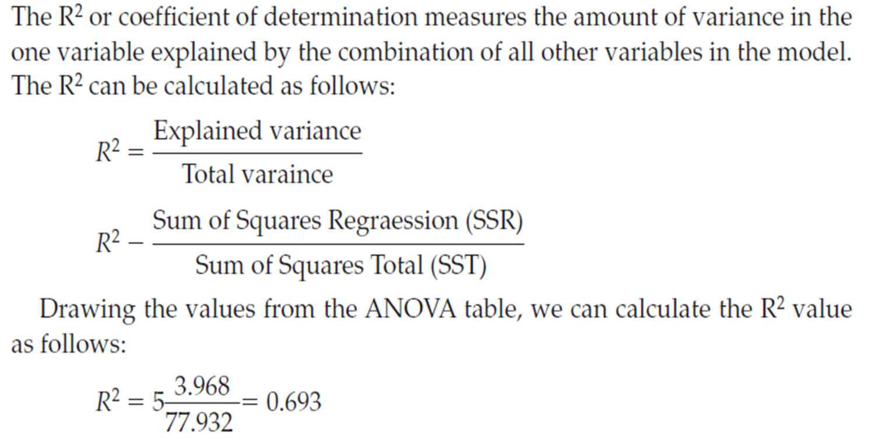
Multiple Linear Regression Analysis
Multiple regression analysis is a statistical technique that can be used to analyse the relationship between a single dependent variable (continuous) and several independent variables (continuous or even nominal).
The R² or coefficient of determination measures the amount of variance in the one variable explained by the combination of all other variables in the model.

Slide 17
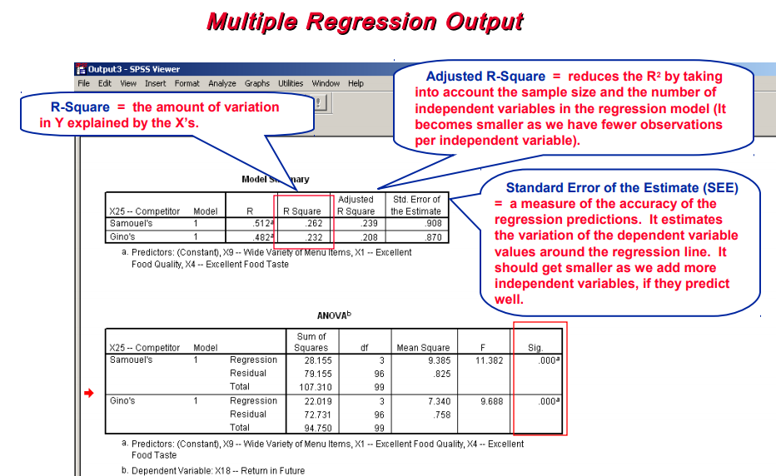
Output from SPSS
R, the multiple correlation coefficient. R can be considered to be one measure of the quality of the prediction of the dependent variable. A value of 0.760, indicates a good level of prediction.
www.statstutor.ac.uk
Notes:
The key table from the regression output in SPSS contains the slope and intercept of the regression line as well as the hypothesis tests. The coefficients of the line are in the column headed B (Unstandardised Coefficients) so the estimated regression equation is y =-6.66 + 0.36x and the slope is significant. (p < 0.001). If students are not interested in predicting using the equation, they just need to report the p-value and interpret the coefficient for the slope e.g. weight increases by 0.36 lbs for each extra week gestation. Note: 2 dp is enough when reporting

Slide 18
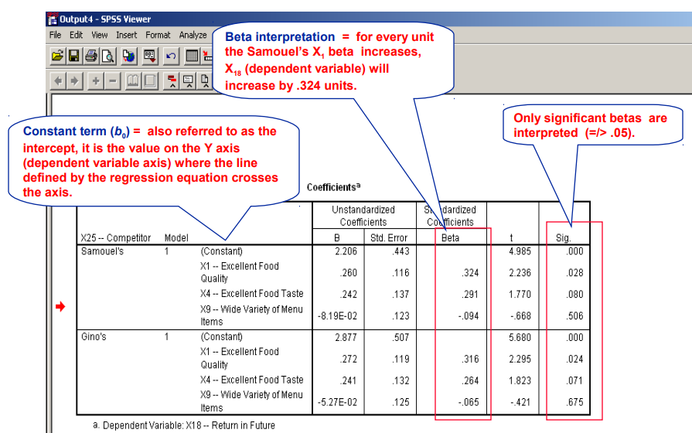

Slide 19
Linear Regression
Linear: Straight line.
Regression: Finds the model that minimizes the total variation in the data (i.e., the best fit).
Linear Regression: Can be divided into two categories:
  Simple regression
  Multiple regression

Slide 20
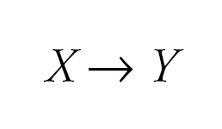
Simple Regression
Simple regression considers the relation between a single explanatory variable and response variable

Slide 21
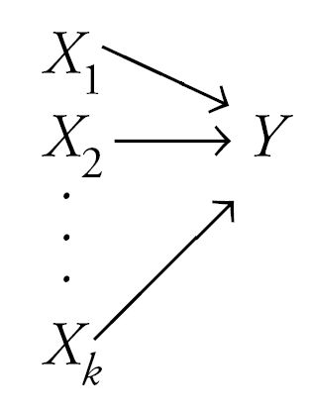
Multiple Regression
Multiple regression simultaneously considers the influence of multiple explanatory variables on a response variable Y
The intent is to look at the independent effect of each variable

Slide 22
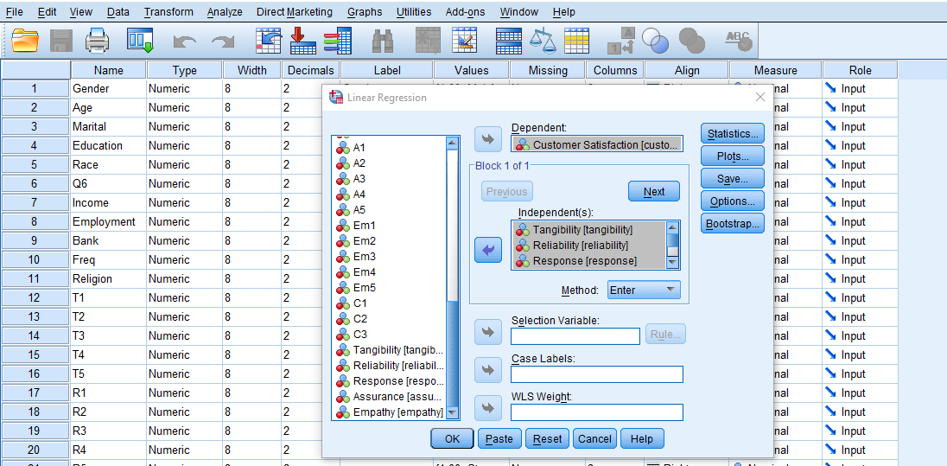
Regression Analysis
Click ‘Analyze,’ ‘Regression,’ then click ‘Linear’ from the main menu.
Move in the Dependant Variable
Move in the Independent Variables

Slide 23
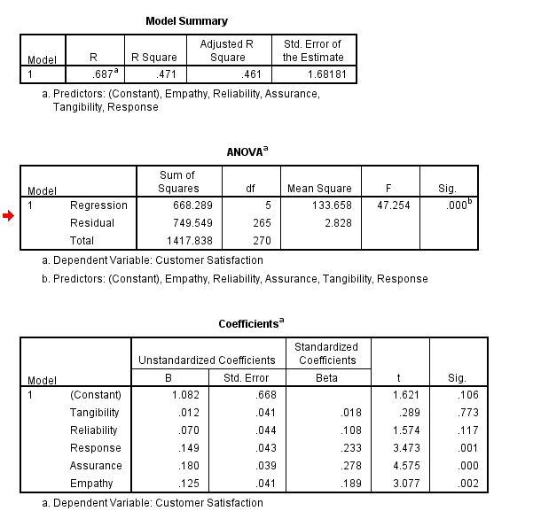
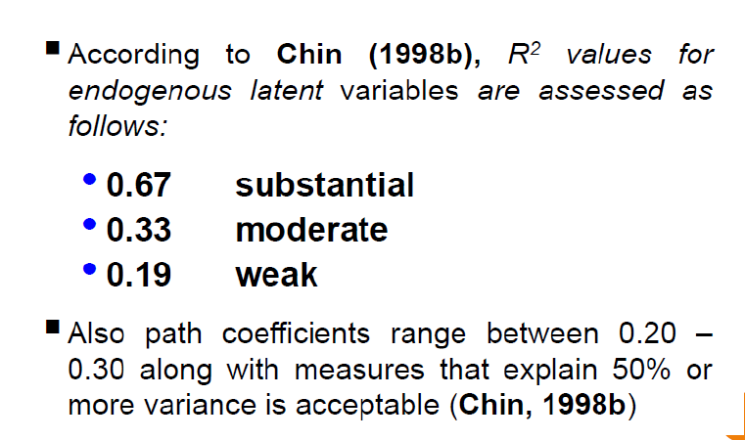
Regression Analysis
This table provides the R and R2 values. The R value represents the simple correlation and is 0.687 (the "R" Column), which indicates a high degree of correlation. The R2 value (the "R Square" column) indicates how much of the total variation in the dependent variable, Customer satisfaction, can be explained by the independent variable, 47.1% can be explained, which is very large.
R – R is the square root of R-Squared and is the correlation between the observed and predicted values of dependent variable.
R-Square – R-Square is the proportion of variance in the dependent variable which can be predicted from the independent variables. This value indicates that 47.1% of the variance in dependent variable can be predicted from the independent.
R-Square is also called the coefficient of determination.
Adjusted R-square – The adjusted R-square attempts to yield a more honest value to estimate the R-squared for the population. The value of R-square was .471, while the value of Adjusted R-square was .461

Slide 24
Regression Analysis - ANOVA
ANOVA table indicates that the regression model predicts the dependent variable significantly well.
How do we know this? Look at the "Regression" row and go to the "Sig." column.
This indicates the statistical significance of the regression model that was run. Here, p < 0.0005, which is less than 0.05, and indicates that, overall, the regression model statistically significantly predicts the outcome variable (i.e., it is a good fit for the data).
F-value is the Mean Square Regression divided by the Mean Square Residual (51.0963039), yielding F=7.25. T
P-value associated with this F value is very small (0.0000).
These values are used to answer the question “Do the independent variables reliably predict the dependent variable?”.
The p-value is compared to your alpha level (typically 0.05) and, if smaller, you can conclude “Yes, the independent variables reliably predict the dependent variable”.

Slide 25
Regression Analysis - Coefficient
B – These are the values for the regression equation for predicting the dependent variable from the IV.
These are called unstandardized coefficients because they are measured in their natural units. As such, the coefficients cannot be compared with one another to determine which one is more influential in the model, because they can be measured on different scales. For example, how can you compare the values for gender with the values for reading scores? The regression equation can be presented in many different ways, for example: Ypredicted = b0 + b1*x1 + b2*x2 + b3*x3 + b3*x3 + b4*x4
Beta – These are the standardized coefficients. These are the coefficients that you would obtain if you standardized all of the variables in the regression, including the dependent and all of the independent variables, and ran the regression. By standardizing the variables before running the regression, you have put all of the variables on the same scale, and you can compare the magnitude of the coefficients to see which one has more of an effect.
t and Sig. – If you use a 2 tailed test, then you would compare each p-value to your preselected value of alpha. Coefficients having p-values less than alpha are statistically significant. For example, if you chose alpha to be 0.05, coefficients having a p-value of 0.05 or less would be statistically significant (i.e., you can reject the null hypothesis and say that the coefficient is significantly different from 0).
The Coefficients table provides us with the necessary information to predict price from income, as well as determine whether income contributes statistically significantly to the model (by looking at the "Sig." column).

Slide 26
Regression Analysis
This table provides the R and R2 values. The R value represents the simple correlation and is 0.687 (the "R" Column), which indicates a high degree of correlation. The R2 value (the "R Square" column) indicates how much of the total variation in the dependent variable, Customer satisfaction, can be explained by the independent variable, 47.1% can be explained, which is very large.
ANOVA table indicates that the regression model predicts the dependent variable significantly well. How do we know this? Look at the "Regression" row and go to the "Sig." column. This indicates the statistical significance of the regression model that was run. Here, p < 0.0005, which is less than 0.05, and indicates that, overall, the regression model statistically significantly predicts the outcome variable (i.e., it is a good fit for the data).
The Coefficients table provides us with the necessary information to predict price from income, as well as determine whether income contributes statistically significantly to the model (by looking at the "Sig." column).

Slide 27
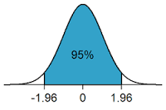
Levels of significance and Confidence
The level of significance is the predetermined level at which a null hypothesis is not supported. The most common level is p < .05
  P =probability
  < = less than (> = more than)
Significance level of 0.05 indicates a 5% risk of concluding that a difference exists when there is no actual difference.
The null hypothesis is rejected if the p-value is less than a predetermined level, α. α is called the significance level, and is the probability of rejecting the null hypothesis given that it is true (a type I error). It is usually set at or below 5%.

Slide 28
P-levels/Significance Levels
Inferential tests use probability to ascertain the likelihood that a pattern
of results could have arisen by chance.
If the probability of the results occurring by chance is below a certain
level we assume these results to be significant
C
H
A
N
C
E
P ≤0.10
P ≤0.05
P ≤0.01
P ≤0.001
We can also write these as 10%, 5%, 1%, 0.1%

Slide 29
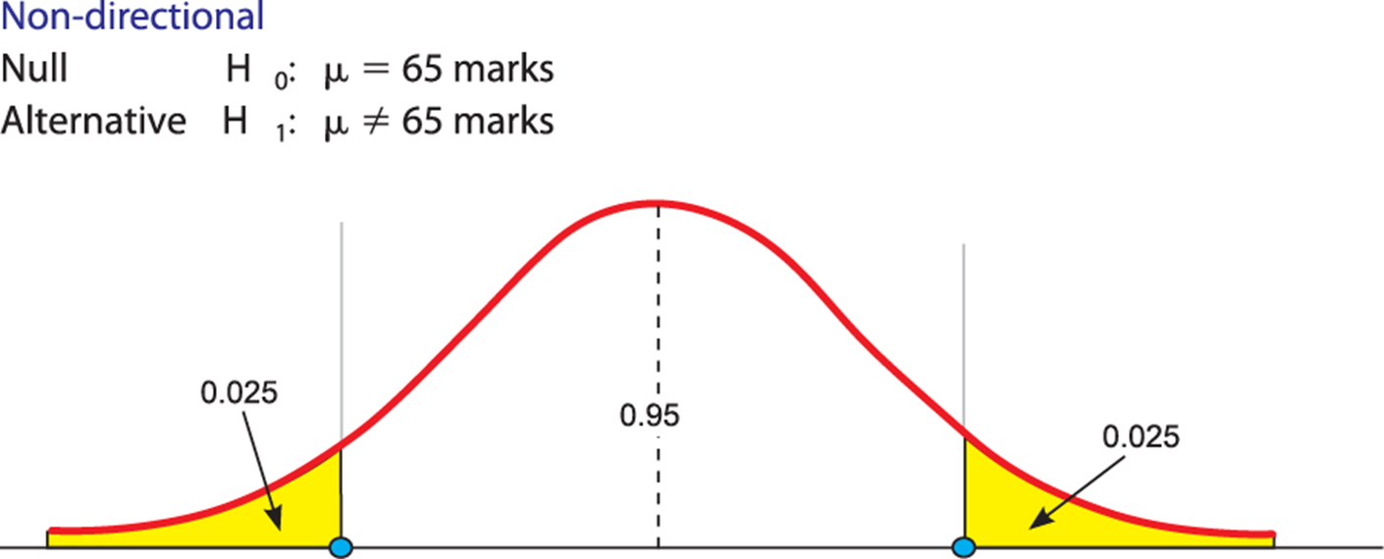
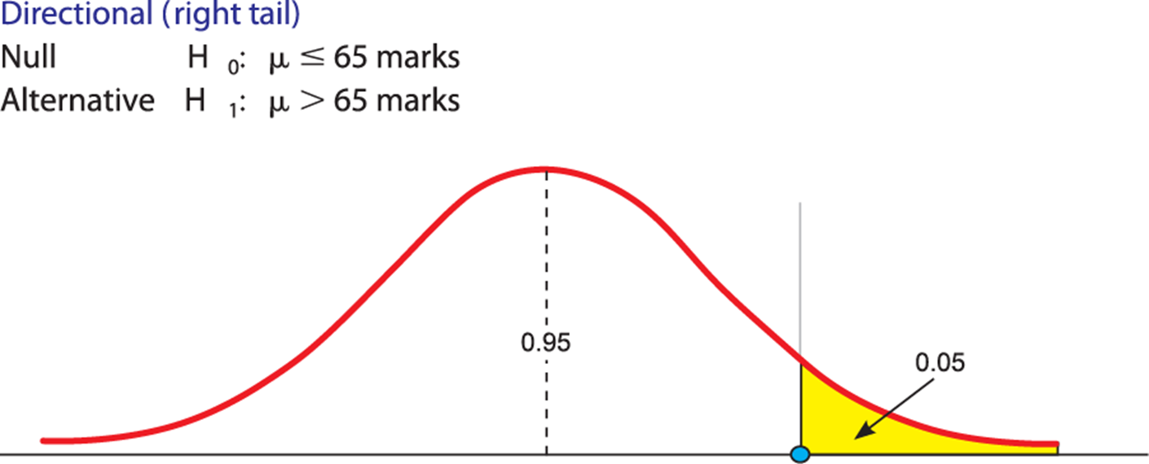
What is Hypothesis?
Hypothesis is a proposed explanation, or an educated guess made by the researcher on the basis of limited evidence.

Slide 30
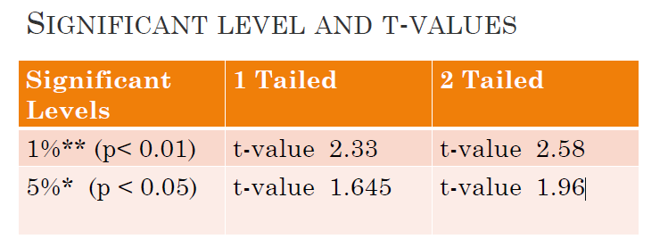

Slide 31
Assumptions
MULTIPLE REGRESSION ANALYSIS
Multiple regression is a statistical technique that permits the researcher to examine the relationship between a single dependent variable and several independent variables (Tabachnick & Fidell, 2007; Hair et al., 2006).
Before conducting the multiple regression analysis, several main assumptions were considered and examined in order to ensure that the multiple regression analysis was appropriate (Hair et al., 2006).
The assumptions to be examined are as follow:
outliers,
normality linearity and homoscedascitity, and
muliticollinearity

Slide 32
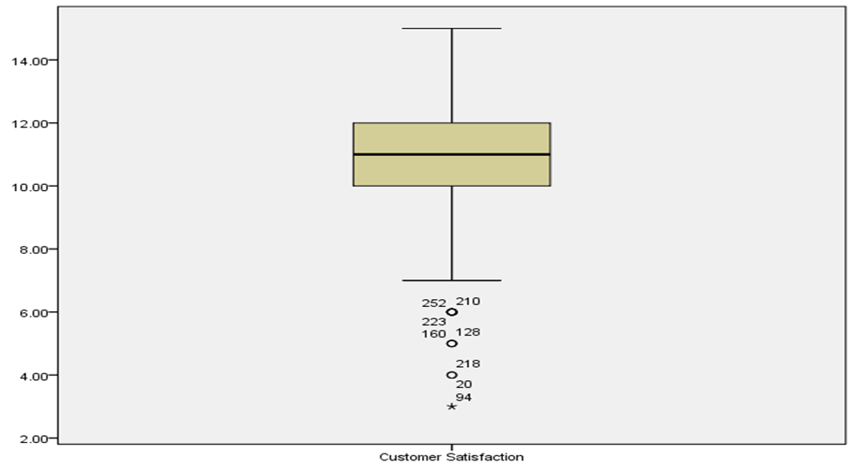
Assumptions
OUTLIERS
Need to check Data whether there are any potential outliers existing in the analysis.
Pallant (2007) noted that “multiple regression is very sensitive to outliers (i.e. very high or low score)” (p. 165).
Outliers can influence the values of the estimated regression coefficients (Field, 2005). hus, outliers should be removed before running the regression analysis (Tabachnick & Fidell, 2007).
Multivariate outliers can be detected by using statistical methods such as casewise diagnostics, Mahalanobis distance, Cook’s distance and COVRATIO (Hair et al., 2006; Tabachnick & Fidell, 2007)

Slide 33
MULITICOLLINEARITY
Multicollinearity appears “when any single independent variable is highly correlated with a set of other independent variables” (Hair et al., 2006, p. 170).
Multicollinearity was examined by inspection of the Tolerance and VIF values.
Hair et al. (2011) recommended that multicollinearity is a concern if VIF value is higher than 5 and tolerance value is <0.20

Slide 34
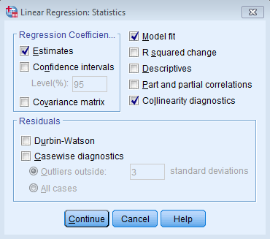
Multicollinearity and Multiple Regressions
One of the serious issues in regression is muticollinearity where two independent variables are highly correlated, generally at r > 0.8 to 0.9, and this is termed as multicollinearity.
How to Detect Muticollinearity
VIF Variance inflation factor.
  Measures the correlation and strength of correlation between the predictor variables in a regression model.
2. Tolerance:
  Proportion of a regressor’s variance not accounted for by other regressors in the model low tolerance values are an indicator of multicollinearity
Hair et al. (2011) recommended that multicollinearity is a concern if VIF value is higher than 5 and tolerance value is <0.20
According to Tabachnick & Fidell (2007) multicollinearity is problem with a correlation matrix that occur when variables are too highly correlated. With multicollinearity, the variables are very highly correlated (say, .90 and above).

Slide 35
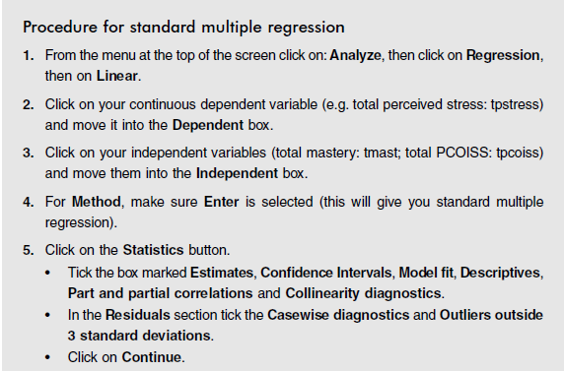
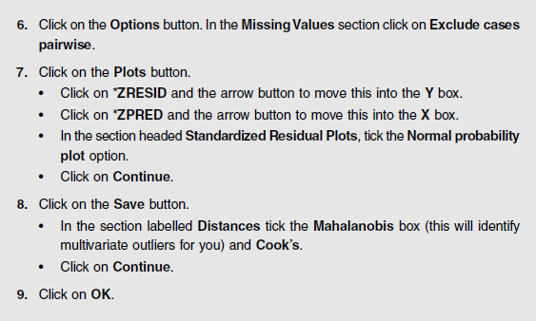
SPSS Exercise: Multiple Regression

Slide 36

T-Test and ANOVA

Slide 37

T-tests
Paired or Independent (Unpaired) Data?
T-tests are used to compare two population means
Paired data: same individuals studied at two different times or under two conditions PAIRED T-TEST
Independent: data collected from two separate groups INDEPENDENT SAMPLES T-TEST
Notes:
We are often interested in comparing two sets of data, prior to analysis you must determine whether this data is paired or independent
Paired data arises when the same individuals are studied twice. For example taken a measurement before treatment, giving treatment and then assessing the subject again.
There is another situation when paired data arises and that is when subjects have been individually matched through experimental design. Such as in a matched case control study. For example, twin studies, an eye treatment where one eye could be considered as control.
Two separate groups (independent group) require different analysis

Slide 38

T Test
One-sample
Compare one sample’s mean to a normal, typical, or population value
Does Sample average = the normal value?
Independent
Compare means of two samples which don’t directly influence each other (samples are two different groups of people or things)
Is there a significant difference in the mean customer satisfaction scores for males and females?
Dependent (or Paired)
Compare means of two samples which you expect to be connected (often, data is from the same sample at two different times)
Is there a significant change in customers satisfaction?

Slide 39
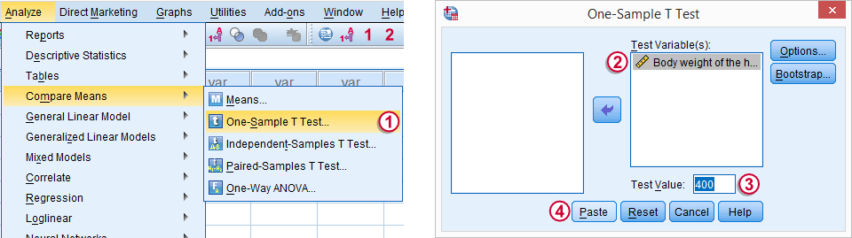
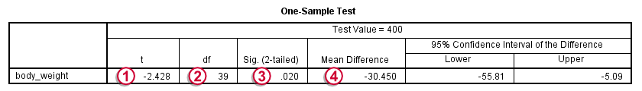
One Sample T-Test
Used for testing whether the mean of one metric variable is equal to some hypothesized population value.
Evaluates whether the mean on a test variable is significantly different from a constant (test value).
Test value typically represents a neutral point. (e.g. midpoint on the test variable, the average value of the test variable based on past research)
Example:
A lecturer from APU believes that students score for a paper is declining. It's well known that - on average – the score is around 400 points (out of 1000). The lecturer gets the score s of 40 students
Exam score

Slide 40
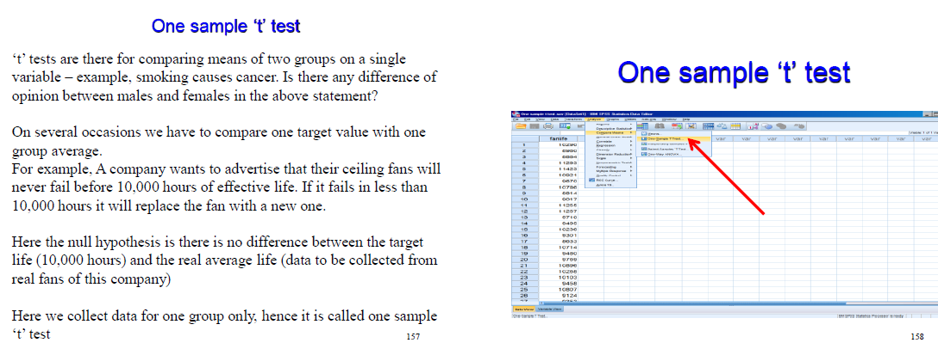
ONE SAMPLE t TEST
Use Analyze / Compare Means / One-Sample T Test

Slide 41
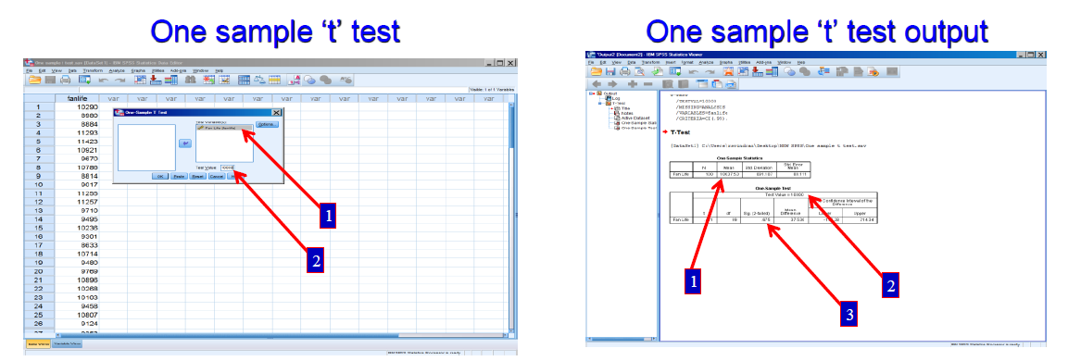
Null hypothesis accepted as the sig value is 0.675. This implies that the fans of this company has 10,000 hours of life. In fact they have slightly more hours (10,037.53 hours).
The company can go in for the advertisement confidently

Slide 42
INDEPENDENT SAMPLE T TEST
Example
Men and women may be different in customer satisfaction
Here we compare two means of two different groups on a particular variable
What you need: Two variables:
• one categorical, independent variable (e.g. males/females)
• one continuous, dependent variable (e.g. Customer satisfaction).
Conditions for t test:
1. Only two groups can be compared
2. The sample size may differ between groups
3. If there are three or more groups then perform ANOVA test

Slide 43
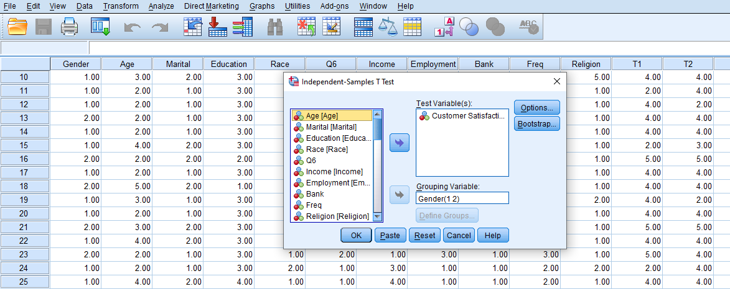
INDEPENDENT SAMPLE T TEST
Example
Men and women may be different in customer satisfaction
Analyze – Compare Means – Independent samples T-Test
Move in the Dependant Variable in the ‘Test Variable”
Move the Categorical variable in the ‘Grouping Variable”

Slide 44
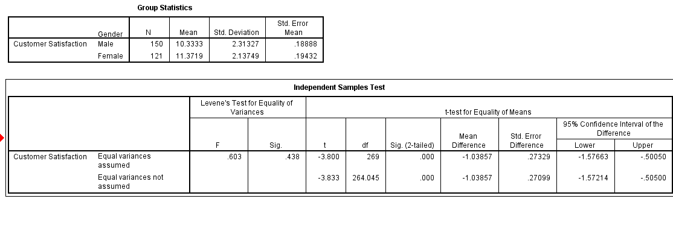
INDEPENDENT SAMPLE T TEST
Example Men and women may be different in customer satisfaction
Step 1: Checking the information about the groups
In the Group Statistics box, SPSS gives you the mean and standard deviation for each of your groups

Slide 45
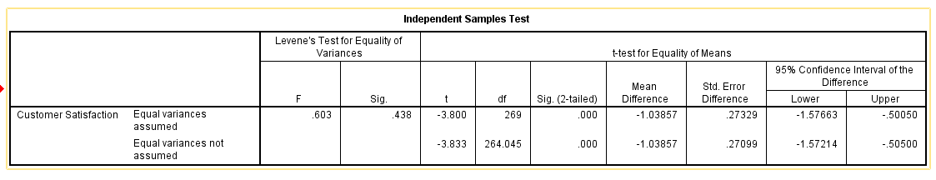
INDEPENDENT SAMPLE T TEST
Step 2: If your Sig. value for Levene’s test is larger than .05 (e.g. .07, .10) you should use the first line in the table, which refers to Equal variances assumed.
In This case, The Sig is >0.05. This means that the assumption of equal variances has not been violated; therefore, when you report your t-value, you will use the one provided in the first line of the table.
You can see that the group means are statistically significantly different because the value in the "Sig. (2-tailed)" row is less than 0.05.

Slide 46
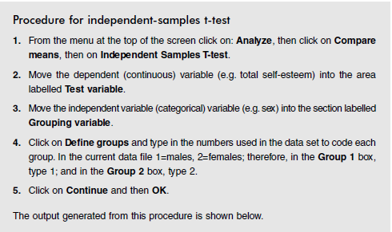
SPSS Exercise Independent sample T Test
An independent-samples t-test is used when you want to compare the mean score, on some continuous variable, for two different groups of subjects.

Slide 47
PAIRED SAMPLE t-TEST
Companies giving training for its employees. We want to know whether the training is effective or not?
To decide whether to train the remaining employees or not?
The company will continue if the training is effective otherwise no
The data is to be collected from the same respondents before and after the event or experiment. If respondents change this paired sample ‘t’ test is meaningless.
Analyze / Compare Means / Paired-Samples T Test
Procedure for paired-samples t-test
1. From the menu at the top of the screen, click on Analyze, then select
Compare Means, then Paired Samples T test.
2. Click on the two variables that you are interested in comparing for each
subject (e.g. fost1: fear of stats time1, fost2: fear of stats time2) and move
them into the box labelled Paired Variables by clicking on the arrow
button. Click on OK

Slide 48

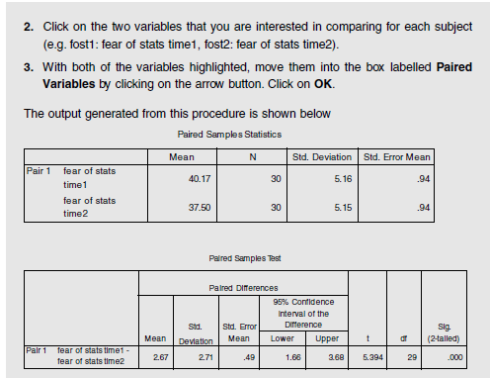
SPSS Exercise; Paired sample T test

Slide 49
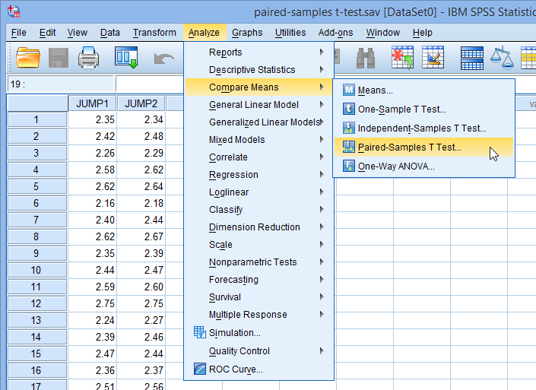
Paired sample t Test
Analyze > Compare Means > Paired-Samples T Test
Compares the means between two related groups on the same continuous, dependent variable.
Example:
Is there a significant change in participants’ Fear of
Statistics

Slide 50
Example of research question: Is there a significant change in participants’ Fear of Statistics Test scores (Time 1 and Time 2) following participation in an intervention designed to increase students’ confidence in their ability to successfully complete a statistics course?
What you need: One set of participants (or matched pairs). Each person (or pair) must provide both sets of scores.
Two variables:
• one categorical independent variable (in this case it is Time; with two different levels Time 1, Time 2)
• one continuous, dependent variable (e.g., Fear of Statistics Test scores) measured on two different occasions or under different conditions.
What it does: A paired-samples t-test will tell you whether there is a statistically
significant difference in the mean scores for Time 1 and Time 2.

Slide 51
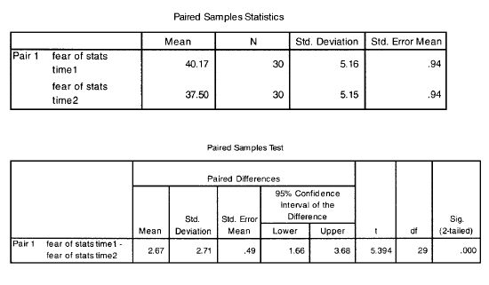
Example of research question: Is there a significant change in participants’ Fear of Statistics Test scores
Step 1: Determining overall significance
In the table labelled Paired Samples Test you need to look in the fi nal column, labelled Sig. (2-tailed)—this is your probability (p) value. If this value is less than .05 (e.g. .04, .01, .001), you can conclude that there is a significant difference between your two scores
Step 2: Comparing mean values
Which set of scores is higher (Time 1 or Time 2). To do this, look in the first printout box, labelled Paired Samples Statistics. This box gives you the Mean scores for each of the two sets of scores. In our case, the mean Fear of Stats score at Time 1 was 40.17 and the mean score at Time 2 was 37.50.
Therefore, we can conclude that there was a significant decrease in Fear of Statistics Test scores from Time 1 (prior to the intervention) to Time 2 (after the intervention).

Slide 52
ANOVA
1. One way Analysis of variance - ANOVA
Comparing the mean scores of more than 2 groups
Example: Examination scores based on 3 different age groups
2. Two way Analysis of variance - ANOVA
Two way means that there are 2 independent variables
Eg: Impact of age and gender on Examination scores
  There are 2 categorical variables: Age and Gender
  There is one continuous variable ie examination score
One-way between-groups ANOVA
Is used when you have one independent (grouping) variable with three or more levels (groups) and one dependent continuous variable. (Pallant, 2010)

Slide 53
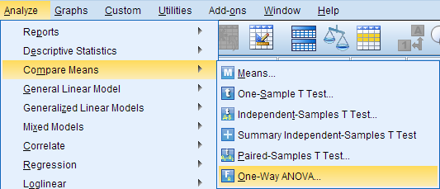
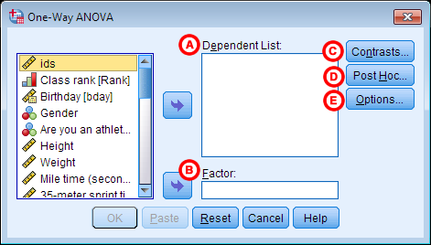
One-Way ANOVA
The One-Way ANOVA ("analysis of variance") compares the means of two or more independent groups in order to determine whether there is statistical evidence that the associated population means are significantly different.
Dependent variable that is continuous (i.e., interval or ratio level)
Independent variable that is categorical (i.e., two or more groups)
Analyze > Compare Means > One-Way ANOVA.
A Dependent List: The dependent variable(s). This is the variable whose means will be compared between the samples (groups).
B Factor: The independent variable. The categories (or groups) of the independent variable will define which samples will be compared

Slide 54
ANOVA: Example of research question: Is there a difference in customer satisfaction scores based on the age groups of participants?
Procedure for one-way between-groups ANOVA with post-hoc tests
1. From the menu at the top of the screen, click on Analyze, then select
Compare Means, then One-way ANOVA.
2. Click on your dependent (continuous) variable (e.g. Customer Satisfaction). Move this into the box marked Dependent List by clicking on the arrow button.
3. Click on your independent, categorical variable (e.g. age groups:
Move this into the box labelled Factor.
4. Click the Options button and click on Descriptive, Homogeneity of
variance test, Brown-Forsythe, Welch and Means Plot.
5. For Missing values, make sure there is a dot in the option marked Exclude
cases analysis by analysis. Click on Continue.
6. Click on the button marked Post Hoc. Click on Tukey.
7. Click on Continue and then OK

Slide 55
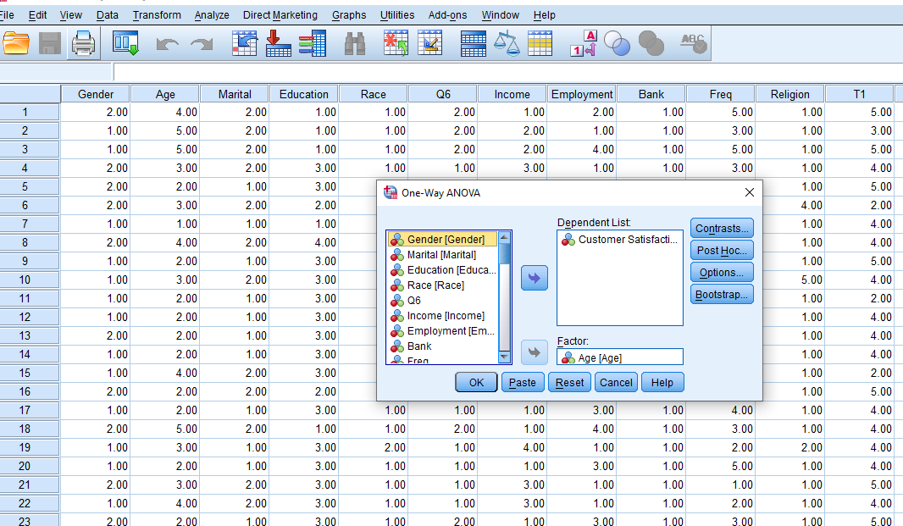

Slide 56
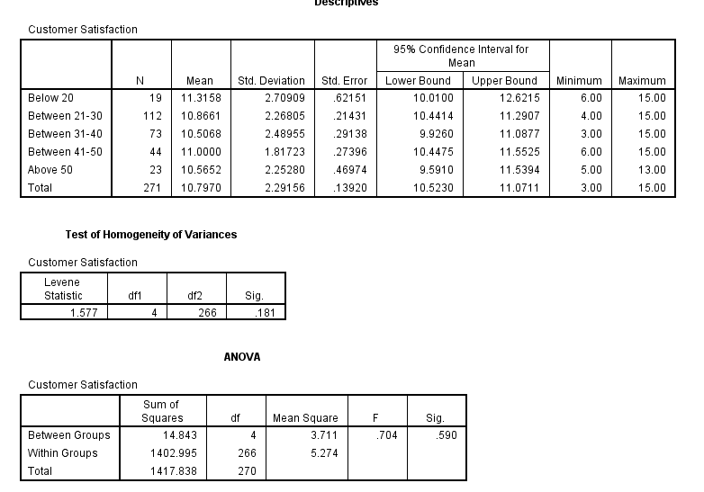
Test of homogeneity of variances
Which tests whether the variance in scores is the same for each of the age
groups.
Check the significance value (Sig.) for Levene’s test. If this number is greater than .05 (e.g. .08, .28), you have not violated the assumption of homogeneity of variance. In this example, the Sig. value is .181. As this is greater than .05, we have not violated the homogeneity of variance assumption.
If violated - Welch and Brown-Forsythe test are preferable when the assumption of the homogeneity of variance is violated.

Slide 57
ANOVA
If the Sig. value is less than or equal to .05 (e.g. .03, .001), there is a significant difference somewhere among the mean scores on your dependent variable for the age groups.
In this case NOT SIGNIFICANT

Slide 58
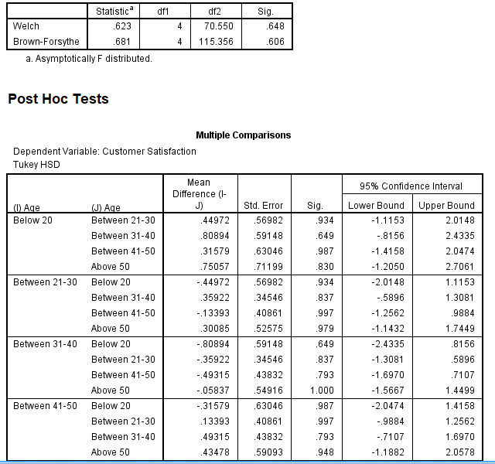
You should look at this table only if you found a significant difference in your overall ANOVA; that is, if the Sig. value was equal to or less than .05. The post-hoc tests in this table will tell you exactly where the differences among the groups occur

Slide 59
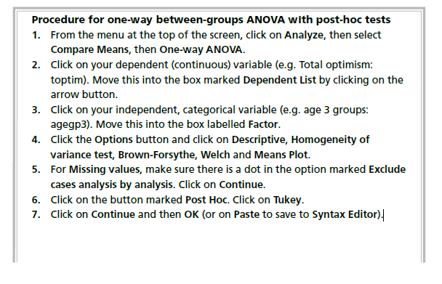
Steps One Way ANOVA

Slide 60
Two-way ANOVA Analyze- General Linear Model-Univariate
So far, our ANOVA problems had only one dependent variable and one independent variable (factor). (e.g., compare gas mileage across different brands)
What if want to use two or more independent variables? (e.g. compare compare gender and age)
We will only look at the case of two independent variables, but the process is the same for larger number of independent variables.
When we are examining the effect of two independent variables, this is called a Two-Way ANOVA.
Example of research question: What is the impact of age and gender on customer satisfaction?
Does gender moderate the relationship between age and optimism?
What you need: Three variables:
• two categorical independent variables (e.g. gender: males/females; age group)
• one continuous dependent variable (e.g. customer satisfaction).
What it does: Two-way ANOVA allows you to simultaneously test for the effect of each of your independent variables on the dependent variable and also identifies any interaction effect. For example, it allows you to test for
(a) gender differences in customer satisfaction,
(b) differences in cust. satisfaction based on age group
(c) the interaction of these two variables—is there a difference in the effect of age on optimism for males and females?

Slide 61
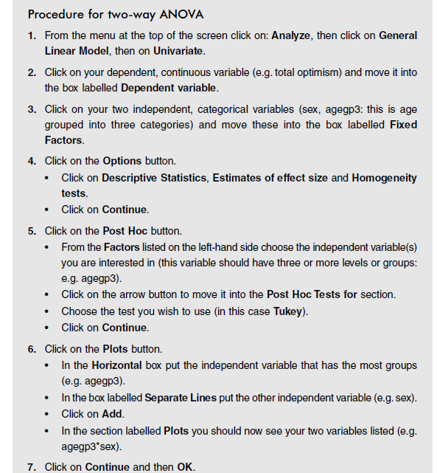
Steps Two Way ANOVA

Slide 62
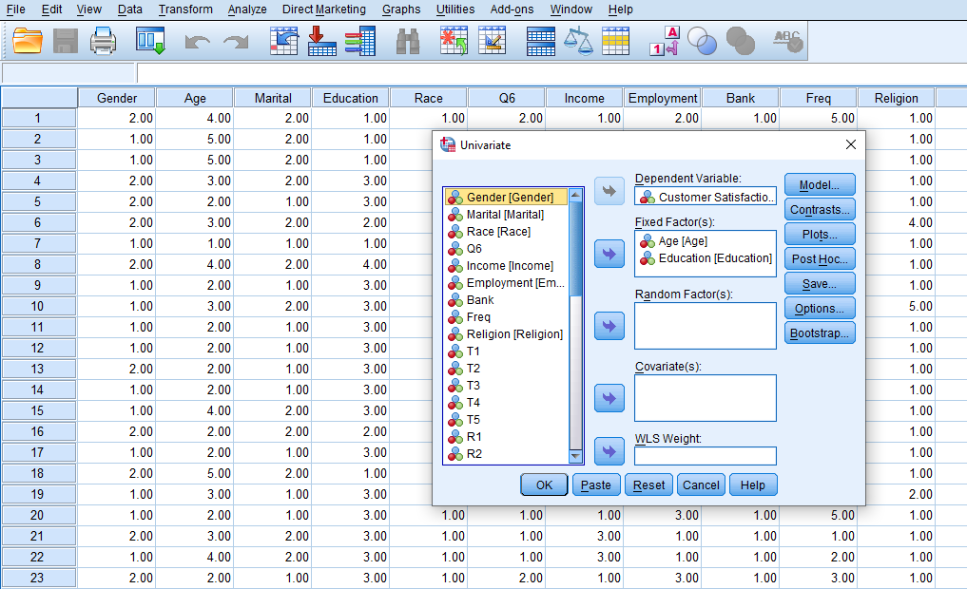

Slide 63
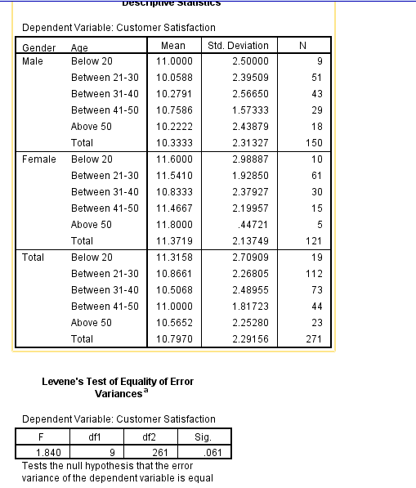
Levene’s Test of Equality of Error Variances
This test provides a test of one of the assumptions underlying analysis of variance.
The value you are most interested in is the Sig. level. You want this to be greater than .05 and therefore not significant.
A significant result (Sig. value less than .05) suggests
that the variance of your dependent variable across the groups is not equal
This study: > .05, - have not violated the homogeneity of variances assumption

Slide 64
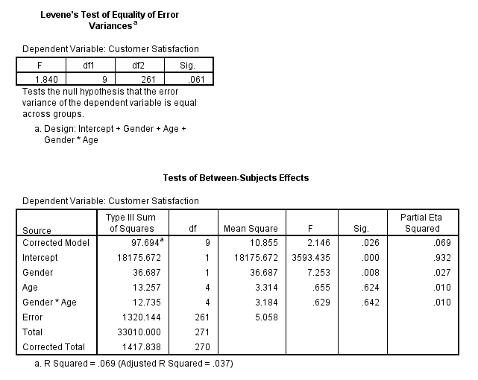
Interaction effects
Check interaction effect(e.g.
that the influence of age on customer satisfaction levels depends on whether you are male or female).
If you find a significant interaction effect, you cannot easily and simply interpret the main effects. This is because, in order to describe the influence of one of the independent variables, you need to specify the level of the other independent variable.
In the SPSS output, the line we need to look at is labelled Gender*Age. To find out whether the interaction is significant, check the Sig. column for that line. If the value is less than or equal to .05, there is a significant interaction effect.
In this study, the effect is not significant (sig. = .642). This indicates that there is no significant difference in the effect of age on customer satisfaction for males and females

Slide 65
CHI SQUARE
Non-parametric statistics

Slide 66
Chi-Square tests of independence( or relationship)
2 Categorical variables
Two variables are associated or independent of the other.
The chi-square test for independence is used to determine whether two categorical variables are related.
It compares the frequency of cases found in the various categories of one variable across the different categories of another
For example: Is the proportion of smokers to non-smokers the same for males and females?
Or, expressed another way: Are males more likely than females to be smokers?
Chi-square for independence
Example of research question: What is the relationship between gender and dropout rates from therapy?
What you need:
• one categorical independent variable (e.g., Gender: males/females)
• one categorical dependent variable (e.g., dropout: Yes/No).
You are interested in the number of people in each category (not scores on a scale).
A test to see whether a relationship (or association) exists between two nominal variables

Slide 67
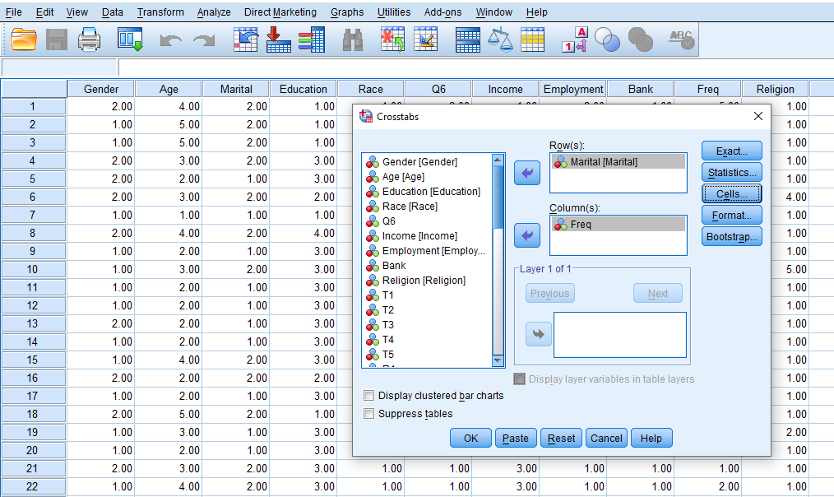
Test of Independence
Analyze/Descriptive Statistics/Crosstabs…

Slide 68
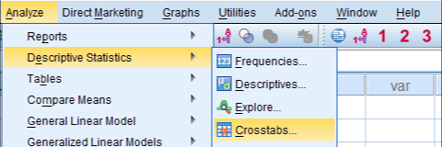
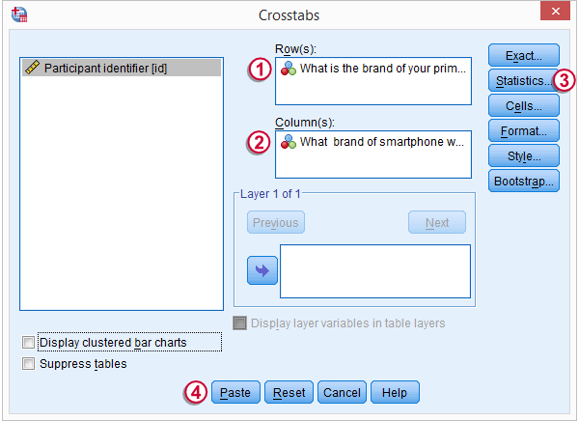
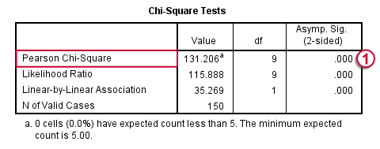
Chi-Square Independence Test
SPSS Chi-Square Independence Test is a procedure for testing whether two categorical variables are associated in any way in some population
Example:
A marketeer wants to know the relation between the brand of smartphone people use and the brand they'd like to use. She collects data on 150 respondents

Slide 69
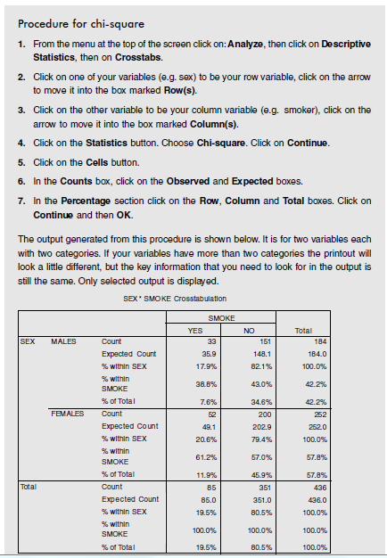
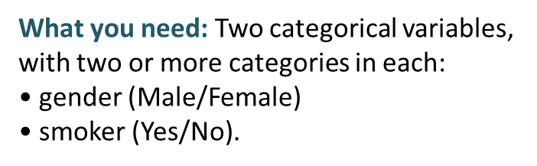

SPSS Exercise: CHI Square Test of Independence
Eg2: Is the proportion of smokers to non-smokers the same for males and females? Or, expressed another way: Are males more likely than females to be smokers?

Slide 70
SPSS Exercise: CHI Square Test of Independence
Eg: Is the proportion of smokers to non-smokers the same for males and females?
Are males more likely than females to be smokers?
The main value is the Pearson Chi-Square (Chi-Square Tests). If you have a 2 by 2 table (i.e. each variable has only two categories), however, you should use the value in the second row (Continuity Correction).
In the example presented above the corrected value is .337, with an associated significance level of .56—(Asymp. Sig. (2-sided).
To be significant, the Sig. value needs to be .05 or smaller.
In this case the value of .56 is larger than the alpha value of .05, so we can conclude that our result is not significant.

Slide 71
Tests of goodness-of-fit
Observed frequencies of one variable are significantly different from the expected frequencies of the same variable.
The chi-square for goodness of fit (also referred to as one-sample chi-square) explores the proportion of cases that fall into the various categories of a single variable and compares these with hypothesized values.
E.g. Test whether the number of smokers in the survey is equivalent is equivalent from previous study (20%)
Analyze- Non-parametric Test-Legacy Dialogs-Chi-square

Slide 72
Chi-Square Test for Goodness of Fit
Example 12.1
Let us assume for the case of a BRM class, we classify students into Pass and Fail based on the marks they obtain. Students with a score of 60 and above are considered as Pass while students with a score of below 60 are considered as Fail. The data is reported in table given.
Results | Frequency
Pass | 6
Fail | 4
Total | 10
Let us assume from the past record we know that 80% of the students pass while 20% fail in BRM course. Based on this information we need to get the expected frequencies.
Results | Frequency | Expected Frequency (Ei)
Pass | 6 | 10 X 0.8 = 8
Fail | 4 | 10 X 0.2 = 2
Total | 10

Slide 73
Chi-square test for goodness of fit
Example of research question: I will test whether the number of smokers in the survey4ED.sav data file is equivalent to that reported in the literature from a previous larger nationwide study (20%).
What you need:
• one categorical variable, with two or more categories: smoker (Yes/No)
• a hypothesised proportion (20% smokers; 80% non-smokers or .2/.8).
Procedure for chi-square test for goodness of fit
To follow along with this example, open the survey4ED.sav data file.
1. From the menu at the top of the screen, click on Analyze, then select Non-parametric Tests, then Legacy Dialogs and then Chi-Square.
2. Click on the categorical variable (smoker) and click on the arrow to move
it into the Test Variable List box.
3. In the Expected Values section, click on the Values option. In the Values box, you need to type in two values.
• The first value (.2) corresponds with the expected proportion for the first coded value for the variable (1=yes, smoker). Click on Add.
• Type in the second value (.8), which is the expected proportion for the
second coded value (2=no, non-smoker). Click on Add.
4. Click on OK

Slide 74

Chi-square test for goodness of fit
Interpretation of output from chi-square for goodness of fit
In the first table the observed frequencies from the current data fi le are presented, showing that 85 out of the 436 (19.5%) were smokers. The expected N from the
previously reported proportion specified (20%) is given. In this case, 87 cases were expected, while 85 were observed.
The Test Statistics table reports the results of the Chi-Square Test, which compares the expected and observed values. In this case, the discrepancy is very small and not
statistically significant (Asymp. Sig. = .79).

Slide 75
TEST OF GOODNESS OF FIT– CHI SQUARE
Normally with observed data (collected data), we try to fit models or forecast after applying simulated values to the model
We have to VALIDATE the model, meaning that the model works well, we have to prove
It is also called back testing
Here we compare our estimated data with the observed data
If the predicted data matches with the observed data, we say our model is perfect
If some small deviations are there (say less than 0.05) we say the model is good
If more small deviations are noted (say more than 0.05) we say the model is undependable
This test is used when you have a nominal variable with 2 or more categories and want to determine whether the proportion of individuals who fall into each category equals a set of hypothesized proportions (e.g., it might be hypothesized that individuals will fall equally into all categories).

Slide 76


A professor was interested in whether students prefer to
take classes face to face or online. A poll was taken with
100 students to determine their preference for learning.
Goodness of Fit
Run the Analysis
Analyze " Nonparametric " Legacy Dialogs "
Chi-square
Move the variable (Delivery Method) to the “Test variable list” box
Under “Expected Values,” select “All categories equal”
Click “Ok
The null hypothesis stated that the number of students who prefer to take classes face to face is equal to the number of students who prefer to take classes online. A chi-square goodness-of-fit test revealed that significantly more students prefer to take courses online (61%) compared to face to face (39%, X2 = 4.84, df = 1, p = .028). Consequently, the null hypothesis was rejected.

Slide 77


SPSS One Sample Chi-Square Test
SPSS one-sample chi-square test is used to test whether a single categorical variable follows a hypothesized population distribution
Example:
A marketeer believes that 4 smartphone brands are equally attractive. He asks 43 people which brand they prefer,

Slide 78

Thank You Done

