Slide 1
Topic 7 SPSS Data File Data Transformation
Dr Jugindar Singh

Slide 2
What is SPSS

Slide 3
APPROPRIATE SCALES AND Coding
CODING RESPONSES
Each response must be assigned a numerical code before it can be entered into IBM SPSS.
Some of the information will already be in this format (e.g. age in years); other
Variables such as Gender will need to be converted to numbers
(e.g. 1=males, 2=females).

Slide 4
Introduction: What is SPSS?
Originally it is an acronym of Statistical Package for the Social Science but now it stands for Statistical Product and Service Solutions
One of the most popular statistical packages which can perform highly complex data manipulation and analysis with simple instructions

Slide 7
How to Open a New File
Import from Excel
Create file in SPSS directly

Slide 8
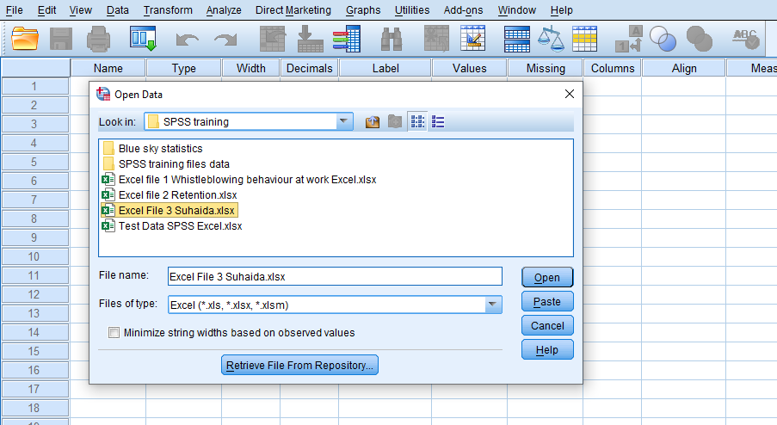
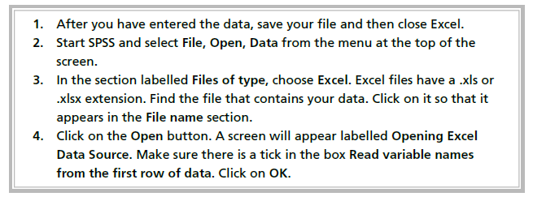
Import data from Excel
Select File Open Data
Choose Excel as file type
Select the file you want to import
Then click Open

Slide 9
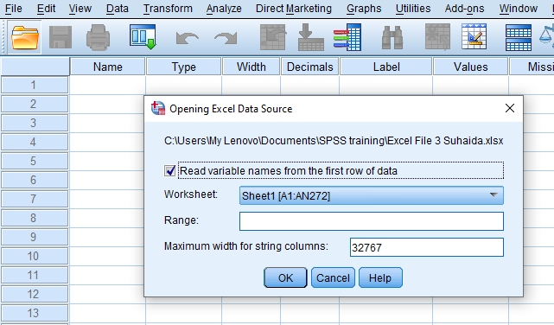
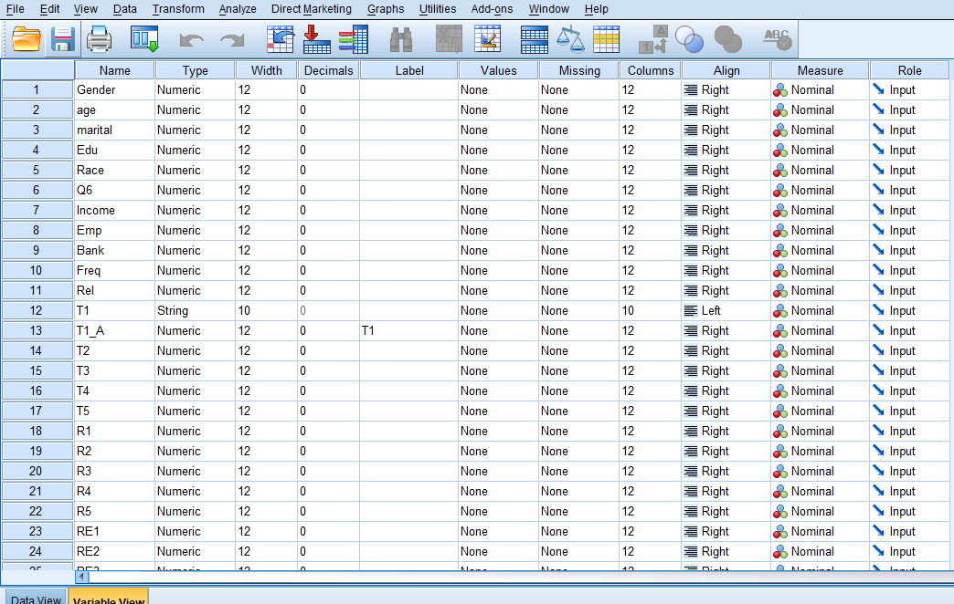
Open Excel files in SPSS

Slide 10
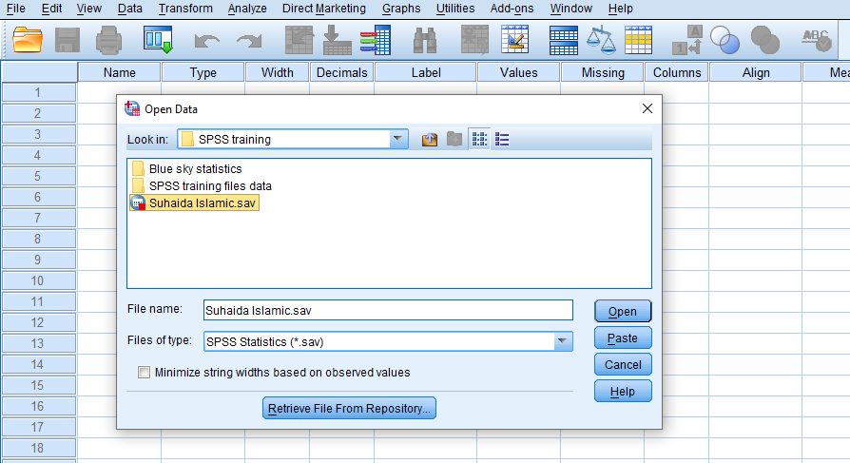
Reading Statistical data files of IBM and SPSS Data of IBM and SPSS statistical files are saved with the .sav extension
Open the “Menu” and go to “File” option.
Select “Open”.
Click on “Data”.
Search for the file sample.sav and open it.
The Data Editor displays the data in the file.

Slide 11
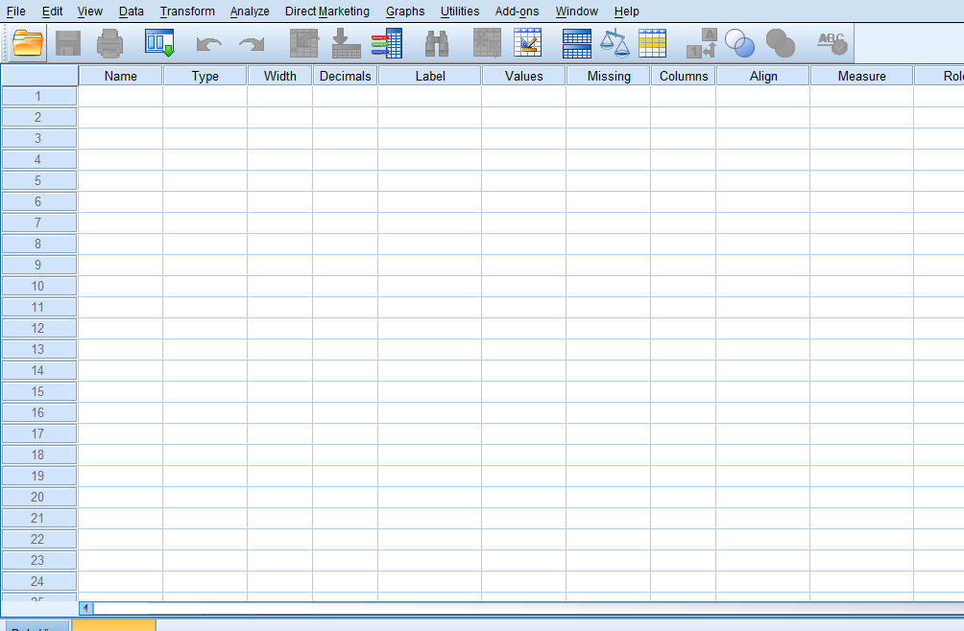
Open New File – Add data
File-New - Data

Slide 12
Menus

Slide 13
Data Editor - Creating Data in SPSS
Variable View
Data View

Slide 14
SPSS interface Data View and Variable View
Data view
The place to enter data
Columns: variables
Rows: records
Variable view
The place to enter variables
List of all variables
Characteristics of all variables

Slide 15
Columns: variables
Rows: cases
Under Data View

Slide 16
The Data View window
Data Editor comprises two screens:
Data View: the previous screen
Variable View: used to define the variables
To move between the two:
Use the View tab at the bottom of the screen OR
Ctrl + T OR
View/Variables from the Data View window
View/Data from the Variable View window
Cell edit field
Cell information
View tabs
Status bar/boxes
Notes:
SPSS is built around of a number of windows: the “Data Editor“, which comprises the “Data View“ and “Variable View” windows, and the “Output” and “Syntax” windows, which are the most important. By default, SPSS opens to “Data View” in the “Data Editor”.
Starting from the top, the “Data Editor” consists of a title bar, the “Minimize” and “Maximize/Restore” and “Close” buttons, a menu bar, a toolbar, a cell information box, a cell editor, a matrix of cells, an active cell which is highlighted in black, horizontal and vertical scroll bars, a view tab, and, at the very bottom, five status boxes appear (only three are visible in the above slide, but five appear when the software is displayed full screen).
When fully displayed, the status boxes give the following information:
- The current status of the processor, for example, running or ready
- A case counter, which counts the processing of the cases when an analysis is undertaken
- A filter status to signify that a subset of the data has been selected for analysis
- A weight status, indicating that weights have been applied to the data
- A split file status box indicating whether the data has been grouped according to a categorical variable.

Slide 17
Sample Data
Factors that influence Customer satisfaction among students of Samsung handphones in APU
Gender
1- Male
2- Female
Age Group
20-25
26-30
31-40
41-45
Above 45
M- Marital Status
1- Single
2- Married
Response
1- Strongly Disagree
2- - Disagree
3- Neutral
4- Agree
5- Strongly Agree
Demographics |  |  |  | Tangibles |  |  | Reliability |  |  | Customer Satisfaction
Gender | age | marital |  | T1 | T2 | T3 | R1 | R2 | R3 | CS1 | CS2 | CS3
2 | 4 | 2 |  | 5 | 5 | 3 | 5 | 5 | 3 | 4 | 3 | 5
1 | 5 | 2 |  | 3 | 3 | 4 | 4 | 5 | 5 | 3 | 3 | 3
1 | 5 | 2 |  | 5 | 5 | 5 | 5 | 4 | 4 | 4 | 4 | 3
2 | 3 | 2 |  | 4 | 5 | 5 | 4 | 4 | 4 | 4 | 2 | 2
2 | 2 | 1 |  | 5 | 5 | 5 | 4 | 4 | 4 | 5 | 4 | 4
2 | 3 | 2 |  | 2 | 4 | 5 | 4 | 1 | 5 | 4 | 4 | 2
1 | 1 | 1 |  | 4 | 5 | 3 | 3 | 4 | 4 | 4 | 3 | 4
2 | 4 | 2 |  | 4 | 4 | 5 | 3 | 4 | 2 | 2 | 4 | 4
1 | 2 | 1 |  | 5 | 5 | 5 | 5 | 1 | 4 | 5 | 1 | 4
1 | 3 | 2 |  | 4 | 4 | 4 | 4 | 5 | 4 | 1 | 4 | 4
1 | 2 | 1 |  | 2 | 4 | 4 | 4 | 4 | 4 | 2 | 3 | 4
1 | 2 | 1 |  | 4 | 2 | 4 | 2 | 5 | 5 | 2 | 4 | 4
2 | 2 | 1 |  | 4 | 4 | 4 | 1 | 5 | 4 | 4 | 4 | 4
1 | 2 | 1 |  | 4 | 4 | 4 | 2 | 4 | 4 | 4 | 4 | 4
1 | 4 | 2 |  | 2 | 3 | 3 | 3 | 4 | 4 | 3 | 4 | 4
2 | 2 | 2 |  | 5 | 5 | 5 | 4 | 1 | 2 | 2 | 3 | 3
1 | 2 | 1 |  | 4 | 4 | 4 | 2 | 4 | 4 | 4 | 4 | 4
2 | 5 | 2 |  | 4 | 4 | 4 | 2 | 4 | 4 | 3 | 4 | 4
1 | 3 | 1 |  | 4 | 2 | 4 | 3 | 3 | 3 | 4 | 4 | 4
H1: Tangibles are related to customer satisfaction of Samsung Handphones
H2: Reliability is related to customer satisfaction of Samsung Handphones

Slide 18
Types of data
Continuous data
Categorical data
Data that can be quantified or measured on a scale that can take an «infinite» number of values.
Examples: Age, Likert scale, Score etc.
Category/Order. Nominal (cannot be ordered).
Examples: Gender, Nationality, etc.
Ordinal (can be ”naturally” ordered).
Examples: Grades, education, pain scale, age groups, etc.
Binary data is also categorical (but with only two levels).
Examples: healty/sick, gender, smoker/non-smoker, etc.
Categorical data must be quantified to be used in a statistical analysis (SPSS can do it for us).
NOTE! In SPSS the type of data is called «measure».

Slide 19
Variable View
Variable definition
Name
Type
Width
Decimals
Label
Values
Missing
Columns
Align
Measure
Notes:
“Variable View” is used to define the variables. Each row in “Variable View” defines a single variable and corresponds to a column in “Data View”. The first row in “Variable View” corresponds to the first column in “Data View”, the second row to the second column, and so forth.
The columns in “Variable View” are variable attributes, which are introduced in the following slides and developed further in later sessions.
Describing the screen, the standard title bar and the “Minimize”, “Maximize” and “Close” buttons appear at the top. The menu bar, the toolbar, the “View” tabs, the status boxes and the horizontal and vertical scroll bars are identical to those in “Data View”. The current cell is highlighted.

Slide 20
The data entry process
Define your variables in Variable View
Enter the data, the values of the variables, in Data View
10 characteristics are used to define a variable:
Name | Values
Type | Missing
Width | Column
Decimals | Align
Label | Measure
Notes:
The two parts (Views) of the “Data Editor” are used in combination to enter data. First, variables are defined in “Variable View”. Second, the data are entered in “Data View”.

Slide 21
Name
Each variable must have a unique name of not more than 8 characters and starting with a letter
Try to give meaningful variable names:
Describing the characteristic: for example, age
Linking to the questionnaire: for example, A1Q3
Keep the names consistent across files
Notes:
The questionnaires or data collection forms used by the participants are relatively small. Meaningful variable names are therefore possible. For larger questionnaires, setting up meaningful names for each variable is time- consuming. An alternative naming strategy is to use the question numbers from the questionnaire as variable names.
It is advisable to keep variable names consistent across files. For example, calling a variable “Gender” in one file and “Sex” in another can be a cause of confusion.
For large questionnaires, it is common for information (variables) on the same case to be held in different files. Analysis involving variables from both of the files requires the files to be merged. Merging of cases is completed according to a unique identifier for each case, an identification number. The identification number appears as a variable in both files. The merge variable must have the same name in both files. If, for example, one file has a variable called “ID” as the unique identifier, while another has the variable “REFNO” as the unique identifier, one of the variables would have to be renamed before the files could be merged.
As an aside, the identification number should also be written on the physical questionnaire, thus allowing a link between the electronic information and the source questionnaire. The link to the questionnaire is essential. First, it allows all personal information, such as name and address or any other identifying characteristics to be omitted from the SPSS file. This ensures anonymity of the respondent. Second, if there are errors in the data entry process, reference has to be made to the questionnaire as the definitive source.

Slide 22
Type
Internal formats:
Numeric
String (alphanumeric)
Date
Output formats:
Comma
Dot
Scientific notation
Dollar
Custom currency
Leave it as NUMERIC
Numeric variables:
Numeric measurements
Codes
String variables contain words or characters; strings can include numbers but, taken here as characters, mathematical operations cannot be applied to them
The maximum size of a string variable is 255 characters
Notes:
“Variable type” refers to either the way the variable is stored internally by the software package or specifies the format of numeric variables when they are displayed.
“Numeric”, “String” and “Date” refer to the internal storage. “Numeric” are numbers. “String” or “Alphanumeric” are characters or words. “Date” is stored as the number of seconds from a reference time and date.
“Comma”, “Dot”, “Scientific notation“, “Dollar”, and “Custom Currency” refer to output formats for numeric variables, for example, to display $30, the variable would be of type dollar.
The participants’ questionnaires are almost entirely categorical variables. The variables will be coded, changing the categories into numeric values. In turn, the numeric values are given labels, allowing the category names to be retained. The process sounds redundant, with the obvious question being, why bother coding in the first place? Coding reduces data entry errors and exploits the computing power of the software. Coding is described in some detail in training sessions 5 and 6.

Slide 23
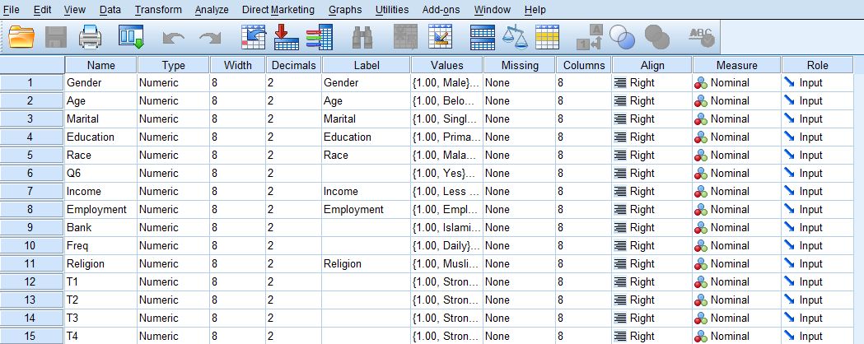
Example
Create two variables:
Gender: the gender identifier, which will be numeric with a maximum of 8 characters
Age: the age of the respondent measured in years, a discrete variable ranging between 10 and 100
Notes:
Enter the name “id” in the “Name” column of row 1 of “Variable View”.
Enter the name “age” in the “Name” column of row 2 of “Variable View”.
Note that a number of default values will appear in the remaining variable definition columns.

Slide 24
Label
Descriptors for the variables
Maximum 255 characters
Used in the output
Notes:
Meaningful labels should be attached to each variable. This is of particular importance when the variable name is not descriptive, for example, when questionnaire numbers are used as variable names. Variable names are limited to 8 characters, while the labels can be up to 255 characters. Providing meaningful variable labels will help to avoid misinterpretation.
Here the variable names are clear and can also be used as the variable labels: for example, “id” for the identifier “id” variable and “age” for “Age”.

Slide 25
Decimals
Decimals
Number of decimals
It has to be less than or equal to 16

Slide 26
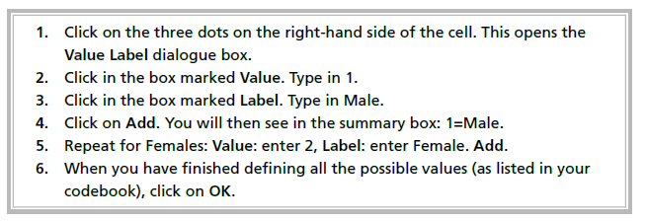
Defining the value labels
Click the cell in the values column as shown below
For the value, and the label, you can put up to 60 characters.
After defining the values click add and then click OK.
Value labels are descriptors of the categories of a variable
Coding
Example:
Gender
1=Male
2= Female
Click

Slide 27
Values
Value labels are descriptors
of the categories of a variable
Coding
Example:
Gender
1=Male
2= Female
Notes:
The “Values” column is used to define the categories of a variable. This is of particular importance when a coding scheme has been adopted. Computers work more efficiently with numbers than with words. Where there is a fixed, finite, mutually exclusive and collectively exhaustive number of responses to a question, numbers are used to represent categories, for example, 1 = Male; 2 = Female. The value labels are used to associate the numbers with the categories, that is, a value label of “Male” would be associated with the value 1 in the variable “Gender” and a value label of “Female” would be associated with the value 2 in the variable “Gender”.
The value labels are used by the software in the output as, unlike computers, people appear to understand words more easily than numbers.
Neither “ID” nor “Age” would benefit from code values being defined, as both are continuous variables with a large number of values. There is no benefit to be accrued by coding a variable like “ID”, where each case holds a unique value. There are simply too many different values and the coding would be one to one. The “Age” variable may be recoded into categories, in which case labels would be appropriate, but in their raw form, the data contain too many values to make coding appropriate.
Coding will be discussed in some detail in training sessions 5 and 6.

Slide 28
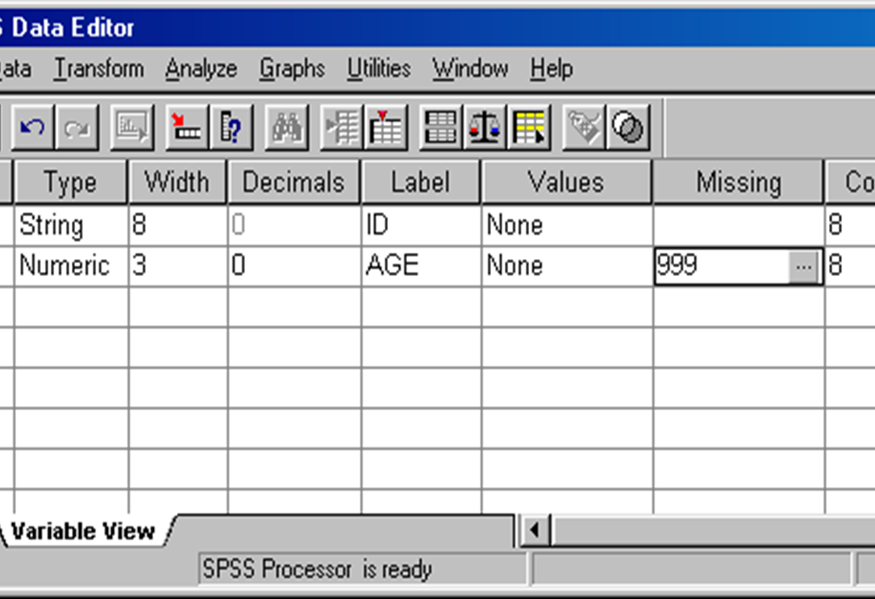
Missing
Defines missing values
The values are excluded from some analysis
Options:
Up to 3 discrete missing values
A range of missing values plus one discrete missing value
Notes:
There will undoubtedly be some questionnaires with answers missing. SPSS requires that codes be established for missing values and then treats these values in a particular manner. For example, SPSS calculates percentages in frequency tables for the data including the missing values; in addition, it calculates percentages excluding the missing values. SPSS thus provides both the percentage in that category of all responses and of all valid responses. The reasons for this are discussed in training session 8.

Slide 29
Columns and Align
Columns sets the amount of space reserved to display the contents of the variable in Data View; generally the default value is adequate
1
Align sets whether the contents of the variable appear on the left, centre or right of the cell in Data View
2
Numeric variables are right-hand justified by default and string variables left-hand justified by default; the defaults are generally adequate
3
Notes:
Trainer’s notes
Demonstrate the effect of changing these by making changes and switching to “Data View”.

Slide 30
Measure - Scale
Levels of measurement:
Nominal
Ordinal
Interval
Ratio
In SPSS, interval and ratio are designated together as Scale
The default for string variables is Nominal
The default for numeric variables is Scale
Notes:
The level of measurement is useful in determining appropriate statistical techniques and will be discussed in more detail in training sessions 8 and 9. Briefly, nominal data are qualitative data that do not display any ordering, such as gender, region and race. Ordinal data are data that have an order, but no sense of magnitude, such as level of schooling (primary, secondary and tertiary). Secondary is not twice as much schooling as primary, but it is more schooling. Interval and ratio data are continuous data that are measured with a constant scale. For example, the difference between 10 and 20 is the same as the difference between 80 and 90. Ratio data have an absolute zero, whereas interval data do not. The absolute zero makes it possible to calculate ratios. For example, income has a ratio level of measurement: 20 pounds is half as much money as 40 pounds. Temperature in Centigrade has an interval level of measurement. Twenty degrees Centigrade is not half as hot as 40 degrees Centigrade. Money has an absolute zero, whereas 0 degrees Centigrade is not the absence of temperature, it is simply a point on the scale that has been labelled 0.
The defaults are fine here. SPSS uses these designations in some of the charting procedures and “Answer Tree” procedures. The decision as to suitable statistical techniques is up to the user. Training session 8 will describe how to use the level of measurement as a guide to which statistical techniques are appropriate.

Slide 31
Variable View window
Name -- the unique variable name
Type -- the kind of data to be recorded (e.g., strings of characters, numeric values, or special numbers like dates)
Width -- the number of characters used
Decimals -- the number of decimal places displayed
Label -- a text entry to describe the data provided by the variable, which can be much longer than the variable name and may include spaces. With questionnaires, for example, the label is usually the text of the question.
Values -- if specific numeric values have a non-intuitive meaning, these values can be labeled (e.g., 1 = male and 2 = female)
Columns -- determines how wide the variable column should be in Data View mode
Align -- determines whether the data should be left-justified, right-justified, or centered
Measure -- describes the level of measurement (nominal, ordinal, or scale)
This sheet contains information about the data set that is stored with the dataset
Name
The first character of the variable name must be alphabetic
Variable names must be unique, and have to be less than 64 characters.
Spaces are NOT allowed.
Click

Slide 32
Variables
1. NAME
The name of the variable, which is used to refer to that variable in syntax. Variable names can not contain spaces. To change a variable's name, double-click on the name of the variable that you wish to re-name. Type your new variable name.
2. TYPE
The type of variable (e.g., numeric, string, etc.).
3. WIDTH
The number of digits displayed for numerical values or the length of a string variable.
4. DECIMALS
The number of digits to display after a decimal point for values of that variable. Does not apply to string variables. Note that this changes how the numbers are displayed, but does not change the values in the dataset.
4. LABEL
A brief but descriptive definition or display name for the variable. When defined, a variable's label will appear in the output in place of its name.

Slide 33
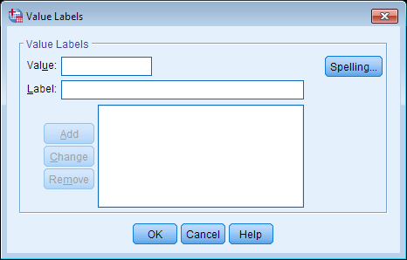
Variables
5. VALUES
For coded categorical variables, the value label(s) that should be associated with each category abbreviation. Value labels are useful primarily for categorical (i.e., nominal or ordinal) variables, especially if they have been recorded as codes (e.g., 1, 2, 3). It is strongly suggested that you give each value a label so that you (and anyone looking at your data or results) understands what each value represents.
6. COLUMNS
The width of each column in the Data View spreadsheet. Note that this is not the same as the number of digits displayed for each value. This simply refers to the width of the actual column in the spreadsheet.
To set a variable's column width, click inside the cell corresponding to the “Columns” column for that variable. Then click the “up” or “down” arrow icons to increase or decrease the column width.
7. ALIGN
The alignment of content in the cells of the SPSS Data View spreadsheet. Options include
left-justified, right-justified, or center-justified.
To set the alignment for a variable, click inside the cell corresponding to the "Align" column
for that variable. Then use the drop-down menu to select your preferred alignment: Left,
Right, or Center.
8. MEASURE
The level of measurement for the variable (e.g., nominal, ordinal, or scale).
Some procedures in SPSS treat categorical and scale variables differently. By default, variables with numeric responses are automatically detected as “Scale” variables. If the numeric responses actually represent categories, you must change the specified measurement level to the appropriate setting.

Slide 34
Data View
Notes:
Note that entering data is simply a matter of entering a value and pressing the Enter key or entering a value and using the Arrow keys. There is no difference in entering text or numbers.
Note that the variable “ID” is a string variable and so left-hand justified. The variable “Age” is a numeric variable and so right-hand justified.
The identifier is a unique number for each observation. The identifier above has the prefix “DAP1”, referring to a specific data collection point, followed by a unique number. Identifiers are frequently composite numbers, different parts referring to, for example, interviewer, province, region, treatment centre, and so forth. When deciding on the format of the identifier, be certain not to include any information that would make it possible to identify the respondent. Information in the data file should be anonymous.
The simplest identifier would be consecutive numbers and the simplicity of this method often outweighs the benefits of composite identifiers.

Slide 35
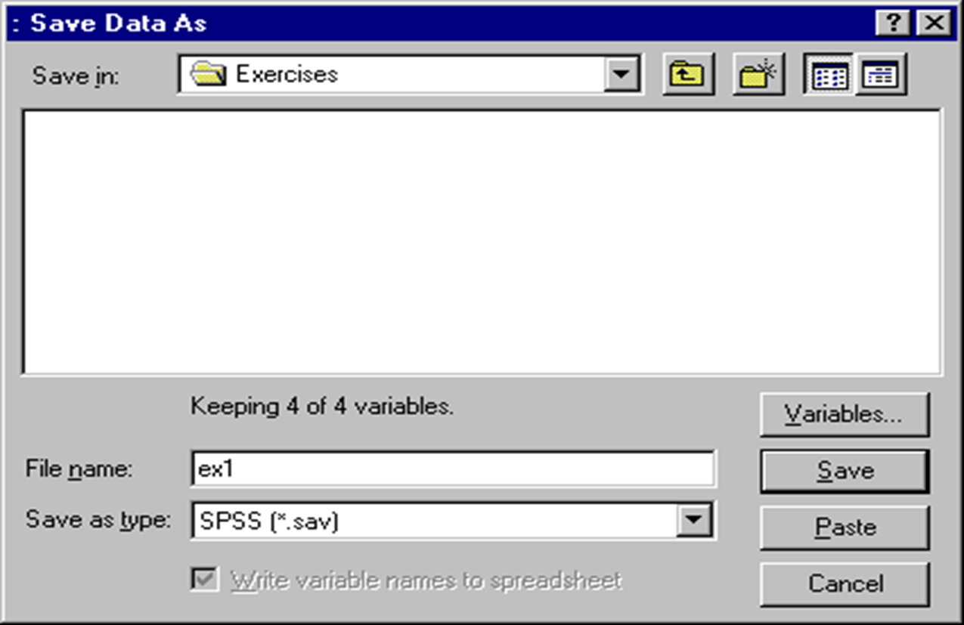
Saving the file
The file must always be saved in order to save the work that has been done to date:
File/Save
Move to the target directory
Enter a file name
Save
Notes:
Follow the sub-points to save the file.
Trainer’s notes
Illustrate the process and ensure participants are saving data to the appropriate directory.

Slide 36
How to Transform Data

Slide 37
Data Transformation
A process of changing the original data to a new format.
Summated scores
Measurement scales that consist of both negatively and positively worded statements (reverse code the questions).
Birth date needs to be transformed into real age of the respondents.
Summated and Average Summated Score using SPSS
Select Transform Compute Variable
Type the variable name in the box labelled Target Variable
Click on parentheses to place in Numeric Expression box
Highlight first variable of interest and click on arrow box
Click on “” sign
Repeat (4) and (5) unless all variables of interest are placed in Numeric
Expression box
Click OK to get the summated score (skip step 7 if interested in average summated score)
Click on the cursor to place it after parentheses and then click slash “/” sign
Click on required number (the required number is total number of variables in Numeric Expression box)
Click OK to get the average summated score

Slide 38
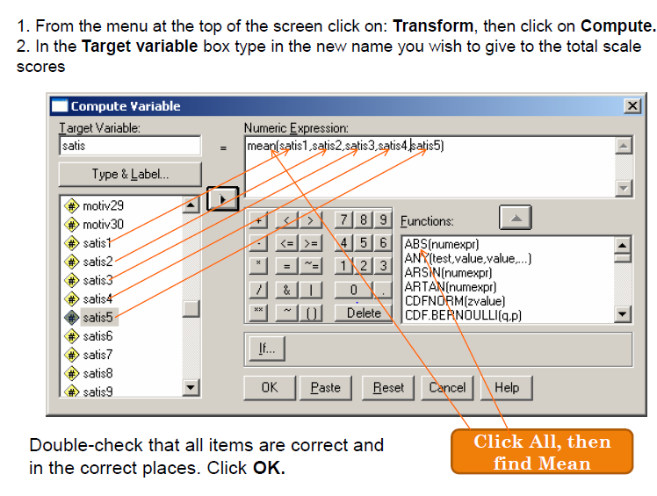
Transforming data

Slide 39
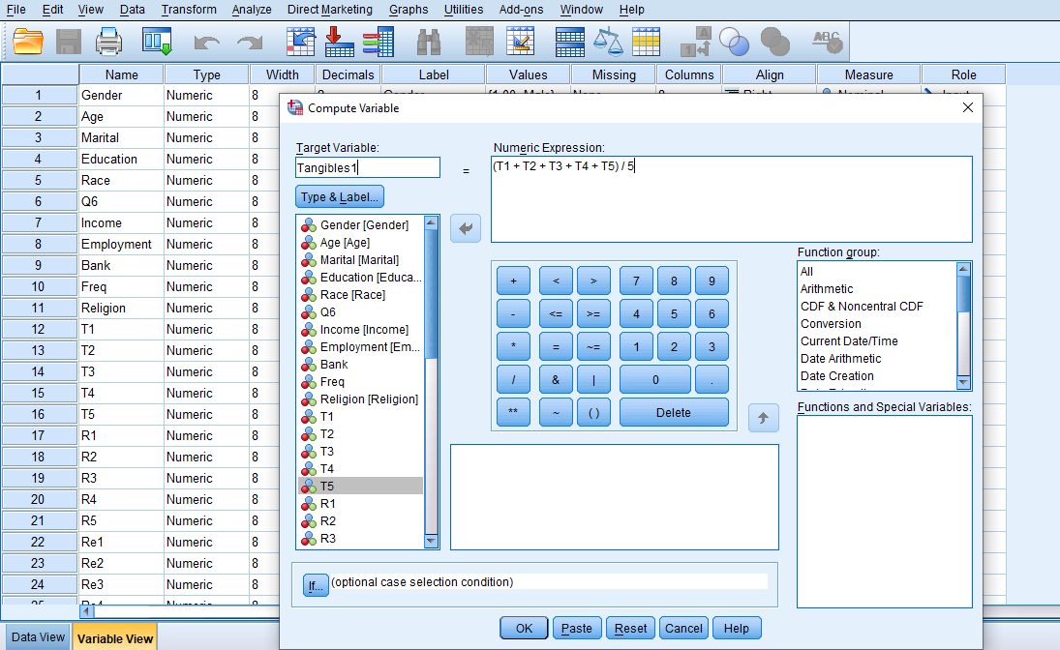
Transforming data
Click ‘Transform’ and then click ‘Compute Variable…’
For each Variable – Move the Questions to the Numeric Expression Box
Type name of Variable in Target Variable Box
Press OK
Move in the Questions

Slide 40
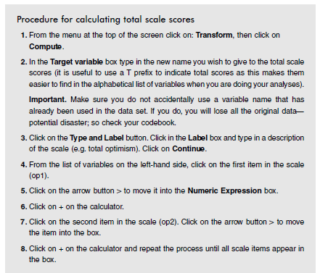
Transforming: Adding total scores

Slide 41
Thank You

