Slide 1
Composing Literature Review
Dr Jugindar Singh

Slide 2
Writing a Literature Review
Draw up your outline
Get writing

Slide 3
Draw up your outline
Decide on your structure and develop a detailed outline before you write anything.
Your literature review chapter needs to present a clear, logical and an easy to follow narrative
Decide whether you’ll lay out your review thematically (into themes) or chronologically (by date/period)
Draw up an outline of your entire chapter

Slide 4
Writing - Descriptive OR Analytical
Descriptive
Summarizes what other people have found without saying what these findings mean for your investigation.
Usually, a chronological list of who discovered what, and when.
For example:
"Green (1975) discovered …."
"In 1978, Black conducted experiments and discovered that …."
"Later Brown (1980) illustrated this in ……"
Analytical
Synthesizes the work and succinctly passes judgement on the relative merits of research conducted in your field.
Reveals limitations or recognises the possibility of taking research further, allowing you to formulate and justify your aims for your investigation.
For example:
There seems to be general agreement on x, (see White 1987, Brown 1980, Black 1978, Green 1975). However, Green (1975) sees x as a consequence of y, while Black(1978) puts x and y as …. While Green's work has some limitations in that it …., its main value lies in …."

Slide 5
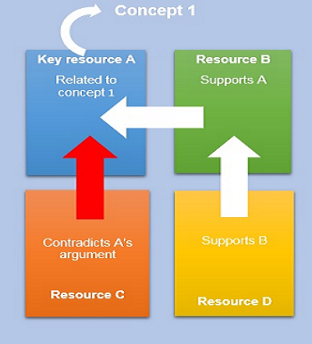
Analysis and synthesis
Example of analysis and synthesis
After reading and analysing individual sources, you have identified a key concept relating to your research topic as well as a key resource (A) relating to that concept.
The argument in resource A is supported by another article (B), which is in turn supported by article (D).
However, you have also found article C, which contradicts the argument presented in resource A.
One way to synthesise these texts, is to group together the texts supporting your key resource (articles B and D) and explain that article C presents contradictory results. Then, you would need to examine the methodological differences or any other possible reasons for the contradictory results.
Analysis and synthesis may appear to be two opposing methods: ‘Analysis involves systematically breaking down the relevant literature into its constituent parts,
Synthesis is the act of making connections between those parts identified in the analysis’ (Bloomberg & Volpe, 2012, p.84).
In a literature review, however, you will notice the synergy between analysis and synthesis
After analysing a range of sources, you should synthesise the relevant sources, connecting, linking and positioning them against each other, in order to identify the recurring themes, trends and areas of agreement or disagreement within your research field.

Slide 6
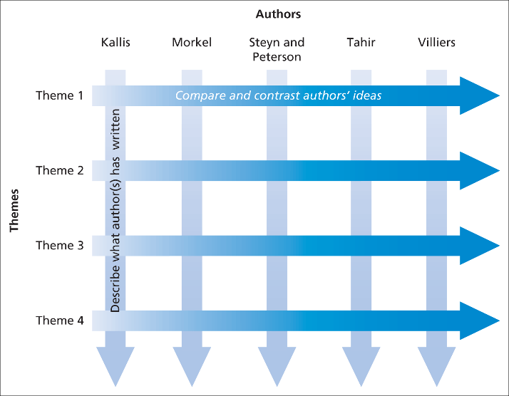
Effective review should:
Summarize and evaluate findings
Compare and contrast different authors’ views to
Group authors who draw similar conclusions, and
Note areas where authors are in disagreement
Highlight exemplary studies
Note gaps in knowledge
Remember:
Cite
Categorize
Compare
Contrast
Criticize - Synthesis

Slide 7
Key Components of Lit. Review (Chapter 2 – Quantitative study)
Constructs/Concepts definition of concepts, different views of the concepts relationship of the concept to others | Relationships/Hypothesis Findings from related studies Relationship bet variables Comparison bet findings | Models Theories Underpinning theories
Summary
Cite Compare Contrast Criticize Connect
Disagreements
Inconsistencies
Controversies
Debates
Argument

Slide 8
Define the Constructs
Example
Example: Customer satisfaction
Thomasson (2003, p. 69) defines customer satisfaction as “the perception of the customer as a result of consciously or unconsciously comparing their experiences with their expectations.” Kotler & Keller (2008, p. 80) build on this definition, stating that customer satisfaction is determined by “the degree to which someone is happy or disappointed with the observed performance of a product in relation to his or her expectations.” Performance that is below expectations leads to a dissatisfied customer, while performance that satisfies expectations produces satisfied customers. Expectations being exceeded leads to a “very satisfied or even pleasantly surprised customer” (Kotler & Keller, 2003, p. 80). The definition of Zeithaml and Bitner (2003, p. 86) is slightly different from that of Thomassen: “Satisfaction is the consumer fulfillment response. It is a judgement that a product or service feature, or the product of service itself, provides a pleasurable level of consumption-related fulfillment.” Zeithaml and Bitner’s emphasis is thus on obtaining a certain satisfaction in relation to purchasing.

Slide 9
Example: Customer satisfaction
Oliver’s (1997, p. 13) definition of customer satisfaction as “a judgment that a product or service feature, or the product or service itself, provided (or is providing) a pleasurable level of consumption-related fulfillment”. Customer satisfaction is the feeling or attitude you have when your needs as a customer are fulfilled and meeting the customer’s expectations for key service quality attributes lead to overall satisfaction with service. A satisfied customer will repeat the purchase of the product and, will tell other potential customers positive things about the service (Patterson and Spreng, 1997; Metawa and Almossawi, 1998). Consequently, satisfaction is considered an antecedent of future intentions (Cronin and Taylor, 1992). In turn, measuring customer satisfaction can provide managers with relatively reliable
indicators of future customer support for their services.
Achieving customer satisfaction is a vital target for most service firms today (Jones and Sasser, 1995) as it leads to improved profits, word of mouth, and less marketing expenditure (Al-Hawari and Ward, 2006). Many empirical studies in the literature have found a positive relationship between customer satisfaction and financial performance (Wiele et al., 2002; Yeung et al., 2002). ……

Slide 10
The Theorized Relationship among Variables in the Study
Example
As a researcher, you should be able to expect how these variables relate to each other in a logical manner.
Example: Service Quality and Customer satisfaction
Research on customer satisfaction is often closely associated with the measurement of service quality (Jamal and Naser, 2002). A number of studies in the services marketing literature have reported that these two constructs are strongly related (Alexandris et al., 2001; Caruana, 2002; Spreng and Chiou, 2002). There is strong support that service quality and satisfaction are distinct constructs and that there is a causal relationship between the two (McDougall and Levesque, 1994). Some researchers and academics described that customer satisfaction is an antecedent of service quality (Parasuraman et al., 1985, 1988, 1991, 1994; Carman, 1990; Bitner, 1990), and others have counterargued that the service quality as an antecedent of customer satisfaction (Cronin and Taylor, 1992, 1994; Bolton and Drew, 1991; Anderson and Sullivan, 1993) and that service quality is not equivalent to satisfaction (Oliver, 1980)…….Based on the review it is posited that:
H1: There is a relationship between service quality and customer satisfaction

Slide 11
Theories
Theories are developed by researchers to explain phenomena, draw connections, and make predictions. In the theoretical framework, you explain the theories that support your research, showing that your work is grounded in established ideas.
Example: SERQUAL Model The SERVQUAL model has provided a comprehensive conceptualization of service quality with an instrument to measure perceived service quality. This method has been very popular with academics and researchers to assess the customer perception of service quality for a variety of service industries.
The five dimensions of service quality include:
1.Tangibles (appearance of physical components);
2.Reliability (dependability of service provider);
3.Responsiveness (promptness and helpfulness);
4.Assurance (knowledge and courtesy of employees and their ability
5.Empathy (caring, individualized attention the firm gives its customers).

Slide 12
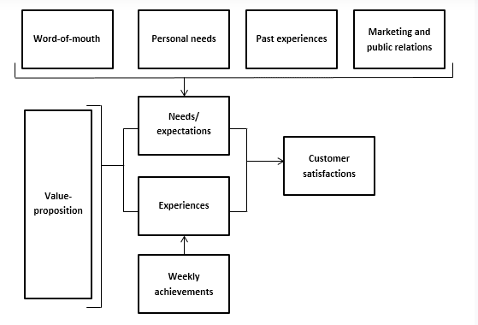
Theories
Thomassen’s Customer Satisfaction Model
According to Thomassen, both the so-called value proposition and other influences have an impact on final customer satisfaction. In his satisfaction model (Fig. 1), Thomassen shows that word-of-mouth, personal needs, past experiences, and marketing and public relations determine customers’ needs and expectations. These factors are compared to their experiences, and this comparison between expectations and experiences determines a customer’s satisfaction level. Thomassen’s model is important for this study: it allows us to determine both the extent to which company X’s customers are satisfied and where improvements can be made.

Slide 13
Some general guidelines
Start with the MOST RECENT and WORK BACKWARDS to the oldest. Many books suggest using a five-year span from the present for sufficient coverage.
Read through abstracts to identify if an article would be good
Believe it or not, some professors actually start with a GOOGLE search or even with WIKIPEDIA to get a general idea about a field.
Look for MAJOR figures in the field and MAJOR studies/articles.

Slide 14
5Cs of Literature Writing

Slide 15
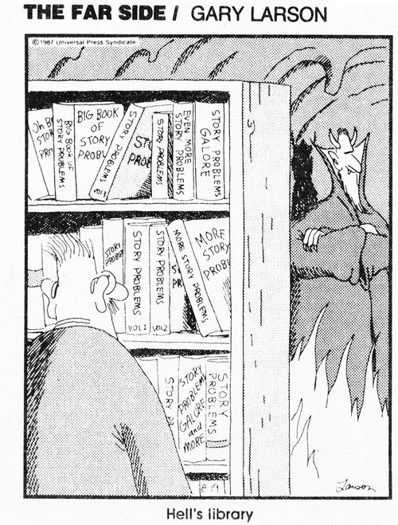
The 5Cs
Cite:
Compare
Contrast
Critique
Connect
To help you frame and write your literature review, think about these five c’s (Callahan, 2014)

Slide 16
The 5Cs
Cite:
Keep the primary focus on the literature. APA Style 7 Ref. APA referencing and Verbs for citations
https://www.port.ac.uk/student-life/help-and-advice/study-skills/research-reading-referencing-and-citation/verbs-for-citations
Compare
The various arguments, theories, methodologies, approaches and findings expressed in the literature: what do the authors agree on? Who employs similar approaches?
Contrast
The various arguments, themes, methodologies, approaches and controversies expressed in the literature: what are the major areas of disagreement, controversy, debate?

Slide 17
The 5Cs
Critique
The literature: which arguments are more persuasive, and why? Which approaches, findings, methodologies seem most reliable, valid, or appropriate,
and why?
Critical thinking is a deeper kind of thinking in which we do not take things for granted but question, analyse and evaluate what we read, hear, say, or write.
Connect
The literature to your own area of research and investigation: how does your own work draw on/depart from/synthesise what has been said in the literature?
As a rule of thumb, in most fields anything more than five years old is probably out-dated

Slide 18
Literature review structures
Example
Relationship bet. Rewards and Motivation
Literature reviews: need to be framed as arguments, controversies, not merely summaries. Critical writing. Your Voice

Slide 19
Critical Analysis
Critical analysis means asking yourself whether you agree with a viewpoint and if so, why? What is it that makes you agree or disagree?
You can ensure you are analysing critically by testing out your own views against those you are reading about: What do you think about the topic? Then as you read each new study, does the evidence presented confirm your view, or does it provide a counter-argument that causes you to question your view?
Also think about the methods used to gather the evidence - are they reliable or do they have gaps or weaknesses?

Slide 20
Example
Entrepreneurship barriers and entrepreneurial inclination among Malaysian postgraduate Students Class Exercise
Aversion to risk
Studies have shown that risk construct dominates literature on entrepreneurship and the ability to bear risk has been identified as the primary characteristic facing entrepreneurs (Van Praag and Cramer, 2001; McClelland, 1987 and Koh, 1995).
However, there is no uniformity in the conclusions from these studies. Segal et al. (2005) in a study covering 114 business students in the USA found tolerance for risk a significant factor influencing entrepreneurial intentions. Sexton and Bowman (1984) and Begley and Boyd (1987) only offer modest support for differences in risk-taking propensity. Busenitz (1999) argued that the higher risk taking propensity of entrepreneurs has not been empirically supported. Several studies covering students found that aversion to risk was a barrier to entrepreneurship (Wang and Wong, 2004; Lane, 2002; Scott and Twomey, 1988; Henderson and Robertson, 1999). However, these studies did not cover undergraduate students.
According to Hofstede (1980) societies with low uncertainty avoidance encourage individuals to be ambitious and competitive, to strive for material success. Societies with high uncertainty avoidance expect the individuals to avoid risk-taking behavior for a material gain. Since Malaysia has a society with very high uncertainty avoidance, it can be assumed that Malaysians are averse to risk that comes with entrepreneurship (Hofstede, 1980; Hofstede and Bond, 1988). Thus, on the basis of the above controversial findings and by applying Hofstede’s (1980) concept of uncertainty avoidance to the Malaysian context, the following hypothesis is developed: H1. Aversion to risk has negative influence on entrepreneurial inclination of postgraduate students.
Cite:
Compare
Contrast
Critique
Connect

Slide 21
Thank You

