Slide 1


Theories in Research
Dr Jugindar Singh

Slide 2
TABLE OF CONTENTS
TITLE PAGE
TABLE OF CONTENTS
LIST OF TABLES
LIST OF FIGURES
LIST OF ABBREVIATIONS
CHAPTER 1 INTRODUCTION
1.1 Background to the Study
1.2 Problem Statement
1.3 Objectives of the Study
1.4 Research Questions
1.5 Research Hypotheses
1.6 Significance of the Study
1.7 Scope of the Study
1.8 Limitations
1.9 Definitions of Terms
CHAPTER 2 REVIEW OF LITERATURE
2.1 Previous Studies Dependant Variable (Concept)
2.2 Previous studies Independent Variables(Concept)
Independent Variable 1
Independent Variable 2
2.3 Relationship between Ind. Variable 1 and DV
2.4 Relationship between Ind. Variable 2 and DV
2.5 Theory (ies) and Theoretical grounding
2.6 Research Framework
2.7 Summary
TABLE OF CONTENTS
CHAPTER 3 METHODOLOGY
3.1 Introduction/Research design
3.2 Research Philosophy
3.3 Research Approach
3.4 Research Strategy
3.5 Research Choices
3.6 Time Horizon
3.7 Data type (Primary or Secondary)
3.8 Instrumentation/ Questionnaire
3.9 Sampling technique and sample size
3.10 Data collection
3.11 Data processing
3.12 Data Analysis
3.13 Ethical Consideration
References
Appendices
Chapter 2

Slide 3

Theory
Theories are formulated to explain, predict, and understand phenomena and, in many cases, to challenge and extend existing knowledge

Slide 4
What is Theory
Theory is a system of constructs (concepts) and propositions (relationships between those constructs) that collectively presents a logical, systematic, and coherent explanation of a phenomenon of interest within some assumptions and boundary conditions (Bacharach 1989).
Example:
The relationship between service quality, customer satisfaction, and customer loyalty in the higher education industry in Malaysia

Slide 5

Definition of a Theory
(Quantitative)
A theory is an interrelated set of constructs (or variables) formed into propositions, or hypotheses, that specify the relationship among variables (typically in terms of magnitude or direction).”Creswell, 2008
Example:
Determinants of customers intention to purchase organic products.
A quantitative study in Malaysia.

Slide 6
Theory
Theories are formulated to explain, predict, and understand phenomena and, in many cases, to challenge and extend existing knowledge within the limits of critical bounding assumptions.
Abend, Gabriel. "The Meaning of Theory." Sociological Theory 26 (June 2008): 173–199; Swanson, Richard A. Theory Building in Applied Disciplines. San Francisco, CA: Berrett-Koehler Publishers 2013.
Theories are not: List of references/data/variables/hypothesis
Examples:
Theory of Reasoned Action
Social Learning Theory
Maslow Hierarch of Needs
Purpose of Theory
Prediction
Understanding
Explanation
Of a Phenomena
Theory
Organizes information
Helps explain past events
Predicts new events

Slide 7
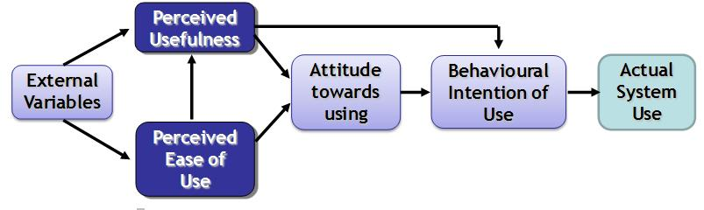
Theory
Theoretical Framework
Theories are formulated to explain, predict, and understand phenomena and, in many cases, to challenge and extend existing knowledge within the limits of critical bounding assumptions.
A theoretical framework is a logically developed and connected set of concepts and premises—developed from one or more theories.
Is a collection of interrelated concepts that can hold or support a theory of a research work and guide a research.
Example:
The effect of Perceived Usefulness and Perceived
Ease of Use towards Intention to use Online Learning by students in Malaysian universities
Technology Acceptance Model (TAM).
Davis et al., 1989

Slide 8
Underpinning Theories
Emanate from theories that influence a research or underpin a construct under study
What theory will best guide my practice or research work?
Is this theory proven through theory-linked research?
What other theories are relevant to this practice?
How can I apply these theories and findings in practice/research?
Example
Technology Acceptance Model (TAM).
Davis et al., 1989

Slide 9

Examples of Theories

Slide 10
Example 1: Theory of Planned Behavior
One’s intentions are formed through the measuring of one’s attitude and subjective norm towards performing a certain voluntary behavior.
TPB suggest that more favorable attitudes toward specific act, more favorable subjective norms, and greater perceived behavioral control strengthen the intention to perform the behavior.
Attitude toward the specific act or behavior
The normative component, our belief about what valued others expect us to do
Perceived behavior control, which is the degree to which a person can control the behavior
Attitude
Behavior Intention
Behavior
Subjective Norms
Perceived Behavioral Control
Ajzen, 1988

Slide 11
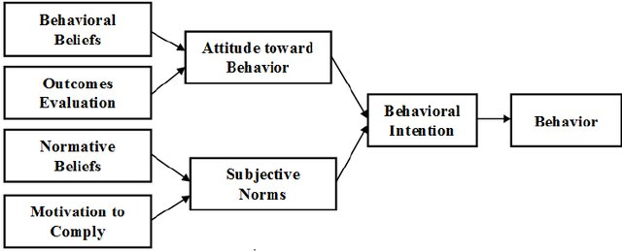
Example 2
According to TRA, a person’s performance of a specific behavior is determined by his/her behavioral intention (BI) to perform the behavior and BI is jointly determined by the person’s attitude (A) and subjective norm (SN) concerning the behavior in question
Theory of Reasoned Action
Theory of Reasoned Action – TRA (Fishbein & Ajzen, 1975)

Slide 12
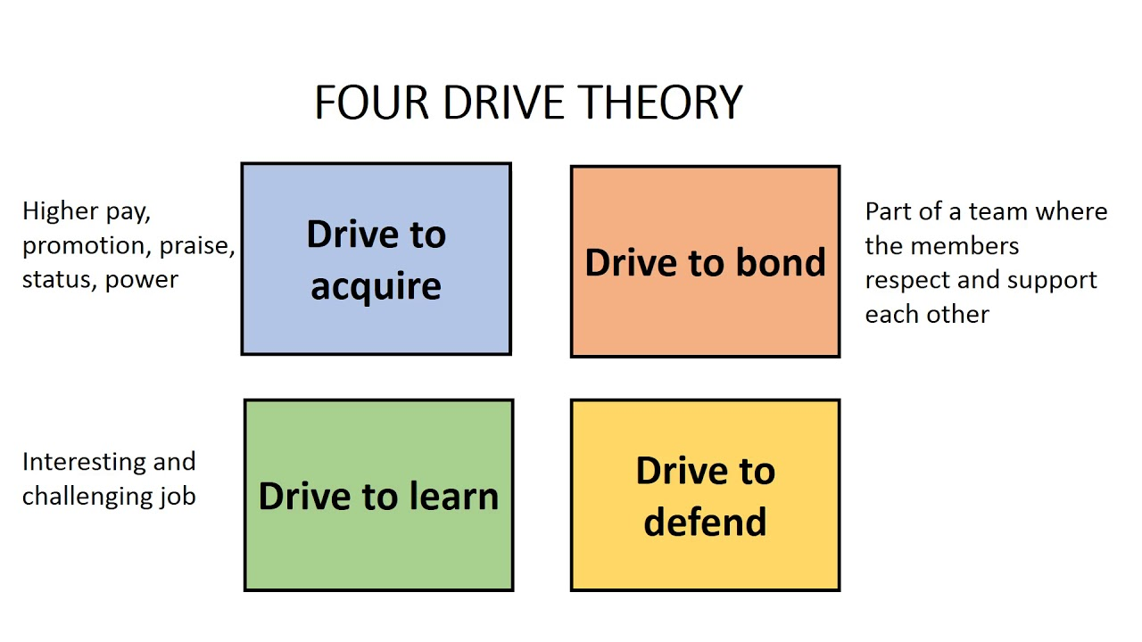
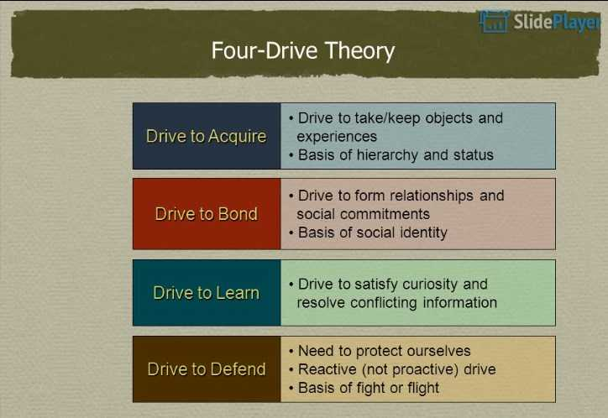
Example 3 - Lawrence and Nohria (2002)

Slide 13
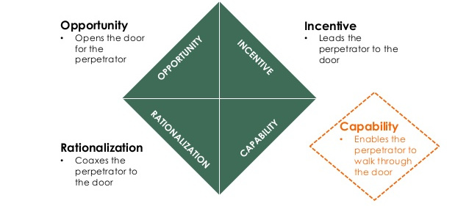
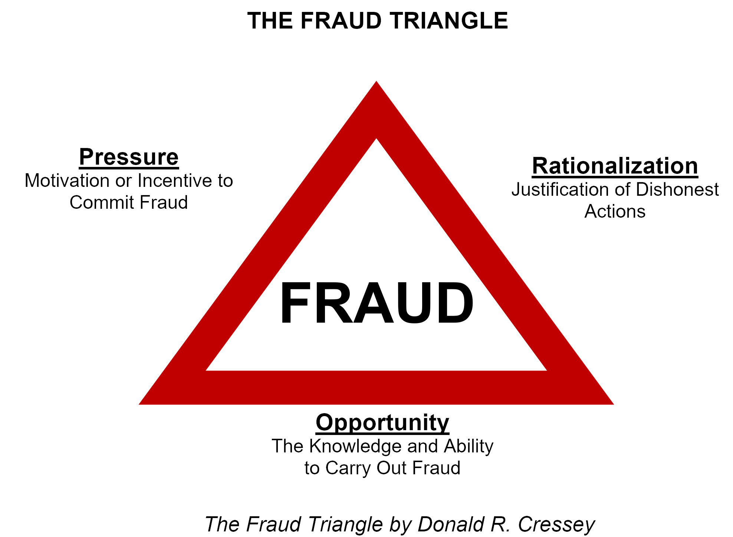
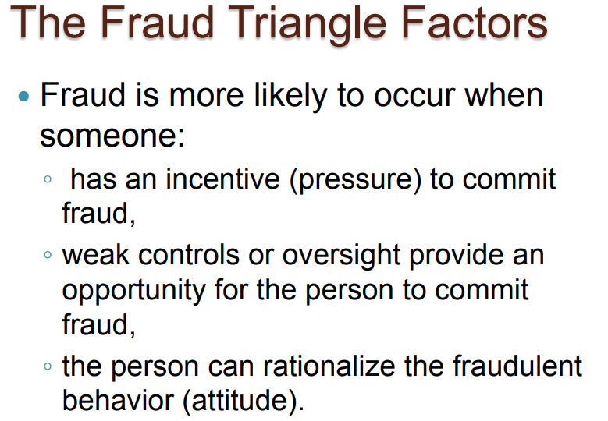
Example 4: The Fraud Diamond
The Fraud Triangle
The three key elements
Rationalization: Justification of dishonest actions
Pressure: Motivation or incentive to commit fraud
Opportunity: The method by which fraud can be committed (i.e. ability to carry out the misappropriation of cash or organizational assets)
Wolfe and Hermanson (2004)
Cressey (1950

Slide 14
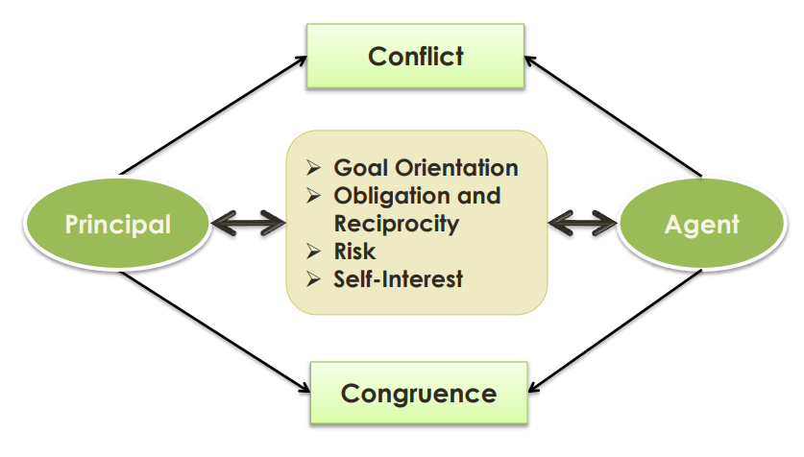
Example 5: Agency Theory
Jensen and Meckling defined:
“A contract under which one or more persons (the principal(s)) engage another person (the agent) to perform some service on their behalf which involves delegating some decision making authority to the agent.” (1976, p.308)

Slide 15
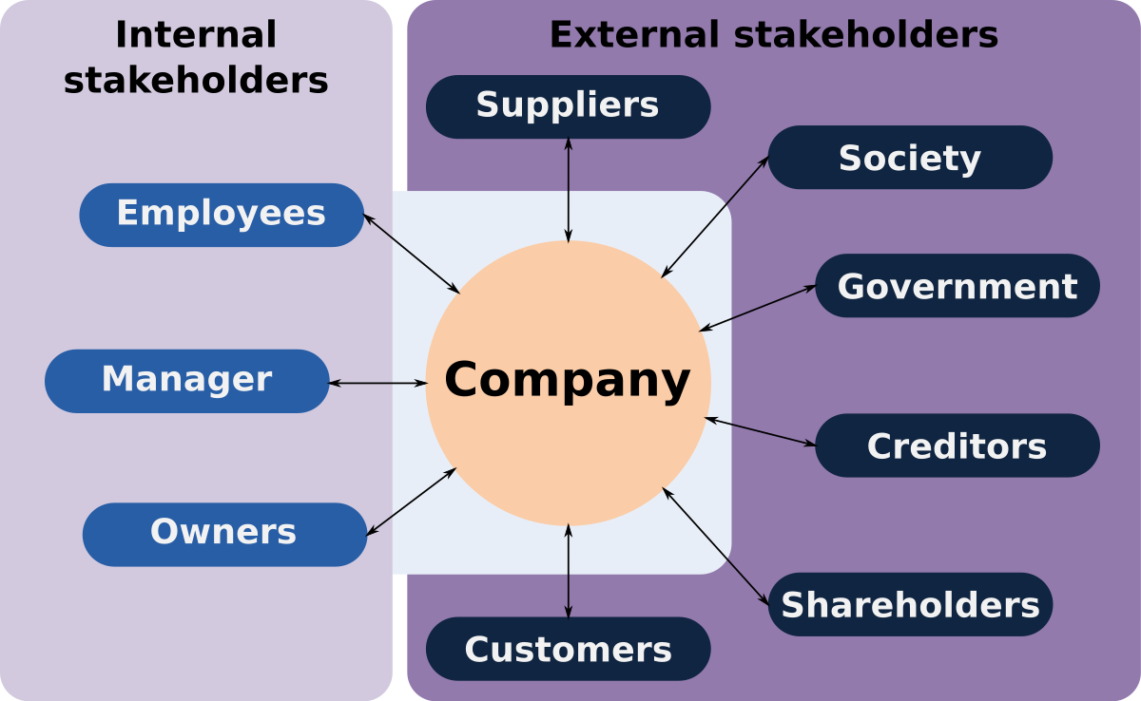
Example 6: Stakeholder Theory
Stresses the interconnected relationships between a business and its customers.
Anyone that is affected by the organization or its workings in any way is considered a stakeholder Eg: Customers, employees etc.
Stakeholder theory holds that organizations and corporations should strive to do right by all these stakeholders and that in doing so, the organization will achieve true, lasting success.
The theory argues that a firm should create value for all stakeholders, not just shareholders.

Slide 16
Example 7: Maslow’s Hierarchy of Needs Theory
14.3
Self-
Actualization
Esteem
Affiliation
Security
Physiological
Adapted from Figure 14.2
Notes:
4

Slide 17
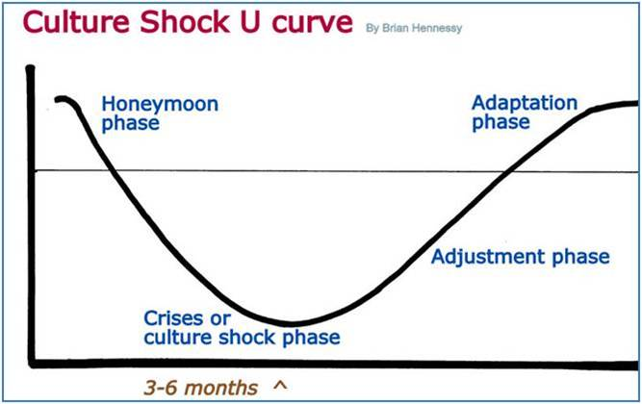
Example 8
U Curve Theory
Oberg 1960

Slide 18
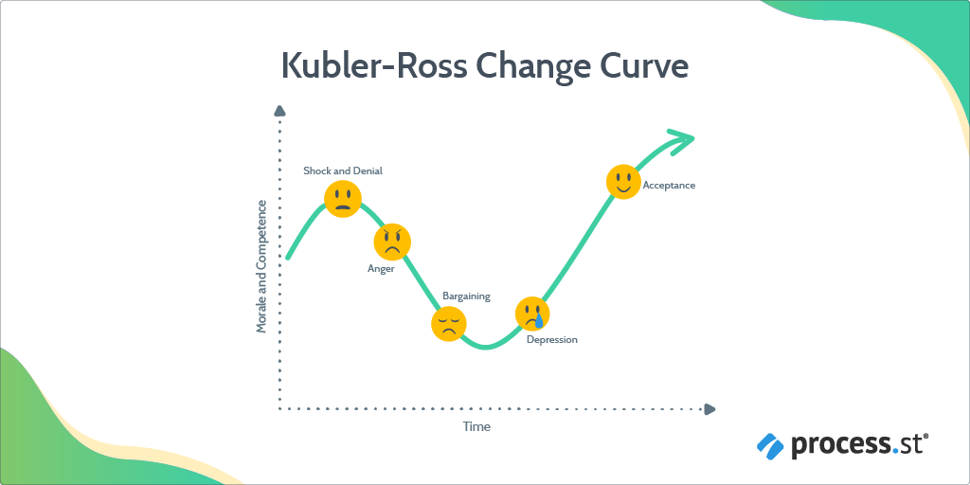
Example 9: Change Curve

Slide 19
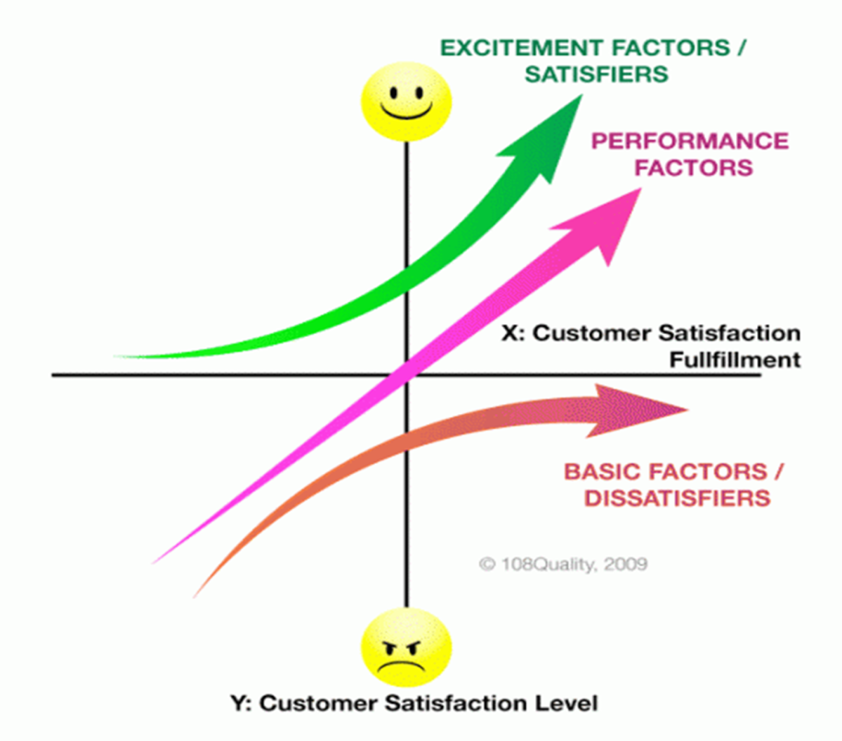
Example 10
Customer Satisfaction
Kano Model: (Dr.Nariaki Kano)
Kano model distinguishes between three types of product or service requirements which influence customer satisfaction in different ways when met.
Basic attributes
Performance attributes
Excitement attributes
Prof. Kano pointed out that not all product/service attributes have same role in satisfying customer needs
Basic Needs: Dissatisfiers is a product or service characteristics that the customer takes for granted. Absence of basic attributes results in extreme customer dissatisfaction.
Performance Needs – Satisfiers A satisfier is something that customer want in their product or service, and usually ask for it.
Excitement Needs – Delighters A delighter is unspoken or unexpected requirement of a customer and can result into high level of customer satisfaction.

Slide 20
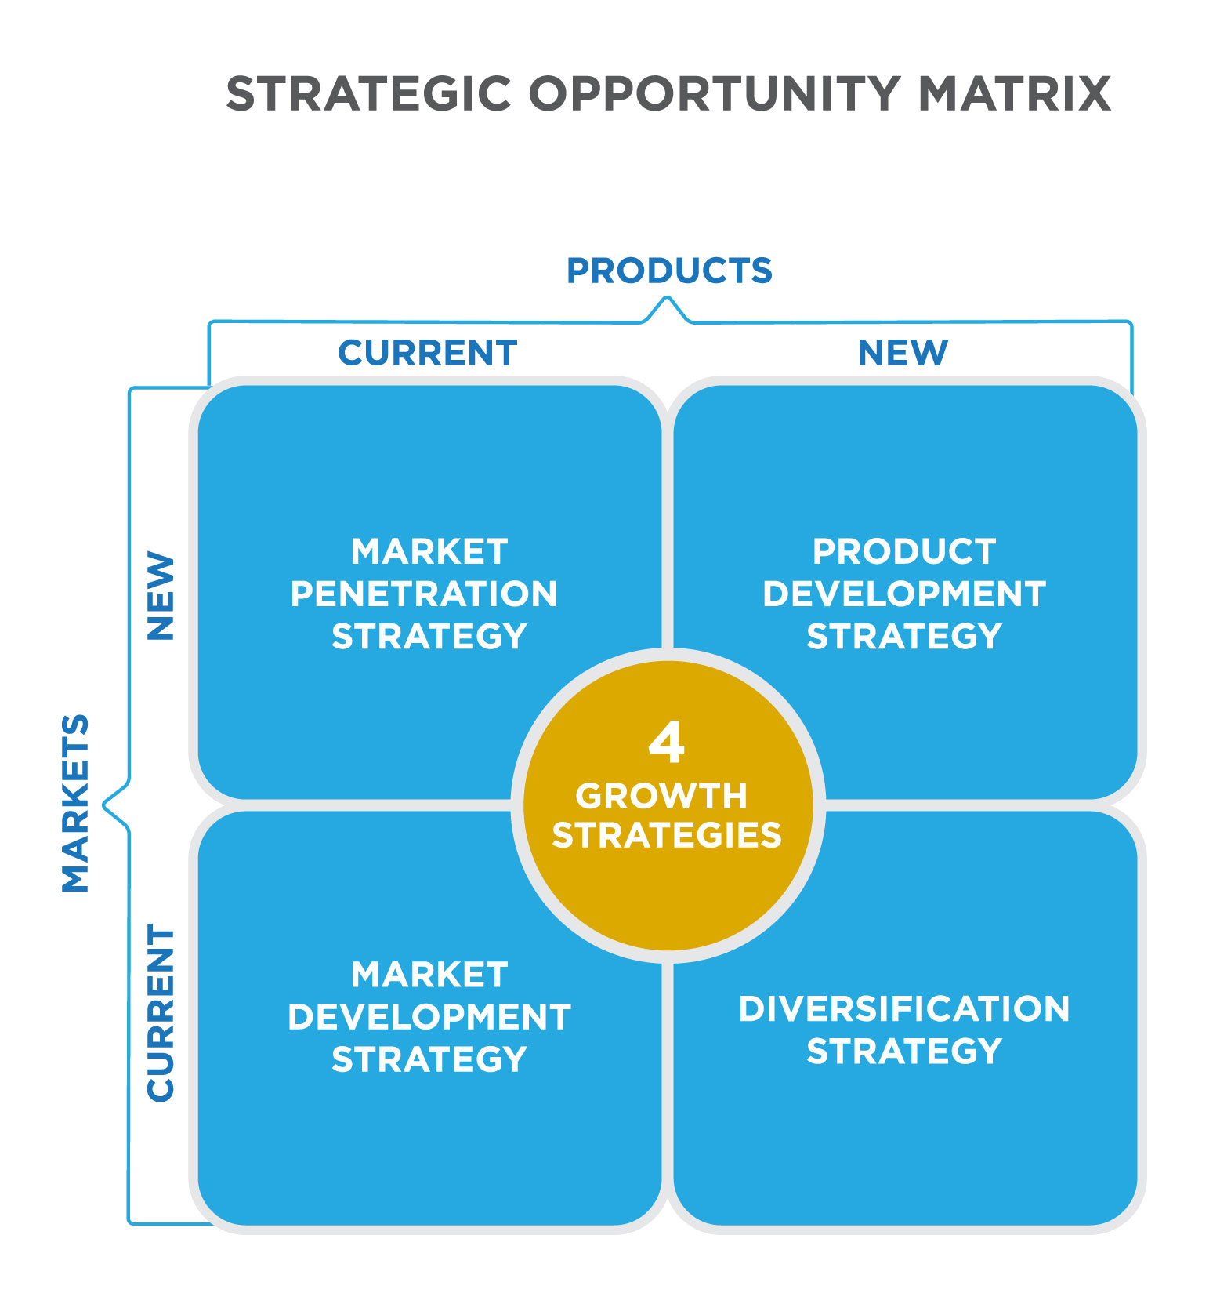
Ansoff Matrix
Intensive Growth Theories
Example 11

Slide 21
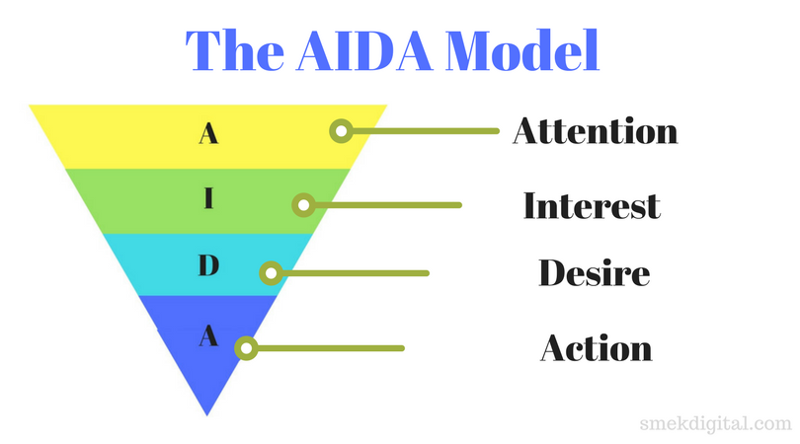
Example 12

Slide 22
The Pecking-Order Theory
Example 13
The pecking order theory suggests that there is an order of preference for the firm of capital sources when funding is needed. The firm will seek to satisfy funding needs in the following order:
Internal funds (Use internal financing first).
External funds
  Debt (Issue debt next, new equity last)
  Equity
The pecking order theory recognizes that different types of capital have different costs. This leads to a pecking order in the financing choices that managers make. Managers choose the least expensive capital first then move to increasingly costly capital when the lower-cost sources of capital are no longer available.

Slide 23
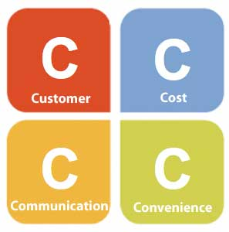
Example 14
Marketing mix
4Ps
McCarthy
(1960)
Product
Price
Promotion
Place
5Ps
Judd
(1987)
Product
Price
Promotion
Place
People
6Ps
Kotler
(1985)
Product
Price
Promotion
Place
Political power
Public opinion
formation
7Ps
Booms and Bitner (1981)
Product
Price
Promotion
Place
Participants
Physical evidence
Process
15Ps
Baumgartner
(1991)
Product / Service
Price
Promotion
Place
People
Politics
Public relations
Probe
Partition
Prioritize
Position
Profit
Plan
Performance
Positive
implementations
The Marketing Mix and Proposed Extensions of the 4Ps
Gummesson (1994)
The 4Ps was expanded to the 4Cs, 5Cs and 7Cs Model to provide a more complete picture of the nature of marketing

Slide 24
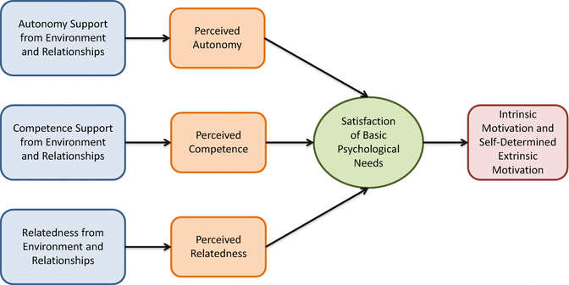
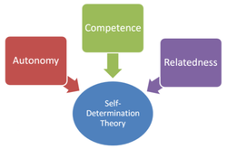
Self Determination Theory
Example 15
Self-determination theory (SDT) is a broad theory of human personality and motivation concerned with how the individual interacts with and depends on the social environment.
SDT defines intrinsic and several types of extrinsic motivation and outlines how these motivations influence situational responses in different domains, as well as social and cognitive development and personality.
SDT is centered on the basic psychological needs of autonomy, competence, and relatedness and their necessary role in self-determined motivation, well-being, and growth.
Finally, SDT describes the critical impact of the social and cultural context in either facilitating or thwarting people’s basic psychological needs, perceived sense of self-direction, performance, and well-being.

Slide 25
Pause:
The Factors that Influence on Intention to adopt Cloud computing by SMEs..
Which Theory

Slide 26
TECHNOLOGY ACCEPTANCE MODEL(TAM)
Example
Davis et.al (1989)

Slide 27
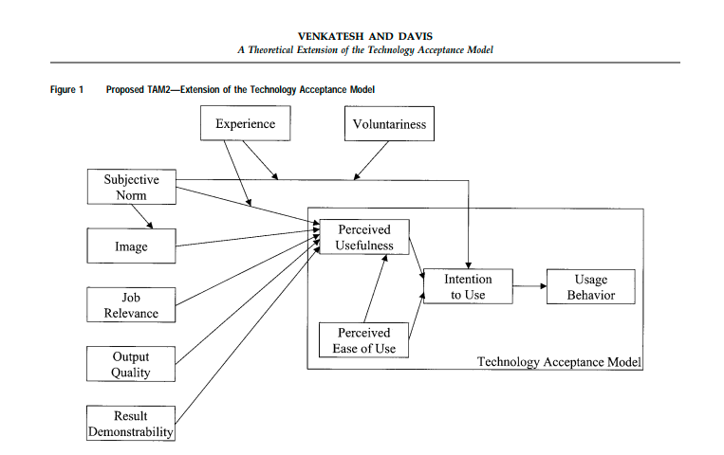
TAM2
Venkatesh and Davis, 2002

Slide 28
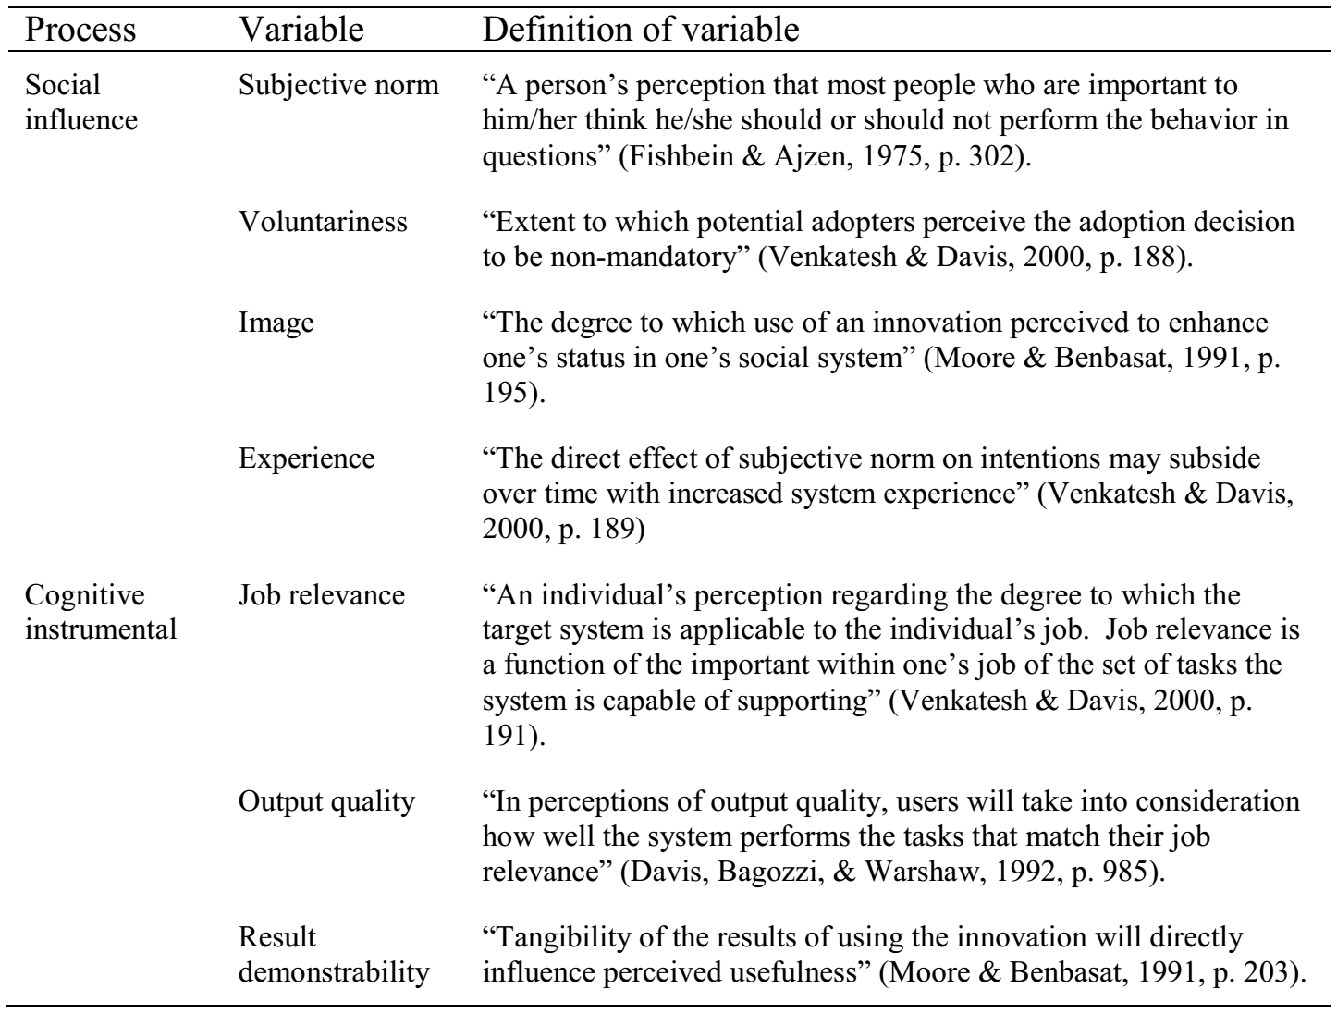
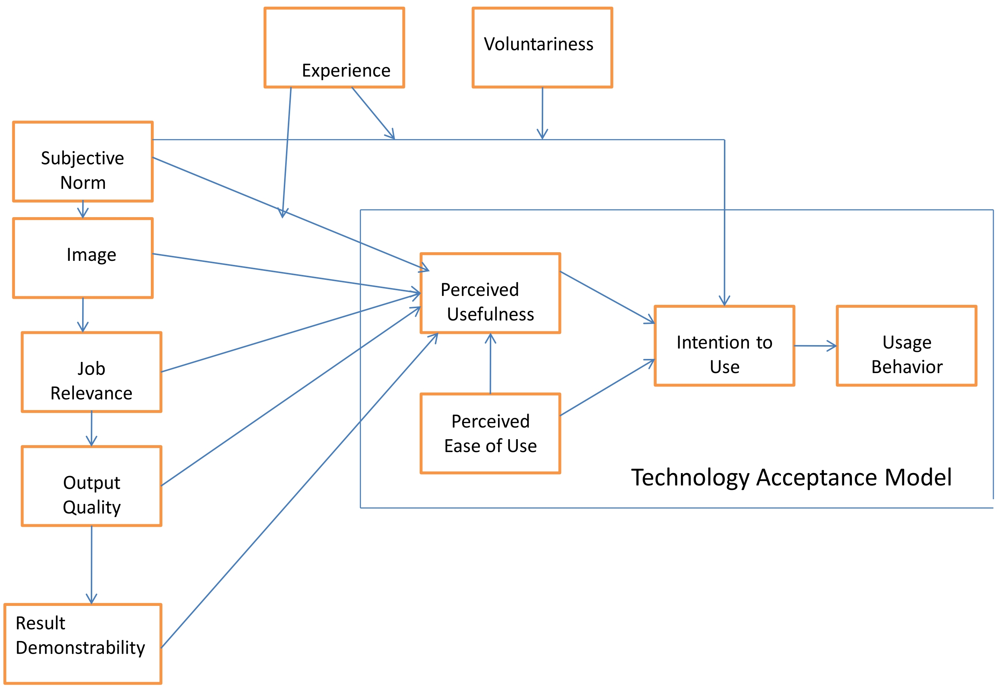
TAM2 model. (Adapted from Venkatesh and Davis, 2000).
TAM2 incorporates the subjective norm, voluntariness, and image, which are three interrelated social forms. These forms help to determine if an individual will adopt or reject a new system, The cognitive determinants of perceived usefulness in TAM2 could be described as perceived ease of use, output, output quality, and job relevance.

Slide 29
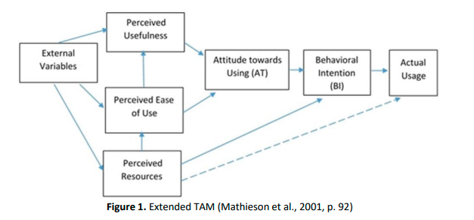
Extended TAM (Mathieson et al., 2001, p. 92)
Perceived resources such as skills, time, money, hardware, software, human assistance, and data are critical in influencing the use of a system

Slide 30
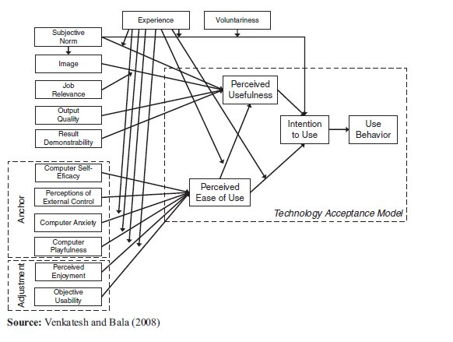
TAM3

Slide 31
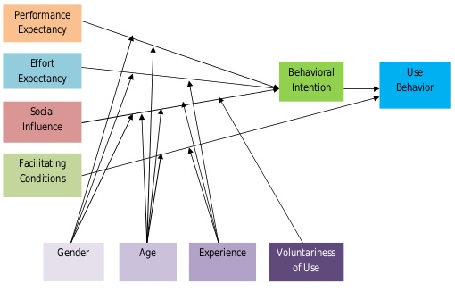
Unified Theory of Acceptance and Use of Technology (UTAUT)
Venkatesh et al (2003)

Slide 32
Venkatesh et al., 2012
UTAUT 2

Slide 33
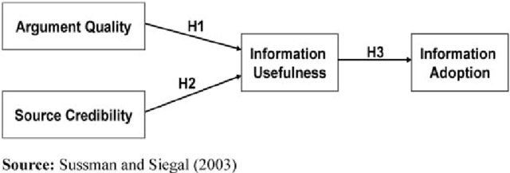
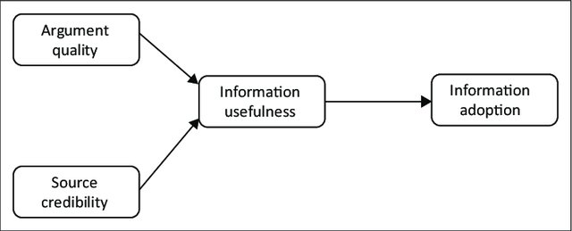
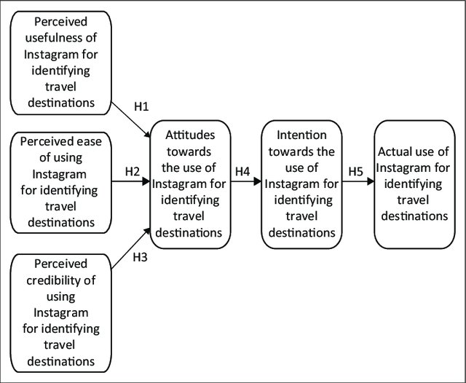
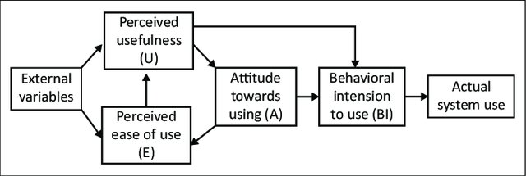
Information Adoption Model The influence of eWOM in social media on consumers’ purchase intentions: An extended approach to information adoption
Example: Examining the usage of Instagram as a source of information for young consumers when determining tourist destinations

Slide 34
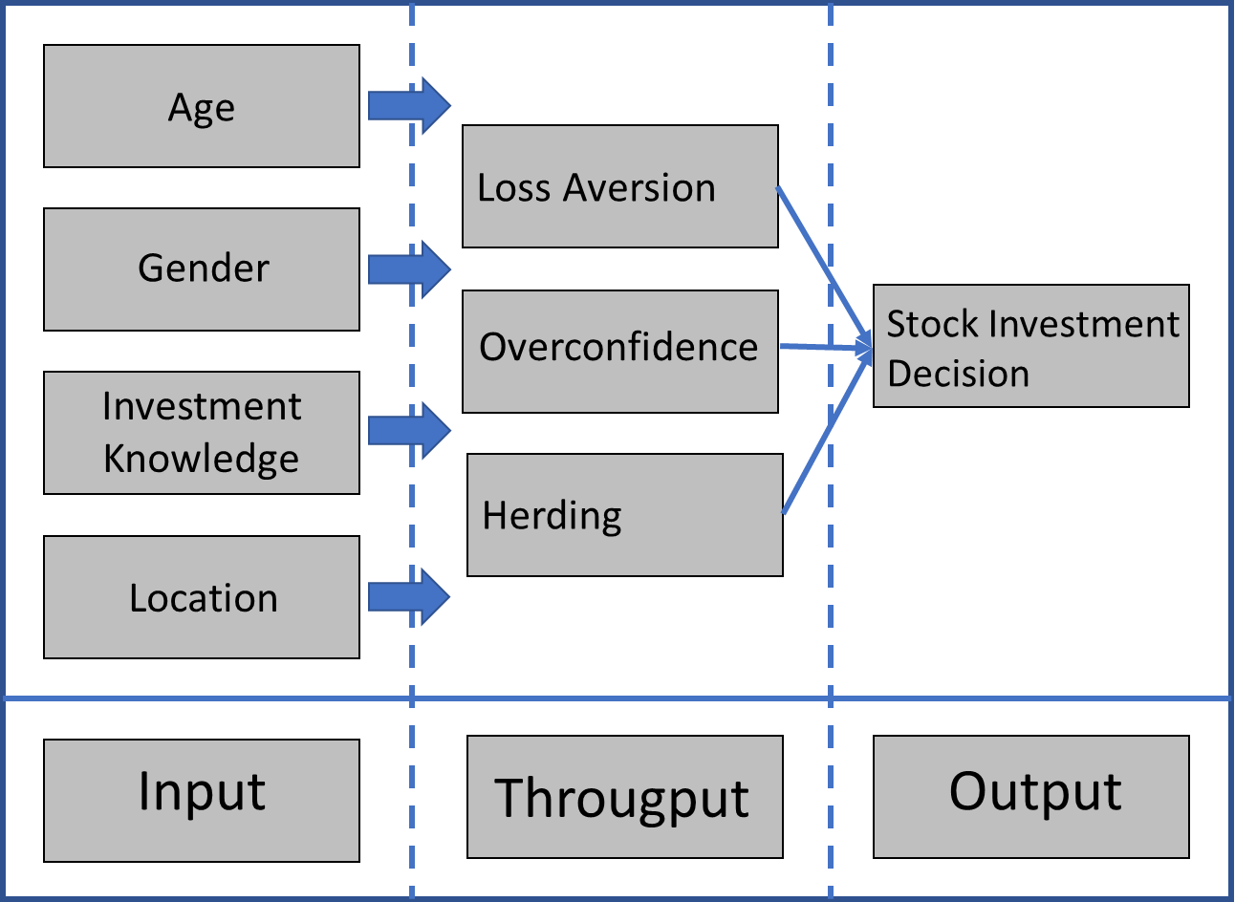
Family Resource Management Model
The model by Deacon and Firebaugh (1988) provides the conceptual basis for a research.
The model consists of input, throughput, and output.
Input refer to the demographic of the respondents (eg: investors).
Througput consists of the variables
Output refer to the Effect (Eg: stock investment decision)..
Example
Loss aversion, overconfidence and herding influence towards Stock investment decisions in Malaysia
This model assumes that the stock investment decisions are attained through effective use of the resources from input and througput combined to affect the output.

Slide 35

Summary
A theory is a well-established principle that has been developed to explain some aspect of the natural world. Theories arise from repeated observation and testing and incorporates facts, laws, predictions, and tested assumptions that are widely accepted [e.g., rational choice theory; grounded theory; critical race theory]

