Slide 1
Topic 2 Positivism Interpretivism
Dr Jugindar Singh

Slide 2
Positivism Positivists believe that reality is stable and can be observed and described from an objective viewpoint (Levin, 1988)
The stance of the natural scientist.
Adheres to the view that only “factual” knowledge gained through observation (the senses), including measurement, is trustworthy.
Cause and effect/Scientific method
Experimentation and measurement can reveal objective reality
Strive for objectivity
Start with hypothesis and test
Eg: Relationship bet. student’s financial position and academic performance
Positivism - research approaches that employ empirical methods, make extensive use of quantitative analysis, or develop logical calculi

Slide 3
The Positivistic approach
Define your research topic
Literature review
Define your research question(s)
i.e. hypothesis
Deductive
Design data collection
Pilot study
Positivists believe that the best way to investigate the world is through objective methods, such as observations.
Objective Facts
Design data analysis
Collect data
Analyse data
Interpret results
Quantitative
Report your findings
Adapted from Maylor and Blackmon (2005)

Slide 4
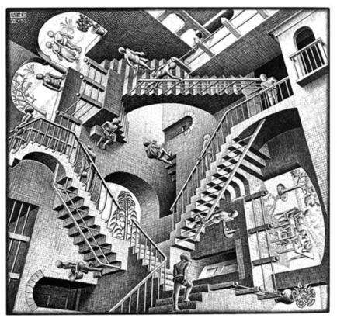
2. Interpretivism/Constructivism Focus on meaning. Interpretivists contend that only through the subjective interpretation of and intervention in reality can that reality be fully understood.
Interpreted by the individual according to his or her ideological positions
Reality is subjective and multiple
Seek to understand meaning as experienced by participants. Researcher as a social actor to appreciate differences between people
Meaning of events is mediated by interactions with others, and social and cultural context
Start with open-ended inquiry and result in hypothesis
Eg: A study of challenges faced by disabled employees
There may be many interpretations of reality
Interpretivism advocates it is necessary for the researcher to understand differences between humans in our role as social actors. Interpretive research is concerned with the meanings that people attach to norms, rules, and values that regulate their interactions

Slide 5
Interpretivism Phenomenological approach
Define your research topic
Literature review
Define your research question(s)
Inductive
Design data collection
Collect data
Analyse data
Literature review
Interpretivism believe that reality does not exist by itself. Instead, it is constructed and given meaning by people. Their focus is therefore on feelings, beliefs and thoughts, and how people communicate these.. Subjective .. Feelings and attitudes
Interpret data
Research question answered?
Report your findings
Qualitative
Adapted from Maylor and Blackmon (2005)

Slide 6
3. Pragmatism
Derived from the Greek word “pragma,” which means action, and which is the central concept of pragmatism (Pansiri 2005).
Pragmatism asserts that concepts are only relevant where they support action (Kelemen and Rumens 2008).

Slide 7
Pragmatism
Derived from the Greek word “pragma,” which means action, and which is the central concept of pragmatism (Pansiri 2005).
Pragmatism asserts that concepts are only relevant where they support action (Kelemen and Rumens 2008).
Pragmatists are more interested in practical outcomes than abstract distinctions
Pragmatist ontology, epistemology and axiology are focused on improving practice.
Strives to reconcile both objectivism and subjectivism, facts and values, accurate and rigorous knowledge and different contextualised experiences
Pragmatists adopt a wide range of research strategies, the choice of which is driven by the specific nature of their research problems.
Pragmatist’s view that it is perfectly possible to work with different types of knowledge and methods

Slide 8
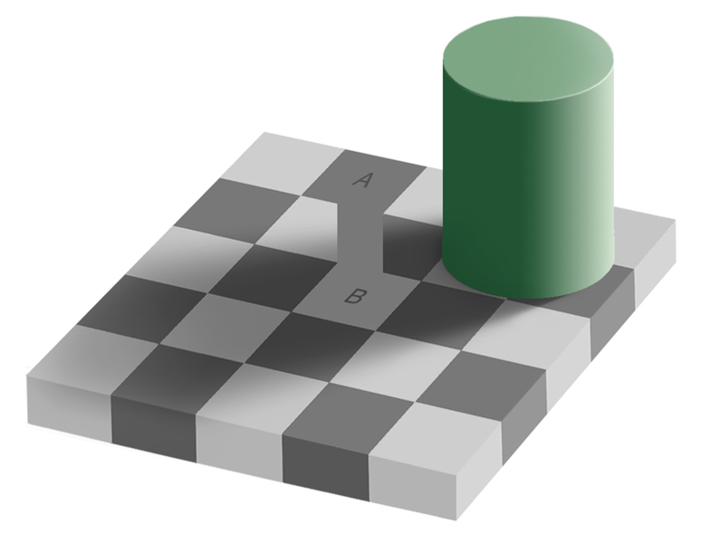
Realism
What the senses show us as reality is the truth;
Relies on the idea of independence of reality from the human mind.
Direct realism - “what you see is what you get. Portrays the world through personal human senses. Saunders, M., Lewis, P. & Thornhill, A. (2012)
Critical Realism: Recognize that our senses and other factors may get in the way between us as
researchers and researched reality. We experience the sensations and images of the real world – can be deceptive and do not portray the real world. Novikov, A.M. &Novikov, D.A. (2013)
Direct realists would state that squares A and B have different colors, because this is what they see.
Critical realists may notice that squares A and B are actually the same colour.

Slide 9
Thank You

